Slide 1
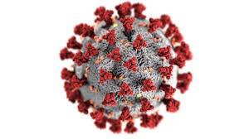
COVID-19
What you need to know
By: Esther Igboerika, RN, BSN, PHN

Slide 2
Objectives
Let’s Start at the Beginning
Definition
Symptoms
Spread
Risk Factors
Protection
Contact Tracing

Slide 3
Let’s start at the beginning
December 2019: increased incidence of respiratory disease in Wuhan, China – rapid spread noted worldwide
Discovered that a novel (new) coronavirus was responsible – its name: severe acute respiratory syndrome coronavirus-2 (SARS-CoV-2, 2019-nCoV)
Outbreak SARS-CoV-2 considered to have originally started via a zoonotic (animal to human) transmission associated with a seafood market in Wuhan, China
The disease caused by this virus = Coronavirus disease 19 (COVID-19)
Pandemic was declared by the World Health Organization (WHO) (c)

Slide 4
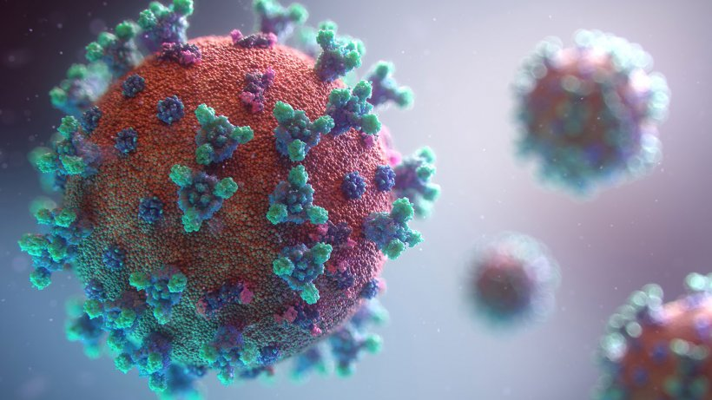
Definition
What is it?
“COVID-19 is the disease caused by the new coronavirus that emerged in China in December 2019.” (a)
What does that mean?
In COVID-19:
‘CO’ for ‘corona’
‘VI’ for ‘virus’
‘D’ for ‘disease’
‘19 ‘for ‘year of discovery’ (b)

Slide 5
Symptoms
Cough
Difficulty Breathing/Shortness of Breath
Congestion or Runny nose
Fatigue
Fever
Muscle pain/Body Aches
Chills
Repeated shaking
Headache
Sore throat
New loss of taste or smell
Nausea/Vomiting
Diarrhea

Slide 6
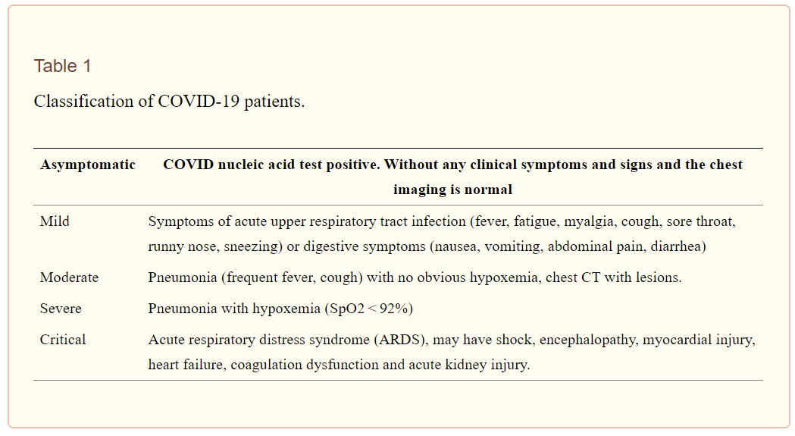
Symptoms
Remember: A person can still carry and spread the virus, even if they have NO symptoms!

Slide 7
SPREAD AND SEVERITY OF ILLNESS
How does is it spread?
Per CDC: “The virus that causes COVID-19 is thought to spread mainly from person to person, mainly through respiratory droplets produced when an infected person coughs, sneezes, or talks. These droplets can land in the mouths or noses of people who are nearby or possibly be inhaled into the lungs. Spread is more likely when people are in close contact with one another (within about 6 feet).” (d)

Slide 8
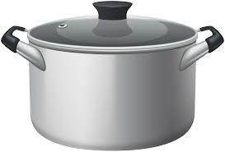
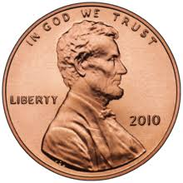
Spread
How long does the virus last on surfaces?
Plastic: 2-3 days
Stainless steel: 2-3 days
Cardboard: 1 day
Copper: 4 hours (e)

Slide 9
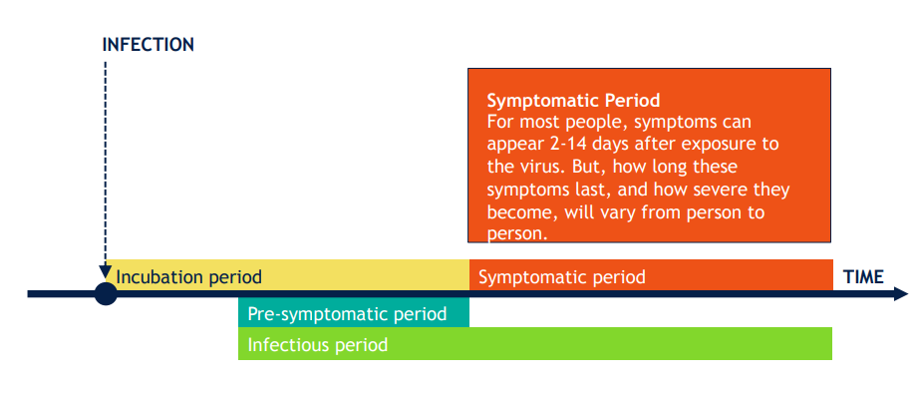
COVID TERMS
Incubation period: the time from exposure to an infectious agent until signs and symptoms of the disease appear. The incubation period for COVID-19 is usually between 4 to 6 days (but can be up to 14 days).
Infectious period: The time when someone who is infected can spread the infection to others, typically 8 to 10 days
Febrile respiratory illness is defined as “a new or worsening episode of either cough or shortness of breath, presenting with fever (temperature 38 degrees C or 100.4 degrees F or higher).
Index: the person diagnosed with COVID-19
Close contact is defined as someone who has spent 15 minutes or more time within 6 feet or less of the index person while unmasked;
Isolation is defined as separation of sick people with a contagious disease from people who are not sick.
Quarantine is defined as separation and restricts the movement of people who were exposed to a contagious disease to see if they become sick.
Social distancing is defined as maintaining a six-foot separation from all persons except for family members.

Slide 10
Protection
How do I protect myself and others?
Wash your hands
Avoid close contact
Maintain 6 feet distance when around others
Wear a mask
Cover coughs and sneezes
Clean and disinfect
Monitor your health daily (f)

Slide 11
Lowering the risk of COVID-19
Encourage mask wearing. at all times
• Allow physical distance between individuals from different households
• Limit the number of people per square foot
• Limit time of exposure
• Limit mixing of people from different households
• Limit amount of physical interactions of visitors/patrons
• Increase airflow (such as operating outdoors or opening windows and doors).

Slide 12
Purpose of contact tracing
Communicate with those who have infectious disease (cases) such as COVID-19 to:
Identify exposed persons (contacts)
Recommend strategies to reduce further transmission
Improve community and population health
……All about breaking the chain of transmission!

Slide 13
School contact tracing
Remember: Close contact is defined as being within 6 feet, for more than 15 minutes, while the index was unmasked. If all three criteria are not met, they are not a close contact.
To the best of our ability we will need to know everywhere a student or staff has been and who they were in contact with:
Who sat around them in class?
Where did they eat lunch?
Who played with them?

Slide 14
References:
https://www.hopkinsmedicine.org/health/conditions-and-diseases/coronavirus
https://www.cdc.gov/coronavirus/2019-ncov/faq.html
https://www.ncbi.nlm.nih.gov/pmc/articles/PMC7169933/
https://www.cdc.gov/coronavirus/2019-ncov/faq.html
https://www.ncbi.nlm.nih.gov/books/NBK554776/
https://www.cdc.gov/coronavirus/2019-ncov/prevent-getting-sick/prevention.html
https://www.cdc.gov/coronavirus/2019-ncov/need-extra-precautions/people-at-increased-risk.html
https://www.mprnews.org/story/2020/03/11/covid19-how-it-compares-with-other-diseases-in-5-charts

