Slide 1


2017
PARAMEDIC REFRESHER COURSE

Slide 2
Paramedic Refresher
Module III
CARDIOVASCULAR
Ventricular assist devices Congestive heart failure Acute coronary syndrome Adult cardiac arrest Post resuscitation care

Slide 3
CARDIOVASCULAR OBJECTIVES
Understand the function on ventricular assist devices
Describe assessment/management of patients with VADs
Discuss pathophysiology of congestive heart failure
Discuss the assessment and management of coronary disease and angina
List the S/S of acute MI
Identify injury patterns on a 12-Lead ECG
Differentiate STEMI from STEMI imposters
Explain the procedure for managing acute MI including STEMI and non-STEMI presentations
Understand the benefits of reperfusion techniques in patients with AMI or suspected AMI

Slide 4
CARDIOVASCULAR OBJECTIVES
Demonstrate current techniques of cardiac arrest management
Discuss airway issues in cardiac arrest management
Discuss airway issues in cardiac arrest management
Determine criteria for terminating cardiac arrest in the out-of-hospital setting
Identify signs associated with ROSC
Descibe how to effectively manage hemodynamic instability
List possible causes of cardiac arrest
Make appropriate treatment choices
Make appropriate destination decision

Slide 5
VENTRICULAR ASSIST DEVICES
What is a Ventricular Assist Device or VAD?
  A pump that assists one or both failing ventricles by transferring a portion of the workload from the myocardium and pumping the blood from the ventricle to the required body system.

Slide 6
VENTRICULAR ASSIST DEVICES
Type of Ventricular Assist Devices
  Pulsatile
    Ventricle like pumping device. Blood fills a flexible chamber through an inflow cannula. The chamber is then collapsed by an electric motor or air pressure forcing the blood into systemic circulation through the outflow cannula.
    Can be Left Ventricular, Right Ventricular, or Bi-Ventricular.
    Patient’s will have a blood pressure and palpable pulse determined by the device output.
    These are first generation devices that have been around since the 1980s but are no longer in use.

Slide 7
VENTRICULAR ASSIST DEVICES
Types of Ventricular Assist Devices
  Non-Pulsatile
    Continuous flow device with an impeller. This device forces blood in a forward pathway into systemic circulation.
    Most devices are only for left ventricular support.
    Patient may present with weak or non-existent pulse.
    Patient may have narrow pulse pressures and may not have an obtainable BP due to the continuous flow of the device.

Slide 8
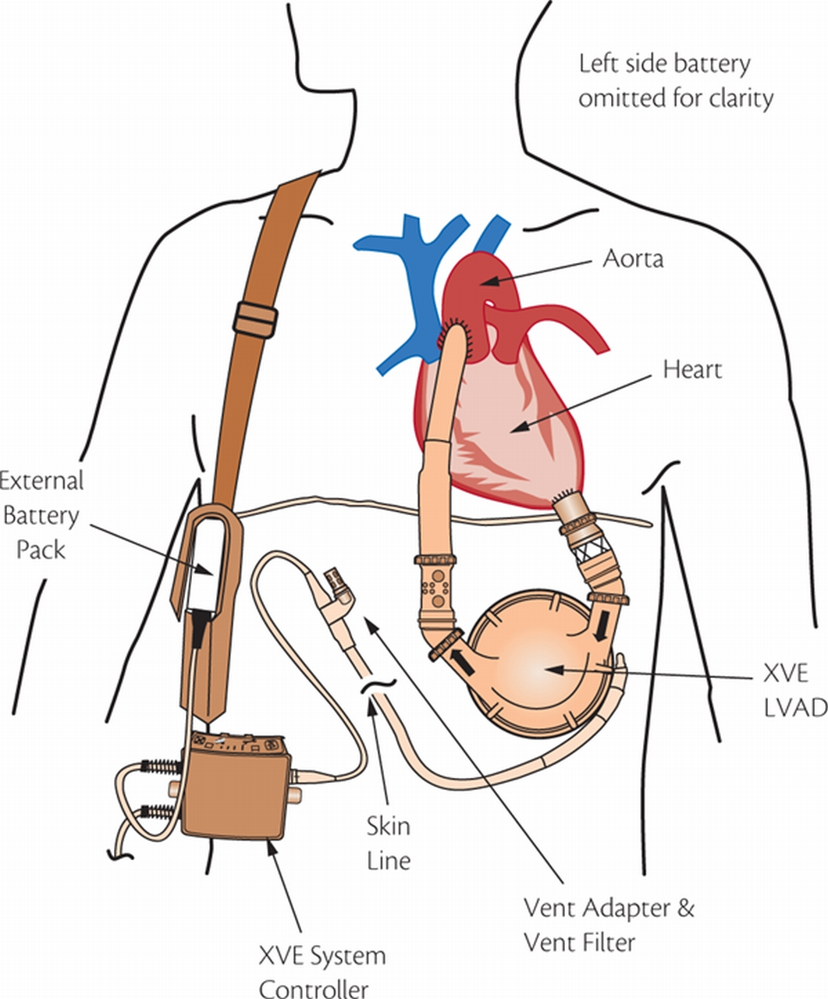
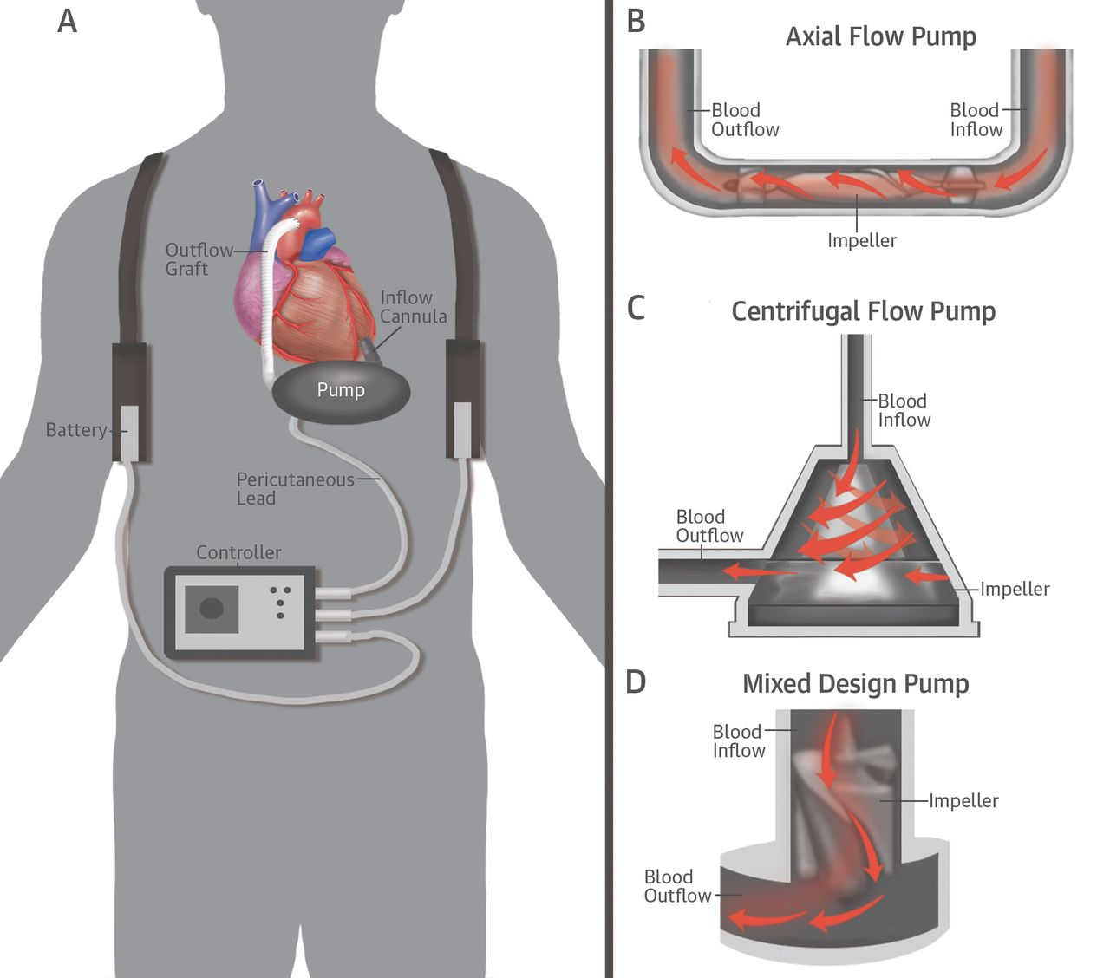
VENTRICULAR ASSIST DEVICES

Slide 9
VENTRICULAR ASSIST DEVICES
Components of Ventricular Assist Devices
  Made up of three components
    The pump – weighs approximately 1-2 pounds and is located inside or outside the body.
    The electronic controller – A small computer that controls the VAD functions.
    Batteries – Carried outside the body in a harness as seen in the pictures on the previous slide. The batteries are connected to the pump by a cable that goes into the abdomen.

Slide 10
VENTRICULAR ASSIST DEVICES
Ventricular Assist Device Variety
  LVAD
    Left ventricular assist devices have an inlet connected to the left ventricle that leads into the pump and then to the outlet connected to the aorta.
  RVAD
    Right ventricular assist devices have an inlet connected to the right atria or right ventricle that leads into the pump and then to the outlet connected to the pulmonary artery.
  BI-VAD
    In rare circumstances of heart failure a patient may require both an LVAD and RVAD. When used in conjunction they are called a Bi-Vad. In a Bi-Vad the LVAD and RVAD share an electronic controller and battery pack.

Slide 11
VENTRICULAR ASSIST DEVICES
Ventricular Assist Device Uses
  Bridge to Transplant
    Most common device use.
    Allow heart to rest while awaiting a heart transplant.
  Bridge to Recovery
    Used to assist the heart in recovery from heart failure.
    In some cases VAD is removed and patient discharged.
  Destination Therapy
    Device is permanent instead of a bridge to transplant device.
    Only used in patients that are not eligible for a heart transplant.

Slide 12
VENTRICULAR ASSIST DEVICES
How do ventricular assist devices function?
  VADs are pre-load dependent.
    VADs can only pump the blood that gets to the device so a decreased pre-load leads to diminished output of the VAD.
  Do not require an sinus or organized rhythm to work.
    The electronic controllers do not read or interpret any cardiac electrical activity and therefore will continue to operate as normal if there are no malfunctions or pre-load changes
  VADs are sensitive to afterload.

Slide 13
VENTRICULAR ASSIST DEVICES
Assessment of a patient with a ventricular assist device
  Start the assessment the same as you would a patient without a VAD.
    BSI / Scene Safety
      As with all alarms be sure you are wearing appropriate PPE and the scene is safe for you to enter.
    Why did you call EMS today?
      Just because the patient has a VAD does not mean it is the reason for contacting EMS.
    Airway
      Is it patent?
    Breathing
      Is it present and adequate?

Slide 14
VENTRICULAR ASSIST DEVICES
Assessment cont.
  Circulation
    Here is where things change slightly.
      Most VADs are non-pulsatile continuous flow devices meaning the patient is unlikely to have a pulse.
      The patient is also unlikely to have a blood pressure. NIBP devices will also be ineffective.
      The best way to assess the patients BP is with a manual BP cuff and a doppler unit. Using this method you are obtaining the patient’s Mean Arterial Pressure or MAP with a normal range of 60-90 mmHg.

Slide 15
VENTRICULAR ASSIST DEVICES
Assessment Cont.
  Circulation
    Another complication is pulse oximetry. Pulse oximetry may be innacurate.
    Be sure to auscultate the anterior chest listening for a machinery like hum to determine if the device is functioning.
    Assess the patient’s mental status and skin color/temperature/condition as these will most likely be your best indicators of proper perfusion.
    A 12-Lead ECG should be obtained on all VAD patients and will provide insight into the functionality of the patient’s heart.

Slide 16
VENTRICULAR ASSSIT DEVICES
Assessing ventricular assist device function
  Auscultate for a continuous machinery like sound to confirm device is running.
  The external controller
    Will provide important information including:
      Pump speed: 2200 - 10,000 rpm depending on device
      Power: 4 – 6 watts
      Flow: 4 – 6 L/min
  VAD malfunctions
    Second generation VADs 54% at 2 years

Slide 17
VENTRICULAR ASSIST DEVICES
Common ventricular assist device malfunctions
  Pump thrombus – results in low cardiac output
  Suction Event – negative pressure in the left ventricle causes the ventricular septum to collapse leftward
  Bleeding – could be from multiple reasons but VAD patients are on anti-coagulant therapy
  Right ventricular failure- typically occurs early after LVAD implantation
  Infection- Patient’s have open portals in skin allowing greater chance of infection

Slide 18
VENTRICULAR ASSIST DEVICES
Treating patient’s with ventricular assist devices
  Hypertension
    Increased after load can limit VAD output
    DO NOT administer nitrates or anti-hypertensives without orders from a physician or VAD coordinator.
  Hypotension
    All VADs are pre-load dependent. Hypotension being a decrease in per-load will cause a decreased VAD output

Slide 19
VENTRICULAR ASSIST DEVICES
Infection
  Leading cause of mortality in VAD patients
  Make sure you are using clean/sterile equipment and techniques when treating these patients due to increase risk of infections
Suckdown
  Initiate peripheral IV and if ordered by a physician slowly administered fluid to increase preload.
  Also possible to reduce the speed of the VAD with the external controller if ordered by the VAD coordinator

Slide 20
VENTRICULAR ASSIST DEVICES
Transporting
  Determine where your patient is being transported. The nearest appropriate facility may be the nearest VAD center.
  Ensure you have all the patients VAD equipment. A checklist should be available with the patient provided by the VAD center.
  Secure batteries and controller to prevent mishandling or damage.
  Be sure all cables are tangle and kink free for duration of treatment and transport.

Slide 21
CONGESTIVE HEART FAILURE
What is congestive heart failure?
  Congestive heart failure also known as CHF or simply heart failure is a weakening of the cardiac muscle which leads to the heart not pumping blood as well as it should or is needed.

Slide 22
CONGESTIVE HEART FAILURE
Types of heart failure
  Low output
    Systolic
      Decreased cardiac output
      Decreased left ventricular ejection fraction
    Diastolic
      Elevated bi-ventricular end diastolic pressures
      Left ventricular ejection fraction may be normal or decreased
  High output
    Anemia, peripheral shunting, hyperthyroidism
  Right ventricular
    Pulmonary hypertension, right sided MI

Slide 23
CONGESTIVE HEART FAILURE
Causes of congestive heart failure
  Low Output Failure
    Decrease contractility
      Myocarditis
      Tako-Tsubo
      Sepsis
    Impaired filling
      Hypertensive hypertrophy
      Mitral/Tricuspid valve stenosis
      Cardiomyopathy
    Excess afterload
      Aortic/Pulmonary valve stenosis
      Hypertension
    Dysrhythmias

Slide 24
CONGESTIVE HEART FAILURE
Causes of congestive heart failure
  High output failure
    Anemia
    Pregnancy
    Hyperthyroidism
    Arterial/Venous malformations
    Beri beri

Slide 25
CONGESTIVE HEART FAILURE
Signs and symptoms of congestive heart failure
  Dyspnea – trouble breathing, most common symptom
  Edema – swelling caused by fluid buildup, rapid buildup can lead to pulmonary edema
  Ascites – accumulation of fluid > 25mL in the perotineal cavity
  Orthopnea – dyspnea when lying flat
  Paroxysmal Nocturnal Dyspnea – severe dyspnea with coughing that typically wakes a patient from sleep occurring 1-2 hours after falling asleep

Slide 26
CONGESTIVE HEART FAILURE
Signs and symptoms of congestive heart failure cont.
  Fatigue – especially on exertion
  Weakness – vague symptom which requires EMS to perform additional assessments to effectively determine patient’s condition and treat based on results of combined assessments
  Crackles or decreased breath sounds at bases of lungs
  Presence of jugular venous distention (JVD) – obvious distention of the jugular veins in the neck

Slide 27
CONGESTIVE HEART FAILURE
  Classifying congestive heart failure
    New York Heart Association (NYHA)
      Class I
        No limitation on physical activity
        No overt symptoms
      Class II
        Slight limitation on physical activity
        Comfortable at rest but normal physical activity causes symptoms of heart failure
      Class III
        Marked limitation on physical activities
        Comfortable at rest but < normal activity causes symptoms of heart failure
      Class IV
        Inability to carry on any activity without symptoms
        Presence of symptoms even at rest

Slide 28
CONGESTIVE HEART FAILURE
Classifying congestive heart failure cont.
  AHA- Divides the classification into Patient symptoms and objective assessment
  Patient symptoms divided into four classifications I-IV
    Class I
      No limitation of physical activity. Ordinary physical activity does not cause undue fatigue, palpitation, dyspnea
    Class II
      Slight limitation of physical activity. Comfortable at rest. Ordinary physical activity results in fatigue, palpitation, dyspnea
    Class III
      Marked limitation of physical activity. Comfortable at rest. Less than ordinary activity causes fatigue, palpitation, or dyspnea
    Class IV
      Unable to carry on any physical activity without discomfort. Symptoms of heart failure at rest. If any physical activity is undertaken, discomfort increases

Slide 29
CONGESTIVE HEART FAILURE
Classifying congestive heart failure cont.
  Objective assessment divided into four classifications A-D
    Class A
      No objective evidence of cardiovascular disease. No symptoms and no limitation in ordinary physical activity
    Class B
      Objective evidence of minimal cardiovascular disease. Mild symptoms and slight limitation during ordinary activity. Comfortable at rest
    Class C
      Objective evidence of moderately severe cardiovascular disease. Marked limitation in activity due to symptoms, even during less-than-ordinary activity. Comfortable only at rest
    Class D
      Objective evidence of severe cardiovascular disease. Severe limitations. Experiences symptoms even while at rest

Slide 30
CONGESTIVE HEART FAILURE
ECG findings in congestive heart failure
  Ischemic heart disease
    Myocardial arteries are narrowed
  Dilated cardiomyopathy
    Enlargement of the left ventricle causes it to weaken decreasing the ability to pump blood; frequently caused by ischemic heart disease, uncontrolled hypertension, and valvular disease
  Amyloidosis
    Rare disease that causes buildup of Amyloid (protein produced in bone marrow) in organs, frequently the heart, liver, kidneys, and spleen
  Idiopathic dilated cardiomyopathy
    Dilated cardiomyopathy of an unknown cause

Slide 31
CONGESTIVE HEART FAILURE
ECG findings in congestive heart failure cont.
  Ischemic heart disease
    N-STEMI
      Non-ST segment Elevated Myocardial Infarction
        ST depression
          Horizontal or downsloping depression ≥ 0.5 mm at the J-point in 2 or more contiguous leads
    Unstable angina pectoris
      Symptomatic chest pain without present ECG changes, cardiac enzyme testing confirms

Slide 32
CONGESTIVE HEART FAILURE
ECG findings in congestive heart failure cont.
  Dilated cardiomyopathy / idiopathic cardiomyopathy
    While there are no specific abnormalities noted with DCM/ICM the ECG does not look normal.
    Most common changes are ones also associated with atrial hypertrophy or ventricular hypertrophy.
    QRS discrepancies in V4-V6 with associated low voltage QRS in limb leads.
    Pseudoinfarction pattern in V1-V4.

Slide 33
CONGESTIVE HEART FAILURE
CPAP (Continuous Positive Airway Pressure)
  Indications
    Respiratory distress with symptoms consistent with:
      CHF, COPD, Asthma, Pulmonary Edema, or Pneumonia
    Is awake and oriented
    > 12 years old
    Ability to maintain open airway
    SBP > 90
    And at least TWO of the following:
      Retractions or accessory muscle use
      Respirations >24 per minute
      Inability to speak full sentences due to dyspnea

Slide 34
CONGESTIVE HEART FAILURE
CPAP cont.
  Contraindications
    Respiratory arrest
    Hypotension
    Suspected pneumothorax
    Tracheostomy
    FBAO
    Facial deformity or swelling causing seal issues
    Actively vomiting
    Recent facial, neurological, or gastric surgery
    Chest, head, or face trauma

Slide 35
CONGESTIVE HEART FAILURE
Nitro
  If the patient presents with rales and has a SBP >180
    Administer Nitro 0.4mg SL q 3-5 minutes to total dose 1.2mg
      Obtain a manual BP between doses of Nitro and monitor patient’s condition prior to continuation of Nitro therapy
    Note that if patient has taken sexual enhancement medication within the past 24-72 hours depending on medication do NOT administer Nitro

Slide 36
CONGESTIVE HEART FAILURE
Lasix
  If the patient does NOT take Lasix and systolic BP > 100
    Administer 40mg Lasix IV/IO
  If the patient DOES take Lasix and systolic BP > 100
    Administer 80mg Lasix IV/IO

Slide 37
ACUTE CORONARY SYNDROME
What is acute coronary syndrome?
  A condition in which blood supplied to the heart muscle is suddenly blocked.
What are some common acute coronary syndromes?
  Unstable angina
  N-STEMI
  STEMI

Slide 38
ACUTE CORONARY SYNDROME
Signs and symptoms of ACS
  Chest pain (angina) or discomfort
  Radiating pain
  Nausea and/or vomiting
  Indigestion
  Dyspnea
  Diaphoresis
  Lightheadedness, dizziness, syncope
  Fatigue
  Restlessness

Slide 39
ACUTE CORONARY SYNDROME
Signs and symptoms of ACS cont.
  Angina is usually described as aching, pressure, tightness, or burning
  Pain usually radiates from chest to shoulders, arms, upper abdomen, back, neck, or jaw
  Signs and symptoms may vary significantly, depending on:
    Age
    Sex
    Previous medical history
Women , older adults, and diabetics are all more likely to have signs and symptoms without chest pain

Slide 40
ACUTE CORONARY SYNDROME
What causes ACS?
  Plaque buildup in or on the arteries ruptures or splits causing a blood clot to form
  The clot becomes lodged in an artery and obstructs blood flow to the heart
  Absent flow of oxygenated blood causes ischemia followed by infarction
  Even in only ischemia the decreased oxygenation causes abnormal or inefficient work of the heart
  ACS that does not result in cell death is known as unstable angina

Slide 41
ACUTE CORONARY SYNDROME
Risk factors for ACS
  Age >45 for men or >55 for women
  Hypertension
  Hypercholesterolemia
  Smoking
  Sedentary lifestyle
  Diet
  Obesity
  Diabetes
  Family history
  Gestational diabetes
  Preeclampsia

Slide 42
ACUTE CORONARY SYNDROME
12-Lead ECG
  Grouping
    High Lateral
      I and aVL
    Inferior
      II, II, and aVF
    Septal
      V1 and V2
    Anterior
      V3 and V4
    Low Lateral
      V5 and V6

Slide 43
ACUTE CORONARY SYNDROME
12-Lead Grouping
I LATERAL | aVR | V1 SEPTAL | V4 ANTERIOR
II INFERIOR | aVL LATERAL | V2 SEPTAL | V5 LATERAL
III INFERIOR | aVF INFERIOR | V3 ANTERIOR | V6 LATERAL

Slide 44
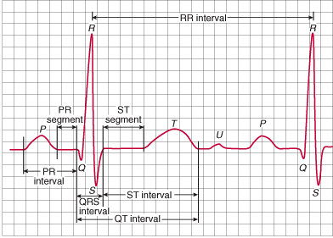
ACUTE CORONARY SYNDROME
Reading an ECG

Slide 45
ACUTE CORONARY SYNDROME
Identifying a STEMI
  On a 12-Lead ECG you must have the following to declare a STEMI
    0.1 mV of elevation at the J point that is new or believed to be new.
    The elevation has to occur in two or more contiguous leads.
    0.1 mV is equal to 1 mm.
    Elevation has to occur in absence of a Left Bundle Branch Block (LBBB)

Slide 46
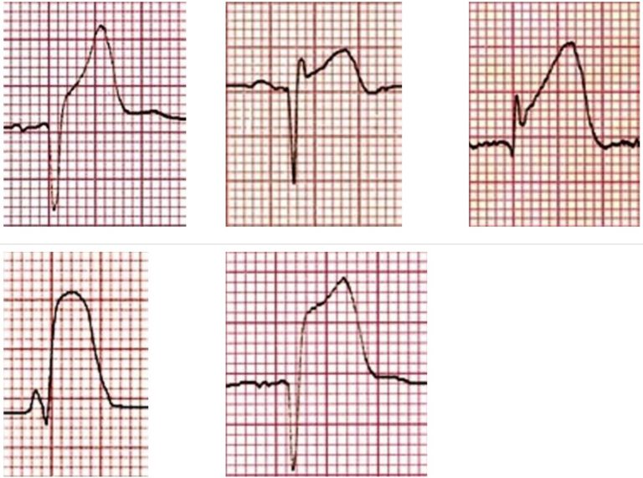
ACUTE CORONARY SYNDROME
STEMI waveform morphology

Slide 47
ACUTE CORONARY SYNDROME
STEMI Mimics
  Pericarditis
  Benign Early Repolarization
  Left Bundle Branch Block (LBBB)
  Brugada Syndrome
  Prinzmetal’s Angina
  Left Ventricular Hypertrophy (LVH)

Slide 48
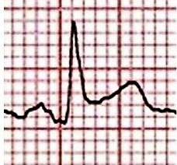
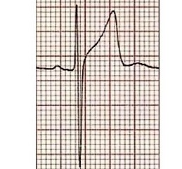
ACUTE CORONARY SYNDROME
Pericarditis
Benign Early Repolarization

Slide 49
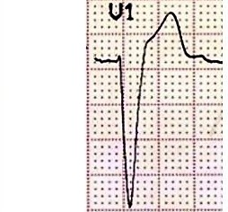
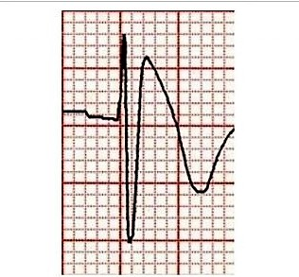
ACUTE CORONARY SYNDROME
Left Bundle Branch Block (LBBB)
Brugada Syndrome

Slide 50
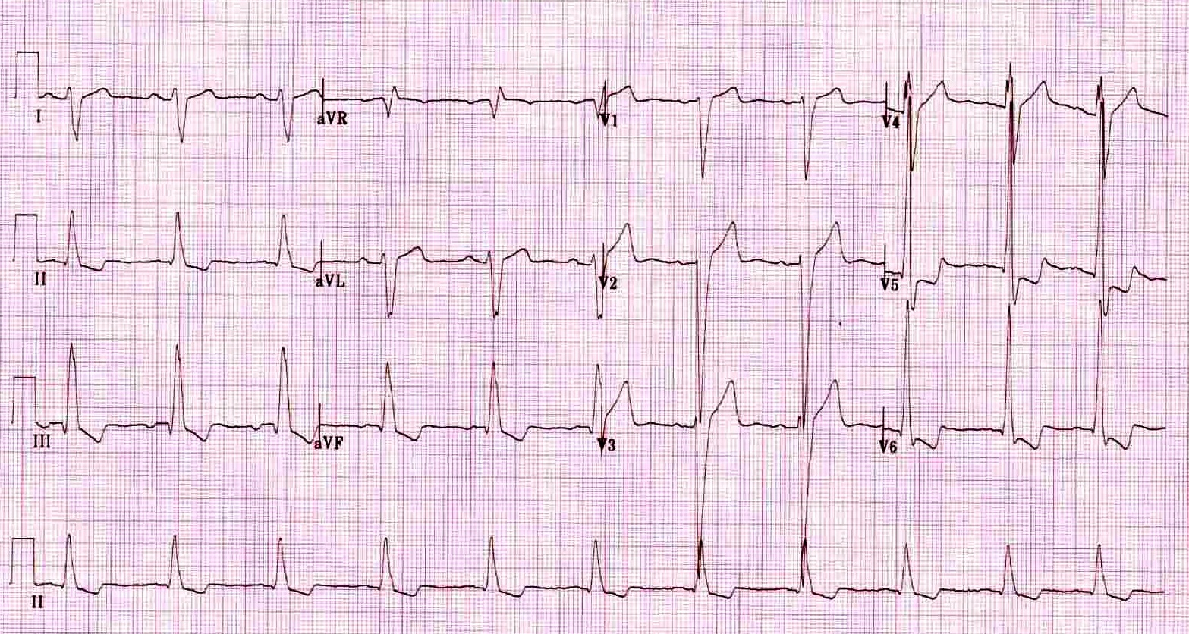
ACUTE CORONARY SYNDROME
Left Ventricular Hypertrophy

Slide 51
ACUTE CORONARY SYNDROME
Identifying Left Ventricular Hypertrophy
  Sokolov-Lyon Criteria
    S wave depth in V1 + the tallest R wave in V5 or V6 > 35mm
  Voltage criteria must be accompanied with non-voltage criteria
  Non-voltage criteria
    R wave peak time > 50ms in V5 or V6
    ST segment depression and T wave inversion in left sided leads
      Left ventricular strain pattern

Slide 52
ACUTE CORONARY SYNDROME
Prinzmetal’s Angina
  Causes STEMI elevation patterns with reciprocal changes
  ECG changes come and go
  Reversible with vasodilators
  Not associated with myocardial tissue death
  Unlikely to differentiate STEMI from Prinzmetal’s based on ECG alone

Slide 53
ACUTE CORONARY SYNDROME
Identifying STEMI in presence of Left Bundle Branch Block (LBBB)
Modified Sgarbossa Criteria
  ≥ 1 lead with ≥ 1mm of concordant ST elevation
  ≥ 1 lead of V1-V3 with ≥ 1mm of concordant ST depression
  ≥ 1 lead anywhere with ≥ 1mm STE and proportionally excessive discordant STE as defined by ≥ 25% of the depth of the preceding S wave

Slide 54
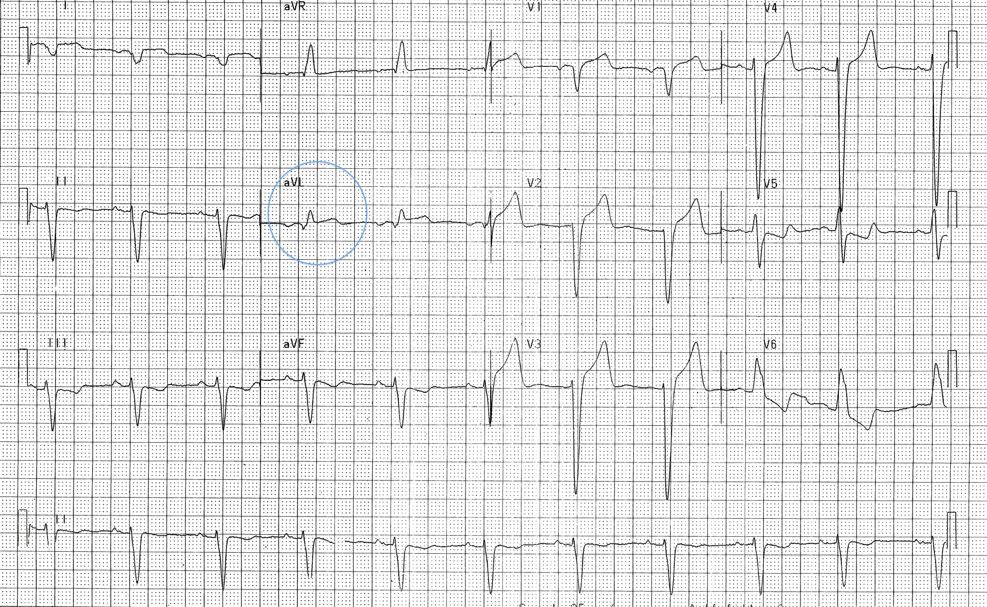
ACUTE CORONARY SYNDROME
LBBB with positive Sgarbossa Criteria

Slide 55
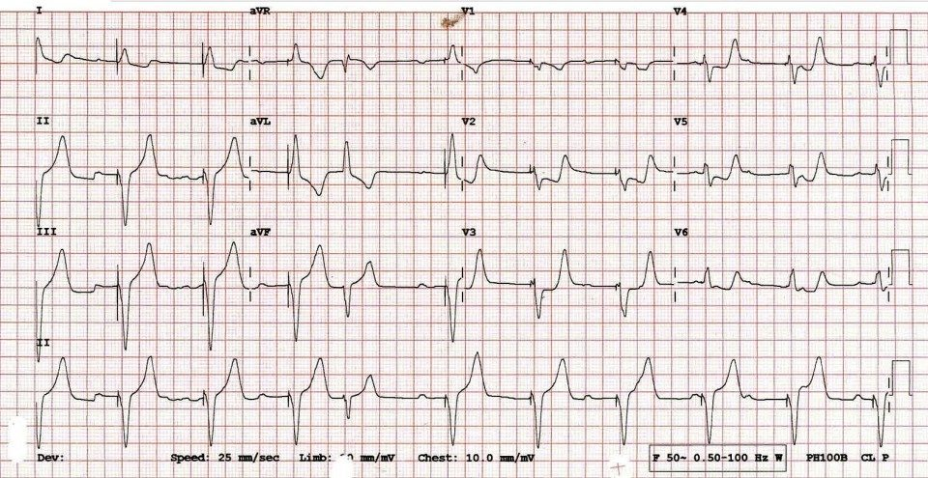
ACUTE CORONARY SYNDROME
Ventricular pacer with positive Sgarbossa Criteria

Slide 56
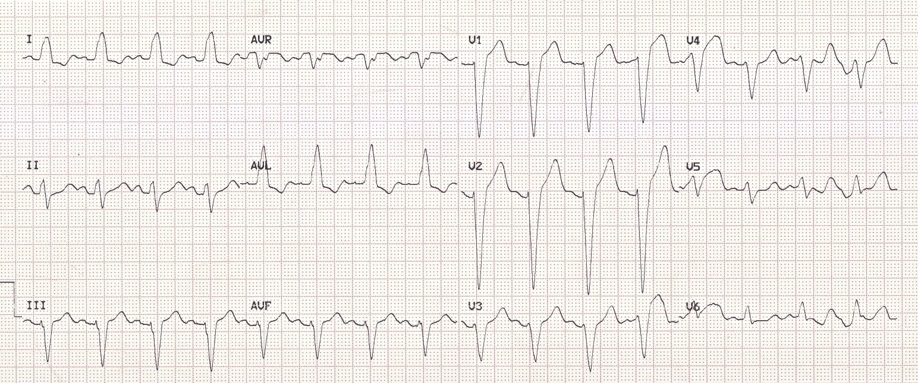
ACUTE CORONARY SYNDROME
Left Bundle Branch Block ECG

Slide 57
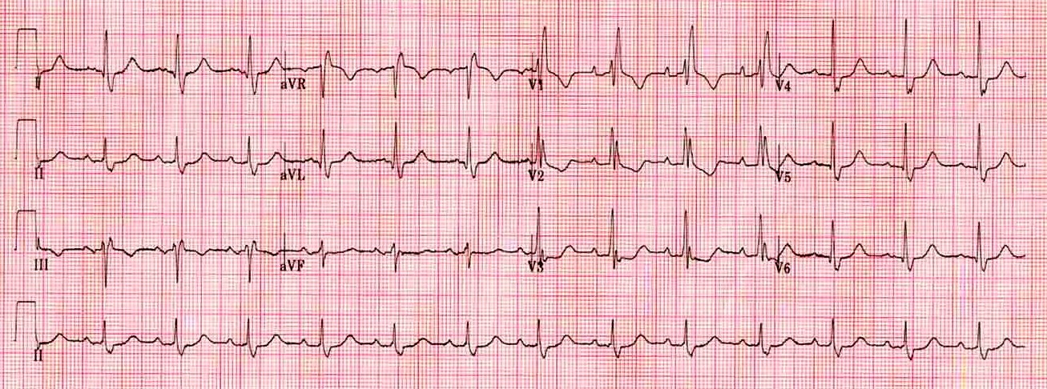
ACUTE CORONARY SYNDROME
Right Bundle Branch Block ECG

Slide 58
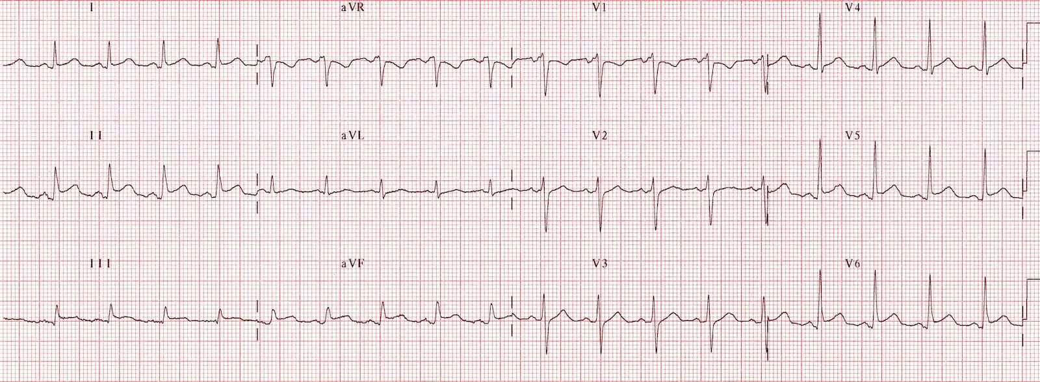
ACUTE CORONARY SYNDROME
Pericarditis ECG

Slide 59
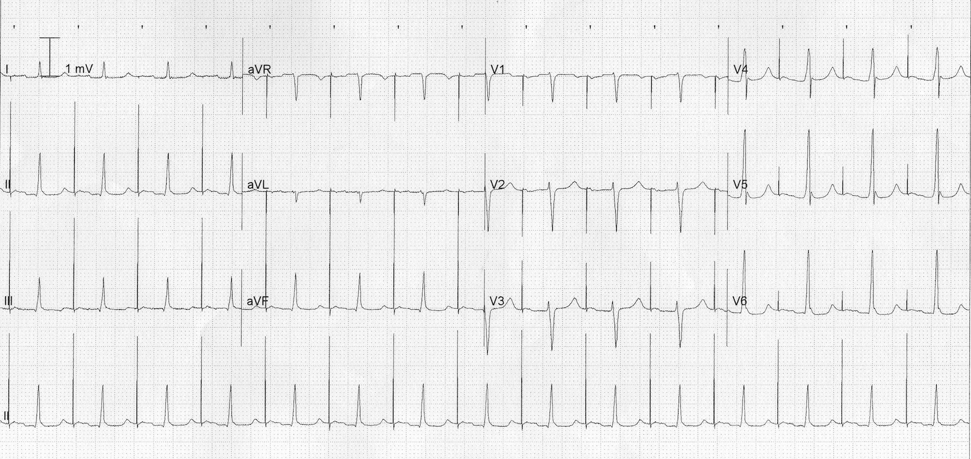
ACUTE CORONARY SYNDROME
ATRIAL PACEMAKER ECG

Slide 60
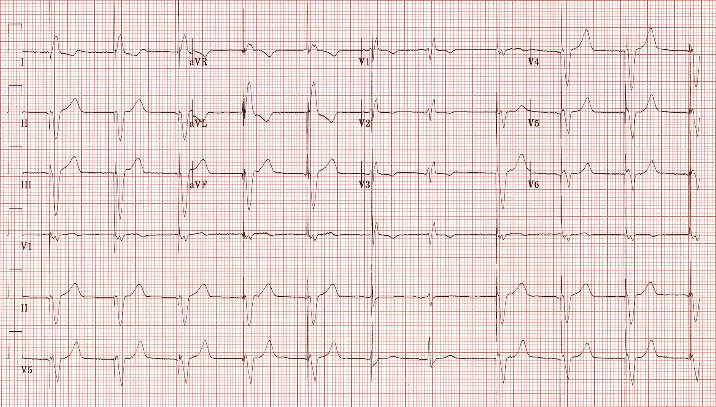
ACUTE CORONARY SYNDROME
VENTRICULAR PACEMAKER ECG

Slide 61
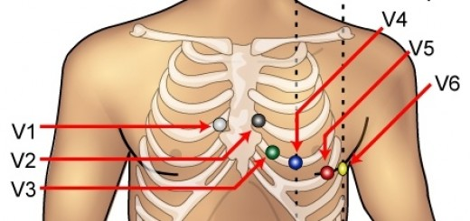
ACUTE CORONARY SYNDROME
ECG PLACEMENT STANDARD

Slide 62
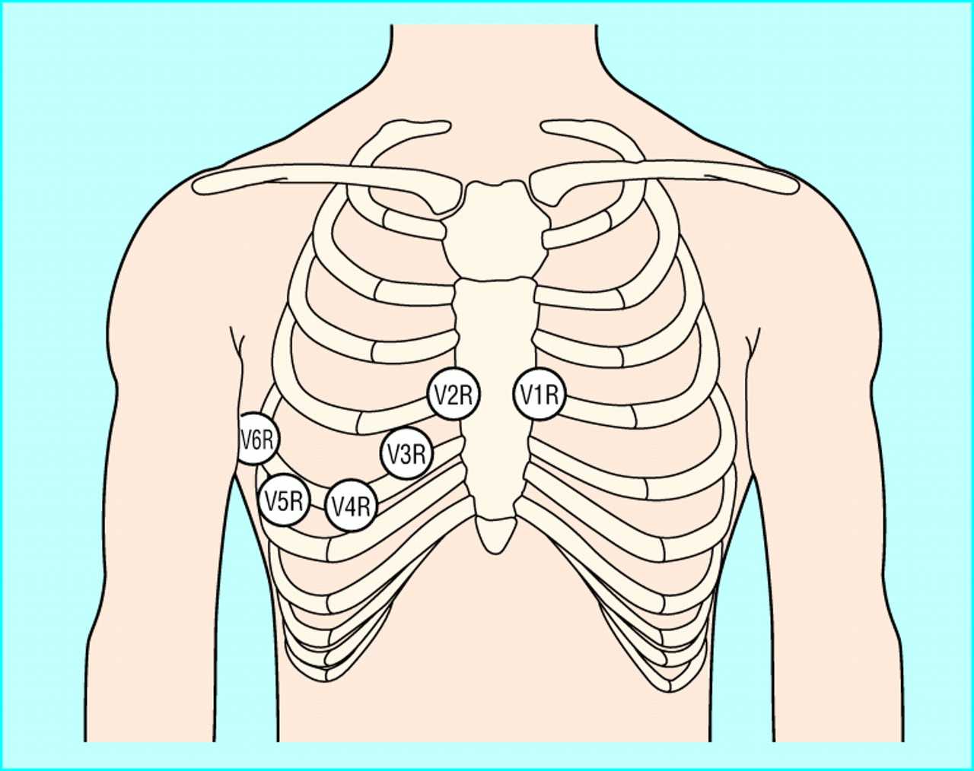
ACUTE CORONARY SYNDROME
ECG PLACEMENT RIGHT

Slide 63
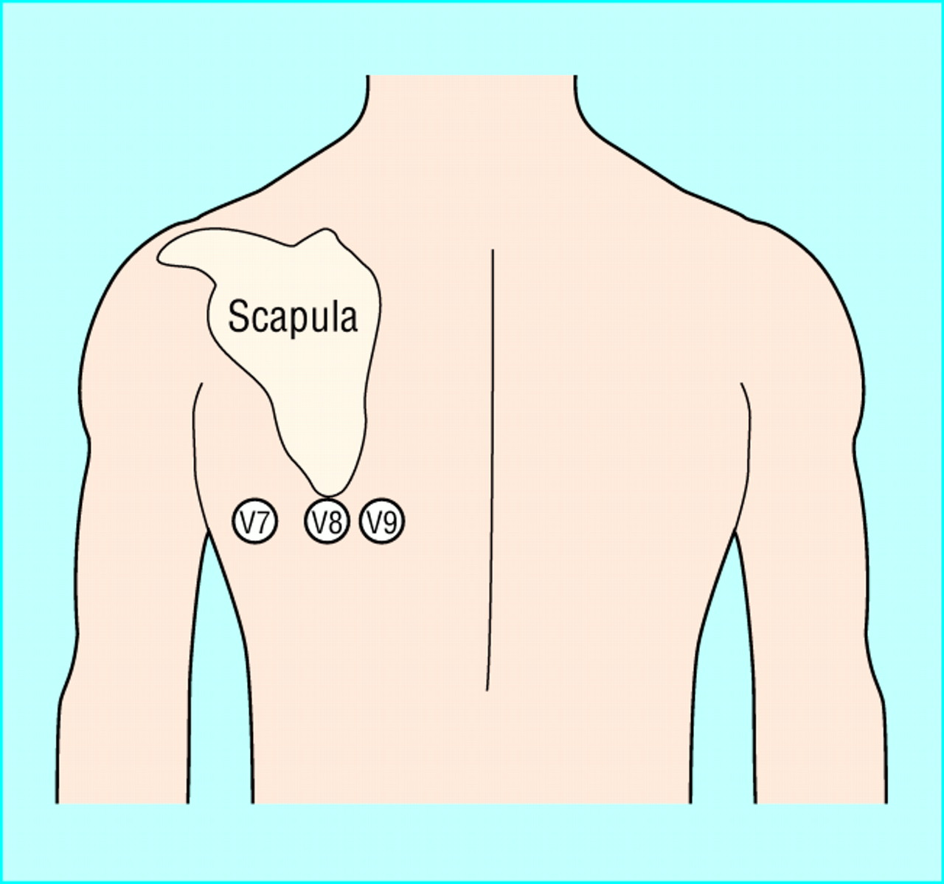
ACUTE CORONARY SYNDROME
ECG PLACEMENT POSTERIOR

Slide 64
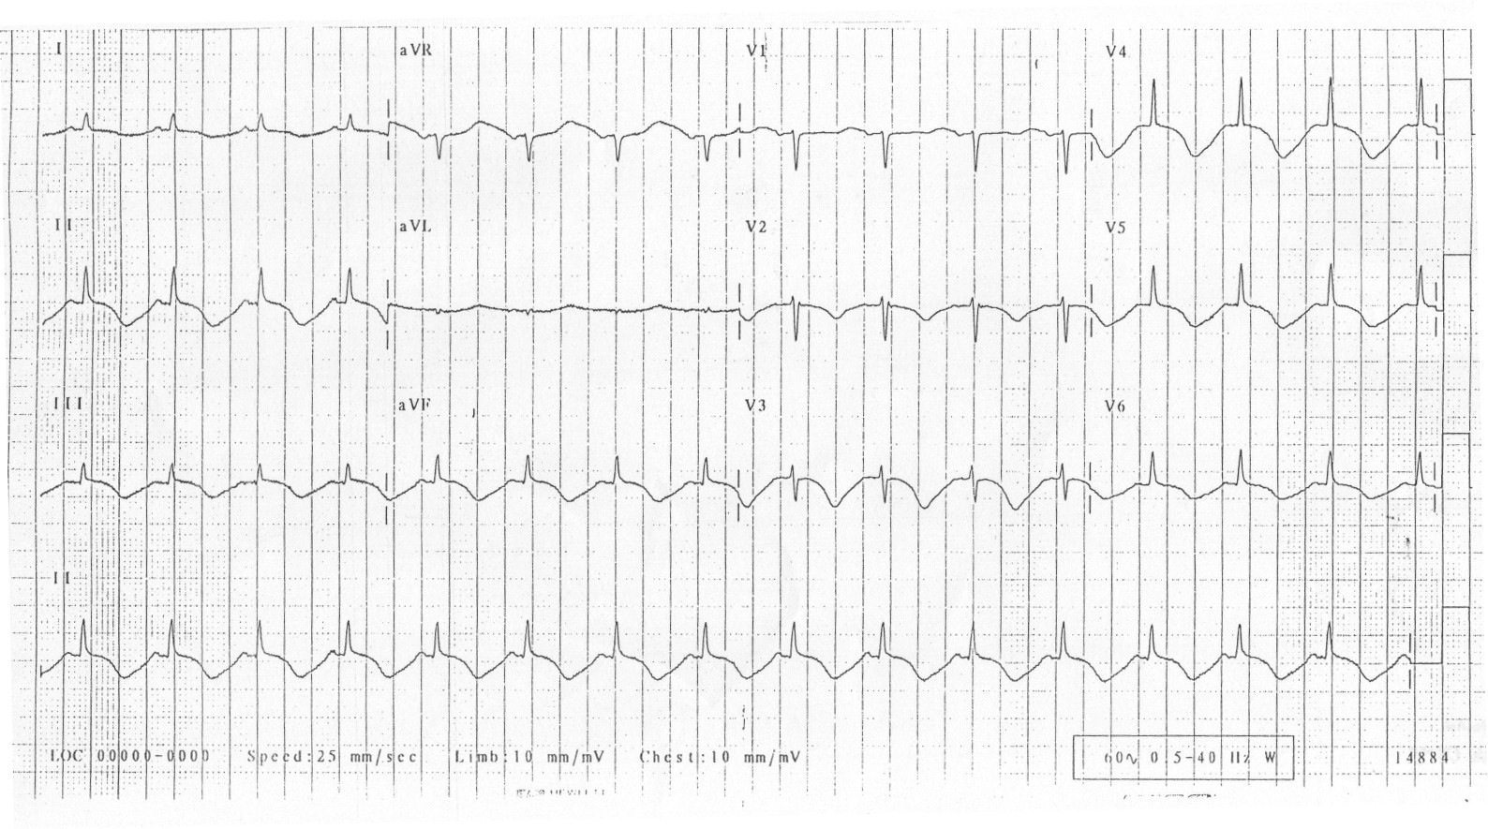
ACUTE CORONARY SYNDROME
Cerebral T Waves

Slide 65
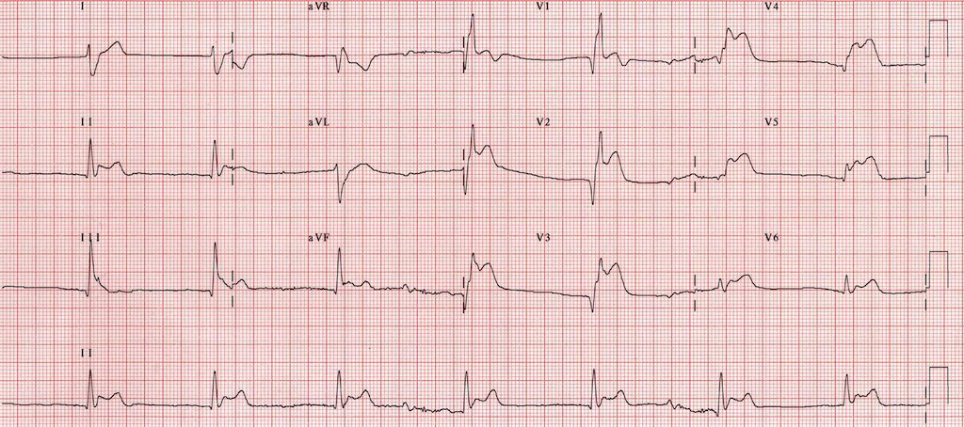
ACUTE CORONARY SYNDROME
Tako-Tsubo Cardiomyopathy

Slide 66
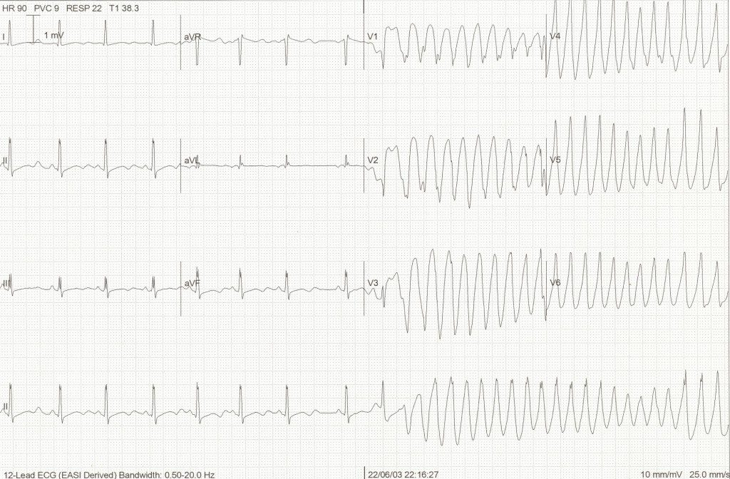
ACUTE CORONARY SYNDROME
Torsades de Pointes

Slide 67
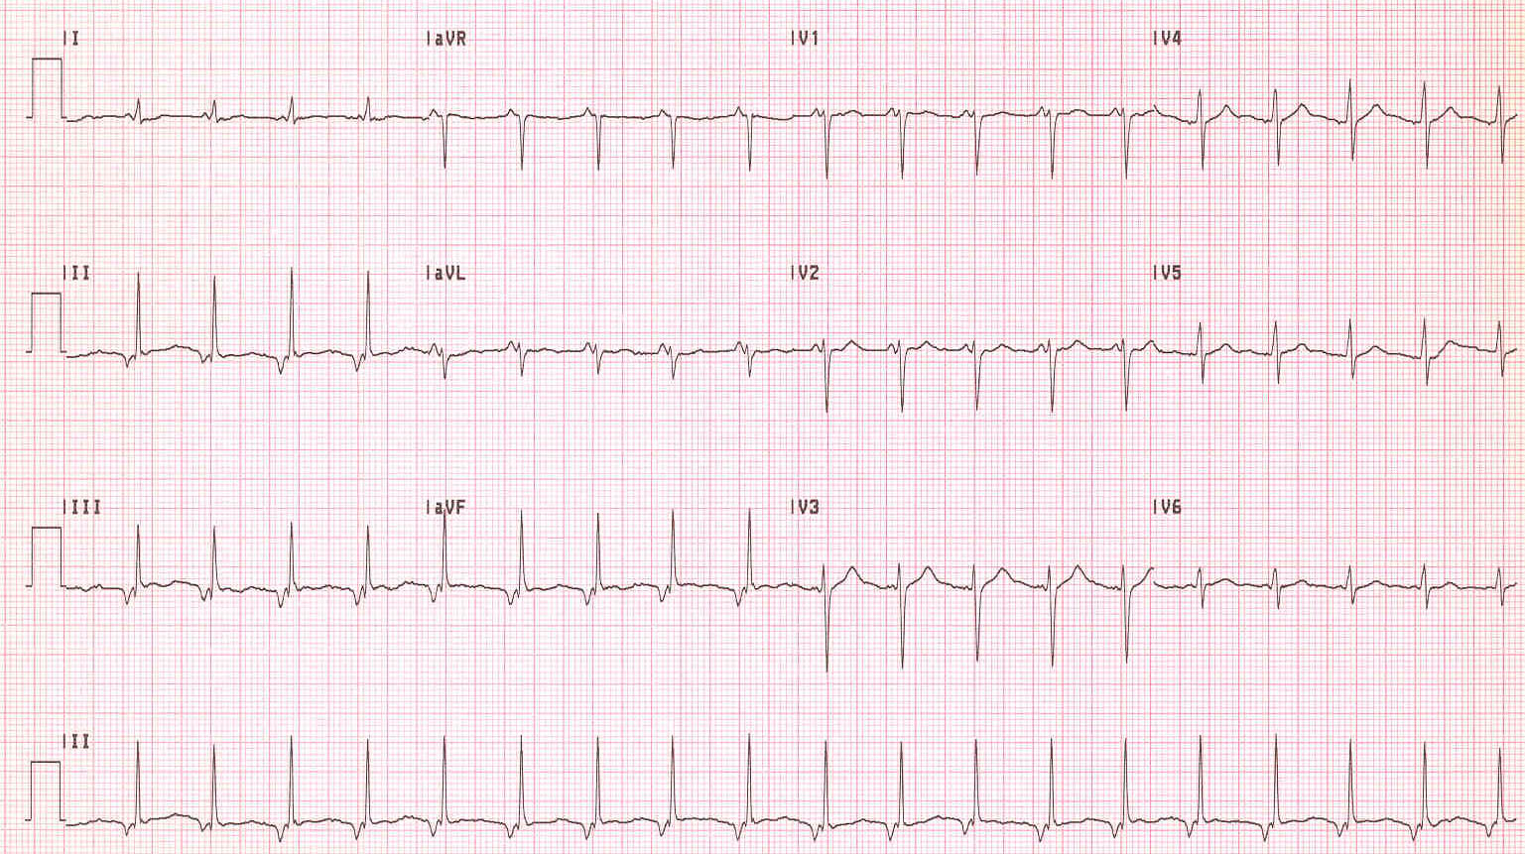
ACUTE CORONARY SYNDROME
What is this rhythm?
Notes:
Junctional Tach

Slide 68
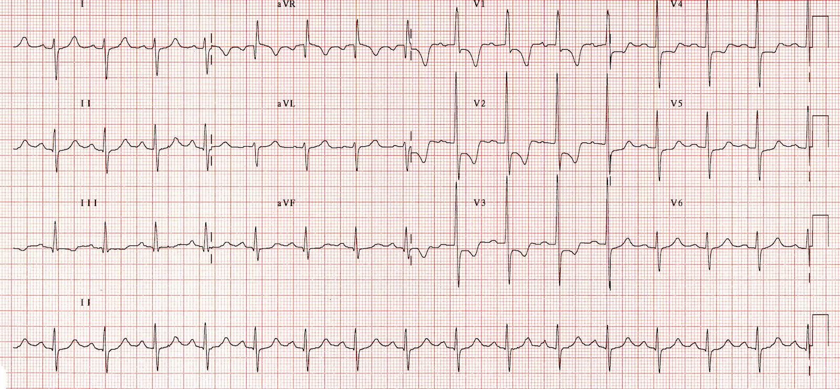
ACUTE CORONARY SYNDROME
What is this rhythm?
Notes:
Right Ventricular Strain Pattern

Slide 69
ADULT CARDIAC ARREST
CHAIN OF SURVIVAL 5 LINKS
  Immediate recognition of cardiac arrest and activation of emergency response.
    Immediate recognition of cardiac arrest includes:
      Identifying apnea in patients
      Distinguishing between agonal gasps and inadequate respirations
      Confirming pulslessness by checking carotid pulse for not more than 10 seconds
        The exception is patient’s in hypothermia get a pulse check for a full minute
    Activation of emergency response includes:
      Starting EMS if not already enroute
      Requesting additional resources as necessary

Slide 70
ADULT CARDIAC ARREST
CHAIN OF SURVIVAL 5 LINKS
  Early CPR with emphasis on chest compressions
    Early CPR is key in cardiac arrest
    Chest compressions are the primary factor in restoring Coronary Perfusion Pressure (CPP)
    CPP must be > 15 mm Hg to achieve ROSC (Paradis, 1990)
    Chest compressions should have limited interruptions
    Observational study shows survival rates dropping when compressions fall between 80-90 (Abella, 2005)

Slide 71
ADULT CARDIAC ARREST
CHAIN OF SURVIVAL 5 LINKS
  Rapid defibrillation
    Defibrillation is the passing of DC current through the myocardium
    Successful defibrillation occurs with the current causes a uniform depolarization in the myocardium
    AEDs advise to shock in two rhythms:
      Ventricular Fibrillation
      Ventricular Tachycardia
    Multiple studies have shown that defibrillation is most effective if performed within 8-10 minutes following a shockable arrest

Slide 72
ADULT CARDIAC ARREST
CHAIN OF SURVIVAL 5 LINKS
  Effective advanced life support
    Remember that effective advanced life support begins and should be maintained around effective BLS care
    Taking time away from chest compressions to perform advanced care techniques could be detrimental to patient well being
    Advanced procedures should be done when enough personnel are available to provide effective BLS care with advanced procedures are performed
    IV/IO access should be obtained without interfering with compressions
    ETT access should be obtained if at all possible without interfering with compressions and if compressions are halted should not be longer than 10 seconds… Remember CPP must be > 15 mm Hg and no compressions mean no CPP

Slide 73
ADULT CARDIAC ARREST
CHAIN OF SURVIVAL 5 LINKS
  Integrated post cardiac arrest care
    12-Lead ECG should be routinely performed on all ROSC patients to help to identify cardiac etiology and help determine need for immediate angiography
    Prehospital cooling of patients with rapid infusion of cold IV fluids is not recommended
    Using clues in patient presentation, bystander observations, and scene size up to determine the possible cause of arrest could prove significantly beneficial in the long term post arrest care of the patient

Slide 74
ADULT CARDIAC ARREST
PROPER CHEST COMPRESSIONS
  Chest compressions should be performed at a rate of 100-120/min
  Maintaining a consistent and adequate compression rate is a significant factor in obtaining ROSC.
  Compress the chest at least 5cm but not more than 6cm
  Maintaining a consistent compression depth in the field is difficult and a feedback device to monitor compression rate and depth should be used

Slide 75
ADULT CARDIAC ARREST
PROPER CHEST COMPRESSIONS
  Chest recoil is as important in the compression process as the compression itself
  Incomplete recoil leads to:
    Increased positive intrathoracic pressure
    Inhibits venous blood return
    Decreases arterial pressures
    Reduces CPP

Slide 76
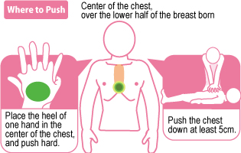
ADULT CARDIAC ARREST
PROPER CHEST COMPRESSIONS

Slide 77
ADULT CARDIAC ARREST
HIGH PERFORMANCE CPR
  The primary goal of high performance CPR is the reduction of interruption in compressions
  Early compressions rotating between compressors every 100 compressions
    Shown to reduce rescuer fatigue and increase effective compressions
  Each rescuer has a clearly defined role within the team
    Compressor 1, Compressor 2, Head/Airway, AED, ALS

Slide 78
ADULT CARDIAC ARREST
HIGH PERFORMANCE CPR
  Compressor 1 assesses patient and begins CPR
  Compressor 2 attaches AED as soon as possible without interrupting CPR
  Head/Airway inserts airway adjunct, applies oxygen, ventilates in coordination with compressions and runs AED/Monitor
  ALS establishes access IV/IO, administers medications, reversible causes
    If head/airway is BLS may insert ETT is necessary and monitor rhythm

Slide 79
ADULT CARDIAC ARREST
HIGH PERFORMANCE CPR
  The goal is to provide a consistent high level of BLS care
  ALS interventions do not take priority over BLS measures
  Compressions should not be interrupted for insertion of an ETT unless unable to maintain a patent airway with BLS adjuncts
  ETCO2 should be applied and monitored as soon as available

Slide 80
ADULT CARDIAC ARREST
HIGH PERFORMANCE CPR VIDEO

Slide 81
ADULT CARDIAC ARREST
MECHANICAL CPR
  Mechanical CPR refers to the use of a mechanical device to perform compressions in place of a human rescuer.
  Mechanical CPR has been in study since the mid 1970s starting with the piston driven thumper
  While the AHA shows no clear benefit to the use of mechanical CPR over manual CPR when in a controlled and stable sitting there is evidence that mechanical CPR is more beneficial than manual CPR when it is difficult, dangerous, or unlikely for a provider to provide accurate, effective, and consistent compressions (i.e.: during ambulance transport)

Slide 82
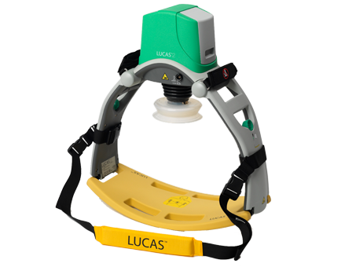
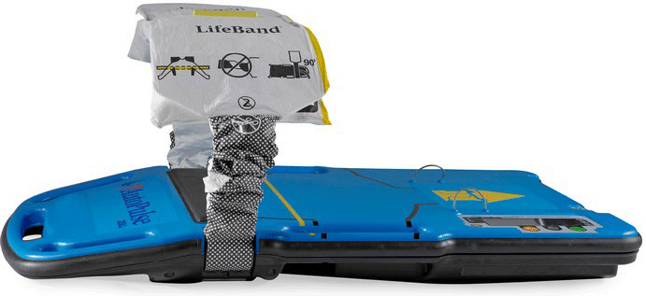
ADULT CARDIAC ARREST
MECHANICAL CPR
  Two styles of mechanical CPR devices currently dominate the market
    Load Distributing Band (LDB) devices such as the ZOLL Autopulse
    Lund University Cardiac Arrest System (LUCAS) devices

Slide 83
ADULT CARDIAC ARREST
MECHANICAL CPR VIDEO, APPLICATION AND USE OF AUTOPULSE

Slide 84
ADULT CARDIAC ARREST
MECHANICAL CPR VIDEO, APPLICATION AND USE OF LUCAS

Slide 85
ADULT CARDIAC ARREST
AIRWAY MANAGEMENT BVM
  Avoid hyperventilation
    Excessive ventilation rates and depths increase pressure in the thoracic cavity reducing the blood return to the heart during compressions
  One breath every 6-8 seconds after advance airway placement
    Breaths should be administered only until the chest rises
    You should NOT need to deflate the entire BVM to provide effective ventilations
    Reposition the airway if necessary and monitor for gastric distension and airway compliance
  Adjust rate based of ETCO2

Slide 86
ADULT CARDIAC ARREST
AIRWAY MANAGEMENT ETT
  ETT in cardiac arrest is only necessary if airway patency is in question
  Compressions should not be halted or delayed for the placement of an ETT
  ETT placement should be done while chest compressions continue if possible, a video laryngoscope may be helpful

Slide 87
ADULT CARDIAC ARREST
AIRWAY MANAGEMENT ETT
  Signs for use of an ETT in cardiac arrest setting
    Lack of airway patency with BLS adjuncts
    Inability to create chest rise with BVM
    Inability to maintain ETCO2 >15 during arrest with effective compressions
    Gastric distension with concern for emesis
    Arrest etiology suggests airway trauma (i.e.: burns, clothesline injury)

Slide 88
ADULT CARDIAC ARREST
AIRWAY MANAGEMENT SUPRAGLOTTIC
  Considered an advanced airway
  Secures the airway while providing indirect ventilation to the lungs and preventing gastric distention
  Alternative to ETT placement
  Acceptable during CPR and when ETT cannot be placed for any number of reasons
  Capnography should be used to ensure patency of these airways

Slide 89
ADULT CARDIAC ARREST
AIRWAY MANAGEMENT SUPRAGLOTTIC
  King Tubes
    Various sizes
    Size based on patient height
    Ensure lung sounds/chest rise with placement
    ETCO2 placed as secondary confirmation and maintenance of airway

Slide 90
ADULT CARDIAC ARREST
AIRWAY MANAGEMENT SUPRAGLOTTIC AIRWAY VIDEO

Slide 91
ADULT CARDIAC ARREST
ETCO2
  35-45 mm/Hg in normally perfusing patient
  >45 mm/Hg
    Hypercapnia, respiratory acidosis
    Ensure ventilation rate and volume
  15-35 mm/Hg
    Hypocapnia, respiratory alkalosis
    Common in cardiac arrest patients with effective CPR in progress
  <10-15 mm/Hg
    Ensure effective and adequate compression and ventilations
    Prolonged readings <10 in cardiac arrest have poor prognosis

Slide 92
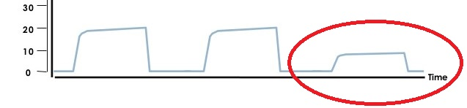
ADULT CARDIAC ARREST
ETCO2 inadequate CPR

Slide 93
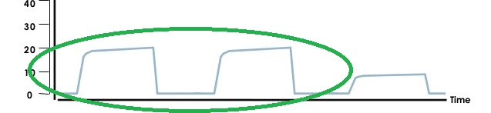
ADULT CARDIAC ARREST
ETCO2 adequate CPR

Slide 94
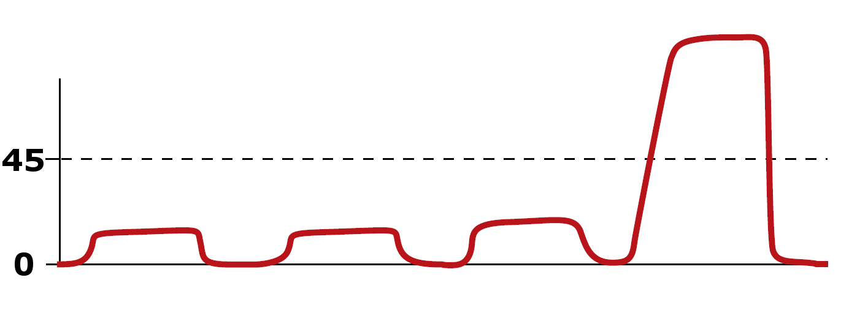
ADULT CARDIAC ARREST
ETCO2 ROSC

Slide 95
ADULT CARDIAC ARREST
DEATH IN THE FIELD
  EMS personnel encounter patients who are dead at the time of arrival in which resuscitation is medically inappropriate
  The decision to not begin resuscitation may occur under the following circumstances if ordered in consultation with MCP
    When there are changes to the body which indicate a prolonged postmortem interval
    Injuries incompatible with life such as decapitation or transection of torso
    Pulseless, apneic patients in multiple casualty situations where available resources are required to maintain living patients
    Proper DNR documentation has been discovered or clarified by family, End of Life Registry, or power of attorney
    Resuscitation efforts pose a danger to the health and/or safety of the rescuers

Slide 96
ADULT CARDIAC ARREST
DEATH IN THE FIELD
  The decision to not begin resuscitation may occur under the following circumstances by order of MCP
    Victims of trauma who are pulseless and apneic at the time of arrival of first responders
    Blunt trauma patients, who become pulseless and apneic, cannot be extricated quickly, and the entrapment precludes medically effective resuscitation efforts
    Circumstances where beginning or continuing resuscitation is not medically appropriate as determined by EMS personnel and direct contact with the Medical Command Physician
    Proper DNR documentation has been discovered or clarified by family, End of Life Registry, or power of attorney

Slide 97
ADULT CARDIAC ARREST
TERMINATION
  The medical decision is made to discontinue resuscitation efforts in the field
  EMS personnel may request orders to cease resuscitation efforts on a patient in the field when any of the following are present
    Resuscitation initially started is determined to have been medically inappropriate
    Full cycle of ALS treatment has been unsuccessful and patient has been confirmed pulseless and apneic by EMS for at least 20 minutes
    Proper DNR documentation has been discovered or clarified by family, End of Life Registry, or power of attorney
    BLS resuscitation has proved unsuccessful and no ALS is available for an extended period of time patient has been confirmed pulseless and apneic by EMS for at least 20 minutes
    Physical exhaustion of available providers to provide care
    The scene environment is judged to be unsafe for rescuers to continue resuscitation
    Extremely remote areas where evacuation may require hours or days

Slide 98
ADULT CARDIAC ARREST
TERMINATION
  EMS personnel will contact Medical Command and speak directly to the MCP
  Specific history and details of care will be discussed and MCP will make final decision, give final order to cease resuscitation, and note exact date and time

Slide 99
ADULT CARDIAC ARREST
TERMINATION
  Exceptions
    Situations may necessitate transport of patients and continued resuscitation efforts per direct MCP order
      Volatile or potentially dangerous situations where movement of the patient and exit from the scene is required for the safety of the rescuers
      Hypothermic patients
      Pediatric patients less than 12 years of age
      If patient is removed from scene and resuscitation continued, the resuscitation efforts should be continued until arrival at the hospital.

Slide 100
ADULT CARDIAC ARREST
PREGNANT CPR
  Ensure adequate chest compressions
  Transport to hospital, monitor and treat as normal
  Increasing child survivability is based on adequate care of the mother in arrest
  Be sure to advise hospital of full situation so they can have proper resources at the ready

Slide 101
ROSC
CPR should be continued until signs of life are observed
  Sudden increase in ETCO2 level
    ETCO2 will spike when circulation returns because CO2 that built up during arrest, even with compressions, is getting washed out of the lungs
    Waveform with ventilation and no compressions means circulation is taking place
    Often present prior to pulse
  Presence of pulse with an organized rhythm
    An organized rhythm on the monitor with a pulse present is obvious return of circulation
    Some studies suggest that CPR should continue even with a pulse present until the pulse rate is greater than 40 unassisted

Slide 102
ROSC
CPR should be continued until signs of life are observed cont.
  Patient breathing
    Return of spontaneous respirations does not always occur immediately in ROSC situations
    Even is respirations return they need to be monitored for adequacy and assisted as necessary
    ETCO2 should be maintained on patients with return of spontaneous respirations
  Patient movement
    Patient movement is a positive sign for neurological activity
    Be sure to watch patient movement does not interfere with interventions
    Due to potential of AMS in ROSC situations sedation may be necessary

Slide 103
ROSC
OPTIMIZING OXYGENATION
  Look of obtain and maintain SpO2 ≥ 94%
    Once an SpO2 of 94% has been achieved more oxygen is not always better
    Aim to maximize ventilatory and oxygenation efforts by utilizing ETCO2 and SpO2 in conjunction
  Avoid excessive ventilation
    Excessive ventilation reduces cardiac output and cerebral blood flow both of which are critical to maintain in the post arrest situation

Slide 104
ROSC
OPTIMIZING OXYGENATION
  Monitor ETCO2
    Look to obtain and maintain ETCO2 between 35-40 mm/Hg
      Unless head injury with ICP is suspected in which case maintain ETCO2 30-35 mm/Hg

Slide 105
ROSC
HEMODYNAMIC INSTABILITY
  Monitor vital signs
    BP: ≥ 90 mm/Hg
    SpO2: ≥ 94%
    ETCO2: 35-45 mm/Hg
    Respirations: Adequate rate and depth
    Mental status: AVPU, changes in status

Slide 106
ROSC
HEMODYNAMIC INSTABILITY
  Ensure vascular access
    If not performed earlier in the arrest establish vascular access
    If performed earlier in the arrest ensure patency of vascular access after all movements
  Manage hemodynamic instability
    Hypotension- Systolic BP < 90 mm/Hg
      Fluid bolus
      If fluid bolus inadequate move to vasopressors
        Dopamine titrated to effect of systolic BP at least 90 mm/Hg

Slide 107
ROSC
Identifying cause of arrest
  As soon as possible after ROSC obtain a 12-Lead ECG
    Evidence of AMI may require direct transfer to a PCI facility
    If AMI is cause of arrest PCI care is key in patient treatment
    If no PCI facility in the area consult with medical command about patient condition and the availability of aviation to PCI facility of ground transport to local facility

Slide 108
ROSC
Identifying cause of arrest
  Consider and manage reversible causes
    Remember the H’s and T’s
      Hypovolemia
      Hypoxia
      Hydrogen Ion Excess (Acidosis)
      Hypoglycemia
      Hypokalemia
      Hyperkalemia
      Tension Pneumothorax
      Tamponade
      Toxins
      Thrombosis

Slide 109
ROSC
Targeted temperature management
  Studies have shown that a reduction in core temperature can increase positive neurological outcomes in ROSC patients
  Lower and controlling core temps slows cellular metabolism which reduces cell damage and death
  Performed with application of cold packs to the axilla, groin, and neck
  Core temperature measurement is an in-hospital consideration
    Axillary, tympanic, temporal, and oral temps are unreliable in identifying core temperature
    Foley catheter or esophageal probes are the commonly used tools in hospital

Slide 110
ROSC
Targeted temperature management
  Current AHA guidelines recommend against the routine cooling of ROSC patients in the prehospital setting.
  This is secondary to the frequent use of rapidly infusing chilled IV fluids in these patients which has been shown to have adverse effects.

Slide 111
ROSC
SYSTEM OF CARE
  Most deaths following ROSC occur with the first 24 hours
    It is important to start post care immediate and effectively
    Maintaining ventilatory rates, oxygenation, and circulation are key in improving patient survivability
    Recognition of scene clues and patient presentation to rule out or rule in possible causes will improve continuation of care
    Obtaining a clear 12-Lead ECG as soon as possible after ROSC can improve patient destination decision making
    Be sure to consider right sided and posterior look ECGs when a non-diagnostic 12-Lead ECG is obtained after ROSC

Slide 112
ROSC
SYSTEM OF CARE
  Transport the patient to the most appropriate facility
    Understand that the most appropriate facility for a ROSC patient is NOT necessarily the closest facility
    Recognition of the potential causes and identifying diagnostic 12-Lead ECGs in the post arrest sitting will help you decide if a specialty center is a better option for the patient
    If unclear consult with medical command about the patient presentation, condition, concerns, and transport options

