Slide 1
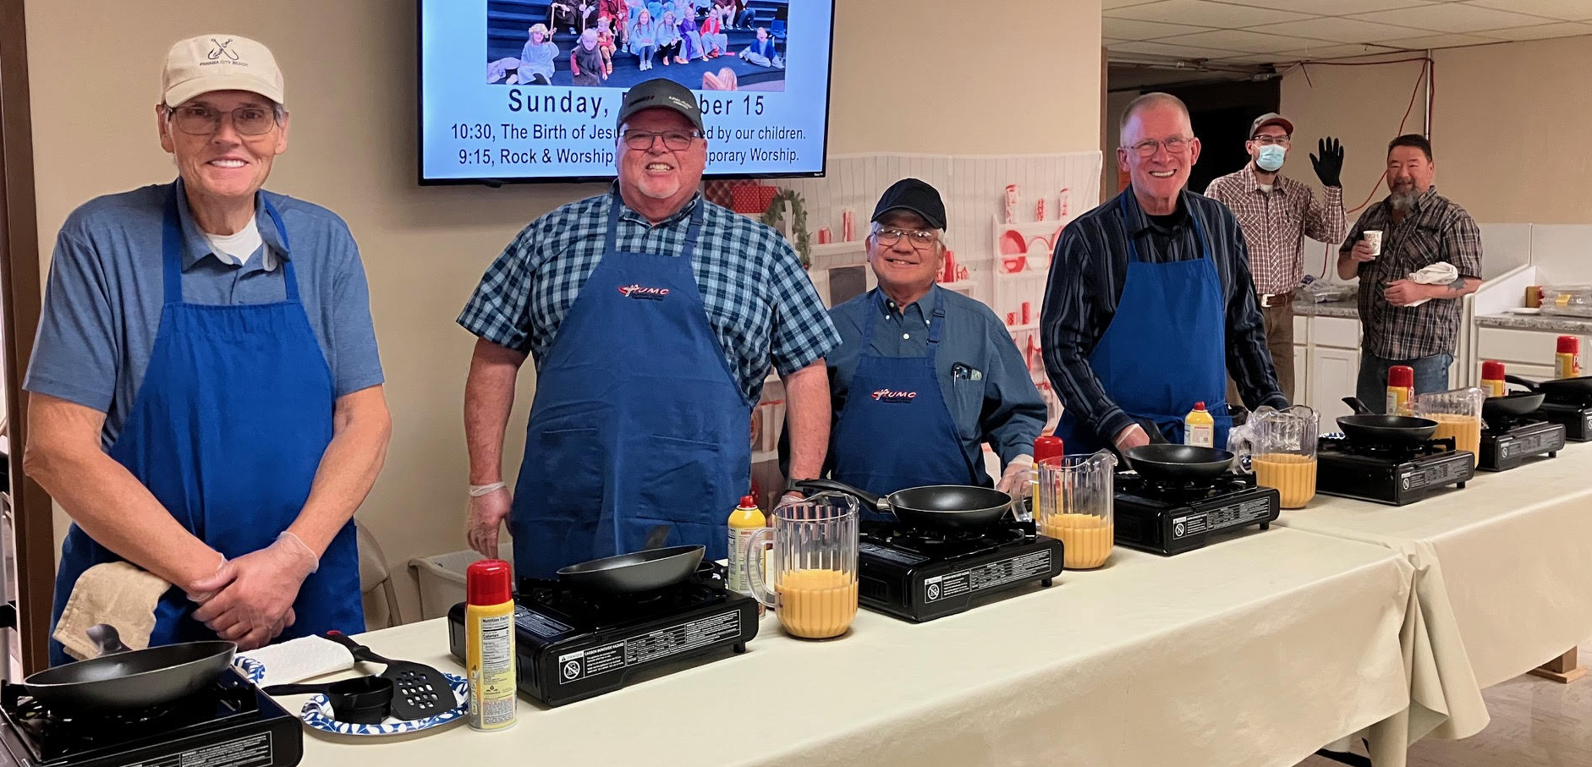
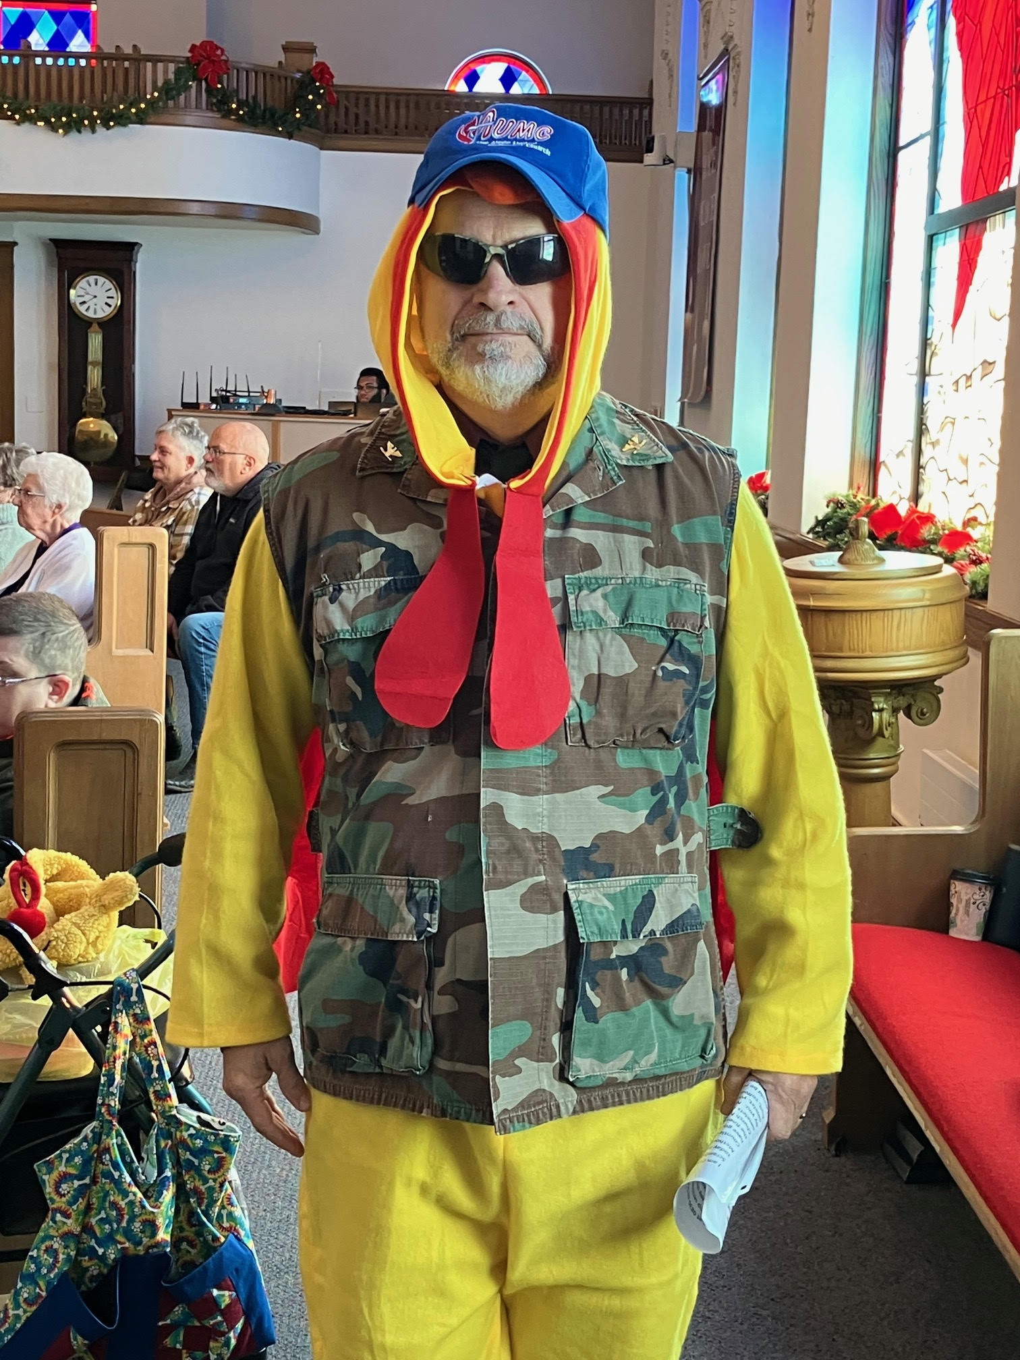
Sunday, December 7, 8:30 to 12:30
Annual Omelet Breakfast
Served by the United Methodist Men

