Slide 1

Transportation Inequities Impacting Educational Expenditures
A look at some Southeast Iowa School Districts
Nov. 24, 2015

Slide 2
Background
Maps come from ISFIS FACTMapping tool, which inputs data districts report to the DE, then allows for comparison and geographic representation.
Date sources: DE Annual Transportation Report (FY 2013 and FY 2014), School Certified Annual Report (FY 2014), BEDS staffing and enrollment data, ISFIS Calculations
Value statement: students in all Iowa districts deserve a great educational program fairly funded. Geography shouldn’t dictate the quality of an Iowa student’s education.

Slide 3
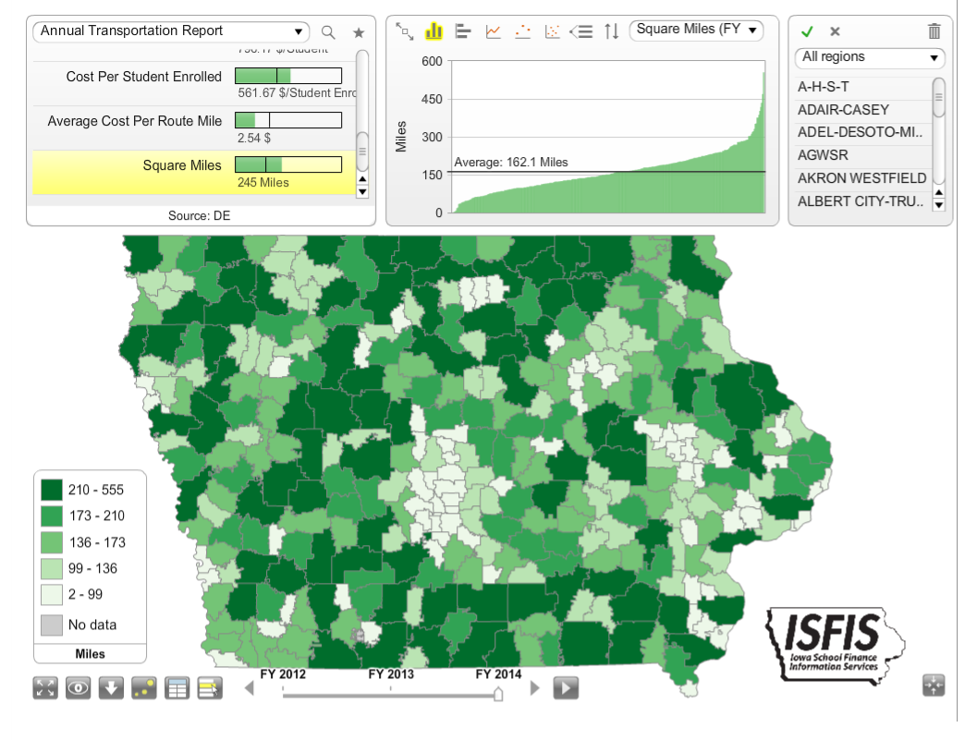
Transportation: Statewide Stats
District Square Miles:
Low of 2 square miles
Average of 162.1
High of 555 square miles

Slide 4
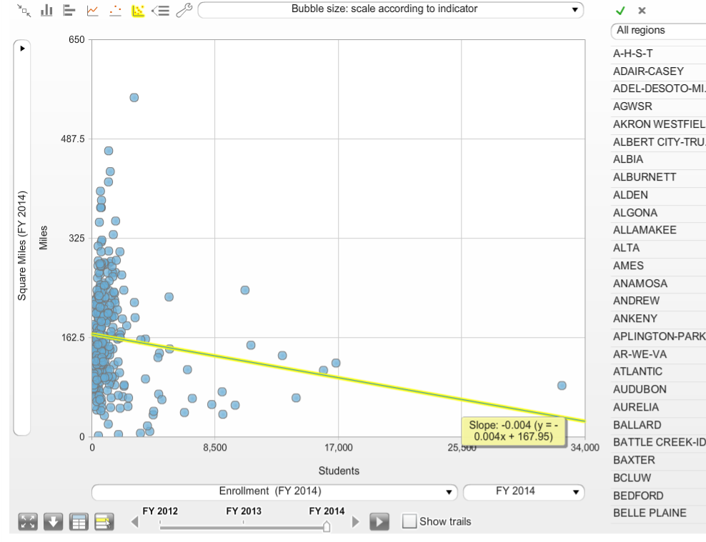
Transportation: Statewide Stats
Square Miles inversely related to enrollment:
The fewer students a district has, the more likely they are to have more square miles
Definition of Sparsity (fewer people per square mile)
Enrollment based formula disadvantages sparsely populated school districts

Slide 5
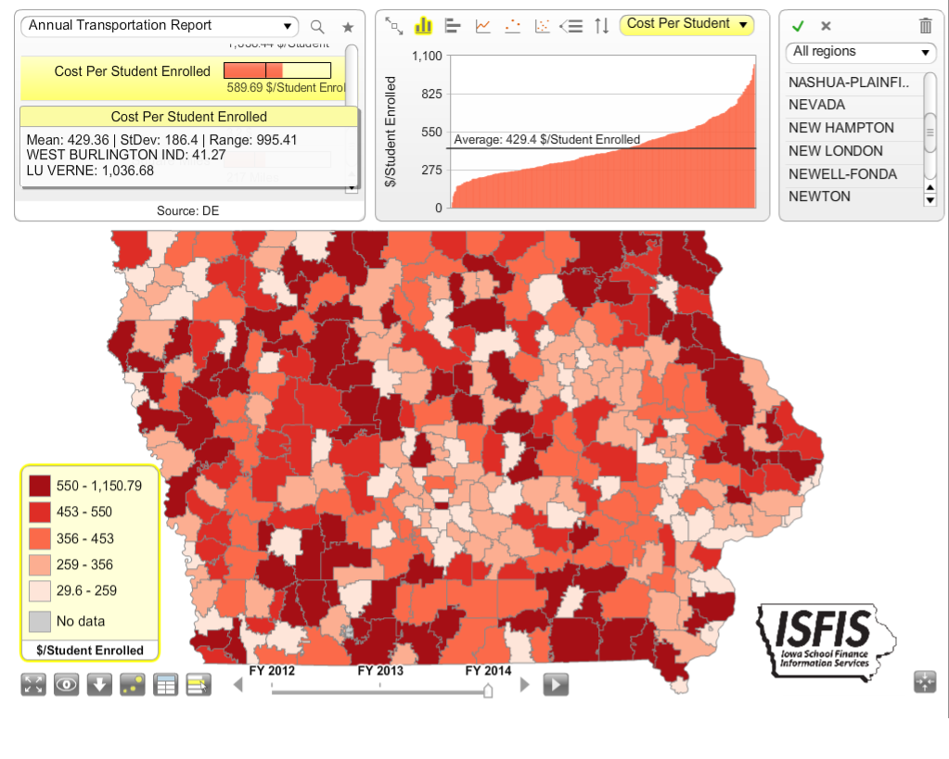
Transportation: Statewide Stats
Cost per Student Enrolled FY 2014
Low of $41
Average of $429
High of $1,037 cost per student enrolled
Includes all transportation costs (regular and special education)

Slide 6
Look at each of the following school district impacts: Fairfield, Harmony, Pekin and Van Buren
Square miles and enrollment
Route miles
Sparsity factor (students per square mile)
Cost per route mile
Cost per student enrolled
Opportunity cost – what would that money buy for our students?

Slide 7
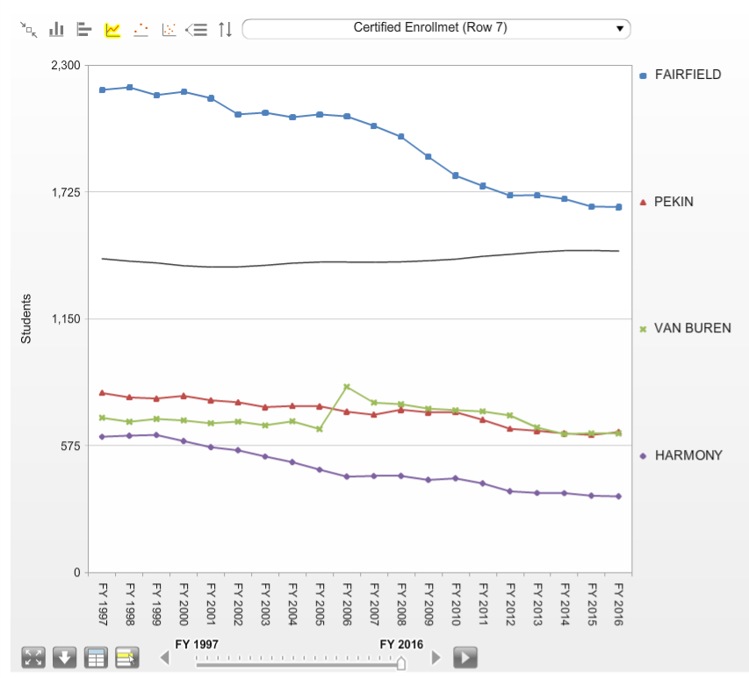
A look at 4 south central Iowa districts:
Statewide average enrollment = 1,411.7
Fairfield has a certified enrollment of 1,657.7 (FY 16).
Pekin and Van Buren are similar at 636.9 and 631.1 respectively, and
Harmony is smaller at 345.5

Slide 8
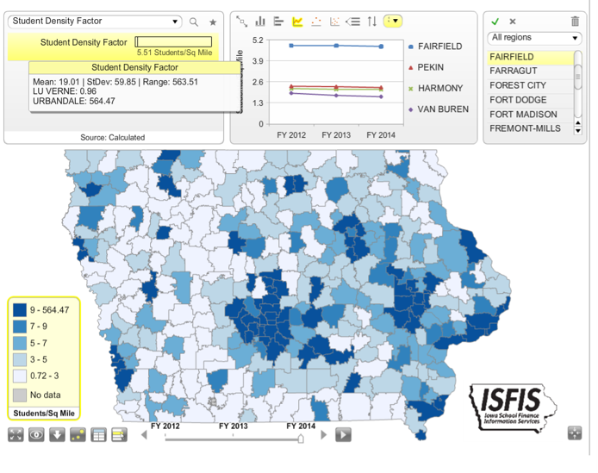
Fairfield
1,657.7 students enrolled (FY 2015)
353 square miles
4.8 students per square mile
206,301 route miles
$2.94 cost per mile
$364 transportation cost per student enrolled
Opportunity cost statement:
$605,036 total transportation cost is equivalent to 13 teachers in Fairfield (calculated based on average regular education teacher pay.)

Slide 9
Pekin
636.9 students enrolled (FY 2015)
280 square miles
2.25 students per square mile
135,939 route miles
$3.27 cost per mile
$712 transportation cost per student enrolled
Opportunity cost statement:
$444,283 total transportation cost is equivalent to 9 teachers in Pekin (calculated based on average regular education teacher pay.)

Slide 10
Harmony
345.5 students enrolled (FY 2015)
169 square miles
2.13 students per square mile
139,697 route miles
$1.69 cost per mile
$676 transportation cost per student enrolled
Opportunity cost statement:
$235,781 total transportation cost is equivalent to 5 teachers in Harmony (calculated based on average regular education teacher pay.)

Slide 11
Van Buren
631.1 students enrolled (FY 2015)
375 square miles
1.68 students per square mile
216,229 route miles
$2.80 cost per mile
$958 transportation cost per student enrolled
Opportunity cost statement:
$605,387 total transportation cost is equivalent to 13 teachers in Van Buren (calculated based on average regular education teacher pay.)

Slide 12
Policy Considerations
Where a student lives in Iowa shouldn’t dictate or limit the educational opportunities available to the student.
Special Education Transportation is paid out of special education funds. Weightings generate revenue which includes state funding, so there’s already an effort to equalize. To get at true equity, take special education out of the equation.
Not all route miles are equal: geographic conditions (rivers, hills, fog, ice conditions) and human conditions (state borders, location of bridges and interstates, gravel vs. paved roads) can all contribute to cost differences, both in cost per mile and bus repair costs.
Transportation is a mandate, with time limits for how long a student is on a bus. Bus travel is safer than student drivers so don’t want to discourage school transportation.
State cost constraints: do the most you can with limited dollars. May have to phase in state contributions to transportation equity.

Slide 13
Policy Considerations - Efficiency
School general fund dollars are precious:
  Schools have a bias towards transportation efficiency because we would all rather spend money on instruction (course offerings, class size, textbook books, curriculum, materials, teacher training, technology) then on busing.
  If the state is concerned about efficiency, a weighting tied to the difference between transportation costs today and the state cost per pupil today could create a ceiling. You would have to revisit over time as district enrollment declines and square miles per district increase.
  Transportation costs shouldn’t be a barrier to reorganization decisions if reorganization is in the best interest of students and communities. Reorganizations change square miles and enrollment, so sparsity changes too.
  A weighting in the formula could be indexed to the state cost per pupil, considering density (students per square mile) at a percentile ranking of expenditure, so the last dollar spent is on the school district, not the state, if policy makers find this issue compelling.

Slide 14
Questions?
Thank you for engaging in this critical topic of fairness that impacts our students in Iowa. Please contact us with further questions.
  Margaret Buckton
  Professional Advocate
  Rural School Advocates of Iowa
  http://www.rsaia.org/
  Margaret.buckton@isfis.net

