Slide 1
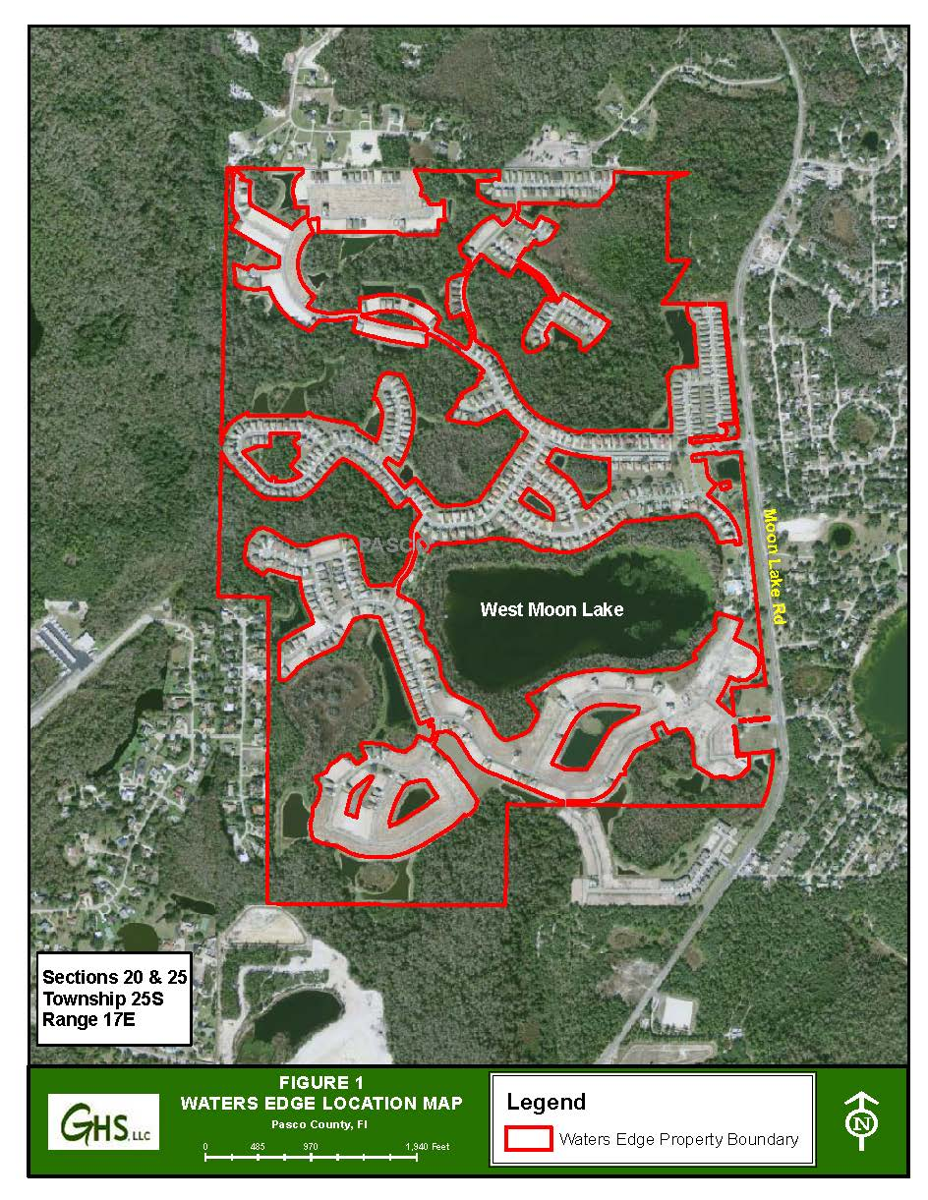

Gaydos Hydro Services
What about all that water?
Anything Water!

Slide 2
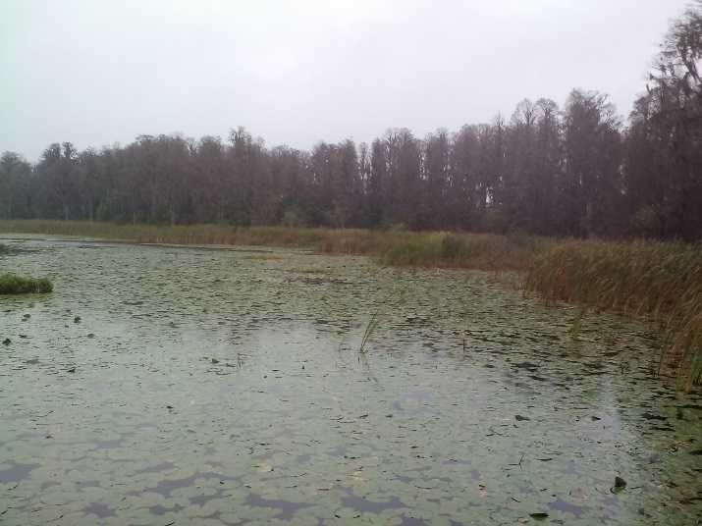


What We Do for Waters Edge
Water Use Permitting
Environmental Monitoring
(per Water Use Permit conditions)
Supervision of/and Maintenance on West Moon Lake
Minimis Maintenance of Stormwater Ponds Areas and Outfalls as needed

Slide 3
Other Professional Services
Monitoring & Reporting
Data Analysis
Sampling
Compliance
Design & Permitting
Feasibility
Testing
Permits
Modeling
& Studies
Environmental
Water Quality
Wetlands
MFLs
Groundwater Modeling
Lakes & Ponds
Stormwater Inspections

Slide 4
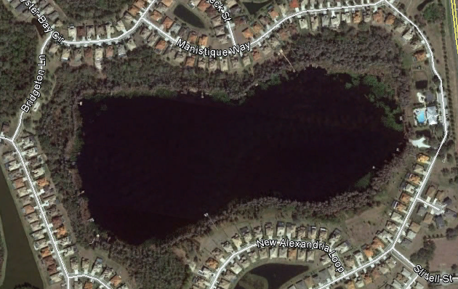
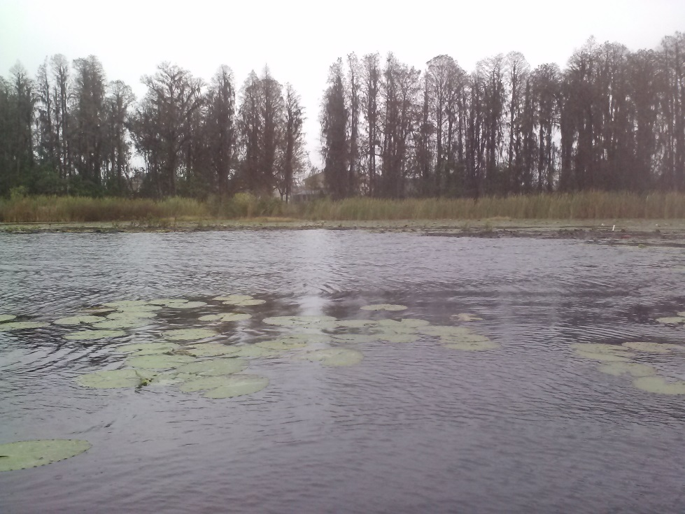
WUP #12754
  2010 - Modified permit to gain a 10% increase
  2012 - Modified permit for two additional groundwater wells to lesson the draw on the irrigation pond
  Annual Avg = 248,600 gpd
  Peak Month = 864,500 gpd
  Permitted to use surface water from West Moon Lake
West Moon Lake

Slide 5

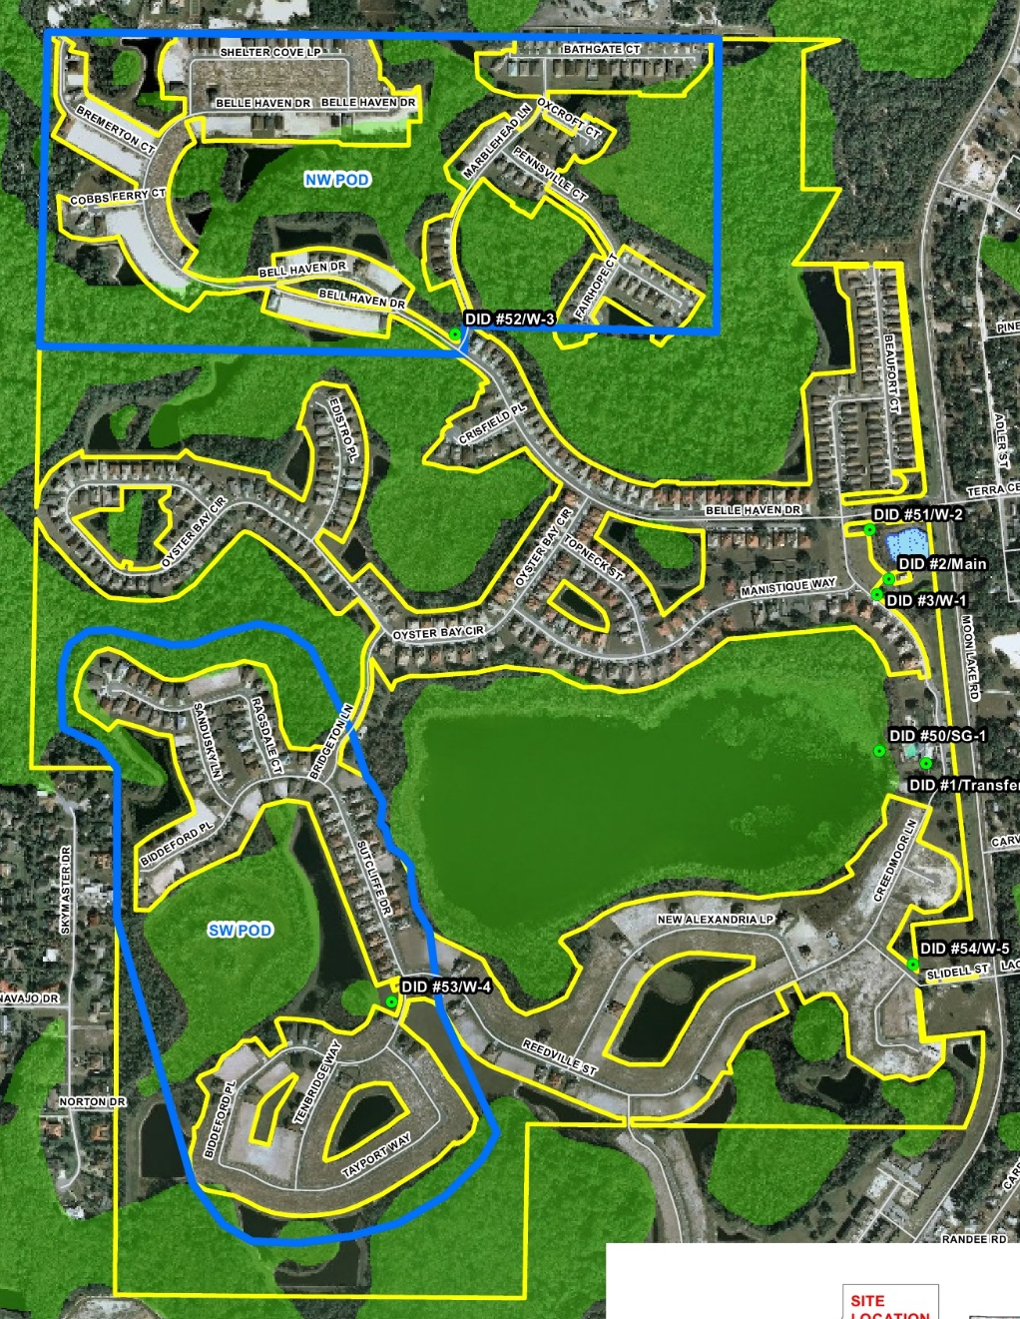
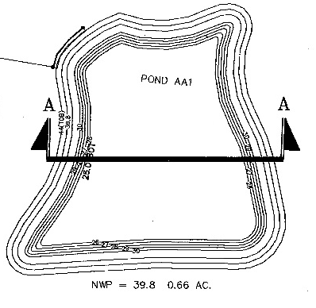
Irrigation Sources
Northern portion of Moon Lake Road
NW Pod
W-3
W-2
W-1
WML
Transfer
SW Pod
W-5
Southern portion of Moon Lake Road
W-4

Slide 6
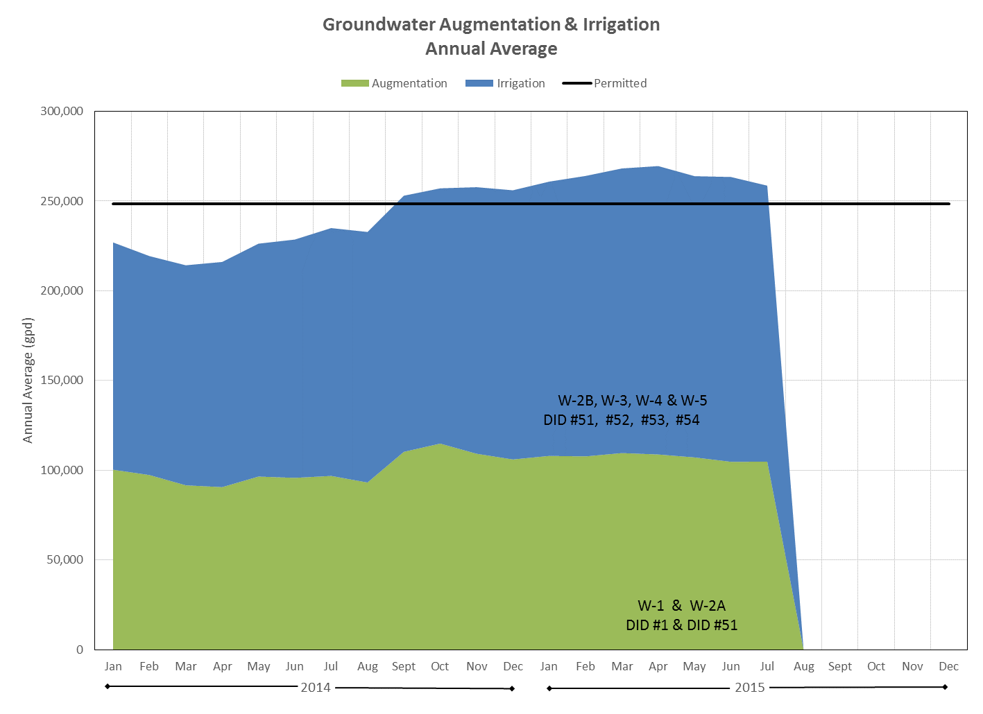
Recent Water Use

Slide 7
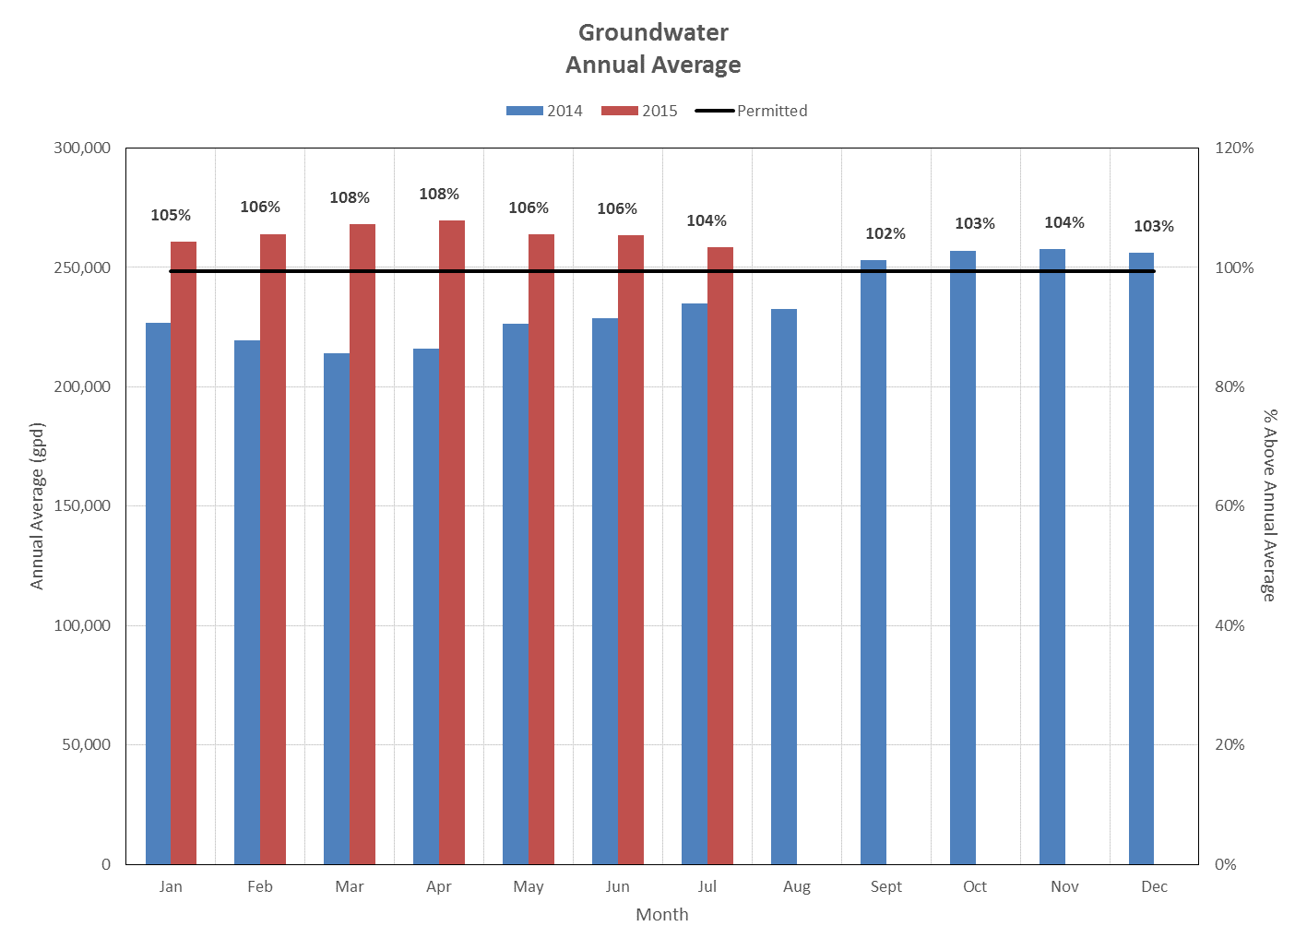
Recent Water Use

Slide 8
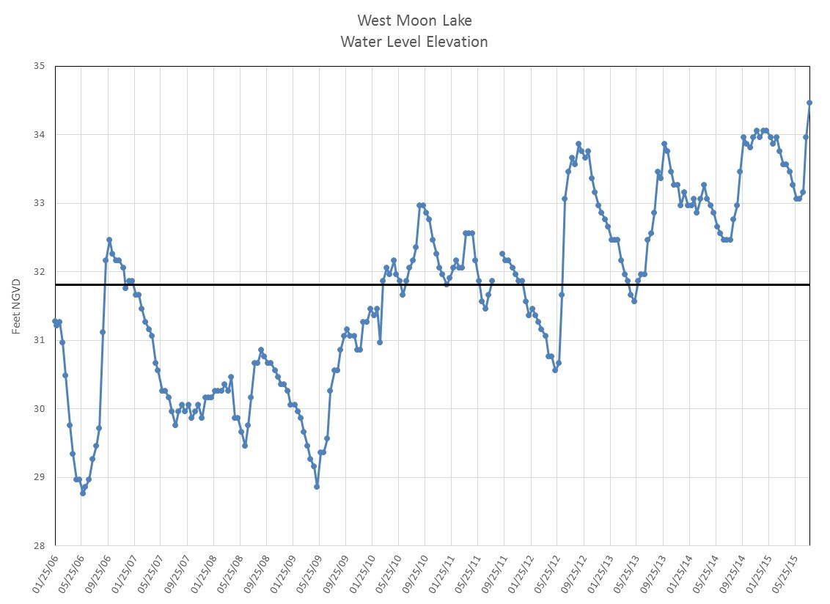
Water Level Elevation of WML

Slide 9
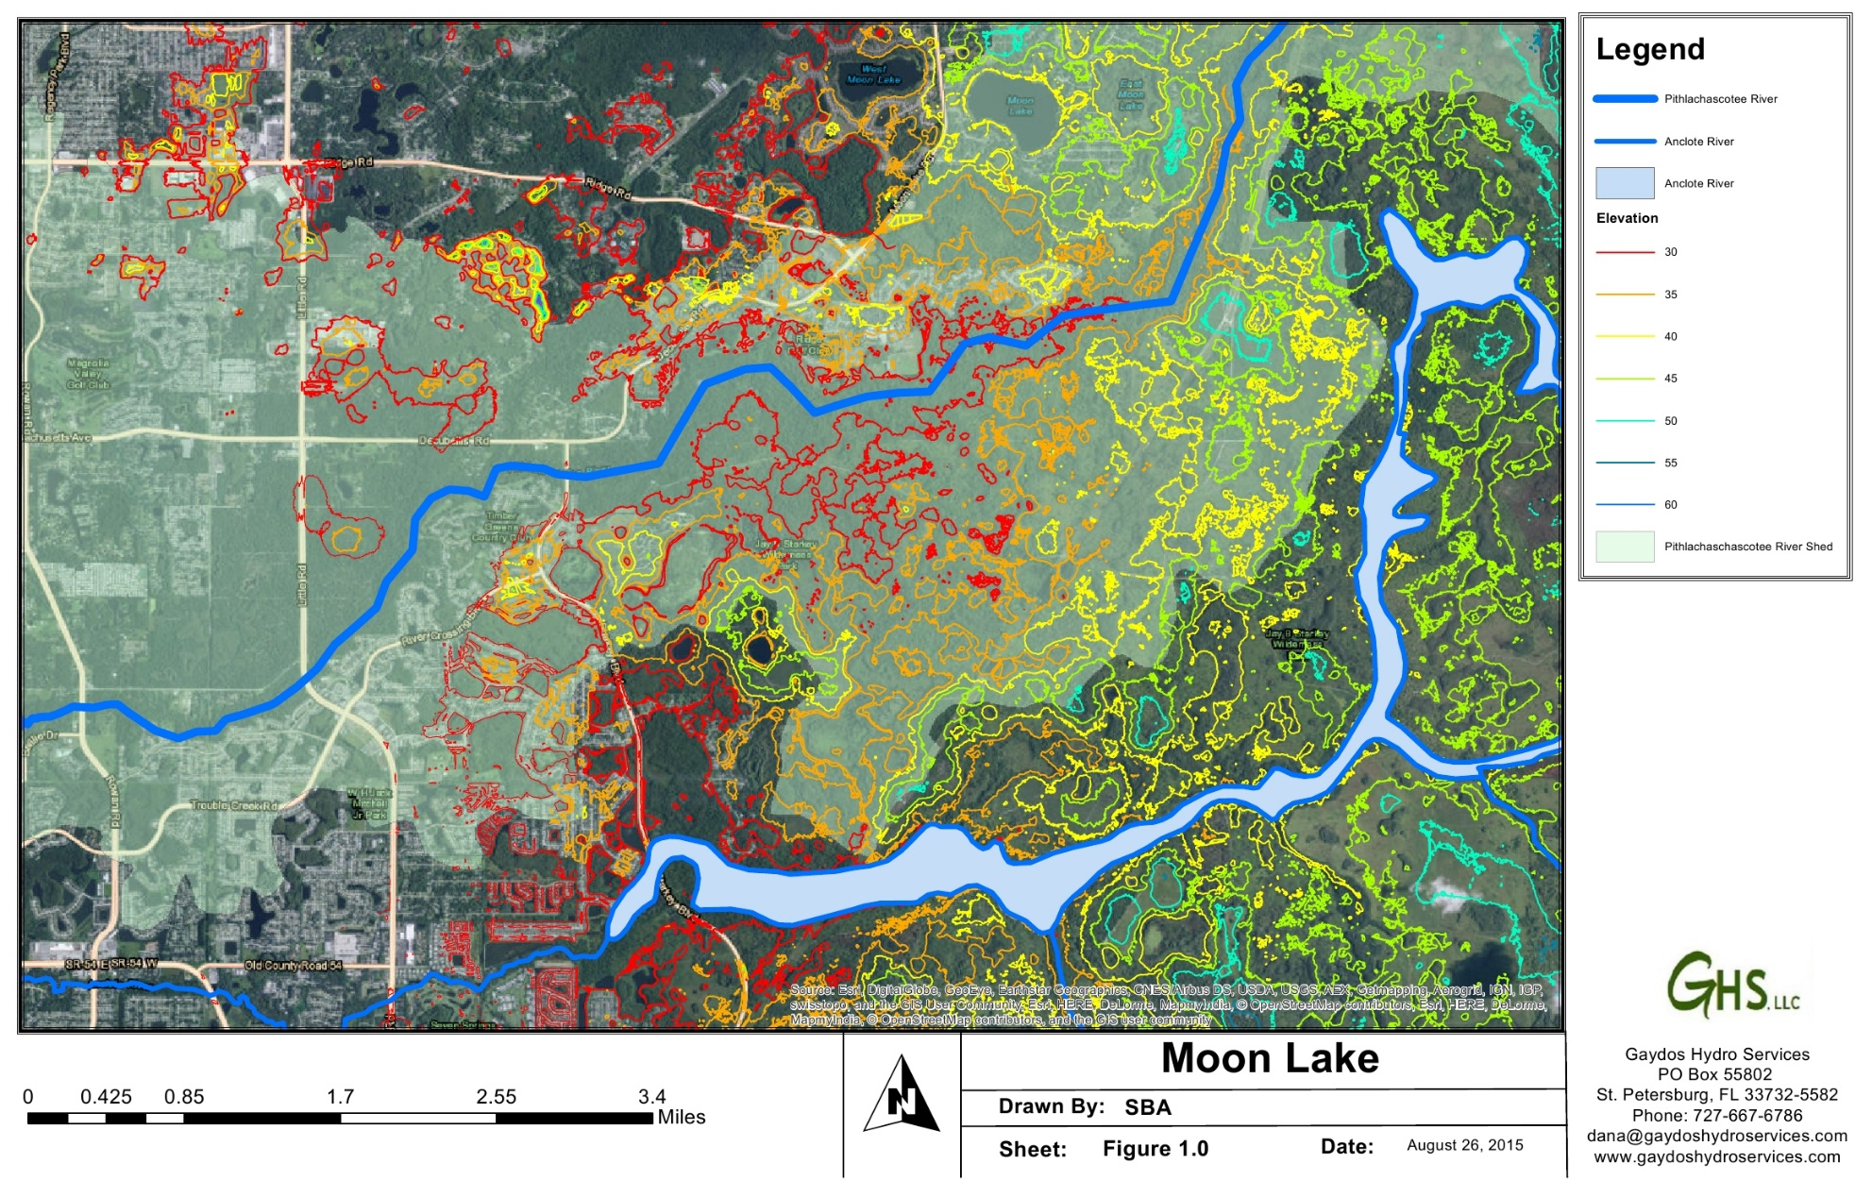
General Topographic Area

Slide 10

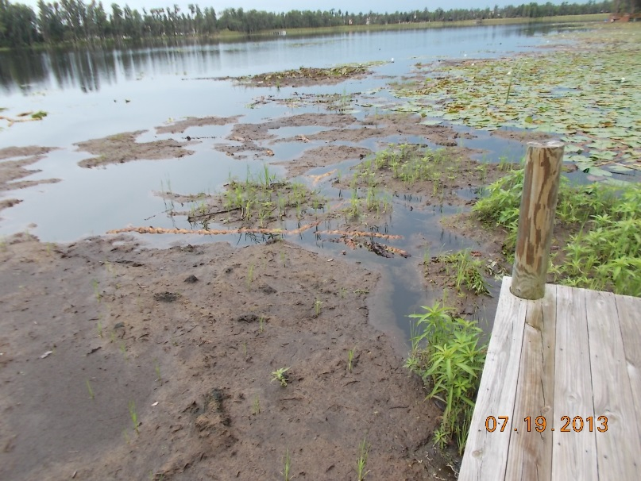
Lake Maintenance
  2013 – Shredded lily pads, tussocks and floating vegetative mats
  2014 - Shredded lily pads, tussocks and floating vegetative mats
  Lily pads, tussocks and floating mats are relatively under control
  2015 – Cattail shredding
  2016 – Cattail shredding
  2017 – Nuisance/Exotic Species Removal along wetland border
2013

Slide 11
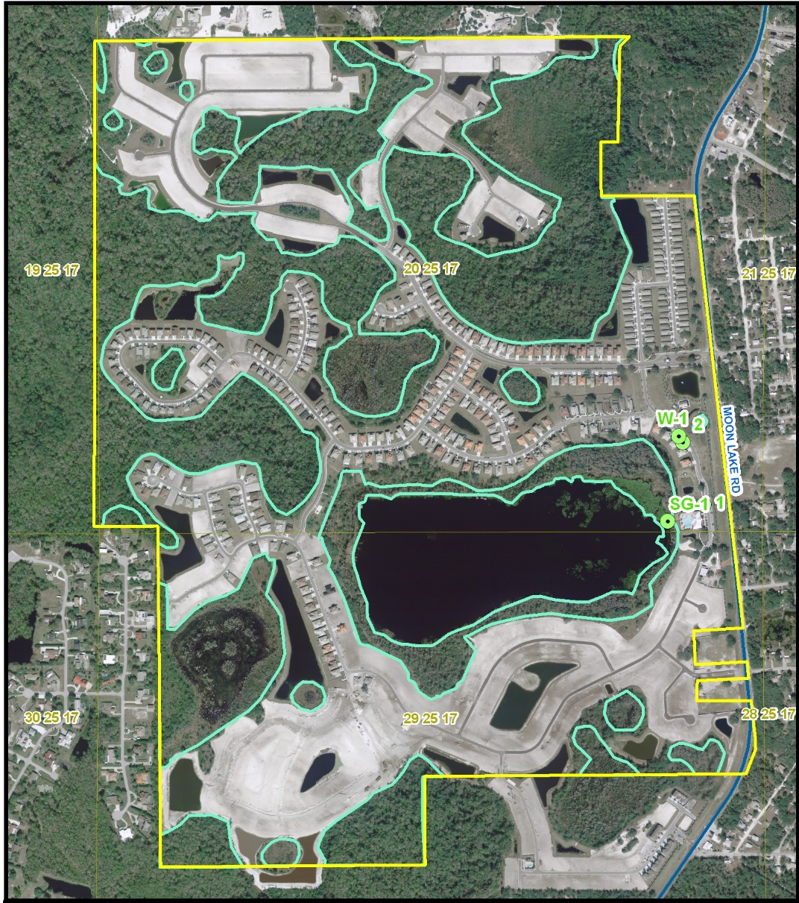
Potential Environmental Issues
  Wetland Encroachment around West Moon Lake
  Enforceable by SWFWMD and Pasco County
  Pasco County Land Development Code
    Ch. 805.4
      Delineated Wetlands
Except as otherwise permitted in this section and by regulatory agencies with jurisdiction, no development activity or grading, clearing, grubbing, or tree removal shall be undertaken within wetlands and required, post development, upland wetland buffers.

