Slide 1
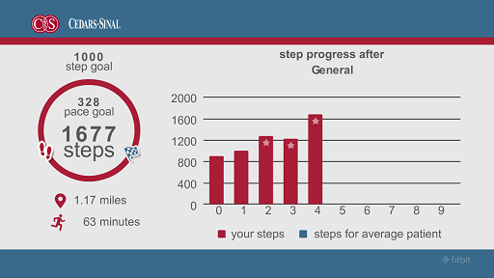
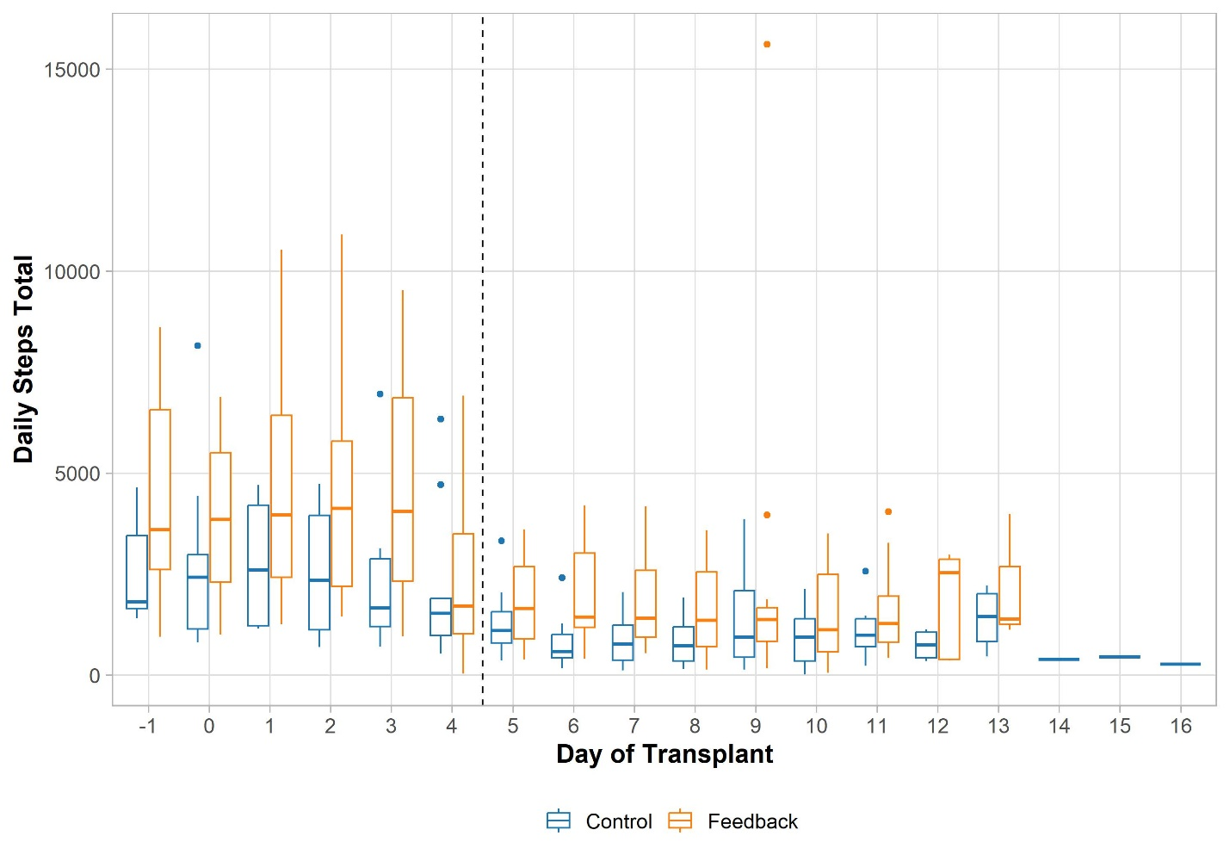
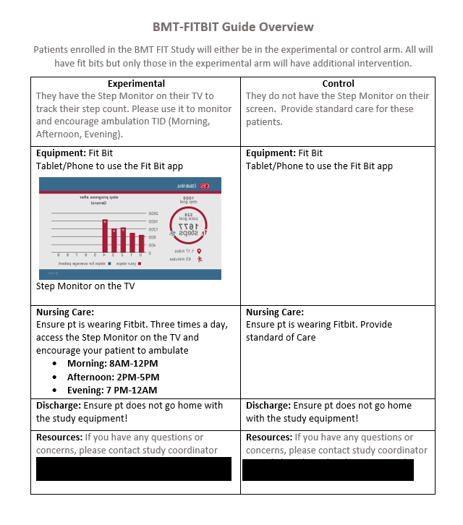
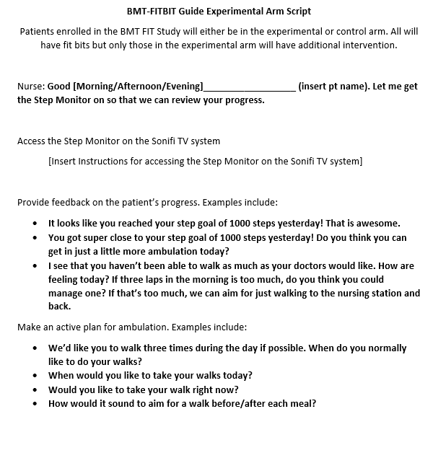
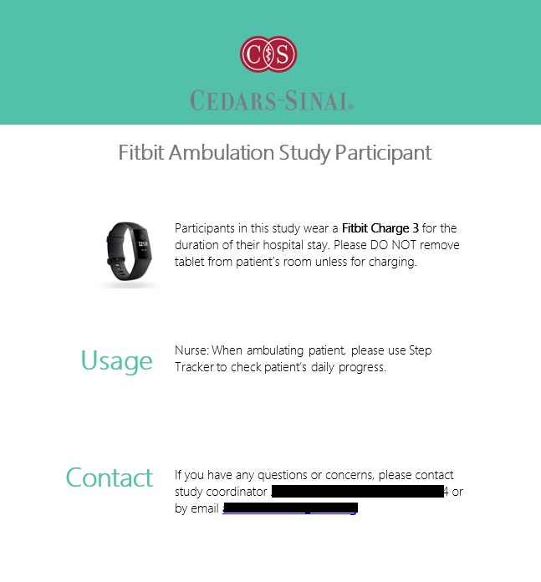
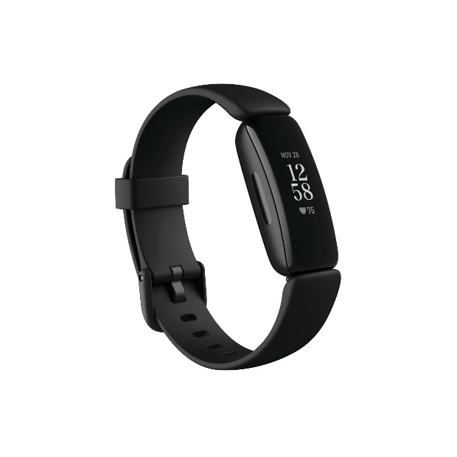
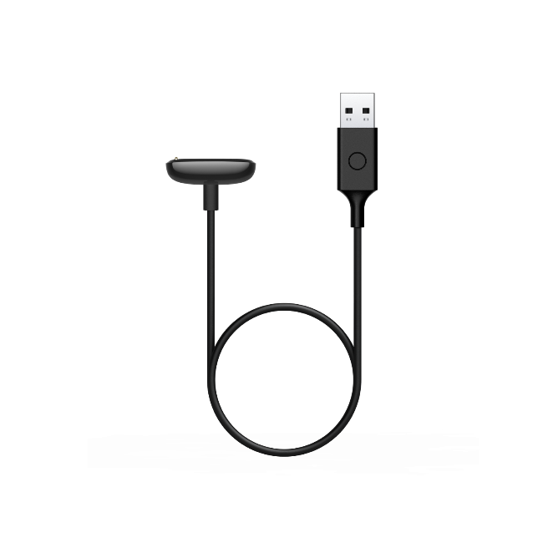
Stepping Up: Utilizing Wearable Activity Monitors to Improve Inpatient Ambulation During Hospitalization for Autologous Stem Cell Transplant
Sarah Low, RN, MSN, OCN, CMSRN, Claudia Maldonado, MSN, FNP, BS, CMSRN, Robert Vescio, MD, Justin Darrah, MD, Noah Merin, MD, PhD, Jean Flores, RN, MSN, OCN, Yvette Federizo, RN BSN PHN OCN, Leticia Uy, RN, OCN, BMTCN, Margarita Guerrero, MSN, RN, OCN, BMTCN, CHTC, Michelle R. Lua RN, MSN, OCN, BMTCN, Michael Luu, MPH, Timothy J. Daskivich MD, MSHP, Ronald Paquette, MD
Background
Physical activity could help prevent deconditioning during hospitalization for patients undergoing autologous stem cell transplant (ASCT). Although patients are encouraged to ambulate, no mechanism for accurately capturing ambulation exists, and no structured program to incentivize activity exists.
Purpose
      To evaluate the effect of inpatient ambulation and a feedback loop facilitated by nursing on fitness at discharge by collecting baseline fitness and measuring daily step counts during hospitalization for ASCT using wearable technology, in myeloma patients randomized to receive feedback or no feedback
Method
23 patients were enrolled, 3 patients ineligible for analysis (1 feedback, 2 control)
    Control (n = 9): Wore Fitbit during waking hours
    Feedback (n = 11): Wore Fitbit during waking hours and had visual feedback loop accessed 3 times/day by nursing + 1 time/day by oncology rounds
Data Points
    6-minute walk test (6MWT) pre and post admission
    Daily step count
Nurse Education
    Nurses were signed off on “BMT Fitbit guide” and “BMT Fitbit Guide Experimental Arm Script”.
Nurse Responsibilities
    RNs to use the feedback loop 3x day.
    Patient list at station.
    A BMT FITBIT note in the charge RN report
    Schedule post 6 MWT.
    Clinical coordinator and ANM would check with nursing staff
    Charging schedule: Every Monday, Wednesday and Saturday night.
Results
    The feedback group had statistically significant higher average daily step counts (2857 vs. 1702, p=0.045). All demonstrated a steep decline in step counts around day +5 when severe pancytopenia sets in. Patients experienced an average drop of 24.4% in 6MWT performance at discharge vs admission, with no statistically significant improvements in post-6MWT captured. Higher pre-mobility scores were associated with higher post-mobility scores, with every 50m increase in pre-6MWT associated with a 31.9m increase in post-6MWT (p=0.0065). For every additional access of the visual feedback loop, there was an increase of 137 steps/day (p=0.019). Accessing the intervention thrice a day occurred 50% of the time with no access occurring 23% of days.
Conclusions
    Utilizing wearable step count devices with a visual feedback loop allows for exact measurements of ambulation and allows nurses to improve ambulation for ASCT patients. Improvements in applying intervention thrice a day may further impact patient ambulation. Further studies will need to assess whether inpatient ambulation affects mobility and quality-of-life outcomes.
Acknowledgements
    Special thanks to the Melamed Foundation, nurses on 4SW and clinical coordinators for making this study possible!
References
Dimeo F. C. et al. Aerobic exercise in the rehabilitation of cancer patients after high dose chemotherapy and autologous peripheral stem cell transplantation. Cancer. 79, 1717-1722 (1997).
Wiskemann J. & Huber G. Physical exercise as adjuvant therapy for patients undergoing hematopoietic stem cell transplantation. Bone Marrow Transplant, 41, 321-329. doi:10.1038/sj.bmt.1705917 (2008)
Coleman E. A. et al. Effects of exercise in combination with epoetin alfa during high-dose chemotherapy and autologous peripheral blood stem cell transplantation for multiple myeloma. Oncology Nursing Forum, 35, E53-E61 (2008)
Baumann F.T. & Kraut L. et al. A controlled randomized study examining the effects of exercise therapy on patients undergoing haematopoietic stem cell transplantation. Bone Marrow Transplant, 45, 355-362 (2010)
Wiskemann J. et al. Effects of a partly self-administered exercise program before, during, and after allogeneic stem cell transplantation. Blood, 117, 2604-2613 (2011)
Baumann F.T. et al. Physical activity for patients undergoing an allogeneic hematopoietic stem cell transplantation: benefits of a moderate exercise intervention. Eur J Haematol, 87, 148-156 (2011)
Knols R. H. et al. Effects of an outpatient physical exercise program on hematopoietic stem-cell transplantation recipeints: a randomized clinical trial. Bone Marrow Transplant, 46, 1245-1255 (2011)
Persoon, S. et al. Effects of exercise in patients treated with stem cell transplantation for a hematologic malignancy: A systematic review and meta-analysis. Cancer Treatment Reviews, 39, 682-690 (2013)
Hacker, E. D. et al. Strength training to enhance early recovery after hematopoietic stem cell transplantation. Biology of Blood and Marrow Transplant, 23, 659-699. doi: 10.1016/j.bbmt.2016.12.637 (2016)
El Jurdi N. et al. Physical Activity and Sleep Measures Using a Fitness Tracking Device during Hematopoietic Cell Transplantation: A Pilot Study. Transplant Cell Ther, 27, 502.e1-502.e6. doi:10.1016/j.jtct.2021.02.015 (2021)
Daskivich T. J. et al. Association of wearable activity monitors with assessment of daily ambulation and length of stay among patients undergoing major surgery. JAMA Network Open. 2, e187673. doi:10.1001/jamanetworkopen.2018.7673 (2019)
Televised Visual Feedback Loop
For every additional access of the visual feedback loop, there was an increase of 137 steps/day (p=0.019).
Daily Step Count by Day of Transplant
Education Materials
Baseline Characteristics
Patient Materials
Characteristic | Control, N = 9¹ | Treatment, N = 11¹ | p-value²
Age | 59 (8) | 62 (8) | 0.405
Race |  |  | 0.498
Asian | 0 (0%) | 3 (27%)
Black or African-American | 3 (33%) | 1 (9%)
Hispanic | 3 (33%) | 3 (27%)
White | 3 (33%) | 4 (36%)
Sex Assigned at Birth |  |  | >0.999
Male | 4 (44%) | 6 (55%)
Female | 5 (56%) | 5 (45%)
Weight (lbs) | 163 (43) | 173 (28) | 0.532
Pre-Six Minute Walk test | 503 (93) | 484 (81) | 0.634
Post- Six Minute Walk Test | 394 (82) | 354 (101) | 0.345
Karnofsky Performance Status |  |  | 0.910
100 | 2 (22%) | 2 (18%)
90 | 4 (44%) | 6 (55%)
80 | 2 (22%) | 3 (27%)
60 | 1 (11%) | 0 (0%)
Length of Stay (Days) | 15.89 (1.83) | 15.55 (1.13) | 0.632
¹Mean (SD); n (%)
²Welch Two Sample t-test; Fisher's exact test
Patient Door Sign
Fitbit Device and Charger
Figure 4 _ Title
TEXT

