Slide 1

Summary of 2019 Legislative Session
RSAI Priority Action

Slide 2
Themes of Rural School Needs
Resources: $$$$$$$$$$$$$$ state, local, federal, other (partnerships, sharing, grants, incentives)
Flexibility: One size does not fit all. Especially in local schools, staff where many hats. Strict expenditure and legal requirements do not always work with very small economies of scale.
Student needs: Changing demographics have significantly impacted rural schools. Poverty, Mental Health, Immigration and Aging resident population, bigger farms with fewer kids, transportation and other barriers to participation, population sparsity

Slide 3
Recent Accomplishments Benefiting Rural Districts
Before 2018:
  Management fund authority to pay for retirements over age 65 and costs of arbitration
  PPEL flexibility to pay for repairs over $1,500
  DoP Flexibility
  Home Rule Statute
  Categorical Fund Flexibility
In 2018 Session
  Even more DoP Flexibility
  Even more Categorical Fund Flexibility
  Staff Flexibility – CTE options for hard-to-staff content and local offerings of on-line learning
  Progress on Transportation (grants) and Formula Equality
  Extension of Operational Sharing Incentives
In 2019 Session
  Transportation in the Formula
  Formula Equity
  Extension of WGS/reorganization Incentives
  State Penny Extension
  Teacher shortage flexibility: Praxis waiver, concurrent enrollment STEM offer and teach, online learning flexibility

Slide 4
Legislation in the 2019 Session
2,067 pieces of legislation introduced, some actually considered
169 agreed to by the House and Senate in the same form and sent to the Governor
Of those 169, 78 were finished the last week of Session
Governor vetoed sparingly, nothing that impacted schools.

Slide 5

Priorities Status on Page 4

Slide 6

State Penny Extension

Slide 7
Action Comments
HF 546 was approved by 95 House members and 48 Senators sending it to the Governor.
Extends through Jan. 2051.
Increased contribution to property tax equity and relief over time to 30% of the total revenue.
Specifically for RSAI, expanded the criteria for certificate of need for smaller schools to include impact on student learning and did not increase the enrollment category for CON requirements.
Added safety and security equipment as an allowable expense. No other action on funding for security staff.
Increase in PTR will make it harder to repeal in 2051.
See specifics in the Legislative Digest.

Slide 8
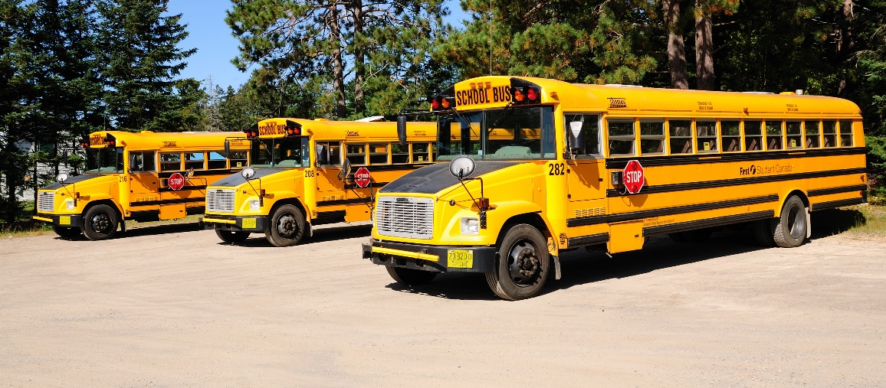
Transportation Equity

Slide 9
Action Comments
HF 307 was enacted. $19 M in transportation in the formula for FY 2020.
Also, state Board of Education administrative rules are proposed to extend ride times by 15 minutes with local process following a public hearing.
Formula supplement instead of a grant – much more secure.
Reimbursement is based on prior year’s expenditures (and other factors in a formula)
Brings all districts down to $381 per pupil enrolled (state average was $330 per pupil enrolled in 2017-18)
DE is required to review usage and the formula.
See specifics in the Legislative Digest.

Slide 10
Formula Equity

Slide 11
Action Comments
HF 307 was enacted. $2.9 M in the formula for FY 2020.
Closes the gap by another $5 per pupil.
$1.7 million reduces property taxes in those districts with higher DCPP
$1.2 million increases DCPP by $5, closing the gap to $165 from highest to lowest DCPP
At this rate, it will take 33 more years to eliminate the gap.
See specifics in the Legislative Digest.

Slide 12

Teacher Shortage and Quality Instruction
Rural school districts require maximum flexibility to provide great instruction to all Iowa students. There was some progress in 2019 but rural districts will still struggle with enough applicants to fill needed positions, in some cases none at all, and in keeping great people when other districts pay more. Loan forgiveness and grow-your-own strategies will have to be on the list. Much of this goes back to adequate funding, too.

Slide 13
Action Comments
SF 603 Concurrent Enrollment for 1 math or 1 science course to meet offer and teach.
SF 394 allows several online learning options to meet offer and teach.
SF 159 Praxis requires DE to set score and creates conditional license for a new teacher with a job offer.
Some flexibility will certainly help all districts, including rural schools, attract and retain great teachers.
Eliminated ILO funding but expanded district ability to create your own, partner with other districts or work with private providers.
Still need some work through resources for loan forgiveness, incentives for teachers to work in shortage area schools, CTE strand to recruit students into teaching, and additional offer and teach flexibilities, and IPERS implications.
Also concerns about licensure requirements for out of state administrators

Slide 14
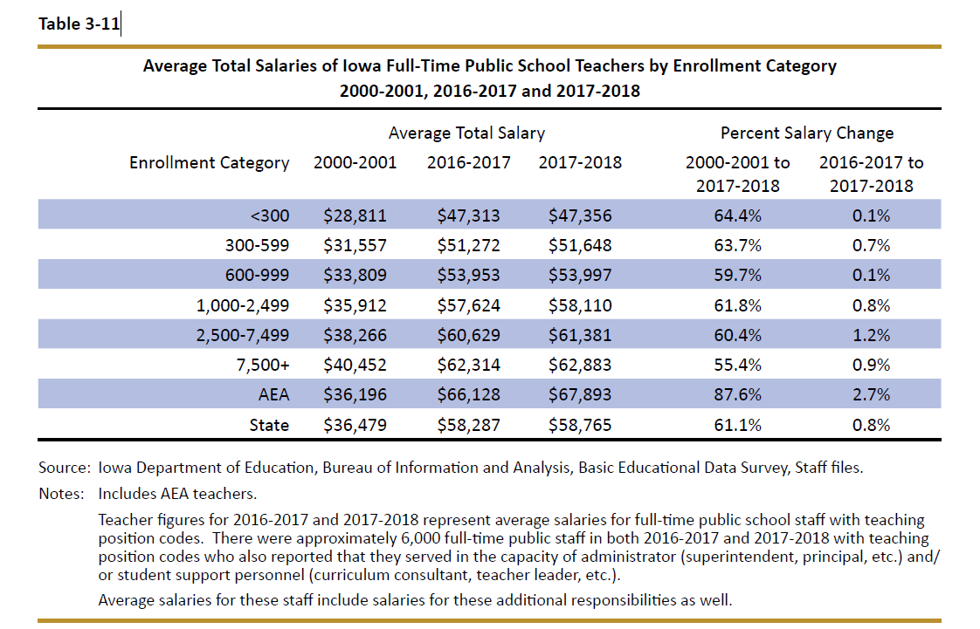
DE’s Annual Condition of Education Report shows average salary by school size (which is a good but not perfect predictor of rural districts), showing a growing difference in pay between the averages of the smallest and largest category of school size, now at $15,527.

Slide 15
Geography Impacts Rural Schools and Students
Distance from Services – transportation takes time. Making up minutes for snow days even becomes difficult if there’s two+ hours on either side of the day. Transportation equity funding is HUGE, but there are still barriers.
Fewer Collaboration Partners – whether that’s private sector businesses for internships in CTE programs or Mental Health services providers for students
Young teachers are not willing to locate in a community with long commutes to amenities, so something has to make up for the lack of access to entertainment, housing, and other services.

Slide 16
Funding / SSA / Formula Changes

Slide 17
Action Comments
HF 306 set 2.06% increase in SSA, Was signed on Feb. 19, 2019, pretty close to Feb. 14, 2019, 30‐day deadline.
Third highest increase in a decade.
Exceeds the REC revenue estimate for FY 2020.
Completed on time based on new deadlines (within 30 days of the Governor’s budget for the upcoming school year, so essentially four months before the school fiscal year begins.)
Other funds (transportation and formula equity, state penny extension) must be considered in total package.
But SSA is the bread and butter of school district budgets. Some data:

Slide 18
Some Economic Indicators
Iowa Per capita Personal Income Grew 4.6% in last 12 months June 30, 2018 to June 30, 2019 (source https://data.iowa.gov/Economic-Statistics/Personal-Income-and-Per-Capita-Personal-Income-by-/vm3e-atwp)
FY 2019 State General Fund Revenue closed up 6.4%. (SSA was 1%). Gov. Kim Reynolds announced Sept. 30, 2019: the State of Iowa will end Fiscal Year 2019 with a balance of $289.3 million in its General Fund. (source: https://governor.iowa.gov/2019/09/iowa-budget-closes-with-full-cash-reserves-surplus-of-289m)
Governor’s Future Ready Iowa, Iowa Grant High Demand Occupations 2019 include 11 different education/teaching positions. https://www.futurereadyiowa.gov/sites/fri/files/basic_page_files/State%20program%20list-%20updated%202019.pdf
Iowa has a 2.5% unemployment rate, which ranks us 3rd in the nation behind North Dakota (2.4%) and Vermont (2.1%) according to the Bureau of Labor Statistics August 2019. Iowa's private sector is clamoring for qualified workers.
NASBO annual expenditure report for all states. November 2018 NASBO report shows education expenditures as a percentages of all state expenditures, not just general fund. In that report, Iowa spends 16.9% of all state funds on elementary and secondary education.
Ranks Iowa 5th out of 7 states in the group called "Plains States" (group average 20.5% of all state funds spent on PK-12 education) with Iowa behind ND, MO, MN, KS and just ahead of NE and SD.
The national average is 19.5%, which also is significantly ahead of Iowa.

Slide 21
State Revenue Policy
School funding adequacy is a function of sufficient state revenues and mix of revenue sources for schools.
Continued property tax relief focus confuses the issue – state investment increases to make up for a reduced property tax dollar but schools don’t receive those funds as additional revenue.
Check out the Legislative Digest for additional information on tax cuts, policy decisions limiting state revenue, and increased tax credit thresholds of private school scholarships (STOs)

Slide 22
Student Mental Health

Slide 23
Action Comments
HF 690 Children’s Mental Health System set up a system but did not provide funds.
HF 758 Education Appropriations included $2.1 million to AEAs for MH training of educators and a resource clearinghouse.
SF 376 MH content in High School health curriculum, did not get approved in the Senate.
SSB 1240 in Senate Human Resources Committee: telehealth screening and treatment in school setting.
HF 690 is a good structural start, but may not overcome the geography limitation of service location. Just like attracting teachers, there are MH services deserts without services.
AEA training is a good start, but it’s not a one-time thing. Must be ongoing.
Both SF 376 and SSB 1240 are in committee and alive for further action as the 2020 Session begins.

Slide 24
Reorganization and Whole Grade Sharing Incentives Extension

Slide 25
Action Comments
HF 596 extends WGS and Reorganization incentives for five years
For reorganizations effective on or before July 1, 2024.
5-year extension was the goal
As the leadership in the legislature become more urban, this will not become easier down the road.
Both the operational sharing and reorg/WGS incentives are critical to rural schools, so keep legislators apprised of the benefits along the way.

Slide 26
Funding/Equity for At-risk Students

Slide 27
Student Inequities and Needs
Funding Equity for At-risk Students: Resources for serving at-risk students should be based on need, such as the percentage of students eligible for Free and Reduced Price Lunch, in addition to enrollment of the district.
The current disparity in dropout prevention capacity ceiling, with some districts held to 2.5% and others allowed to access up to 5% of regular program district cost is unfair, arbitrary, and based on old history no longer relevant to supporting student needs.
Poverty is now a significant factor in many rural schools.

Slide 28
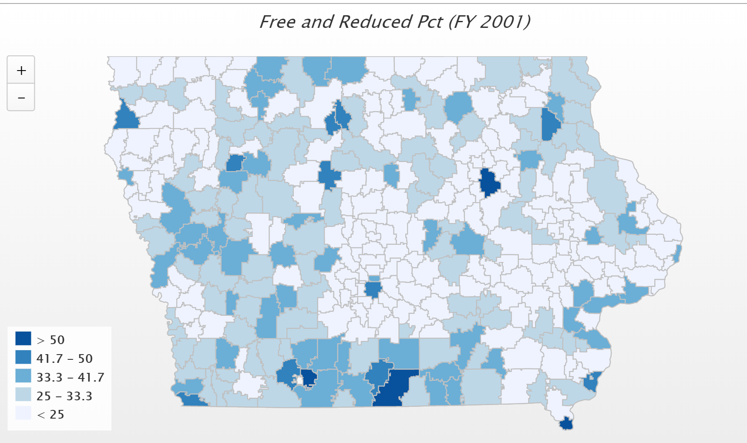
In 2001, only 4 districts had more than 50% of students eligible for FRPL. IFYI – Diagonal was the state high at 60.2%)

Slide 29
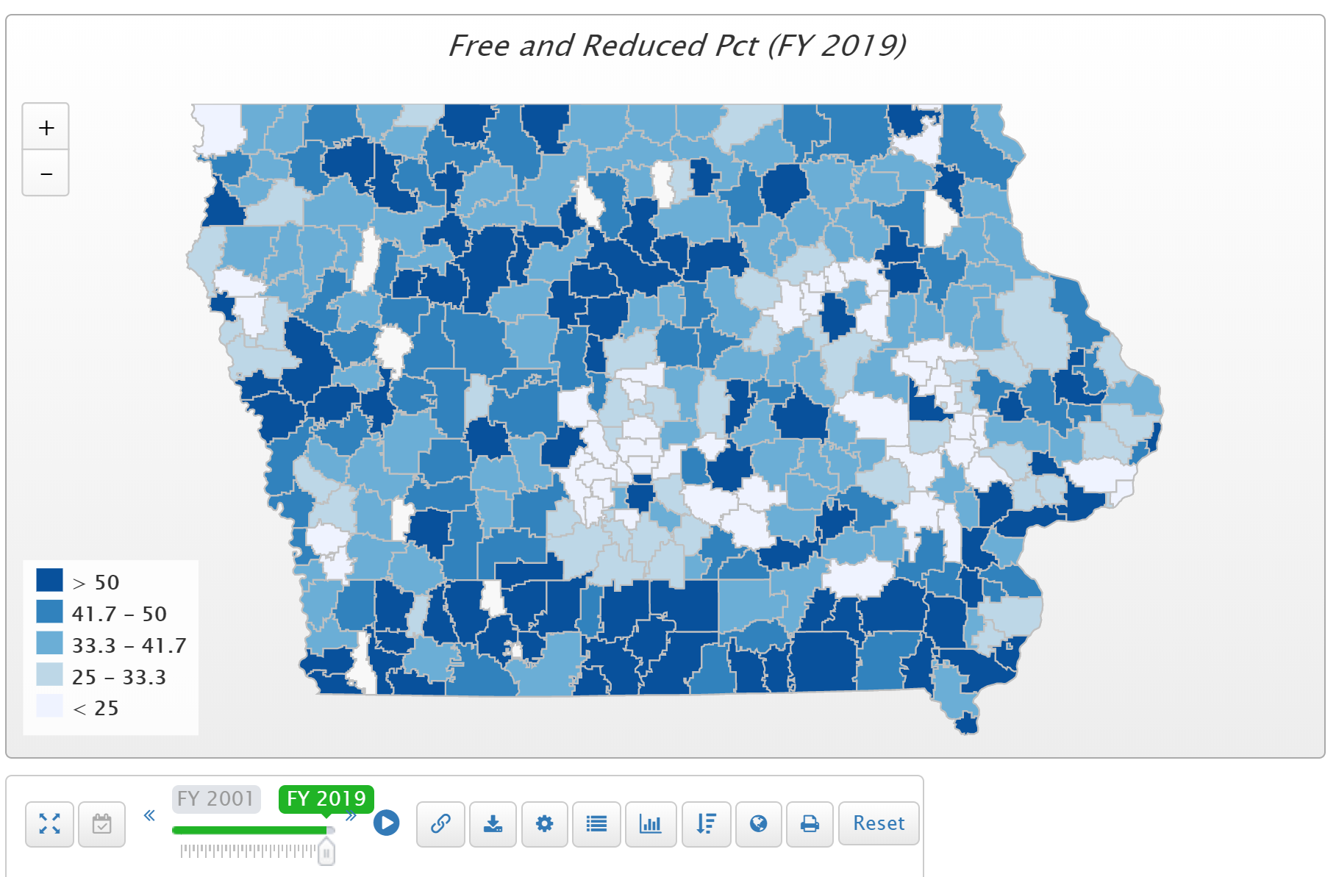
Children from families with incomes at or below 130% of the poverty level are eligible for free lunch those 130-185% eligible for reduced lunch. Districts in the largest and smallest enrollment categories had the highest percentage of students eligible for free or reduced price lunch (Table 1-7). (FYI – Postville is at 100% in FY 2019)

Slide 30
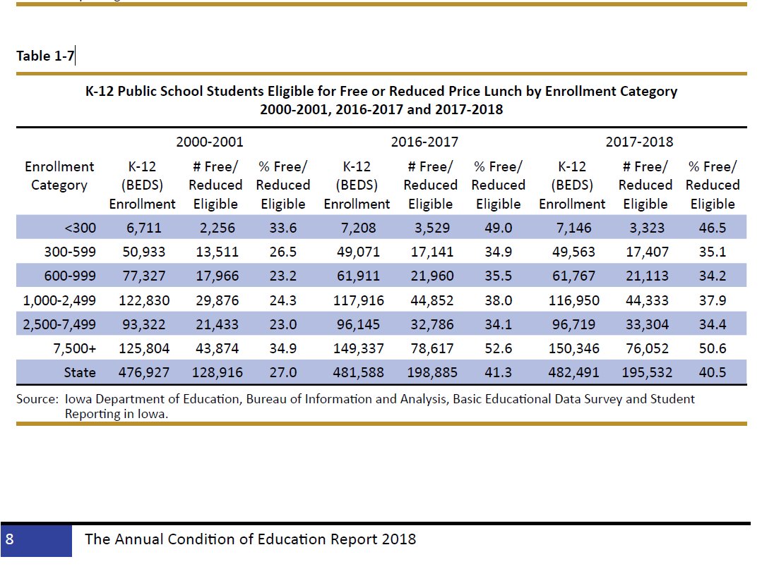

Slide 31
Dropout Prevention Flexibility
Has grown increasingly more flexible due to legislative action in the last several years.
Nothing legislatively this year
DE administrative rules did remove transportation as a prohibited expenditures of DoP / At-risk funds at RSAI request.

Slide 32
Quality Preschool at 1.0 Weighting

Slide 33
Action Comments
none
HF 758 Education Appropriations increased shared visions grants, but no action was taken to increase PK weighting.
HF 783 would have allowed districts to serve and count young 5‐year‐olds but did not advance beyond the House Appropriations Committee. RSAI registered undecided. 5-years olds currently count for 1.0 weighing, even if in transitional K, so this recommended policy is a two-edged sword.

Slide 34
Other Issues
Instructional Support Levy Proration Formula
School Choice Defense/Pro-public School Advocacy
Seclusion/Restraint/Room Clearing Conversations

Slide 35
Instructional Support Proration

Slide 36
Overview: Instructional Support Levy
Originally passed in 1989 legislative session
Successor to Educational Improvement Program
Objective: Provide 10 percent additional Regular Program funds if a district chooses
2

Slide 37
How the Funding Originally Worked
10% of Regular Program District Cost (Cert. Enr. X District Cost per Pupil). For the average valuation district it meant:
  25% Funded by State Aid
  75% from local sources (Property Tax/Income Surtax
Protection for low property valuation districts:
  If a district had half of the average taxable valuation per student, it would get twice the state aid that the average district gets
  Sounds great, right?

Slide 39
ISL State Funding History
State began to prorate state aid in FY 1993
  Because fewer districts had the ISL, the proration wasn’t felt
Capped at a fixed total dollar amount $11.7 million in early 2000’s
  Fixed dollar amount meant that there was at least some state aid
By FY 2012 fully eliminated
Because of other budget turmoil (federal stimulus, low Allowable Growth, ATB cuts, etc.) it largely went unnoticed

Slide 40
ISL Impact (AKA, “What’s all the fuss about?”)
State Aid was and is considered Miscellaneous Income for calculation of Spending Authority purposes
Characteristic of Miscellaneous Income: You can only count what you get
The amount from the state, because it is zero, produces zero spending authority
Cannot make up the spending authority or the cash lost due to the state shortfall

Slide 42
ISL Shortfall Impact
For FY 2020:
  326/327 school districts have implemented the ISL
  State shortfall is $93.5 million
  Shortfall is recurring and growing (occurs every year and grows by the SSA rate)
  All districts that have the ISL are impacted (and if your property valuation per pupil is not growing as fast as the average, your effective reduction grows each year)
FY 2020 Data | ISL Percent Actually Generated
Minimum | 3.4%
Average | 7.6%
Maximum | 9.3%
Full Amount | 10.0%

Slide 43

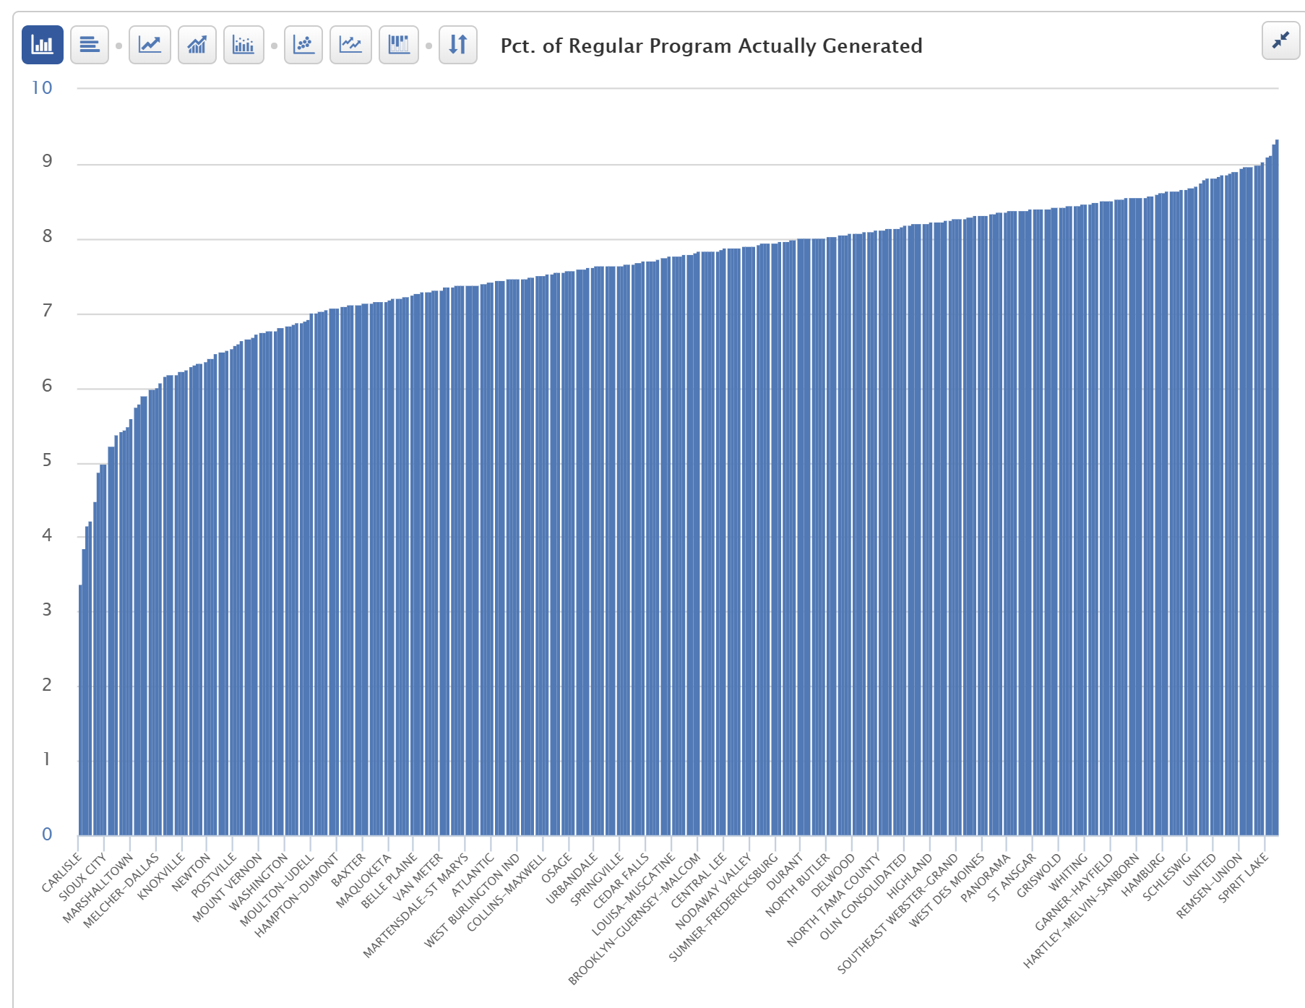
ISL Prorate Impacts all Districts

Slide 44
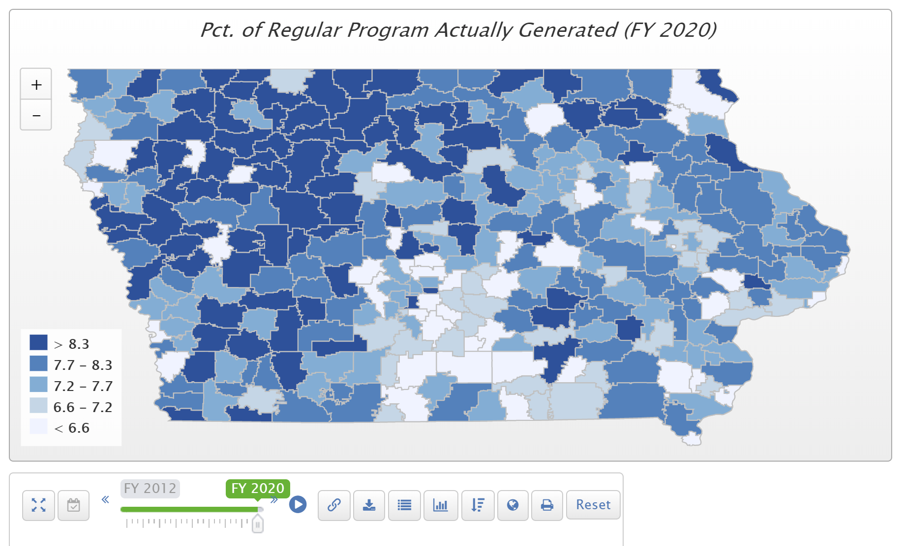
ISL Prorate Impacts all Districts

Slide 45
ISL Shortfall Solutions
Have State fund it
Make it up locally
  Allow a district to recoup up to 1/10th of the shortfall locally annually until the shortfall eliminated
  Continue to allow districts to decide mix of property tax and income surtax
  Would require new ISL resolution/ballot
    Board action, 28 day waiting period, subject to reverse referendum
    Trigger: 100 voters or 30% voting in most recent regular school board election
    Vote: 50%+1 simple majority

Slide 46
School Choice Defense
Important to Rural schools since it will consume funds needed for public education
Bills for ESA’s/vouchers in 2018 and 2019 Sessions did not advance through a chamber, but did get through Senate Education Committee in 2019
Tax bills did expand STOs in 2018 and again 2019
Costly – tight budget applies to this issue too

Slide 47
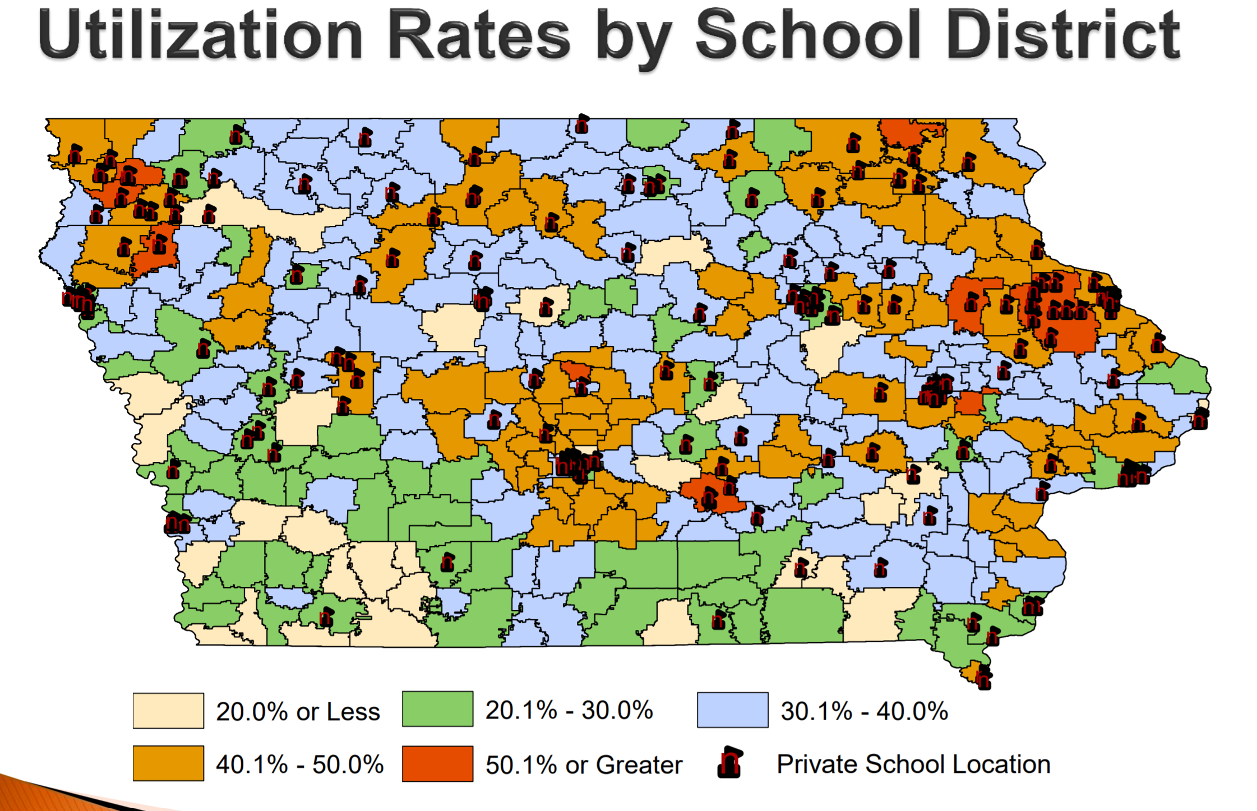
Source: Legislative tax Expenditure Committee DOR Report on Tuition and Textbook Tax Credits https://www.legis.iowa.gov/docs/publications/SD/865242.pdf (in RSAI School Choice Position Paper)
Note location of existing private schools related to legislative seats

Slide 48
Student Behavior Issues
State BOE Rules on Seclusion and Restraint – were tabled to get more input
Make it harder to ever use seclusion rooms or restrain students
Meanwhile, some Senate Education Committee leaders are working on Room Clearing practices
Expect these two issues to collide

Slide 49
RSAI Leadership Group and Terms
Robert Olson, Clarion-Goldfield/Dows, Superintendent, robert.olson@rsaia.org (Sept. 2020)
Laurie Noll, Fairfield, Superintendent, laurie.noll@fairfieldsfuture.org (Sept. 2020)
Dennis McClain*, Clay Central Everly through June 30, Superintendent, moves to Adair-Casey and Guthrie Center effective July 1) (Sept. 2019)
Duane Willhite*, North Fayette Valley, Superintendent, dwillhite@nfv.k12.ia.us (Sept. 2020)
Nick Trenkamp, Central, Superintendent, nicholas.trenkamp@rsaia.org (Sept. 2020)
Paul Croghan, Essex/East Mills Superintendent through June 30, 2019, and Nodaway Valley & CAM beginning July 1, 2019, Superintendent, paul.croghan@rsaia.org (Sept. 2019)
Dan Smith*, Van Buren County, Board Member, dan.smith@rsaia.org (Sept. 2021)

Slide 50
Thanks to the RSAI Legislative Group (one-year term) who supported
RSAI’s policy development and advocacy during the 2019 Session!
includes at large members from Leadership Group plus:
SW – Tim Mitchell / Riverside Superintendent
NE – Darrin Strike /West Fork Superintendent
SE – Sandy Dockendorff / Danville Board Member
NW – Dan Frazier / Belmond-Klemme Superintendent

Slide 51
Thanks to the RSAI Legislative Group (one-year term) who supported
RSAI’s policy development prepping for the 2020 Session!
includes at large members from Leadership Group plus:
SW – Tim Mitchell / Riverside Superintendent
NE – Barb Schwamman/ Osage and Riceville Superintendent
SE – Joel Pedersen/ Cardinal Superintendent
NW – Scott Williamson/Souix Central, Clay Central-Everly and Laurens Marathon Superintendent

Slide 52
RSAI 2020 Legislative Priorities
The Legislative Group reviews and refines the Regional meeting activity, then submits to the RSAI members at the annual meeting.
The members at the annual meeting discuss, amend and approve the slate of priorities at the annual meeting.
See the RSAI website meeting tab for more information such as RSAI Legislative Digest, Position Papers, Draft Platform, Annual Meeting Information, and this PPT on the annual meeting tab
http://www.rsaia.org/

Slide 53
THANK YOU FOR YOUR VOICE on behalf of rural students!
Stay connected through the Interim and into the Legislative Session
Let us know what you need to beef up your advocacy efforts.
Professional Advocate
Margaret Buckton, margaret@iowaschoolfinance.com
1201 63rd Street, Des Moines, IA 50311 (515) 201-3755 cell

