Slide 1
Joint Water Project Update
East Range Water Board, City of Aurora, & Town of White
January 2023 Phase 1 Update

Slide 2
East Range Joint Water Board Established July 2021
Members:
Doug Gregor, Chairman
Jon Skelton, Vice Chairman
Dave Skelton – Secretary & Treasurer
Dennis Schubbe – Aurora at large member
Clark Niemi – Township at large member

Slide 3
Project History Phase 1
Tasks 1-1A – Shared Infrastructure Analysis & Preliminary Design (2019-2020)
Reviewed several raw water intake types and locations for the WTP
St. James Pit Feasibility Study (2020-2021)
Evaluated feasibility of continuing to use St. James Pit as water source
Tasks 2 & 3 – Final Design & Permitting (2021-2022)
Design of WTP, raw water intake, water mains
Environmental Review, Appropriations Permitting, Wetland Delineation
Current Project Information Available on City & Township websites at: www.aurora-mn.com and www.townofwhite.com
Engineering Team – Short, Elliott, & Hendrickson, Inc.

Slide 4
Project Area

Slide 5
Water Treatment Plant
Designed to be constructed primarily of concrete to last decades
Accounts for future expansion in Phase 2
Utilizes modern treatment equipment to minimize footprint required to satisfy current design standards
Treatment process is familiar to existing operators and is similar to other surface water facilities in the area

Slide 6
WTP Exterior Perspective – Viewing from SE

Slide 7
WTP Exterior Perspective – Viewing from NW

Slide 8
Raw Water Intake & Pump Station
Vertical Caisson style pump station on shore of Lake Mine
Intake pipe will extend from caisson structure on shore to a screen minimum of 50’ below water surface
Below future low water level in Embarrass Pit
Pump station structure is sized to include up to four (4) pumps, with only two (2) being installed as Phase 1 of this project.

Slide 9
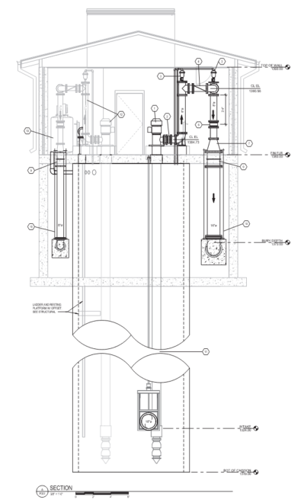
Raw Water Intake & Pump Station

Slide 10
Project Status
Task | Description | Status
1 | Preliminary Design | Complete
2 | Final Design | Complete
3 | Permitting & Regulatory Approvals | Archaeological Assessment Phase 1 Investigation completed MDH has approved Drawings & Specifications DNR water appropriations permit pending
4 | Bidding Services | Final funding package anticipated Spring 2023 Bidding to begin Summer 2023
5 | Construction Phase Services | Construction anticipated to begin in early 2024

Slide 11
Estimated Project Cost
Project Component | Estimated Cost
Water Treatment Plant | $11,362,914
Water Main – Scenic Acres | $985,220
Water Main – Pineville | $505,730
Raw Water Intake Facility | $5,688,931
Raw Water Transmission Main | $1,852,720
Construction Subtotal | $20,395,515
Contingencies & Market Conditions | $2,039,552
Geotechnical Borings & Testing | $163,895
Legal | $101,978
Fiscal | $101,978
Administrative | $101,978
Engineering | $1,500,000
2021 Estimated Total Project Cost | $25,000,000
Current Estimated Total Project Cost with Inflation | $30,000,000

Slide 12
Funding Initiatives
Funding Opportunity | Status | Amount
State Bonding Bill | Secured | $7,500,000
Congressionally Directed Spending (Earmarks) | Secured | $6,500,000
IRRRB | Approved | $1,000,000
Army Corps 569 | Applied | $1,000,000
Public Facilities Authority (WIF) | Pending | Up to $8,000,000
IRRRB | Applied | $1,000,000
Total |  | $25,000,000
Estimated Community Contributions |  | Up to $5,000,000

