Slide 1
Vocabulary
Define the following in your binder
Ch 7 The American Revolution p.177
George Washington Mercenary Strategy Rendezvous Battles of Saratoga Ally Marquis de Lafayette Bayonet Desert Privateer | James Forten John Paul Jones Lord Cornwallis Guerrillas Pacifist Battle of Yorktown Treaty of Paris 1783 Republicanism Elizabeth Freeman Richard Allen

Slide 2





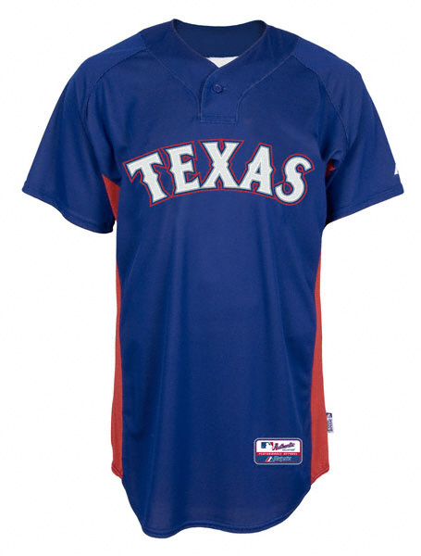


Today’s events are tomorrow’s History!
Design and color a Poster supporting the Texas Rangers in the
2011 MLB World Series

Slide 3
Additional Work
Read pages 166 – 169, The Declaration of Independence
Answer the questions on page 169 Main Ideas and Critical Thinking

