Slide 1
EMPRESARIO AS GATEKEEPER
Lubbock Christian University – School of Education
Sam Ayers, Ed. D., Associate Professor
Brittany Holloway, LCU Undergraduate Student
Kaylee Stewart, LCU Undergraduate Student
Simulation materials created for classroom use - 2015

Slide 2
“Research has demonstrated that engaging students in the learning process increases their attention and focus, motivates them to practice higher-level critical thinking skills, and promotes meaningful learning experiences. Instructors who adopt a student-centered approach to instruction increase opportunities for student engagement, which then helps everyone more successfully achieve the course’s learning objectives.” Center for Learning-University of Washington
http://www.washington.edu/teaching/teaching-resources/engaging-students-in-learning/
Use active exercises/simulations and role-plays.
Use case studies that require students to analyze, make a recommendation and defend it. Center for Excellence and Innovation in Teaching
Boston University
http://www.bu.edu/ceit/teaching-resources/inside-the-classroom/
A simulation is “a staged replication of an event or concept through the teacher's manipulation of the classroom setting in order to enhance students' understanding of the nature of the concept or event.” Max Fischer
http://www.educationworld.com/a_curr/curr391.shtml#sthash.vZwmdBuu.dpuf

Slide 3
4th Grade Social Studies TEKS
(2) History. The student understands the causes and effects of European exploration and colonization of Texas and North America. The student is expected to:
(E) identify the accomplishments and explain the economic motivations and impact of significant empresarios, including Stephen F. Austin and Martín de León, on the settlement of Texas.
(3) History. The student understands the importance of the Texas Revolution, the Republic of Texas, and the annexation of Texas to the United States. The student is expected to:
(B) summarize the significant contributions of individuals such as Texians William B. Travis, James Bowie, David Crockett, George Childress, and Sidney Sherman; Tejanos Juan Antonio Padilla, Carlos Espalier, Juan N. Seguín, Plácido Benavides, and José Francisco Ruiz; Mexicans Antonio López de Santa Anna and Vicente Filisola; and non-combatants Susanna Dickinson and Enrique Esparza;
(C) identify leaders important to the founding of Texas as a republic and state, including José Antonio Navarro, Sam Houston, Mirabeau Lamar, and Anson Jones;
23) Social studies skills. The student uses problem-solving and decision-making skills, working independently and with others, in a variety of settings. The student is expected to:
(A) use a problem-solving process to identify a problem, gather information, list and consider options, consider advantages and disadvantages, choose and implement a solution, and evaluate the effectiveness of the solution; and
(B) use a decision-making process to identify a situation that requires a decision, gather information, identify options, predict consequences, and take action to implement a decision.

Slide 4
7th Grade Social Studies TEKS
(2) History. The student understands how individuals, events, and issues through the Mexican National Era shaped the history of Texas. The student is expected to:
(E) identify the contributions of significant individuals, including Moses Austin, Stephen F. Austin, Erasmo Seguín, Martín De León, and Green DeWitt, during the Mexican settlement of Texas; and
(F) contrast Spanish, Mexican, and Anglo purposes for and methods of settlement in Texas.
(3) History. The student understands how individuals, events, and issues related to the Texas Revolution shaped the history of Texas. The student is expected to:
(B) explain the roles played by significant individuals during the Texas Revolution, including George Childress, Lorenzo de Zavala, James Fannin, Sam Houston, Antonio López de Santa Anna, Juan N. Seguín, and William B. Travis;
(23) Social studies skills. The student uses problem-solving and decision-making skills, working independently and with others, in a variety of settings. The student is expected to:
(A) use a problem-solving process to identify a problem, gather information, list and consider options, consider advantages and disadvantages, choose and implement a solution, and evaluate the effectiveness of the solution; and
(B) use a decision-making process to identify a situation that requires a decision, gather information, identify options, predict consequences, and take action to implement a decision.

Slide 5
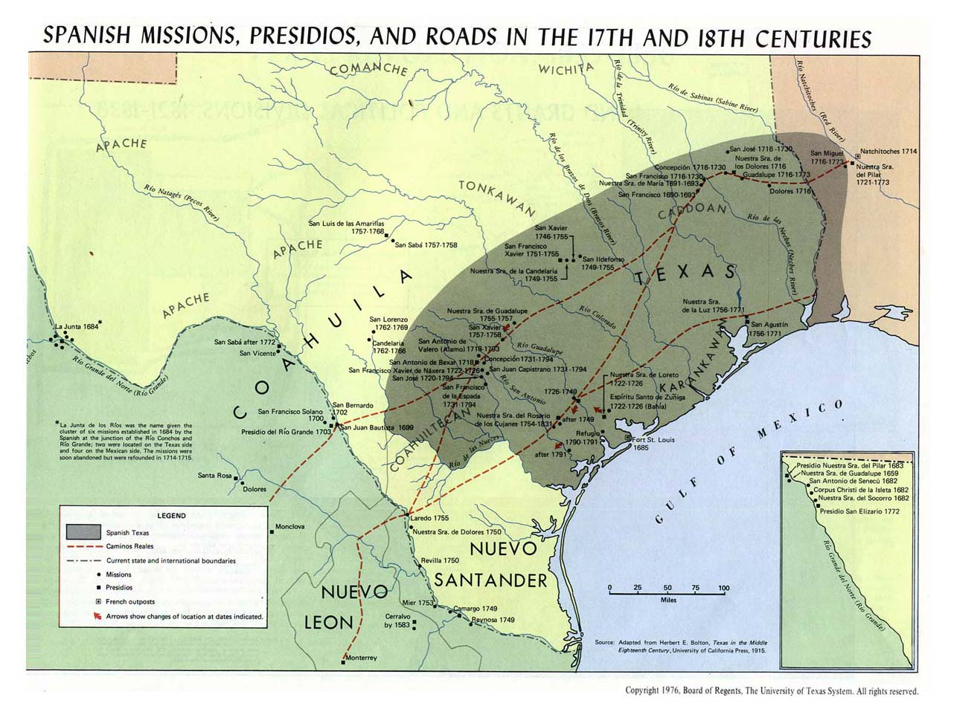

Slide 6
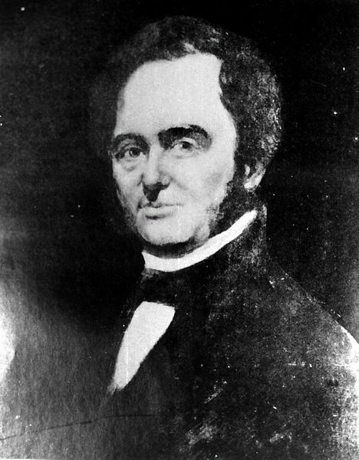
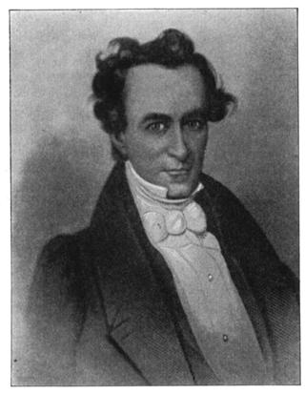
In 1820, American businessman Moses Austin traveled to Spanish Texas, He presented a plan to the Spanish Governor to colonize Texas with Anglo-Americans. Felipe Enrique Neri was a friend of Moses Austin living in San Antonio, and he convinced the Governor to accept the plan. In 1821, Moses Austin was awarded a land grant and given permission to recruit 300 families to Texas. Unfortunately, Moses Austin became ill with pneumonia and died. His son, Stephen F. Austin agreed to carry out the colonization plan. When Mexico announced its independence from Spain, Erasmo Seguin assisted Stephen F. Austin in obtaining his empressario contracts.
MOSES AUSTIN
STEPHEN F. AUSTIN
http://en.wikipedia.org/wiki/File:Moses_Austin-P83-012-0012_enhanced_1.jpg
https://bcestechnologyclub.wikispaces.com/file/view/austin.jpg/212951920/320x413/austin.jpg

Slide 7
In March 1823, the new Mexican government passed the state colonization law of March 24, 1825, which opened the way for Americans to settle in the northern province of Coahuila and Texas. In exchange for a small fee, heads of families could obtain as much as a league or sitio (4428.4) acres of grazing land and a labor (177.1 acres) of cropland. Under the provisions of the decree foreigners had to:
take an oath promising to obey the federal and state constitutions (of Mexico)
practice Christianity (Catholicism)
prove their morality and good habits.
The wording of the decree as it pertained to slavery was vague and did not immediately prohibit the importation of slaves.
Individuals could petition for grants directly, but more often applications were handled by immigration agents, or empresarios. In compensation the agent was entitled to five leagues and five labores for each 100 families they settled.
https://www.tshaonline.org/handbook/online/articles/mpl01
Texas State Historical Association: Land Grants

Slide 8
As an immigration agent or empresario, what basic qualifications must you consider when reviewing applications?
take an oath promising to obey the federal and state constitutions (of Mexico)
practice Christianity (Catholicism)
prove their morality and good habits.
What other considerations might you have for settling this territory void of major cities or towns of any size?
Time to Review the Applications!
The Year… 1834
http://www.nmu.edu/internationalprograms/sites/DrupalInternationalPrograms/files/UserFiles/Pictures/Pre-Drupal/Images/Apply_Hand.jpg

Slide 9
Observations from 4th Grade Presentations – Vocabulary
Attorney – lawyer
Physician – medical doctor
Militia – volunteer army
Artillery - cannons
Land Speculator – land investor, buys and sells land for profit
Duel – Pistol duel for honor
Contempt of court – disobedient or disrespectful toward the judge or the court

Slide 10
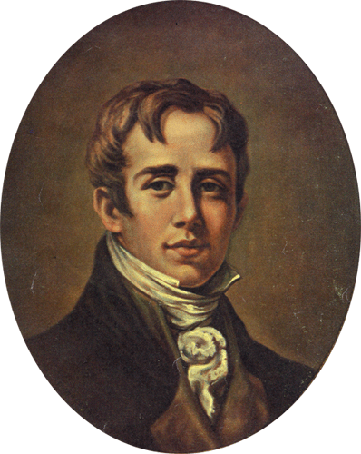
Applicant A Age: 27
Birth Place: Red Banks (Saluda), South Carolina
Ethnicity: White
Single/Married: Single
Children: None
Education: South Carolina College
Work Experience: Attorney
Aid to Governor James Hamilton, Jr.
Captain in Charleston Militia (artillery company)
Extra Information: Expelled from college senior year
90 days in jail for contempt of court

Slide 11
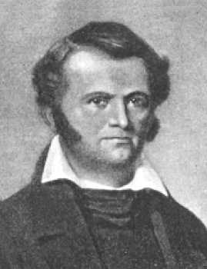
Applicant B Age: 38
Birth Place: Logan County, Kentucky
Ethnicity: White
Single/Married: Single
Children: None
Education: None
Work Experience: Soldier – War of 1812
Slave Trader
Land Speculator
Extra Information: Invented hunting knife
Reputation as a drinker
and knife fighter
killed man in duel

Slide 12
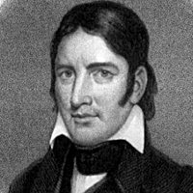
Applicant C Age: 48
Birth Place: Greene County, Tennessee
Ethnicity: White
Single/Married: Married-Polly Finley (died), Elizabeth Patton
Children: 5 children
Education: None
Work Experience: Worked Cattle, Hatter Apprentice, Businessman, State Representative, U.S. Congressman
Extra Information: At 13, attended 4 days of school, beat up class bully, ran away, survived in woods for 3 years
Scout for Militia during Creek Indian War
County Commissioner-determining boundaries for new county
Tennessee General Assembly
U.S. House of Representatives
Wrote Autobiography

Slide 13
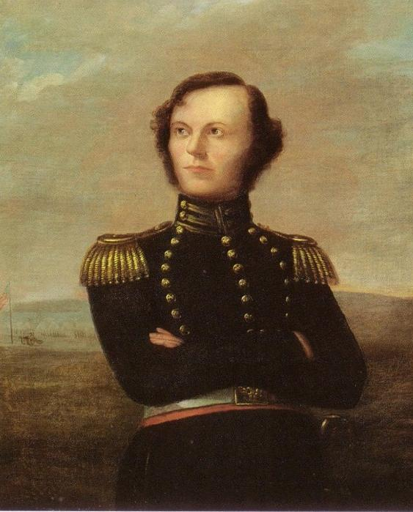
Applicant D Age: 30
Birth Place: Georgia
Ethnicity: White
Single/Married: Married-Minerva Fort
Children: 2 daughters
Education: U.S. Military Academy-West Point…
Tardies and low grades, but left for sick grandparents
Work Exp.: Store Clerk, Slave trader
Extra Info: Volunteer-Georgia Militia

Slide 14
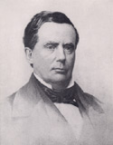
Applicant E Age: 36
Birth Place: Great Barrington, Massachusetts
Ethnicity: White
Single/Married: Married-Mary Smith Jones
Children: 4
Education: Jefferson Medical College
Work Experience: Physician (New York and Pennsylvania)
Store Merchant (New Orleans)
Extra Information: Arrested Pennsylvania for unpaid debts

Slide 15
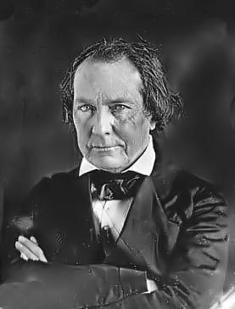
Applicant F Age: 36
Birth Place: Louisville, Georgia
Ethnicity: White
Single/Married: Married-Tabitha Jordan, Henrietta Maffitt
Children: 2 daughters
Education: Homeschooled, Accepted to Princeton University
Work Experience: Store Merchant, Newspaper Business
Extra Information: Private secretary to Georgia Governor
George M. Troup
Georgia State Senator (1 term)

Slide 16
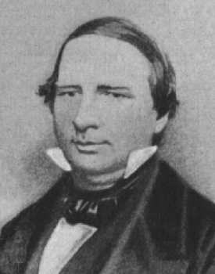
Applicant G Age: 31
Birth Place: Pendleton, South Carolina
Ethnicity: White
Single/Married: Married-Mary Francis “Polly” Cleveland
Children: 7 children
Education: Homeschooled
Work Experience: Attorney, Gold Mining Business (Georgia)
Extra Information: His mining managers robbed him and fled to Mexican Texas

Slide 17
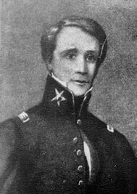
Applicant H Age: 25
Birth Place: Marlboro, Massachusetts
Ethnicity: White
Single/Married: Engaged-Catherine Isabel Cox
Children: None
Education:
Work Experience: Store Clerk (Boston)
Business owner-Cotton Bagging (Kentucky)
Extra Information: Orphan at age 16, moved to Boston and worked in store

Slide 18
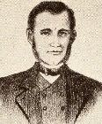
Applicant I Age: 25
Birth Place: Saluda County, South Carolina
Ethnicity: White
Single/Married: Rosanna Cato
Children: 2 children
Education: Sparta Academy-Alabama, McCurdy Academy-Alabama
Work Experience: Teacher/Tutor, Newspaper Publisher, Attorney
Extra Information: Sued for unpaid debts and warrant issued for his arrest

Slide 19
WHAT WERE YOUR DECISIONS?
Who did you approve and reject and why?
http://www.mnrealestateoptions.com/pass-your-inspection/

Slide 20
OK…So who did you Accept and Reject…and what did they go on to do?

Slide 21
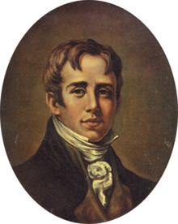
Applicant A Age: 27
Birth Place: Red Banks (Saluda), South Carolina
Ethnicity: White
Single/Married: Single
Children: None
Education: South Carolina College
Work Experience: Attorney
Aid to Governor James Hamilton, Jr.
Captain in Charleston Militia (artillery company)
Extra Information: Expelled from college senior year
90 days in jail for contempt of court
JAMES BUTLER BONHAM
Served as an attorney in Brazoria
Organized a militia calvary unit to serve in Texas
Fought and died at the Alamo manning a cannon
City of Bonham named in his honor
http://en.wikipedia.org/wiki/File:James_Bonham.png

Slide 22
Applicant B Age 38
Birth Place: Logan County, Kentucky
Ethnicity: White
Religion: None
Single/Married: Single
Children: None
Education: None
Work Experience: Soldier – War of 1812
Slave Trader
Land Speculator
Extra Information: Invented Bowie Knife
Reputation as a drinker & knife fighter
killed man in duel
JAMES “JIM” BOWIE
Baptized a Catholic Christian
Married the daughter of the Vice Governor
Engaged in business deals and explorations
Fought and died at the Alamo
http://www.lsjunction.com/people/bowie.jpg

Slide 23
Applicant C Age: 48
Birth Place: Greene County, Tennessee
Ethnicity: White
Single/Married: Married-Polly Finley (died), Elizabeth Patton
Children: 5 children
Education: None
Work Experience: Worked Cattle, Hatter Apprentice, Businessman, State Representative, U.S. Congressman
Extra Information: At 13, attended 4 days of school, beat up class bully, ran away, survived in woods for 3 years
Scout for Militia during Creek Indian War
County Commissioner
Tennessee General Assembly
U.S. House of Representatives
Wrote Autobiography
DAVID “DAVY” CROCKETT
Fought and died at the Alamo
Crockett County named in his honor
U.S. Postage stamp in his honor 1967
http://www.factropolis.com/uploaded_images/davycrockett-757549.jpg

Slide 24
Applicant D Age: 30
Birth Place: Georgia
Ethnicity: White
Single/Married: Married-Minerva Fort
Children: 2 daughters
Education: U.S. Military Academy-West Point…
Tardies and low grades, but left for sick grandparents
Work Experience: Store Clerk, Slave trader
Extra Information: Volunteer-Georgia Militia
JAMES WALKER FANNIN, JR.
Established plantation
Managing Partner-Slave Trading Syndicate
Volunteer-Texas Army
After The Alamo, Colonel Fannin and his soldiers were
captured and executed by Mexican Army at Goliad
Fannin County named in his honor
http://upload.wikimedia.org/wikipedia/commons/f/fd/JamesWFannin.jpg

Slide 25
Applicant E Age: 36
Birth Place: Great Barrington, Massachusetts
Ethnicity: White
Single/Married: Married-Mary Smith Jones
Children: 4
Education: Jefferson Medical College
Work Experience: Physician (New York and Pennsylvania)
Store Merchant (New Orleans)
Extra Information: Arrested Pennsylvania for unpaid debts
ANSON JONES
Medical Practice in Brazoria
Served as Surgeon to Texas Army
Served as Texas Minister to the United States
4th/Last President Republic of Texas (1844-1846)
Served as Republic of Texas Senator
Served as Republic of Texas Secretary of State
Became wealthy farmer
http://jeffline.jefferson.edu/SML/Archives/Highlights/Jones/jones1.jpg

Slide 26
Applicant F Age: 36
Birth Place: Louisville, Georgia
Ethnicity: White
Single/Married: Married-Tabitha Jordan, Henrietta Maffitt
Children: 2 daughters
Education: Homeschooled, Accepted to Princeton University
Work Experience: Store Merchant, Newspaper Business
Extra Information: Private secretary to Georgia Governor
George M. Troup
Georgia State Senator (1 term)
MIRABEAU BUONAPARTE LAMAR
Fought at Battle of San Jacinto
Elected as the first Vice President Republic of Texas
Elected as the second President Republic of Texas
Elected Texas State Legislature
Appointed U. S. Minister to Nicaragua
Lamar County named in his honor
http://www.sonofthesouth.net/texas/pictures/mirabeau-lamar.jpg

Slide 27
Applicant G Age: 31
Birth Place: Pendleton, South Carolina
Ethnicity: White
Single/Married: Married-Mary Francis “Polly” Cleveland
Children: 7 children
Education: Homeschooled
Work Experience: Attorney, Gold Mining Business (Georgia)
Extra Information: His mining managers robbed him and fled to Mexican Texas
THOMAS JEFFERSON RUSK
Appointed Inspector general of the Republic of Texas Army
Signer of Texas Declaration of Independence
Appointed Secretary of War-Republic of Texas
Appointed Commander-in-Chief Republic of Texas Army
Chief Justice Republic of Texas Supreme Court
Elected U. S. Senator
Organized Nacogdoches University-Served as Vice President
City of Rusk and Rusk County named in his honor
http://www.lsjunction.com/people/rusk.htm

Slide 28
Applicant H Age: 25
Birth Place: Marlboro, Massachusetts
Ethnicity: White
Single/Married: Engaged-Catherine Isabel Cox
Children:
Education: Store Clerk (Boston)
Business owner-Cotton Bagging (Kentucky)
Work Experience:
Extra Information: Orphan at age 16, moved to Boston and worked in store
SYDNEY SHERMAN
Raised money for ammunition, rifles and cannons
Joined Texas Army as Colonel at San Jacinto
His soldiers first to cry, “Remember the Alamo!
Remember Goliad!”
Texas House of Representatives
Built Hotel in Galveston
Sherman County and City of Sherman named in his honor
http://en.wikipedia.org/wiki/File:Sidney_sherman.jpg

Slide 29
Applicant I Age: 25
Birth Place: Saluda County, South Carolina
Ethnicity: White
Single/Married: Rosanna Cato
Children: 2 children
Education: Sparta Academy-Alabama, McCurdy Academy-Alabama
Work Experience: Teacher/Tutor, Newspaper Publisher, Attorney
Extra Information: Sued for unpaid debts and warrant issued for his arrest
WILLIAM BARRET TRAVIS
Chief Recruiting Officer for Texas Army,
Promoted to Lt. Colonel
Co-Commander of the Alamo,
Died at The Alamo
Travis County named in his honor
http://en.wikipedia.org/wiki/File:William_B._Travis_by_Wiley_Martin.JPG

Slide 30
What additional information would you have liked to have had about the applicants?
What did you learn from this activity?
http://www.ucdmc.ucdavis.edu/neurology/images/body/brain_activity.jpg

Slide 31
Bio Research Sources
http://en.wikipedia.org/wiki/James_Bonham
http://en.wikipedia.org/wiki/James_Bowie
http://en.wikipedia.org/wiki/Davy_Crockett
http://en.wikipedia.org/wiki/James_Fannin
http://www.lsjunction.com/people/fannin.htm
http://www.tshaonline.org/handbook/online/articles/ffa02
http://www.lsjunction.com/people/fannin.htm
http://en.wikipedia.org/wiki/Anson_Jones
http://en.wikipedia.org/wiki/Mirabeau_B._Lamar
http://en.wikipedia.org/wiki/Thomas_Jefferson_Rusk
https://en.wikipedia.org/wiki/Sidney_Sherman
http://en.wikipedia.org/wiki/William_B._Travis
Alphin, Elaine Marie (2003). Davy Crockett. New York: Barnes and Noble.
Driskill, Frank A. ((1981). Davy Crockett: The Untold Story. Austin, Texas: Eakin press.
Flynn, Jean ((1997). Anson Jones: Last President of the Republic of Texas. Austin, Texas: Eakin Press.
Morgan, Elizabeth Dearing (1994). President Mirabeau B. Lamar. Austin, Texas: Eakin Press.
Photo Research Sources
http://en.wikipedia.org/wiki/File:James_Bonham.png
http://www.lsjunction.com/people/bowie.jpg
http://www.factropolis.com/uploaded_images/davycrockett-757549.jpg
http://upload.wikimedia.org/wikipedia/commons/f/fd/JamesWFannin.jpg
http://jeffline.jefferson.edu/SML/Archives/Highlights/Jones/jones1.jpg
http://www.sonofthesouth.net/texas/pictures/mirabeau-lamar.jpg
http://www.lsjunction.com/people/rusk.htm\
http://en.wikipedia.org/wiki/File:Sidney_sherman.jpg
http://en.wikipedia.org/wiki/File:William_B._Travis_by_Wiley_Martin.JPG
Special Thanks to:
David A. Welton, former professor Texas Tech University College of Education
Alan O. Kownslar, former Trinity University, Department of History

