Slide 1


Financial Aid
Shopping Sheet
Brandi Massey
Subject Matter Expert-Financial Aid
NC Community College System
masseyb@nccommunitycolleges.edu
Karen Britt Statler
Subject Matter Expert-Financial Aid
NC Community College System
statlerk@nccommunitycolleges.edu

Slide 2
Resources
Colleague Student: FA Shopping Sheet (April 29, 2013)
Release Highlights: 2013/2014 COD Processing, Part II (April 11, 2013
JOB AID- FA Shopping Sheet
Help Desk
  cishelpdesk@nccommunitycolleges.edu
  919.807.7048

Slide 3
MNEMONICS NEEDED
FFSP-FA Shopping Sheet
FSGU-FA ShopSheet Awd/ Budgt Grouping Utility
SSRT-Shopping Sheet Rule Table
FSSB-FA Shopping Sheet Batch PDF
FAOP-FA Office Parameters
FIDF-FA Institution Defaults
AWD-Award Definition
SBCD-Budget Component Definition
PDFR-PDF Retrieval
FSSB-FA Shopping Sheet Batch
FAWP-FA Inst Web Parameters

Slide 4
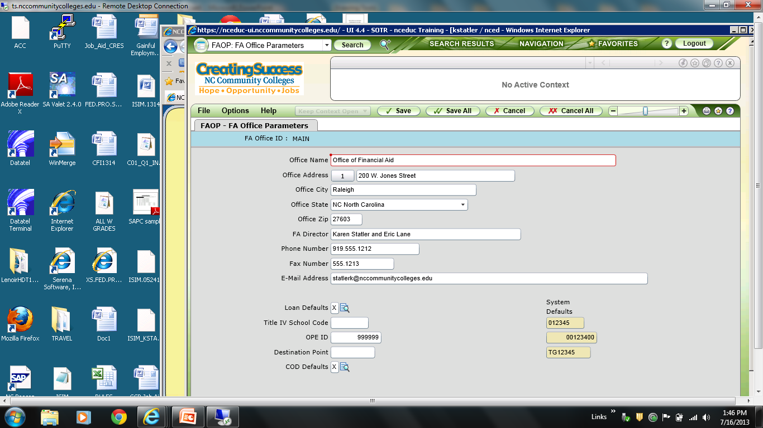
FAOP

Slide 5
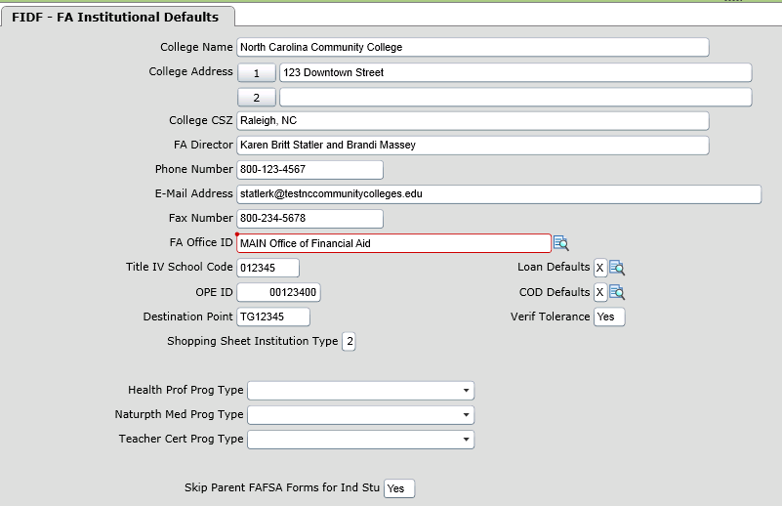
FIDF

Slide 6
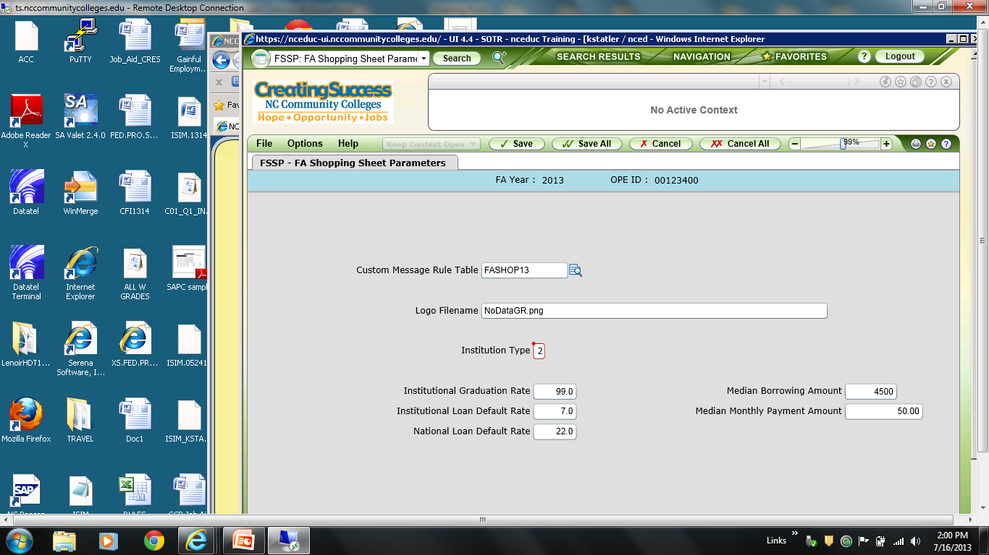
FSSP
Electronic Announcement: Information to be used on FSSP
http://www.ifap.ed.gov/eannouncements/011813InstitutMetricDataFileForFinaidShopSheet.html

Slide 7
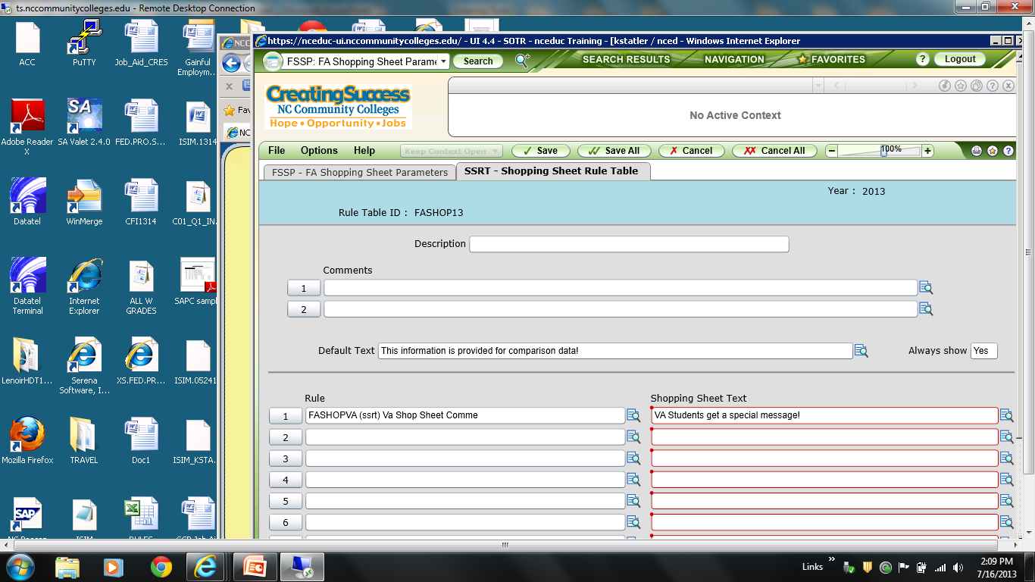
SSRT
The text must be less than 96 characters long and
can only be created on ONCE line of text.

Slide 8
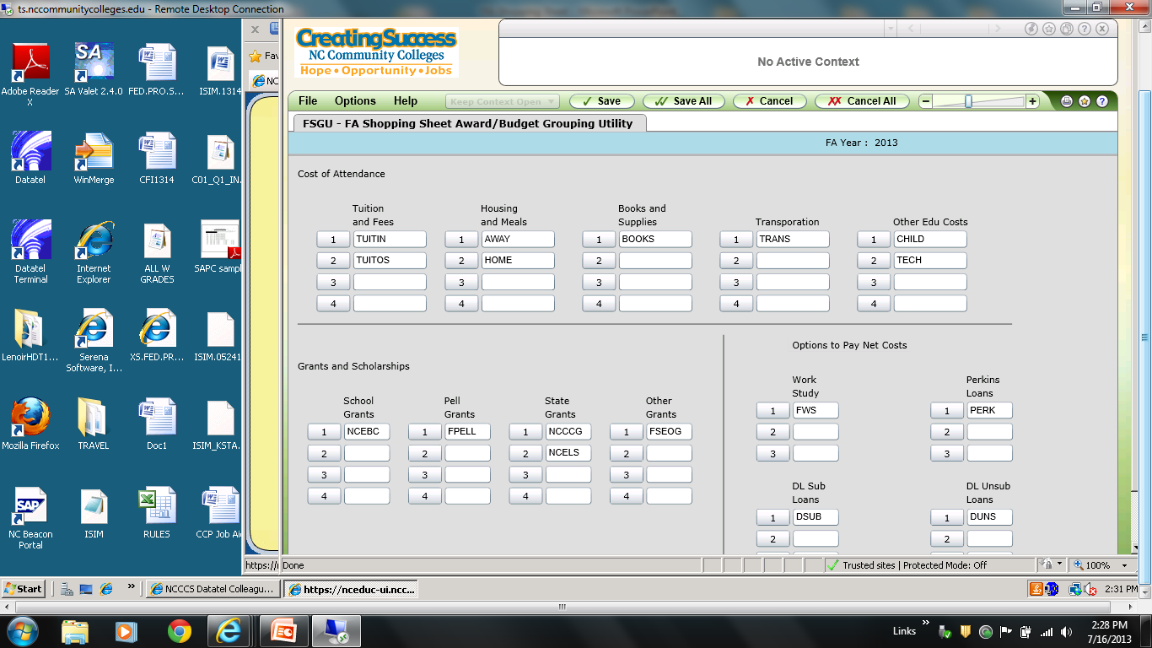
FSGU
Set up can also be done individually on AWD and SBCD.

Slide 9
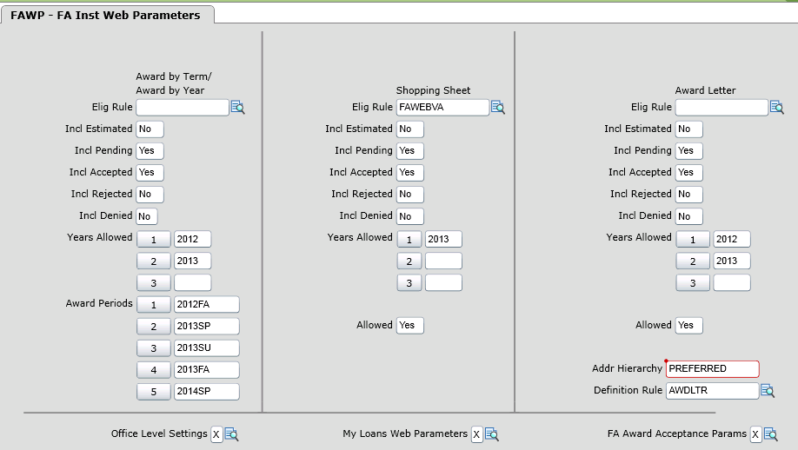
FAWP

Slide 10
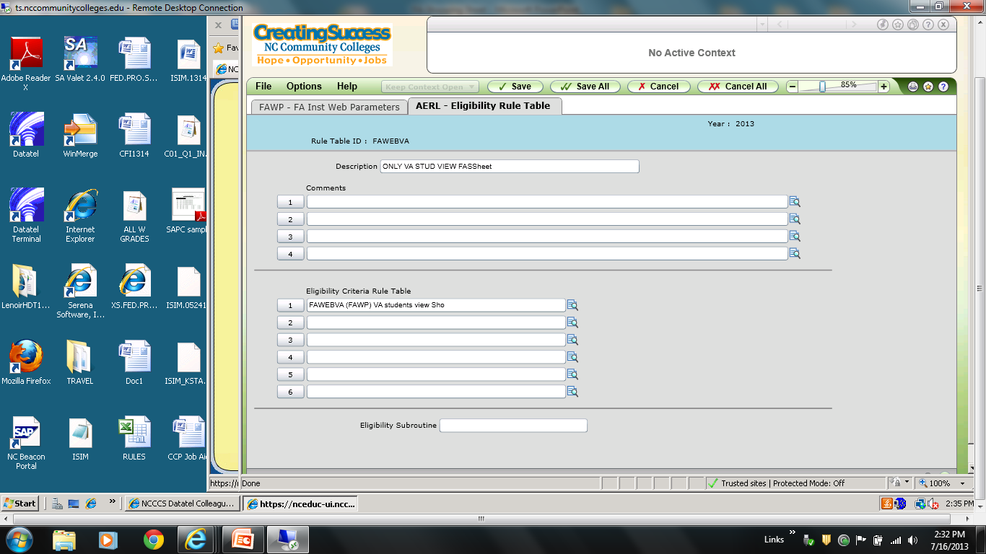
FAWP-AERL

Slide 11
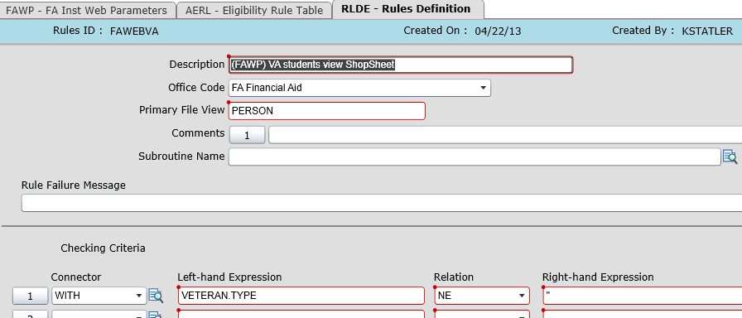
FAWP-AERL

Slide 12
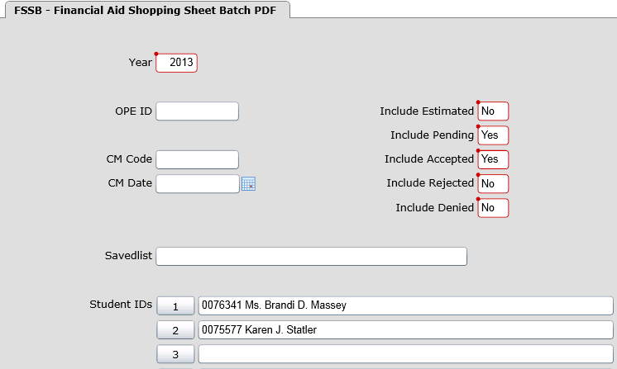
FSSB-to generate PDF

Slide 13
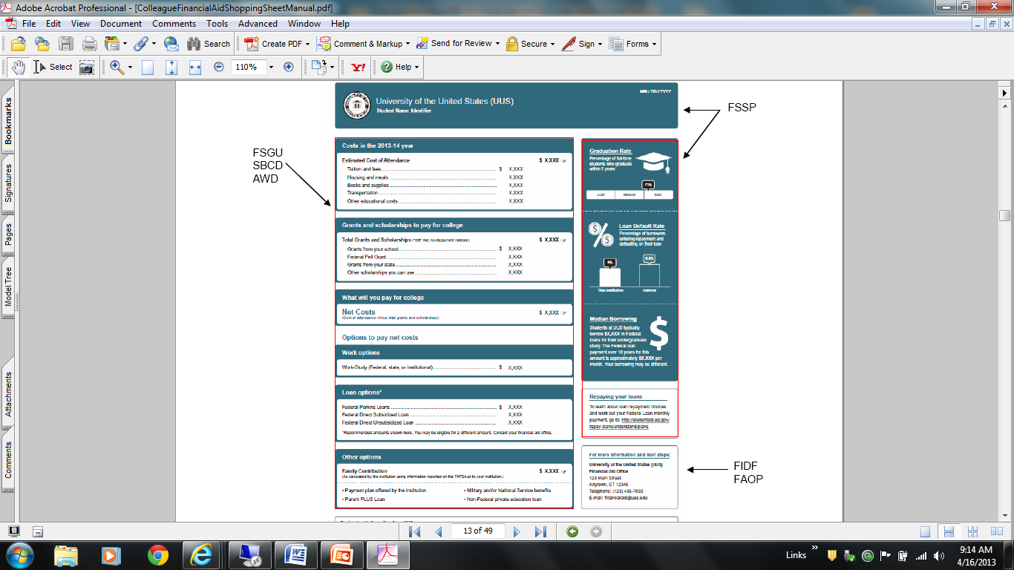

Slide 14
Questions?

