Slide 1
Cardiovascular Emergencies
Assessment Interventions Treatment
Chapin Area Rescue Squad/Spring 2018/B. McCormick, EMT-P

Slide 2
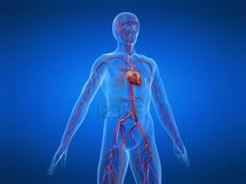
Cardiovascular System

Slide 3
Assessment of Perfusion
Ensure ABCs
If the patient is not breathing and no pulse, change focus to CAB
For the alert patient, note skin conditions
Collect SAMPLE history and History of present illness (OPQRST)

Slide 4
Assessment/History
Determine if the patient has a PMH of chest pain
See if they have any cardiac drugs, such as ASA and Nitro
Initiate Oxygen therapy
Ask to describe and rate any pain

Slide 5
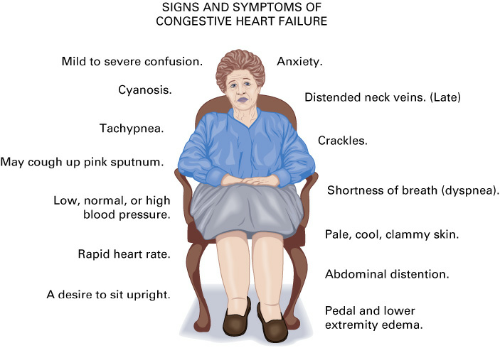
Basic Terms
COPD
Angina/Angina Pectoris
CHF
CABG
Stent
MI

Slide 6
Interventions
Shock/Hypoprofusion
Major Trauma
AAA
Respiratory Emergency

Slide 7
Treatment
For presumed cardiac related chest pain, application of oxygen to maintain SpO2 of higher than 94% is required
Administration or assisted admin of patient prescribed cardiac drugs (Call Med Control)
Early notification of possible Heart Attack, request ALS, prehospital ECG

Slide 8
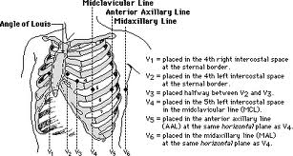
12 Lead ECG

Slide 9
Steps for 12-Lead
CARS/BLS providers cannot interpret ECGs
Field transmit is allowed
If you suspect chest pain is cardiac, conduct the 12 Lead
AMBULANCE MUST NOT BE MOVING!
PATIENT MUST REMAIN STILL!

Slide 10
Conclusion
In addition to difficulty breathing, chest pain is a major response
Application of Oxygen, ASA, Nitro, and early ECG will help improve outcomes
Limit on scene times
Treat all chest pain as legitimate until proven otherwise

