Slide 1

Little Actors’ Studio
presents
Murdock Elementary School Drama Club
at
Sewell Mill Library and Cultural Center
Saturday, March 21, 11AM
Music and Lyrics by
Teresa Jennings
Used by permission from Plank Road Publishing

Slide 2
Director’s message
What a fun time we have had this season preparing this musical! We have enjoyed watching them become a cast, ready to hold one another together and make each other strong.
In this our twelth season, we are happy to see our actors returning to our program as well as discovering new talent. It is an awesome responsibility to be molding the minds of these precious little actors and not one that we take lightly. We ask them to stretch themselves by singing like no one is listening, dancing like no one is watching, and acting like your character is real! We believe that drama club helps little humans gain self-confidence, out-of-the-box thinking, and the ability to work cooperatively with others. These skills will help them throughout their lives.
We love to see the children, staff, and parents who have helped make us what we are today. From now on, wherever you go, whatever you do, you will always be a part of something special. We hope you take what you’ve learned here and use it to do great things while never letting go of your creativity. We are thankful every day that we can be your teachers. It is truly a gift.
Our favorite thing about drama club is watching the bravery displayed by our little actors as they go out on stage and sing, dance, and act. Their favorite part might be dressing up, learning the exciting music, or kicking up their heels, but surely your favorite part will be watching the joy of our little actors as they bring you The Share Bears.
-- Ms. Amber and Mr. Alex

Slide 3
Production Credits
Artistic Director/Choreograper Alex Lopez
Assistant Director/Choreographer Nadia Opperman
Business/Technical Director Amber Lopez
Costume Designer Amber Lopez
Costume Mistresse Pat Sanchez
Set and Prop Design
Amber Lopez , Alex Lopez, Nadia Opperman
Sound Engineer Alex Lopez
Photography Ludmillo Pierre
Thank you to the many parent volunteers!
Thank you to Murdock Elementary School and Mr. Hydo!
Thank you to the staff at Sewell Mill Library and Cultural Center!
Musical Numbers
Merrily Bearily Bears
Bailey and the Bees
Honey Honey
Everybody Needs Some Help Sometimes
When We Give, We Receive
Bows

Slide 4
cast
Harry Bear Abigail Burgess
Bee Addison Park
Pookie Bear Amelia Guzman
Bee/Magical Winter Wind Andersen Ingram
Chicago Bear Aspen Dodoo
Bee Azaria Alphonso
Bee Blakely Linenger
Beary Potter Brett Larrabee
Little Bear Camille Carson
Hibernating Henry Joey Anderson
Bee Kyla Palermo
Bailey Bear Maddon Rockwell
Bee Niam Patel
Bee Norah Klein
Furball Bear Penelope Sullivan
Bee Rida Kaur
Bee Aurora McCarthy
Bee Wesley Cullen
Fuzzy Bear Zaya Omondi
Honey Face Bear Zoe Campbell

Slide 5
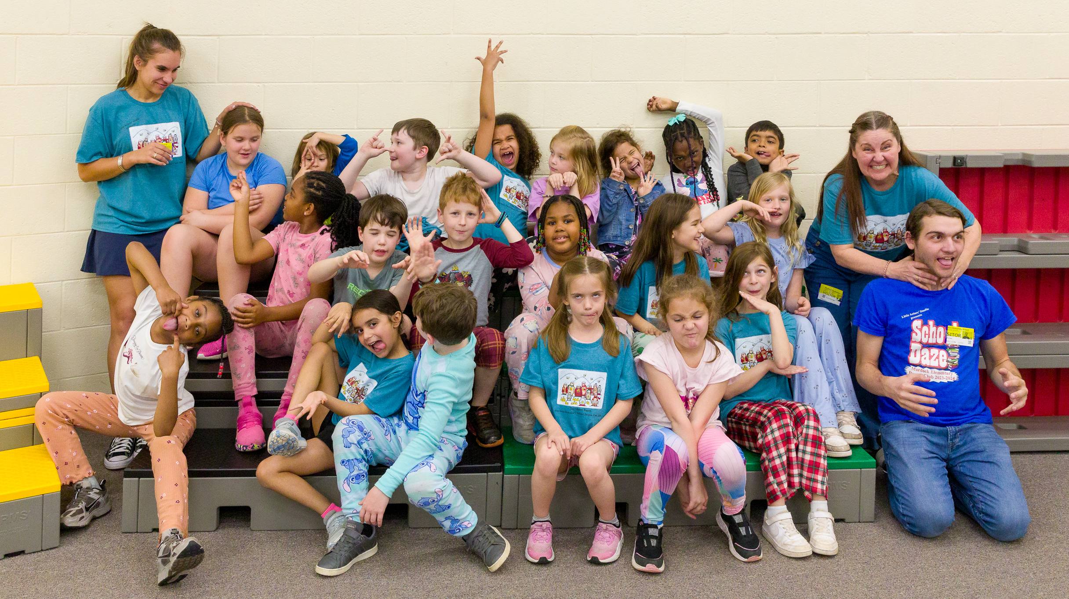
Little Actors’ Studio
www.littleactorsstudio.org
Summer Camps
June 8-19 Shrek Jr. the Musical
July 13-24 Write Your Own Musical
TLC Dance Studio
Join Us
FOR ALL THE
FUN!

