Slide 1
Future of the Savannah River Site
Nicole Nelson-Jean
Savannah River Field Office Manager
September 12, 2019

Slide 2
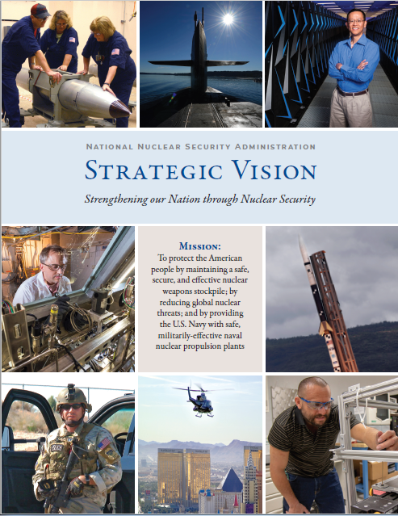
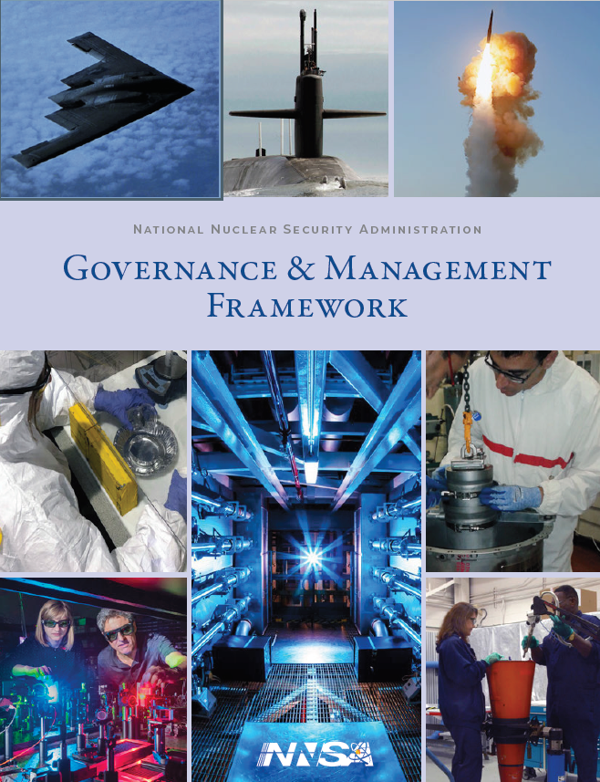
NNSA Strategic Planning
Governance and Management Framework
Focuses on the NNSA Team approach to mission integration and strategic planning, and establishes clear roles and responsibilities across the enterprise
Strategic Vision Identifies our values, principles, mission priorities, and goals
Strategic Integrated Roadmap
Illustrates the path to achieving our goals now and into the future

Slide 3
Future NNSA Work at SRS
Planned NNSA Funding at SRS
Over $3.5B in total funding to SRS over the next five years is expected for all NNSA-related work.
Surplus Plutonium Disposition
NNSA will dilute and dispose of several MT of surplus plutonium.
Tritium Production
Current stockpile requires additional extractions
Overall, the Savannah River Tritium Enterprise is modernizing and will continue to be the Tritium Center of Excellence.
Proposed Plutonium Pit Production
Nuclear Posture Review requires NNSA to produce 80 plutonium pits per year by 2030.
NNSA’s preferred alternative is to produce 50 pits per year at SRS and 30 pits per year at Los Alamos National Laboratory.

Slide 4
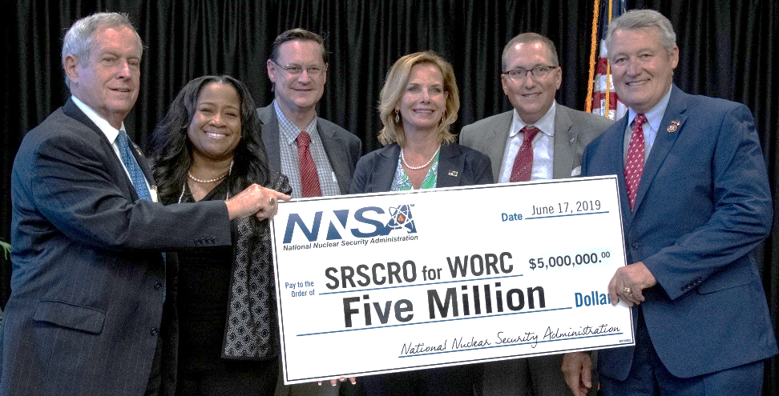
Community Involvement
Workforce Opportunities in Regional Careers (WORC): NNSA recently committed an additional $5 million to local educational institutions to invest in the region and develop the workforce.
State Relationships: Meetings with Governor McMaster and staff, participate in Governor’s Nuclear Advisory Council, partnership with SC and GA Congressional Members.
Local Community: Regular meetings with Aiken Mayor, local Chambers of Commerce, State Legislators, County Council Members and community organizations.

