Slide 1
WRITING Literacy Tools
OPINION WALK (Grades K-5)
ARGUMENT WALK ( GRADES 6-12)
www.kbumreading.com
2016
Cut out each of the Steps in the Walk.
Glue them onto large index cards or card stock.
After laminating individual cards, join them together to make a sequential line of steps in writing an opinion paper.

Slide 2



1
2
3

Slide 3

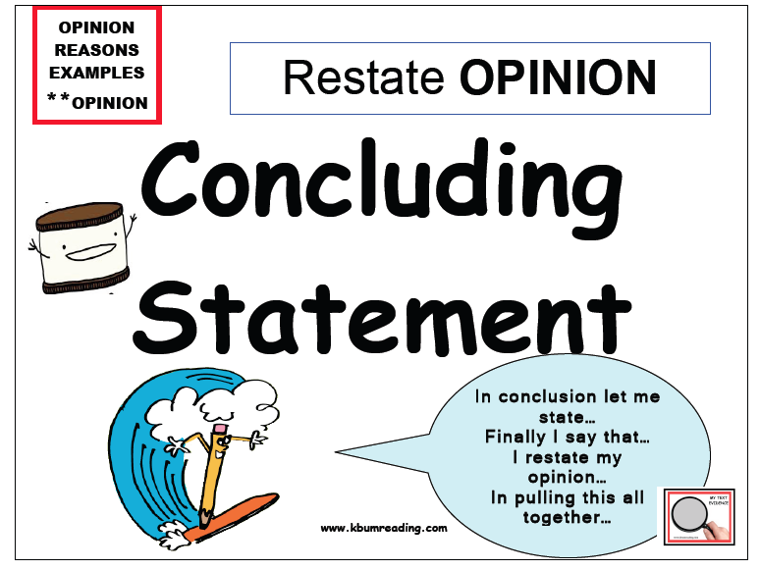
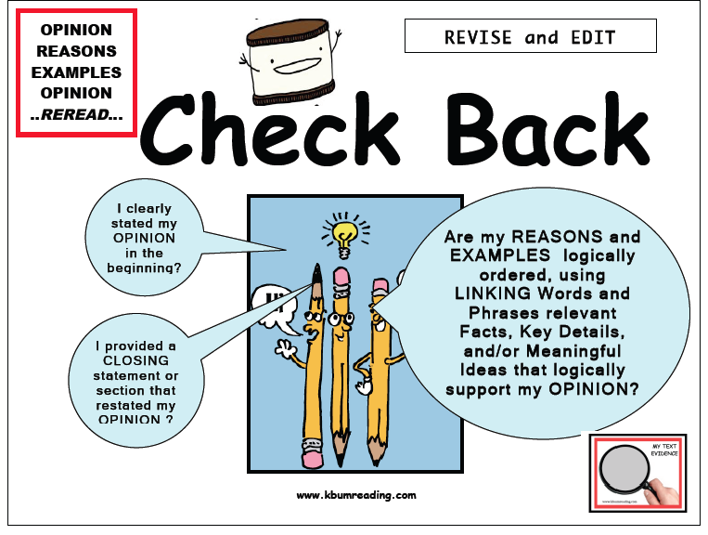
4
5
6

Slide 4



ARGUMENT
WALK
CLAIM
Make a claim.
( Your position…the statement you will prove)
GRADES 6-12
PROVIDE EVIDENCE
( Provide Evidence to support claim )

Slide 5



COUNTER CLAIM
(State the counter claim)
REBUTTAL
Refute counter claim.
( Say why you disagree)
CONCLUDE
ARGUMENT
( Effective Conclusion tied back to Claim)

