Slide 1
Dear Teacher,
These slides were created to support the lessons in the CSO Teacher’s Guide for
“BOLD Voices: A Beethoven Celebration,” November 2019.
You are welcome to modify, convert to a different format, or use as is in any way that would be useful to your teaching.

Slide 2
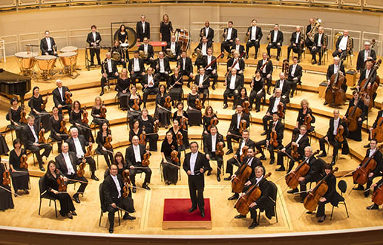

Slide 3
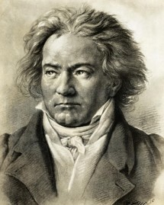
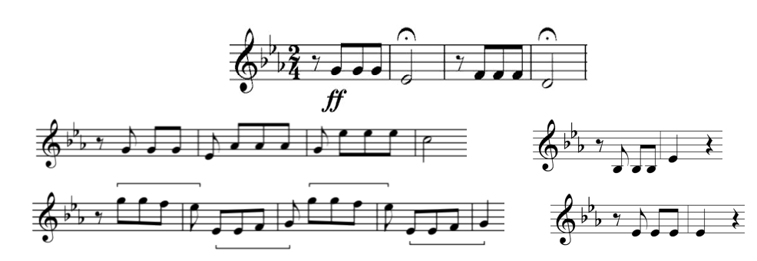
Symphony No 5, Mvt. 1

Slide 4
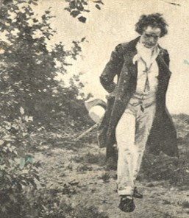
Symphony No 6, Mvt. 4
SYMPHONY No. 5
Allegro con brio
Andante con moto
Scherzo. Allegro
Allegro
SYMPHONY No. 6
Cheerful feelings after arriving in the country
Scene at the brook
Happy gathering of country folk
Thunderstorm
Shepherd’s Song; Cheerful and thankful feelings after the storm

Slide 5
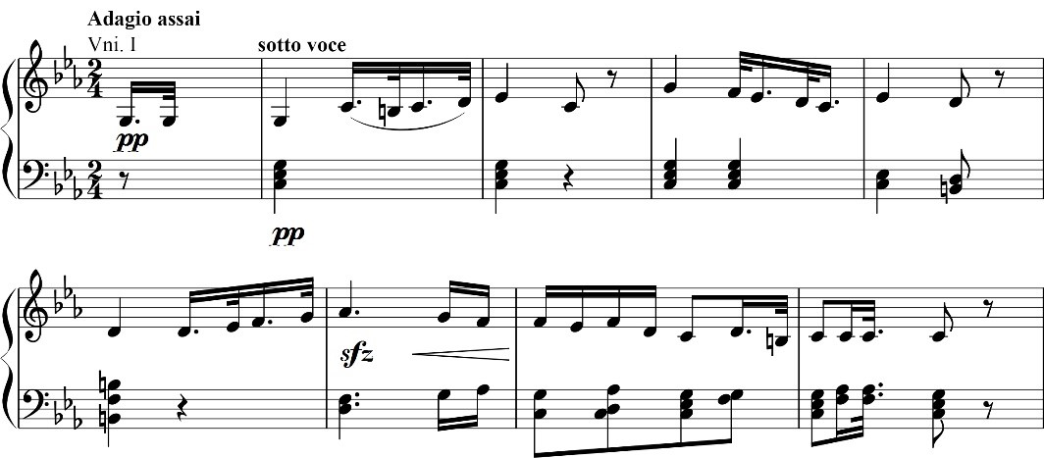
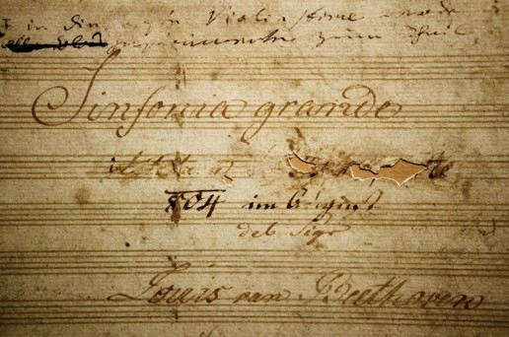
Symphony No 3, Mvt. 2

Slide 6
Symphony No 9, Mvt. 4
Joyful, joyful, join our singing
All be bold and know the truth
With our music we are bringing
freedom to adults and youth.
All our sisters, all our brothers,
all join hands, our love unfurled.
Music brings us all together,
music’s pow'r will change the world.

Slide 7
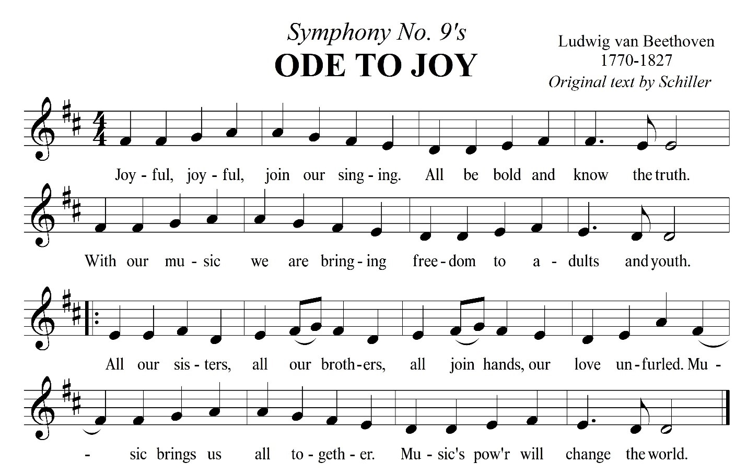
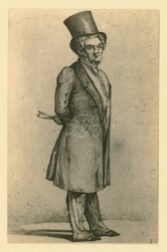
Symphony No 9, Mvt. 4

Slide 8
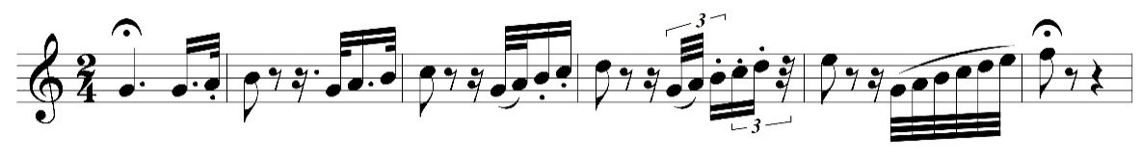
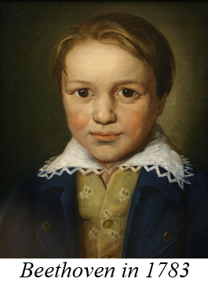
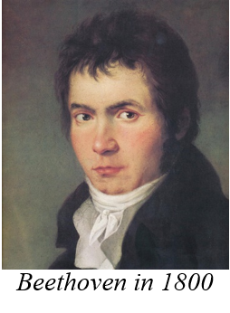
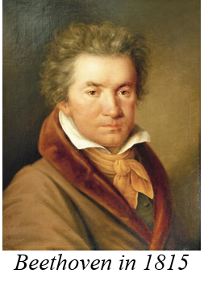
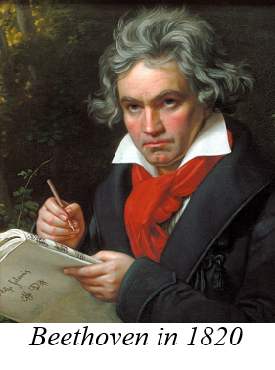
Symphony No 1, Mvt. 4

Slide 9
Symphony No 1, Mvt. 4
1,2,3—2,3,4—3,4,5—4,5,__
1,3,5—2,4,6—3,5,7—4,__,__

Slide 10
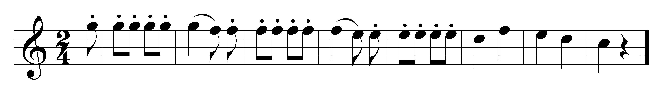
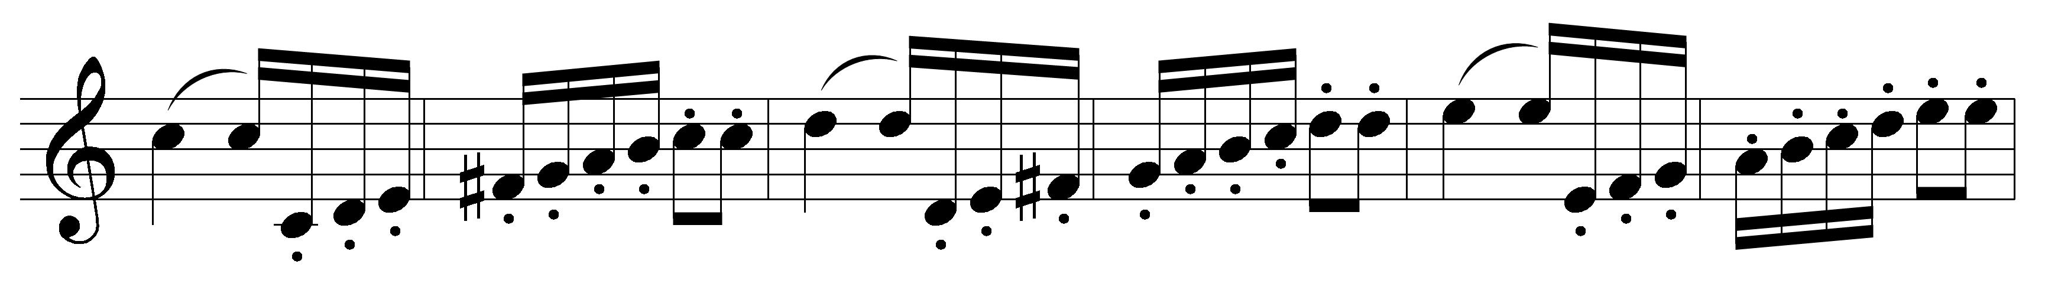
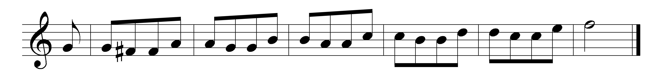
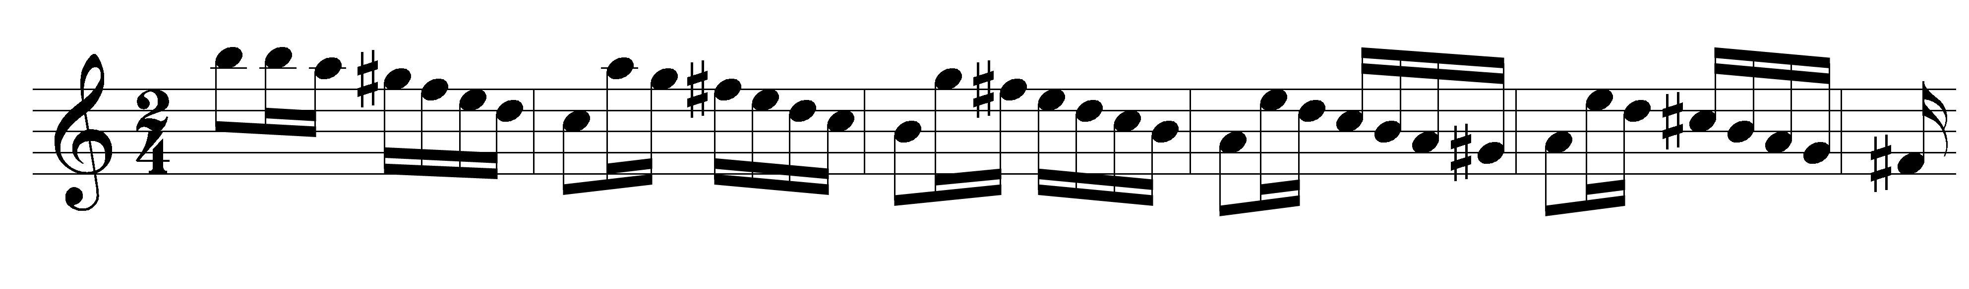
1,2,3—2,3,4—3,4,5—4,5,__
1,3,5—2,4,6—3,5,7—4,__,__
Symphony No 1, Mvt. 4
1
2
3
4
sequence patterns in music

Slide 11

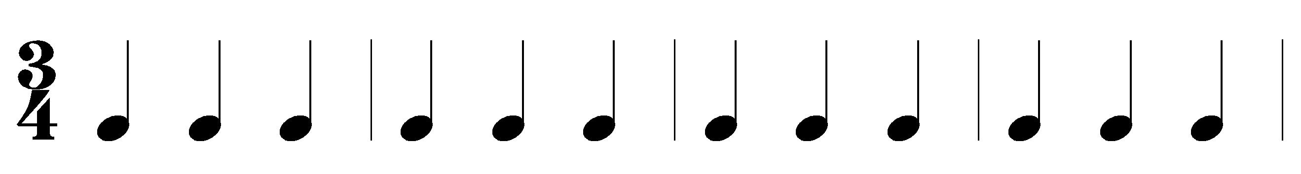
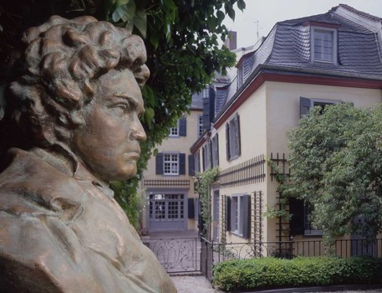
1,2,3—2,3,4—3,4,5—4,5,__
1,3,5—2,4,6—3,5,7—4,__,__
Symphony No 9, Mvt. 2

Slide 12
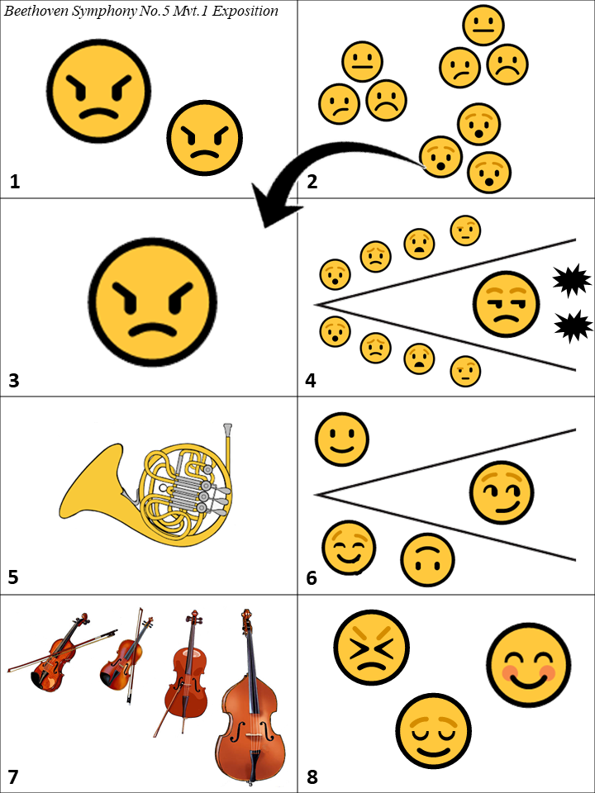
Symphony No 5, Mvt. 1

Slide 13
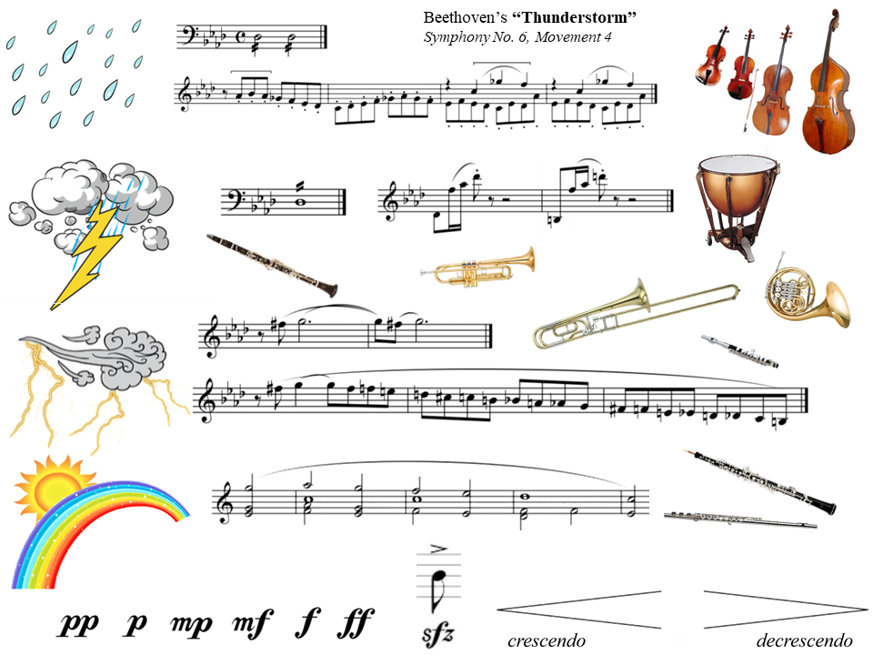

Slide 14

How Do You Feel?
https://gozen.com/a-better-way-to-teach-kids-about-emotions

Slide 15
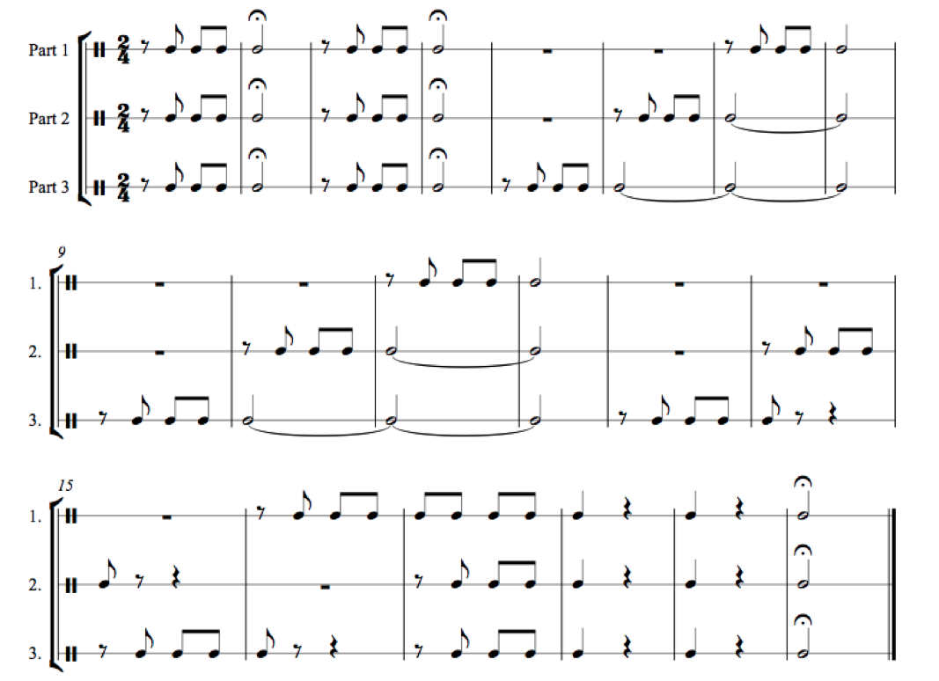
Play the Fifth!
https://www.downsjuniormusic.com/beethoven.html

Slide 16
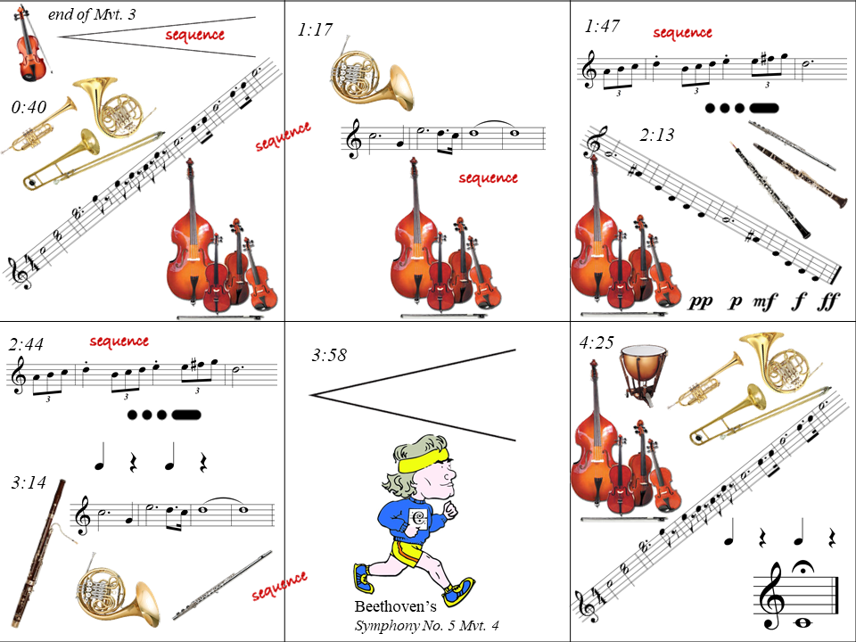

Slide 17
