Slide 1

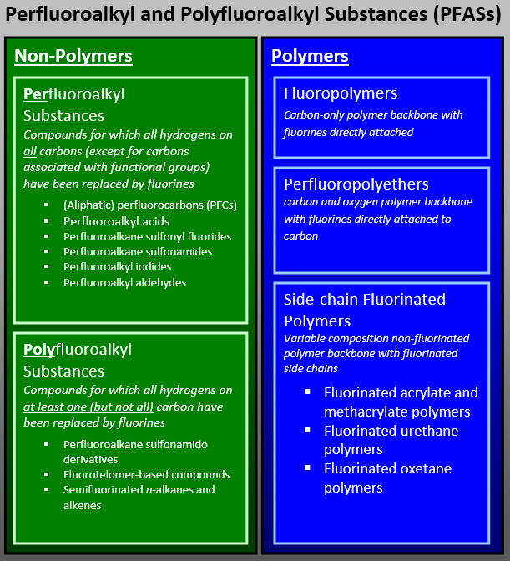
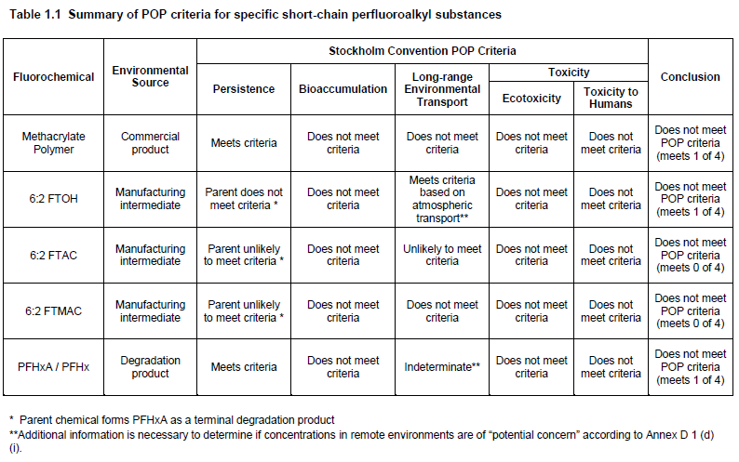
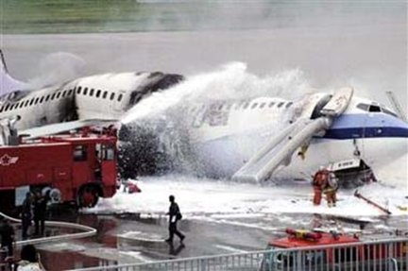


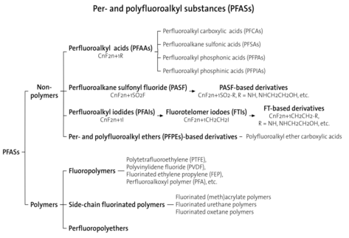
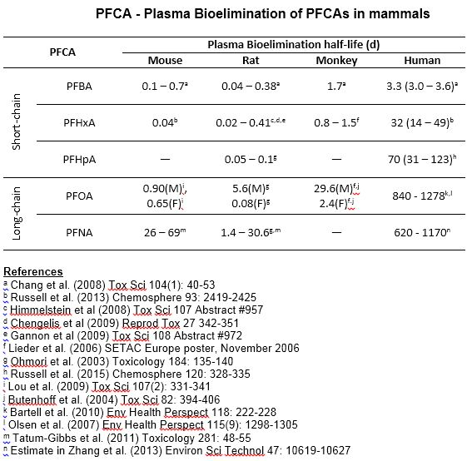
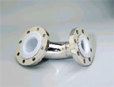



Myths and Facts about Per- and Polyfluoroalkyl Substances (PFASs)
Kai-Volker Schubert, Robert C.Buck, Stephen H. Korzeniowski, Mark H. Russell, and William Buxton
The Chemours Company, LLC, Wilmington, Delaware USA
Poster T-602 presented at Fluoros 2015
13-15 July 2015, Golden, CO
MYTH: PFASs are “all the same”
FACT: Fluorotelomer-based products can be non-polymeric or polymeric
MYTH: Limited information is available on short-chain Alternatives
FACT: Specific short-chain PFAS have been assessed for Stockholm Convention Annex D Criteria (“POP Criteria”)¹⁰
Per- and polyfluoroalkyl substances (PFASs)^{1,2} are a broad and diverse range of substances with very different structures, functionality and physical-chemical and toxicological properties. FACT: PFASs are not “all are the same.”
Non-polymeric fluorotelomer-based products include liquid, functional manufacturing raw materials and solid or liquid water-soluble/dispersible surfactants. The surfactants exhibit ultra-low surface tension and superior spreading properties on polar organic liquids. Side-chain fluorinated polymers are typically dispersed in water and are used for their surface modification and protection properties (oil- and water repellency, stain protection)
Ultra-low surface tension → Wetting → VOC Reduction
Spreading → Fire Fighting Foam → Life Saving
Surface Modification → Oil/Water Repellency → Protection
FACT: Extensive information in publicly available for alternative fluorotelomer-based short-chain products and fluoroether polymer processing aids.
These substances are well studied and have been approved for manufacture and use by global competent authorities (Canada, Europe, Japan, USA). See Fluoros 2015 Posters [LIST THEM]
For example. extensive studies have been conducted on short-chain fluorotelomer-based Commercial Products, Manufacturing Raw Materials, and Degradation Products
Peer reviewed scientific papers on:
Physical-chemical properties
Analytical Methods
Toxicology: Mammalian, Aquatic, Kinetics, In-Vitro
Emissions to and Transport in the Environment
Environmental Fate
The available scientific literature has been reviewed to evaluate the persistent organic pollutant (POP) characteristics as outlined in Annex D of the Stockholm Convention [Stockholm Convention] of three Manufacturing Raw Materials, one Commercial Product and one Degradation Product. Based on the data reviewed for each substance, none of the substances meet all of the criteria required to be classified as a POP and none of the substances might meet more than one criterion. The findings are summarized in the table below:
MYTH: PFOA is used as a stain repellent in textile applications
FACT: Short-chain PFCAs are very different from long-chain PFCAs
FACT: PFOA is not used as a stain repellent and does not provide oil and water repellency on textiles. PFOA is a highly water soluble surfactant.
The major global commercial use for PFOA/APFO (ammonium or sodium salt of PFOA) was/is as a polymerization processing aid in fluoropolymer manufacturing for certain grades of PTFE, FEP (fluorinated ethylene propylene, PFA (perfluoroalkoxy alkane), and PVDF (polyvinylidene fluoride).
Applications for PFOA or its salts⁴ are:
    Polymerization Processing Aid (Major Use)
    Surfactant in the Semiconductor Industry (Minor Use)
    Photographic Industry (Minor Use)
Long-chain PFCAs such as PFOA and PFNA have very long elimination half lives in mammals with significant differences in sexes and species. In stark contrast, short-chain PFCAs such as PFBA, PFHxA and PFHpA eliminate more rapidly in mammals and show no difference between sexes. For PFHxA, bioelimination in mammals is proportional to body weight.¹²
PFCAs have been widely reported found in the environment. Human biomonitoring studies show that short-chain PFCAs are generally not detected in the general population whilst long-chains are with a declining trend observed for some long-chain PFCAs.
MYTH: All “C6”-based Substances are the same
Both PFHxA and PFHxS have six carbons (aka “C6”). However, there is a stark difference in their physical-chemical and toxicological properties. Perfluorohexane sulfonate (PFHxS) has a long elimination half life in mammals and toxicology study no effect levels orders of magnitude lower that perfluorohexanoic acid (PFHxA). PFHxS is a “long’-chain” perfluoroalkyl acid (PFAA), PFHxA is a “short-chain” PFAA (OECD Reference).
 | PFHxA F(CF₂)₅CO₂H | PFHxS F(CF₂)₆SO₃⁻
pKa (acidity | 2 – 3 | Less than -1
Blood T1/2 Rats | 0.05-0.2 days | 15-30 days
Blood t1/2 Monkey | 1 day | 87 - 144 days
Bioaccumulation (Fish) | Not Bioaccumulative | Bioaccumulative
Acute Oral LD50 (Male Rat) | 2,000 mg/kg | No Data
One Generation Repo/Development (Rat) NOAEL | M & F 100 mg/kg/day No effects on developmental or reproductive endpoints | M <0.3 mg/kg/day F > 10 mg/kg/day No effects on developmental or reproductive endpoints at 10 mg/kg/day
Oral Repeated Dose (Rat) NOAEL | 100 mg/kg/day 90 Days | <10 mg/kg/day 28 Days
FACT: Fluoropolymers are Plastics
MYTH: PFHxA replaced PFOA as a polymerization processing aid
Fluoropolymers – such as polytetrafluoroethylene (PTFE) – are plastics. They are used in specialized, harsh environment applications³ where no other plastics can provide the required:
Chemical Resistance → Safety
Thermal Stability → Safety
Non-stick Properties → Durability
Dielectric Properties → High Speed Data Transfer
FACT: PFHxA is not used as a polymerization processing aid. New alternative processing aid technologies are based on fluorinated ethers.
Alternative polymerization processing aids for fluoropolymer manufacture (registered under REACH):
2,2,3-trifluoro-3-[1,1,2,2,3,3-hexafluoro-3 (trifluoromethoxy)propoxy]propanoic acid CAS: 919005-14-4; EC: 700-835-7
perfluoro[(2-ethyloxy-ethoxy)acetic acid], ammonium salt
CAS: 908020-52-0; EC:None assigned
Ammonium 2,3,3,3-tetrafluoro-2-(heptafluoropropoxy) propanoate
CAS: 62037-80-3; EC: 700-242-3
References
Buck, et al., 2011. Perfluoroalkyl and polyfluoroalkyl substances in the environment: Terminology, classification, and origins. Integrated Environmental Assessment and Management 7:513-541.
OECD Environment Directorate, 2013. OECD/UNEP Global PFC Group, Synthesis paper on per- and polyfluorinated chemicals (PFCs).
FluoroCouncil: www.fluorocouncil.org
ECHA, 2014. Annex XV Restriction Report; Proposal for a Restriction, Perfluorooctanoic Acid (PFOA), PFOA salts and PFOA-related substances.
ECHA: PAC-RMOA and hazard assessment activities: perfluorohexane-1-sulphonic acid; May 4, 2015; http://www.echa.europa.eu/web/guest/addressing-chemicals-of-concern/substances-of-potential-concern/pact/-/substance-rev/8834/term
Environ International Corporation, 2014. ; “Assessment of POP Criteria for Specific Short-chain Perfluorinated Alkyl Substances.
Stockholm Convention on Persistent Organic Pollutants, Annex D POP Criteria; http://www.pops.int/documents/convtext/convtext_en.pdf
Russell et al., 2013. Elimination kinetics of perfluorohexanoic acid in humans and comparison with mouse, rat and monkey. Chemosphere 93:2419-2425.

