Slide 1
A gREAT Opportunity!!! Don’t Blow it!!!

Slide 2
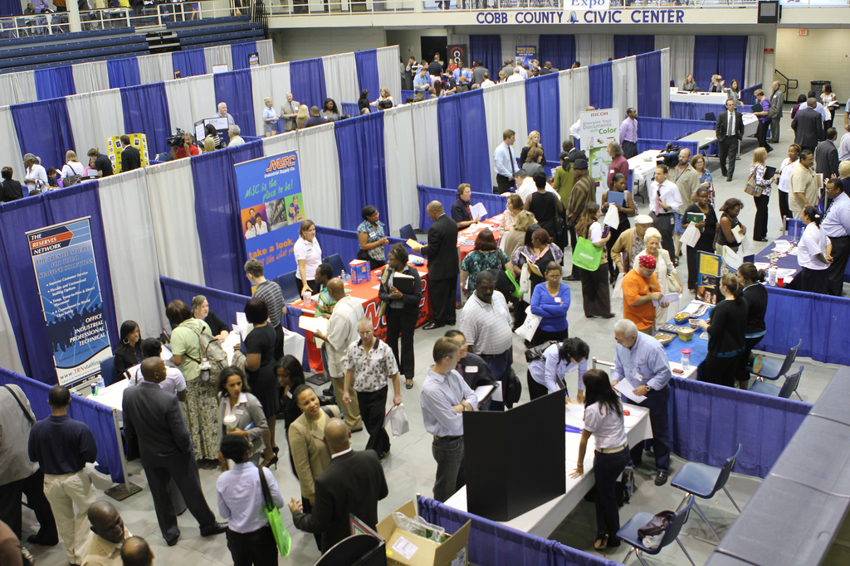
Job Fair
A Job Fair is a great opportunity for perspective employees to connect with perspective employers. It is a win-win for both. It is a buffet for all involved.

Slide 3
Tips to help you have success
Although it is a great opportunity, that opportunity can be lost in a split second. With so many individual participating and so little time, things like first impressions, organization, and time management becomes important. Your preparation is key to your success at a job fair. It is a competition for both you and the potential employer.

Slide 4
Will I get hired on the spot?
Very few employers hire on the spot at a job fair. Let me repeat that – very few employers hire on the spot at a job fair. It does not mean that it is impossible but it is rare. Most companies are hiring but most do not do it at the job fair. The job fair can be a key component that sets you up for an interview that can lead to you being hired..

Slide 5
Your Pitch
Since there can be hundreds and sometimes thousands of people at a job fair, you have a very limited amount of time to speak to a potential employer. Remember to do the following
Have good clean resumes on hand that are easily accessible for you give to the employer and a resume that stands out to the point that employer will look at it and get excited even if it 8 hours later.
Solid elevator speech. You may have about 25 seconds to catch the attention of the potential employer. Within that 25 seconds you need to be able to tell him or her your key attributes that fits within that organization and ask one to two interesting questions. This means you not only need to practice this but you need to research what companies will be a the job fair.
If all possible get to the job fair early. If the job fair has been going on for six hours and you are just now arriving then chances are the employers you may come in contact with may be a little drained. Be first, be positive and leave a great impression

Slide 6
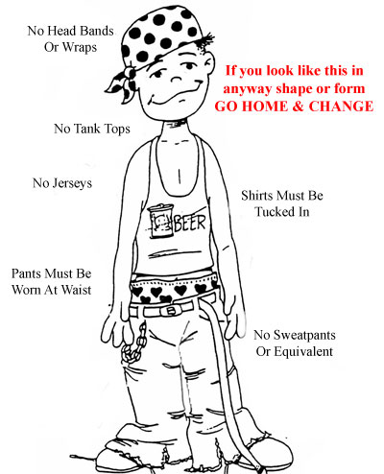
Dress Attire
Respect the process. Successful first impressions are a big part the process if your are wanting someone to take you seriously. Dress in manner that is professional (Business or Business Casual) Do not wear any of the following (unless it is all you have):
Shorts
Tank Tops
Pictures on Shirts in memory of others, pictures on shirts that are unprofessional or inappropriate
Flip flops or slippers
Head bands, rollers, plastic Bags or tie rags on your head (unless it is for religious purposes)
Three piece suit (Yes you can overdress)
Pants sagging or any showing of underwear
Sweat pants or yoga outfits
See through outfits

Slide 7
Family Affair
You are the one looking for a job, so you should be the person that the potential employer is speaking with and seeing. If possible, try not to bring any of the following with you:
Young children (Younger than the legal age to work unless it is a must i.e. you really cannot get a baby sitter for an hour. We also do not encourage leaving kids in the car)
Friends who may not have the same interest as you
Relatives who may not have the same interest as you (Unless there is a legitimate business reason for them to be there to aid you in some way)

Slide 8
Attention
Just like you want the attention of the employer, they would like to have your attention.
Do not go to a booth or table just to get free merchandise and not ask any questions
Do not talk on your cell phone while being at an employer’s booth or table
Do not go to a both or table while eating
Be respectful of other potential employees who may be engaging the potential employer while at the booth or table.

Slide 9
bbv2m-brothersbrooksvision2missionllc.com

