Slide 1
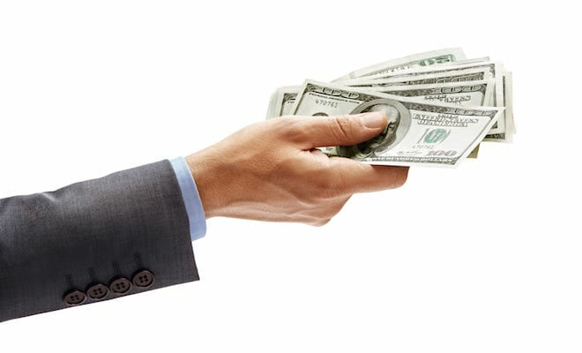
How to Pay Yourself From Your Business

Slide 2
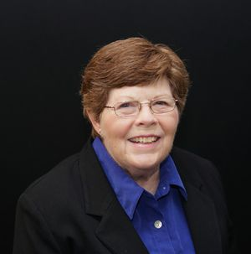
Content
The content of this presentation is by Jean Murray. Jean Murray, MBA, Ph.D., is an experienced business writer and teacher. She has written for The Balance on U.S. business law and taxes since 2008.

Slide 3
Let’See
It's common to hear business owners talk about "getting a salary" from their business, but that's not actually how most business owners get paid by the business. Business owners take money from their businesses as owners, depending on their business type.
How you pay yourself out of the business depends on several factors:
Your business type,
The stage of business you are in now, and
How much you need for personal expenses.

Slide 4
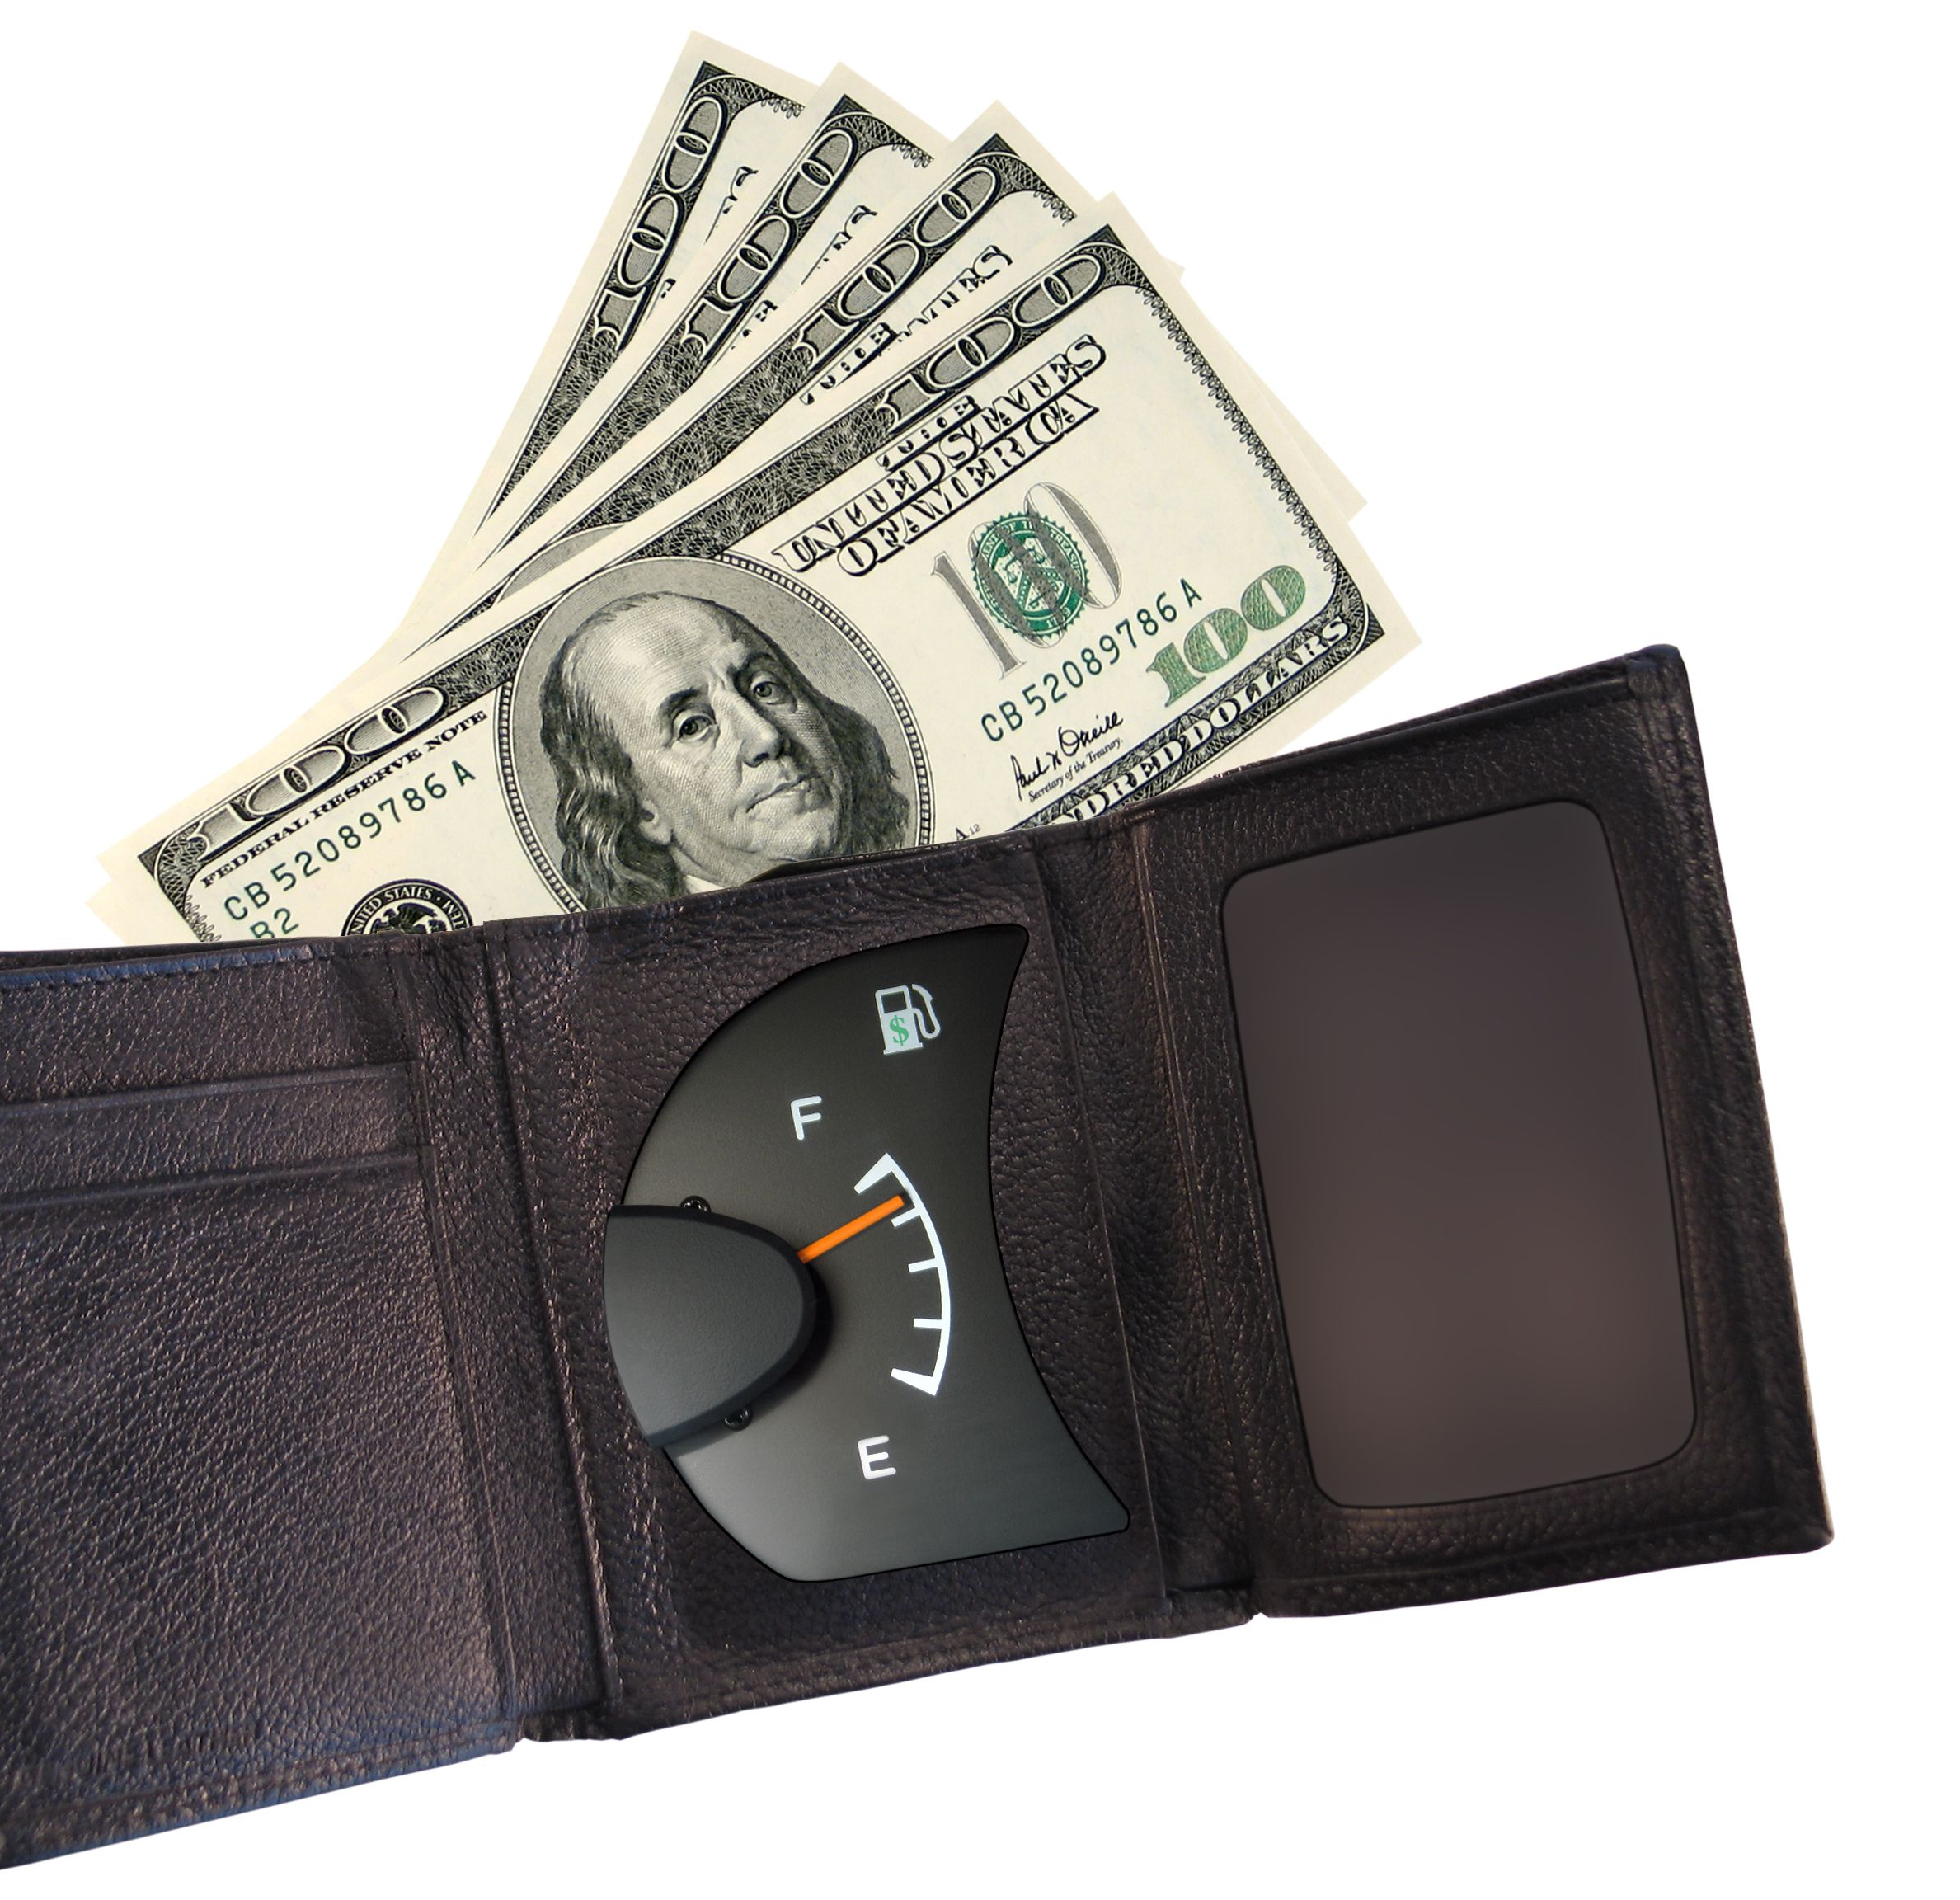
Business Owner Draw vs. Distribution
Notice the terms "draw" and "distributive share" in the table above. A draw is a direct payment to a sole proprietor from the business. A distributive share is an individual owner's share of income, gain, loss, deduction, or credit.³﻿
The difference between a draw and a distribution is significant for tax reporting purposes.
A sole proprietor or single-member LLC owner can draw money out of the business; this is called a draw. It is an accounting transaction, and it doesn't show up on the owner's tax return.
A partner's distribution or distributive share, on the other hand, must be recorded (using Schedule K-1, as noted above) and it shows up on the owner's tax return.
In the same way as a partner, a member of a multiple-owner LLC and an S corporation shareholder take a distributive share, with the amount recorded on Schedule K-1

Slide 5
Sole Proprietors Take a Draw
If you are a sole proprietor you are not an employee and you don't take a salary in the form of a regular paycheck. No FICA taxes (Social Security/Medicare) are deducted and no federal or state income tax is withheld. A sole proprietor gets "paid" by drawing money from the business. Amounts taken out of a business by a sole proprietor may be called a draw because these amounts draw down your capital (ownership) account. Read more about how the owner's draw works.

Slide 6
Partners Take Distributions From Profits
A partner in a partnership also does not get paid a salary. They take distributions from partnership profits and are taxed based on their share of those profits on their partnership income tax return. How profits are distributed in a partnership or LLC depends on the language of the partnership agreement or LLC operating agreement.

Slide 7
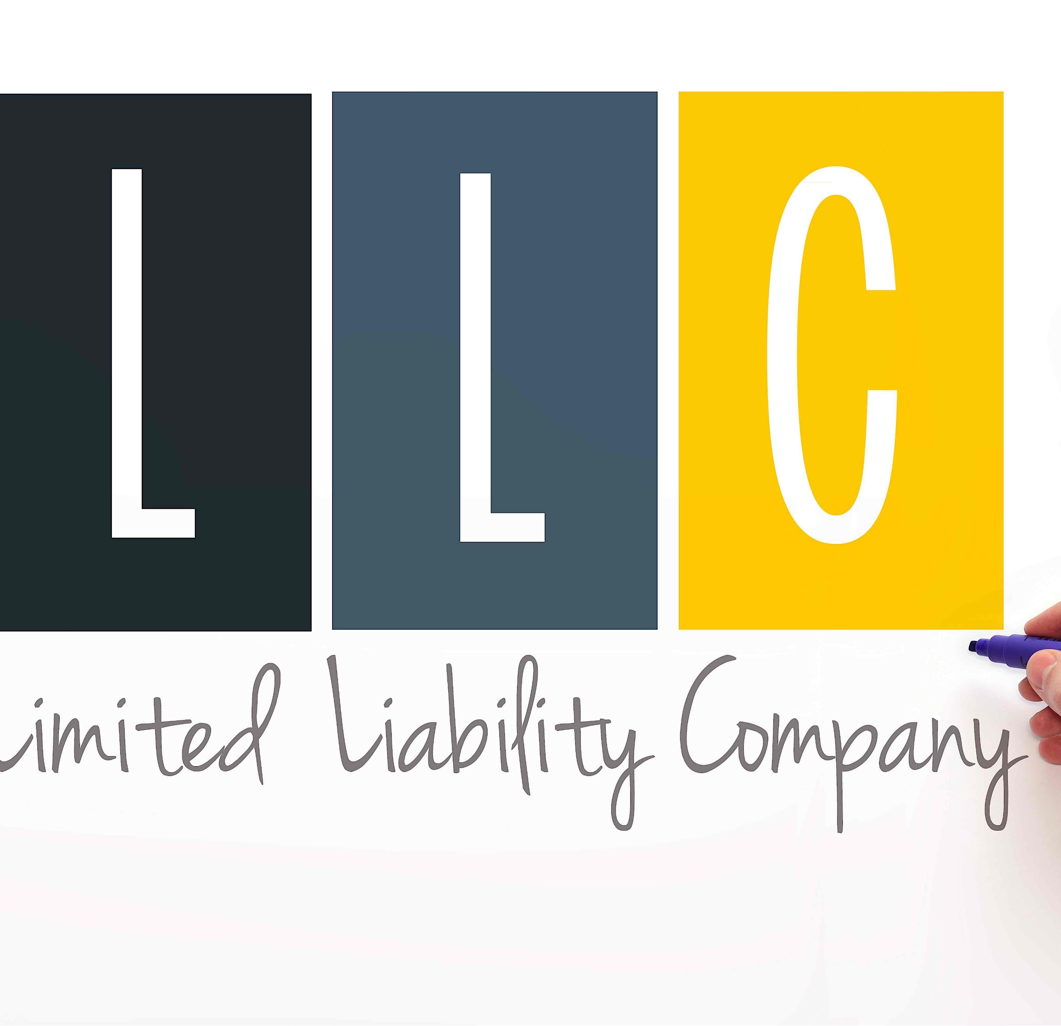
LLC Owners Take a Draw or Distribution
Owners of limited liability companies (LLCs) (called "members") are not considered employees and do not take a salary as an employee. Single-member LLC owners are considered to be sole proprietors for tax purposes, so they take a draw like a sole proprietor. Multiple-member LLC members are considered to be like partners in a partnership, so they take a distribution.

Slide 8
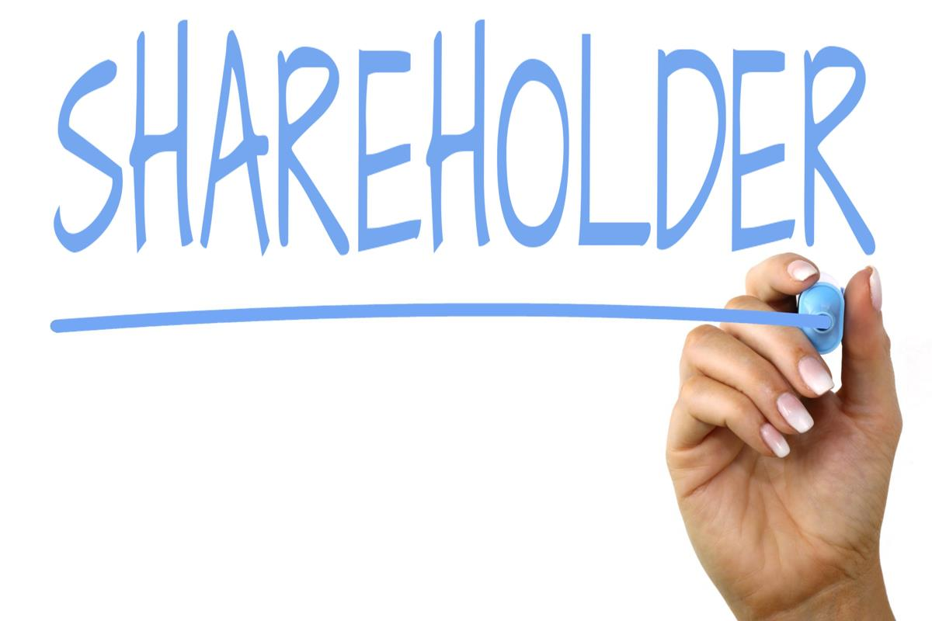
Corporate Shareholders Receive Dividends
An owner of a corporation or s corporation is a shareholder, and as a shareholder, he or she takes dividends when the corporation's board decides to pay them. But many growing companies don't give dividends but put the profits of the corporation back into growth.

Slide 9
S Corporation Owners Who Work in the Business Get a Salary
Corporation and S corporate officers who are involved in the day-to-day running of a business are considered employees and they must take a salary and employment taxes must be paid on that salary. In addition, S corporation shareholders may take additional distributions of profit from the business.²﻿
Some S corporations try to pay minimal amounts to corporate officers to avoid employment taxes, but the IRS says corporate officers must be paid a reasonable amount. The IRS has established guidelines for determining a reasonable salary, based on experience, duties and responsibilities, time spent, comparable amounts paid to others doing similar work, and other factors

Slide 10
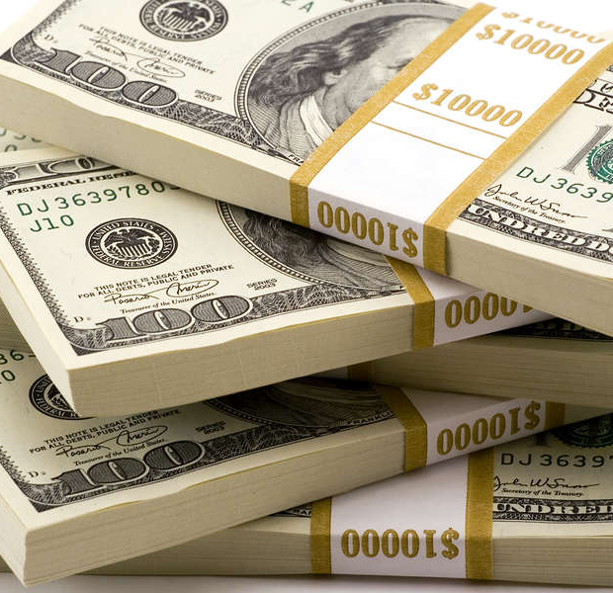
How Much to Take From Your Business
Business owners who take a draw or distribution of profits can take any amount they want from their business. Of course, you shouldn't take money that will be needed to pay employees, pay off business loans, or pay other bills of the business.
The National Federal of Independent Business says:
If you’re just starting out, the biggest determining factor for your pay is going to be your business’ cash flow. Wages, expenses, and all immediate obligations must be covered with cash. With limited or no cash flow—a reality for many startups—you might operate for a while without a paycheck, let alone a predictable salary.
Later in your business life, you may be able to take money from your business on a more regular basis, based on your personal financial situation.

Slide 11
How Much to Take From Your Business - continued
Important - One key point about taking money from your business: You don't take money from "profits" because they aren't in the bank. You take money from the business bank account. Add your personal needs to your business budget and make sure you have enough each month to meet your business obligations first.

Slide 12
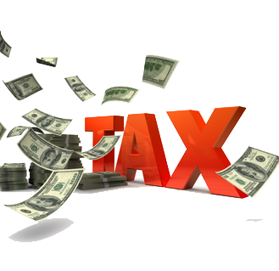
How Self-Employment Taxes Work for Business Owners
Self-employment tax is Social Security and Medicare tax for business owners. The amount of self-employment tax you must pay is based on the profits of your business; if the business does not make a profit in any one year, no self-employment tax is due. These amounts are not withheld from any payments to business owners.
Of course, these taxes are still due and payable at tax time. Sole proprietors, partners, and LLC members must pay self-employment tax when they complete their personal tax returns for the year. (S corporation owners are not considered self-employed.) The self-employment tax is calculated and added to the income tax due; self-employment taxes are paid to the IRS along with federal income taxes.6﻿
Warning - No taxes are withheld from your income as a business owner. To avoid underpayment penalties, you may need to make quarterly estimated tax payments to the IRS, considering both federal income tax and self-employment tax you owe.

