Slide 1
^{Definition of Politics} ^{(Webster’s Dictionary)}
POLITICS IS
“THE ART OR SCIENCE
CONCERNED WITH GUIDING
OR INLUENCING
GOVERNMENTAL POLICY

Slide 2
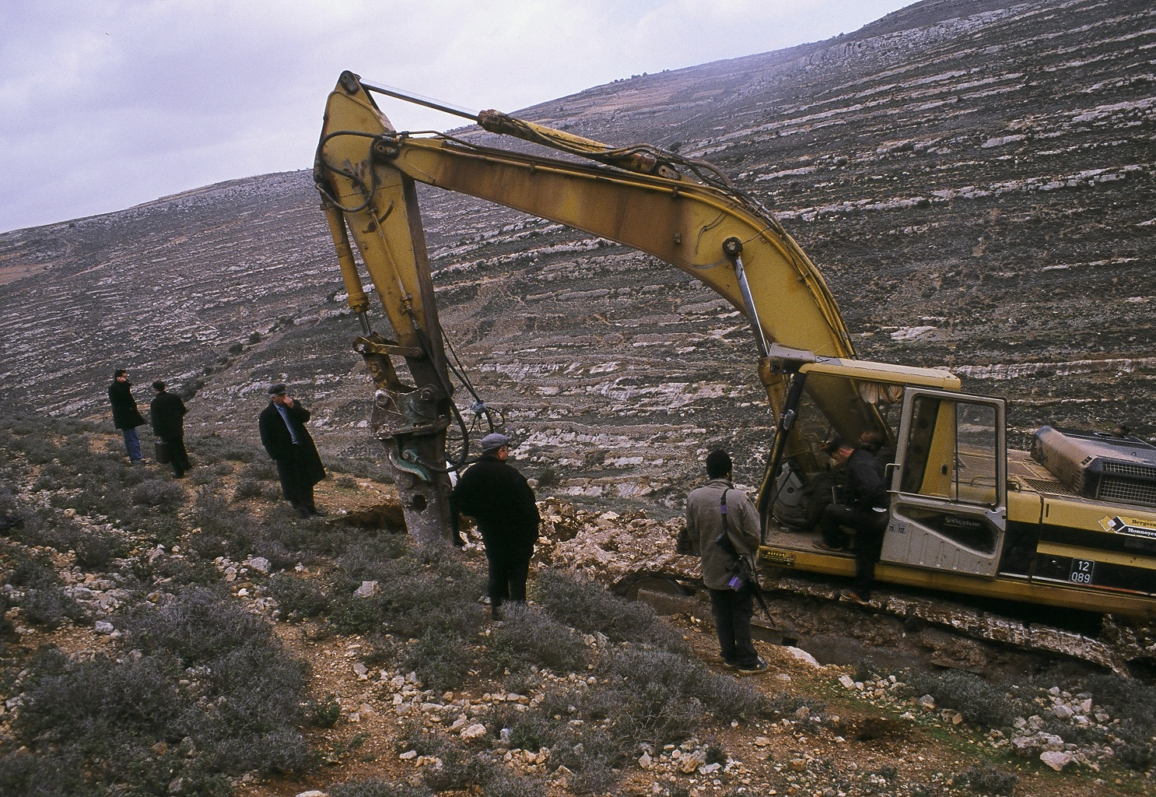

Slide 3
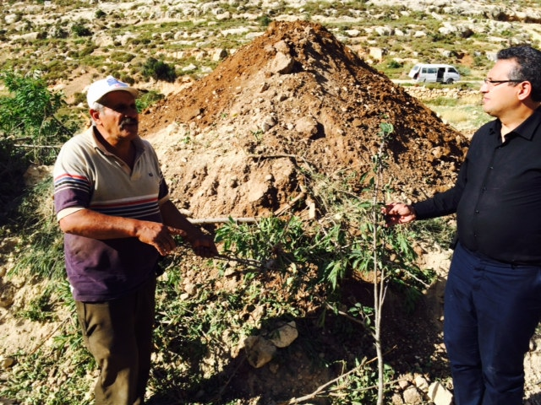
Thaher and Tony pointing to uprooted trees

Slide 4
Men and Women of God
And of politics!

Slide 5
Moses
“Let my People Go!”

Slide 6
The Judges
Gideon, Samson, Deborah and Samuel
Good and bad political leaders

Slide 7
The Kings
The records of the books of Samuel, Kings, and Chronicles:
Good and bad Kings
Good and bad politicians

Slide 8
The Prophets
Isaiah, Jeremiah, Amos, Hosea, Deborah
and Micah
All men and women of God who addressed the political issues of their times and confronted kings, priests and the masses.

Slide 9
Jonah
God changed his political worldview

Slide 10
The birth of Jesus
God’s politics against Herod’s politics

Slide 11
Early Christians
Jesus is Lord!

Slide 12
The Book of Revelation
"Jesus is 'King of Kings and Lord of Lords'“
and
"The kingdom of the world has become the kingdom of our Lord and of His Christ; and He will reign forever and ever" posed political challenges to the emperors in Rome.

Slide 13
Sermon on the Mount
When you pray, "Your kingdom come," and when you act upon your prayer,
you delve in politics

Slide 14
Abraham: Instructor of Justice Genesis 18:19
"For I (God) have known him (Abraham), in order that he may command his children and his household after him, that they keep the way of the Lord, to do righteousness and justice, that the Lord may bring to Abraham what He has spoken to him.”

Slide 15
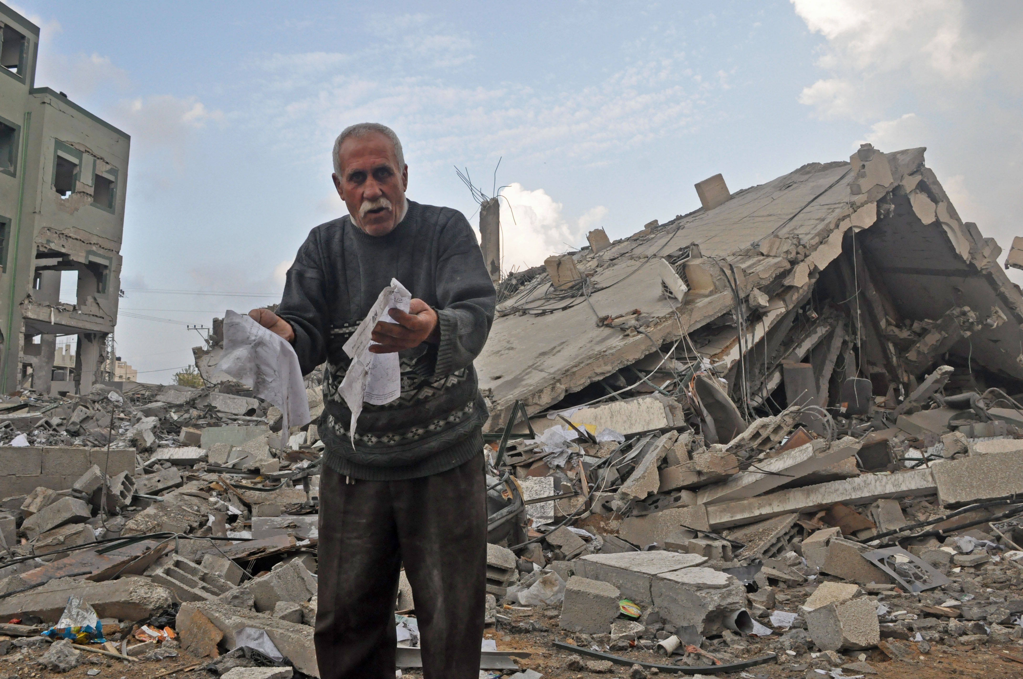
Deuteronomy 16:19
You shall not pervert justice

Slide 16
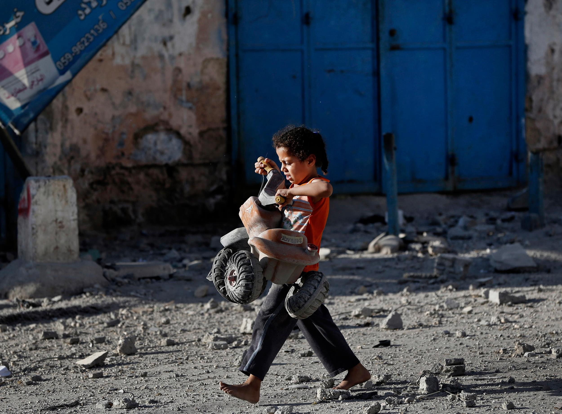
Deuteronomy 16:20 English Standard Version
Justice, and only justice, you shall follow,
that you may live and inherit the land
that the Lord your God is giving you.

Slide 17
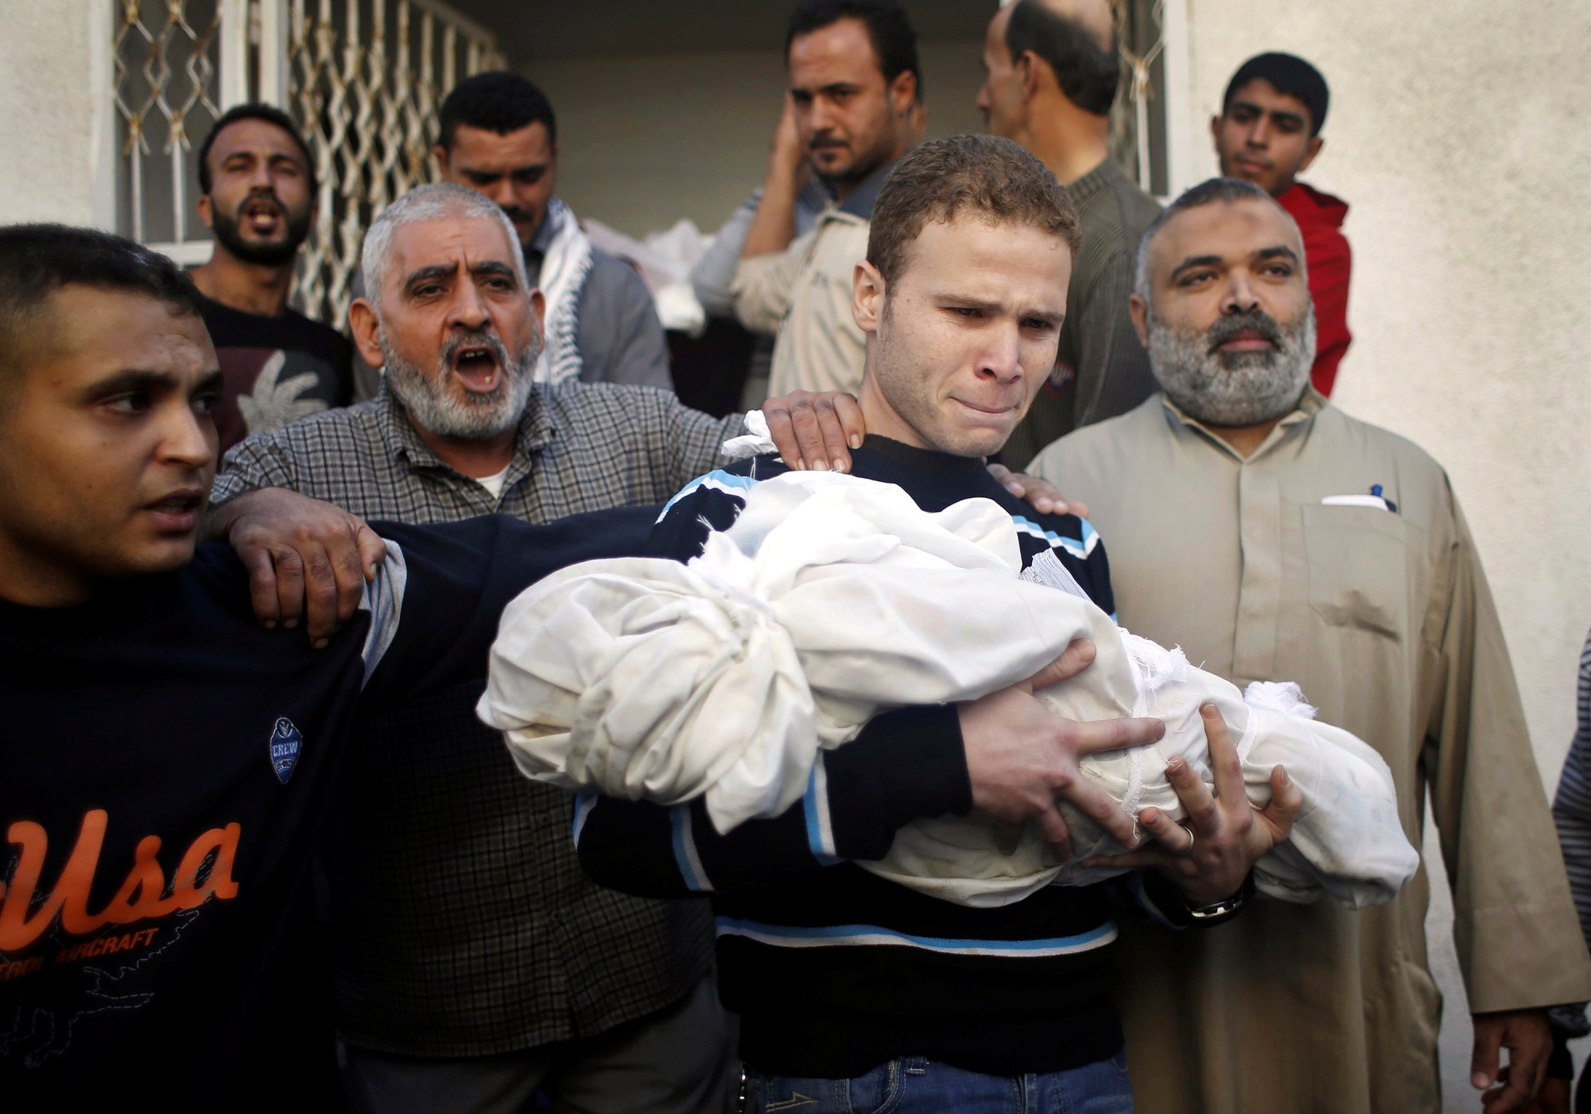
Psalm 37:28
For the Lord loves justice

Slide 18
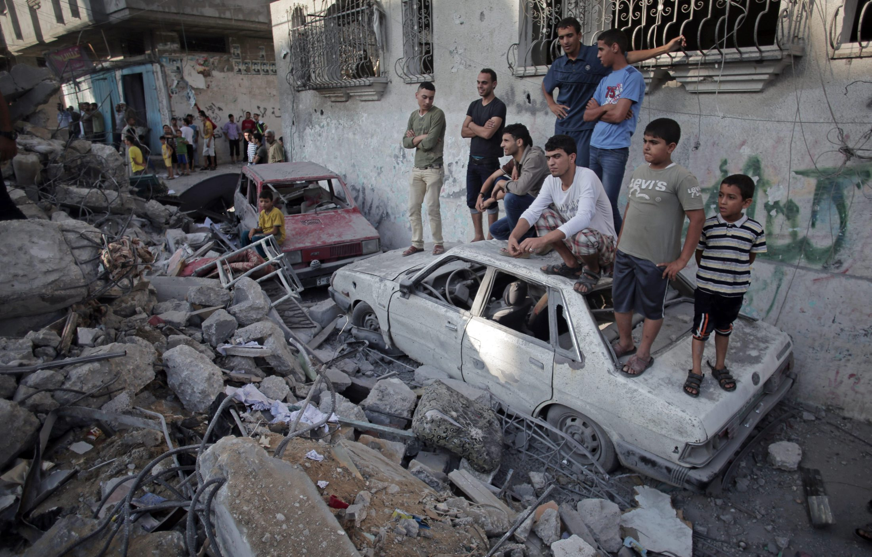
Psalm 106:3
Blessed are those who keep j
Blessed are those who keep justice, And he who does righteousness at all times!
Blessed are those who keep justice,
and he who does righteousness at all times!

Slide 19
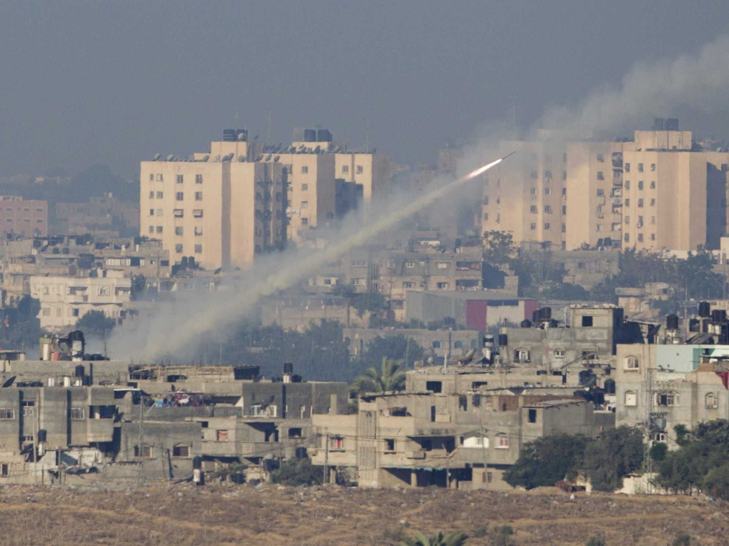
Isaiah 1:17
Learn to do good; Seek justice, Rebuke the oppressor; Defend the fatherless, Plead for the widow.
Learn to do good; Seek justice, Rebuke the oppressor; Defend the fatherless, Plead for the widow

Slide 20
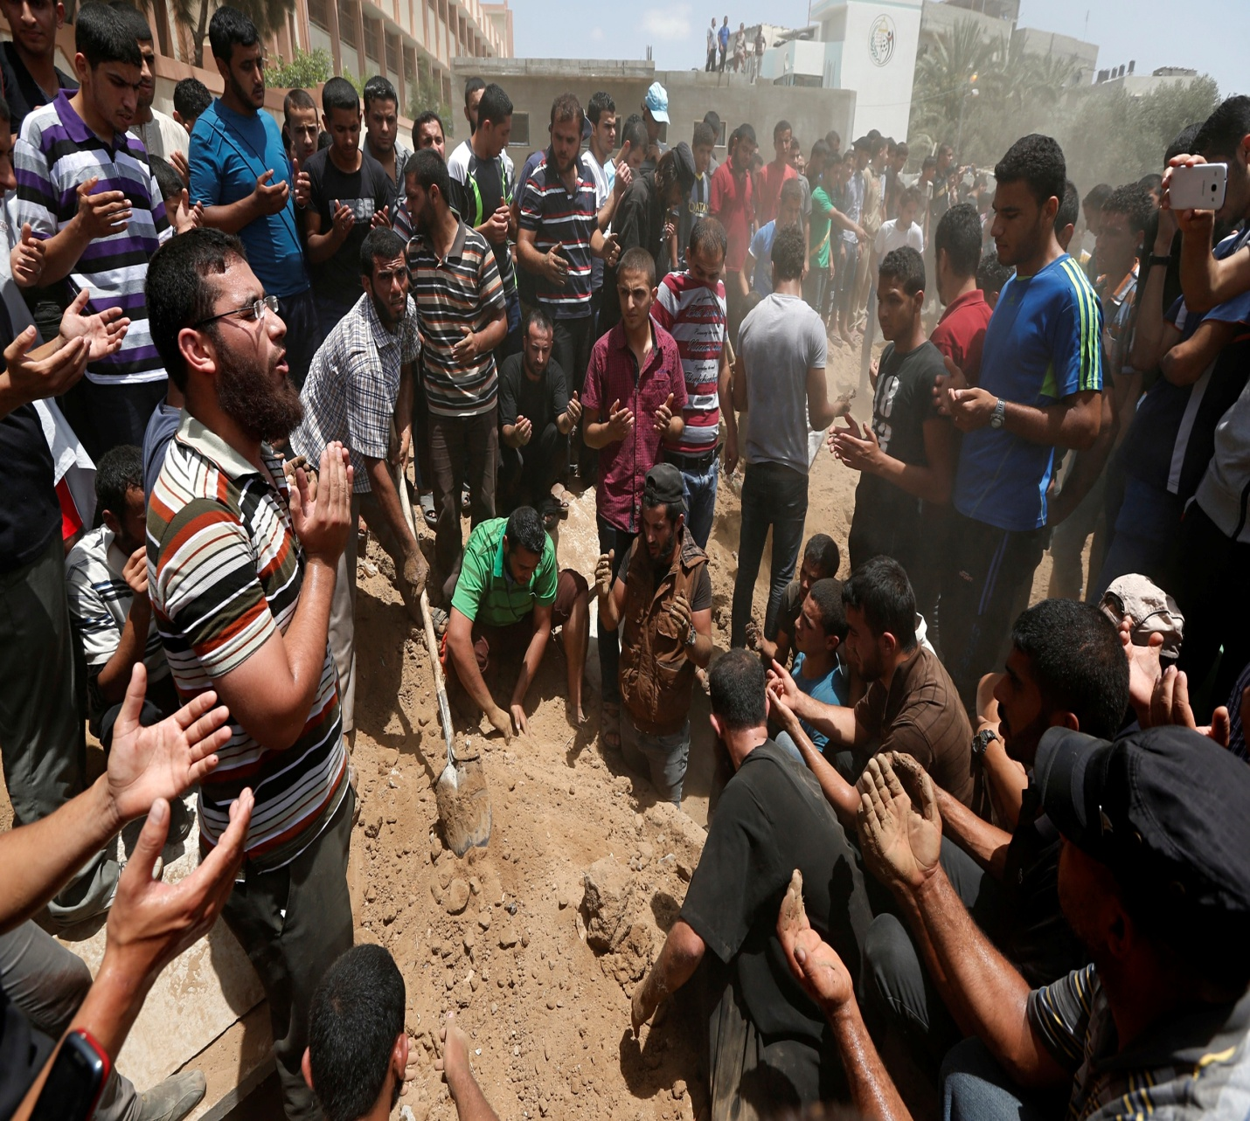
Isaiah 5:7
For the vineyard of the Lord of hosts is the house of Israel, And the men of Judah are His pleasant plant.
He looked for justice, but behold, oppression;
For righteousness, but behold,
a cry for help.

Slide 21
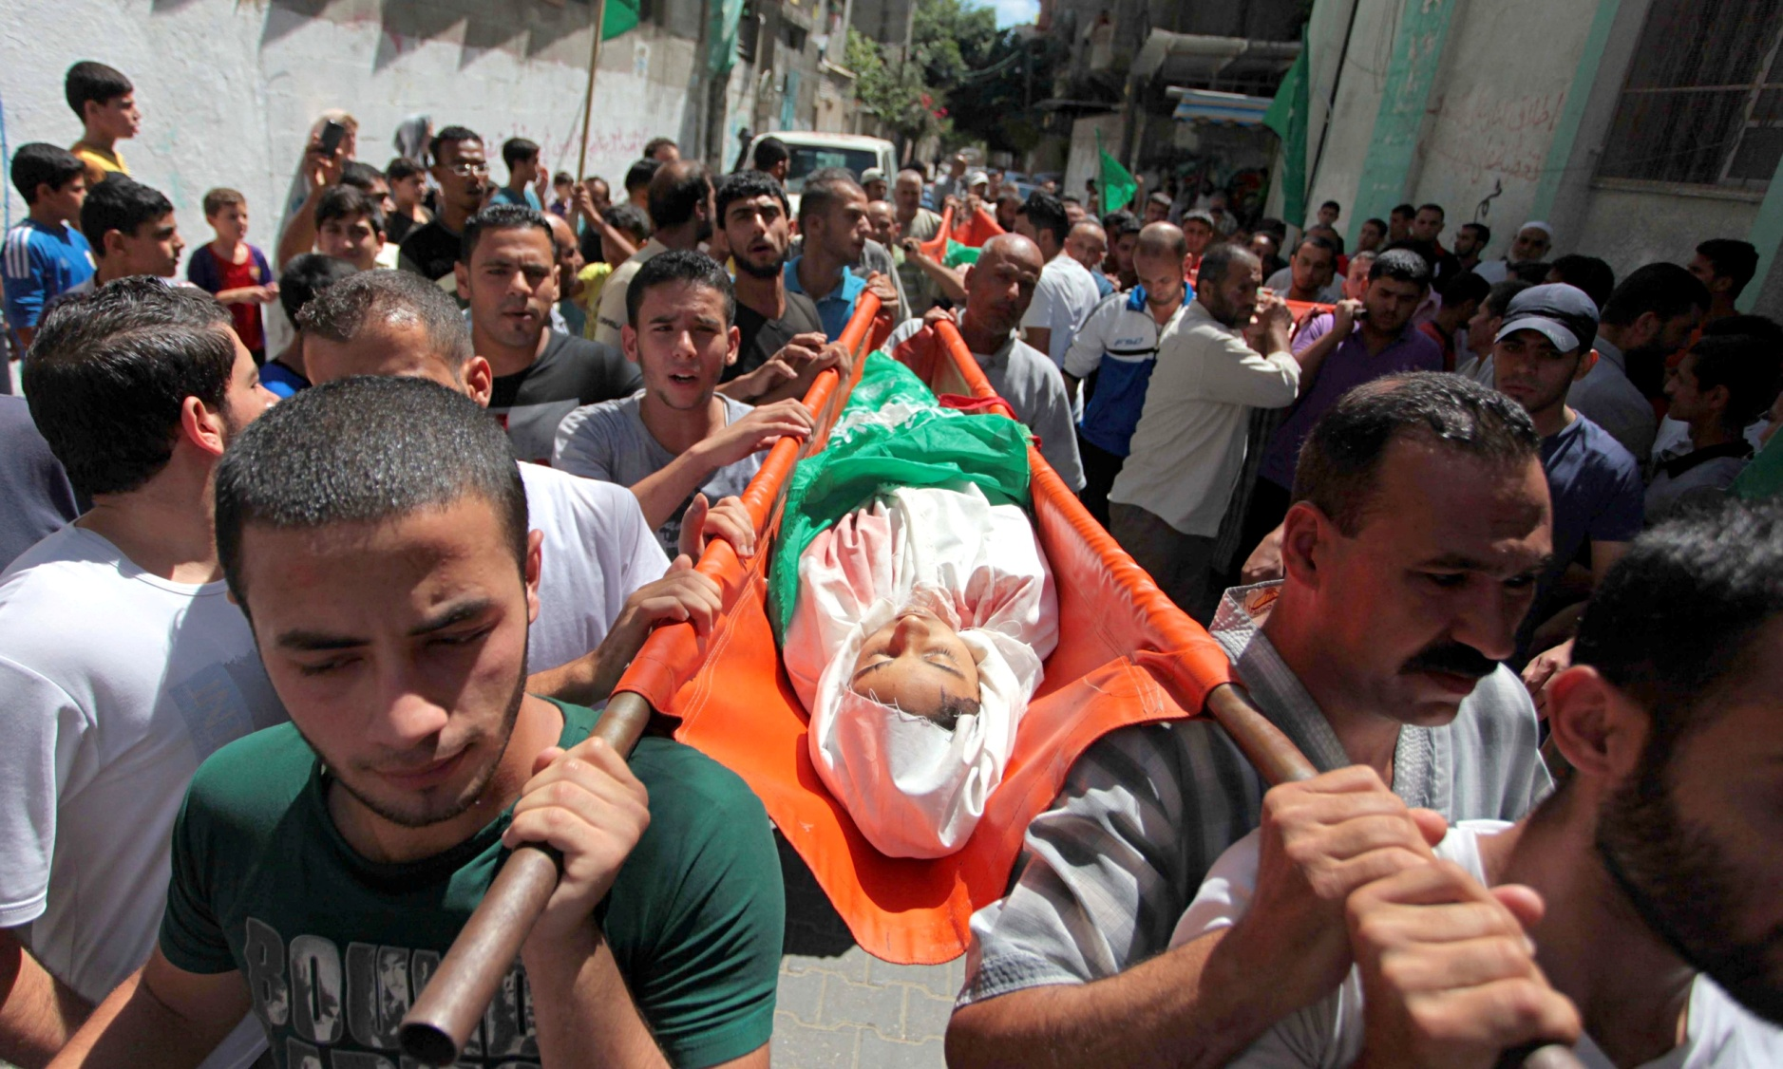
Isaiah 59:15
"...Then the Lord saw it, and it displeased Him That there was no justice.
Truth is nowhere to be found, and whoever shuns evil becomes a prey. The LORD looked and was displeased that there was no justice.

Slide 22
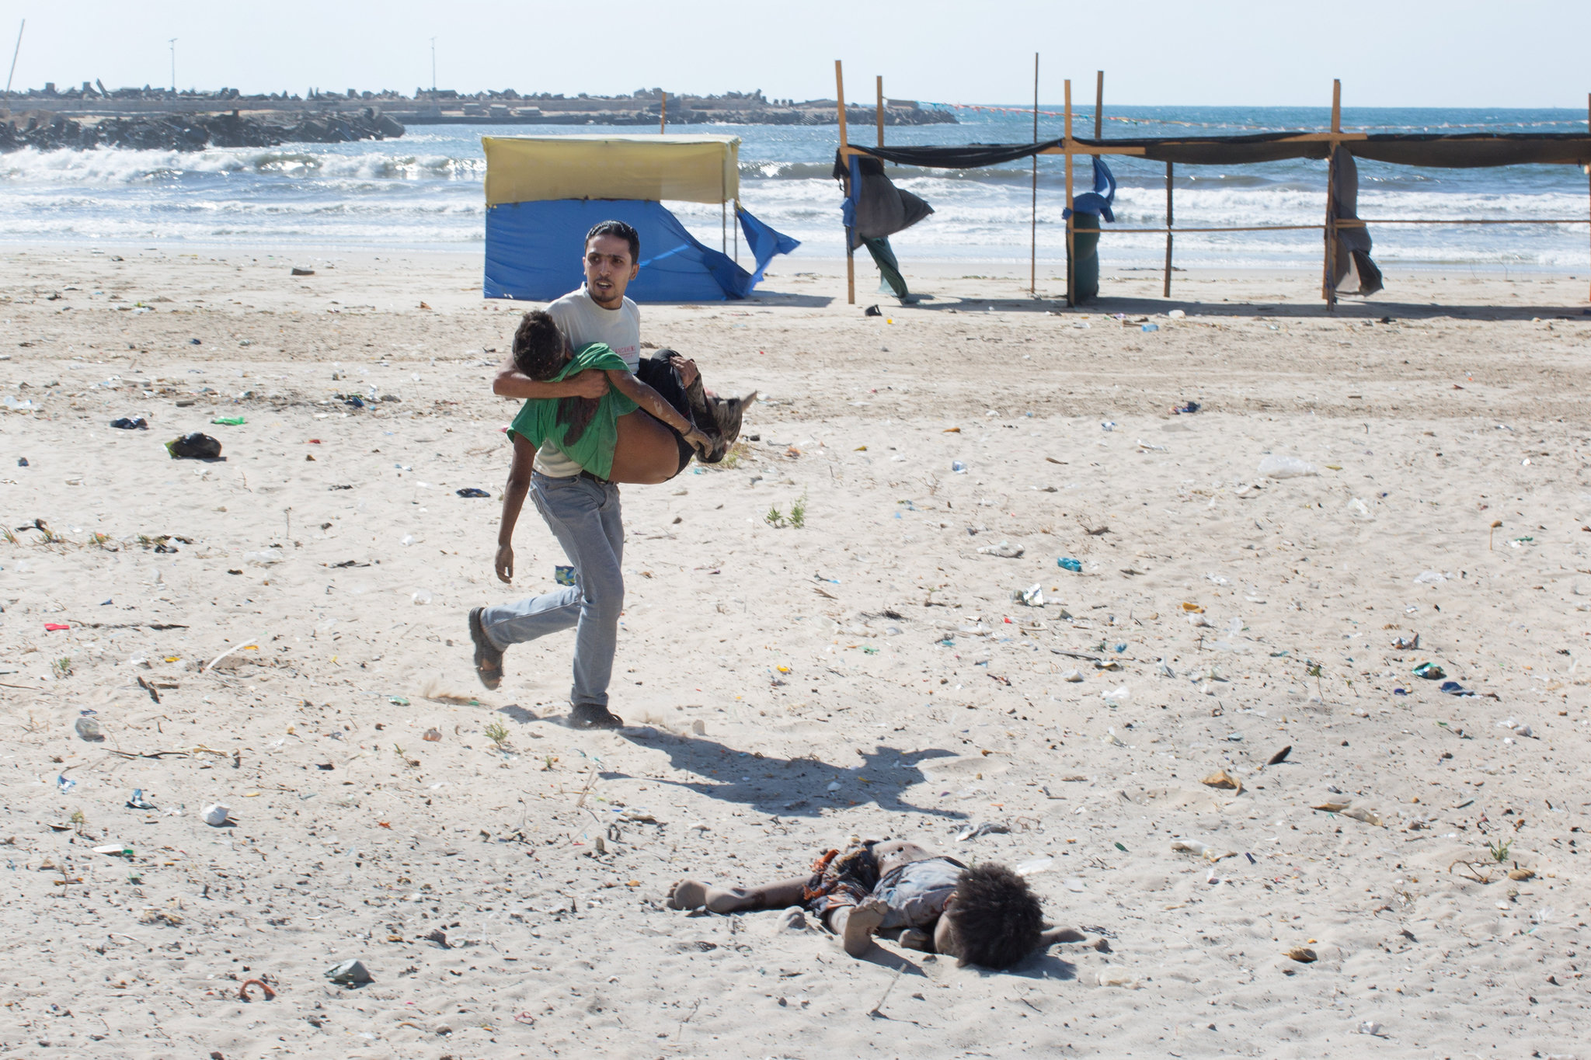
Amos 5:24
But let justice run down like water, and righteousness like a mighty stream.

Slide 23
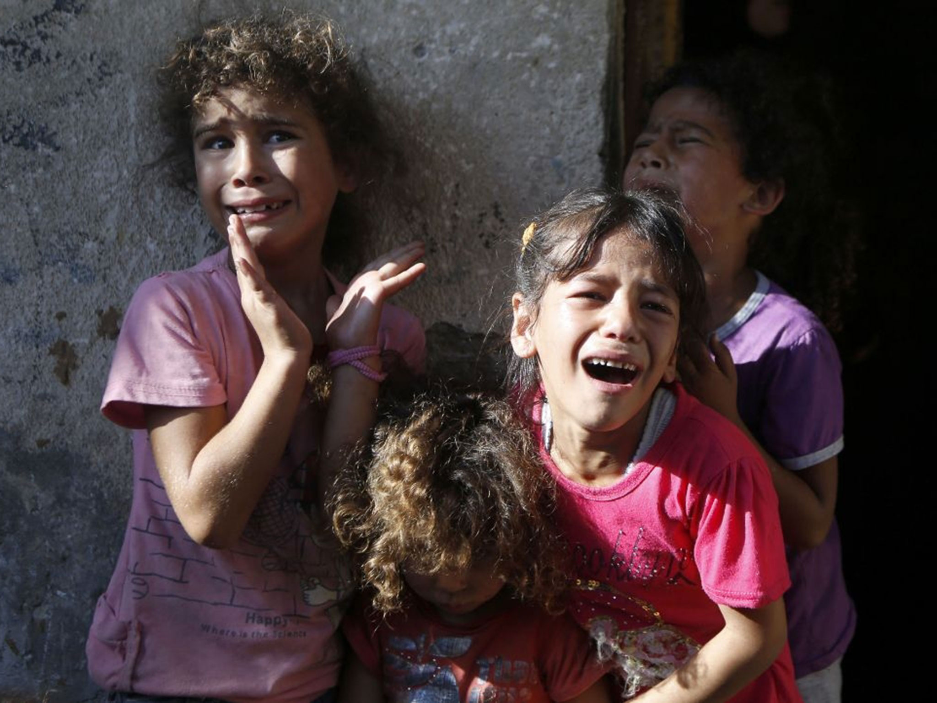
Micah 6:6-9
He has showed you, O man, what is good.
And what does the LORD require of you?
To act justly and to love mercy and to walk humbly with your God.

Slide 24
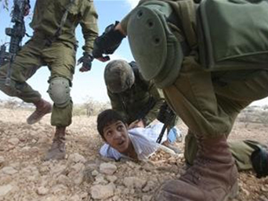
Zechariah 7:9
Thus says the Lord of hosts: ‘Execute true justice, Show mercy and compassion everyone to his brother/sister.'

Slide 25
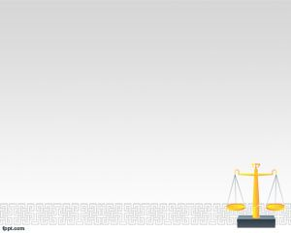
Matthew 23:23
Jesus
"Woe to you, teachers of the law and Pharisees, you hypocrites! You give a tenth of your spices--mint, dill and cumin. But you have neglected the more important matters of the law--justice, mercy and faithfulness.

Slide 26
Proverb 24:11-12
"Deliver those who are drawn toward death, And hold back those stumbling to the slaughter. If you say, 'Surely we did not know this,’ Does not He who weighs the hearts consider it? He who keeps your soul, does He not know it? And will He not render to each man according to his deeds?”

Slide 27
Do You Know

Slide 28
^{1. that} God loves both Israelis and Palestinians equally and wishes for them to live in peace and equality in Israel-Palestine?
Do You Know

Slide 29
Do You Know
2. that Israel started this round of violence based on an unfounded accusation?

Slide 30
Do You Know
3. that Gazans have been strangled by seven years of an unauthorized choking economic blockade, and that Palestinians in both the Gaza Strip and the West bank have suffered for 47 years due to an occupation that the UN Security Council opposed back in 1967 saying it is: ‘inadmissible to take land by force’?

Slide 31
Do You Know
4. that the Palestinian President, Mahmoud Abbas, worked tirelessly with John Kerry to reach a peace agreement and that the Israelis and not the Palestinians frustrated his efforts by moving to build illegal settlements , a move that caused the collapse of the peace negotiations and their ultimate failure?

Slide 32
Do You Know
^{5.} that one main goal of this latest assault on Gaza is Israel's obsession in putting a stop to the unity government between Palestinian political factions in the West Bank and those in Gaza that the US accepted?

Slide 33
Do You Know
6. that the current Israeli government has rejected every offer made to allow for the creation of an independent Palestinian state?

Slide 34
Do You Know
7. that the often unquestioned US support for Israel is one of the biggest obstacles to the success of any past, present or future peace negotiations?

Slide 35
Do You Know
8. that if it is up to Netanyahu and his government the United States would now be engaged in bloody and brutal war in Iran?

Slide 36
Do You Know
9. that the tide is shifting in America, especially among the youth, and one day the US will use its position in the UN Security Council to recognize Palestine as an independent state?

Slide 37
Do You Know
10. that the BDS movement is growing fast around the world and that the movement is the most effective non-violent method to get Israel to stop its assault on the Palestinians and their lands?

Slide 38
Do You Know
^{11.} Do you know that in the latest attacks on Gaza over 300 children were killed? This is perhaps more than the number of children killed in Bethlehem at the hands of Herod the Great.

Slide 39
Do You Know
12. That YOU can make a difference
‘I can do all things through Christ who strengthens me’. Philippians 4:13

Slide 40
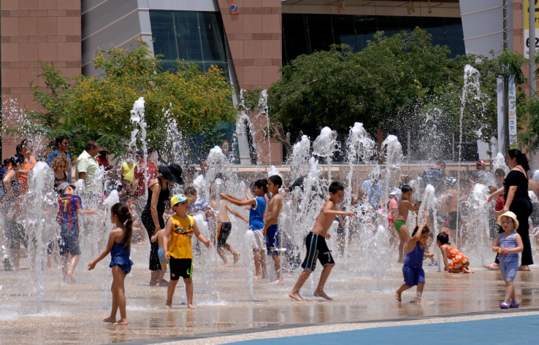
^{What to do?} ^{Dream}

Slide 41
Challenges
1. The continuing occupation of the West Bank
2. The establishment and expansion of illegal Jewish settlements in the West Bank and Arab East Jerusalem
3. The choking blockade and siege of Gaza
4. Numerous and repeated failed peace negotiations
5. The United States' absurd bias towards Israel and its inability to pressure Israel to make concessions that would lead to the success of peace negotiations.
6. Millions of refugees who were ethnically cleansed and never compensated or repatriated.
^{7. US media bias}

Slide 42
Our Focus
1. Israeli settlements: The BDS movement is the most effective no-violent way to do so.
^{2. Congress:} Expose the hypocrisy of the US Congress
^{3.} Christian Zionism: Provide a biblical alternative

