Slide 1
Emergency Dispensing Site Exercise
Presented by Liisa Jackson
Medical Reserve Corps Coordinator

Slide 2
What is Emergency Dispensing Site (EDS)
Emergency Dispensing Site (EDS) or Point of Distribution (POD)
Emergency Dispensing Sites are centralized locations where the public picks up life sustaining commodities following a disaster or emergency
Commodities usually include medications, vaccine, shelf stable food and water

Slide 3
The 3 types of distribution coverage
Mobile delivery is a method that utilizes vehicles to drive into an affected area and provide commodities at different drop locations or where the need is identified. This type of distribution is common in rural areas and where roads are damaged.
Direct delivery is coordinating with a specific location, such as a shelter, feeding site, or hospital for the delivery of specific items and quantities. These commodities could be food, water, comfort kits etc. Direct deliveries are usually larger in size and more specific in commodity type than what is delivered through mobile delivery.
Emergency Dispensing Sites are centralized points where supplies are delivered and the public travels to the site to pick up the commodities.

Slide 4
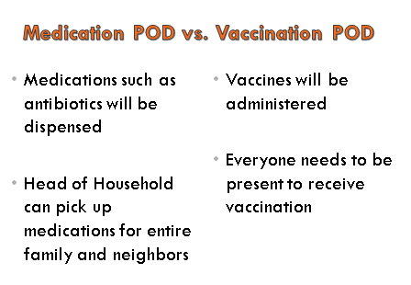
Medication EDS/POD
Vaccine EDS/POD

Slide 5
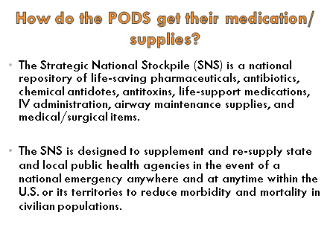
How does the EDS/POD get the supplies?

Slide 6
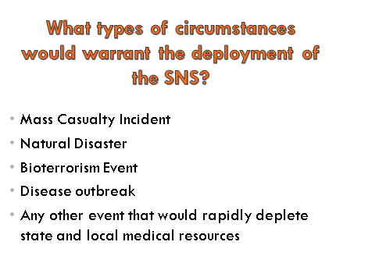

Slide 7

What would the Health Department provide prior to opening an EDS/POD?

Slide 8
SNS Assumptions
Mass casualty incident (MCI), natural disaster, bioterrorism event, or disease outbreak
Population requires mass prophylaxis within
48 hours
State/local resources will be rapidly depleted

Slide 9
How is it Requested?
State makes request to FEMA and Centers for Disease Control and Prevention (CDC)
Governor’s Emergency Declaration
Delivered <12 hours to a pre designated state Receipt, Store, and Stage (RSS) warehouse facility within the state

Slide 10
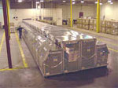
12-Hour Push Package
Package containing all items within
SNS formulary
  Updated/refined periodically
  130 cargo containers (50 tons)
  8 tractor trailer loads
Strategically located throughout U.S.
Delivered <12 hours by ground or air

Slide 11

Breaking News!
Hepatitis A outbreak at Fun town Amusement Park

Slide 12
Exercise Scenario
Reports of a food server possibly contaminating food with Hepatitis A at Fun Town and they have contacted the Local Health Departments to notify them of the situation.
The news stations are reporting that a Fun Town food handler has contaminated food with Hepatitis A served to people at the amusement park.

Slide 13
Exercise Scenario continued
1000’s of calls have been made to Local Health Departments to get information on what is needed to do to protect themselves and their family from Hep A.
DPH has requested SNS resources.
CDC is notified by state health department. The SNS is shipped. Local health department has issued orders to stand up EDS/PODs.

Slide 14
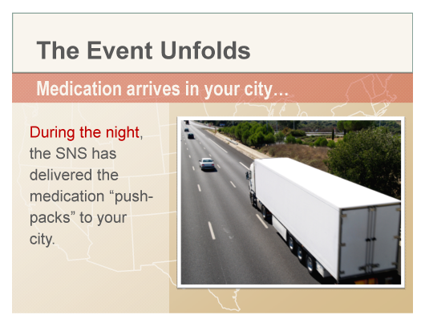
Hepatitis A Vaccine Arrives

Slide 15
Let’s Play!
Identify a Table Leader
Review the plan
Assign team positions

Slide 16
Your team has been asked to stand up the local EDS/POD
Your team stand ups an EDS/POD in your community
You all arrive and are assigned your roles
Discuss your scenario to play out
Brainstorm on how to manage the scenario
Report back

Slide 17
How did your team handle the scenario?
What were the successes of your response?
What were the issues that came up?

Slide 18
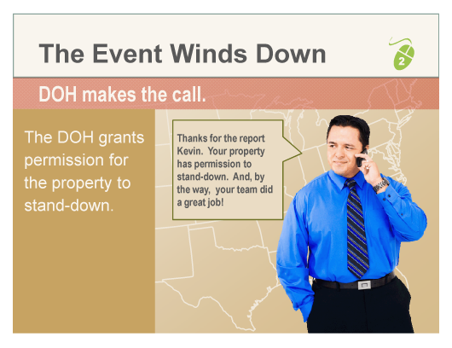

Slide 19
Hot Wash
What gaps were in the plan?
What is needed to improve the response?
What partners were identified ?

Slide 20
Thank you very much for your time and participation!
Liisa Jackson
Medical Reserve Corps Coordinator

