Slide 1
PART I
The Potters, Kilns, and Stoneware
Of Upper Alton, Illinois
By GREG MATHIS

Slide 2

The Potters, Kilns, and Stoneware of Upper Alton,
Madison County, Illinois by Greg Mathis
Hayner Genealogy & Local History Library
Alton, Illinois
December 7, 2016
Notes:
GREETINGS AND THANK YOU! IT’S a real PLEASURE FOR ME TO BE HERE!

Slide 3
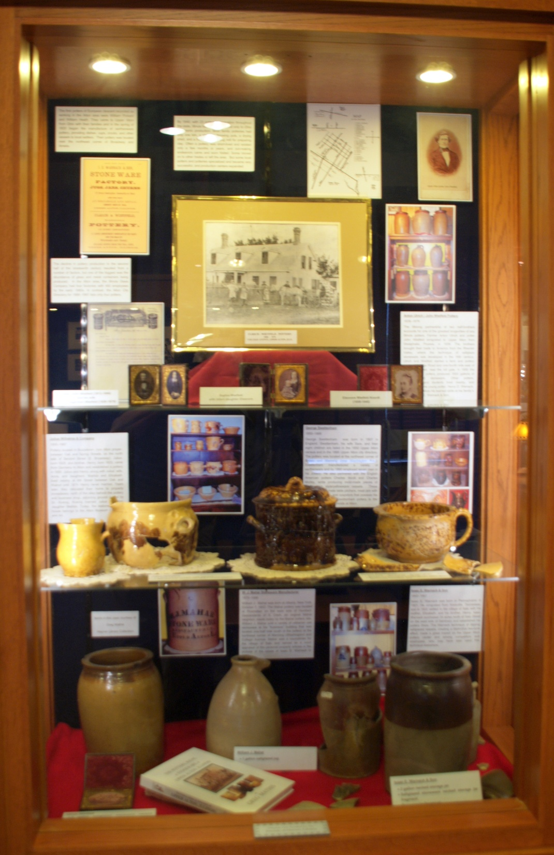
Notes:
A SPECIAL THANK YOU GOE’S TO THE HAYNER GENEAOLOGY AND LOCAL HISTORY LIBRARY FOR THEIR GREAT DISPLAY WHICH HIGHLIGHTS A VERY IMPORTANT HANDCRAFT … A TYPE MANUFACTURING SO SIGNIFICANT TO 19TH CENTURY ALTON.
NOW……LETS TALK ABOUT “The Potters, Kiln locations, and the Stoneware of 19th Century Upper Alton.”

Slide 4
Upper Alton Potters:
1. Kiln locations, and Stoneware.
2. Salu Land Purchases
3. Land Deeds of Warnack & Ulrich-Wietfeld
4. Heirlooms, Family Portraits, Genealogy
Notes:
OUR MAIN TOPICS ARE 1 *The Potters of Alton/Upper Alton, their Kiln locations, and their Stoneware.
2 *Salu Village Land Purchases
3 *Land Deed Records of potters like Warnack and Ulrich-Wietfeld
AND 4 *Some of the interesting Family Heirlooms, Portraits, Genealogy, of these potters.
OUR SOURCES INCLUDE: Federal and State Census, Courthouse Records, Cemetery Records, Family Accounts, Photography and Genealogy

Slide 5
WHO POTTERS
WHERE SPECIFIC KILN LOCATION / WASTER DUMPS
WHEN DATES OF MANUFACRURING
WHAT TYPES OF CERAMIC OBJECT PRODUCED
WHY SETTLE IN UPPER ALTON
Notes:
NOW TO FOCUS ON THE 5 IMPORTANT “Ws”……….EXACTLY….
WHO WERE THE POTTERS
WHERE LOCATED WERE THEIR KILN LOCATIONS AND WASTER DUMPS
WHEN WERE THEIR KILNS IN OPERATION
WHAT TYPES OF CERMAICS WERE THERE PRODUCED
WHY IN ALTON ------ THE LAND OF MILK AND HONEY

Slide 6
Professional and amateur archaeological excavations and digs by the pot hunter provide us insight.
2. Envisioned on recoveries at pottery waster dumps….. Is a time that reflects on the broken pottery shard, a piece of ceramic vessel that once preserved the family’s food and served a family for generations.
3. Most stoneware produced at Upper Alton was intended for the basic utilitarian use of storage and serving foods.
Notes:
IT NEEDS BE POINT OUT THAT ........Much we know is based on what professional and amateur excavations by Alton students of archaeology, records research, and by the Alton pot hunter. Many of us desire gathering information and artifacts of Alton’s past. Intrigue is always realized while uncovering and physically touching a vessel used by people of an earlier time and place. Broken pottery shards become treasures, and with imagination shards becomes a whole vessel. Sentimental students invision the history of the shard/piece of stoneware, as it goes through the manufacturing process, onto a straw nested horse drawn wagon, being carted off to market, being pridefully shown to the customer, and eventually sold for a few hard earned valuable pennies.

Slide 7
THE LAND OF MILK AND HONEY
1. As America’s Midwest frontier regions became settled in the early Nineteenth Century, many seeking improved social, economic, and religious conditions took advantage of the opportunity to obtain good quality ground at low prices.
2. Most common were immigrants seeking good ground for farming. Some that farmed also potted on the side to satisfy their personal household storage needs. Occasionally, their secondary side talent of potting expanded to provide their manufactured wares to neighboring farms and the immediate community.
3. Pot making grew further into the primary business at hand and farming became the secondary family task. Examples of this were the family operations of Ulrich-Wietfeld and Isaac E. Warnack at Upper Alton, Illinois.
Notes:
YES, as we know, early Alton was all about..OPPORTUNITY AND PROXIMITY...
Beside the affluent land speculators from the East, this opportunity attracted a variety of trades that were a promising means toward sustaining better livelihoods. Most common were those geared toward obtaining good ground for farming, and at a price much less than in Ohio. Some that farmed also potted on the side to satisfy their personal household storage needs. Occasionally, this secondary side talent of potting expanded to provide their wares to neighboring farms and then the immediate community.
To some, Pot making became the primary business at hand ..... and farming their secondary family task.

Slide 8
THE KILN SETUP AND PROCESS:
1. The potting process all began with locating suitable clays that were often retrieved from riverbanks or creeks.
2. Prepare the high quality the Upper Alton clay, suitable for pot making.
3. On a hand powered kick wheel, a ball of clay was “kneaded” to remove air pockets and then placed on a simple foot- powered kick wheel and then “turned” and hand shaped into a desired vessel.
Notes:
The KILN SETUP AND PROCESS was hard work !!!! Paraphrasing archaeologist Dr. Robert D. Mazrim’s great writing “The Sangamo Frontier,” the potting process all began with locating suitable clays, retrieved from riverbanks or creeks, ideally being a fine potter clay source convenient for transporting the clay by horse and wagon. Once the clay was brought to the pottery, the clay was allowed to cure or season in a pit or cellar. When seasoned, it was mixed and refined in a pug mill operated by hand or horsepower. All processed clay was then stored in balls or blocks. Eventually...... a ball of this high quality Upper Alton clay was placed on a hand powered kick wheel and then “turned.” BORN WAS A hand shaped vessel....... A treasure......... so desired and needed for the home.

Slide 9
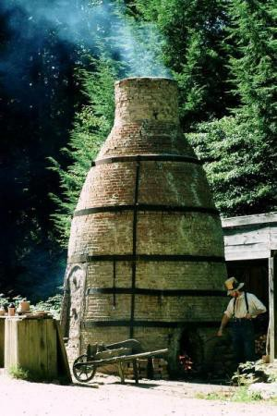
Updraft bottle kiln
Notes:
THIS IS AN EXAMPLE OF A COMMON UPRIGHT BOTTLE KILN……. To repeat, a ball of clay was placed on a simple foot- powered kick wheel and then “turned” and hand shaped into a desired vessel. A simple small block of wood, called a "rib," was usually the only tool used to smooth the surface of a vessel, or to create a complex rim design. After pulling this clay vessel from the kick wheel and allowing it to air dry outdoors or in a pole shelter, and when totally dry, this "green ware” object was glazed by its immersion into a liquid bath of powdered lead, clay slip, and silica, producing a clear glaze that slightly alters the surface color shade variations of earthenware ...... Commonly referred to as Redware and Yellowware. (i.e. Wilhelms)......... (i.e. Old Sturbridge Village. cc: 1830 Courtesy of Central Massachusetts Convention and Visitors Bureau).

Slide 10
VESSEL DESCRIPTIONS
Pot – an open wide mouth vessel used for serving or storage that accommodates no lid. Jar- a wide mouth vessel that accommodates a lid, often called a crock.
Necked jar - a vessel more narrow in diameter at the rim than at the slight incurved body. The area near the top takes the shape of a neck on a shoulder. Examples ranging in capacities of half gallon to five gallon are attributed to Warnack and Ulrich-Wietfeld.
Incurved jar - a vessel wider at the rim than at the base with a gradual incurved shape. Ulrich- Wietfeld produced many in the four and five gallon size.
Straight walled jar - a near vertical vessel wall, formed with a jigger, created this crock-like shaped vessel. Capacities of half gallon to six gallon are attributed to Warnack, Mahar, Ulrich- Wietfeld, and Western Stoneware Company of Buck Inn (North Alton).
Shelfed jar / churn - an inside ledge formed to accommodate a stoneware lid or churn lid was applied to a three to five gallon necked jar. This inside ledge is referred to as the vessel’s shelf, and the separate lid provided best content preservation. A popular vessel style of the Warnack, and the Ulrich-Wietfeld pottery.
Preserve jar - an ovoid shaped, direct rim, vessel commonly produced at the Warnack pottery in the half gallon capacity. They have various slip heights bearing the distinct two-toned effect.
Canning jar - a half gallon capacity, necked jar, two-toned, direct rim, hand turned, vessel with a canning jar type insert at top. This unusual rim accommodated a lid (stoneware or tin) and is attributed to the Warnack pottery based on slip height.
Jug - a hand turned, ovoid or beehive shaped body with an applied smooth or ridged strap handle attached to the neck or body of the half gallon to two gallon vessel. Warnack and Ulrich- Wietfeld examples exist.
10
Notes:
Nearly every type of utilitarian ware were potted at Upper Alton ……….
THE POT, NECKED JAR, INCURVERD JAR, SHELFED JAR CHURN, PRESERVE JAR, CANNING JAR, JUG

Slide 11
Basin - a heavy, large two to three gallon bowl with a pronounced collared type rim is attributed to the Warnack pottery. A large heavy example with medium everted rim and a grooved primary treatment is tied to the Ulrich-Wietfeld pottery.
Incurved bowl - a vessel larger in diameter at rim and slightly incurved shape. A one gallon, two-tone vessel is attributed to Warnack.
Slip cast bowl - mold made, one gallon, vessel with collared rim and the familiar two-tone effect common to several Midwestern potteries.
Hand turned bowl - a shallow vessel with rounded bolstered rim. The straight wall connects to the base at a 45 degree angle. One gallon, spattered yellow ware specimens are attributed to Julius Wilhelms.
Ten Sided panel jar - marked mold made Rockingham/yellowware food storage jars with ten sides in capacities of one quart to one gallon are produced by George Swettenham.
Molded meat jar with elaborate lid - mold made, straight sided, gallon and a half, Rockingham, table serving vessel. Embossed ornate grapes, vines and leaves decorations adorn the marked vessel and the separate matching lid produced by George Swettenham.
Table pitcher - bulbous body with direct rim and smooth strap handle and tall slip height, and multiple grooves treatment attributes two toned vessel to the Warnack pottery.
Batter pitcher - yellowware, sharp everted rim, bulbous body of various capacities bears short spout, 90 degrees from applied smooth strap handle, ergonomically positioned for the common right handed user. Spattered decorated yellowware vessels are attributed to the Wilhelms pottery.
Squat pitcher - similar to yellowware table, and batter pitcher, only shorter and wider proportioned body. Attributed to Julius Wilhelms and Company.
Pipkin - bulbous, bean pot type vessel with sharp everted rim, short spout 90 degrees off its hollow tube type handle. Spattered decoration yellow ware vessels with accommodating lids are of Julius Wilhelms.
11
Notes:
….BASIN, SLIP CAST BOWL, HAND TURNED BOWL, TEN SIDED PANEL JAR, SWEET MEAT JAR, TABLE PITCHER, BATTER PITCHER

Slide 12
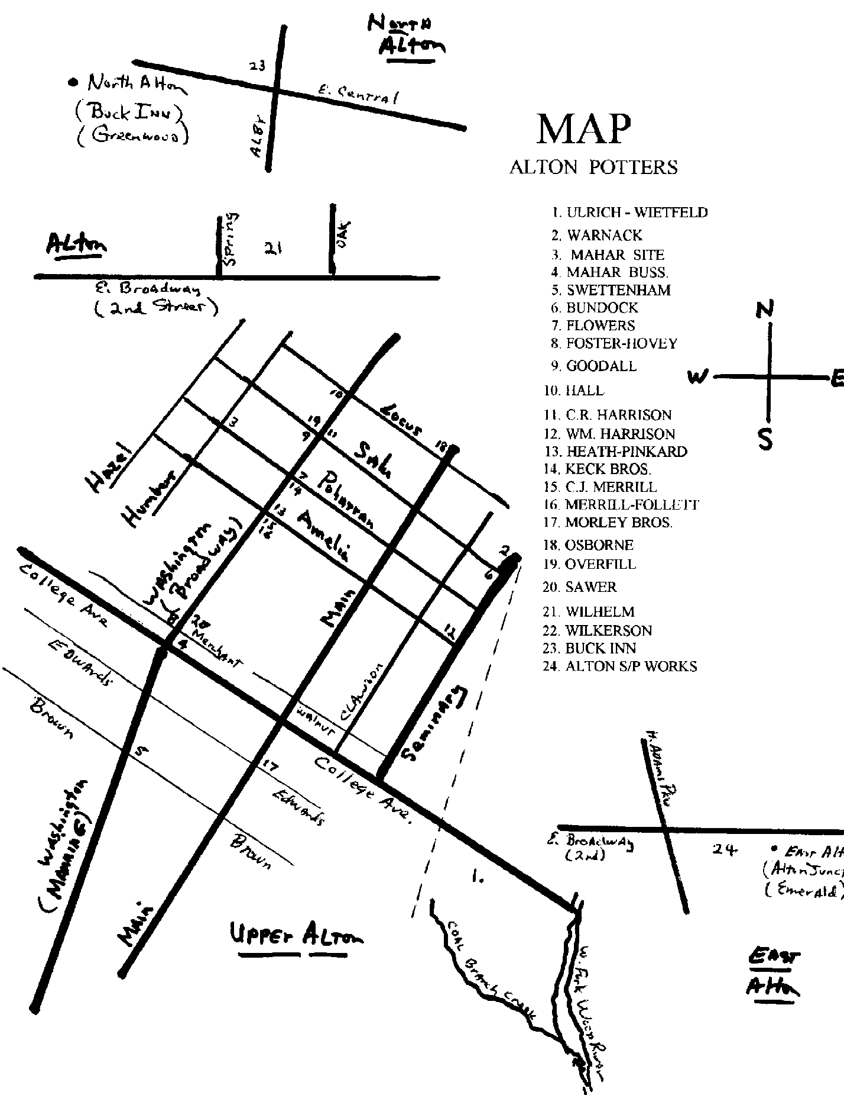
FIGURE 5: Map of Upper Alton Pottery locations.
54
10
Notes:
THIS IS ……… “WHERE” UPPER ALTON POTTERIES WERE LOCATED?”……. please note THE RED STARS
THIS MAP REFECTS A GREAT AMOUNT OF TIME AND RESEARCH OVER SEVERAL YEARS……..THOUGH IT LOOKS SO SIMPLE!
THESE RED STARS INDICATE 7 OF 24 KNOWN POTTERY LOCATIONS WE ARE HIGHLIGHTING IN OUR DISCUSSION TODAY.
ULRICH-WIETFELD……WARNACK…..MAHAR…….SWETTENHAM…….WILHELMS……BUCK INN…… ALTON JUNCTION PIPE CO.

Slide 13
Julius Wilhelms & Company
1855 - 1887
Julius Wilhelms Henry Wilhelms William Hack
potter potter potter
Julius and Henry Wilhelms and Company
Pottery located in Bozzatown, now Alton proper, between Oak and Spring street, on the north side of Second Street (E. Broadway).
Notes:
Julius and Henry Wilhelms and Company - Pottery located in Bozzatown, now Alton proper, between Oak and Spring street, on the north side of Second Street (E. Broadway). Julius, born 1828, and brother, Henry born 1833, came from Germany to Alton and established a pottery in 1855. Julius and his wife, Anna, daughters Matilda and Elizabeth, and brother Henry, lived nearby at 6th Street between Oak and Walnut until 1874. Koenig married Julius Wilhelms’ daughter, Matilda. Today, this elaborate Koenig house is home to the Alton Museum of History and Art. CHARLENE GILL

Slide 14
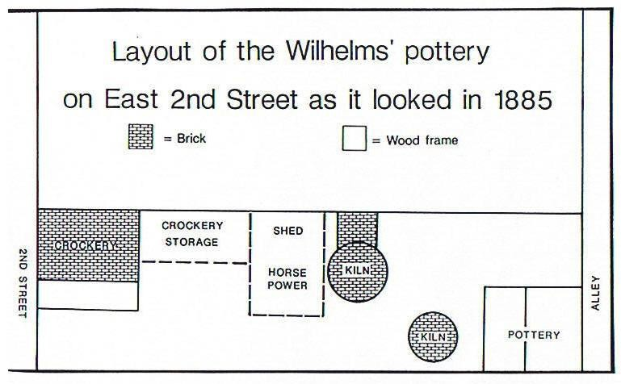
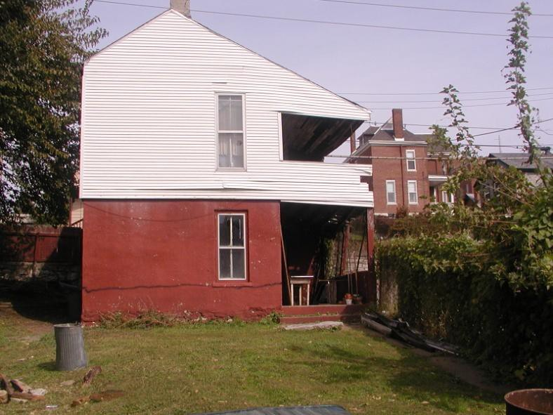
FIGURE 6: Home of William Hack. Built off alley entrance to the Wilhelms’ pottery in 1886. The home of Julius Wilhelms was located behind this house next to the tall red brick house at far background right, The Koenig House. Extensive archeological excavations have been conducted on this property’s cisterns, privies, and wells. Depicted on detailed sketches of an 1885 Sanborn Fire Insurance map illustration, two Wilhelms kilns were located in the approximate vicinity of the above trash can in foreground. The early directories and city mappings locate this property as Second Street (Broadway) between Oak and Spring, west side of alley. Diagram of pottery at top.
57
Notes:
Here was located the Wilhelms pottery, BETWEEN OAK AND SPRING OFF 2ND STREET, (now 2NS ST. CURRENT DAY BROADWAY)
NOTE KOENIG HOUSE IN FAR RIGHT BACKGROUND
CISTERN WAS LOCATED NEAR TRASH CAN IN YARD FOREGROUND. SEE RED ARROW. THIS WASTER DUMP AREA WAS ESCAVATED BY SENIOR STATE ACHAEOLOGIST KEN FARNSWORN, ALTONIAN - DALE STEEL AND A FEW OTHERS……….. JEFF CRESS

Slide 15
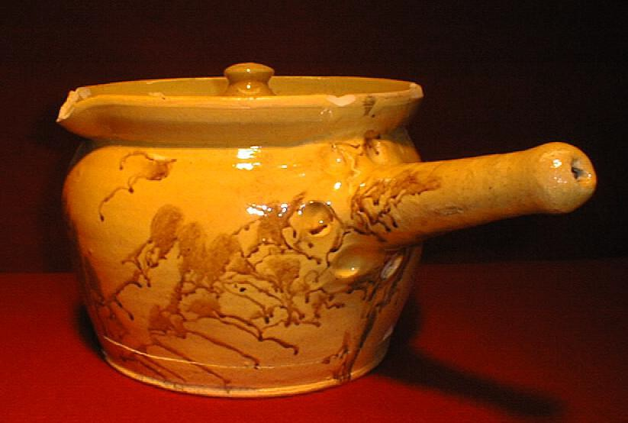
WILHELMS PIPKIN
Notes:
THIS IS A BEAUTIFUL EARTHENWARE WILHELMS PIPKIN !!!!!
…. PLEASE NOTE THE BLUE ARROW AT WILHELMS PIPKIN HOLLOW PIPE LIKE HANDLE, FINGER MOLDS AROUND HANDLE BASE, AND SPATTERRED MANGANESE DECORATIONS ON THIS LEAD GLAZED EARTHENWARE PIPKIN
Contents were often heated in pipkins. The hole in the tube-like handle permitted heat to escape out the hole, making handle cooler to the touch.

Slide 16
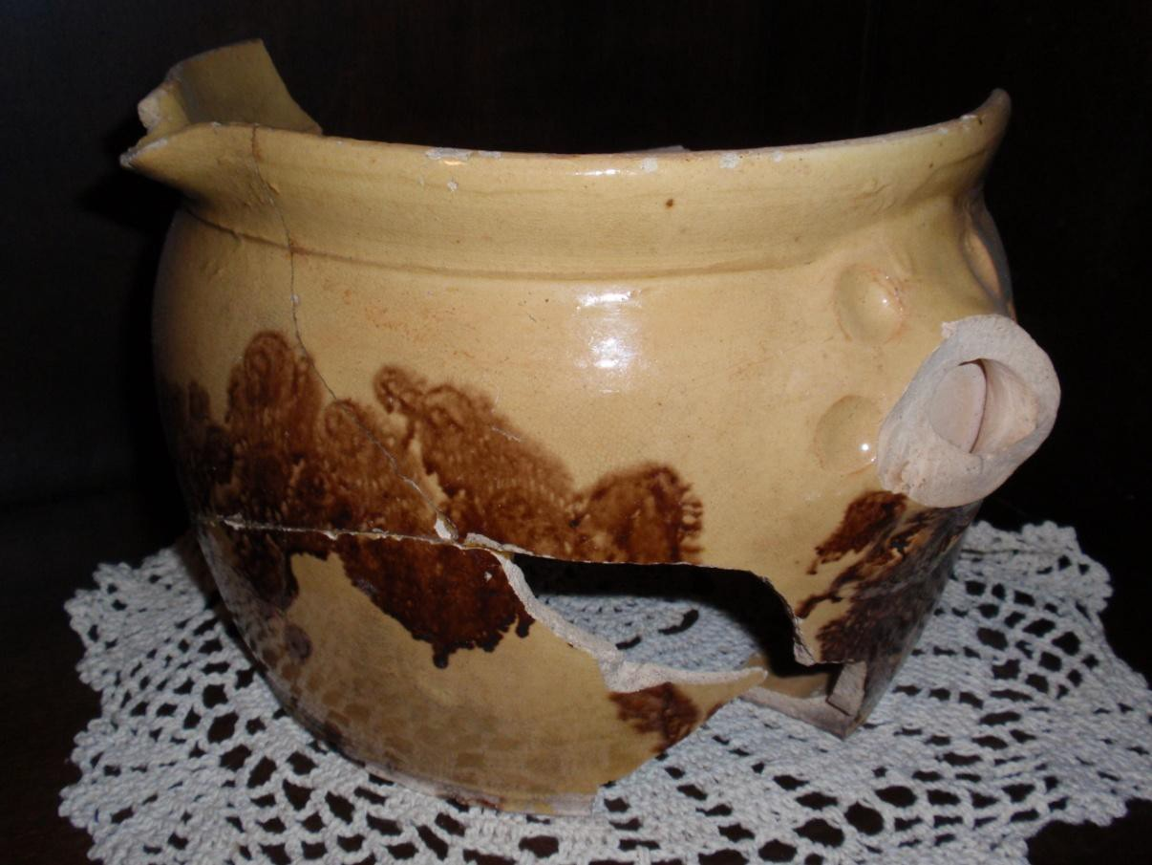
WILHELMS PIPKIN
Notes:
ANY BEAUTIFUL WILHELMS PIPKIN
…. AGAIN, NOTE THE HOLLOW PIPE LIKE HANDLE, FINGER MOLDS, SPATTERRED MANGANESE DECORATED LEAD GLAZED EARTHENWARE

Slide 17
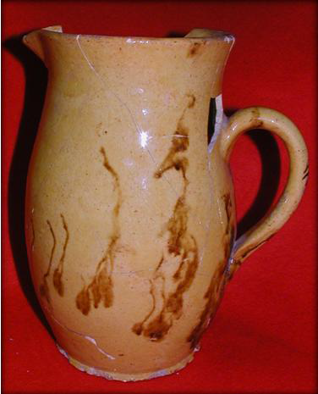
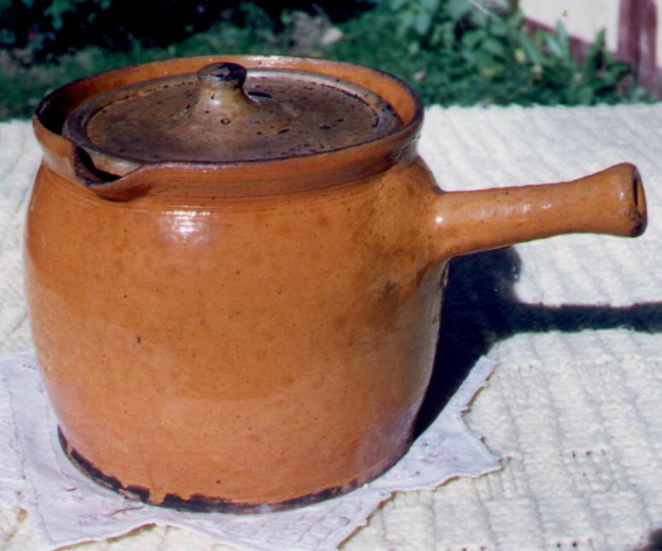
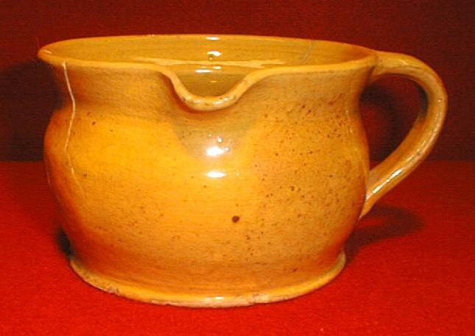
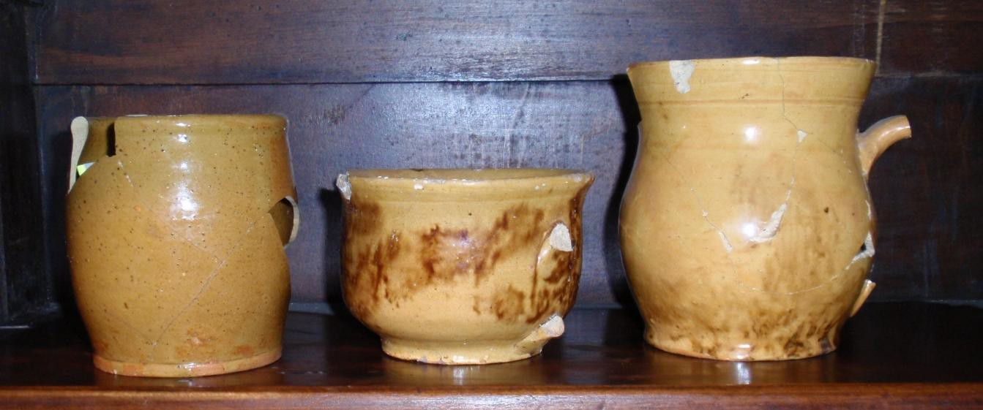
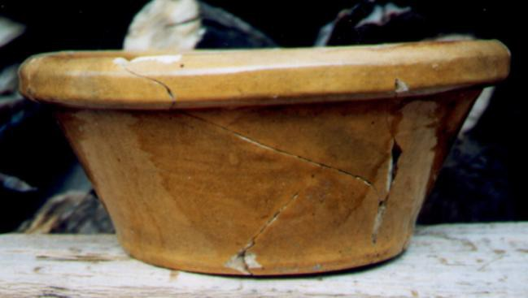
Notes:
THIS IS A SAMPLE OF WILHELMS EARTHENWARE
TOP (L TO R) QUART SIZE PITCHER, PIPKIN, SMALL CREAMER ON RIGHT
BOTTOM (L TO R) HALF GALLON BOWL, CUP ASSORTMENT

Slide 18
George Swettenham
1843 - 1867
George Swettenham Charles Alcott Charles Morley Charles Brown
potter potter potter neighbor
George Swettenham Pottery
An Upper Alton potter from 1850 to 1866. The Swettenham pottery was located at northeast corner of Brown and Manning (now Washington Ave., pictured above). Swettenham manufactured variety of earthenware while employing seven men in 1860. The Swettenham pottery is the only identified user of molds at Alton.
Notes:
The George Swettenham Pottery operated from 1850 to 1866. George Swettenham was born in 1807 in England. His wife Sara, eight children, and associate Charles Brown are listed within 1850 Upper Alton census and in the 1866 Upper Alton city directory. The pottery was located at northeast corner of Brown and Manning. (today, Manning is now Washington Ave.).

Slide 19
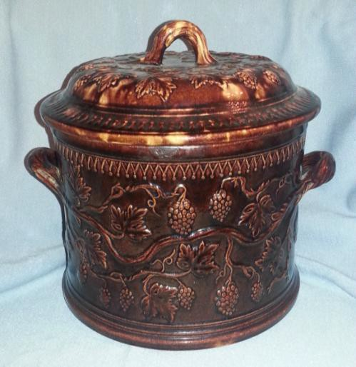
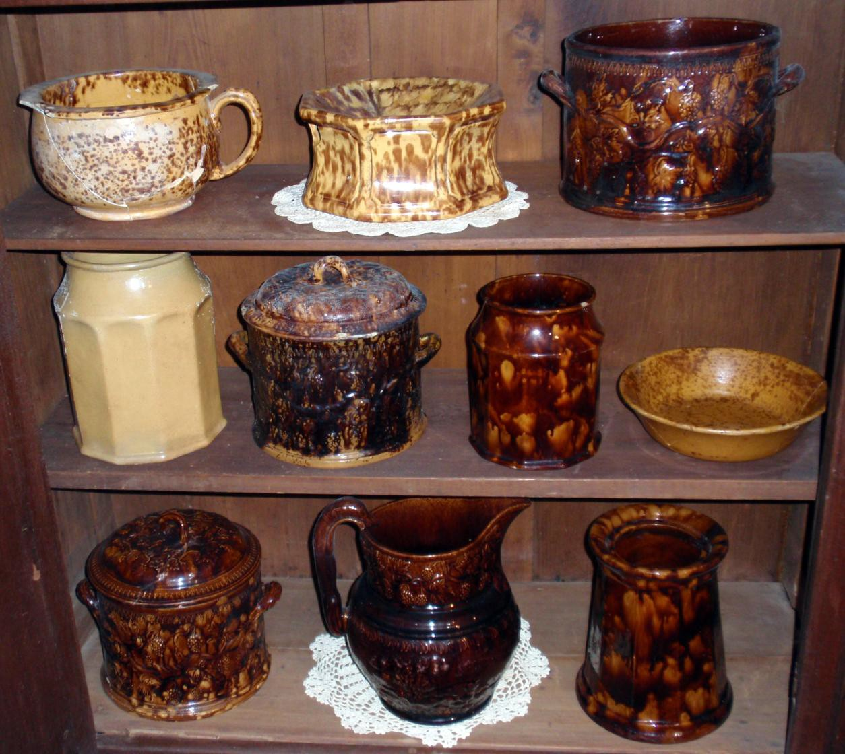
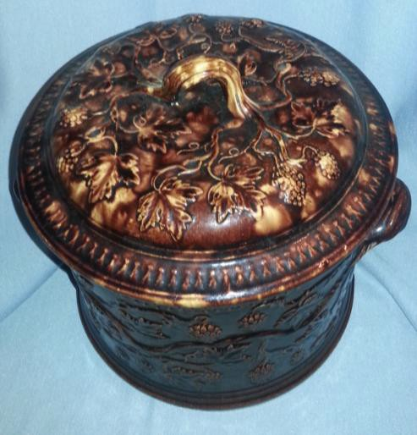
Notes:
Swettenham manufactured variety of earthenware while employing seven men in 1860. He also partnered with the English American potters Charles Alcott and Charles Morley, while producing mold made pieces of Rockingham style/yellowware vessels. These items included ornate table pitchers, meat jars with lids, preserve jars, and cuspidors, that possess his embossed “ox-bow” mark. The inclusion of two names on these marks indicate a joint venture. The Swettenham pottery is the only “identified” user of molds of Alton potters. Some holds are believed brought with him from England.

Slide 20
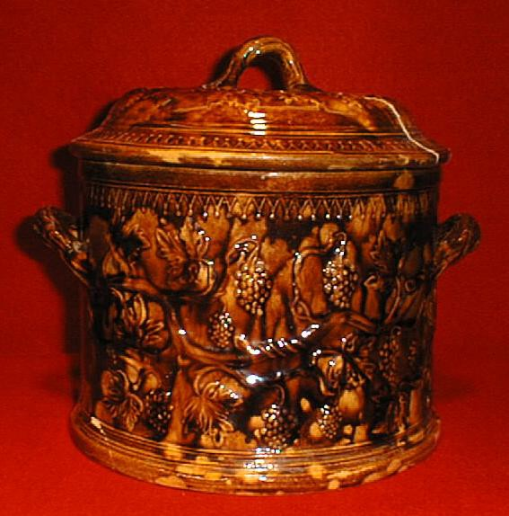
SWETTENHAM SWEET MEAT LIDDED JAR
Notes:
THIS IS AN OUTSTANDING ORNATE SWETTENHAM SWEET MEAT LIDDED JAR “GRAPES AND VINES PATTERN.”

Slide 21
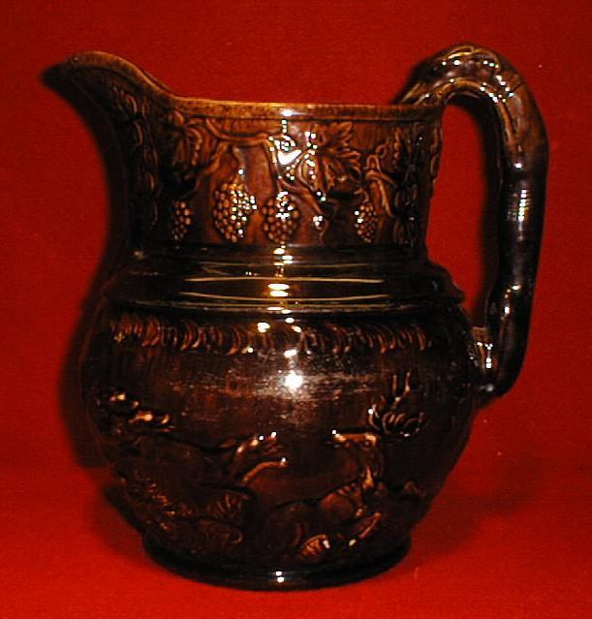
SWETTENHAM HOUND HANDLED PITCHER
Notes:
HERE, IS A VERY UNCOMMON (NEAR UNIQUE) SWETTENHAM HOUND HANDLED PITCHER “SWETTENHAM AND ALCOTT.”

Slide 22
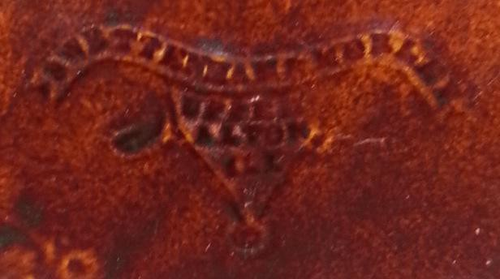
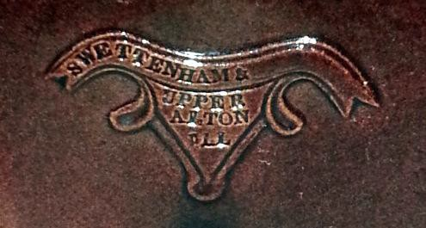
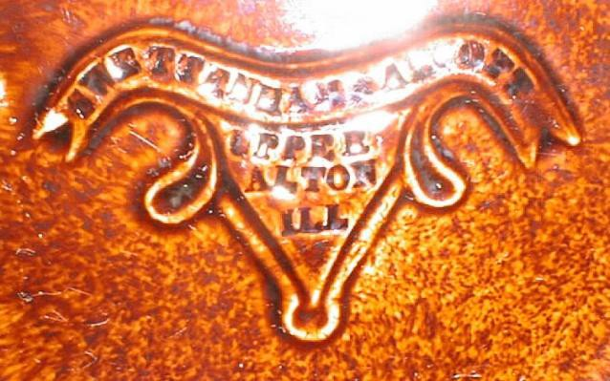
OXBOW OR RAMS HEAD EMBOSSED MARK
“SWETTENHAM & MORELY / UPPER ALTON ILLINOIS”
Notes:
HERE ARE EXAMPLES OF SWETTENHAM”S OXBOW OR RAMS HEAD EMBOSSED MARK
“SWETTENHAM & MORELY / UPPER ALTON ILLINOIS”
“SWETTEMHAM & ALCOTT”
“SWETTENHAM & _______’

Slide 23
Western Stoneware Company.
Buck Inn (North Alton), Ills.
1868 - 1875
This pottery was located near the intersection of Ably Street and Center on the north edge of Greenwood, North Alton bordering Godfrey, Illinois.
68
Notes:
NEXT... Is the Western Stoneware Company - Located near the intersection of Ably Street and Center on the north edge of Greenwood, North Alton bordering Godfrey, Illinois, the Buck Inn pottery operated 1868 to 1875.
After the Western Stoneware Company pottery site closed, the famed Alton Brick Company was established.

Slide 24
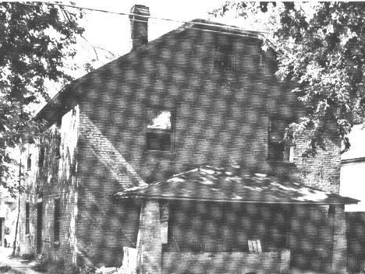
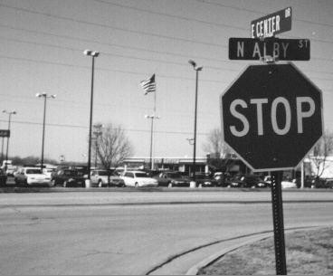
FIGURE 17 The Buck Inn dwelling, built in 1837 at Delmar and State.
FIGURE 18: Western Stoneware Company was located northeast of intersection of North Alby street and East Center Dr., bordering the Godfrey city limits (by pictured American flag).
Notes:
AT TOP …..THE ACTUAL BUCK INN….. The original Buck Inn dwelling served as a stage coach stop, post office, inn, and as a livestock drive staging area. This two story brick structure was erected in 1837 at the north west corner of State Street and Delmar and served as a major stop and overnight station for live stock drives to Alton from distant farms. After a night’s layover, live stock would be driven about a mile to the Alton river front and river landing for processing and sale to the local stockyards in St. Louis, Illinoistown (Town of Illinois, or E. St. Louis), Cairo and other markets.
AT BOTTOM…………WESTERN STONEWARE POTTERY EVOLVED INTO ALTON BRICK YARD CURRENT DAY CAR DEALERSHIP

Slide 25
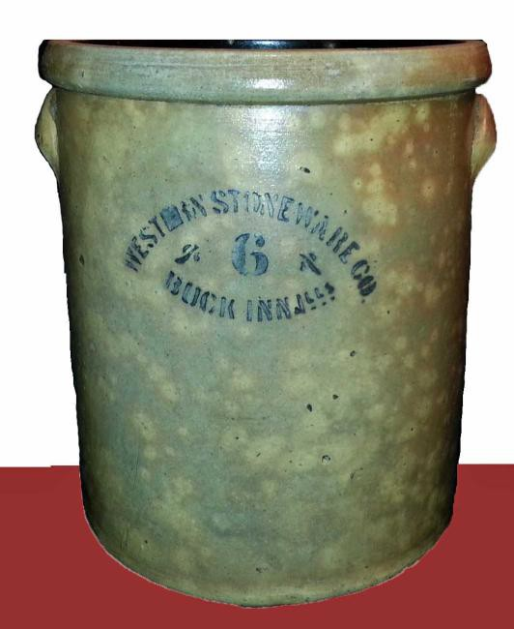
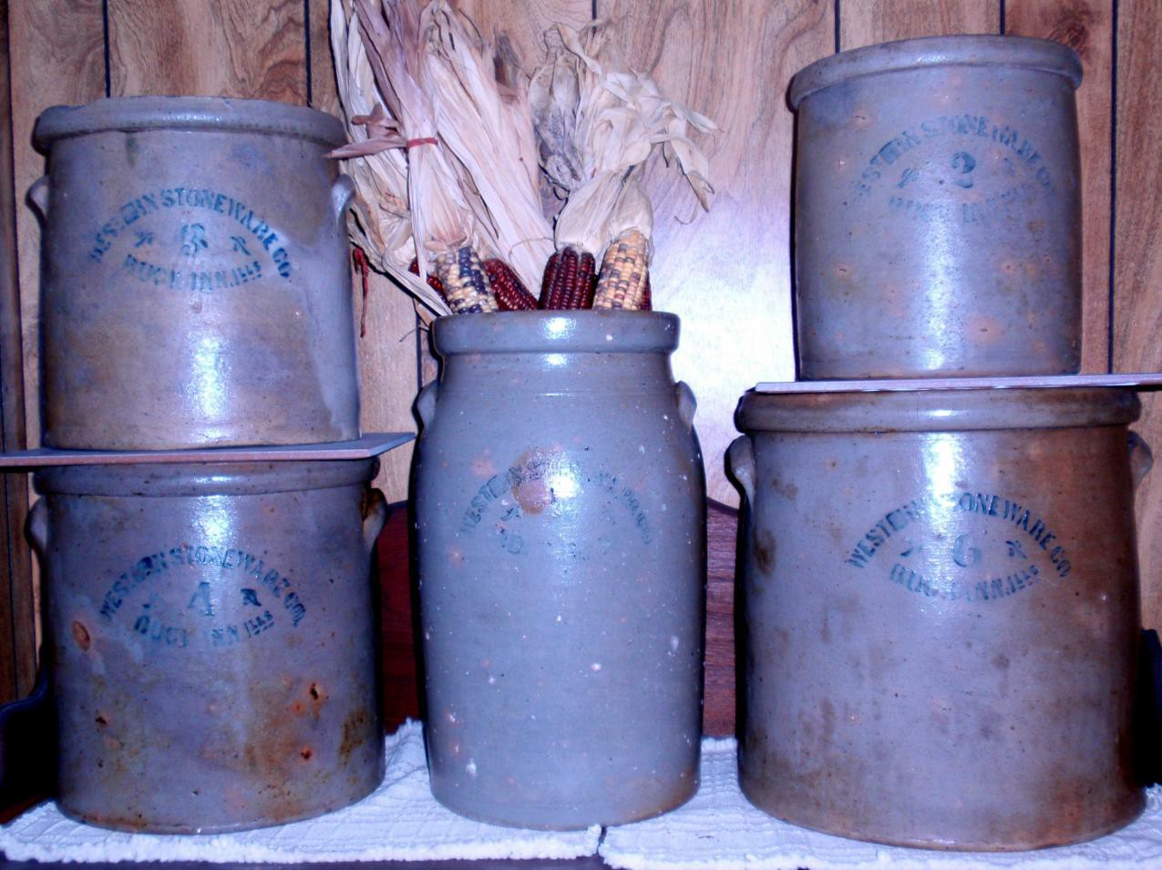
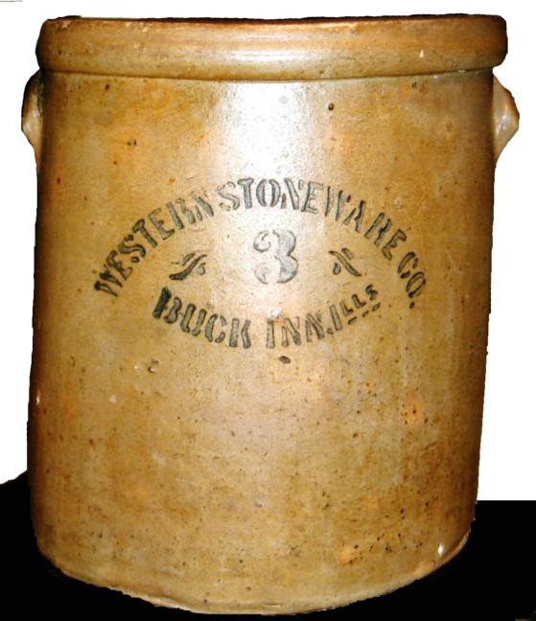
Sample of cobalt stenciled marked “Western Stoneware Company / Buck Inn, Ills.” salt glazed storage straight sided jars in capacities of 2, 3, 4, and 6 gallons and 4 gallon churn (top center).
Notes:
This is a sample of Cobalt stencilled marked “Western Stoneware Company / Buck Inn, Ills.” salt glazed storage straight sided jars in capacities of 2, 3, 4, and 6 gallons and a 4 gallon churn (top center).
70

Slide 26
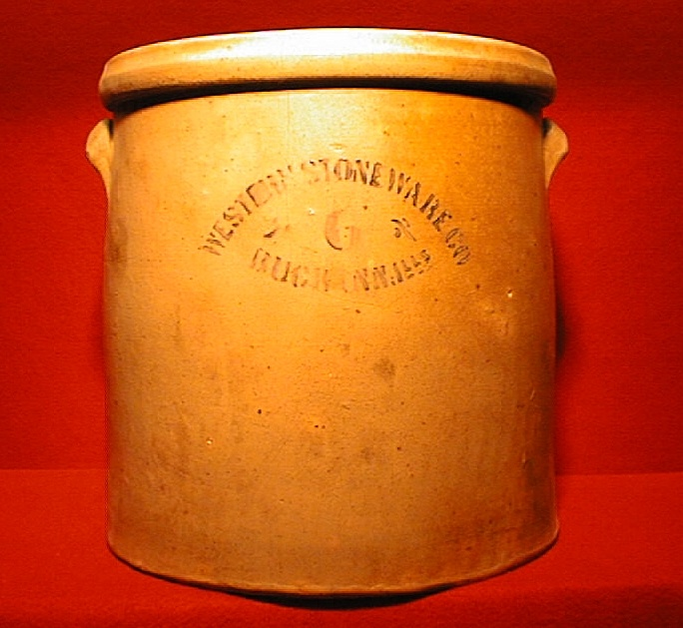
Notes:
The Buck Inn pottery was located approximately one half mile northeast of the Buck Inn post office.
Salt glazed, cobalt stencil marked “Western Stoneware Co./ Buck Inn, Ills,” jars are known in the 2, 3, 4, and 6 gallon capacities. All six known jars are all straight sided with rounded bolstered rims. One 4 gallon straight sided shelfed jar/churn with a direct rim exists in a private collection.
All vessels possess smooth lug handles without finger welds with the exception of the small 2 gallon vessel that required no handles. After the Western Stoneware Company pottery site closed, the famed Alton Brick Company was established.

Slide 27
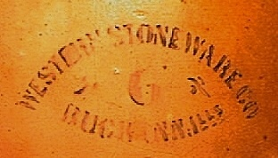
Notes:
Their cobalt stencil mark is often very weak and partially incomplete.
MOST COMMON IS THAT THE 2ND “E” IN WESTERN IS BLURRED. SEE BLUE ARROW

Slide 28
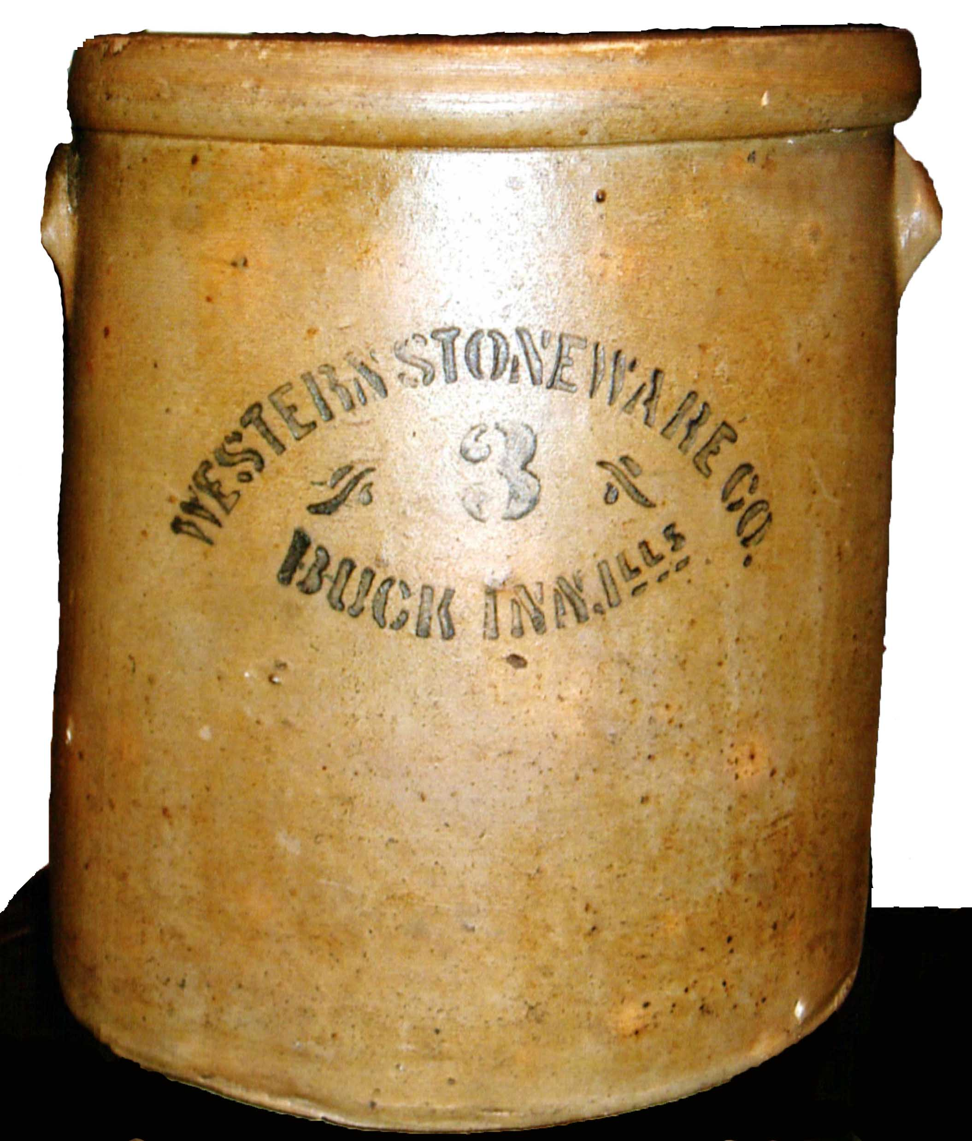
Notes:
LESS THAN A DOZEN KNOWN MARKED VESSELS ARE KNOWN IN PRIVATE COLLECTIONS.
THIS 3 GALLON JAR POSSESSES A CLEAR COMPLETE MARK.

Slide 29
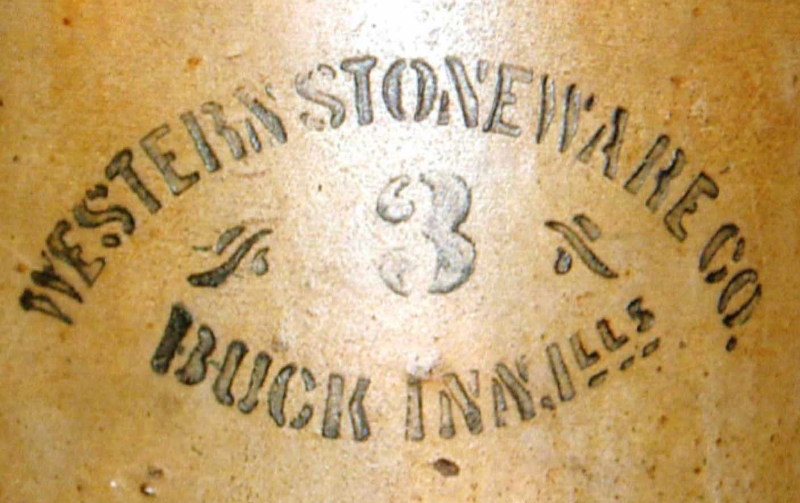
Notes:
NOTE THE “E” AT BLUE ARROW IS CLEAR, AS ARE ALL LETTERS.

Slide 30
W. J. Mahar Stoneware Manufacturer
1875 - 1888
William J. Mahar
merchant / potter
Employed 5 men
This Upper Alton pottery operated from 1875 to -1888. William J. Mahar was born at Albany, New York, October 7, 1843. The pottery was located at Powhattan on the west side of Humbert. Descendants of S. Clark, an original Mahar neighbor, reside today by the Mahar pottery site. William J. Mahar sold a variety of utilitarian use stoneware at his “business” building that was located one half mile south of the pottery at the northeast corner of Manning (Washington) and College Avenue.
71
Notes:
The WILLIAM J. MAHAR Upper Alton pottery operated from 1875 to -1888. William J. Mahar was born at Albany, New York, October 7, 1843. The pottery was located at Powhattan on the west side of Humbert. William J. Mahar sold a variety of utilitarian use stoneware at his “business” building that was located one half mile south of the pottery at the northeast corner of Manning (Washington) and College Avenue. Mahar was a councilman for the village of Salu served as a councilman for the village of Salu. A very interesting historical note is Mahar served as a court appraiser of the personal property articles in the probate of the estate of Isaac E. Warnack in 1868.

Slide 31
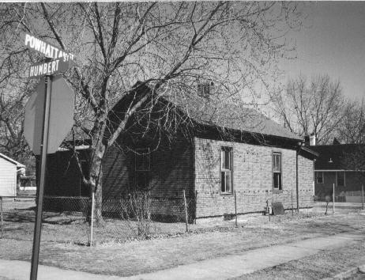
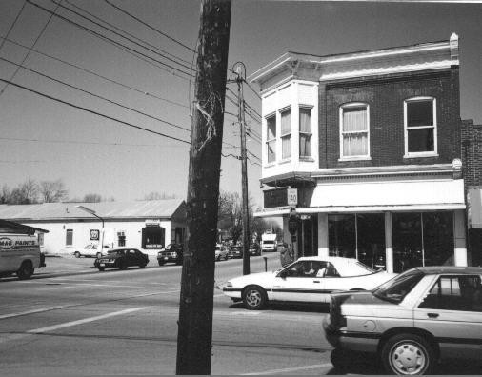
Mahar pottery site located at northwest corner of Powhattan and Humbert streets.
FIGURE 21: Mahar’s business at northeast corner of College Ave. and Broadway (top left).
Notes:
AT TOP IS THE APPROXIMATE LOCATION OF THE MAHAR POTTERY SITE AT POWHATTAN AND HUMBERT STREETS.
BOTTOM IS MAHAR BUSINESS AT COLLEGE AVE AND WASHINGTON (FORMERLY BROADWAY).

Slide 32
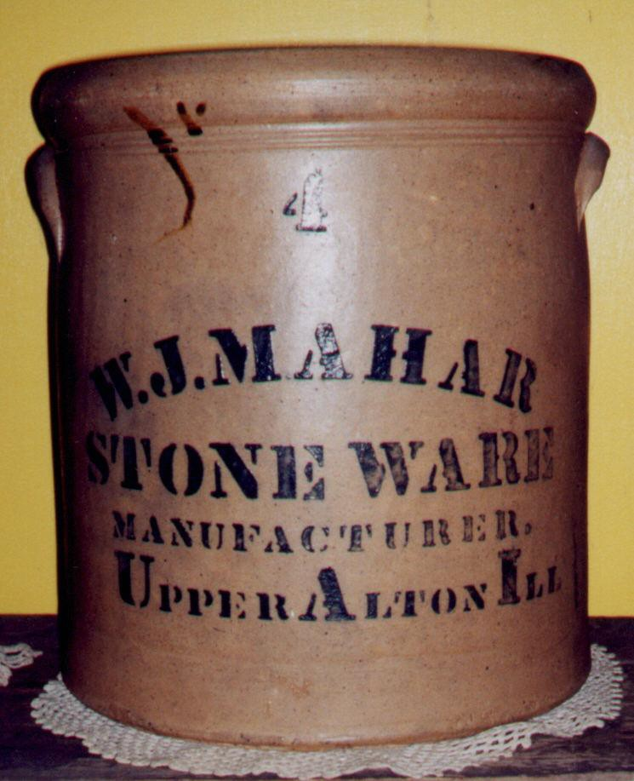
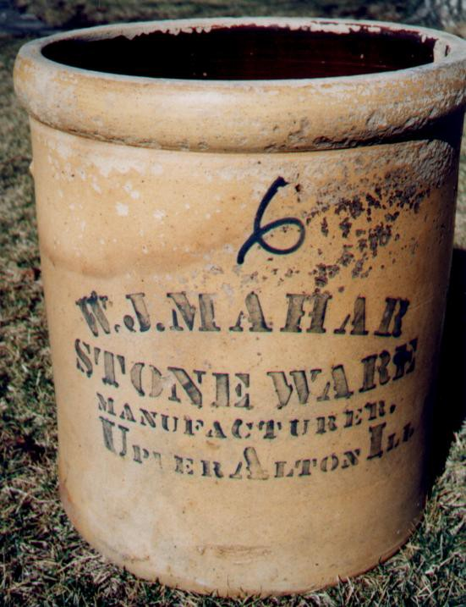
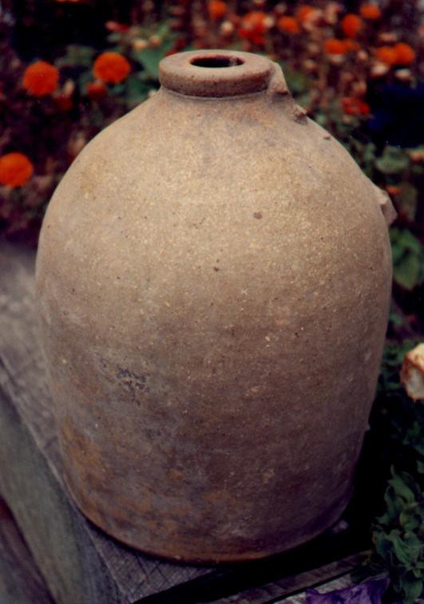
Salt glazed jars read “W. J. Mahar
/ Stone Ware Manufacturer / Upper Alton Ill.”
Notes:
HERE ARE A STENCILLED 4 and SCRIPT 6 gallon salt glazed jars stencilled mark “W. J. Mahar / Stone Ware Manufacturer / Upper Alton Ill.”
THE JUG AT RIGHT WAS RECOVERRED AT THE MAHAR PROPERTY, BY THE LATE AMEATURE ARCHAEOLOGIST DALE STEELE .

Slide 33
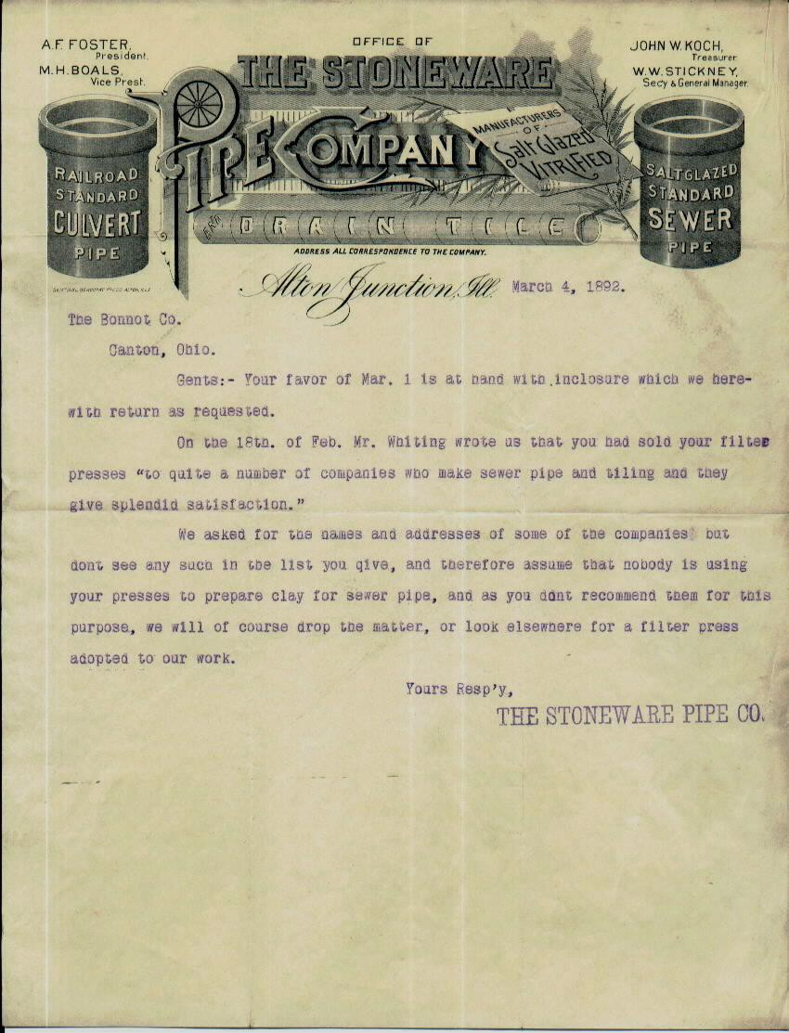
The Alton Junction Stoneware Pipe Company
Alton Junction, Illinois.
Notes:
THIS IS A FANCY LETTERHEAD OF The Stoneware Pipe Company. This billing correspondence is dated March 4, 1892.

Slide 34
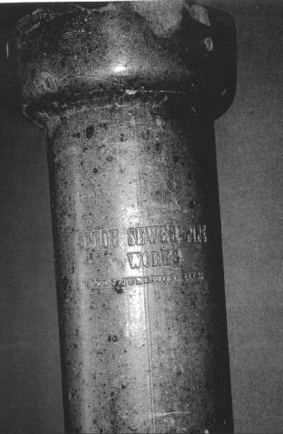
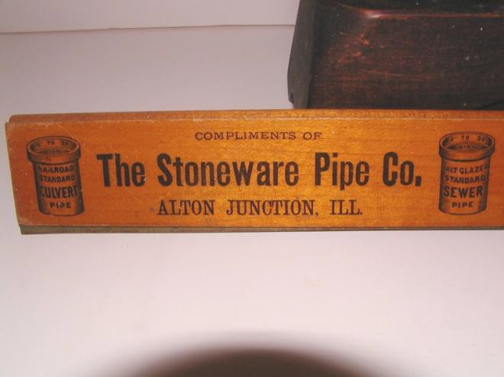
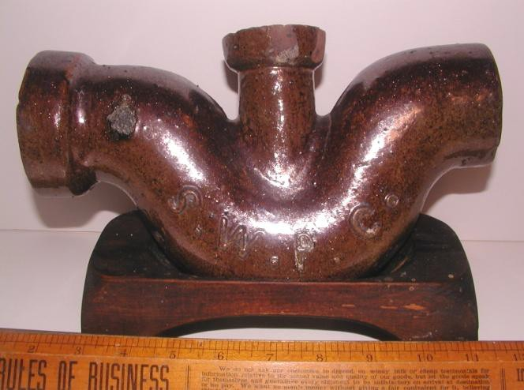
ALTON
JUNCTION
SEWER PIPE
COMPANY
Notes:
AT TOP LEFT IS a Sewer pipe section.
Other pictures depict Salesman sample pipe.

