Slide 1

U. S. Government, History and Geography
Practice for the CASAS 965
You will hear each question 2 times. Choose the correct answer. You may repeat the question by clicking the sound icon. Click the arrow to advance to the next slide.
Garden Grove Adult Education Updated February 2020 ESLAmerica.US

Slide 2

A. George Bush
B. Thomas Jefferson
C. George Washington
D. Abraham Lincoln

Slide 3




A. New York
B. Texas
C. California
D. Florida

Slide 4
A. 35 years old
B. 40 years old
C. 45 years old

Slide 5
A. The slaves
B. The American Indians
C. The Pilgrims
D. The colonists

Slide 6
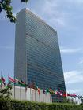
A. a branch of the U.S. government.
B. the place where Congress meets.
C. where many countries resolve
world problems.

Slide 7

A. In the 1950s
B. In the 1960s
C. In the 1980s

Slide 8

A. The White House & the Supreme Court
B. The Senate & the House of
Representatives
C. Washington, D.C. & the 50 States
D. The Legislative & Judicial Branch

Slide 9
A. The Pacific Ocean
B. The Atlantic Ocean
C. The Indian Ocean
D. The Arctic Ocean

Slide 10
A. The Women’s Rights Movement
B. The Civil Rights Movement
C. The Environmental Movement

Slide 11
A. Kennedy & Johnson
B. Washington & Roosevelt
C. Washington & Lincoln

Slide 12
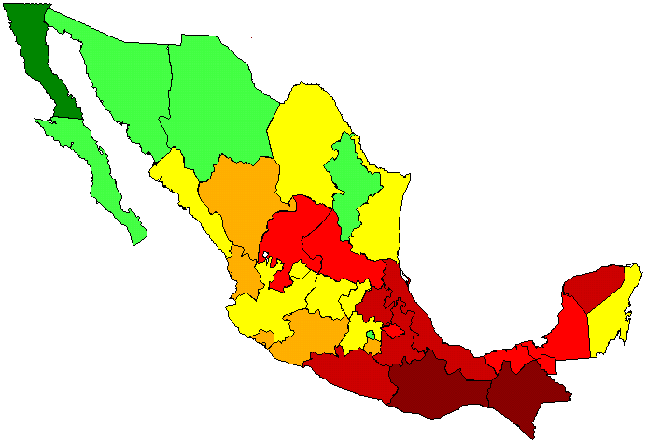
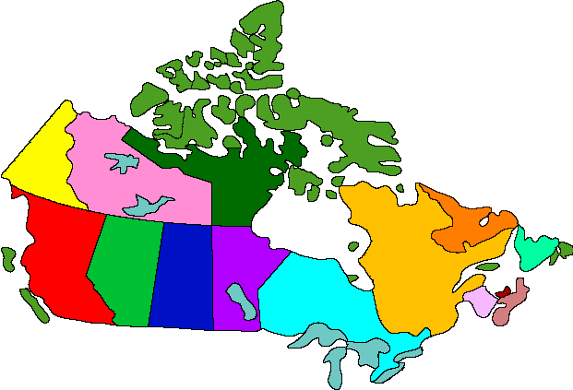

A. Mexico
B. Canada
C. Alaska

Slide 13
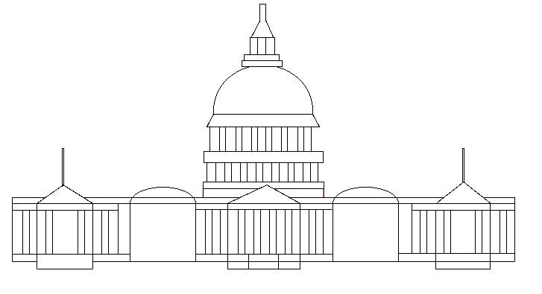
A. To appoint justices
B. To veto bills
C. To declare war

Slide 14
A. The first part of the
Emancipation Proclamation
B. An addition to the Declaration
of Independence
C. A change in the Constitution

Slide 15
A. November
B. January
C. February

Slide 16
A. governor
B. president
C. mayor

Slide 17
A. The President
B. The Congress
C. The Speaker of the House
D. The Supreme Court

Slide 18
A. Commander in Chief
B. The Chief Justice
C. The Speaker of the House

Slide 19
A. declare war
B. veto bills
C. make new laws
D. change laws

Slide 20


A. Alaska
B. Florida
C. Hawaii

Slide 21
A. The Colorado & Ohio River
B. The Mississippi & Missouri River
C. Rio Grande & Columbia River

Slide 22
A. Native Americans
B. Africans
C. Pilgrims

Slide 23
A. The Secretary of Housing
B. The President
C. The Vice President
D. The Speaker of the House

Slide 24
A. soldiers
B. presidents who have died
C. world leaders

Slide 25
A. governor
B. president
C. mayor

Slide 26
A. January
B. November
C. May

Slide 27



A. Mexico
B. Canada
C. Alaska

Slide 28
A. The Speaker of the House
B. The Vice President
C. The Secretary of State

Slide 29




A. Spain
B. Mexico
C. France
D. England

Slide 30
A. The U.S. attacked Iraq
B. The World Trade organization
met in New York
C. Terrorists attacked the U.S.

Slide 31
A. The flag
B. The president
C. The military

Slide 32
A. Easter
B. Mother’s Day
C. Thanksgiving
D. United Nations Day

Slide 33
A. governor
B. president
C. mayor

Slide 34

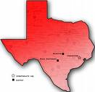
California
Texas
Alaska

Slide 35
A. Washington & Lincoln
B. soldiers who died in wars
C. soldiers who are still living

Slide 36
A. Puerto Rico & U.S. Virgin Islands
B. Hawaii & Guam
C. Panama & Cuba

Slide 38
A. Texas
B. Massachusetts
C. Alaska

Slide 39
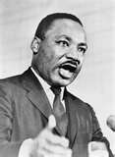
A. He helped write the
Declaration of Independence
B. He fought for equal rights
C. He signed the Civil Rights
  Bill into law

Slide 40
A. Hawaii
B. Massachusetts
C. Rhode Island

Slide 41
A. an amendment
B. The Declaration of Independence
C. The Constitution
D. The Emancipation Proclamation

Slide 42
A. communist
B. capitalist
C. socialist
D. imperialist

Slide 43
A. General Eisenhower
B. George Washington
C. Abraham Lincoln

Slide 44
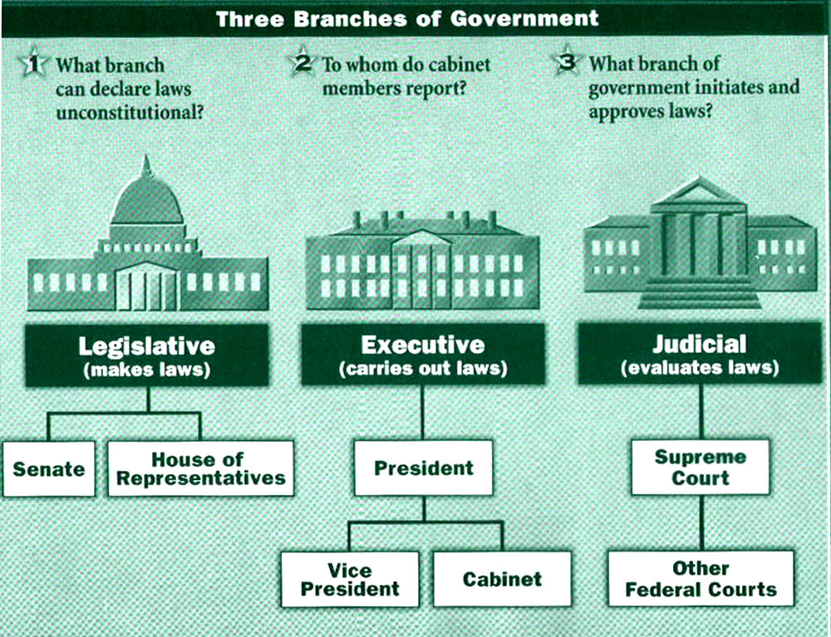

Slide 45
A. northern
B. southern
C. eastern
D. western

Slide 46
A. Mexico
B. Canada
C. Alaska

Slide 47
A. a city
B. a county
C. a state

Slide 48


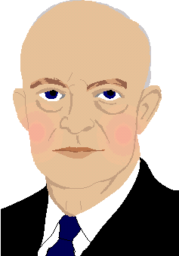
A. John F. Kennedy
B. Franklin D. Roosevelt
C. Dwight Eisenhower

Slide 49
A. Susan B. Anthony
B. Eleanor Roosevelt
C. Martha Washington

Slide 50

A. The people
B. The president
C. The senators

Slide 51

A. Washington
B. Virginia
C. Washington, D.C.

Slide 52

A. 13
B. 50
C. 100
D. 345

Slide 53
A. paying taxes
B. carrying identification
C. voting

Slide 54

A. Washington
B. Ohio
C. Maine
D. Virginia

Slide 55
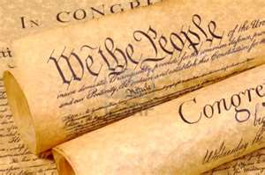
A. the right to liberty
B. the right to vote
C. the right to have a gun
D. the right to own land

Slide 56
A. 50
B. 100
C. 345
D. 435

Slide 57
A. Give me liberty
B. I pledge allegiance
C. We the people

Slide 58
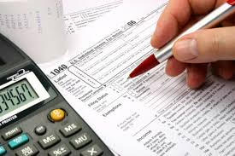
A. January 1
B. December 31
C. April 15

Slide 59
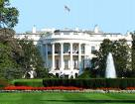


A. White House
B. Pentagon
C. Congress

Slide 60
A. Kansas
B. California
C. Alaska

Slide 61
A. no one is above the law
B. people must practice a religion
C. people can practice no religion or any religion

Slide 62
A. The Supreme Court
B. The United Nations
C. The Cabinet

Slide 64
A. the gun policies
B. the Congress
C. the Armed Forces

Slide 65
A. Army
B. Navy
C. Police
D. Marines

Slide 66
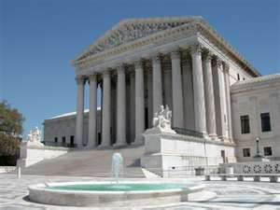
A. makes laws
B. interprets laws
C. vetoes laws

Slide 67

A. the original colonies
B. one for each state
C. bravery

Slide 68
A. The right of religious freedom
B. The right of free speech
C. The right to vote
D. The right to drive

Slide 69
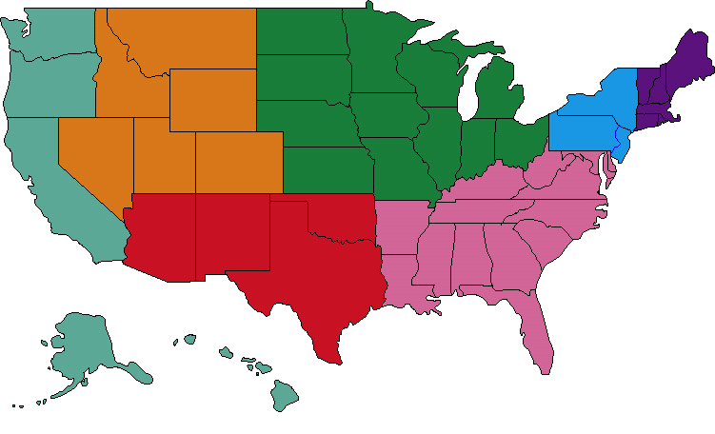

Slide 70


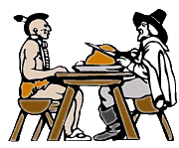
A. Christmas
B. Memorial Day
C. Thanksgiving

Slide 71
A. the first 10 Amendments
B. the supreme law of the land
C. the introduction to the Constitution

Slide 72
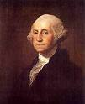
A. discovered America
B. became the first U.S. president
C. freed the slaves
D. said, “Give me liberty or
give me death.”

Slide 73
A. 1492
B. 1776
C. 1787

Slide 74
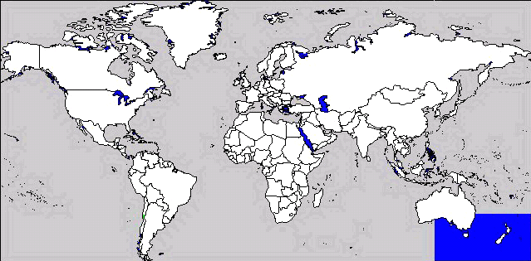

Slide 75
A. 10
B. 13
C. 27
D. 50

Slide 76
A. gave us freedom of speech
B. changed the voting age to 18
C. gave us freedom of religion
D. gave women the right to vote

Slide 77
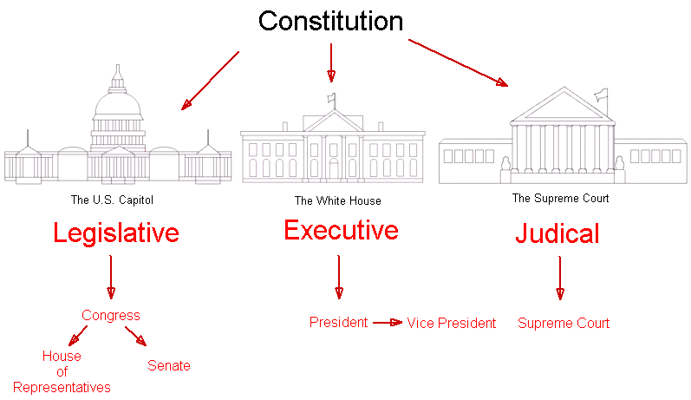

Slide 78
A. The Bill of Rights
B. the Preamble
C. The Declaration of Independence

Slide 79
A. the people.
B. the President .
C. the Congress.

Slide 80
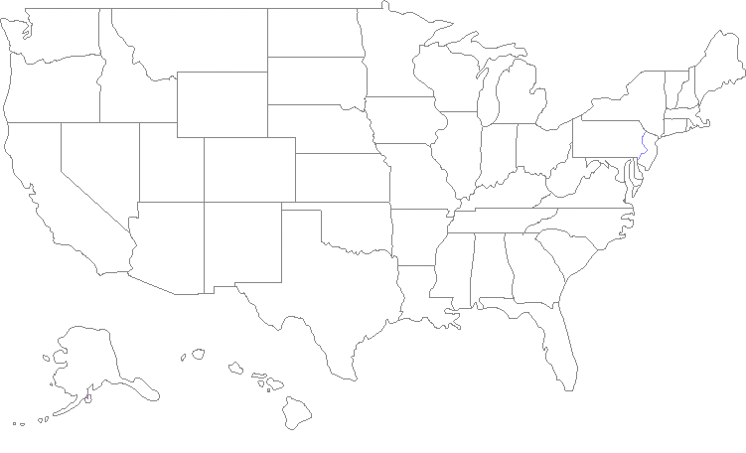


Slide 81
THE END

