Slide 1
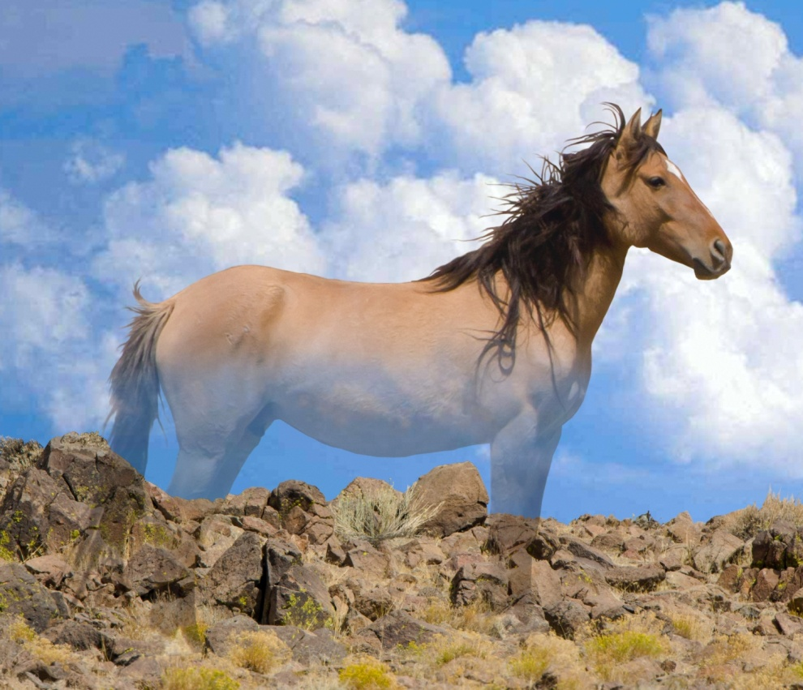
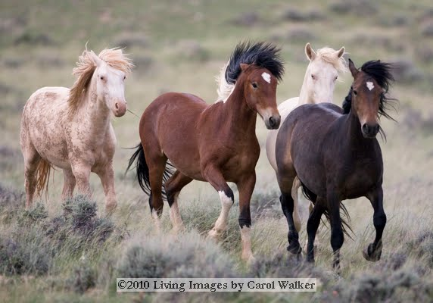
Suzanne Roy, director, American Wild Horse Preservation Campaign
Working Smarter and Together for Wild Horses and Burros

Slide 2
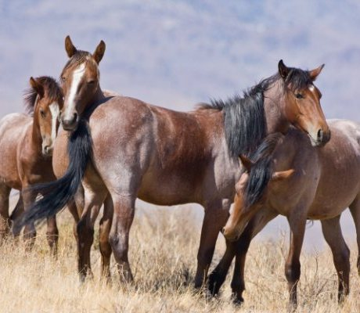
American Wild Horse Preservation Campaign
Established: 2004
Goal: Unified Platform/Voice
45+ Coalition Partners

Slide 3
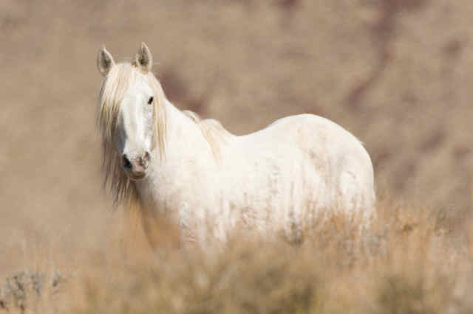
Expanding Our Grassroots Network
e
Issue Weekly eNewsletter
Provide Easy-To-Use Action Alerts
Create Strong Public Record of Opposition

Slide 4
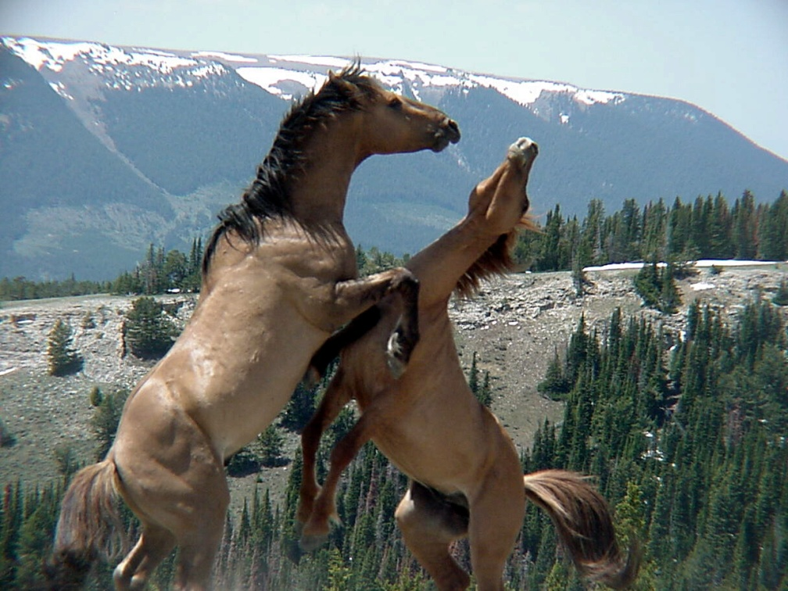
Litigation
Stopped Sterilization on the Range
Exploring National Litigation Strategy
Monitoring BLM Activities – i.e. Decision Records, etc.

Slide 5
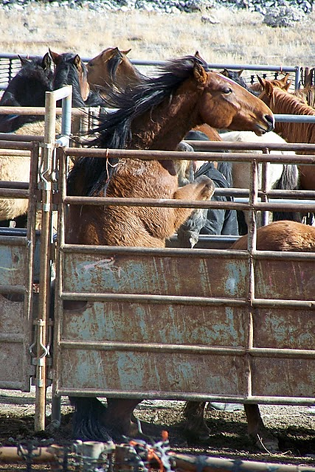
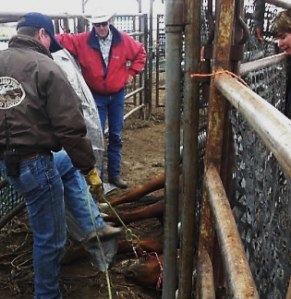
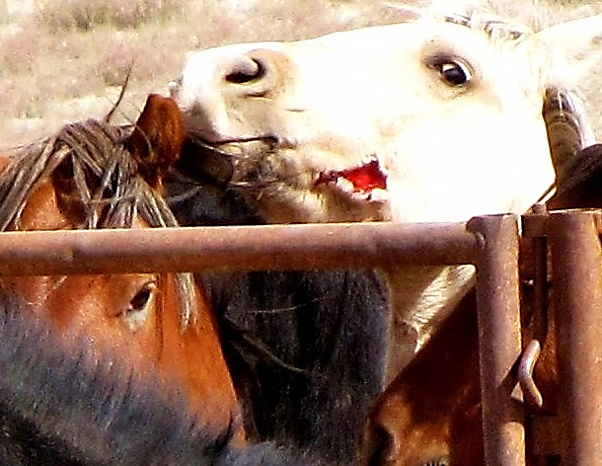
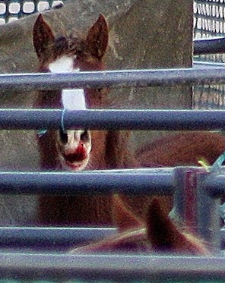
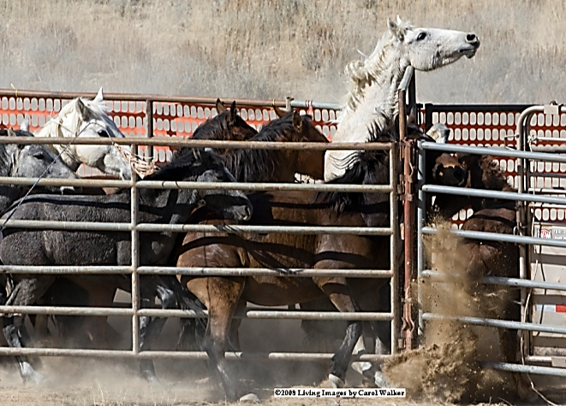
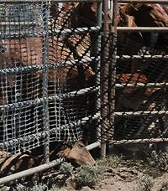
Observation

Slide 6
Public Education & Media Outreach

Slide 7
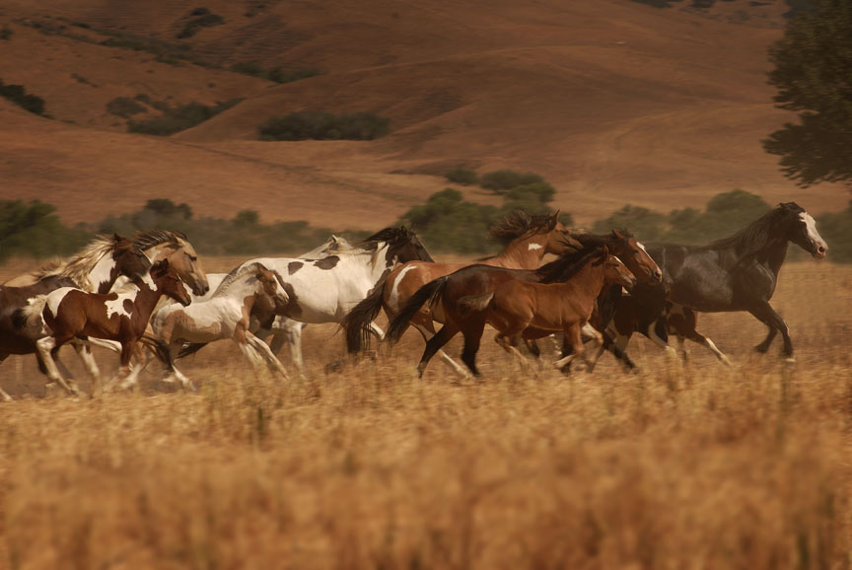
Opportunities
Issue that Moves People
BLM Statistics Support Our Position
Roundup & Removal Proven Ineffective
Economics

Slide 8
Economics: Escalating Costs

Slide 9
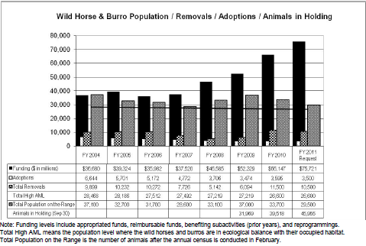
Economics: Escalating Costs

Slide 10
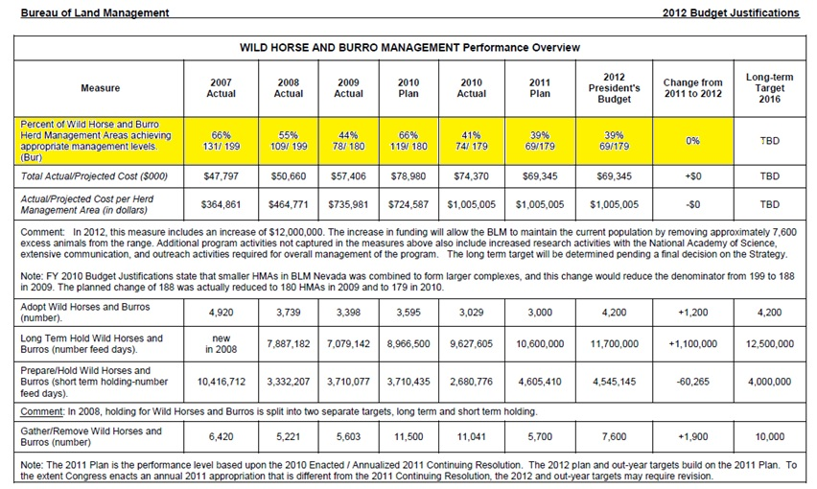
Roundup & Removal Proven Ineffective

Slide 11
Challenges
Powerful Cattlemen’s Lobby
Lack of Unified Message on Solutions
BLM’s Cultural Bias

Slide 12
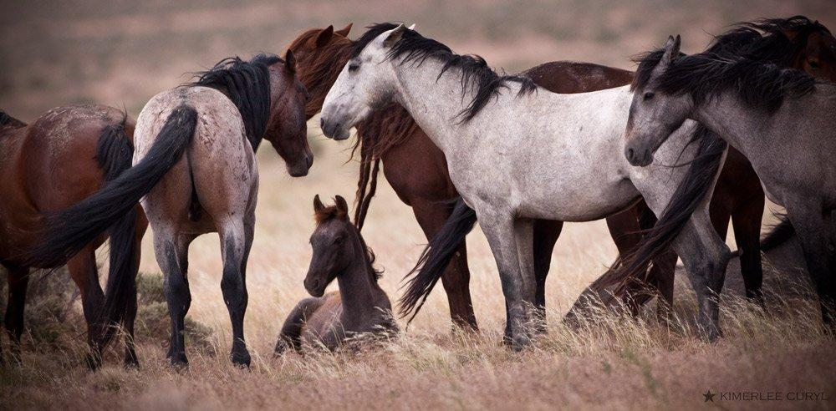
Moving Forward: Working Smarter & Together
Grow the Grassroots
Unify Platform and Solutions
Work Effectively with Congress

Slide 13
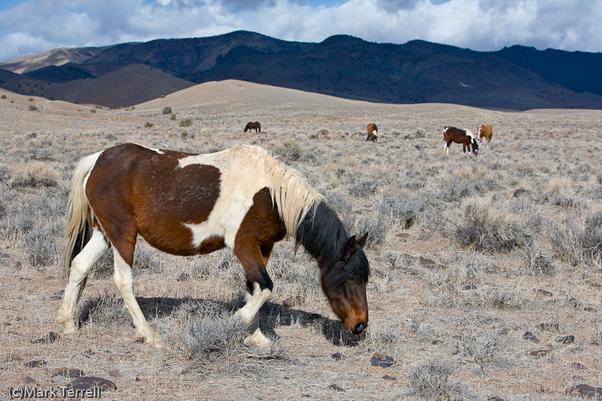
WildHorsePreservation.org
StopTheRoundups.com

