Slide 1
Business Case - Acquisition
Lefty Panayiotou – June 2022
Disclaimer: Where Information provided includes Opinions and Interpretations of the Author or data sourced from other Information Providers – the Author provides no guarantee as to the correctness nor interpretation made, nor use of the information or comments to make investment decisions.

Slide 2
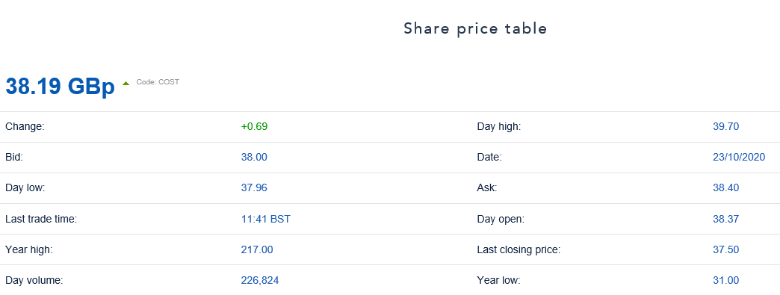
Business Case - Acquisition
The key has been to identify a company that is well know, is profitable, has potential future growth prospects, a confirmed order book, and presents opportunity to utilise any tax losses and maximise potential return.
Costain PLC fits this criteria, with:
Established business since 1865
Profitable in core activities and markets
£4.2bn committed order book, with £2 bn orders secured in first 6 months of 2020
6 months results to June 2020 reflects pre-tax loss of £92.3M, but results impacted by extraordinary charges due to A465 contract (£45.4 million) and Peterborough & Huntingdon contract (£49.3 million); with £3.8M pre-tax profits from other activities
Current share price is 38.9p with market cap based on c.275m issued shares of £106.87M. 12 month high at £2.17 with market cap then at £597M

Slide 3
Costain PLC - Overview
Core Markets:
Transportation
- Highways England RIS2 and Network Rail CP6
- HS2
- Government’s Project SPEED
- Aviation clients
Water
- Water companies progressing approved AMP7 investment programs
- Clients include Anglian Water and Thames Tideway
Energy
- Energy investment programs
- Government progressing pathfinder schemes looking to increase zero
carbon energy
- No longer pursuing Energy EPC contracts
Defence
- Critical defence equipment related programs

Slide 4
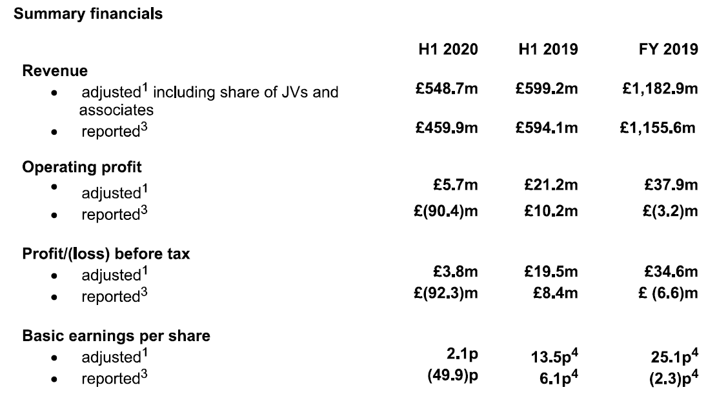
Costain PLC

Slide 5
Costain PLC
Notes to Financial summary:
Results before impact of charges due to A465 contract (£45.4 million) and Peterborough &
Huntingdon contract (£49.3 million).
2019 reported figures include the impact of one-off cost of £9.7M in respect of an arbitration
award and a one-off aggregate charge of £8.9M for the loss on disposal and asset impairment
for the Group’s non-core business assets in Spain.

Slide 6
Costain PLC

Slide 7
Costain PLC

Slide 8
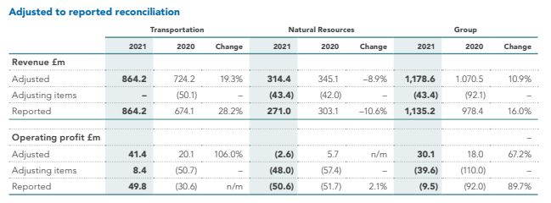
Costain PLC
Progress since 2020
Adjusted 2021 Group Operating Profit £30.1m

Slide 9
Costain PLC
Rationale for the acquisition:
Expand existing core market sectors
Market penetration into new market sectors with track history
Instant access to profitability
Increased market cap following restructure, to optimise short-term return
Secured order backlog
Utilisation of tax losses
Market awareness and greater UK and grow International coverage
Strong global brand identity and reputation

Slide 10
Costain PLC
Possible Growth Strategies through further acquisition could include:
Infrastructure savings with shared locations
Shared centralised resource – Legal, HR, Finance, Marketing, bidding, etc
Shared local IT support & infrastructure
Insurance cost from common policies
Improved sales and marketing
Economies of scale
Reduced staff and related costs
Proposal obviously subject to legal and financial due-diligence.

Slide 11
Business Case - Summary
Rationale for Acquisition of Costain PLC
Costain has a strong Global Brand identity and Reputation
Established business since 1865, Profitable and a Market Leader in its core Growth Markets of Transportation, Water, Energy and Defence, has a £4.2bn committed Order Book
Results in 2019/2020 were impacted by One-off Costs: due to impact of charges on the A465 contract (£45.4 million) and Peterborough & Huntingdon contract (£49.3 million), the result of an arbitration award (£9.7m) and aggregate charges for the loss on disposal and asset impairment for the Group’s non-core business assets in Spain (£8.9m)
Share price has suffered from One-off Losses and current Market Cap is only £107m, with Net Cash of £119m, making the Acquisition/ Enterprise Value of Costain attractive
Productivity Levels affected by Covid-19 have since been restored ( up to 90% by July 2020)
Adjusted Operating Profits were £18m and £30m in 2020/2021 respectively before Adjusting Items, and 2022/23 Profit forecasts are positive and growing – representing instant access to profitability, as well as utilization of historic Tax Losses, and synergistic savings post acquisition
Post Acquisition Growth Strategy
Realization of Synergy Savings in Overheads (Offices, Legal, HR, Finance, IT, Insurances, etc)
Economies of Scale
Merged Management Changes, improved Leadership, Marketing, Operational Management
Access to new Overseas Markets and investment in related Market growth and Diversification

