Slide 1
Idaho Cleanup Project Success Stories
Jack Zimmerman, Manager
Idaho Cleanup Project
Kliss McNeel
ES&H Director, Fluor Idaho

Slide 2
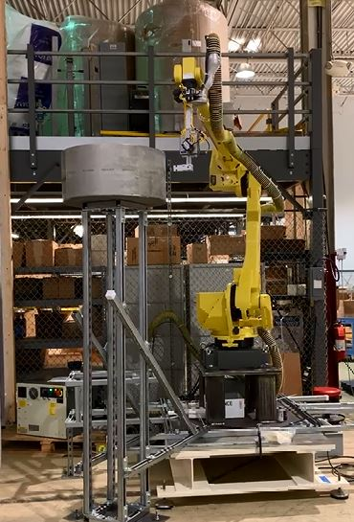
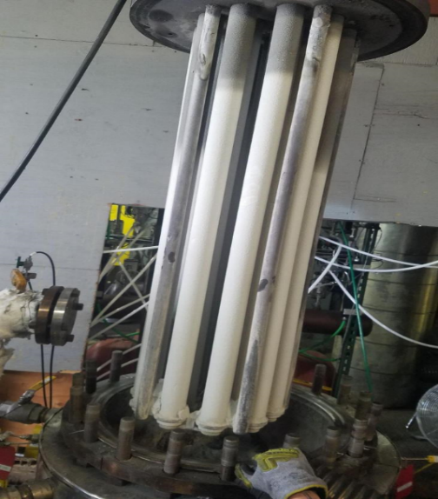
Integrated Waste Treatment Unit
Recent Simulant Run Confirmed Re-designed Unit Will Treat Waste
Sustained operations on simulated waste for over 50 days; longest plant operations to date
Processed over 63,000 gallons of simulant
Completed 14 of 14 test conditions
Process controls proved effective
No major equipment malfunctions or failures
Verified satisfactory performance at baseline and boundary conditions
Canister decontamination robot arm
Preparing for Rad Operations
PGF replacement media evaluation and selection completed
PGF filter design modifications and long term testing at Hazen
Integrated system testing of canister decontamination system.
Initiated installation of the cell wet/dry decon system
Refractron filter test at Hazen Facility

Slide 3
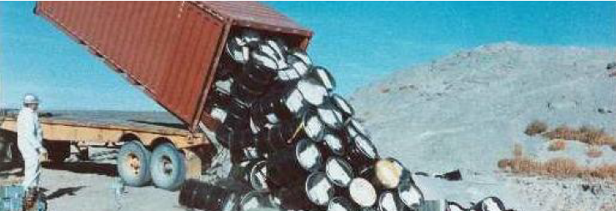
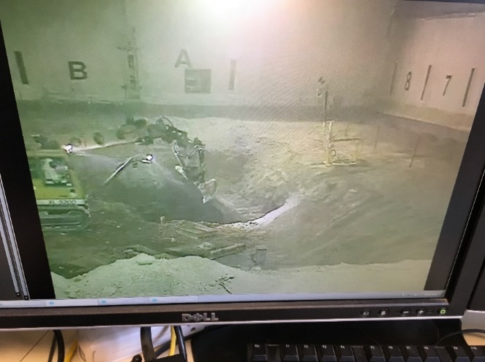
Buried Waste Exhumation
From 1954 to 1970, mixed waste was buried in unlined pits and trenches (left). Over the last 15 years, targeted buried waste has been exhumed in enclosures like the ARP-IX facility shown below.
Buried Waste Mission Near Completion
Under agreement with State of Idaho, DOE exhuming “targeted” buried waste – that with largest concentrations of plutonium and hazardous chemicals
As of 08/01/19, 9,077 cubic meters of buried waste have been exhumed and repackaged for offsite disposal – 121 percent of 7,485 required under the agreement with the State
As of 08/01/19, waste exhumed from just over 5 acres – the agreement requires exhumation from 5.69 acres; Anticipate completing ~1 year – almost 2 years ahead of our baseline schedule
Using a vapor vacuum extraction process, removed and destroyed 256,371 pounds of organic vapors from the subsurface.
Ultimate Remedy
Regulators approved final design of a trans-evaporation “cap” consisting of native soils and vegetation that will cover the entire Subsurface Disposal Area once exhumation is complete 4 months ahead of the milestone

Slide 4
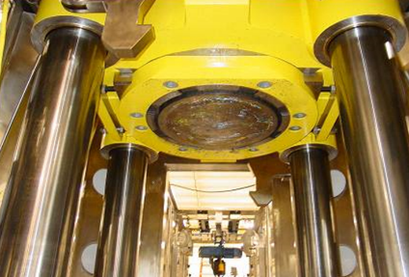
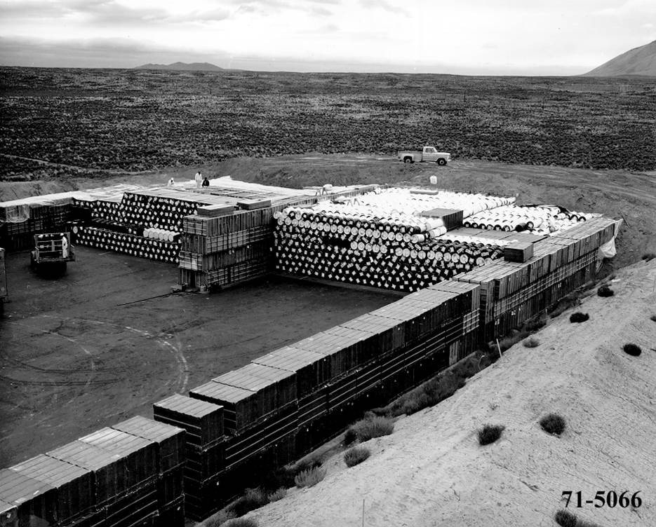
Solid Waste Treatment and Disposal--AMWTP
Advanced Mixed Waste Treatment Plant (AMWTP) was constructed to allow retrieval and treatment of stored waste.
A supercompactor was used to apply over 4 million pounds of pressure on waste drums, greatly reducing the volume of waste to be shipped and disposed at WIPP.
264,964 compactions resulting in 54,325 100-gallon product drums
59,795 cubic meters of Idaho Settlement Agreement waste dispositioned offsite.
6,023 cubic meters of exhumed targeted waste shipped to WIPP.
97% plant availability since commissioning
From 1970 to 1984, transuranic and mixed low-level waste that arrived from Rocky Flats and other sites was stacked on an asphalt pad and eventually covered with an earthen berm.

Slide 5
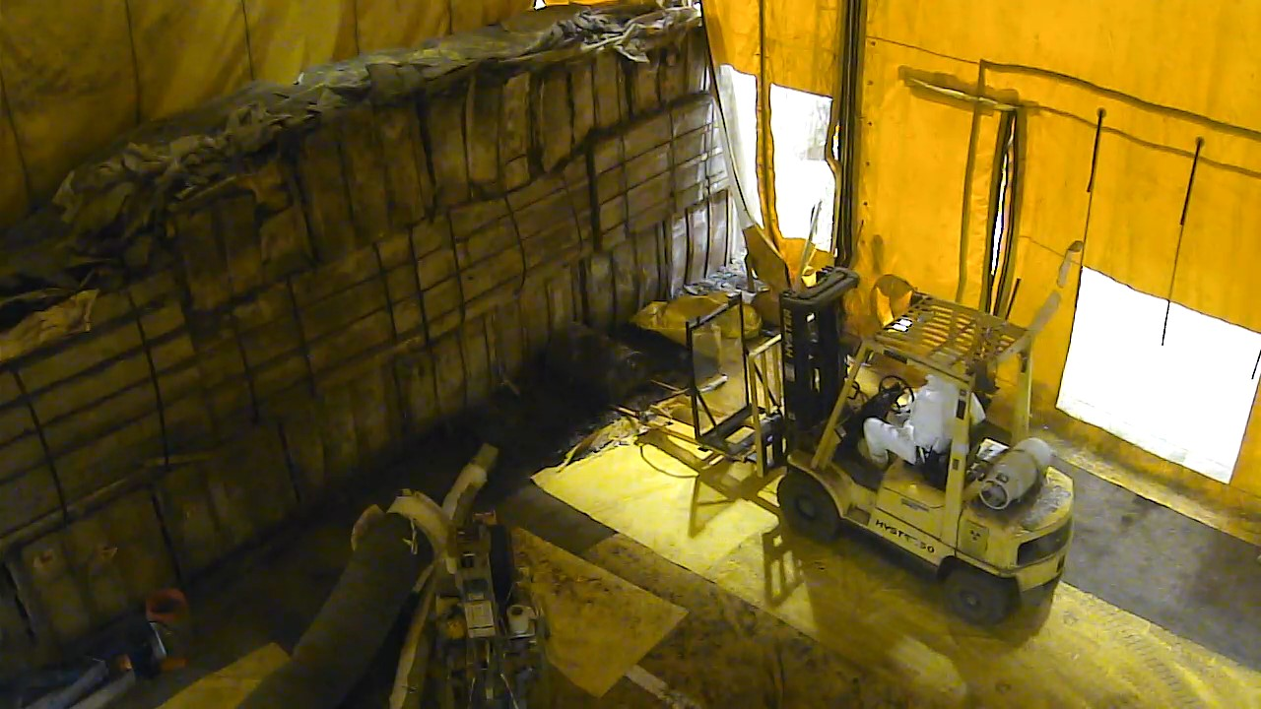
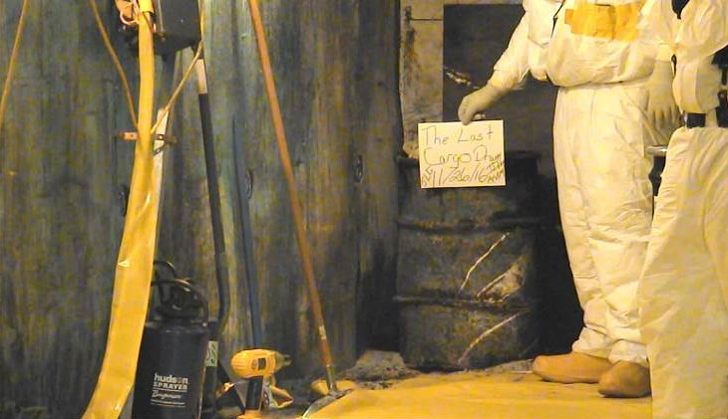
Solid Waste Treatment and Disposal (continued)
AMWTP Safety
Average 46,000 safe RadWorker entry hours/yr into high risk and highly contaminated areas
Safely completed 644,322 container movements in the past 4 years
Safely shipped 5,993 shipments of CH waste to WIPP
Thousands of boxes and drums, some badly deteriorated, were safely retrieved at the Transuranic Storage Area/Retrieval Enclosure over a period of about a dozen years (above).
Left, more than 14,500 drums were removed to get to this, the last drum stored in a cargo container, that was retrieved in late 2016.
Notes:
Average High Risk & Highly Contaminated Area entries only count the time in the areas by the workers, does not include the other workers who are not in those areas or that support the workers that have entered.
Average 150,000 container moves a year
Total safe man hours – I had an estimate from one of the Fluor folks but it was only for the Fluor contract and it was about 6.7 Million hours. Hard to calculate the total number of hours because of the contract changes
Saved approximately 6,000 shipments from being transported and disposed at WIPP by using the super-compactor

