Slide 1
Jordan Booster Club
Strategic Planning Retreat
July 18, 2018

Slide 2
Agenda
 |  | Time
Introductions and Planning Overview |  | 5:30 to 6:30
Planning Context and Review
Booster Club 2020 Vision and Goal Identification |  | 6:30 to 7:15
Break |  | 7:15 to 7:30
Key Strategy Development |  | 7:30 to 8:15
Implementation Considerations and Key Requirements |  | 8:15 to 9:00

Slide 3
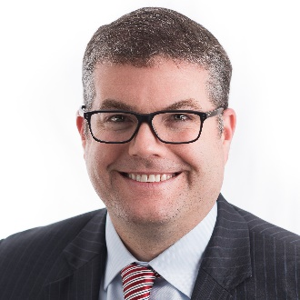
Introductions
Introductions and Planning Overview
Family
Lived in Jordan since 2005 (13+ Years)
Wife, Nicole, grew up in Jordan
Three boys Aiden, Finn, and Ari who will attend JHS, JMS, and JES respectively next year
Career
Healthcare Management Consultant
Specialty areas include Children’s Hospitals and Academic Medical Centers
Provide Strategic Advisory Services to Senior Leadership Teams and Boards
Rob Langheim
Community Involvement
Jordan School District Board Member
Booster Club Board Member
Univ of MN Carlson Consulting Enterprise Advisory Board Member

Slide 4
Key Questions
Introductions and Planning Overview
      Team Coordination
      How can the Booster Club more effectively interface / coordinate with each sport and activity?
      Middle School Presence
      What steps should we take to broaden the booster club to middle school sports and activities?
      Fundraising
      How do we most effectively coordinate around small scale and large scale fundraising pursuits?
      Corporate Sponsorships
      How should the School, Booster Club, and individual teams pursue corporate sponsorships?
      Membership Targets
      What are appropriate annual fundraising and membership targets?
      Merchandise
      What role should the school store (website) play in selling merchandise to support all sports and activities (new mascot designs and crest will be unveiled this year)?
      Gaming
      What is the quickest path to get a gambling license?
      Big Ticket Pursuits
      How should we coordinate on “big ticket” fundraiser pursuits (e.g., expansion of weight room, new field house)?
      Others?

Slide 5
Why a Booster Club?
Planning Context and Review
    Importance of Extracurricular Activities
    Numerous national studies show that participating in extracurricular
    activities (athletics, arts, clubs, etc.) increase a child’s level of success
Practice
Sacrifice
Hard Work
Time Management
Team Work
Goal Setting
Perseverance
Connection
Community
Identity
Safety
Friendships
Self-Esteem
Confidence
Self Actualization
Future Success
    Booster Club’s Role
    Support all teams and activities provide this important service to our students

Slide 6

Booster Club Mission & Values
Planning Context and Review
    Jordan Booster Club Mission Statement
    Support, encourage, and advance 7-12 grade activity programs of the Jordan School District and thereby cultivate wholesome school spirit, promote good sportsmanship, and develop high ideals of character

Slide 7
Booster Club Timeline and Key Milestones
Planning Context and Review
    Booster Club (while still young) has taken steps to serve as a strong umbrella organization to support Jordan’s sports teams and activities – organizational structure, board, financial controls, etc.
    Booster Club
    Launched
    First Donation
    Retail Store
    Launched
2015
2016
2017
2018
    Gambling Opportunity with Jordan Supper Club
    Initial Membership Drive

Slide 8
Booster Club Participation
Planning Context and Review
    17 Participating Teams & Activities; Over 150 unique families participating
Football
General Fund
(all activities)
Soccer: Boys
Basketball: Boys
Drama
Soccer: Girls
Basketball: Girls
Baseball
Softball
Cheerleading
Golf
Tennis
Cross Country
Music
Track
Dance
Robotics
Volleyball

Slide 9
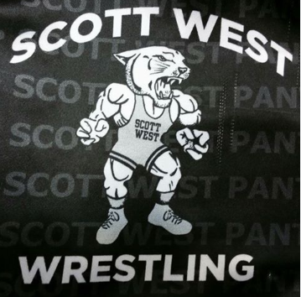

Booster Club Participation
Planning Context and Review
    Other Activities Not Included at this time
    Speech
    Spanish Club
    Other Booster Clubs (or Lookalikes)

Slide 10
Booster Club Timeline and Key Milestones
Planning Context and Review
    Modest membership and net contributions to-date; previous success with “membership levels”
Year
YR2015
YR2016
YR2017
Members
45
65
60
Net Contributions
$6,897
$9,933
$5,065
Cont. / Member
$153.27
$152.82
$84.41
No Levels; Members
Selected where what
team / activity wanted
donations to go

Slide 11
Booster Club & School District Fundraising
Planning Context and Review
    63 fundraisers targeted to families of 1,800 enrolled students and 6,000 residents; unknown proceeds
JES, JMS, and JHS
Fundraisers
JHS Fundraisers
Only
JHS Sports / Activities Fundraisers
63
49
25
    JES: Pennies for Patients
    JES: PTO Readathon
    JMS: Candy Bar Sales for Wolf Ridge
    JHS: Senior Class Magazine Sales
    JHS: Poster Ad Sales for SW Wresting
    JHS: Spanish Club Fundraisers (6)
    Gold Cards
    Spaghetti Dinner
    Golf Tournament

Slide 12
Booster Club Financials
Planning Context and Review
    District budgets $275,000 annually for ALL sports and activities; $165,000 for “Booster” sponsored activities
2018 Jordan School District Annual Budget
$165,000 in annual support
for all activities supported
by Booster Club
Note 1: Concessions

Slide 13
Booster Club Financials
Planning Context and Review
    Cash balances in individual funds range from $0 to $18,000; general fund has $11,000
June 2018 Booster Club Cash Balance
Total Dollars = $113,519
Note 1: Concessions

Slide 14
Booster Club Support
Planning Context and Review
    The Booster Club has provided funding to the following teams and activities over the last three years:
      Softball Spring Training Trip
      Football Bleachers
      Coaches Donation
      Weight Room Updates
      Cheerleading Camp
      Concession Supplies
      Softball Outfield Fence
      Football Uniforms
      Dollars for Scholars
      Athletic Equipment
      Captain Council Shirts
      Basketball Pads for Shoes
      Robotic Supplies
      Speaker Fees for Rick Rassier and Darrel Thompson
      Waseca Baseball for field the burned down
      Cancer Fundraising Donations
      Alumni Night Food
      End of Season Awards / Banquets
      Annual Coach Dues

Slide 15
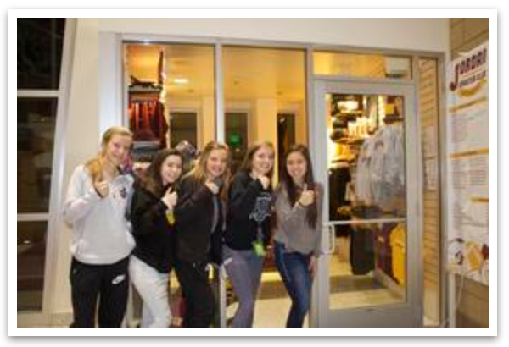
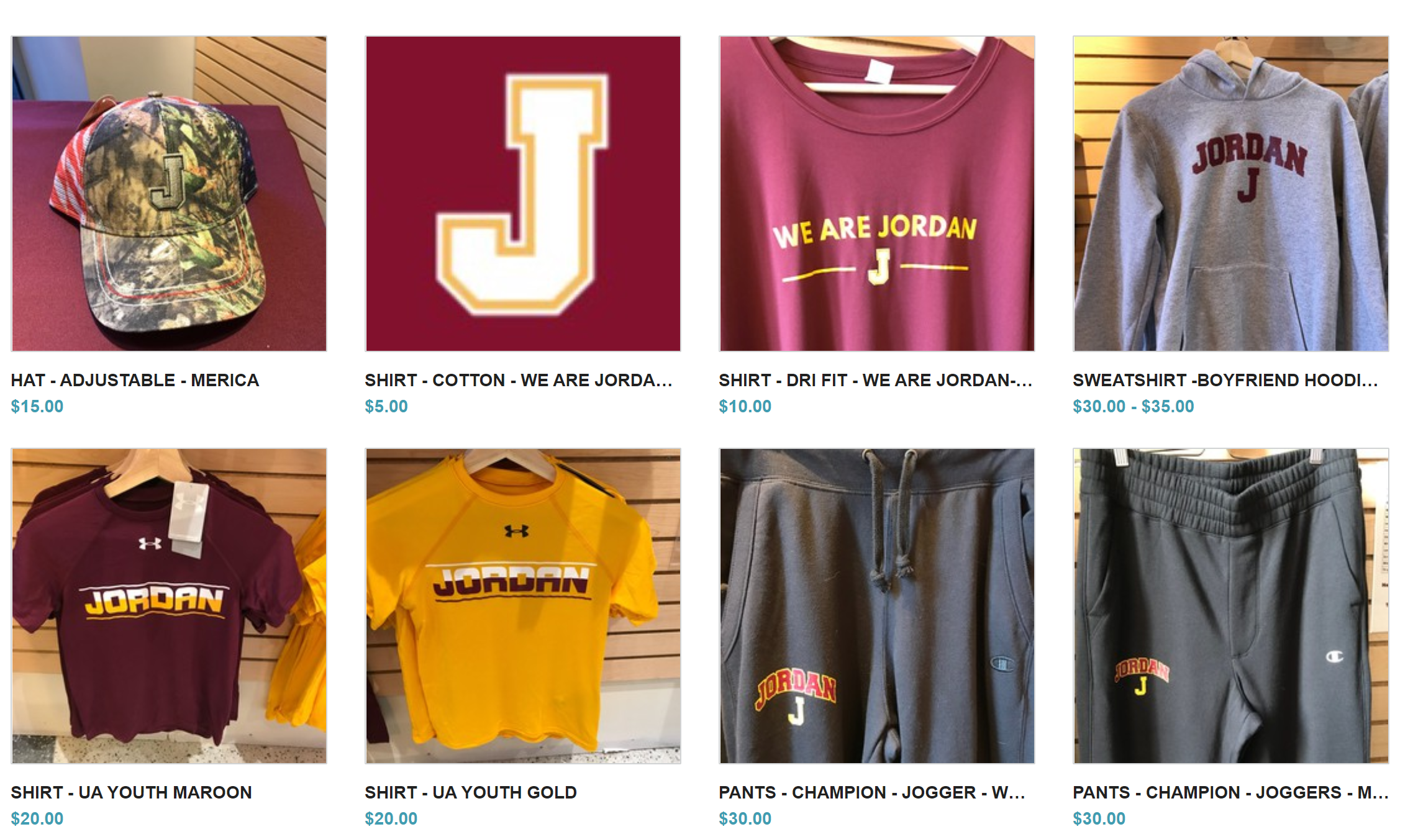
School Store and Website
Planning Context and Review
    School Store launched in 2017; On-line store now able to sell select items
    Opportunity to use store and website as a “one stop” location for purchasing Jordan merchandise
High School Store
On-line Spirit Store

Slide 16
Clothing and Merchandise Contracting
Planning Context and Review
    Jordan Public Schools have negotiated contracts with BSN, Nike, and Varsity Brands; all clothing purchases should take advantage of these negotiated contracts to maximize activity and community benefit
BSN Incentive Program
Nike Uniform Contract
Varsity Brands
Jordan to receive a 10% rebate on ALL purchases made by JPS programs, community education, and the booster club
Jordan will purchase ALL uniforms through BSN/Nike. In doing so, Nike to give Jordan Activities Department $10,000 per year in Nike stock for next 5 years
Jordan to receive VIP Branding to rebrand its Mascot Logos and School Crest and will receive a new mascot costume at no cost
Value of $10,000 on purchase
of $100,000 in inventory
Value of $50,000 over 5 years
Value of $14,500

Slide 17

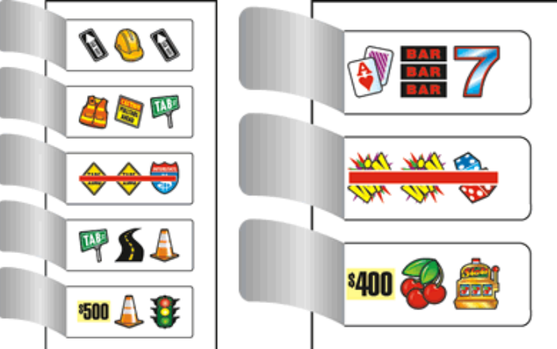
Gaming
Planning Context and Review
    Opportunity to benefit from Pull Tab proceeds at the Jordan Supper Club / Tap Room
    In process of receiving state gambling license; opportunity for $25,000+ annually through this endeavor
    Framework needed in where dollars go --- general fund, big ticket purchase fund, spread across each activity fund

Slide 18
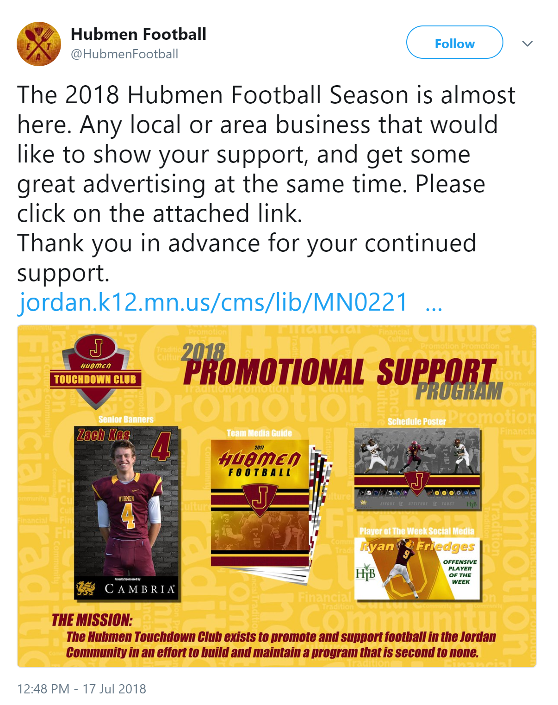
Corporate & Individual Support
Planning Context and Review
Jordan School District
Booster Club
Individual Teams
    BSN Sports
    Nike
    VIP Branding
    St. Francis Medical Center
    Dick Ames
    Jiv Pauley
    NA
    Twin Cities Orthopedics
    Cambria

Slide 19
“Best in Class” Booster Club Takeaways
Planning Context and Review
1. Must ensure Jordan’s Booster Club is positioned to maximize our overall community impact
$$$$$$
Advanced
Strong, Highly Engaged Board
Coordinated, Diverse Fundraising
Strong Financial Infrastructure
Strong Membership
Strong Overall and Individual Brands
Consistent Communication
$$
Moderate
Board & Committee Structure
Emerging Brand Recognition
Strong Financial Infrastructure
Focused Fundraising
$
Basic
*501c3 Tax Except Status*
Semi-committed Board
Modest Membership Aspirations
Loose, Uncoordinated Fundraising
Near Term, Annual Budget Focus
$ = Community Impact

Slide 20
“Best in Class” Booster Club Takeaways
Planning Context and Review
2. Ensure the Booster Club is well organized and has clear protocols
Category | Best In Class
Clear Vision | Alignment with school district and individual sports / activities
Strong Leadership | President, VP, Treasurer, Secretary
Established Committees | Membership, Retail, Communications, Alumni, Spirit, Fundraising
Lofty Membership Goals | 50% School Families; 20% Alumni
Consistent Communication | Social media messaging, website
Focused Revenue Activities | Memberships, Sponsorships, Concessions, Retail, Fundraisers, etc.
Fundraising Coordination | 1 individual team fundraiser; 2 Booster Club galas
Clear Funds Flow | % Margin to Individual Funds; % Margin to General Fund
Sponsored Key Activities | Coach conferences, awards, wall of fame

Slide 21
“Best in Class” Booster Club Takeaways
Planning Context and Review
    3. Maximize Community Engagement
People seek out opportunities to be part of something bigger than themselves --- that said, the activity (1) must be compelling and (2) people must feel like they can play a role
Fewer, bigger Fundraising Events
Active Engagement with Coaches & Administration
Clear roles and areas of responsibility
Strong connection with alumni
Fun, inviting atmosphere
Compelling Purpose Statement
Spreading of volunteer tasks and requests

Slide 22
“Best in Class” Booster Club Takeaways
Planning Context and Review
    4. Establish Clear Guidelines in Distributing Proceeds to “Boost” sports and activities
    Guiding Principles Related to Distributing Funds
    Booster Club to fund 50% of request to help monitor need / want
    Booster Club DOES NOT provide funding for uniforms out of the general or gaming fund
    All request records are kept to maintain transparency
    Treasurer provides update on account balances at each monthly meeting
      Account #1: General and SAA
      Account #2: Retail
      Account #3: Gaming
    Set working capital amount in Retail and Gaming Account; transfer margin at EOY
    All purchases coming from General Account require “pre-approved” purchase order with 2 signatures, including a school administrator
    No conflicts of interest related to signing purchase orders

Slide 23
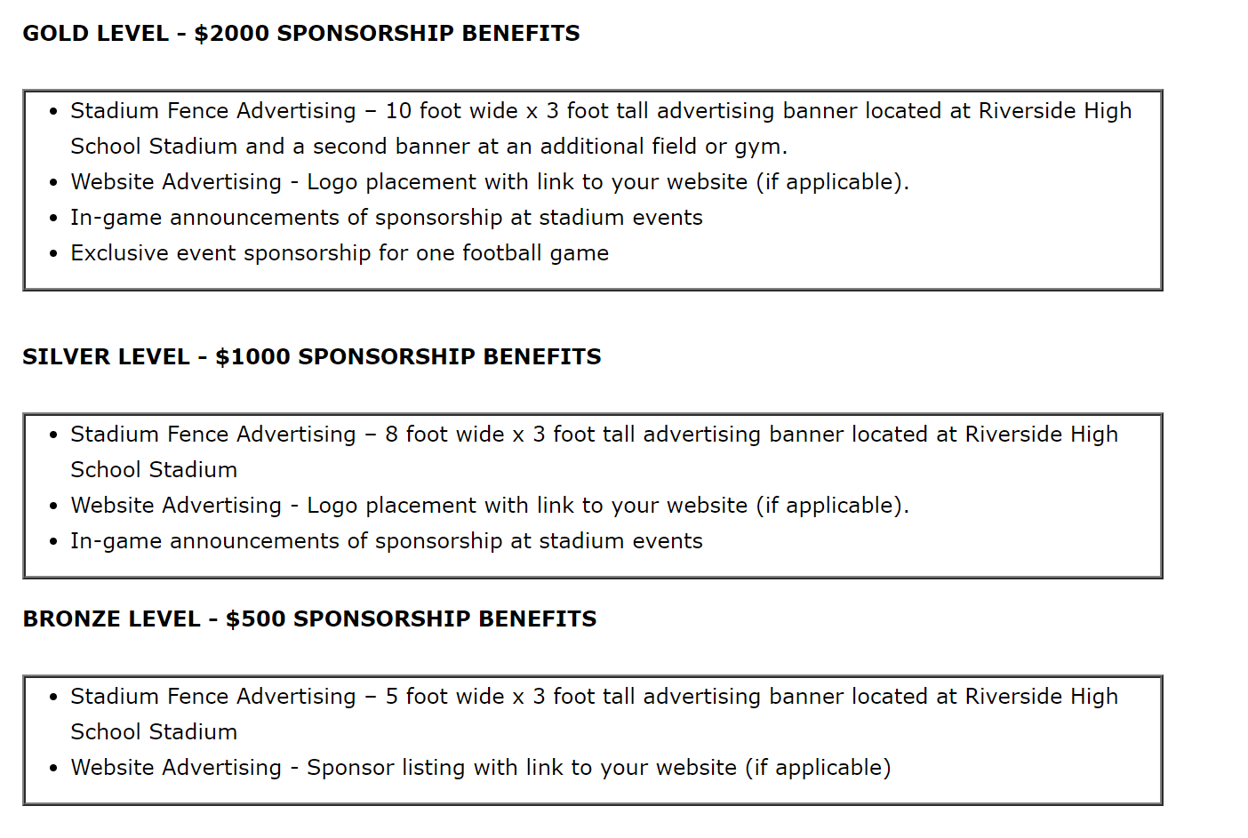
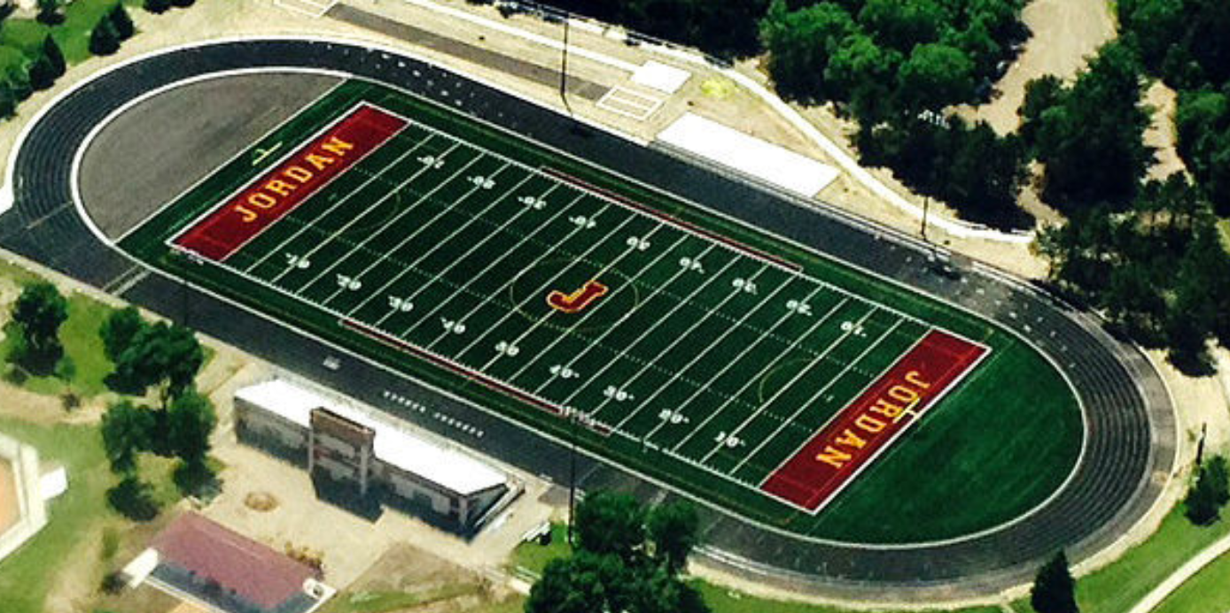
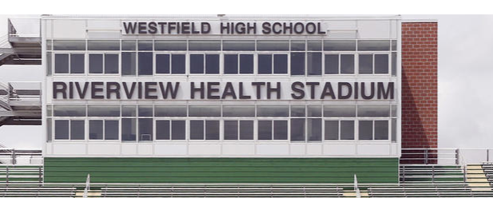
“Best in Class” Booster Club Takeaways
Planning Context and Review
    5. Ensure clear vision and tight coordination related to corporate sponsorship pursuits
Generous Annual Support
Extremely Generous,
Specific Project Support
or Naming Rights

Slide 24
Polling Questions
Planning Context and Review
    I identify myself as follows:
      Coach, Board Member, District Representative
    I think the Booster Club plays an important role in advancing Jordan athletics and activities
      Strongly agree, Agree, Disagree, Strongly Disagree
    I believe we have an opportunity to significantly increase Booster Club membership and engagement
      Strongly agree, Agree, Disagree, Strongly Disagree
    I believe the Booster Club has the biggest opportunity to increase membership is by
      Targeting families with students enrolled in the district
      Focusing on alumni
      Promoting the Booster Club at school and community sponsored events
    I believe we have the population size and number of volunteers to have separate booster clubs for select sports
      Strongly agree, Agree, Disagree, Strongly Disagree
    I believe more money can be generated by having fewer, larger fundraising efforts
      Strongly agree, Agree, Disagree, Strongly Disagree

Slide 25
Polling Questions
Planning Context and Review
    My biggest fear in pursuing a more coordinated fundraising strategy is:
      Potentially giving up my established fundraisers
      Not receiving enough annual funds from the district to sustain my program
      Not receiving enough support from fundraising efforts to support my program
      Other
    I believe it’s clear on what coaches can request from the Booster Club general fund?
      Strongly agree, Agree, Disagree, Strongly Disagree, Not Sure
    I believe the current process to request funds from the general fund are overly complicated
      Strongly agree, Agree, Disagree, Strongly Disagree, Not Sure
    I think the savings and incentives are large enough to exclusively use BSN services and Nike branding for all purchased services
      Strongly agree, Agree, Disagree, Strongly Disagree, Not Sure
    I believe the School Store and website (if done well) would serve as a great “one stop” location for purchasing all Jordan sponsored apparel
      Strongly agree, Agree, Disagree, Strongly Disagree

Slide 26
Polling Questions
Planning Context and Review
    The District, Booster Club, and teams should have a more coordinated approach to reaching out to corporate sponsors
      Strongly agree, Agree, Disagree, Strongly Disagree
    Booster Club should support a bigger ticket fundraising initiatives
      Strongly agree, Agree, Disagree, Strongly Disagree

Slide 27
Booster Club 2020 Vision and Goal Identification

Slide 28
2020 Vision
Proposed Strategic Direction
    Equipping Teams be More Successful
    Increased Membership
    Stronger Community Engagement
    Fundraising for Bigger Ticket Items
    Consistent Communication
    Stronger connections with Alumni
    Greater Coordination with Coaches and District Representatives

Slide 29
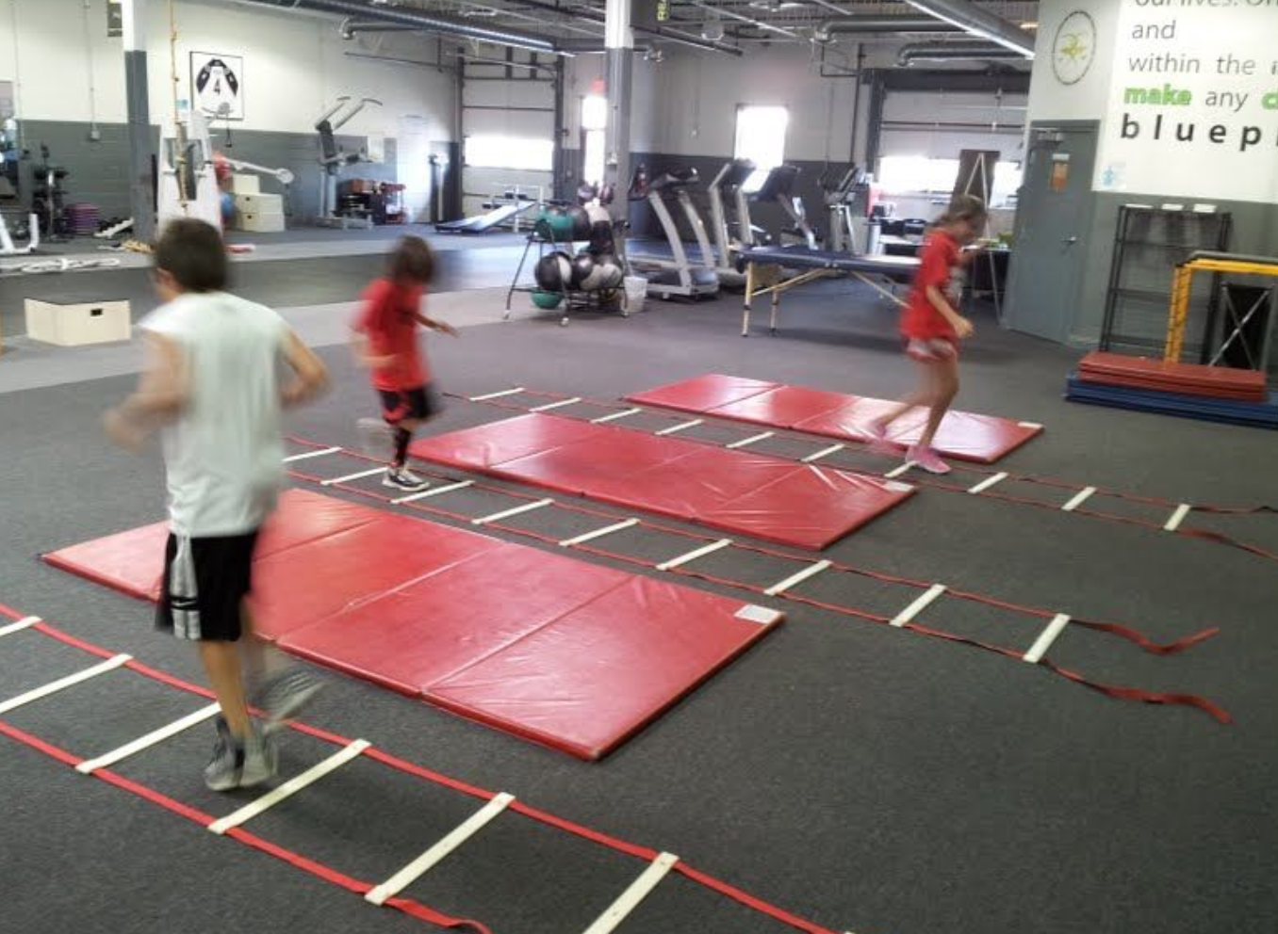

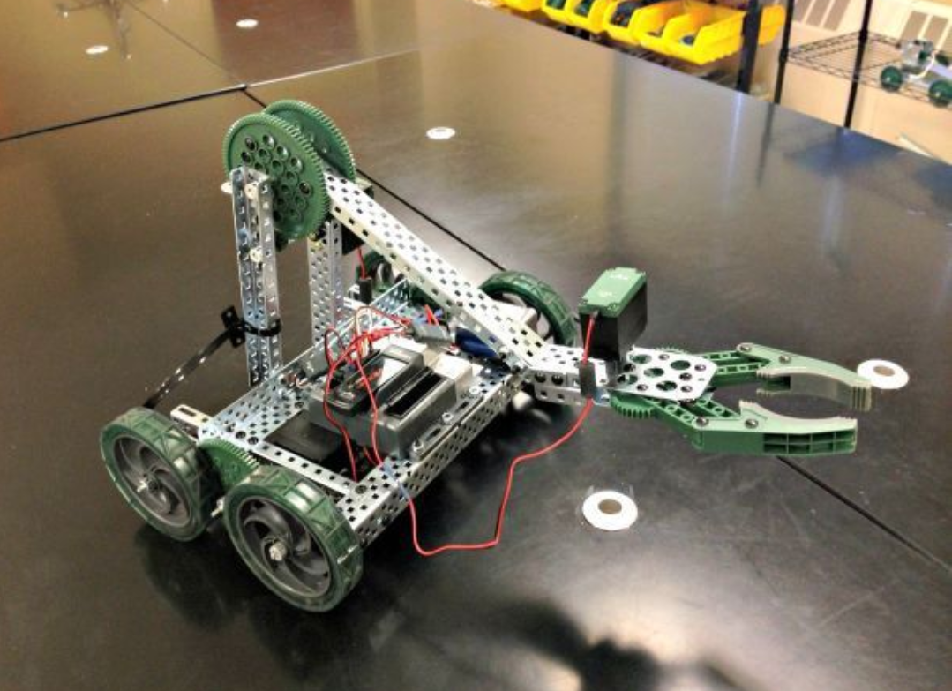
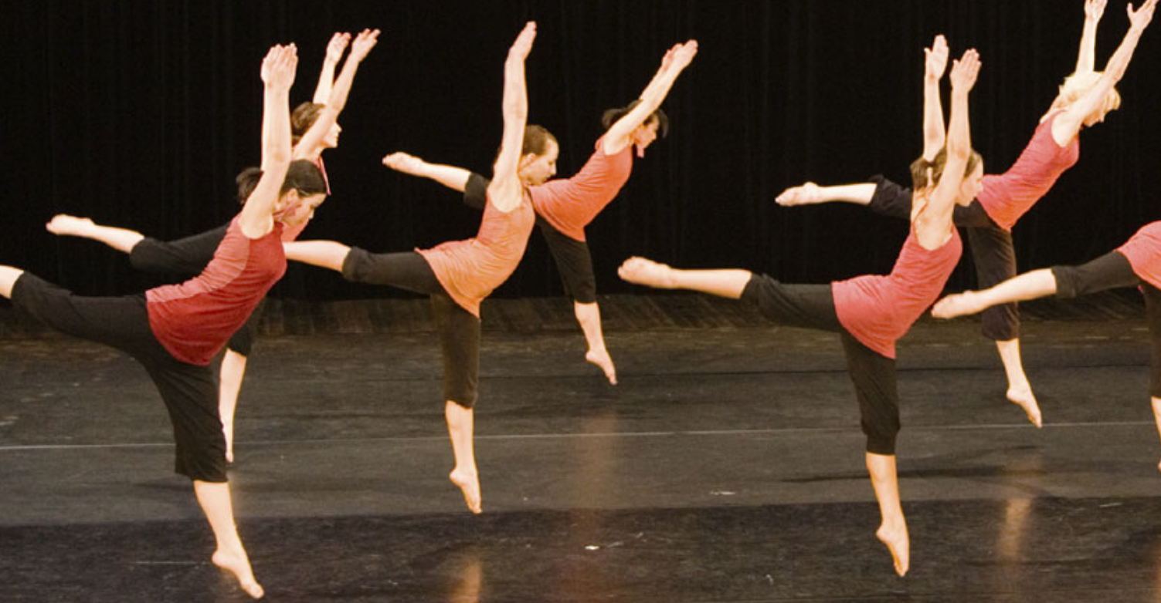
2020 Vision
Proposed Strategic Direction
    New Weight Room?
    New Field House?
    New Performance Center?

Slide 30
Mission, Strategic Pillars & Goals
1
2
3
Membership
Board Member Lead
Attract New Members
Retain Existing Members
Membership Benefit Package
Retail and Gaming
Board Member Lead
Product Selection Merchandise Management
Gaming
Communication
Board Member Lead
Website Management
Social Media
Activity Coverage
4
5
6
Alumni
Board Member Lead
Contact List Management
Engagement Activities
Wall of Fame Ceremony
Spirit
Board Member Lead
Event Planning
Concessions Coordination
Volunteer Coordinator
Fundraising
Board Member Lead
Fundraising Coordination
Gala Planning

Slide 31
Mission, Strategic Pillars & Goals
1
Membership
Board Member Lead
Attract New Members
Retain Existing Members
Membership Benefit Package
    Goal #1: Increase participation from 60 to ___ members
    Strategy 1
    Strategy 2
    Strategy 3
    Goal #2: Increase alumni participation to ___ members
    Strategy 1
    Strategy 2
    Strategy 3
    Goal #3: Retain _% of existing members
    Strategy 1
    Strategy 2
    Strategy 3

Slide 32
Mission, Strategic Pillars & Goals
2
Retail and Gaming
Board Member Lead
Product Selection Merchandise Management
Gaming
    Goal #1:
    Strategy 1
    Strategy 2
    Strategy 3
    Goal #2:
    Strategy 1
    Strategy 2
    Strategy 3
    Goal #3:
    Strategy 1
    Strategy 2
    Strategy 3

Slide 33
Mission, Strategic Pillars & Goals
3
Communication
Board Member Lead
Website Management
Social Media
Activity Coverage
    Goal #1:
    Strategy 1
    Strategy 2
    Strategy 3
    Goal #2:
    Strategy 1
    Strategy 2
    Strategy 3
    Goal #3:
    Strategy 1
    Strategy 2
    Strategy 3

Slide 34
Mission, Strategic Pillars & Goals
4
Alumni
Board Member Lead
Contact List Management
Engagement Activities
Wall of Fame Ceremony
    Goal #1:
    Strategy 1
    Strategy 2
    Strategy 3
    Goal #2:
    Strategy 1
    Strategy 2
    Strategy 3
    Goal #3:
    Strategy 1
    Strategy 2
    Strategy 3

Slide 35
Mission, Strategic Pillars & Goals
5
Spirit
Board Member Lead
Event Planning
Concessions Coordination
Volunteer Coordinator
    Goal #1:
    Strategy 1
    Strategy 2
    Strategy 3
    Goal #2:
    Strategy 1
    Strategy 2
    Strategy 3
    Goal #3:
    Strategy 1
    Strategy 2
    Strategy 3

Slide 36
Mission, Strategic Pillars & Goals
6
Fundraising
Board Member Lead
Fundraising Coordination
Gala Planning
    Goal #1:
    Strategy 1
    Strategy 2
    Strategy 3
    Goal #2:
    Strategy 1
    Strategy 2
    Strategy 3
    Goal #3:
    Strategy 1
    Strategy 2
    Strategy 3

Slide 37
Next Steps

