Slide 1

Chapin Area Rescue Squad
2017
Emergency Medical Responder

Slide 2
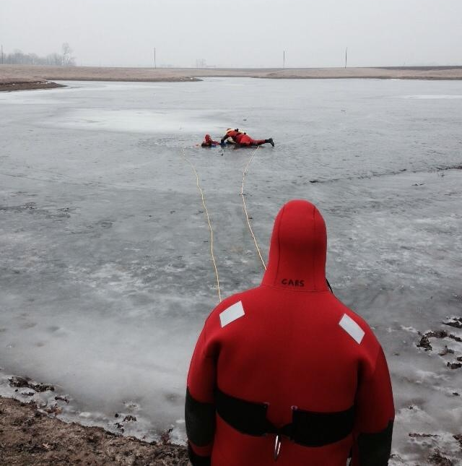
Chapter Twelve: Environmental Emergencies

Slide 3
Objectives
Define Key Terms
Describe Heat Loss and Production
S/S, Assessment and Management of Hyop/Hyper thermia
Injuries associated with water-incidents
Safe techniques for water/ice rescue
S/S, Assessment and Management of bites and stings

Slide 4
Cold Exposure
How the Body Loses Heat
  Conduction
  Convection
  Radiation
  Evaporation
  Respiration
Predisposing factors of hypothermia
  Injury
  Chronic illness
  Geriatric/pediatric

Slide 5
Hypothermia Assessment
Shivering, in early stages
Numbness
Stiff or rigid posture
Drowsiness
Rapid breathing or pulse
Loss of motor coordination
Joint/muscle stiffness
Unconsciousness
Cool abdominal skin temperature

Slide 6
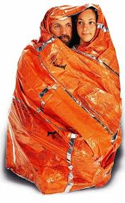
Rewarming the Patient
Passive
  Cover patient
  Remove wet clothing
Active
  Apply external heat source
Central
  Apply heat to lateral chest, neck,
  armpits, and groin

Slide 7
Extreme Hypothermia
Patient unconscious, no discernible vital signs
  Heart rate can slow to 10 beats/minute
  Very cold to touch
If no pulse, start CPR with AED
If pulse present, care as for any unresponsive patient
“You’re not dead until you’re warm and dead”
Handle the patient gently
  Risk for cardiac issues, such as V-Fib

Slide 8
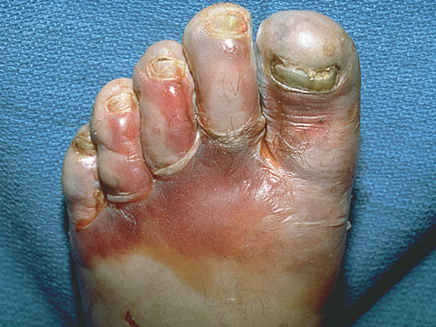
Localized Cold Injuries
Most commonly affects ears, nose, face, hands, and feet
  Blood flow limited by constriction of blood vessels
  Tissues freeze, may form ice crystals
Early/superficial (frostnip)
  Remove from cold and cover
Late/deep (frostbite)
  Cover and immobilize gently

Slide 9
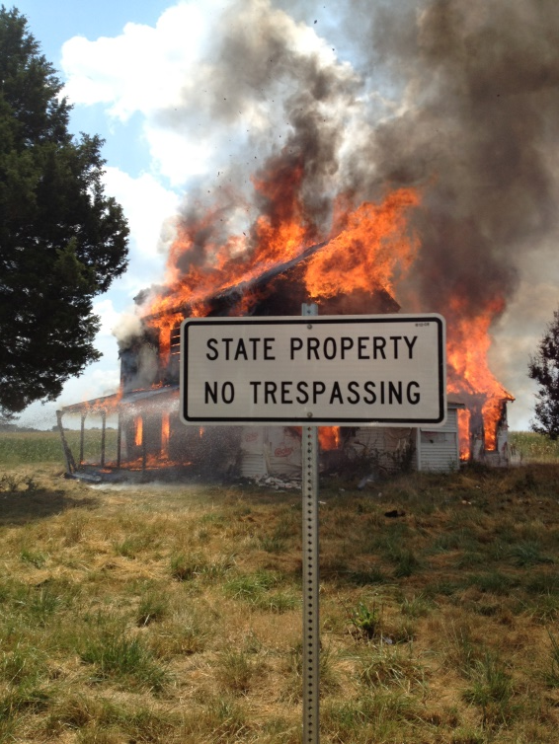
Heat
Heat not needed for temperature maintenance, and not lost, creates hyperthermia
Left unchecked, leads to death
Heat cramps and heat exhaustion
  Moist, pale, normal-to-cool skin
Heat stroke
  Hot, dry, or possibly moist skin

Slide 10
Heat Exhaustion
Muscular cramps
Weakness or exhaustion
Rapid, shallow breathing
Weak pulse
Heavy perspiration
Loss of consciousness

Slide 11
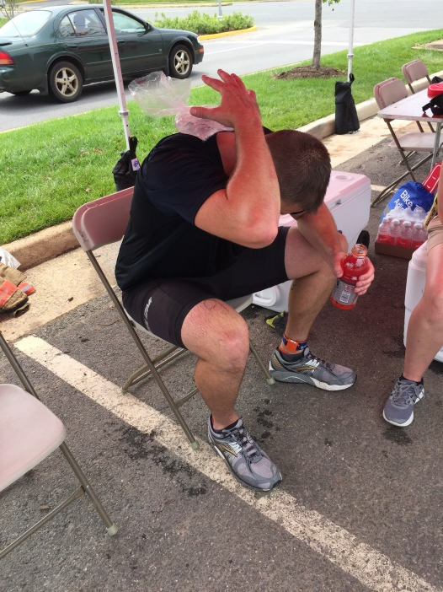
Treatment of Heat Exhaustion
Remove from hot environment
Administer oxygen
Loosen or remove clothing
Position supine
Small sips of water
Transport

Slide 12
Heat Stroke
Rapid, shallow breathing
Full, rapid pulse
Generalized weakness
Little or no perspiration
Altered mental status
Dilated pupils
Seizures

Slide 13
Treatment of Heat Stroke
Remove from hot environment
Remove clothing
Apply cool packs to neck, groin, and armpits
Administer oxygen
Transport immediately

Slide 14
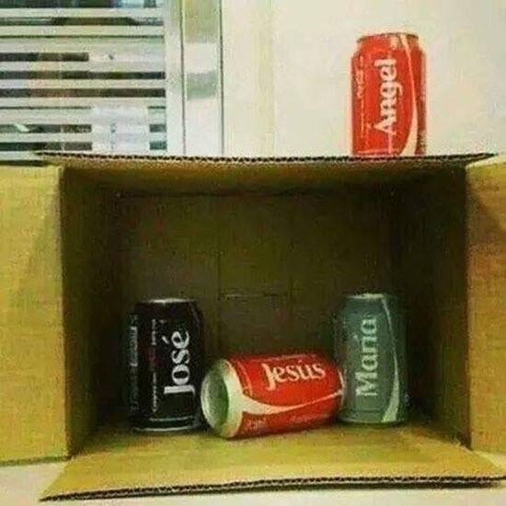
Water Emergencies
Boating
Water-skiing
Wind surfing
Jet-skiing
Diving
Scuba-diving

Slide 15
Drowning
Often begins as person struggles to keep afloat
When they start to submerge, they try to take one more deep breath
Water may enter airway, followed by coughing and swallowing, and involuntary swallowing of more water
Reflex spasm of larynx is triggered, sealing airway; unconsciousness results from hypoxia
Most attempt a final breath (or are unconscious) and water enters lungs

Slide 16
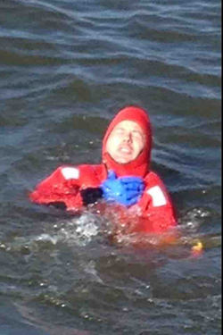
Drowning Treatment
Begin rescue breathing without delay
If you reach a non-breathing patient in water, support patient in semi-supine position and provide ventilations
May encounter airway resistance; will probably have to ventilate more forcefully than other patients
Do not delay transport

Slide 17
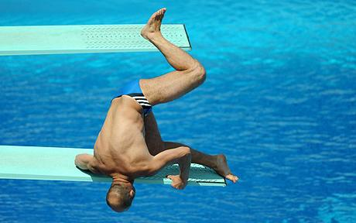
Diving Accidents
Most involve head and neck, but many also involve spine, hands, feet, and ribs
Emergency care is the same as for any accident patient out of water

Slide 18

SCUBA
Arterial gas embolism (gas bubbles in bloodstream): diver holding breath
  May be due to inadequate training, equipment failure, underwater emergency, or trying to conserve air
Decompression sickness: diver surfacing too quickly from deep, prolonged dive
  Takes 1–48 hours to appear
Diver Alert Network: 919-684-8111

Slide 19
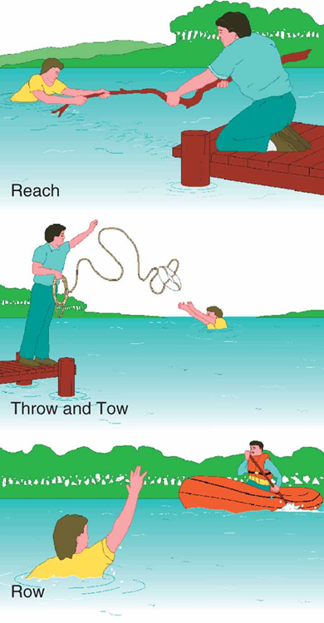
Water Rescue (EMT Level)
Reach
  Hold object for patient to grab
Throw
  Throw object that will float
Row
  Row boat to patient
Go
  Swim to patient (last resort)

Slide 20
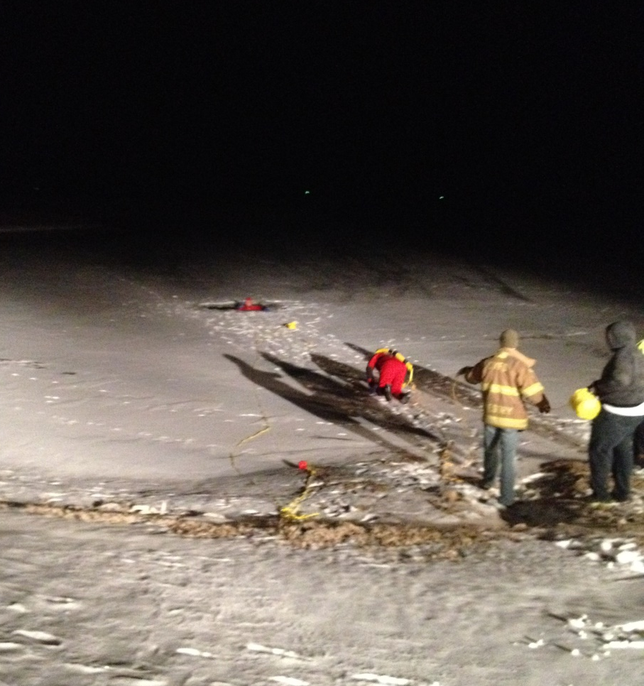
Ice Rescue (EMT)
Throw flotation device to patient
Toss rope with loop
Push out flat bottomed aluminum boat
Lay ladder flat on ice to distribute weight of rescuer
Treat patient for hypothermia
Always transport

Slide 21
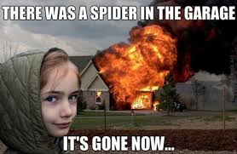
Spider and Insect Bites
All spiders are poisonous
Insect stings and bites are rarely dangerous
Anaphylactic shock
is a major concern
Remove stinger
quickly

Slide 22
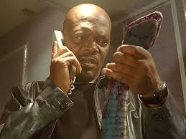
SNAKES
Require special care but are not usually life-threatening
Death is not sudden unless anaphylactic shock develops
Stay calm
Keep patient calm
and at rest

Slide 23
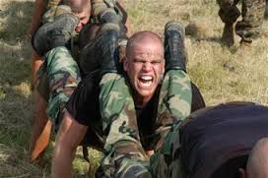
Marine Life
Can occur in variety of ways
  Eating improperly prepared seafood or poisonous organisms
  Stings and punctures
Fresh water activates toxins on skin, increasing pain
Use salt water to rinse affected area

Slide 24
