Slide 1
2015 MCBS Chartbook: Supplement
Data Year 2015

Slide 2
Overview
This slide deck contains reusable versions of the exhibits contained in the 2015 MCBS Chartbook, including the exhibit titles, graphs, source documentation and footnotes, for public use.
When reusing these exhibits, please be sure to include the associated source documentation and footnotes that accompany each chart.
This slide deck does not contain the detailed statistical tables, glossary or technical appendix that are included in the MCBS Chartbook. Please consult these resources as needed.
For detailed point estimates, see the detailed statistical tables.
For definitions of key terms and information on the construction of measures, see the glossary.
For technical information on the production of the estimates and standard errors, see the technical appendix.
Link to 2015 MCBS Chartbook: https://www.cms.gov/Research-Statistics-Data-and-Systems/Research/MCBS/Data-Tables.html

Slide 3
Section 1: Who is in the Medicare Population?

Slide 4
Exhibit 1.1
Demographic and Socioeconomic Characteristics of All Medicare Beneficiaries, 2015
SOURCE: Centers for Medicare & Medicaid Services, Medicare Current Beneficiary Survey, Survey File, 2015.
NOTES: Totals may not sum to 100 percent due to rounding. Estimates are not presented for the "other race/ethnicity" category. FPL stands for Federal Poverty Level.

Slide 5
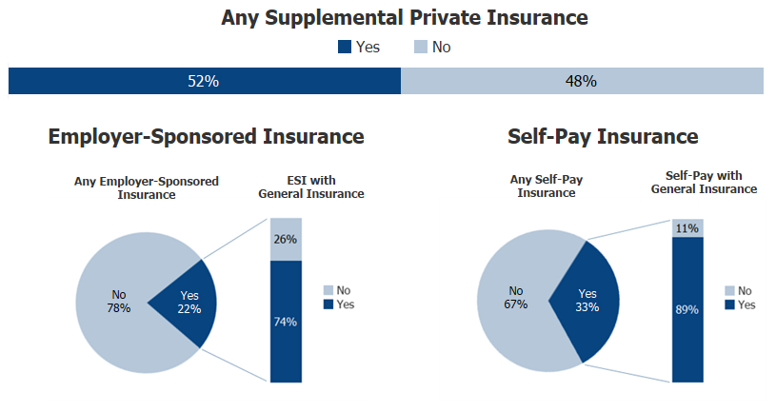
Exhibit 1.2
Insurance Coverage of All Medicare Beneficiaries, 2015
SOURCE: Centers for Medicare & Medicaid Services, Medicare Current Beneficiary Survey, Survey File, 2015.
NOTES: Totals may not sum to 100 percent due to rounding. FFS stands for Fee-for-Service. MA stands for Medicare Advantage. Supplemental private insurance includes beneficiaries who have employer-sponsored insurance, self-pay insurance, or both types of insurance. ESI stands for Employer-Sponsored Insurance. General insurance refers to major medical coverage.

Slide 6
Exhibit 1.3
Type of Medicare Coverage and Dual Eligible Status of All Medicare Beneficiaries by Age, 2015
SOURCE: Centers for Medicare & Medicaid Services, Medicare Current Beneficiary Survey, Survey File, 2015.
NOTES: Totals may not sum to 100 percent due to rounding. FFS stands for Fee-for-Service. "Yes" includes beneficiaries with both full-benefit and partial-benefit Medicaid coverage.

Slide 7
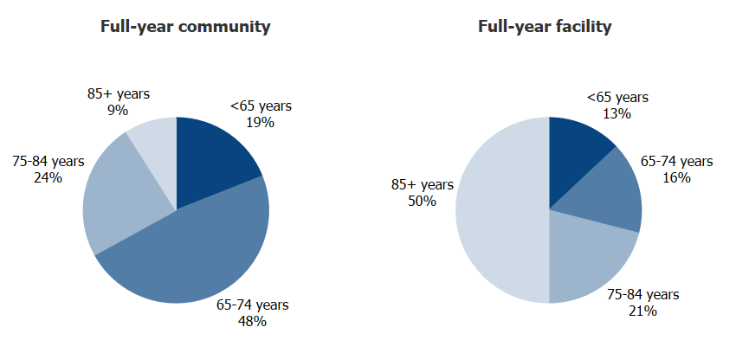
Exhibit 1.4
Residence Status of All Medicare Beneficiaries by Age, 2015
SOURCE: Centers for Medicare & Medicaid Services, Medicare Current Beneficiary Survey, Survey File, 2015.
NOTES: Totals may not sum to 100 percent due to rounding. Estimates for the category “Both community and facility” are not presented due to suppression.

Slide 8
Section 2: How Healthy are Medicare Beneficiaries?

Slide 9
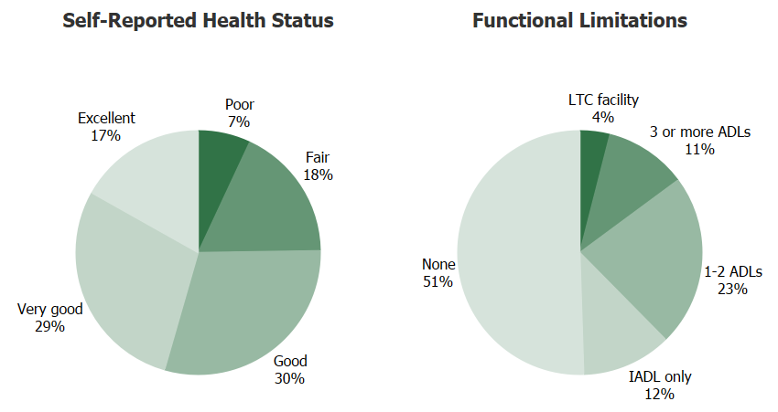
Exhibit 2.1
Quality of Life Metrics Among All Medicare Beneficiaries, 2015
SOURCE: Centers for Medicare & Medicaid Services, Medicare Current Beneficiary Survey, Survey File, 2015.
NOTES: Totals may not sum to 100 percent due to rounding. Beneficiaries who were administered a community interview answered questions themselves, unless they were unable to do so. A facility staff member, such as a nurse, always answered questions about the beneficiary for long-term care facility interviews. Data for beneficiaries residing in long-term care facilities were drawn from the Long Term Care Minimum Data Set (MDS) 3.0 when available. LTC stands for Long-Term Care. ADL stands for Activities of Daily Living. IADL stands for Instrumental Activities of Daily Living. "LTC facility" includes beneficiaries who resided only in a long-term care facility during the year.

Slide 10
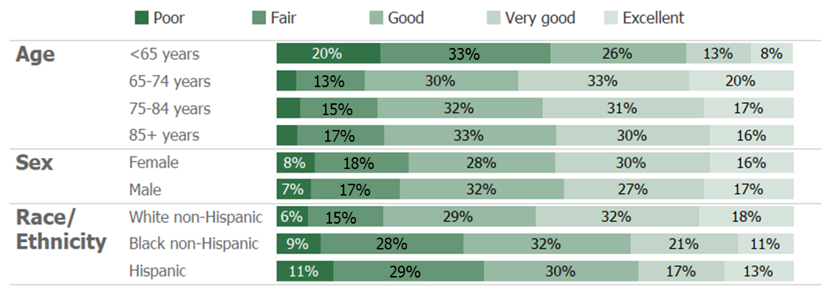
Exhibit 2.2
Self-Reported Health Status Among All Medicare Beneficiaries by Age, Sex, and Race/Ethnicity, 2015
SOURCE: Centers for Medicare & Medicaid Services, Medicare Current Beneficiary Survey, Survey File, 2015.
NOTES: Totals may not sum to 100 percent due to rounding. Beneficiaries who were administered a community interview answered questions themselves, unless they were unable to do so. A facility staff member, such as a nurse, always answered questions about the beneficiary for long-term care facility interviews. Data for beneficiaries residing in long-term care facilities were drawn from the Long Term Care Minimum Data Set (MDS) 3.0 when available. Estimates are not presented for the "other race/ethnicity" category.

Slide 11
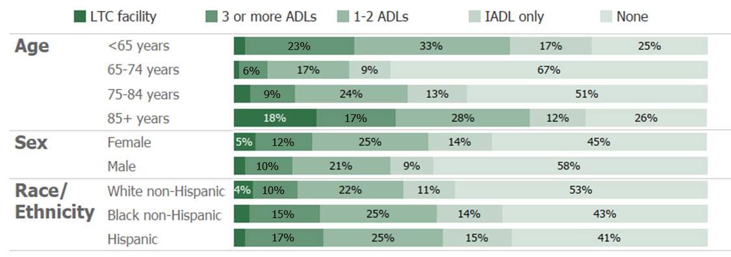
Exhibit 2.3
Functional Limitations Among All Medicare Beneficiaries by Age, Sex, and Race/Ethnicity, 2015
SOURCE: Centers for Medicare & Medicaid Services, Medicare Current Beneficiary Survey, Survey File, 2015.
NOTES: Totals may not sum to 100 percent due to rounding. Beneficiaries who were administered a community interview answered questions themselves, unless they were unable to do so. A facility staff member, such as a nurse, always answered questions about the beneficiary for long-term care facility interviews. Data for beneficiaries residing in long-term care facilities were drawn from the Long Term Care Minimum Data Set (MDS) 3.0 when available. Estimates are not presented for the "other race/ethnicity" category. LTC stands for Long-Term Care. ADL stands for Activities of Daily Living. IADL stands for Instrumental Activities of Daily Living. "LTC facility" includes beneficiaries who resided only in a long-term care facility during the year.

Slide 12
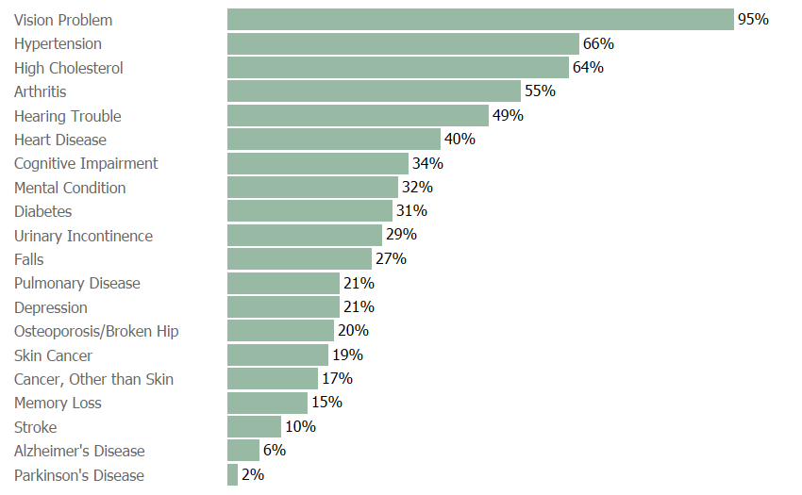
Exhibit 2.4
Self-Reported Chronic and Other Health Conditions Among All Medicare Beneficiaries, 2015
SOURCE: Centers for Medicare & Medicaid Services, Medicare Current Beneficiary Survey, Survey File, 2015.
NOTES: Totals may not sum to 100 percent due to rounding. Beneficiaries who were administered a community interview answered questions themselves, unless they were unable to do so. A facility staff member, such as a nurse, always answered questions about the beneficiary for long-term care facility interviews. Data for beneficiaries residing in long-term care facilities were drawn from the Long Term Care Minimum Data Set (MDS) 3.0 when available.

Slide 13
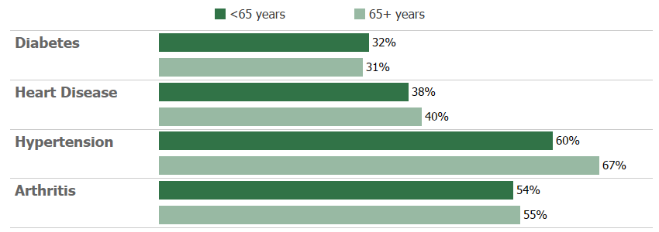
Exhibit 2.5
Selected Self-Reported Chronic Conditions Among All Medicare Beneficiaries by Age, 2015
SOURCE: Centers for Medicare & Medicaid Services, Medicare Current Beneficiary Survey, Survey File, 2015.
NOTES: Totals may not sum to 100 percent due to rounding. Beneficiaries who were administered a community interview answered questions themselves, unless they were unable to do so. A facility staff member, such as a nurse, always answered questions about the beneficiary for long-term care facility interviews. Data for beneficiaries residing in long-term care facilities were drawn from the Long Term Care Minimum Data Set (MDS) 3.0 when available.

Slide 14
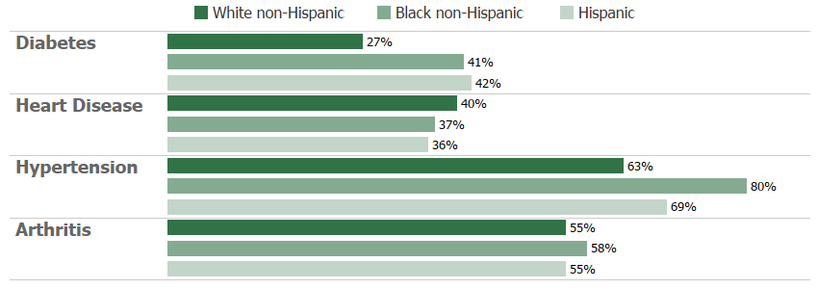
Exhibit 2.6
Selected Self-Reported Chronic Conditions Among All Medicare Beneficiaries by Race/Ethnicity, 2015
SOURCE: Centers for Medicare & Medicaid Services, Medicare Current Beneficiary Survey, Survey File, 2015.
NOTES: Totals may not sum to 100 percent due to rounding. Beneficiaries who were administered a community interview answered questions themselves, unless they were unable to do so. A facility staff member, such as a nurse, always answered questions about the beneficiary for long-term care facility interviews. Data for beneficiaries residing in long-term care facilities were drawn from the Long Term Care Minimum Data Set (MDS) 3.0 when available. Estimates are not presented for the "other race/ethnicity" category.

Slide 15
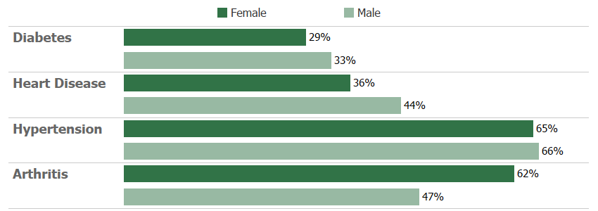
Exhibit 2.7
Selected Self-Reported Chronic Conditions Among All Medicare Beneficiaries by Sex, 2015
SOURCE: Centers for Medicare & Medicaid Services, Medicare Current Beneficiary Survey, Survey File, 2015.
NOTES: Totals may not sum to 100 percent due to rounding. Beneficiaries who were administered a community interview answered questions themselves, unless they were unable to do so. A facility staff member, such as a nurse, always answered questions about the beneficiary for long-term care facility interviews. Data for beneficiaries residing in long-term care facilities were drawn from the Long Term Care Minimum Data Set (MDS) 3.0 when available.

Slide 16
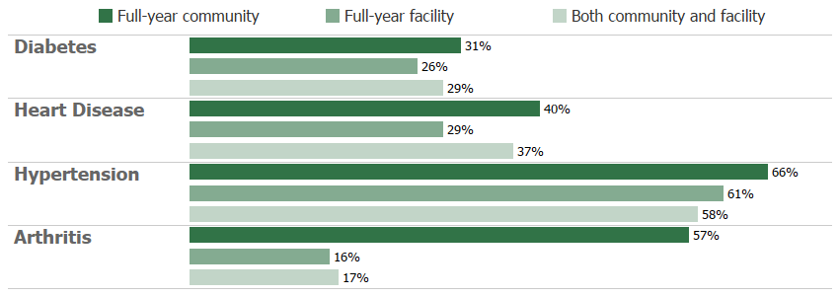
Exhibit 2.8
Selected Self-Reported Chronic Conditions Among All Medicare Beneficiaries by Residence Status, 2015
SOURCE: Centers for Medicare & Medicaid Services, Medicare Current Beneficiary Survey, Survey File, 2015.
NOTES: Totals may not sum to 100 percent due to rounding. Beneficiaries who were administered a community interview answered questions themselves, unless they were unable to do so. A facility staff member, such as a nurse, always answered questions about the beneficiary for long-term care facility interviews. Data for beneficiaries residing in long-term care facilities were drawn from the Long Term Care Minimum Data Set (MDS) 3.0 when available.

Slide 17
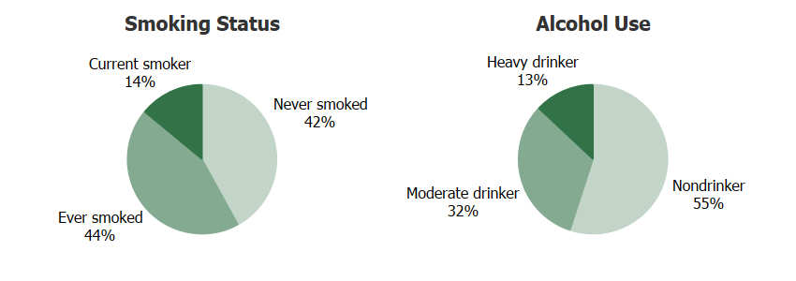
Exhibit 2.9
Self-Reported Health Risk Factors Among All Medicare Beneficiaries, 2015
SOURCE: Centers for Medicare & Medicaid Services, Medicare Current Beneficiary Survey, Survey File, 2015.
NOTES: Totals may not sum to 100 percent due to rounding. Beneficiaries who were administered a community interview answered questions themselves, unless they were unable to do so. A facility staff member, such as a nurse, always answered questions about the beneficiary for long-term care facility interviews. Data for beneficiaries residing in long-term care facilities were drawn from the Long Term Care Minimum Data Set (MDS) 3.0 when available.

Slide 18
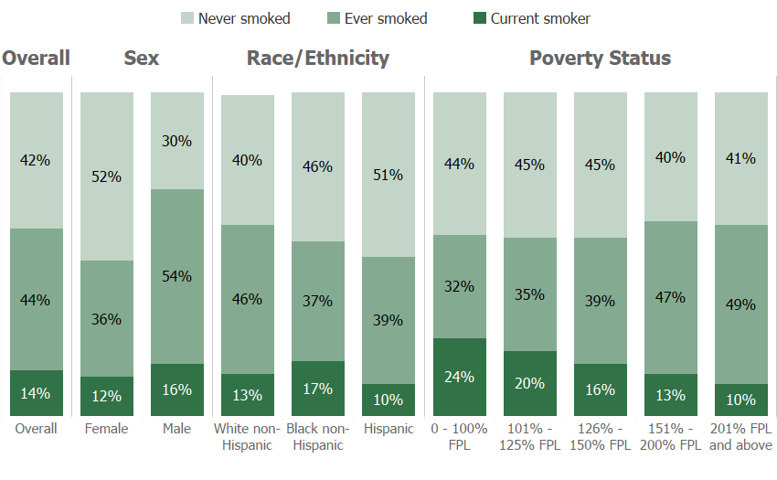
Exhibit 2.10
Self-Reported Smoking Status Among All Medicare Beneficiaries by Sex, Race/Ethnicity, and Poverty Status, 2015
SOURCE: Centers for Medicare & Medicaid Services, Medicare Current Beneficiary Survey, Survey File, 2015.
NOTES: Totals may not sum to 100 percent due to rounding. Beneficiaries who were administered a community interview answered questions themselves, unless they were unable to do so. A facility staff member, such as a nurse, always answered questions about the beneficiary for long-term care facility interviews. Data for beneficiaries residing in long-term care facilities were drawn from the Long Term Care Minimum Data Set (MDS) 3.0 when available. Estimates are not presented for the "other race/ethnicity" category, although they are included in the total. FPL stands for Federal Poverty Level.

Slide 19
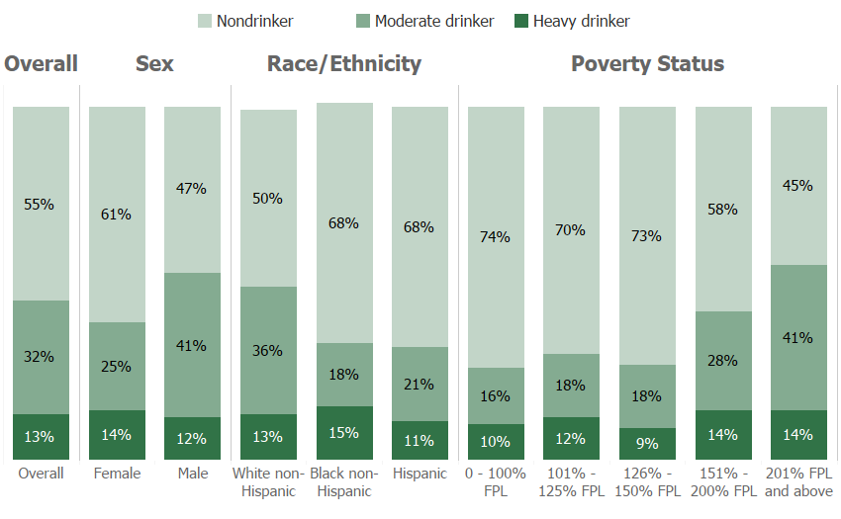
Exhibit 2.11
Self-Reported Alcohol Use Among All Medicare Beneficiaries by Sex, Race/Ethnicity, and Poverty Status, 2015
SOURCE: Centers for Medicare & Medicaid Services, Medicare Current Beneficiary Survey, Survey File, 2015.
NOTES: Totals may not sum to 100 percent due to rounding. Beneficiaries who were administered a community interview answered questions themselves, unless they were unable to do so. A facility staff member, such as a nurse, always answered questions about the beneficiary for long-term care facility interviews. Data for beneficiaries residing in long-term care facilities were drawn from the Long Term Care Minimum Data Set (MDS) 3.0 when available. Estimates are not presented for the "other race/ethnicity" category, although they are included in the total. FPL stands for Federal Poverty Level.

Slide 20
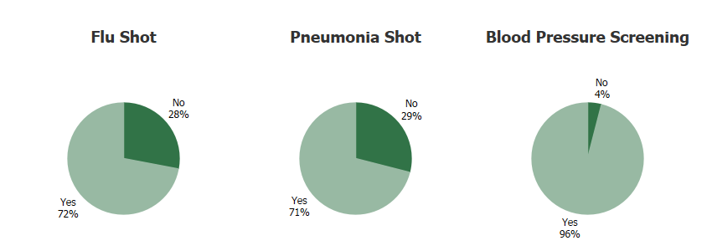
Exhibit 2.12
Preventive Health Behaviors Among Medicare Beneficiaries Residing in the Community, 2015
SOURCE: Centers for Medicare & Medicaid Services, Medicare Current Beneficiary Survey, Survey File, 2015.
NOTES: Totals may not sum to 100 percent due to rounding. Estimates are presented for beneficiaries who resided only in the community during the year, and includes beneficiaries who resided part of the year in the community and part of the year in a long-term care facility. This excludes beneficiaries who resided only in a long-term care facility during the year. Beneficiaries who were administered a community interview answered questions themselves, unless they were unable to do so. A facility staff member, such as a nurse, always answered questions about the beneficiary for long-term care facility interviews. Data for beneficiaries residing in long-term care facilities were drawn from the Long Term Care Minimum Data Set (MDS) 3.0 when available. The flu shot measure is coded as "Yes" if it was done in the last year. The pneumonia shot measure is coded as "Yes" if it was ever done. The blood pressure screening measure is coded as "Yes" if it was done in the last year.

Slide 21
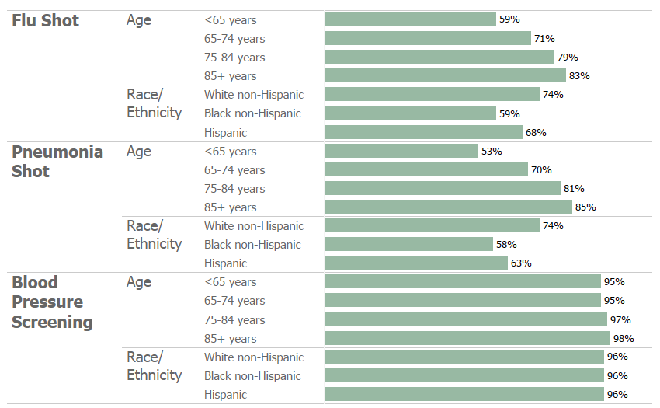
Exhibit 2.13
Preventive Health Behaviors Among Medicare Beneficiaries Residing in the Community by Age and Race/Ethnicity, 2015
SOURCE: Centers for Medicare & Medicaid Services, Medicare Current Beneficiary Survey, Survey File, 2015.
NOTES: Totals may not sum to 100 percent due to rounding. Estimates are presented for beneficiaries who resided only in the community during the year, and includes beneficiaries who resided part of the year in the community and part of the year in a long-term care facility. This excludes beneficiaries who resided only in a long-term care facility during the year. Beneficiaries who were administered a community interview answered questions themselves, unless they were unable to do so. A facility staff member, such as a nurse, always answered questions about the beneficiary for long-term care facility interviews. Data for beneficiaries residing in long-term care facilities were drawn from the Long Term Care Minimum Data Set (MDS) 3.0 when available. Estimates are not presented for the "other race/ethnicity" category. The flu shot measure is coded as "Yes" if it was done in the last year. The pneumonia shot measure is coded as "Yes" if it was ever done. The blood pressure screening measure is coded as "Yes" if it was done in the last year.

Slide 22
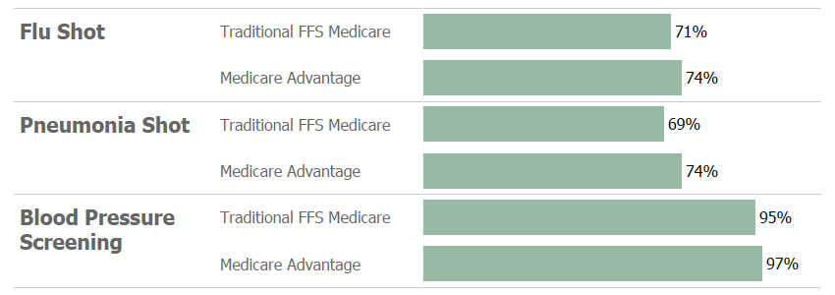
Exhibit 2.14
Preventive Health Behaviors Among Medicare Beneficiaries Residing in the Community by Type of Medicare Coverage, 2015
SOURCE: Centers for Medicare & Medicaid Services, Medicare Current Beneficiary Survey, Survey File, 2015.
NOTES: Totals may not sum to 100 percent due to rounding. Estimates are presented for beneficiaries who resided only in the community during the year, and includes beneficiaries who resided part of the year in the community and part of the year in a long-term care facility. This excludes beneficiaries who resided only in a long-term care facility during the year. Beneficiaries who were administered a community interview answered questions themselves, unless they were unable to do so. A facility staff member, such as a nurse, always answered questions about the beneficiary for long-term care facility interviews. Data for beneficiaries residing in long-term care facilities were drawn from the Long Term Care Minimum Data Set (MDS) 3.0 when available. FFS stands for Fee-for-Service. The flu shot measure is coded as "Yes" if it was done in the last year. The pneumonia shot measure is coded as "Yes" if it was ever done. The blood pressure screening measure is coded as "Yes" if it was done in the last year.

Slide 23
Section 3: What is the Medicare Population’s Access to Care and How Satisfied are They With Their Care?

Slide 24
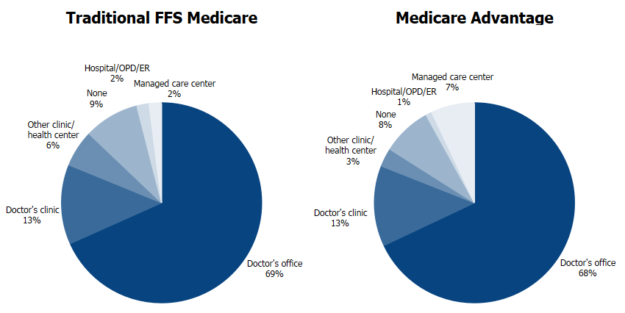
Exhibit 3.1
Usual Source of Care Among Medicare Beneficiaries Residing Only in the Community by Type of Medicare Coverage, 2015
SOURCE: Centers for Medicare & Medicaid Services, Medicare Current Beneficiary Survey, Survey File, 2015.
NOTES: Totals may not sum to 100 percent due to rounding. Estimates are presented for beneficiaries who resided only in the community during the year. This excludes beneficiaries who resided part of the year in the community and part of the year in a long-term care facility, and beneficiaries who resided only in a long-term care facility during the year. FFS stands for Fee-for-Service. OPD stands for Outpatient Department. ER stands for Emergency Room.

Slide 25
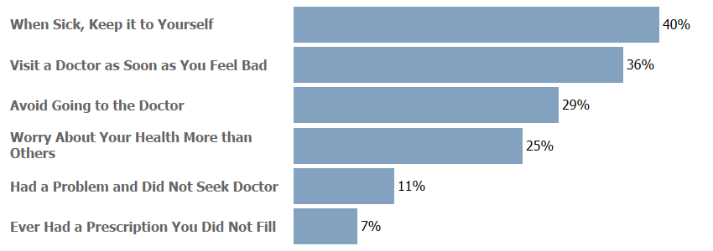
Exhibit 3.2
Indicators of Propensity to Seek Care Among Medicare Beneficiaries Residing Only in the Community, 2015
SOURCE: Centers for Medicare & Medicaid Services, Medicare Current Beneficiary Survey, Survey File, 2015.
NOTES: Totals may not sum to 100 percent due to rounding. Estimates are presented for beneficiaries who resided only in the community during the year. This excludes beneficiaries who resided part of the year in the community and part of the year in a long-term care facility, and beneficiaries who resided only in a long-term care facility during the year.

Slide 26
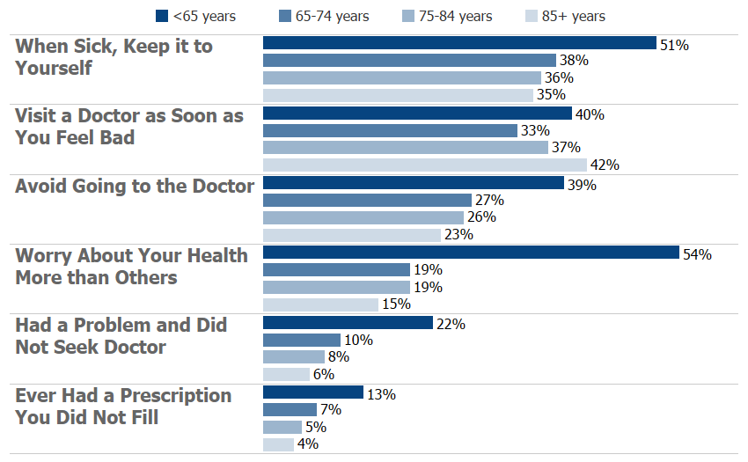
Exhibit 3.3
Indicators of Propensity to Seek Care Among Medicare Beneficiaries Residing Only in the Community by Age, 2015
SOURCE: Centers for Medicare & Medicaid Services, Medicare Current Beneficiary Survey, Survey File, 2015.
NOTES: Totals may not sum to 100 percent due to rounding. Estimates are presented for beneficiaries who resided only in the community during the year. This excludes beneficiaries who resided part of the year in the community and part of the year in a long-term care facility, and beneficiaries who resided only in a long-term care facility during the year.

Slide 27
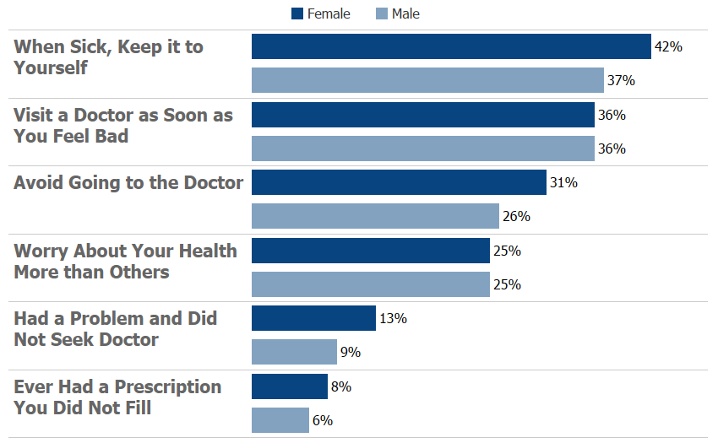
Exhibit 3.4
Indicators of Propensity to Seek Care Among Medicare Beneficiaries Residing Only in the Community by Sex, 2015
SOURCE: Centers for Medicare & Medicaid Services, Medicare Current Beneficiary Survey, Survey File, 2015.
NOTES: Totals may not sum to 100 percent due to rounding. Estimates are presented for beneficiaries who resided only in the community during the year. This excludes beneficiaries who resided part of the year in the community and part of the year in a long-term care facility, and beneficiaries who resided only in a long-term care facility during the year.

Slide 28
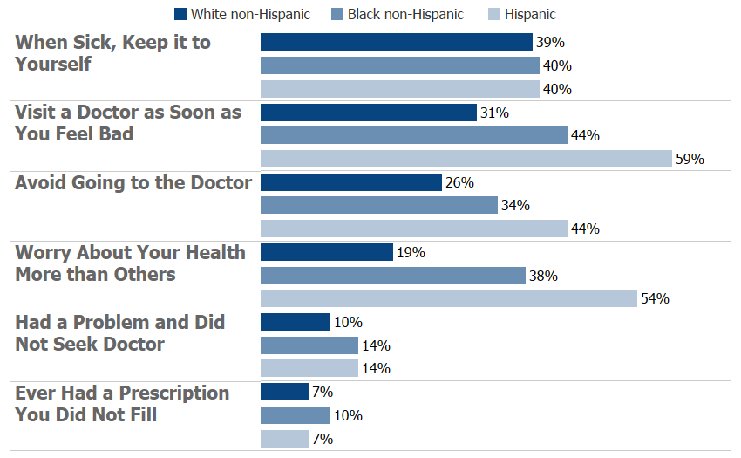
Exhibit 3.5
Indicators of Propensity to Seek Care Among Medicare Beneficiaries Residing Only in the Community by Race/Ethnicity, 2015
SOURCE: Centers for Medicare & Medicaid Services, Medicare Current Beneficiary Survey, Survey File, 2015.
NOTES: Totals may not sum to 100 percent due to rounding. Estimates are presented for beneficiaries who resided only in the community during the year. This excludes beneficiaries who resided part of the year in the community and part of the year in a long-term care facility, and beneficiaries who resided only in a long-term care facility during the year. Estimates are not presented for the "other race/ethnicity" category.

Slide 29
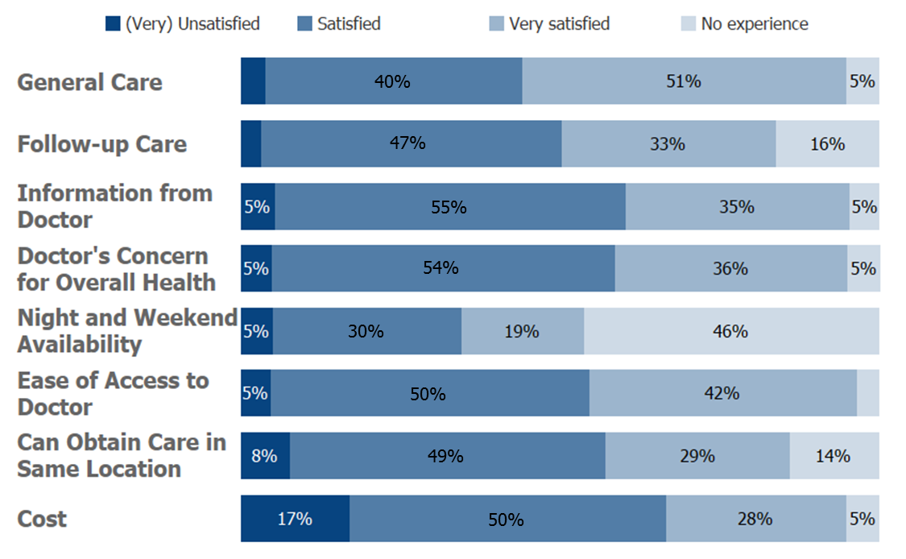
Exhibit 3.6
Indicators of Satisfaction with Care Among Medicare Beneficiaries Residing Only in the Community, 2015
SOURCE: Centers for Medicare & Medicaid Services, Medicare Current Beneficiary Survey, Survey File, 2015.
NOTES: Totals may not sum to 100 percent due to rounding. Estimates are presented for beneficiaries who resided only in the community during the year. This excludes beneficiaries who resided part of the year in the community and part of the year in a long-term care facility, and beneficiaries who resided only in a long-term care facility during the year. The category "(Very) Unsatisfied" includes beneficiaries whose response to the question was "unsatisfied" or "very unsatisfied".

Slide 30
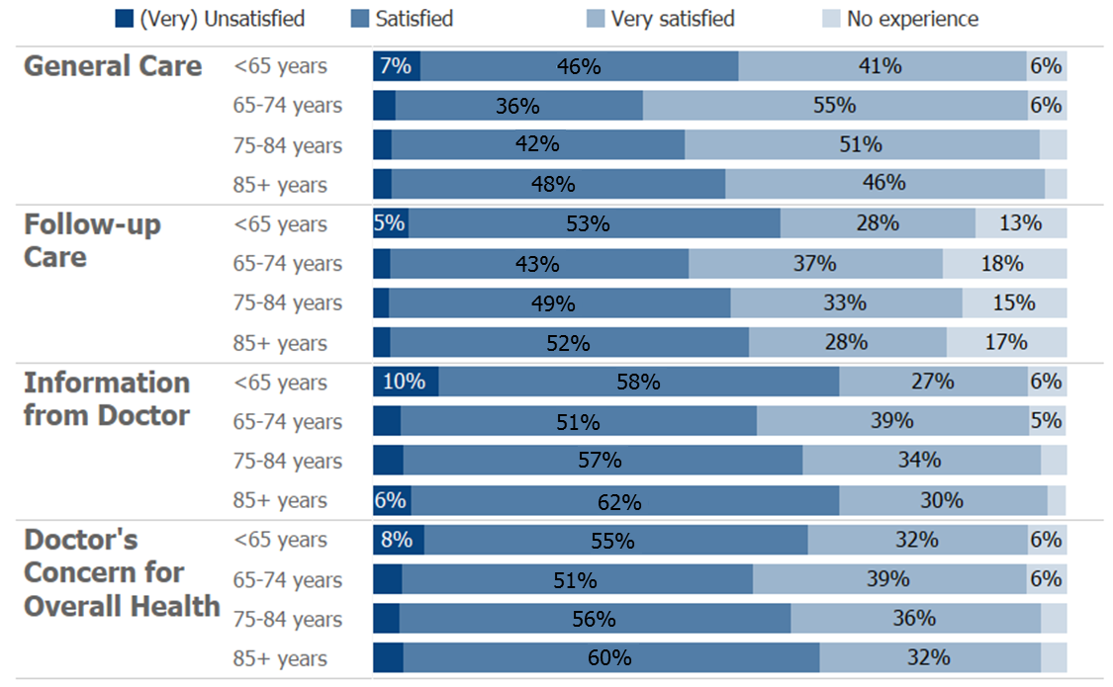
Exhibit 3.7
Satisfaction with Quality of Care Among Medicare Beneficiaries Residing Only in the Community by Age, 2015
SOURCE: Centers for Medicare & Medicaid Services, Medicare Current Beneficiary Survey, Survey File, 2015.
NOTES: Totals may not sum to 100 percent due to rounding. Estimates are presented for beneficiaries who resided only in the community during the year. This excludes beneficiaries who resided part of the year in the community and part of the year in a long-term care facility, and beneficiaries who resided only in a long-term care facility during the year. The category "(Very) Unsatisfied" includes beneficiaries whose response to the question was "unsatisfied" or "very unsatisfied".

Slide 31
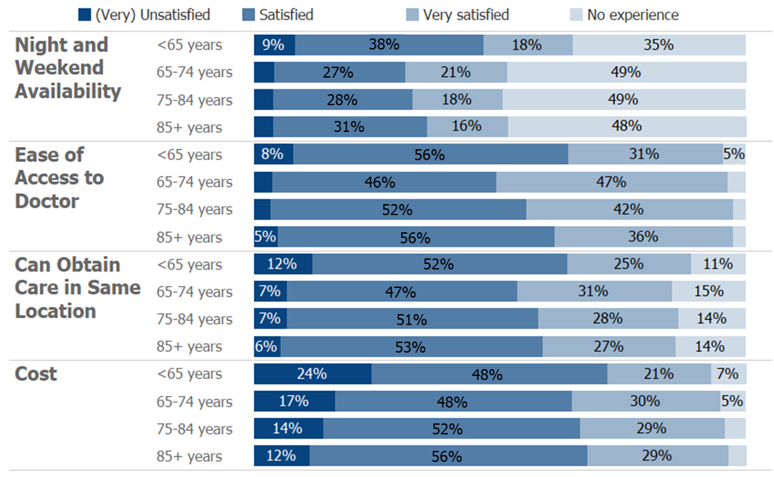
Exhibit 3.8
Satisfaction with Access to and Cost of Care Among Medicare Beneficiaries Residing Only in the Community by Age, 2015
SOURCE: Centers for Medicare & Medicaid Services, Medicare Current Beneficiary Survey, Survey File, 2015.
NOTES: Totals may not sum to 100 percent due to rounding. Estimates are presented for beneficiaries who resided only in the community during the year. This excludes beneficiaries who resided part of the year in the community and part of the year in a long-term care facility, and beneficiaries who resided only in a long-term care facility during the year. The category "(Very) Unsatisfied" includes beneficiaries whose response to the question was "unsatisfied" or "very unsatisfied".

Slide 32
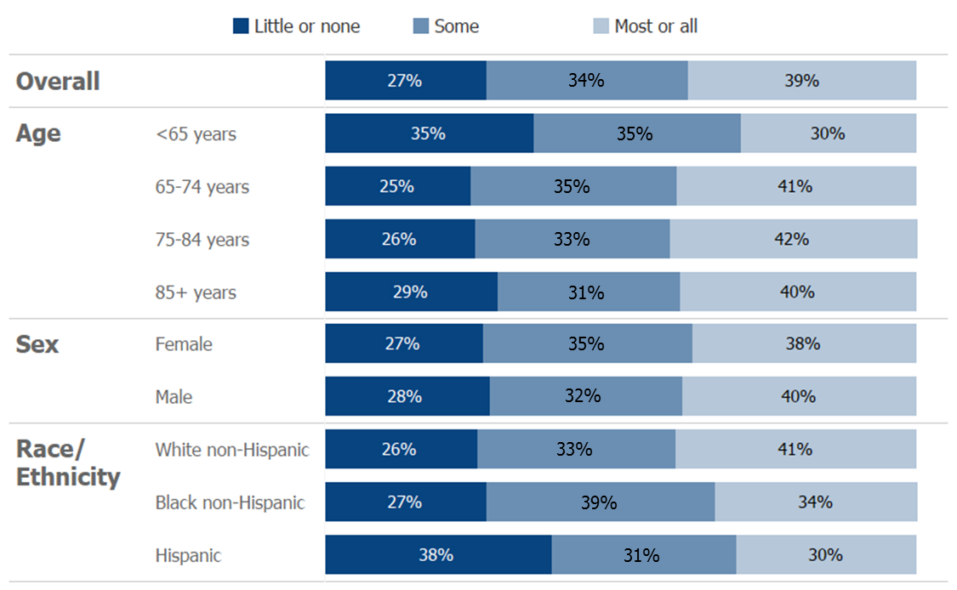
Exhibit 3.9
Level of Knowledge of the Medicare Program Among Medicare Beneficiaries Residing Only in the Community Overall and by Age, Sex, and Race/Ethnicity, 2015
SOURCE: Centers for Medicare & Medicaid Services, Medicare Current Beneficiary Survey, Survey File, 2015.
NOTES: Totals may not sum to 100 percent due to rounding. Estimates are presented for beneficiaries who resided only in the community during the year. This excludes beneficiaries who resided part of the year in the community and part of the year in a long-term care facility, and beneficiaries who resided only in a long-term care facility during the year. Estimates are not presented for the "other race/ethnicity" category.

Slide 33
Thank you!

