Slide 1
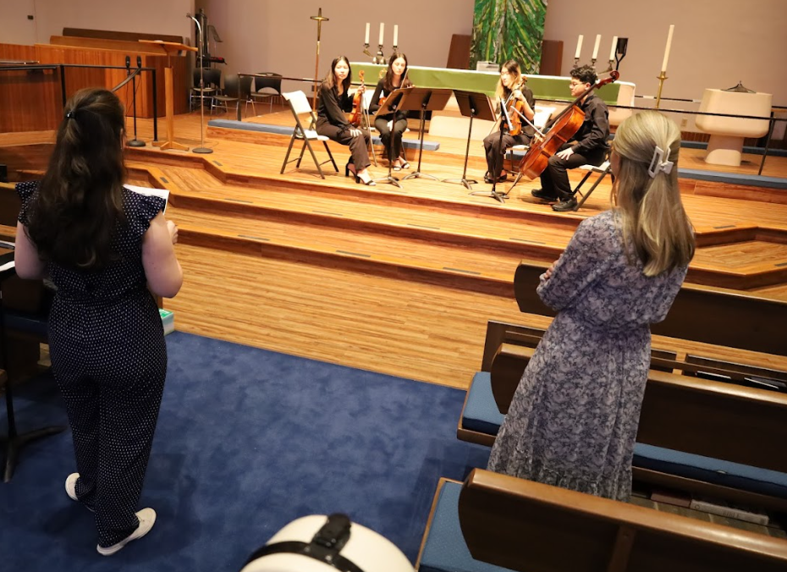
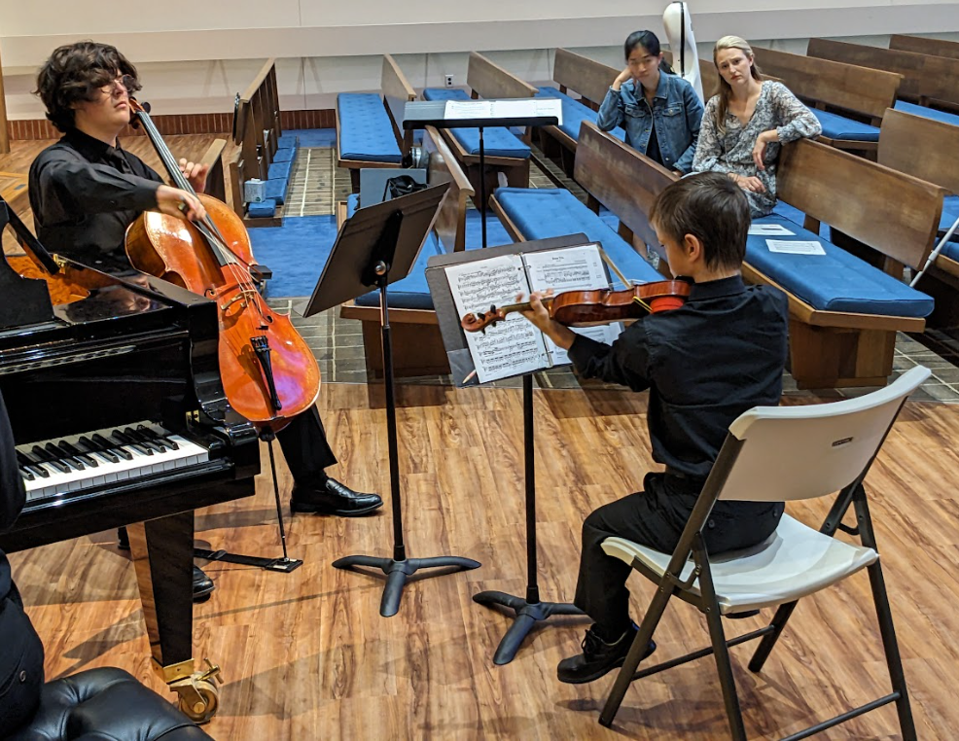
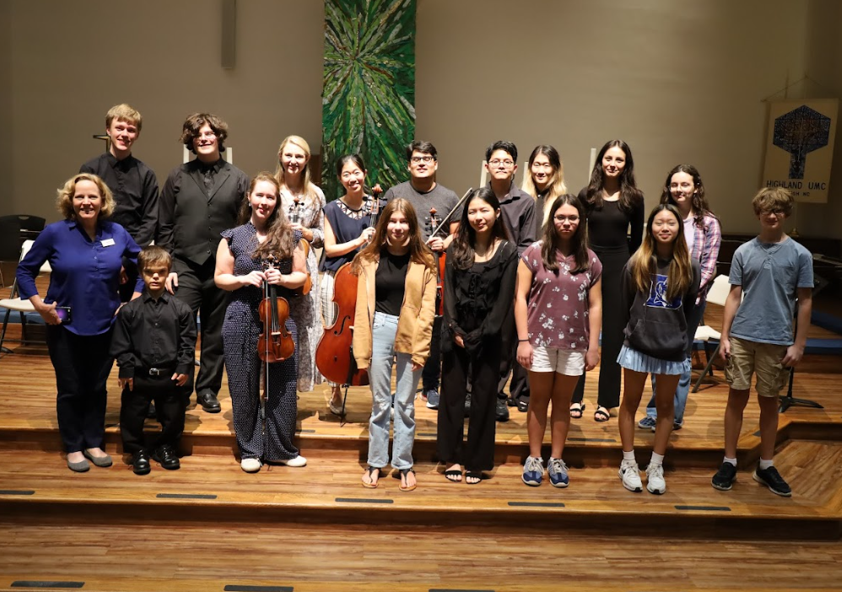
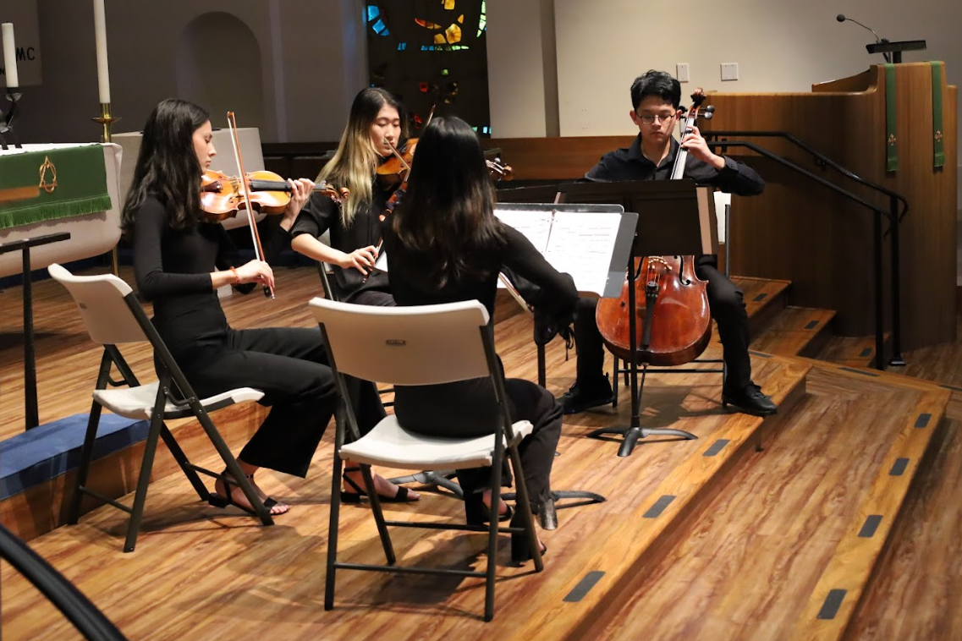
TERRA STRING QUARTET MASTER CLASS NC CHAMBER MUSIC INSTITUTE
BOARD OF DIRECTORS’ BRIEFING
October 2, 2023 Virtually Communicating Musically Connected
SEPTEMBER 25, 2023

Slide 2
Season 82 Subscriptions
Individual Ticket Sales
NCArtist = .09
VA = .125
$6,429
ARTIST FEES
$5,000
$3,989
$4,000
$2,800
$5,618
$2,500
$3,869
$9,500
$7,000
$3,819
$4,000
$ 572
$7,000
$ 4,507
$ 3,762
$5,000
$ 3,912
$8,000
$4,000
$ 2,764
TOTAL $ 48,741
$49,300

Slide 3
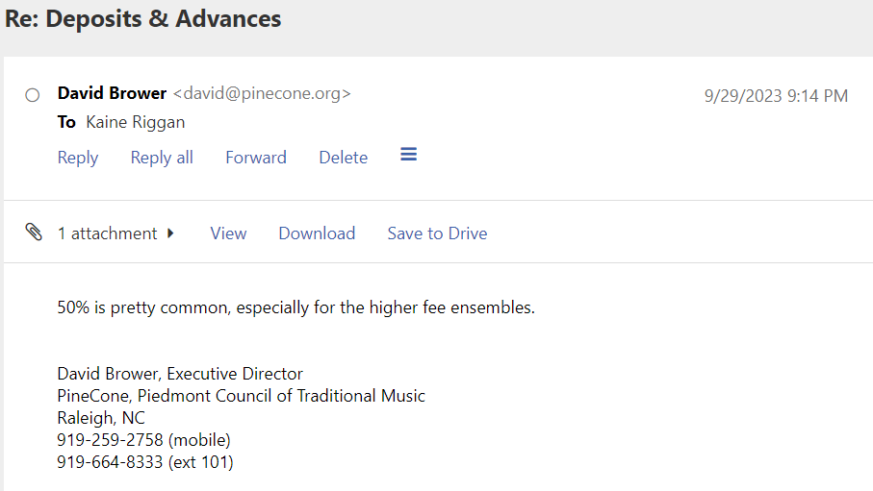
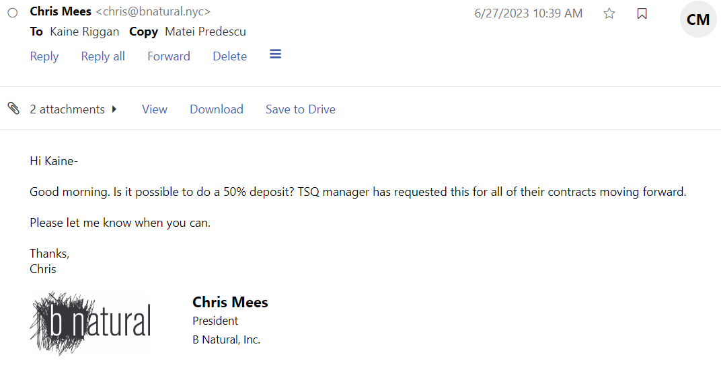
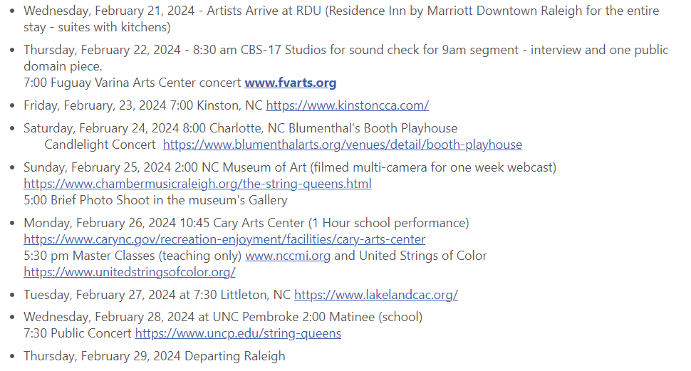
THE STRING QUEENS BLACK HISTORY MONTH RESIDENCY
REVENUE VS. EXPENSES $27K Buy-out Guarantee (Ticket Sales) $ 5K Corporate Sponsorship
$ 5K Mary J.C. Cresimore Sponsorship $21K NCAC Inclusion Grant Award $58K Total Current Income EXPENSES $31,000 Artist Fee $ 5800 Marriott 4 Rooms $ 1200 Van & Fuel $38,000 Expenses
PENDING
$15,000 NEA Grant Request (December Decision) $6,665 Available Ticket Revenue @ NCMA $21K

Slide 4
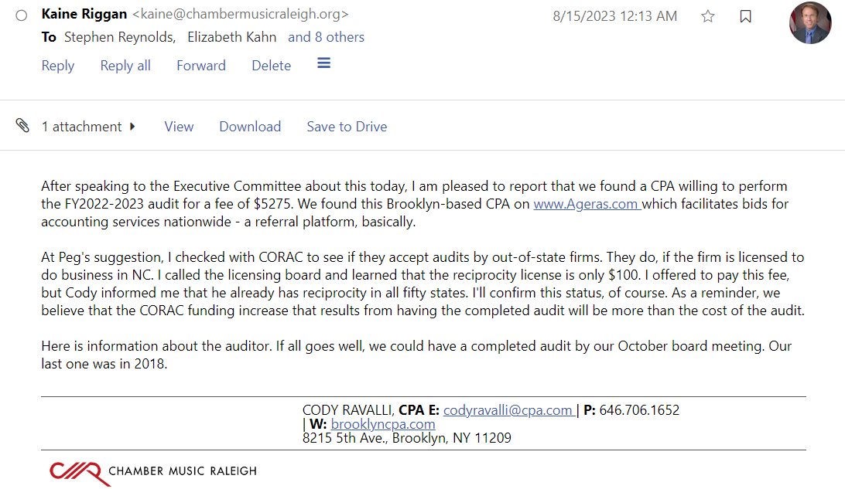
$5,275 AUDIT FEE + LORI AVENI’S TIME
$187,654 Season 81 Expenses CORAC REQUEST IS 25% $46,913 REQUEST VS. $24,999 CAP
AUDIT SHOULD RESULT IN $15-$20k INCREASE IN CORAC FUNDING

Slide 5
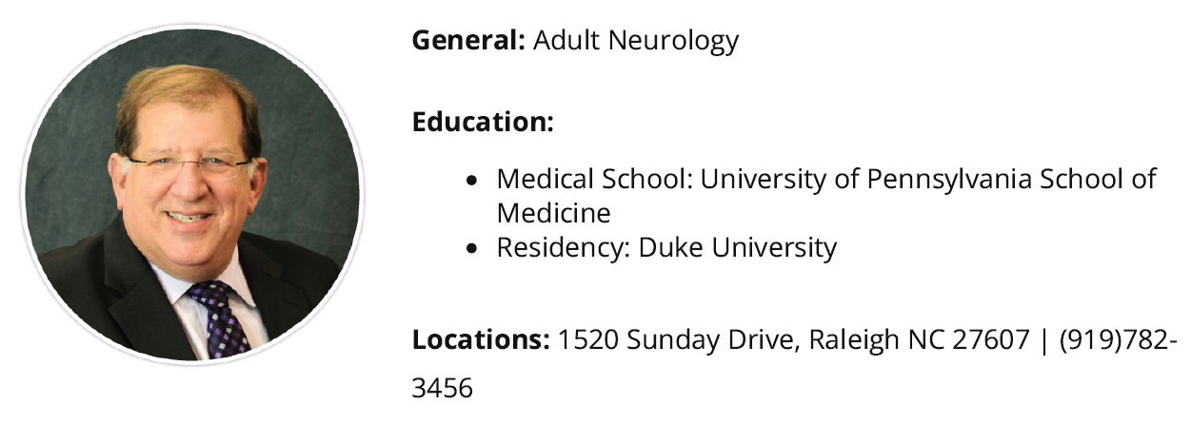
NCHC GRANT APPLICATION SUBMITTED “Music on the Brain”
Dr. Mitchell Freedman
NCHC GAP YEAR NEXT YEAR

Slide 6
WCPE Drafted An Agreement
Dan Proper Suggested Artist Should Grant Permissions, Not CMR
Artists Signed Broadcast Release
Last Week, Dan, Peg, Kaine & Stephen Met To Discuss
Dan McHugh Left WCPE for Habitat for Humanity
Calling New Post on Her First Day Monday
Agreement Between Artists & WCPE is Preferred

Slide 7
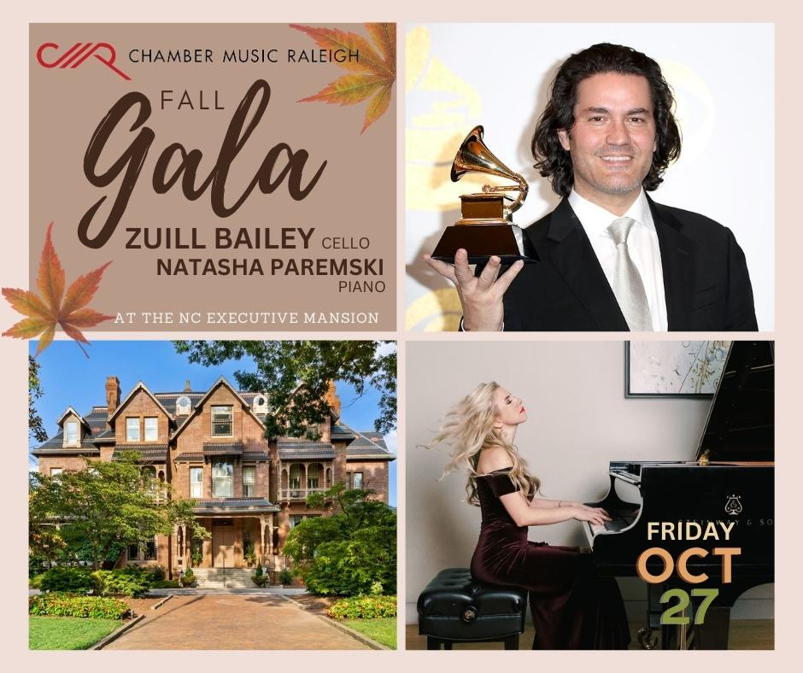
TWO REMAINING CONCERTS IN THE CALENDAR YEAR
October 15, 2023 Mac McClure & Juan Carlos Higuita SOLD OUT
October 27, 2023 Zuill Bailey & Natasha Paremski @ Executive Mansion
5:30 Reception
5:50 Dining Room-Wine Program
6:20 Ballroom Concert
$150 Individual $250 Couple
90 Person Capacity

Slide 8
TWO REMAINING CONCERTS IN THE CALENDAR YEAR
October 15, 2023 Mac McClure & Juan Carlos Higuita SOLD OUT
October 27, 2023 Zuill Bailey & Natasha Paremski @ Executive Mansion
NOVEMBER – ANNUAL CAMPAIGN LETTERS = $55K Budget Goal Between Board & Individuals
DECEMBER 4, 2023 Next Board Meeting Scheduled
JANUARY 2024 SEASON 83 PROGRAMMING COMMITTEE BEGINS
JANUARY 2024 Grant Writing Season
SNOWBIRD CONCERT SERIES – ONE WEEK FREE ACCESS
SEASON 82 RESUMES FEBRUARY 4 with IVALAS STRING QUARTET

Slide 9
QUESTIONS?

