Slide 1
2020 CASHA Workshop
Cleft Palate and VPI:
Overview, Assessment and Treatment
October 26, 2020
Jackie Klein, MA, CCC-SLP, MBA

Slide 2
Overview of Craniofacial Anomalies
Part 1

Slide 3
What is a Craniofacial Anomaly?
Cranio – head = above eyelids
Facial – face = below eyelids
Anomaly = something that deviates from the norm
Craniofacial Anomaly = Structural and/or functional difference affecting the head (cranium) and/or face
Cleft Lip and/or Palate is a craniofacial disorder
Craniofacial Disorder does not have to be a cleft Lip and/or palate

Slide 4
More Common:
Cleft lip and/or palate
Craniosynostosis
Plagiocephaly
Hemifacial Microsomia
Hemangioma

Slide 5
Cleft Lip and/or Palate
Clefts of any type = 1 in 700 live births (WHO, 2001)
  Parker et. al., 2010 - CL +/ - Palate second most common birth defect in US
  1 in 940 births
  4437 cases per year
Isolated Cleft less common – 1 in 1574 births (Parker et. al., 2010)
Isolated more frequently found in females ratio 2:1
2:1 male to female ratio for CL +/- Palate (Mossey, et. al, 2009)

Slide 6
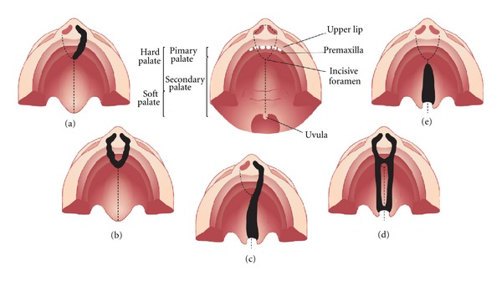
© Copyright/License - Open Access
Figure 1: Representation of the most common types of cleft affecting the palate. (a) Unilateral cleft lip with alveolar involvement; (b) bilateral cleft lip with alveolar involvement; (c) unilateral cleft lip associated with cleft palate; (d) bilateral cleft lip and palate; (e) cleft palate only (© Copyright Brito, Meira, Kobayashi, & Passos-Bueno, 2012).

Slide 7
Submucous Cleft Palate
Occult (hidden)
1910 Kelly described the “Classic Triad”
  Notch in posterior border of hard palate
  Translucent zone
  Bifid uvula
Garcia, et. al, 1988 went further
  Not all three have to be present (2 out of 3)
  Added:
    Short plate
    Hypoplastic (under or incomplete development ) uvula

Slide 8
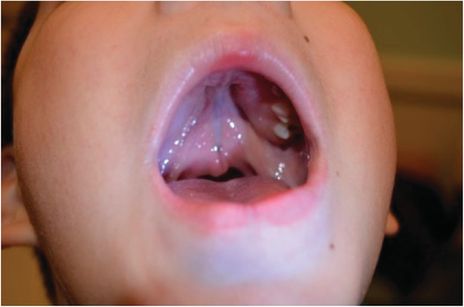
Grames and Patel (2016)

Slide 9
Submucous Cleft Palate
“Hidden”
Reiter, et. al,
  439 patients Symptomatic for a submucous cleft palate
    51% hypernasal
    45% Conductive hearing loss
    59% bifid uvula

Slide 10
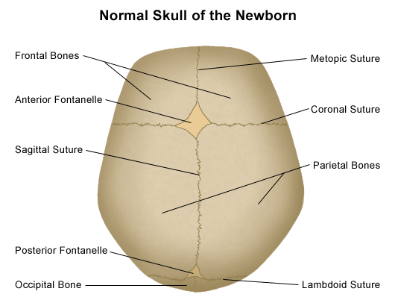
Craniosynostosis
Stanford Children's Health, 2019

Slide 11
Craniosynostosis
Premature closure of the sutures of the skull
Sutures open during child birth
Leaves room for brain to grow
Will eventually fuse to form skull = one piece
Head/Brain Growth = path of least resistance

Slide 12
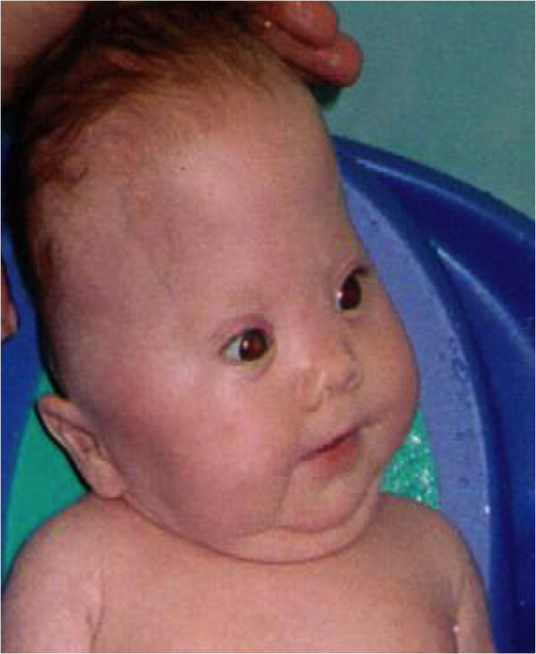
Craniosynostosis

Slide 13

Plagiocephaly
Specific areas of infants head develop abnormally flat
More common in multiple or premature births
Usually resolves by 6 weeks – sleeping and sitting preferences may complicate this
Repositioning or helmet is general treatment
Plagiobaby, 2020
Price, 2020

Slide 14
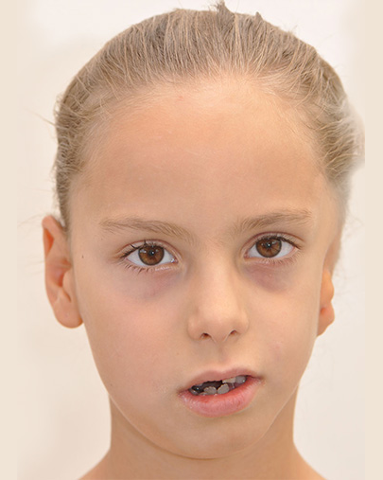
Hemifacial Microsomia
Congenital
Tissues on one side of the face underdeveloped
Etiology is unclear
Treatment varies based on severity
CHOP EDU, 2020.
Delhicraniofacialsurgery.com, 2020

Slide 15
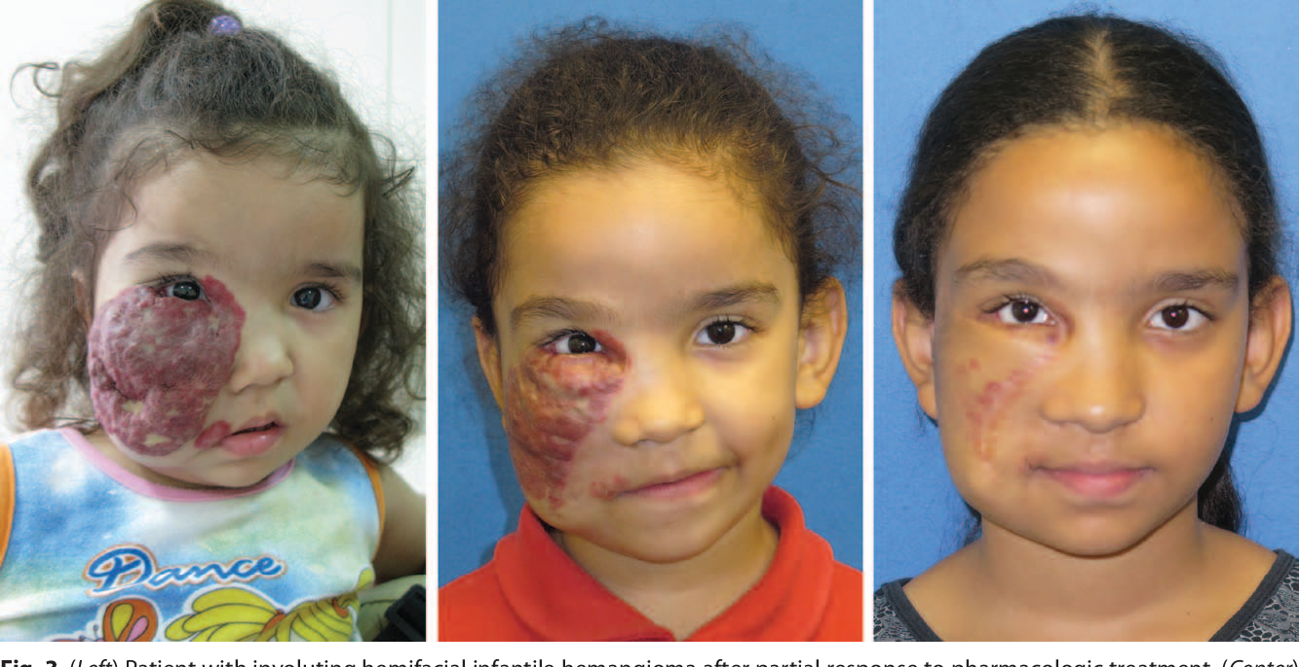
Hemangioma
Bright red birth mark
Usually in first or second week of life
Compromised of blood vessels
Goldenberg et. al, 2016

Slide 16
Anatomy Review

Slide 17
Kummer, 2008

Slide 18
Facial Anatomy
Nares (one is naris)
Upper lip – top is cupid’s bow
  Vermilion – red portion of lip
Philtrum – base of nose to upper lip (cupid’s bow)
Tubercle – prominent point of on upper lip – located at bottom

Slide 19
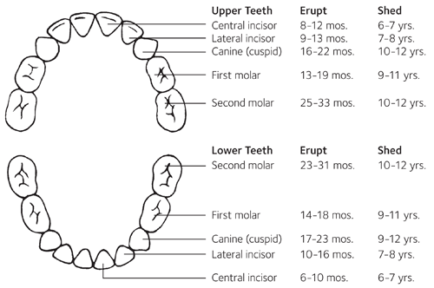
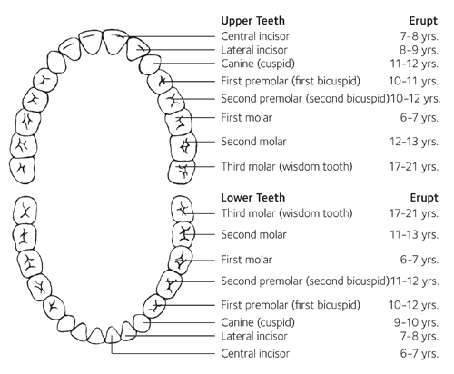
Teeth
Deciduous (Baby) Teeth
Permanent Teeth
  American Dental Association, 2019

Slide 20
        Kummer, 2008

Slide 21
Kummer, 2008

Slide 22
Hard and Soft Palate
Premaxilla up to the incisive foramen
Primary Palate = premaxilla, alveolar ridge
Secondary Palate = Incisive foramen to uvula

Slide 23
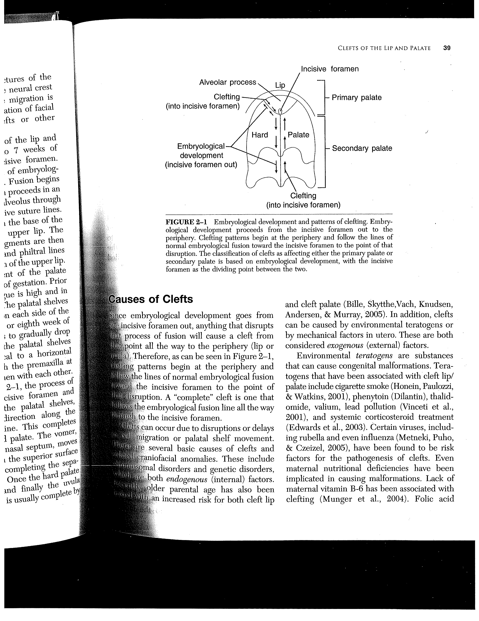
    Kummer, 2008

Slide 24
Muscles of the Soft Palate
Muscle of Soft Palate | Action
Levator (veli) Palatine | Pulls soft palate up and back to meet posterior pharyngeal wall
Tensor (veli) Palantine | Tenses soft palate Opens Eustachian tube during swallow
Uvula | Raises and shortens uvula
Glossopalatine (palatoglossus) | Raises posterior portion of tongue Depresses side of palate
Pharyngopalatine | Depresses soft palate Aides in elevation of larynx and pharynx
      Palmer, 1993

Slide 25
Motor and Sensory Nerves of the Palate
Motor Nerves | Sensory Nerves
Glossopharyngeal (IX) | Vagus (X)
Vagus (X) | Glossopharyngeal (IX)
Accessory (XI)
Trigeminal (V)
Facial (VII)
      Palmer, 1993

Slide 26
Embryology

Slide 27
Impact of Maternal and Paternal Age
Maternal Age
  Women born with all eggs – mature during puberty
  Over time fewer eggs available
  Egg age is same as chronological age
  Therefore, risk for chromosomal abnormality increases with age
  Difficulty with meiosis more likely
Paternal
  New sperm continuously
  Over 45 increased risk for autosomal dominant conditions

Slide 28
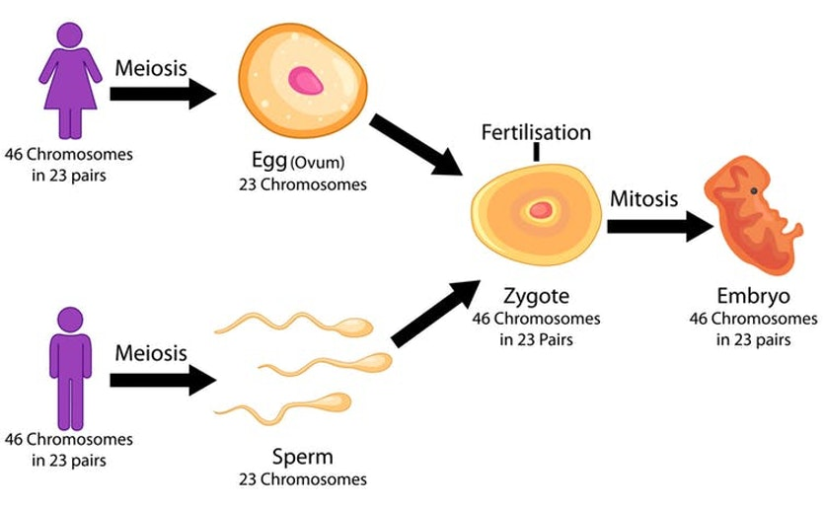

Slide 29
Gestation
Pre-embryonic Stage – first two weeks
Embryo – weeks 3-8
Fetus –week 9 – birth
Moore, 1998

Slide 30
4 Stages of Embryological Development
Fertilization -
Morula - rapid mitotic division to form mass of cells
Blastocyst – mass of cells form this stage
Implantation - Gastrula

Slide 31
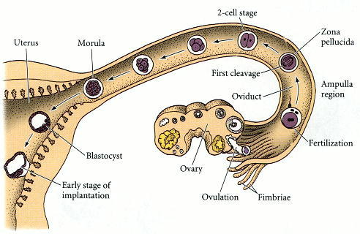
        Gilbert, 2000

Slide 32
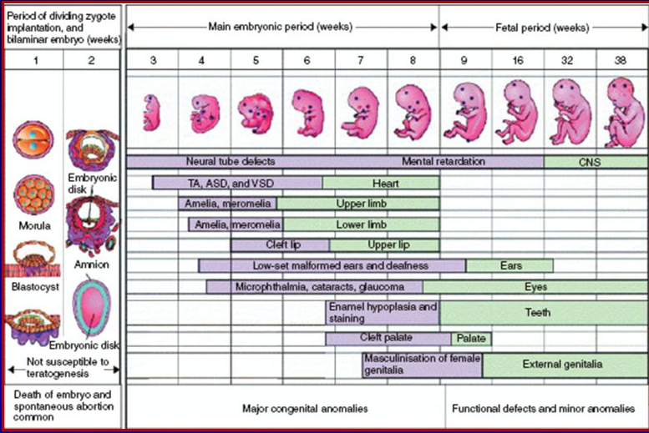
Moore, 1998

Slide 33
First Three Weeks
Cellular disk made up of three layers – these will develop all tissues and organs in the body
  Ectoderm
  Mesoderm
  Endoderm

Slide 34
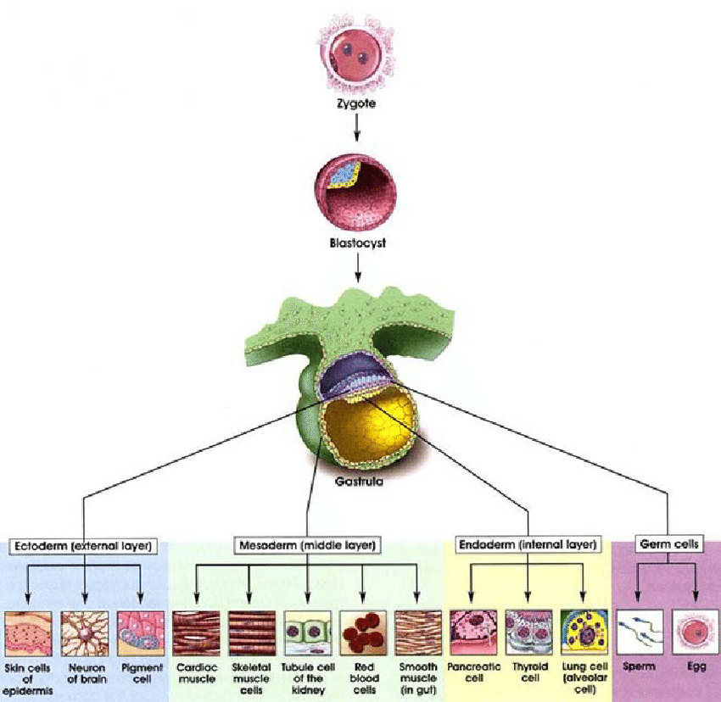
  Hiens, et al, 2004

Slide 35
Flexion Period
Critical period beginning at end of third week
Rapid growth in head and tail regions
28 days – head and tail and midline folds – changing disc into more human form

Slide 37
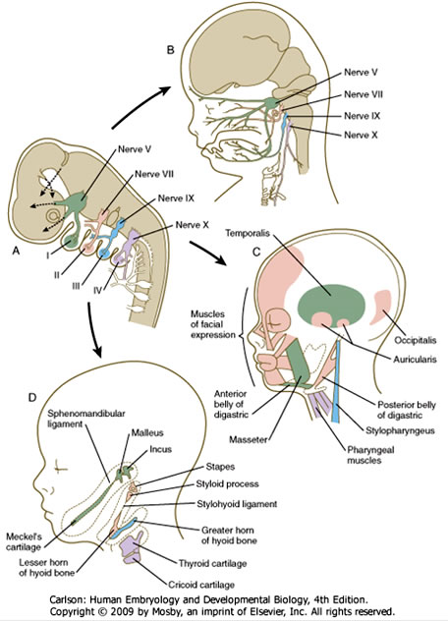

Slide 38
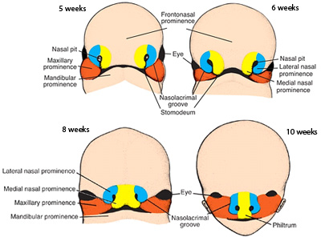
      Duke.edu, 2011

Slide 39
Formation of Palate
Tongue grows rapidly – fills oral spaces – pushes into nasal cavity
From maxillary processes form palatal shelves
Shelves in vertical position on either side of tongue
7-8th week – downward growth of mandible -tongue drops – shelves horizontal above tongue
Shelves grow toward each other
Fusion anterior to posterior
12 weeks – complete fusion of hard and soft palate with final closure of uvula

Slide 40
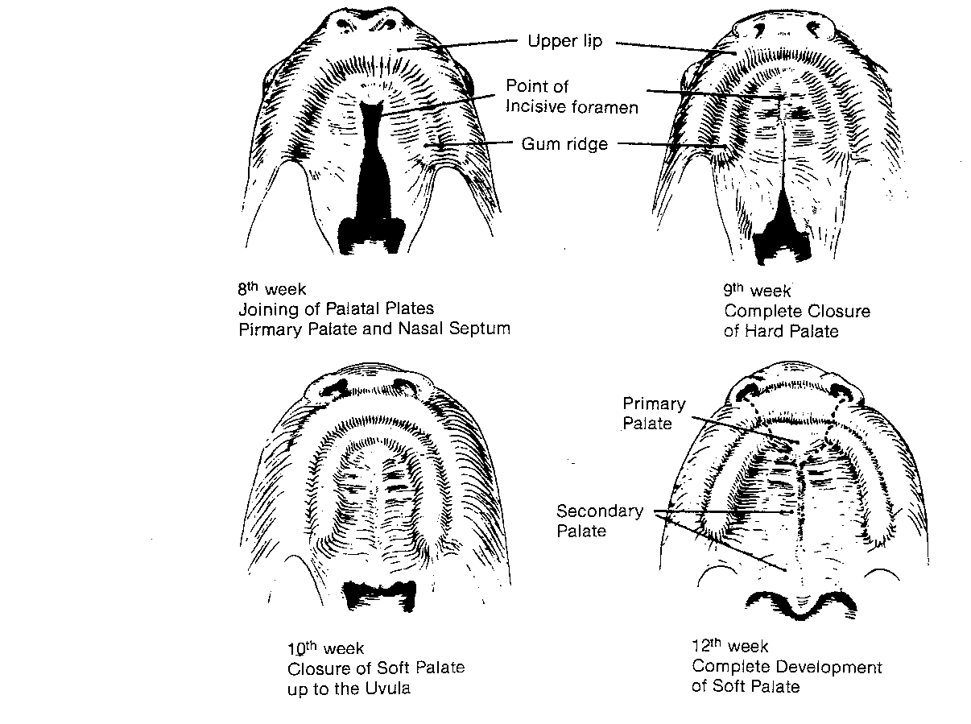
From Bzoch, KR, Williams WN. Introduction, rationale, principles, and related basic embryology and anatomy. In: Bzoch KR. Communicative disorders related to cleft lip and palate. Boston: Little, Brown, 1979:11.

Slide 41
What Can Go Wrong?
Number of Factors
  Cell death or degeneration
  Failure of fusion to occur
  Inadequate migration
  Genetic Mutation
  Chromosomal abnormalities
  Environmental – smoke, alcohol, medication , viruses, lack of folic acid
  Maternal age

