Slide 1
Common Eye Conditions in Children
Madhav Vempali
Vempali Medical Ltd

Slide 2
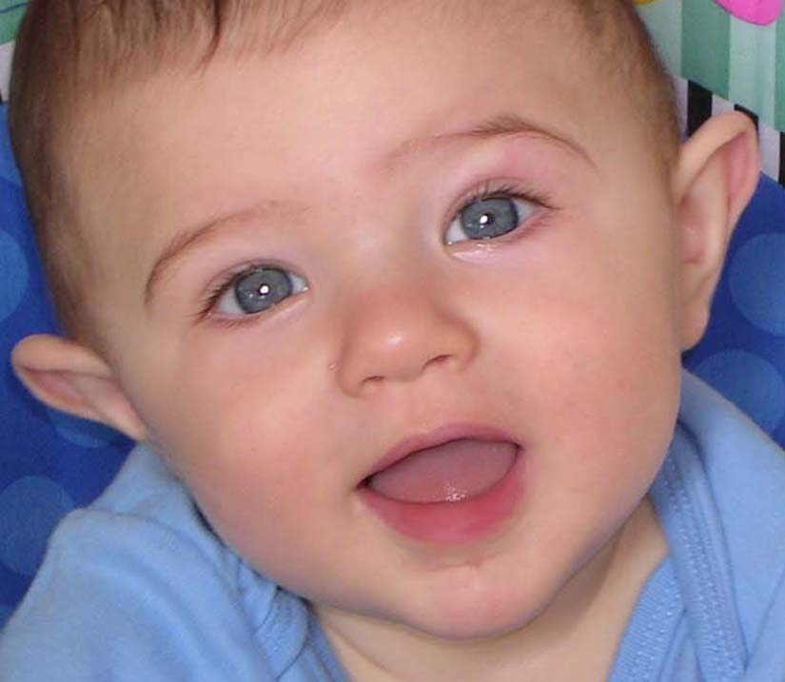
Visual development in children
Newborn infants are able to see.
As babies use their eyes during the first months of life, vision improves.

Slide 3
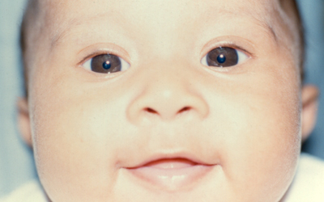
Visual development in children
If a child cannot use his or her eyes normally, vision does not develop properly and may even decrease.
An infant’s eyes may drift in or out a small amount at times, which is perfectly normal during the first few months.
At two or three months of age, when a baby begins to focus on the world around him or her, the eyes should be straight nearly all the time.
Corneal light reflexes in an infant

Slide 4
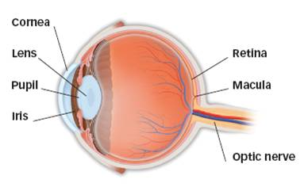
How the eye works
To see clearly, light rays must be bent or refracted by the cornea and lens so they can focus on the retina (the layer of light-sensitive cells lining the back of the eye).
The retina sends images to the brain through the optic nerve.
Eye anatomy

Slide 5
How the eye works

Slide 6
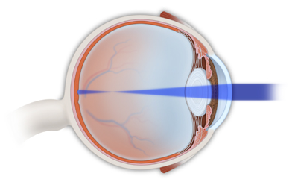
Refractive errors
Myopia (nearsightedness):
Light rays focus in front of the retina instead of on it.
Close objects will look clear, but distant objects will appear blurred.
Myopia

Slide 7
Refractive errors
Myopia:
When the body grows rapidly as a teenager, myopia may increase; frequent eyeglass changes may be necessary.
After age 20 or 25, there is usually little change.
Myopia can run in families.
If your child has high myopia, regular eye examinations will be needed to watch for changes in the retina.

Slide 8
Myopia

Slide 9
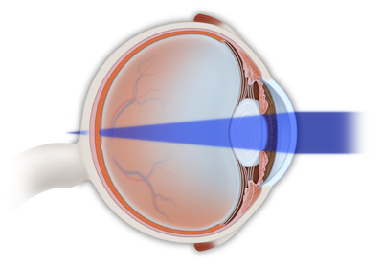
Refractive errors
Hyperopia (farsightedness):
Light rays are focused behind the retina.
Hyperopia

Slide 10
Refractive errors
Hyperopia:
Most children are farsighted, yet do not experience blurry vision.
With focusing (accommodation), children’s eyes are able to bend light rays and place them directly on the retina.
As long as farsightedness is not too severe, hyperopic children will have clear vision for distance and near.

Slide 11
Hyperopia

Slide 12
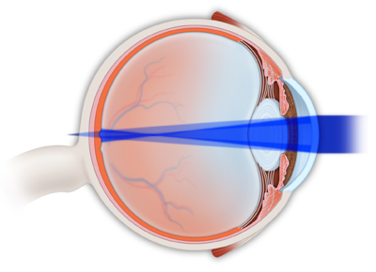
Refractive errors
Astigmatism:
The front of the eye is shaped more like a football than a basketball.
Both near and far objects appear blurry.
A child with myopia or hyperopia can also have astigmatism.
Astigmatism

Slide 13
Astigmatism

Slide 14
Refractive errors
Eyeglasses commonly correct refractive errors that cause blurry vision by refocusing light rays onto the retina.
Glasses must fit well, as many children will need to wear them all the time

Slide 15
Refractive errors
Some older children may be candidates for contact lenses (discuss with your ophthalmologist).
There is no scientific evidence to suggest that eye exercises or vitamins can prevent or cure refractive errors.

Slide 16
Warning signs in children
Children usually don’t complain about their eyesight; watch for the following signs:
any misalignment of the eyes, even if intermittent
persistent head turn
a jiggle (nystagmus) in one or both eyes
unusual sensitivity to light
frequent rubbing of the eyes
redness or discharge of the eyes
tearing
squinting
droopy eyelid

Slide 17
Warning signs in children
If you see these signs, speak with your pediatrician and arrange for a comprehensive eye exam by an ophthalmologist.
If you have any family history of amblyopia, strabismus, blindness or wearing thick glasses, your child should visit an ophthalmologist (Eye M.D.).

Slide 18
Vision screening for children
All children 3 to 3 ½ years old should have their vision checked by pediatrician/family practitioner/individual trained in vision assessment of preschool children.
Most physicians test vision as part of a child’s medical examination.
Any child who fails vision screening should have a complete eye exam by an ophthalmologist.

Slide 19
Vision screening for children
An ophthalmologist should examine your child’s eyes earlier than age 3 if there is:
a family history of strabismus (misaligned eyes) or amblyopia (“lazy eye”); or
a known medical condition that increases the chances of strabismus or amblyopia.
No child is too young to have an eye examination.

Slide 20
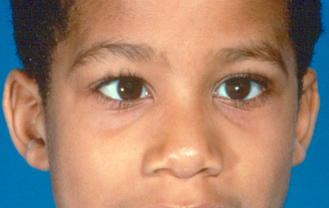
Amblyopia
Amblyopia is poor vision in an eye that did not develop normal sight during early childhood. It is sometimes called “lazy eye.”
While usually only one eye is affected by amblyopia, both eyes can be “lazy.”
The best time to correct amblyopia is during infancy and early childhood.
Amblyopia is common, affecting two or three out of every 100 people

Slide 21
Causes of amblyopia
Strabismus (misaligned eyes)
Unequal focus/refractive error
Cloudiness in the normally clear eye tissues

Slide 22
Causes of amblyopia
Strabismus:
The misaligned eye “turns off” to avoid double vision. The child uses only the better-seeing eye, causing the misaligned eye to fail to develop good vision.
Strabismus is a common cause of amblyopia.

Slide 23
Causes of amblyopia
Unequal focus/refractive error:
One eye is out of focus because it is more nearsighted, farsighted, or astigmatic (blurry) than the other.
The unfocused (blurred) eye “turns off” and becomes amblyopic, although the eye will appear normal.
Amblyopia may also occur in both eyes if both eyes are very blurred.

Slide 24
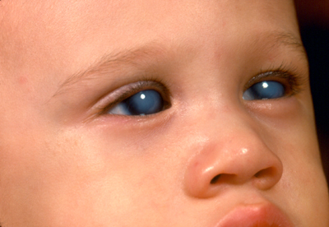
Causes of amblyopia
Cloudiness in the normally clear eye tissues.
Cataract in one or both eyes can lead to amblyopia; surgery may be necessary.
Any factor that prevents a clear image from being focused inside the eye can lead to development of amblyopia.
Cloudy corneas

Slide 25
Detecting amblyopia in kids
Detecting amblyopia can be difficult if there is no obvious eye turn
In infants:
Amblyopia may be detected by observing baby’s reaction when one eye is covered. If forced to look with the “lazy eye,” a baby may cry, try to look around eye cover or pull cover off.
In older children:
Amblyopia may be detected by carefully measuring vision.

Slide 26
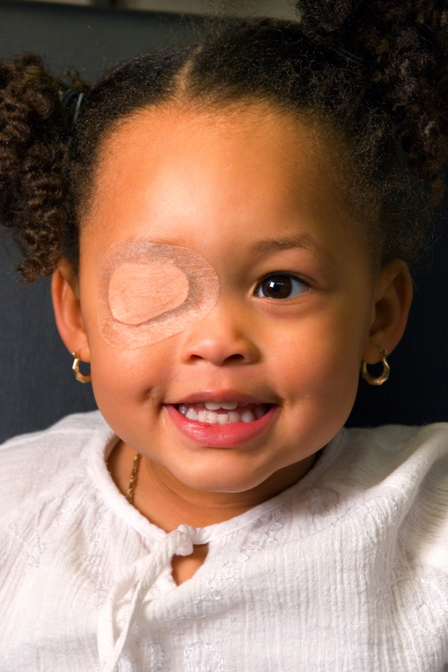
Treating amblyopia
The weaker eye must be made stronger. The child must be made to use the weak eye.
Patching:
A patch is placed over better-seeing eye to make child use and develop good vision in the “lazy eye.”
Eyedrops:
Atropine is placed in the better-seeing eye daily to blur vision, forcing the child to use the “lazy eye.”
Patching the eye

Slide 27
Treating amblyopia
Glasses may be prescribed to correct focusing errors.
Surgery may be needed if a cataract or other abnormality is found.
Treatment for amblyopia should begin as early as possible.
If amblyopia is not treated when child is young, permanent visual loss could occur.
Parents have to convince their child to do what is best for their vision.

Slide 28
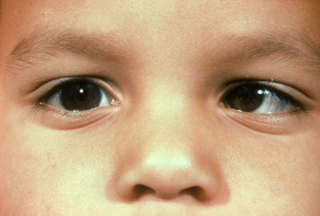
Strabismus
Strabismus is a condition in which eyes are misaligned and point in different directions.
One eye may look straight ahead, the other turns in, out, up or down. The eye turn may be constant or may come and go.
Eye turning in

Slide 29
Strabismus
Strabismus affects about 4 percent of all children in U.S.
A young child’s brain learns to ignore the image from the misaligned eye and sees only the image from straight eye.
The misaligned eye may lose vision and become amblyopic (“lazy eye”).

Slide 30
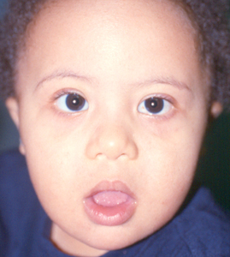
Strabismus
Occurs in healthy children, and may be hereditary.
More common among children with disorders that may affect the brain (Down syndrome, cerebral palsy, hydrocephalus and prematurity).
Can be diagnosed during an eye exam.
Down syndrome

Slide 31
Treating strabismus
Treatment involves straightening the eyes and restoring binocular (two-eyed) vision.
prescription eyeglasses
surgery

Slide 32
Common types of strabismus
Congenital esotropia: eyes turn inward during first six months of life.
Most cases require early surgery to straighten eyes.

Slide 33
Common types of strabismus
Accommodative esotropia: inward turning of the eye, occurring in children two years or older; when child focuses eyes to see clearly, they cross inward.
Treatment options:
glasses (to reduce focusing effort)
bifocals
surgery

Slide 34
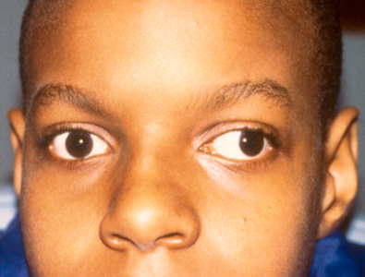
Common types of strabismus
Exotropia: outward turning of the eye, most often when child focuses on distant objects.
May only occur occasionally, particularly when child is daydreaming, ill or tired; child may squint when out in bright sunlight.
Treatment options include patching an eye, glasses, eye exercises and surgery.
Exotropia

Slide 35
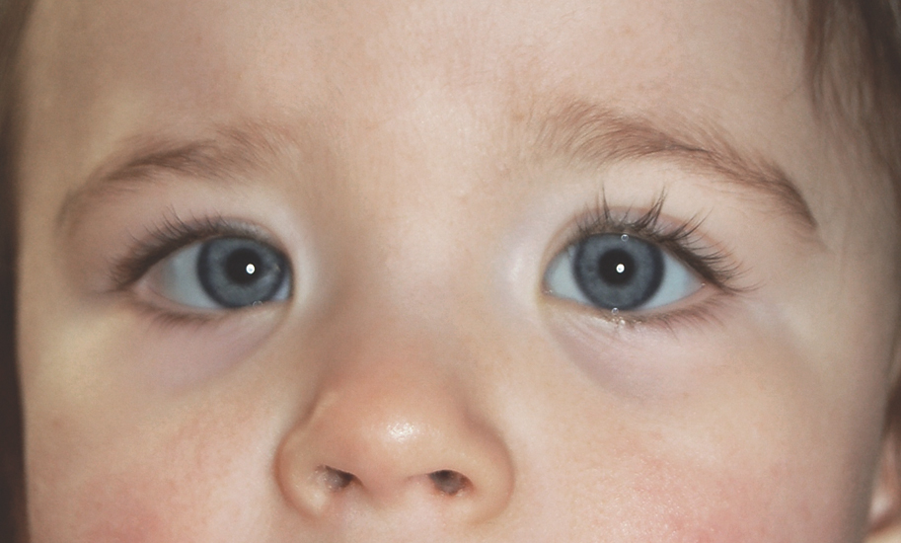
Pseudostrabismus
False appearance of misaligned eyes.
Usually in infants; eyes appear crossed, but are not; young children have wide flat noses, folds of skin at inner eyelid which can make eyes appear crossed.
Condition often improves/disappears as infant’s facial structures mature.
Pseudostrabismus

Slide 36
Ptosis
Ptosis is drooping of the upper eyelid, either slightly or covering the pupil entirely.
Congenital ptosis is present at birth; it is often caused by poor development of muscle that lifts the eyelid.
Congenital ptosis usually does not improve with time.
Ptosis

Slide 37
Ptosis
Amblyopia (“lazy eye”) can be a problem if ptosis causes astigmatism (blurring) or drooping is severe enough to block vision.
Amblyopia can be corrected by patching, eyedrops, glasses prescription or surgery.
Ptosis can be corrected surgically.

Slide 38
Conjunctivitis
Conjunctivitis is inflammation of the conjunctiva — the thin, filmy membrane that covers inside of eyelids and white part of eye
It is most commonly referred to as red or “pink” eye

Slide 39
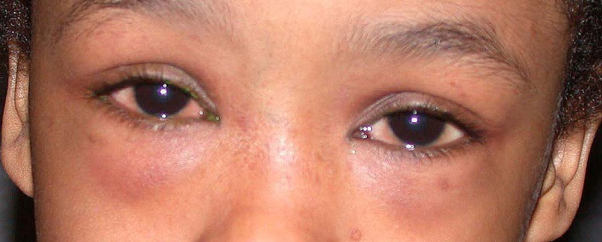
Conjunctivitis
Commonly a viral or bacterial infection (very contagious)
Viral conjunctivitis: Patients may have sore throat and runny nose with red, watery eyes; moist compresses may help, but generally no medicine necessary.
Bacterial conjunctivitis: Patients often have a red eye with discharge of pus; antibiotics are generally used.
Can also be caused by allergies (not contagious)
Allergic conjunctivitis: Patients may have itchy, red, tearing eyes; treatment may include cool compresses and allergy eyedrops.
Allergic conjunctivitis

Slide 40
Conjunctivitis
Infectious conjunctivitis, whether viral or bacterial, can be quite contagious.
Practice good hygiene to prevent spread:
Avoid reusing towels after the infected eye has been wiped.
Wash your hands frequently.
Keep your hands away from your face and eyes.
If symptoms persist, have your child’s eyes examined by an ophthalmologist.

Slide 41
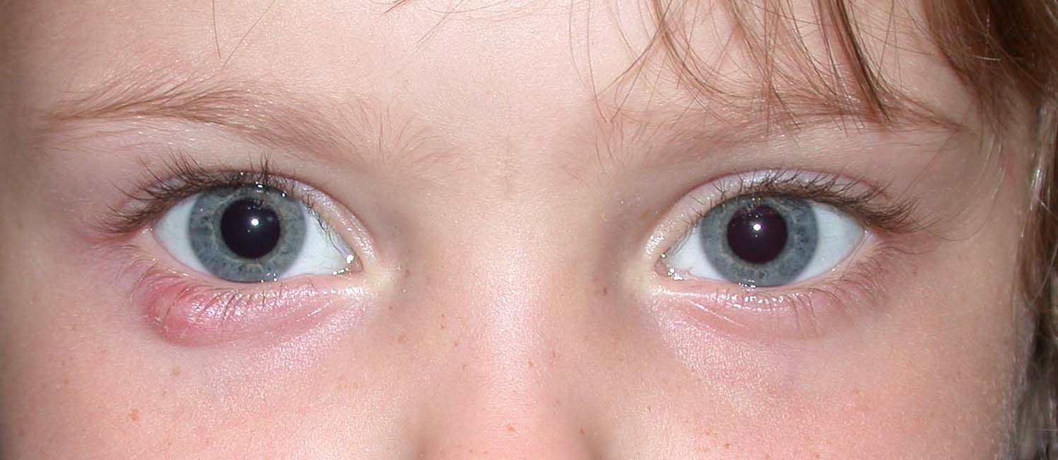
Chalazion
Chalazion is a small lump on the eyelid when the meibomian gland becomes clogged with oil secretions.
It is not caused by infection.
Treatment includes:
Warm compress applied for 10 to 15 minutes, 3 to 4 times daily
Antibiotics, if bacteria infects the chalazion
Surgery to drain the chalazion, if necessary
Chalazion

Slide 42
Stye
A stye is a red, sore lump near edge of eyelid caused by infected eyelash follicle.
Treatment may include:
hot compresses
topical antibiotics

Slide 43
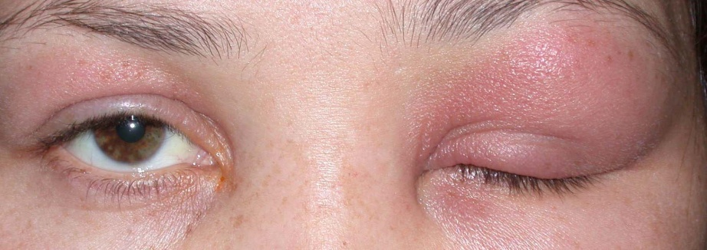
Preseptal cellulitis
Preseptal cellulitis is red, painful swelling of tissues around the eye. It usually occurs in one eye, which may be swollen shut.
A child with preseptal cellulitis may have a fever.
It is usually caused by:
trauma
upper respiratory infection
associated eyelid infection
Although preseptal cellulitis is generally treated with antibiotics, hospitalization may be necessary.
Preseptal cellulitis

Slide 44
Orbital cellulitis
Orbital cellulitis is infection in the deeper structures behind the eye.
Symptoms include a red, painful, swollen eye. The patient may not be able to move the eye well.
The eye may be pushed forward, and vision may be affected.
Orbital cellulitis must be taken seriously; it requires urgent hospitalization and antibiotic treatment.

Slide 45
Tearing in infants
Abnormal or overflow tearing is common in infants; approximately 1/3 of newborns have excessive tears/mucus.
Overflow tearing occurs when the membrane in the nose fails to open before birth, blocking part of the tear duct (tear drainage system).
Tears do not drain properly and collect inside tear drainage system; they spill over eyelid, causing tearing.

Slide 46
Tearing in infants
This condition may also lead to conjunctivitis (“pink eye”).
The blocked tear duct often opens spontaneously 6 to 12 months after birth.
Until the tear duct opens, you may need to:
apply pressure (or massage) over lacrimal sac area;
use antibiotic eyedrops or ointment for infection; or
gently clean eyelids with warm water.
For persistent tearing, your ophthalmologist may need to pass a probe through the obstructed tear duct to open it surgically.

Slide 47
Tear drainage system

Slide 48
Eye injury and sports
Many children’s eye injuries occur during sports or recreation.
Ages 5 to 14 years, baseball is number one cause of sports-related injuries.
Ages 15 to 24 years, basketball is the most common cause of eye injury (the injuries are caused by fingers and elbows).
90 percent of all eye injuries can be prevented.

Slide 49
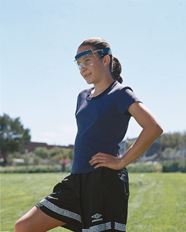
Eye injury and sports
Children should wear sports eye protectors made of polycarbonate lenses for:
baseball
basketball
football
racquet sports
soccer
hockey
lacrosse
paintball
Protective lenses for soccer

Slide 50
Eye injury and sports
Some helmets can be fitted with a polycarbonate face mask or wire shield.
If your child has permanently reduced vision in one eye, consider risks of injury to the one fully-functioning eye before allowing participation in contact or racquet sports.

Slide 51
Eye injury and toys
Select toys and games that are appropriate for a child’s age and responsibility level.
Avoid projectile toys, such as:
darts;
bows and arrows;
missile-firing toys; and
pellet or BB guns.

Slide 52
Eye injury around the house
Keep all chemicals and sprays (such as oven cleaners) out of reach of small children.
Do not allow children to ignite fireworks or stand near others who are doing so.
Do not allow children in the yard while the lawnmower in use; stones and debris thrown from moving blades can cause severe eye injuries.
Watch out for common household items that can cause serious eye injury:
paper clips
pencils
scissors
bungee cords
wire coat hangers
rubber bands
fish hooks

Slide 53
Eye injury around the house
Demonstrate good eye safety habits by always wearing protective eyewear while using power tools, rotary lawnmowers, trimmers or hammers.
Children will learn by your example.

Slide 54
Learning disabilities
Learning disabilities are disorders in understanding or using spoken or written language.
Children with learning disabilities may experience problems with:
reading (dyslexia)
writing
listening
speaking
concentration
mathematical calculations
Learning disabilities are caused by the brain, not the eyes.
No scientific evidence has shown that visual training; eye exercises; or muscle, perceptual or hand/eye coordination exercises can improve a child’s learning disability.

Slide 55
Learning disabilities
Children with learning disabilities do not have more visual problems than those without.
If you or your child’s teacher suspect a learning disability, you should contact your child’s school and, if necessary, the local or state director of special education.
Public law requires schools to evaluate any child who is thought to have a learning disability. The evaluation should include a complete medical eye examination.

Slide 56
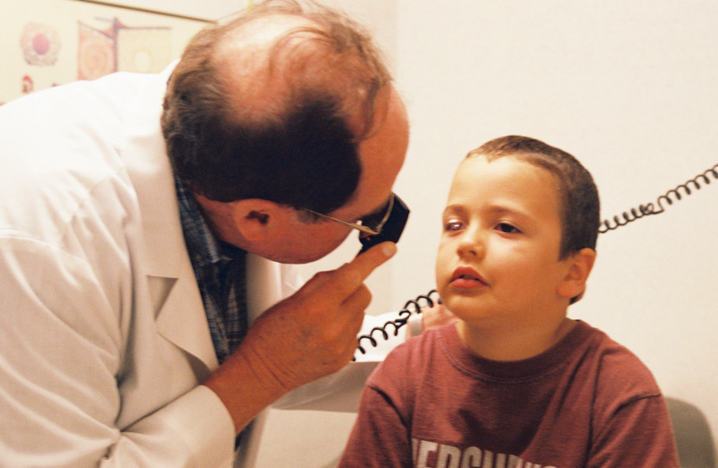
Preserve your child’s good vision with regular eye exams
Infants and young children should have their eyes examined by an ophthalmologist or other medical professional (pediatricians, family physicians, nurse practitioners or physician assistants) at the following intervals:
Newborn to 3 months
3 months to 6 months
6 months to 1 year
3 to 3 1/2 years
5 years

