Slide 1
The national Infection in Critical Care Quality Improvement Programme for England

Slide 2
Background: Infections in ICUs
Background
Development of surveillance
Results
Next steps
Future Developments
Conclusions
Blood stream infections (BSIs) from central venous catheters (CVCs) increase morbidity, mortality and the costs of care
Widely used in patients in ICUs
Evidence suggests rates of CVC-BSIs are modifiable
Michigan Keystone project: 103 ICUs in the USA
March 2004 – September 2005
5 evidence-based procedures + programme to improve safety culture
Mean rate of CVC-BSI decreased from 7.7 to 2.3 infections per 1,000 CVC-days
Was this the technical interventions, the cultural interventions, both, or neither?
In 2008, the NHS Next Stage Review recommended a national patient safety initiative to reduce CVC-BSIs in ICUs, using Michigan Keystone Project methodology
In 2009, Department of Health gave National Patient Safety Agency £2M to undertake “Matching Michigan”

Slide 3
Background: Matching Michigan
Background
Development of surveillance
Results
Next steps
Future Developments
Conclusions
England-wide study to reduce blood stream infections (BSIs) from central venous catheters (CVC)
Three components:
Technical interventions (evidence-based measures for reducing risk of CVC-BSIs)
Non-technical interventions (behaviour change in culture and systems)
Establishing standardised national reporting system for CVC-BSIs
2-year, 4-cluster, prospective stepped-wedge, interventional, non-randomised study in 196 adult and 19 paediatric ICUs
Rates of CVC-BSIs declined from first quarter to last quarter of the study (adults: 3.7 to 1.48 CVC-BSIs/1,000 CVC-days)
HOWEVER among adults, each cluster that joined study had similar pre-entry CVC-BSI rates to post-interventional rates of clusters already in study AND pre-ICU CVC-BSIs declined at the same rate as ICU-acquired CVC-BSIs, indicating a system-wide phenomenon

Slide 4
Background: Matching Michigan
Background
Development of surveillance
Results
Next steps
Future Developments
Conclusions
Ethnographic study of 17/196 adult ICUs in England that participated in Matching Michigan (MM) and 2 units that did not participate in MM.
MM not exact replica of original Michigan Keystone (MK) project
Technical interventions in MM not fresh as they were in MK
Care bundles from Dept. of Health already in place
Organisation of studies differed significantly – including training days and follow-up of participating staff
Infection Prevention & Control procedures generally good
Use of non-technical interventions were limited
Wide variation between ICUs
MM viewed as a top-down government-led initiative
may have prevented engagement – units where senior medical and nursing staff believed in programme and worked together, had greater impact than units whose senior staff did not

Slide 5
ICCQIP: Conception
Background
Development of surveillance
Results
Next steps
Future Developments
Conclusions
Conclusions from MM:
A permanent standardised national infection surveillance & reporting system in the ICU was needed
Strong professional ownership required for sustainable success
In 2011, a national collaboration of organisations representing adult, paediatric and neonatal intensive care medicine, microbiology and infection control was formed, under the aegis of Public Health England (PHE)
Infection in Critical Care Quality Improvement Programme (ICCQIP)

Slide 6
Background
Development of surveillance
Results
Next steps
Future Developments
Conclusions

Slide 7
ICCQIP: Establishment
Background
Development of surveillance
Results
Next steps
Future Developments
Conclusions
Develop voluntary web-based data capture system for ICUs in England.
Data owned by ICUs, governance by PHE through a Board composed of representatives of professional organisations in adult, paediatric and neonatal intensive care, microbiology & infection control.
To launch ICCQIP and determine clinical engagement and priorities for the improvement programme, a survey was conducted
Sent out December 2012 to via a number of professional critical care and infection prevention and control bodies

Slide 8
ICCQIP: Survey results
Background
Development of surveillance
Results
Next steps
Future Developments
Conclusions
763 respondents, covering staff from 141/160 NHS Trusts in England, 7 in Wales and 4 in NI
80% ICU doctors; 8% nurses; 5% microbiologists
94% supported establishing a surveillance programme
How to fund work for data collection?
48% within existing resources
33% wanted additional funding
80% favoured linkage to patient outcomes through existing NHS information systems
CVC-associated infections & multi-resistant infections considered the highest priority
Respondents wanted data on infection patterns and organisms, case-mix comparisons and benchmarking between ICUs and regions.
Also linkage to antimicrobial use and patient outcomes

Slide 9
Development of CVC-BSI surveillance tools
Background
Development of surveillance
Results
Next steps
Future Developments
Conclusions
In MM clinicians reported aggregate number of CVC-associated or CVC-related BSIs and selected the definition they had applied to their data
In the ICCQIP surveillance, wanted patient-level data to be collected
allowing for the application of numerous internationally comparable definitions
removes any subjectivity
In 2013 a paper-based pilot surveillance tool was designed
In 2014 an online data capture system was developed

Slide 10
Preliminary experience
Background
Development of surveillance
Results
Next steps
Future Developments
Conclusions
Pilot February-May 2015
6 Trusts entered data
Results: 80 bacteraemia episodes amongst 77 patients
50% ICU-associated (occurring at ≥ 2 days after the date of admission)
13% (n=10) polymicrobial (mixed culture growth), of 2 organisms
43% (n=39/90) skin commensals
14% (n=13/90) E. coli
41% episodes defined as BSIs
Data entry for 30-bed ICU took roughly 1.5 days for full data entry, including daily bed census
Feedback sought from participating Trusts on how to improve the software
Many changes incorporated into a new release for a sentinel surveillance programme

Slide 11
Sentinel surveillance scheme BSIs in ICU
Background
Development of surveillance
Results
Next steps
Future Developments
Conclusions
NHS Trusts received a letter from the ICCQIP Board inviting them to register interest in participating in sentinel surveillance scheme
58 units from 43 NHS Trusts registered their interest
Contacted January 2016 with formal invitation and asking for nominations for Local Administrator(s) for the Trust
8 Trusts withdrew (2 due to lack of resources)
28 completed Local Administrator training
New online surveillance data capture system (DCS) released April 2016
Surveillance protocol and user guides
Registration process for access to Data Capture System

Slide 12
Sentinel scheme registration process
Background
Development of surveillance
Results
Next steps
Future Developments
Conclusions
Trusts need to provide ICU name(s) to be loaded onto system AND to nominate Local Administrator(s) to act as organisations manager for staff access to DCS
Local Administrators contacted with online link to training materials and their details and who nominated/authorised them as Local Administrators within the organisation
Copy sent to “authoriser” for confirmation
Once training completed, a link to the DCS is sent, to apply for online account
Email sent from the DCS to new user to verify user’s professional email address
PHE authorises account request of Local Administrators, providing access for the Trust
Data Entry users apply for accounts, Local Administrators for their Trust manage these account requests

Slide 13
Data Collection: The numerator
Background
Development of surveillance
Results
Next steps
Future Developments
Conclusions
Participating units asked to enter data on all positive blood culture episodes.
An episode is defined as 7 days. EXACT matches for PBCs within this period not to be reported
We collect patient level data, and apply various internationally recognised definitions to it, to limit bias
Up to 6 sections to complete:
Patient/Specimen details
Clinical Symptoms (age specific)
Repeat Positive Blood Culture (only if initial culture contains a skin commensal)
Treatment
CVC Data
Source of Infection

Slide 14
Data Collection: The denominator
Background
Development of surveillance
Results
Limitations
Summary
Conclusions
In order for rates to be calculated, units also need to enter data on denominators
Total number of occupied patient-days in the unit for the month
Total number of occupied patient-days in the unit for the month, restricted to only include patient-days for patients in ICU >2 nights
Total number of CVC-patient-days in the unit for the month, restricted to only include CVC-patient-days for patients in ICU >2 nights
Total number of blood culture sets taken in the unit for the month

Slide 15
Data Collection: The denominator
Background
Development of surveillance
Results
Limitations
Summary
Conclusions
3 ways to enter denominator data:
Daily bed census
Daily unit census
Monthly summary
Minimum requirement – that there are data in monthly summary (direct entry or via daily entry aggregation)
Notes:
Data can be entered in any of the following ways
Daily bed census, provides a daily record of each bed in your ICU.
The Daily unit census, provides a daily record of the sum total for a specific day for your unit.
Finally, the monthly summary is an aggregate of all of the denominators for all days in the month for your unit.
The system automatically aggregates the daily bed census up to the Daily unit census and with a click of a button, both of the daily metrics can calculate the monthly totals for the unit. As such, even if only a single day is entered in either of the daily denominator tools, the system can calculate a monthly value on the assumption that the single day of data entry is representative of the full month and will scale it up. If more than one day is entered but not the full month, an average of the data entered is calculated and then scaled up to the full month.
Minimum requirement is that monthly totals for each unit are present, however that is entered.

Slide 16
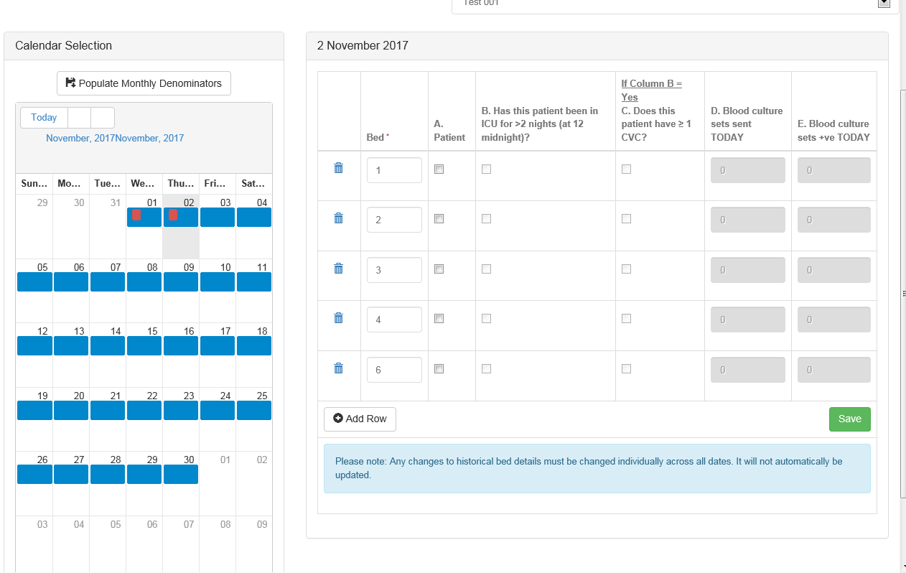
Data Collection: Daily bed census
Background
Development of surveillance
Results
Limitations
Summary
Conclusions
Users can set up their units’ beds. This is carried forward for every day but can be edited
For each day and each bed, users’ use the tick/text boxes to show occupancy, CVC and blood culture sets
The system will use the daily bed census data to calculate the monthly totals if instructed to by the user

Slide 17
Sentinel BSI surveillance programme data capture system – Outputs
Background
Development of surveillance
Results
Next steps
Future Developments
Conclusions
Currently (2017):
download line listings for positive blood cultures or the three denominator data
quarterly offline tailor-made reports to all participating units, providing data from their unit and the overall data from units of the same type (adult, paediatric or neonatal)
Tabulated counts and rates of various metrics, i.e.:
Rate of BSI per 1,000 patient-days
Rate of BSI per 1,000 blood culture sets taken
Rate of ICU BSI per 1,000 patient days (restricted to patients in ICU >2 nights)
Rate of CVC-associated and CVC-related ICU-associated BSI per 1,000 CVC days (restricted to patients in ICU >2 nights)
CVC utilisation rate
Counts of positive blood cultures which are of skin commensals, mixed growth (polymicrobial), top organisms

Slide 18
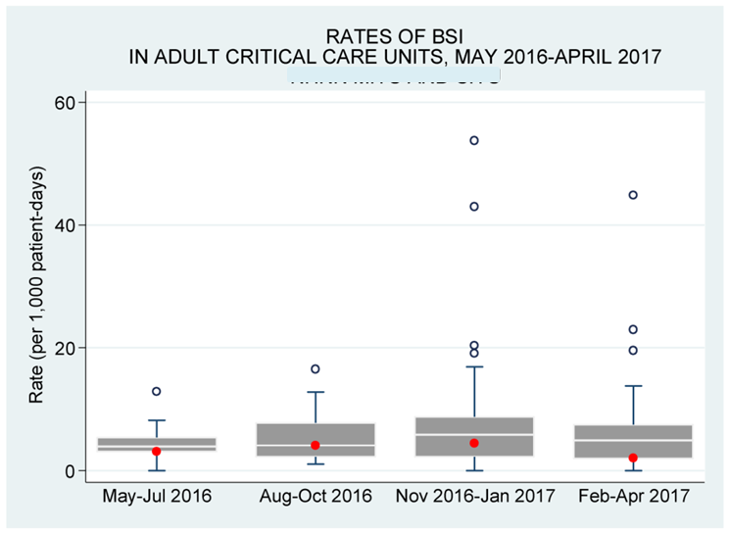
Sentinel BSI surveillance programme data capture system – Outputs
Background
Development of surveillance
Results
Next steps
Future Developments
Conclusions
Also provided, box and whisker plots showing range of rate of positive blood culture and BSIs with the specific units highlighted within this (red dot)
Notes:
Red dots denote a specific unit
This allows units to see where they fall in the scheme of other units of the same type (NB these are crude rates, i.e. do not take into consideration case mix etc)

Slide 19
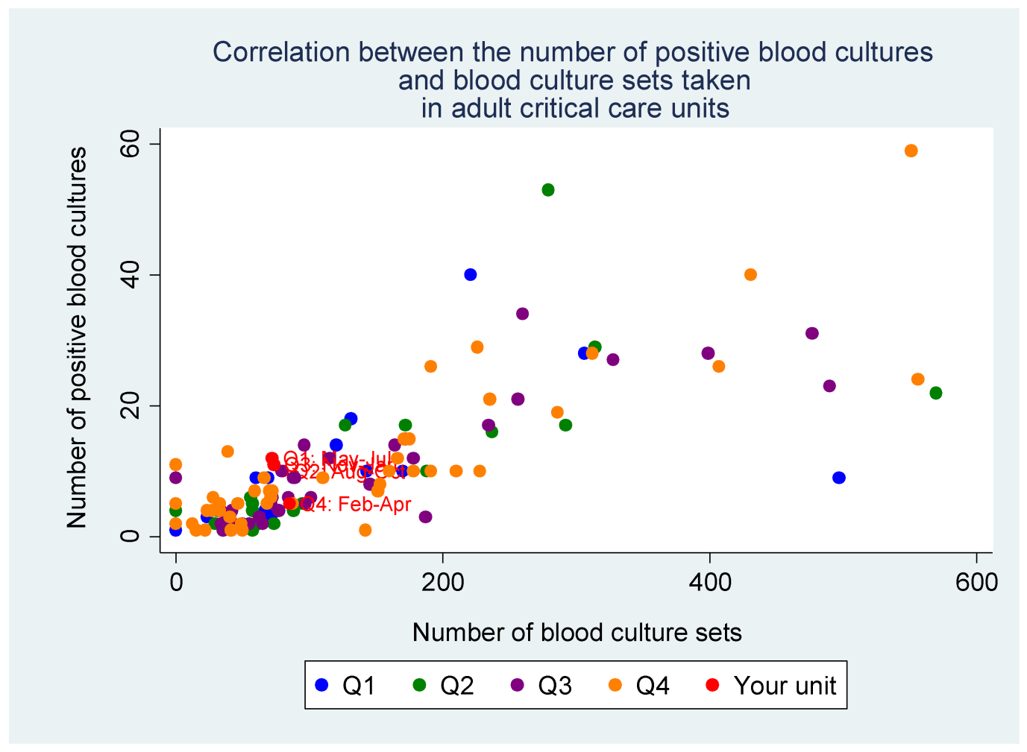
Sentinel BSI surveillance programme data capture system – Outputs
Background
Development of surveillance
Results
Next steps
Future Developments
Conclusions
Scatter plot of the number of blood culture sets taken per unit vs. number of positive blood cultures
Notes:
Red dots denote specific unit and are labelled with the quarter they represent – this one isnt super clear as the red dots are all in a similar place for this unit.
Scatter plots show correlation between the number of blood culture sets taken and the number of positive blood cultures.
(Of note, you can see at the far bottom left hand corner that there are some unit who have reported 0 blood culture sets via the denominator data entry but have positive blood culture episodes entered as case-level data entry.)

Slide 20
Sentinel BSI surveillance programme – National roll-out
Background
Development of surveillance
Results
Next steps
Future Developments
Conclusions
In November 2016, letters were sent to all acute Trust CEOs from Professor Dame Sally Davies (CMO) and Professor Paul Cosford, Director for Health Protection and Medical Director of PHE
Thank you to participating Trusts
Invitation to non-participating Trusts to sign up & submit data to the surveillance scheme
Of 152 acute Trusts in England:
102 have Local Administrators registered (191 ICUs)
70 entering data (100 units)
AIM: to increase number of Trusts signed up to the system & entering data
Notes:
Actually now 151 Trusts as Central and South Manchester have merged. We have not yet merged these Trusts on our system, but this would reduce the numbers to
151 acute Trusts in England,
101 have local Administrators (191 units)
69 entering data (100 units)
BUT data provided based on organisational structure for time period we are looking at, i.e. by 31st July 2017 there were 152 Trusts. Just providing this data in case anyone questions the total of acute Trusts

Slide 21
Sentinel BSI surveillance programme Results: 1 May 2016 – 31 July 2017
Background
Development of surveillance
Results
Next steps
Future Developments
Conclusions
70 Trusts entered data (100 units)
88 adult
7 paediatric
5 neonatal
2,137 positive blood culture-episodes reported: 1,974 adult, 73 paediatrics, 90 neonates
43% CoNS
11% E. coli
8% Enterococcus spp.
7% S. aureus
7% Klebsiella spp
13% polymicrobial infections (defn. mixed culture or multiple PBC episodes from blood cultures taken on the same day)
Notes:
Due to Manchester merger, this should be 69 Trusts (100 units) the rest remains the same though.

Slide 22
Sentinel BSI surveillance programme results, 1 May 2016 – 31 July 2017
CVC-associated BSI (clinical definition)
Criteria for bloodstream infection
AND
The presence of at least one central venous catheters at the time of the positive blood culture, or CVC removed within 48 hrs before positive blood cultures
AND
The signs and symptoms, and the positive laboratory results, including pathogen cultured from the blood, are not primarily related to an infection at another site
Background
Development of surveillance
Results
Next steps
Future Developments
Conclusions
58% met definitions for BSI (n=1,241/2,137 +ve blood cultures)
59% ICU-associated BSI (n=769/1,241)
21% ICU-associated CVC-associated BSI (n=161/769)
17% ICU-associated CVC-related BSI (n=127/769)
CVC-related BSI (surveillance definition)
Criteria for bloodstream infection
AND
The presence of at least one central venous catheters at the time of the positive blood culture or CVC removed within 48 hrs before positive blood cultures
AND
At least one of the following where the same culture was identified: quantitative CVC culture 103 CFU/ml or semi-quantitative CVC culture > 15 CFU quantitative blood culture ratio CVC blood sample/peripheral blood sample> 5 differential delay of positivity of blood cultures: CVC blood sample culture positive 2 hours or more before peripheral blood culture (blood samples drawn at the same time) positive culture with the same micro-organism from pus from insertion site symptoms improve within 48hr of removal of CVC

Slide 23
Sentinel BSI surveillance programme Results: 1 May 2016 – 31 July 2017
Background
Development of surveillance
Results
Next steps
Future Developments
Conclusions
58% of +ve blood cultures met criteria for Blood Stream Infections (n=1241 of 2137 +ve blood cultures)
59% of BSIs were ICU-associated BSI (n=769/1,241)
21% ICU-associated CVC-associated BSI (n=161/769)
17% ICU-associated CVC-related BSI (n=127/769)
29% of ICU-associated BSIs were CVC-BSIs* (222 / 769)
* The diagnosis of a CVC-BSI is made ‘automatically’ using clinical and microbiological data supplied by the clinician. It is possible for a single episode to fulfil the criteria for both the CVC-associated and the CVC-related definition. Cases are not double counted in the summary measure (see next slide using earlier data)

Slide 24
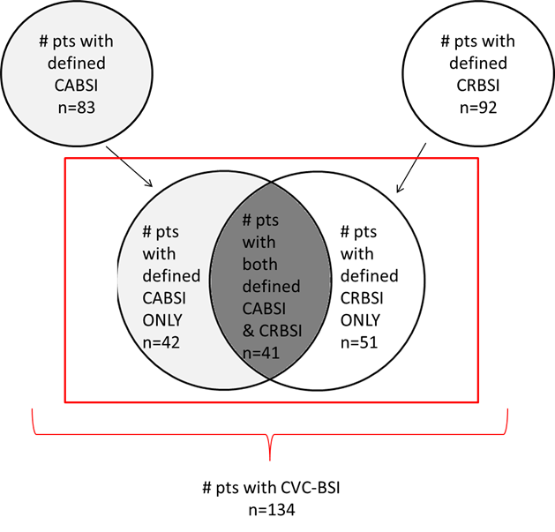

Slide 25
Sentinel BSI surveillance programme results, 1 May 2016 – 31 July 2017
Background
Development of surveillance
Results
Next steps
Future Developments
Conclusions
 | Adult CCUs | Paediatric CCUs | Neonatal CCUs
Total number of positive blood cultures* | 1,893 | 73 | 72
Total number of patient days | 188,385 | 21,510 | 21,428
Total number of blood culture sets taken | 25,188 | 1,387 | 1,526
Rate of positive blood cultures per 1,000 patient days | 10.0 | 3.4 | 3.4
Rate of positive blood cultures per 1,000 blood culture sets taken | 75.2 | 52.6 | 47.2
Total number of BSIs* | 1,120 | 30 | 26
Rate of BSI per 1,000 patient days | 5.9 | 1.4 | 1.2
*Including only numerator data from units who provided denominator data
Notes:
Next slide has relevant rates highlighted

Slide 26
Sentinel BSI surveillance programme results, 1 May 2016 – 31 July 2017
Background
Development of surveillance
Results
Next steps
Future Developments
Conclusions
 | Adult CCUs | Paediatric CCUs | Neonatal CCUs
Total number of positive blood cultures* | 1,893 | 73 | 72
Total number of patient days | 188,385 | 21,510 | 21,428
Total number of blood culture sets taken | 25,188 | 1,387 | 1,526
Rate of positive blood cultures per 1,000 patient days | 10.0 | 3.4 | 3.4
Rate of positive blood cultures per 1,000 blood culture sets taken | 75.2 | 52.6 | 47.2
Total number of BSIs* | 1,120 | 30 | 26
Rate of BSI per 1,000 patient days | 5.9 | 1.4 | 1.2
*Including only numerator data from units who provided denominator data

Slide 27
Sentinel BSI surveillance programme results, 1 May 2016 – 31 July 2017
Background
Development of surveillance
Results
Next steps
Future Developments
Conclusions
 | Adult CCUs | Paediatric CCUs | Neonatal CCUs
Number of ICU-associated BSIs* | 683 | 19 | 19
Number of patient days, amongst patients in the ICU >2 days | 129,990 | 9,794 | 20,084
Rate of ICU-associated BSI per 1,000 ICU-patient days | 5.3 | 1.9 | 0.9
Number of ICU-associated CVC-BSI* | 192 | 6 | 10
Number of CVC days, amongst patients in the ICU >2 days | 79,313 | 5,589 | 4,672
Rate of ICU-associated CVC-BSI | 2.4 | 1.1 | 2.1
CVC utilisation | 61.0 | 57.1 | 23.3
*Including only numerator data from units who provided denominator data
Notes:
Next slides have relevant rates/metrics highlighted

Slide 28
Sentinel BSI surveillance programme results, 1 May 2016 – 31 July 2017
Background
Development of surveillance
Results
Next steps
Future Developments
Conclusions
 | Adult CCUs | Paediatric CCUs | Neonatal CCUs
Number of ICU-associated BSIs* | 683 | 19 | 19
Number of patient days, amongst patients in the ICU >2 days | 129,990 | 9,794 | 20,084
Rate of ICU-associated BSI per 1,000 ICU-patient days | 5.3 | 1.9 | 0.9
Number of ICU-associated CVC-BSI* | 192 | 6 | 10
Number of CVC days, amongst patients in the ICU >2 days | 79,313 | 5,589 | 4,672
Rate of ICU-associated CVC-BSI | 2.4 | 1.1 | 2.1
CVC utilisation | 61.0 | 57.1 | 23.3
*Including only numerator data from units who provided denominator data

Slide 29
Sentinel BSI surveillance programme results, 1 May 2016 – 31 July 2017
Background
Development of surveillance
Results
Next steps
Future Developments
Conclusions
 | Adult CCUs | Paediatric CCUs | Neonatal CCUs
Number of ICU-associated BSIs* | 683 | 19 | 19
Number of patient days, amongst patients in the ICU >2 days | 129,990 | 9,794 | 20,084
Rate of ICU-associated BSI per 1,000 ICU-patient days | 5.3 | 1.9 | 0.9
Number of ICU-associated CVC-BSI* | 192 | 6 | 10
Number of CVC days, amongst patients in the ICU >2 days | 79,313 | 5,589 | 4,672
Rate of ICU-associated CVC-BSI | 2.4 | 1.1 | 2.1
CVC utilisation | 61.0 | 57.1 | 23.3
*Including only numerator data from units who provided denominator data

Slide 30
Sentinel BSI surveillance programme – User Feedback
Background
Development of surveillance
Results
Next steps
Future Developments
Conclusions
Survey to be sent out to Trusts for feedback on:
Blockers and facilitators for participating in the surveillance scheme
Ease of contributing to sentinel surveillance scheme
Value of surveillance sentinel scheme
Content of offline reports
Notes:
This was before we started to design questionnaire/survey. So if you want to remove bits such as content of reports, value of surveillance scheme, then pls do.

Slide 31
National BSI surveillance programme – New Data Capture System 2018
Background
Development of surveillance
Results
Next steps
Future Developments
Conclusions
New features:
Migration of data from previous system
Data upload wizard – allowing all data for a month to be batch uploaded for a specific unit
Live on-demand reporting features available
Tabular and graphic
Counts and rates
Device utilisation rates
Data can be stratified by a variety of user-selected parameters
Aggregate-level so can look at data from all units and also for sub-national and national groups
Exported as multiple different file types
Notes:
Pls note that approx. a month ahead of launch we will alert users.
We are trying to identify strategies to help move over Local Administrators from one system to another, although all users will have to re-register on the new system.
Notification and advice will come around to all users ahead of time.

Slide 32
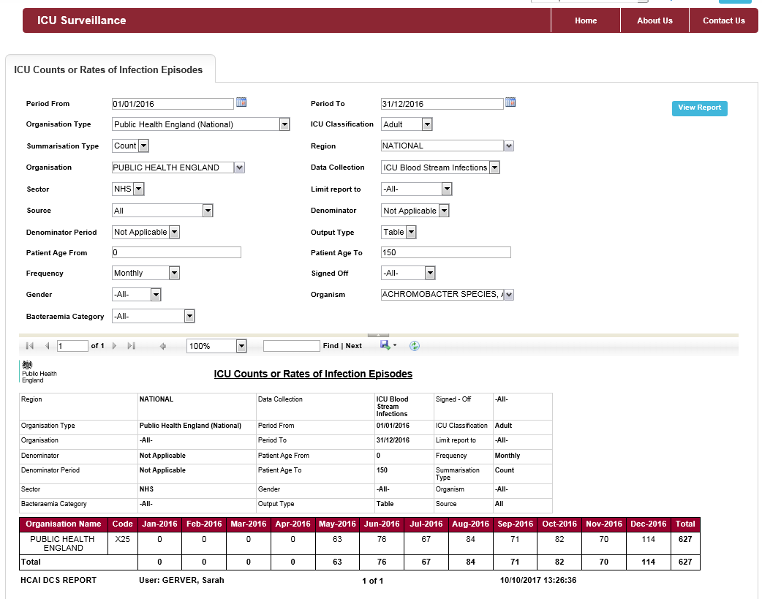
Background
Development of surveillance
Results
Next steps
Future Developments
Conclusions
Filters to change data you want in report
Ability to export output as a .csv, Excel file, Word file or PDF
On-screen output with parameters selected as a header
Notes:
Example of one report: Counts or Rates of Infection Episodes.
Report is aggregate level so a user can see total counts or rates for any unit in the country.
Allows a user to define the data they want to see using the drop-down parameters/filters (top half of screen). i.e. a user can define to view counts or rates, they can chose the organisation type they wish to view the data for (i.e. PHE, ICU, NHS Region etc) and then limit to specific organisations of that type.
A report can be restricted by age, gender, organism cultured, the source of the bacteraemia/fungaemia. They can also limit the data to show only ICU-associated cases or pre-ICU cases, as well as all cases. Likewise they can limit the data brought back by bacteraemia category (i.e. if the case is a BSI, or doesn’t meet BSI definitions). Totally flexible.
The selected data will show on screen (bottom part of image) but can be exported into Excel, Word, CSV or as a PDF.

Slide 33
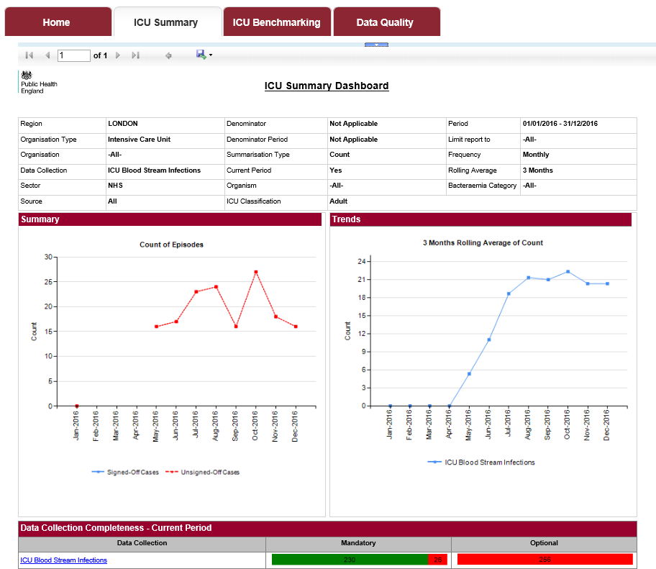
National BSI surveillance programme – Launch with new Data Capture System
Background
Development of surveillance
Results
Next steps
Future Developments
Conclusions
Output can be exported
More roles available – Local Administrators, Data Entry, Report Only etc allowing for more flexibility about who can view the data and perform associated actions
Introducing “Sign-off” function
Senior user will be assigned a “sign-off” role
At the end of a month, data can be signed-off signalling data entry and quality check completion
Up to 3 months to complete this function
Dashboards will be available for benchmarking, data quality and summary of results – data can be viewed by that which is signed-off or not
Counts or Rates and rolling average graphs for specified unit(s)
Counts or Rates and rolling average graphs for specified unit(s)
Indication of data quality completeness for both mandatory and optional questions with hyperlinks to access cases which require attention
Notes:
Real units data – so redacted for presentation
There are multiple dashboards allowing quick views of the data. Access is role and organisation specific. Different elements will be seen by different user types.
Like the previous report, there are a variety of parameters which can be changed to filter the data on view. However, the summary dashboard will show you only data for the organisations for which you have access. These include quick views of counts/rates and a rolling average of the same data.
Depending on the user role, you may also be able to see a data collection completeness element (at the bottom of the screen) which is broken down into the total number of records with completed (in green) and incomplete (in red) mandatory and optional questions there are for the data collection (here ICU BSI).
Additional elements may be available for other roles.
For the benchmarking dashboard, you can look at all organisations again and select a single organisation to highlight in maroon.
Again these data are shown on screen and are exportable.

Slide 34
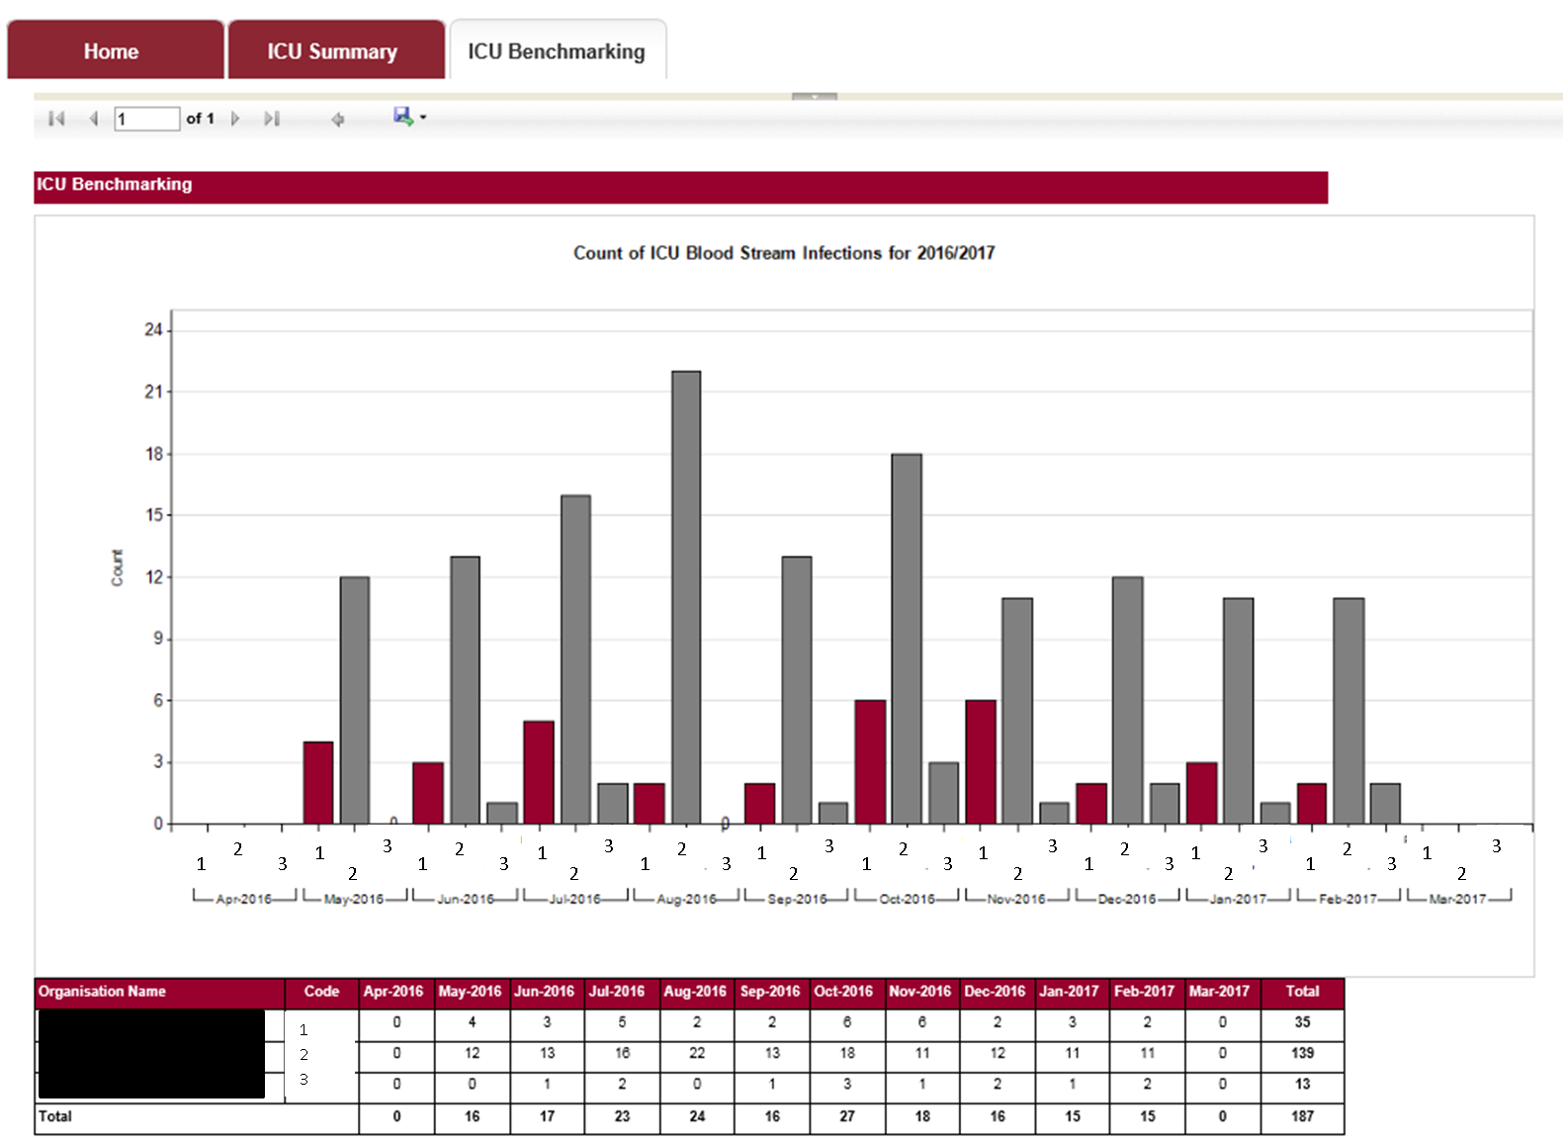
Output can be exported
Chart output comparing comparable ICUs/Trusts with a specific ICU (maroon).
Can be counts or rates.
Tabular output of counts or rates, as per chart above

Slide 35
National BSI surveillance programme – Access by CCGs & other bodies
Background
Development of surveillance
Results
Next steps
Future Developments
Conclusions
This software traces cases using the NHS Spine (via the demographic batch service), allowing cases to be attributed to a CCG
The software has an inbuilt organisational hierarchy for both the reporting route (e.g. ICU -> NHS Trust -> PHE Centre -> PHE Region -> PHE National), commissioning route (for non-specialist care: pt -> CCG -> NHS Local Office -> NHS Region -> NHS Commissioning Board Region) and to Local Authority of pt residence.
We can allow users from these organisations to access the DCS.

Slide 36
National BSI surveillance programme – Security
Background
Development of surveillance
Results
Next steps
Future Developments
Conclusions
It has a security model based on both organisation and role
A user can only access data based on the organisation and the role(s) they are registered with
Data Entry roles will only be available for ICUs.
Case-level data can only be viewed by users with relevant roles who have rights to see data from that ICU (as per the organisation hierarchy)

Slide 37
National BSI surveillance programme – Support
Background
Development of surveillance
Results
Next steps
Future Developments
Conclusions
Updated user guides and protocol will be launched with the new DCS
“Contact Us” directly through website to PHE support staff

Slide 38
Linkage with other datasets
Background
Development of surveillance
Results
Next steps
Future Developments
Conclusions
Most existing critical care audits do not capture the relevant infection data for the ICU CVC-BSI surveillance
Standalone ICU DCS
However, to reduce burden of data entry, limited data items collected via the ICU DCS
Data on positive blood cultures
Data items to apply internationally-comparable definitions of BSIs & CVC-associated/related BSIs
Patient identifiers so that we can link to other datasets
Case mix adjustment via linking ICCQIP data to the existing critical care audits (ICNARC – adults, PICANET – paediatric cases, NDS – neonates, via NDAU and BadgerNet)
Data on antimicrobial susceptibility via linkage with PHE’s Second Generation Surveillance System (SGSS)

Slide 39
Additional plans for Phase 2
Background
Development of surveillance
Results
Next steps
Future Developments
Conclusions
Include case-mix adjusted rates via linkage with existing critical care audits
On-demand reports and benchmarking options.
From data to action: ICCQIP partnership could form clinician-led working groups to evaluate
interventions focused on IPC
Ventilator associated pneumonia
Urinary catheter associated infections
etc

Slide 40
Conclusions after 15 months
Background
Development of surveillance
Results
Next steps
Future Developments
Conclusions
High number/percentage of +ve blood cultures with skin commensals
Potential target for QI of methods of taking of blood cultures?
Cannot assume all/majority are contaminates?
Rate of ICU-associated CVC-BSI at end of Matching Michigan was 1.5 in adults and 2.9 in paediatric patients. Now 2.4 & 1.1 respectively
Some differences in definitions, MM asked clinician to report number of infections based on a definition. ICCQIP surveillance scheme applies definitions to raw data – may impact rates
Primary goal of surveillance is to provide data for action
If rates have increased in adult ICUs, we need to revisit our IPC processes of care – set ambitious targets to minimise (?abolish) CVC-BSIs
Monitoring and benchmarking provides the foundation for optimising patient care

Slide 41
Contact information
Background
Development of surveillance
Results
Next steps
Future Developments
Conclusions
If you have any questions about the surveillance protocol, or wish to sign up and start submitting data, send queries to:
ICCQIP.surveillance@phe.gov.uk

Slide 42
Acknowledgements
Background
Development of surveillance
Results
Next steps
Future Developments
Conclusions
Thank you to all units participating in the sentinel surveillance scheme
Together we can reduce CVC-BSIs and antimicrobial resistant infections

Slide 43
Definitions: BSI by age range (1)
Background
Development of surveillance
Results
Next steps
Future Developments
Conclusions
Adults (≥13 years) | Paediatrics (<13yrs)
Meets one of the following criteria: | Meets one of the following criteria:
A recognised pathogen from at least one blood culture | A recognised pathogen from at least one blood culture
OR | OR
A common skin microorganism* from 2 blood cultures drawn on separate occasions and taken within a 48hr period | A common skin microorganism* from 2 blood cultures drawn on separate occasions and taken within a 48hr period
AND The patient has at least ONE symptom of fever >38ºC, chills or hypotension | AND The patient has at least TWO symptoms of paediatric SIRS: tachycardia, bradycardia (<1yr), temperature >38.5ºC <36ºC, elevated respiratory rate, leukocytes (elevated/depressed for age), leukocyte count (if leucocyte is selected)

Slide 44
Definitions: BSI by age range (2)
Background
Development of surveillance
Results
Next steps
Future Developments
Conclusions
Neonates (<28 days)
Meets one of the following criteria:
A recognised pathogen from at least one blood culture
OR A common skin microorganism* is cultured from blood AND Patient has ONE of: C-reactive protein >2.0 mg/dL , immature/total neutrophil ratio (I/T ratio) >0.2 , leukocytes <5/nL , platelets <100/nL
AND
At least TWO of: temperature >38°C or <36.5°C or temperature instability, tachycardia or bradycardia Apnoea, extended recapillarisation time , metabolic acidosis, hyperglycaemia , other sign of BSI such as apathy

