Slide 1
Notes:
Introductions

Slide 2
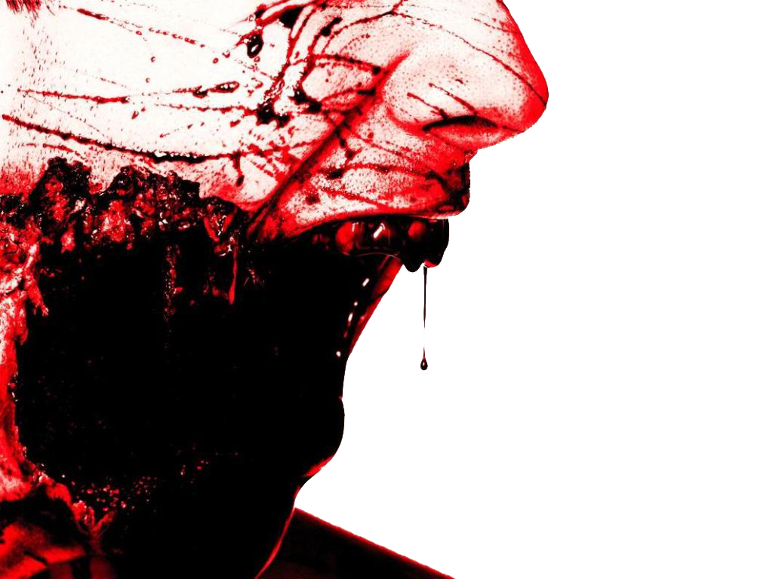
How to Survive a Zombie Apocalypse and Save your friends and family from turning into ZOMBIES
By Liisa Jackson

Slide 3
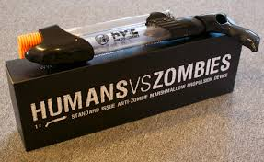
Person or Zombie
Zombies are no minded living dead walkers that want to eat your brains.
People have vital signs and we need to save them so they don’t turn into zombies.
Notes:
They are extremely stupid and quite clumsy because the lack of barely or no brain activity
. These zombies are more dangerous than normal zombies because they are much smarter and clever.
This form of zombie can spread the mutation by biting its victims. They are oblivious to most injuries and can only be stopped by destroying the brain.

Slide 4
Weapons
When it comes to weapons its all about precision and accuracy. The weapons of choice for most zombie enthusiasts is a high powered Marshmallow gun that will stop the Zombie in its tracks!
Zombies are afraid of Marshmallows, but there is some drawbacks.
You may eat all the marshmallows before you see a Zombie
Marshmallow guns are short range so you have to get close to the Zombie
Your hands get sticky when loading the gun
Notes:
Some of the best weapons to have are a 9mm pistol or a pump shotgun.
But another weapon to consider is the flamethrower. Most zombies are afraid of fire, but there is some drawbacks.
Heavy
Short range compared to the range of a pistol or rifle
Small fuel container

Slide 5
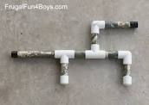
2 types of marshmallow guns: store bought or homemade!
Notes:
Here's a clip of a flamethrower

Slide 6
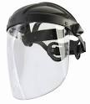
Armor
Perhaps the best way to prepare for the Zombies is to assemble the perfect zombie fighting attire.
To avoid marshmallow sludge when blasting zombies is by wearing a full face mask.
Use bubble wrap to make a bite-proof body suit.
Notes:
Avoid brain spray-back by wearing goggles and covering your face with a non-porous material. Use plate mail or leather to create a bite-proof body suit.

Slide 7
Home
A building that’s secure, but also has escape routes in case there's a problem.
A secure home requires all entrances to be blocked or protected by marshmallow barriers.
Always have a survival bag packed and ready to go in case of an emergency
Have your marshmallow gun and plenty of marshmallows

Slide 8
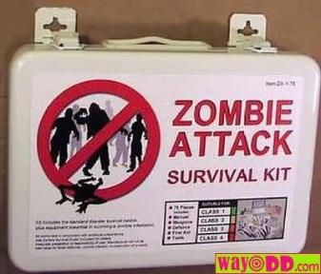
Survival kits
One gallon of water per person
3 day supply of food
Hand Crank powered radio
Flashlight
First aid kit
Map
Wrench
Whistle
Books
Notes:
A gallon of water per person
Suplly of food
Hand crank radio
Flashlight
First aid
Map
Wrench
Whistle to signal for help if needed
to keep your sanity

Slide 9
Our primary goal is to stop people from becoming Zombies!
We can save people by doing rapid triage
To prepare for Z-Day know how to tell if someone will turn into a Zombie through this triage class
Once someone dies they become a Zombie and you will have to shoot them with the marshmallow gun so they don’t bite a person and we end up with more zombies!
Notes:
If you have no one to trust you will most likely die very quickly
One thing to always think about is who you would want to survive a z-day with. You need to pick people that you can trust your life with, and that you can depend on to keep you safe.
By picking who you would survive best with means your one step closer to living longer

Slide 10
Checklist
Keep yourself safe
Marshmallow guns
Armor
Secure your home
Prepared survival kits
How to save people
Notes:
So the things you need to keep in mind is:
Know your classes
Weapons to survive with
Armor to keep you safe
Survival kits
And trust.

Slide 11
Why field triage?
Incidents which produce multiple human casualties are somewhat rare but do occur and must be planned for. A multiple or mass casualty incident can be defined as any incident in which more casualties are present than an initial response assignment can reasonably handle.
We will need your help!

Slide 12
Triage Unit Leader
Triage: A rapid approach to prioritizing
a large number of patients
Casualty
Collection
Point
Simple Triage And Rapid Treatment
Incident Site
Notes:
INSTRUCTOR NOTES:
This subject matter should be familiar to the student and is provided here as both a brief refresher and to tie together the components of the training program.

Slide 13
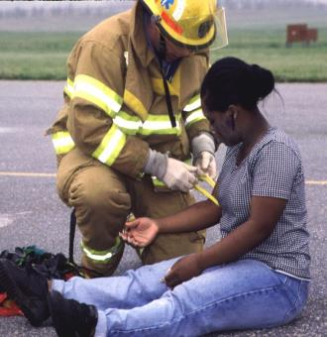
Triage
Triage should be performed RAPIDLY
Utilize START Triage to determine priority
30–60 seconds per patient
Affix tag on left upper arm or leg
Notes:
INSTRUCTOR NOTES:
MOVE QUICKLY!
Use S.T.A.R.T. to determine the priority of the patient:
No more than 30–60 seconds per patient
Check:
Respiration
Pulse
Mental Status
Attach ribbon to UPPER ARM, if possible. The next option would be HIGH on a THIGH. The goal is to be consistent so they are easily recognized as the priority flag.

Slide 14
START – Triage
Clear the “walking wounded” with verbal instruction:
If you can hear me and you can move, walk to…
Direct patients to the casualty collection point (CCP) or treatment area for detailed assessment and medical care
Green Minor Manager will be the area to control patients and manage area
Green tag will be issued at the CCP
These patients may be classified as MINOR
Notes:
INSTRUCTOR NOTES:
Talk the students through the triage process using these guidelines. Essentially, if a patient can hear you, understand and follow your commands, and has the physical ability to walk on their own, their injuries are non-emergent and can be tended to later. Of course, triage is a dynamic process and these patients should be re-assessed at the treatment area for any deterioration in their condition. The action of moving the MINOR patients from the scene also helps clear space and reduce confusion so the remaining patients can be quickly categorized.

Slide 15
START-Triage
Now use START to assess and categorize the remaining patients…
USE Color System
Notes:
INSTRUCTOR NOTES:
Basic, quick patient care

Slide 16
START-Triage
Categorize the patients by assessing each patient’s RPMs…
Respirations
Pulse
Mental Status
Notes:
INSTRUCTOR NOTES:
These are the three decision criteria to be used in categorizing those patients who have not already been determined to be “walking wounded.”

Slide 17
START—RPM
RESPIRATIONS
Is the patient breathing?
Yes
Adult – respirations > 30 = Red/Immediate
Pediatric – respirations < 15 or > 45 =
Red/Immediate
Adult – respirations < 30 = check pulse
Pediatric – respirations > 15 and < 45 = check
pulse
Notes:
INSTRUCTOR NOTES:
Address respirations first. Many triage decisions can be made on this assessment alone. This corresponds to the “A” and “B” of the ABCs of patient care.

Slide 18
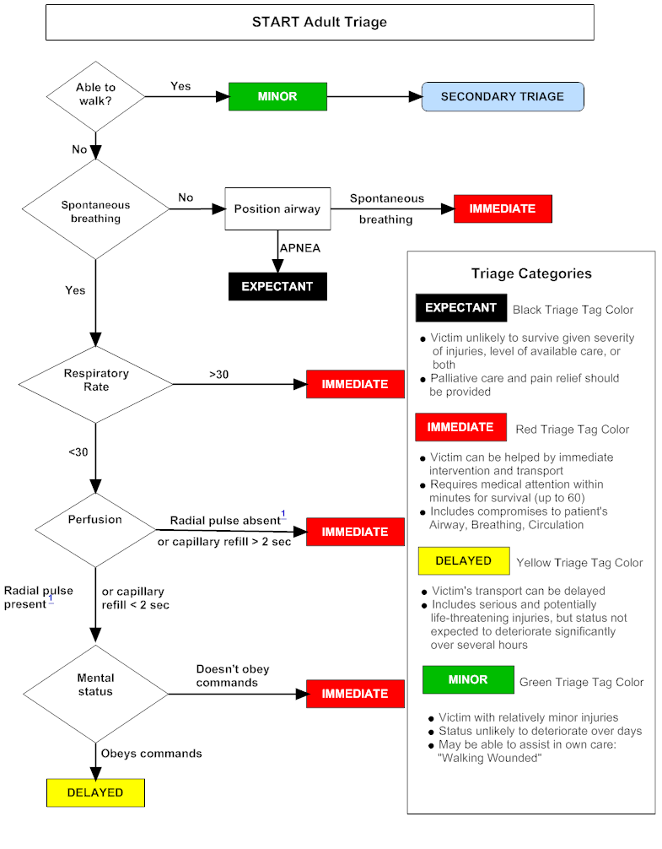
START—RPM
RESPIRATIONS
Is the patient breathing?
No
Reposition the airway…
Respirations begin = IMMEDIATE/RED
If patient doesn’t breath
Adult – deceased = BLACK-Zombie
Pediatric: Pulse Present – give 5 rescue breaths
respirations begin = IMMEDIATE/RED
absent respirations – deceased = BLACK
Notes:
INSTRUCTOR NOTES:
Address respirations first. Many triage decisions can be made on this assessment alone. This corresponds to the “A” and “B” of the ABCs of patient care.
18

Slide 19
START—RPM
PULSE
Is the RADIAL pulse present?
Is capillary refill (CR) LESS than < 2 seconds?
Yes
Check mental status
No
Adult: Pulse absent or CR > 2 seconds patient = IMMEDIATE/RED
Pediatric: No palpable pulse patient = IMMEDIATE/RED
Notes:
INSTRUCTOR NOTES:
This assessment corresponds to the “C” of the ABCs.

Slide 20
START-RPM
MENTAL STATUS…
Can the patient follow simple commands?
Yes
Adult = DELAYED / YELLOW
Pediatric: alert, verbal, or pain response is appropriate
= DELAYED / YELLOW
No
Adult = IMMEDIATE / RED
Pediatric – “P” pain causes inappropriate posturing or “U” unresponsive to noxious stimuli = IMMEDIATE/ RED
Notes:
INSTRUCTOR NOTES:
Patients that have respirations more than 30/minute and capillary refill greater than 2 seconds, but who can follow commands, are still categorized as IMMEDIATE.

Slide 21
START Triage
If the patient is IMMEDIATE/RED upon initial assessment…then, before moving the patient to the treatment area, attempt only life-saving interventions:
Airway, Tourniquet, Antidote
DO NOT ATTEMPT ANY OTHER
TREATMENT AT THIS TIME
Notes:
INSTRUCTOR NOTES:
Only emergent and immediately life-saving interventions should be performed at this stage. All other interventions should be made at the treatment area.

Slide 22
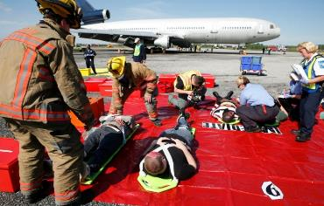
RED Triage Category (Immediate)
Adult
Respirations > 30 BPM
CR > 2 seconds or
no palpable radial pulse
Cannot follow simple
commands
Collapsed lung
20% blood loss
Closed Head Injury
Pediatric
Respirations < 15 or > 45
CR > 2 seconds or no palpable radial or brachial pulse
Inappropriate “Pain”
(e.g., posturing) or “Unresponsive”
Notes:
INSTRUCTOR NOTES:
The RED category is also referred to as IMMEDIATE and follows START criteria.
Requires medical attention within minutes for survival (up to 60 minutes)
Victim can be helped by immediate intervention and transport
Includes compromises to patient’s Airway, Breathing and Circulation

Slide 23
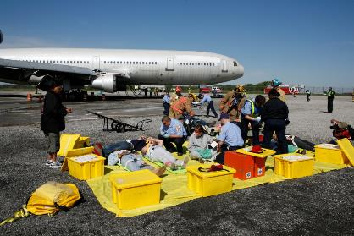
YELLOW Triage Category (Delayed)
Adult: respirations, capillary refill, and mentation are normal
Isolated burns
Extremity fractures
Stable other trauma
Most patients with medical complaints
Pediatric: “A,” “V,” or appropriate “P”
(e.g., withdrawal from pain stimulus)
Notes:
INSTRUCTOR NOTES:
The YELLOW category is also referred to as DELAYED.
• Victim’s transport can be delayed
Includes serious and potentially life-threatening injuries, but status not expected to deteriorate significantly over several hours

Slide 24
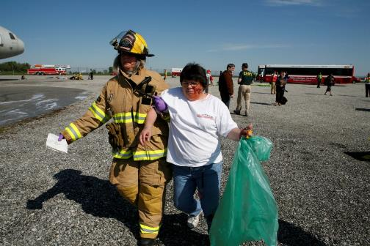
GREEN Triage Category (Minor)
“Walking wounded”
Psychological casualties
Always look for children being carried and assess them
Notes:
INSTRUCTOR NOTES:
The GREEN category is also referred to as MINOR.
Victim with relatively minor injuries
Status unlikely to deteriorate over days
May be able to assist in own care
“Walking Wounded”

Slide 25
Black/Expectant Triage Category (will a be a Zombie)
Black is for the patient that is not likely to survive even with emergent interventions
Injuries incompatible with life
Brain matter visible
Obvious mortality or death (pulseless and apneic)
Notes:
INSTRUCTOR NOTES:
GREY is the new category for patients who are encountered alive but not expected to survive. This may be very short term survival (minutes) or may also include patients that could live for hours (such as extensive third degree burns), but ultimately not survive. It is anticipated that the GREY category will ultimately be adopted nationally but, until it is, will not be employed until notice is given by MIEMSS. There are no Grey ribbons in use currently.

Slide 26
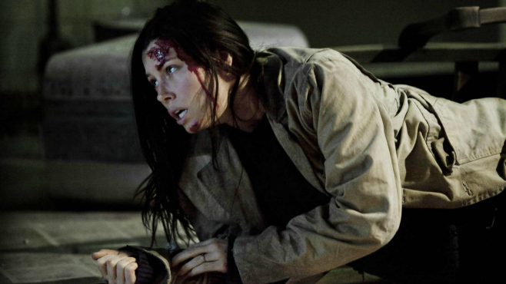
Patient #1
Visible head trauma
Unable to walk
Can follow simple commands

Slide 27
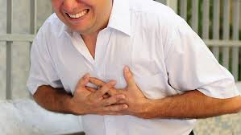
Patient #2
Complaining of chest pain
Can walk
Can follow simple commands

Slide 28
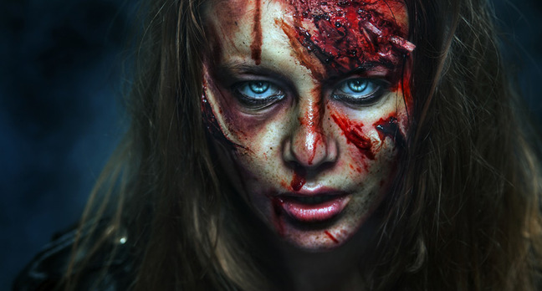
Patient #3
No Respirations
Brain matter showing
Mumbling brains

Slide 29
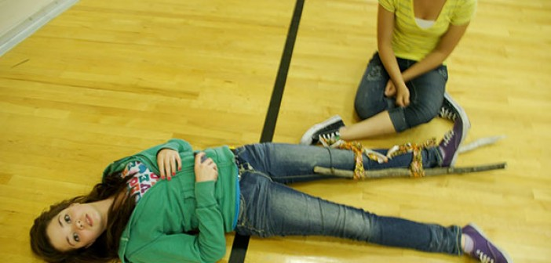
Patient #4
Broken leg set by friend
Not able to walk
Not able to follow simple commands

Slide 30
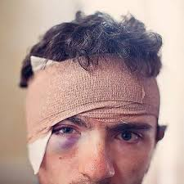
Patient #5
Head Trauma
Slurred speech
Falling every time he stands up

Slide 31
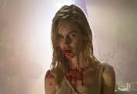
Patient #6
More than 3/4 loss of blood
Lunging at you trying to eat your brains

Slide 32
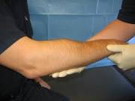
Patient # 7
Obvious broken arm
Able to walk
Can follow simple commands

Slide 33
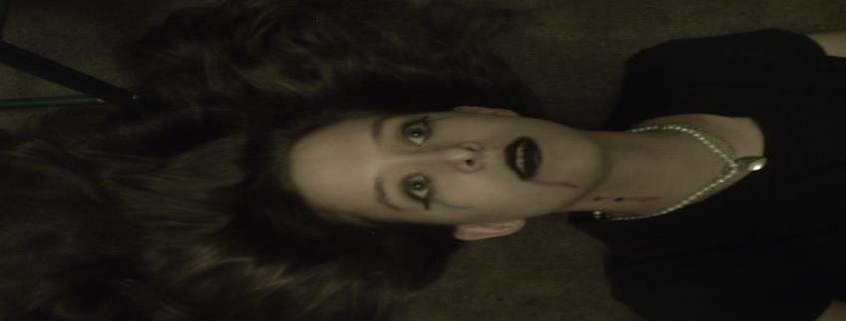
Patient # 8
Not breathing
No pulse
When airway is opened no respirations

Slide 34
Congratulations you can now survive a Zombie Apocalypse

Slide 35
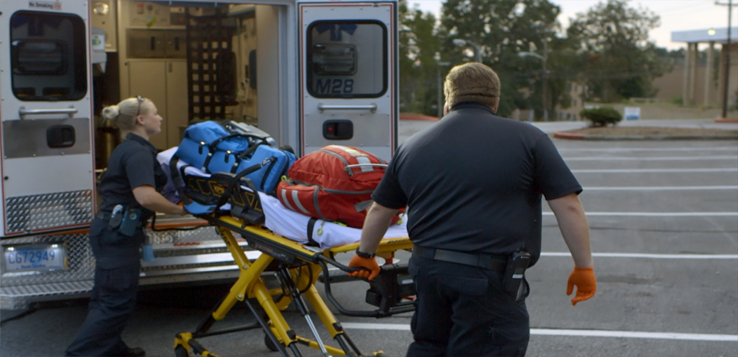
UNTIL HELP ARRIVES

Slide 36
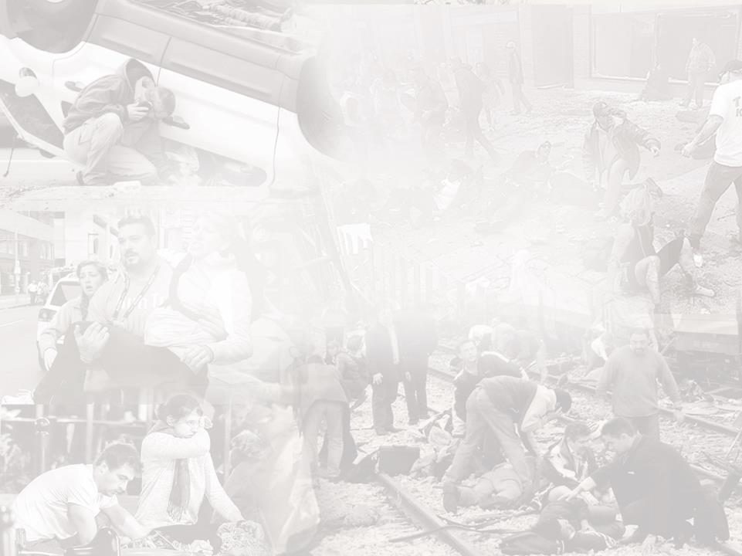
GOAL OF THE COURSE
Teach you basic skills to keep people with life-threatening injuries alive until professional help arrives.

Slide 37
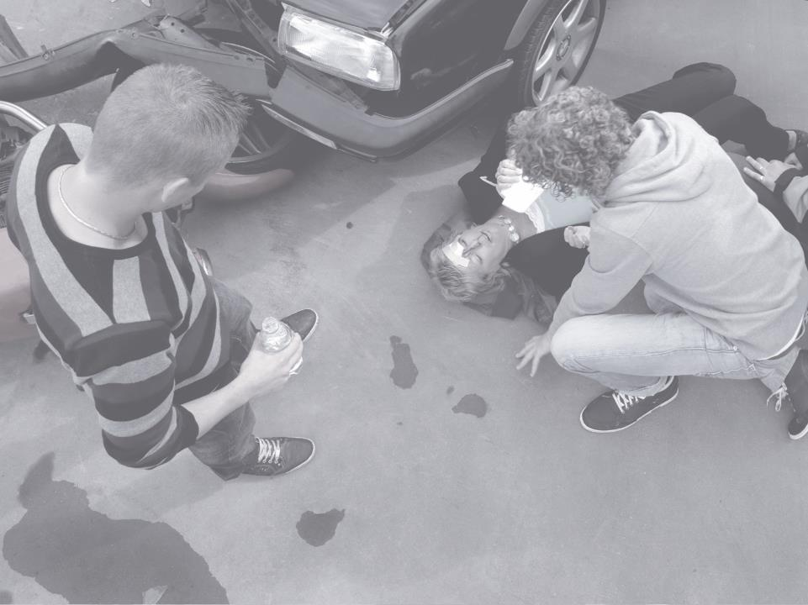
Topic 1 You Make a Difference
Topic 1
You Make a Difference

Slide 38
YOU MAKE A DIFFERENCE
If you act quickly and purposefully, you can save lives:
Call 9-1-1 to activate the Chain of Survival.
Move the injured away from danger to keep them safe.
Keep them alive until medical responders arrive:
Apply pressure to bleeding.
Help them to breathe by allowing them to sit up or lean forward, or by placing them on their side if they are unconscious.
Talk to the injured and provide comfort.

Slide 39
TYPES OF INCIDENTS
Life-threatening injuries can occur as the result of different types of incidents.
Life-threatening injuries can occur as the result of different types of incidents.
Common. Type: Vehicle crashes, and home-related injuries. Examples: Car, motorcycle, bicycle, pedestrian, home repair injuries, etc.
Rare. Type: Man-made and local weather incidents. Examples: Tornado, multi-vehicle crashes, active shooter, etc.
Very Rare. Type: Large-scale disasters. Examples: Acts of terrorism, bombings, large-scale transportation incidents, etc.
Common
Type:
Vehicle crashes and home-related injuries
Examples: Car, motorcycle, bicycle, pedestrian, home repair injuries, etc.
Rare
Type:
Man-made and local weather incidents
Examples: Tornado, multi-vehicle crashes, active shooter, etc.
Very Rare
Type:
Large-scale disasters
Examples: Acts of terrorism, bombings, large-scale transportation incidents, etc.

Slide 40
CHAIN OF SURVIVAL
How the emergency medical system flows to keep people with life-threatening injuries alive:
First Care YOU. Non-medical First Responders. Pre-hospital Medical Care. Emergency Medicine. Trauma Surgeons.
First Care
YOU
Pre-hospital
Medical Care
Emergency
Medicine
Surgeons
Non-medical First Responders

Slide 41
CALLING 911
Always call 9-1-1 as soon as possible.
Provide as much specific information as possible including where you are, what happened, how many are injured, and the severity of the injuries.
Follow the operator’s instructions and guidance.

Slide 42
SCENE SAFETY
Decide whether to stay and help, grab the injured and get to safety, or get yourself to safety.
Demonstrate how to safely move an injured person away from further harm.

Slide 43
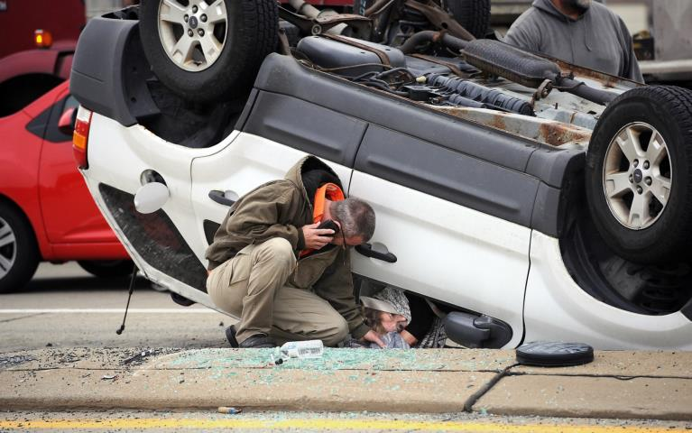
CAR CRASH

Slide 44
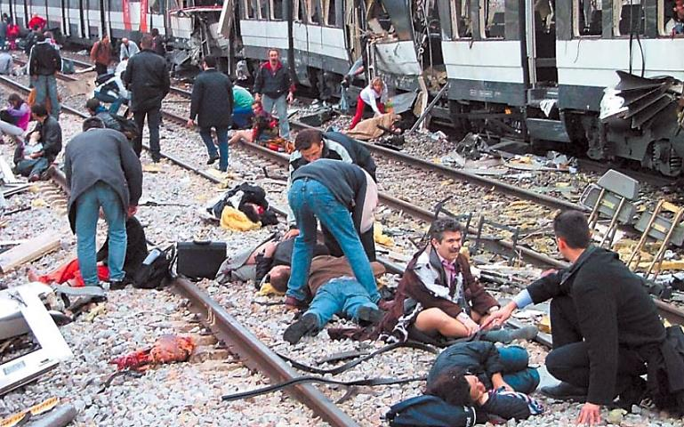
BOMB ON TRAIN

Slide 45
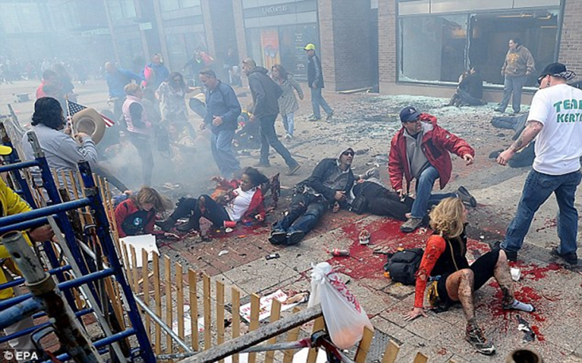
BOMB AT SPECIAL EVENT

Slide 46
WHEN PEOPLE ACT
TEND TO HELP
Event is unexpected, sudden
More than one person is injured
Experience the event firsthand
Believe they can help
Recognize an immediate threat to life that appears to be getting worse
Empathize with the injured
TEND NOT TO HELP
Assume professional medical responders will arrive quickly and take action
Feel they don’t know what to do
Are afraid

Slide 47
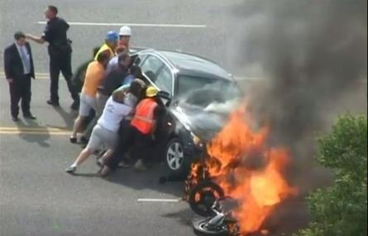
DIFFUSION OF RESPONSIBILITY
When multiple people witness an emergency, everyone assumes that someone else will help.
First person to step forward often triggers a supportive response from others nearby.
Someone must be the first to act!
Please select the picture within the slide to play the video.
Video can be found at: https://youtu.be/BmzSEYNTkHA

Slide 48
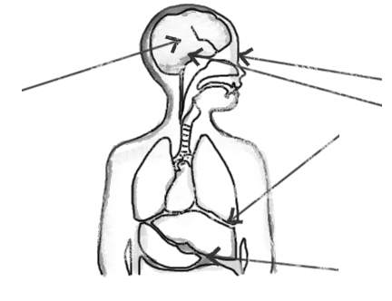
IMPACT OF STRESS
In a life-threatening emergency, you will experience physical and psychological effects that may include:
Distortion of Senses:
Sight (Tunnel Vision)
Sound
Adrenaline (Fight/Flight Response)
Temperature change
Shaky
Loss of other functions
Nausea
Distortion of Time
Assessment Loop:
Denial
Deliberation
Action
Distortion of Time
Assessment Loop:
Denial
Deliberation
Action
Distortion of Senses:
Sight (Tunnel Vision)
Sound
Adrenaline (Fight/Flight Response)
Temperature change
Shaky
Loss of other functions
Nausea

Slide 49
ASSESS THE SITUATION
Briefly pause. Use all your available senses:
What do you see?
What do you hear?
What do you smell?
Downed power lines
Smoke
Debris
Moving vehicles
People running
Gasoline
Smoke
Chemicals
Gunshots
Booms
Hissing
Creaking
Voices
What do you see?
Downed power lines
Smoke
Debris
Moving vehicles
People running
What do you hear?
Voices
Creaking
Hissing
Booms
Gunshots
What do you smell?
Gasoline
Smoke
Chemicals
What do you see?
Downed power lines
Smoke
Debris
Moving vehicles
People running
What do you hear?
Voices
Creaking
Hissing
Booms
Gunshots
What do you smell?
Gasoline
Smoke
Chemicals

Slide 50
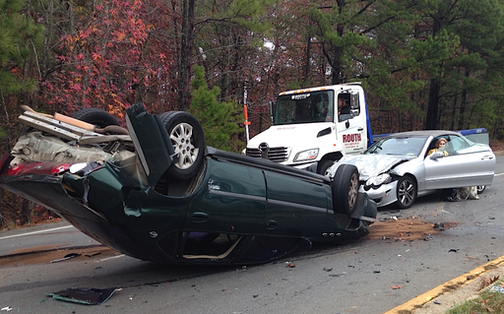
SCENE: CAR WRECK

Slide 51
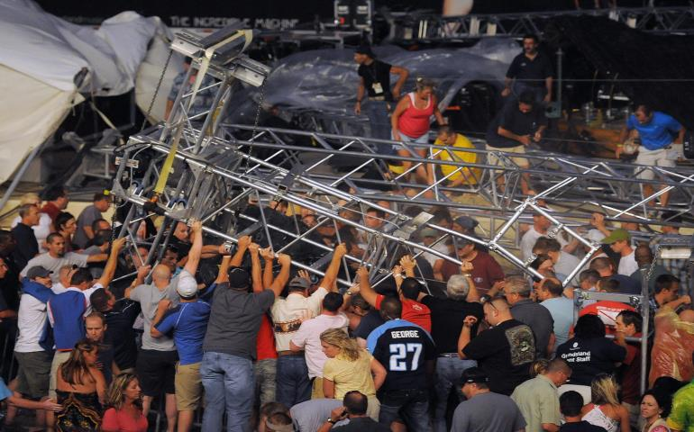
SCENE: CONCERT COLLAPSE

Slide 52
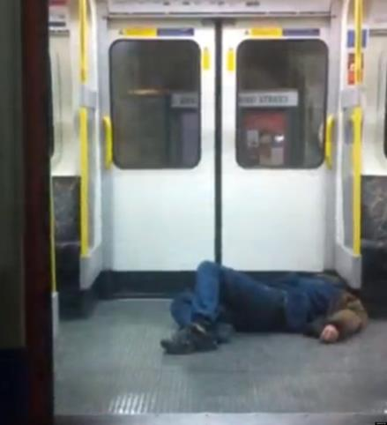
SCENE: PASSENGER DOWN

Slide 53
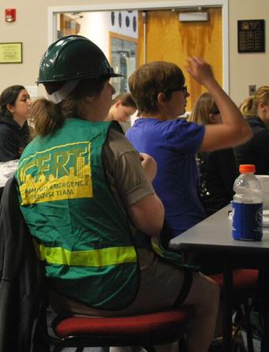
IMPROVE YOUR RESPONSE
Train your brain.
Talk about and practice what you would do in various emergency situations to improve the speed with which you respond.

Slide 54
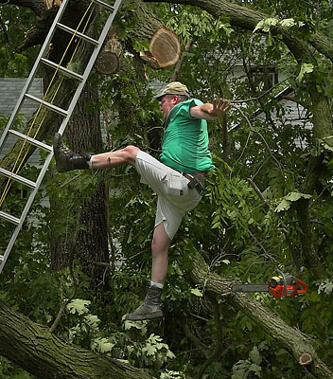
SCENE: TREE FALL

Slide 55
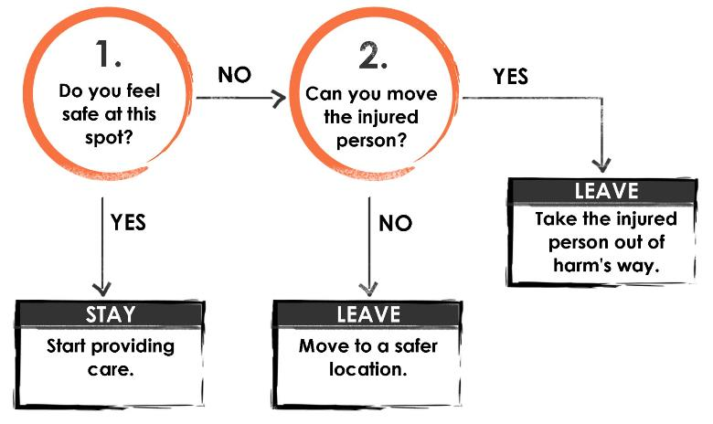
BEFORE TAKING ACTION
Use your best judgment…

Slide 56
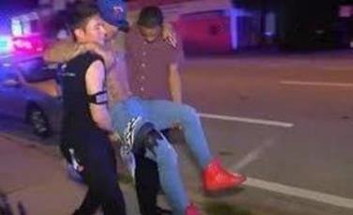
HOW TO MOVE THE INJURED
Move Smartly
Use others around you
Use things around you: blankets, chairs, carts etc.
Moving an injured person who is in grave danger will not cause more harm than leaving them to die.

Slide 57
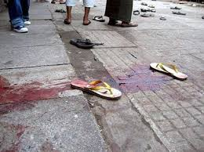
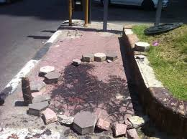
TIME IS CRUCIAL
Stop the Clock!
Every minute with uncontrolled bleeding decreases chance of survival!

Slide 58
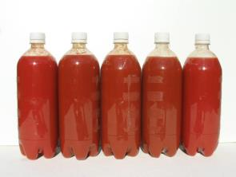
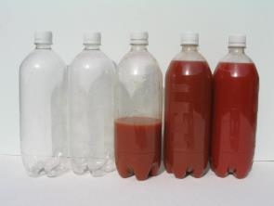
IRREVERSIBLE SHOCK
When your body loses approximately half its blood volume, it cannot survive – regardless of the quality of medical care you eventually receive.
You can lose that amount in just minutes!
5 liters of blood
2.5 liters of blood

Slide 59
STEPS TO CONTROL BLEEDING
STEP 1: Find the source(s) of bleeding.
STEP 2: If you have something to put in between the blood and your hands, use it. (Examples: gloves, a cloth, a plastic bag, etc.)
STEP 3: Apply firm, steady pressure directly on the source of the bleeding. Push hard to stop or slow bleeding – even if it is painful to the injured!
STEP 4: Keep pressure until EMS arrives.

Slide 60
WHEN TO USE A TOURNIQUET
Think of a tourniquet as another way to apply firm, steady pressure when:
The injury is to an arm or leg.
The bleeding is so severe it cannot be controlled otherwise.

Slide 61
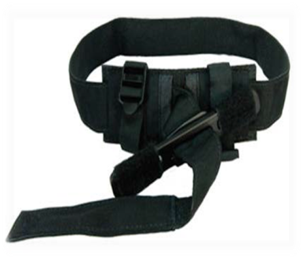
HOW TO USE A TOURNIQUET
Place as high as possible on the injured limb – closest to the torso. (Can be placed over clothing.)
Pull the strap through the buckle.
Twist the rod tightly until bleeding stops/slows significantly. (May be very painful.)
Secure the rod.
If bleeding doesn’t stop place a second tourniquet.
Leave in place until EMS takes over care.

Slide 62
MAKESHIFT TOURNIQUETS
If you don’t have a commercially available tourniquet, you can attempt to improvise one using material that is:
Broad
Flexible
Strong
Able to be twisted, tightened, and secured

Slide 63
KEY POINTS
Apply firm, steady pressure on the source of bleeding.
If you cannot control the bleeding with manual pressure, then consider applying a tourniquet.
Keep pressure until professional first responders arrive.

Slide 64
TOURNIQUETS
Let’s practice!

