Slide 1
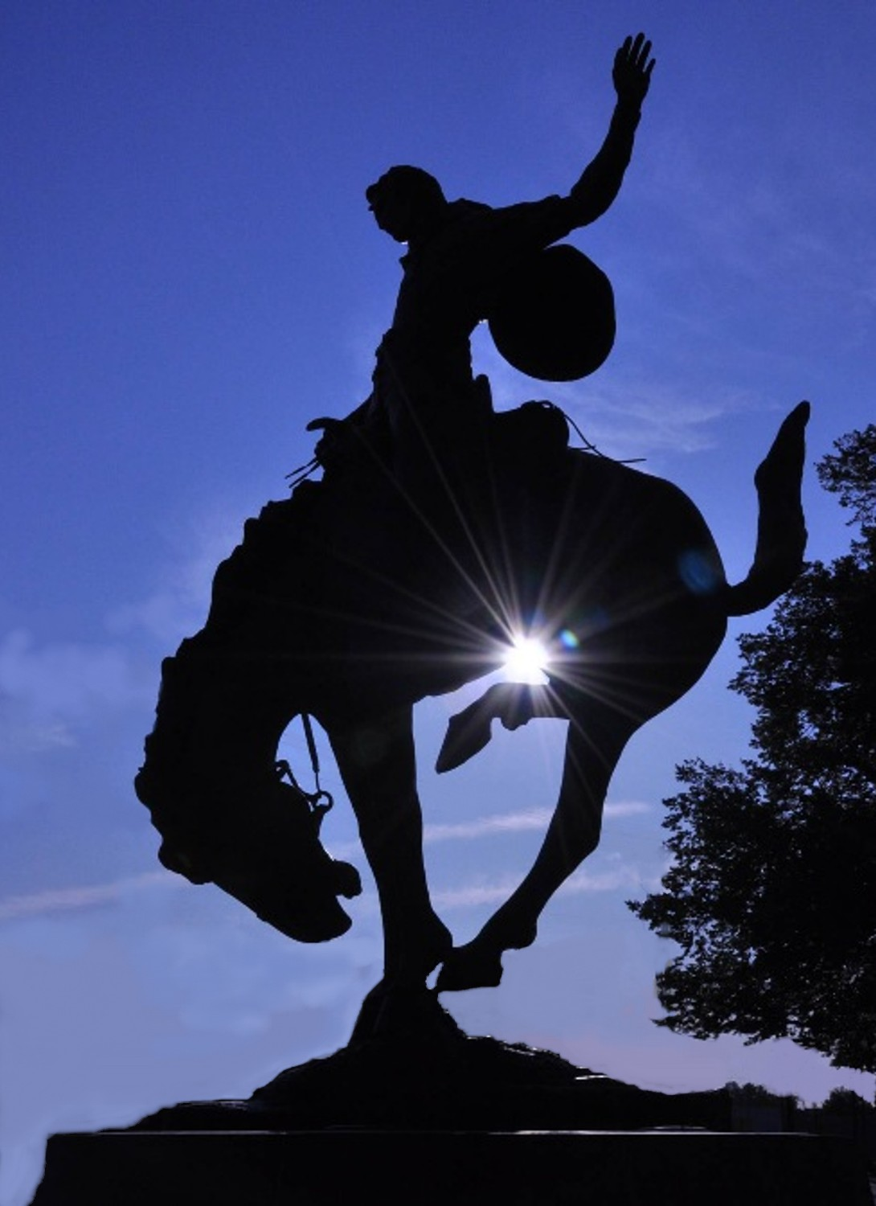

Slide 2
Agenda
What’s Happening?
Embracing Who We Are
Five Things that Absolutely, Positively Need to Happen Here
What the Future Holds

Slide 3
Investment/Expansion in Last 5 years?
Actual
Planned
New Hospital $70 million
PSD School Bond $55 million
Interpath Labs HQ $10 million+
Hill Meat Company $ 8 million+
Colby Rock Mtn Pipe $ 15 million+
Melanie Square $ 3 million
Newly Weds Foods $ 3 million+
Walgreens $ 1.2 million
Life Flight $ 1 million
Flex Hangar $ 1 million
Pepsi Distributor Expansion $ 1 million
Grocery Outlet $ 350k
Keystone RV Co. $ 500k
Tutuilla Duplexes (35) $ 3 million
TOTAL $ 172 million
Hangar Project $ 6 million
60-acre Solar Field $ 15 million
Food Processor Exp. $ 4 million
Data Center $ 45 million
Hotel $ 8 million
100-unit Apt. Complex $ 7.8 million
Police Crime Lab $ 8 million
13 Duplexes $ 4 million
Apartments (26) $ 2 million
Total $ 99.8 million

Slide 4
Pendleton: How Deep Is Your Love?
Would You fight for her?

Slide 5
Who You’re Not!
Quality of Life

Slide 6
Who You Are?
Best Town in Oregon to Raise a Family (Bloomberg Business Week, 2011)
Near 95% Graduation Rate
Named Best Community for Music Education (NAMM, 2013)(Twice)
Top True Western Town in the US (True West Magazine, 2011)
Best Large Outdoor Rodeo (2015, 2016 & 2017)
Largest Motorcycle Rally in Northwest
Best Outdoor Music Festival in Northwest (just my opinion)
Fastest Internet in the State
Most Solarized City in the State
Near Drought-Proof Water Filtration System
Eco-Friendly Wastewater Filtration System
Only Subsidized Air Service in the Northwest
Entertainment Capital of Eastern Oregon

Slide 7
Five Things That Absolutely, Positively Have to Happen Here

Slide 8
#1 DEVELOP THE RIVERFRONT & VIEWS OF THE BLUES

Slide 9
#2 Pendleton Sports Complex

Slide 10
#3 Roundup Hotel & Convention Center

Slide 11
#4 Embrace Tourism

Slide 12
There’s Only Once Place This Could Happen

Slide 13
#5 Develop Housing
52% of our Workforce Commute in for Work
Over 40% Commute more than 25 Miles to Work
Pendleton needs 100’s of Units of Housing
Apartments – 300+ Units
Single Family Starter Homes – 100+ Units
Luxury Homes – Riverfront and Views of the Blues
Housing-Population-School Enrollment-Tax Base

Slide 14
Love Thy Neighbors
East Side
West Side
Strategic Partnerships
Wildhorse Casino Resort
Walla Walla
La Grande
Joseph
Baker City
Strategic Partnership
Hermiston
Umatilla
Port of Morrow
Stanfield
Echo

Slide 15
The Most Critical Key to Our Success
STOP
START

Slide 16
Championship Field Home Plate View

Slide 17
#3 Roundup Hotel & Convention Center

Slide 18
Major Employers-Available Jobs (Winter 2018)
Wildhorse Resort & Casino 40 open jobs
CTUIR 13 open jobs
Keystone RV Company 65 open jobs
EOCI (Prison) 10 open jobs
St. Anthony’s Hospital 53 open jobs
Cayuse Technologies 150 open jobs
Hill Meat Company 20 open jobs
Newly Weds Foods 8 open jobs
Umatilla County 7 open jobs
Interpath Labs 6 open jobs
US Forest Service 10 open jobs
City of Pendleton 1 open job
East Oregonian 1 open job
TOTAL 384 open jobs

Slide 19
This is Good Growth
Business Licenses
2012- Renewed-884 New- 93
2013- Renewed-957 New-134
2014- Renewed-930 New-137
2015- Renewed-920 New-158
2016- Renewed-925 New-122
2017- Renewed-934 New-115
108 more licenses (2017 vs. 2011)

Slide 20
1. Single Family Subdivision ($150k-$250k) 2. Luxury Home Subdivision ($300-$600k) 3. Riverfront Condos (very underdeveloped River) 4. 100-200 unit Apartment Complex (300+ open jobs) 5. Boutique Hotel(s) on Historic Main Street
Five Opportunities::
Steve Chrisman, Economic Development Director & Airport Manager
541-276-7754
Steve.Chrisman@ci.Pendleton.or.us
www.develop-pendleton.com

Slide 21
Target Industries
Advanced Manufacturing
Advanced Food Processing
Warehousing and Distribution
Data Centers
Clean Tech
Aviation and UAS
Tourism and Entertainment
Retail Shopping Center

Slide 22
Pendleton’s Uncommon Assets
Authentic Cowboy & Indian Culture
Pendleton Woolen Mill (Store & Tour)
Hamley’s Western Store & Saloon
Underground Tour
Wildhorse Casino & Resort
Tamastslikt Cultural Institute
Water Park
Pendleton Convention Center
1,200 Hotel Rooms
Roundup Grounds (Roman Coliseum of the Northwest)
Happy Canyon Theatre
Largest Airport East of Portland
Daily Scheduled Air Service (only subsidized)
UAS Test Range (drones)
20 miles of Mountain Biking Trails & Drone Air Park

Slide 23
Events, Tours & Activities
Pendleton Ag Drone Rodeo
Blue Mountain Nitro Hill Climb (motorcycles)
Wildhorse Casino: Monthly Concerts and Gaming Tournaments
First Draft Writers’ Series (monthly)
Rock & Roll Camp
Octoberfest
Color Dash (marathon)
Frisbee Golf Competitions
Farmer’s Market (every Friday)
Concerts in the Park
Movies in the Park
Weiner Dog Races
Pendleton Roundup/Happy Canyon Show & Teepee Village
Westward Ho! Parade
Pendleton Bike Week & Concert (motorcycle rally)
Underground Tour Comes Alive
Pendleton Main Street Walking Tours/Bronze Trail
Cattle Baron’s Weekend
Pendleton Whiskey Music Fest
Umatilla Indian Pow Wow(s)
Eastern Oregon Symphony (monthly)
Historic Pendleton Woolen Mill Walking Tours (daily)
Home of the 2A State Basketball Championships
Beaver State Regional Aerobatic Contest (Planes)

Slide 24
Surprising Statistics (2015)
Jobs & Commuting
Population
Pendleton- 7,481 Primary Jobs
52% Commute in for Work (3,890)
48% Live & Work in Pendleton (3,591)
47% Commute Out For Work (3,200)
Pendleton-16,904

