Slide 1
Covid claim filing in ECOMP
How to file a CA-1 for a positive Covid-19 diagnosis

Slide 2
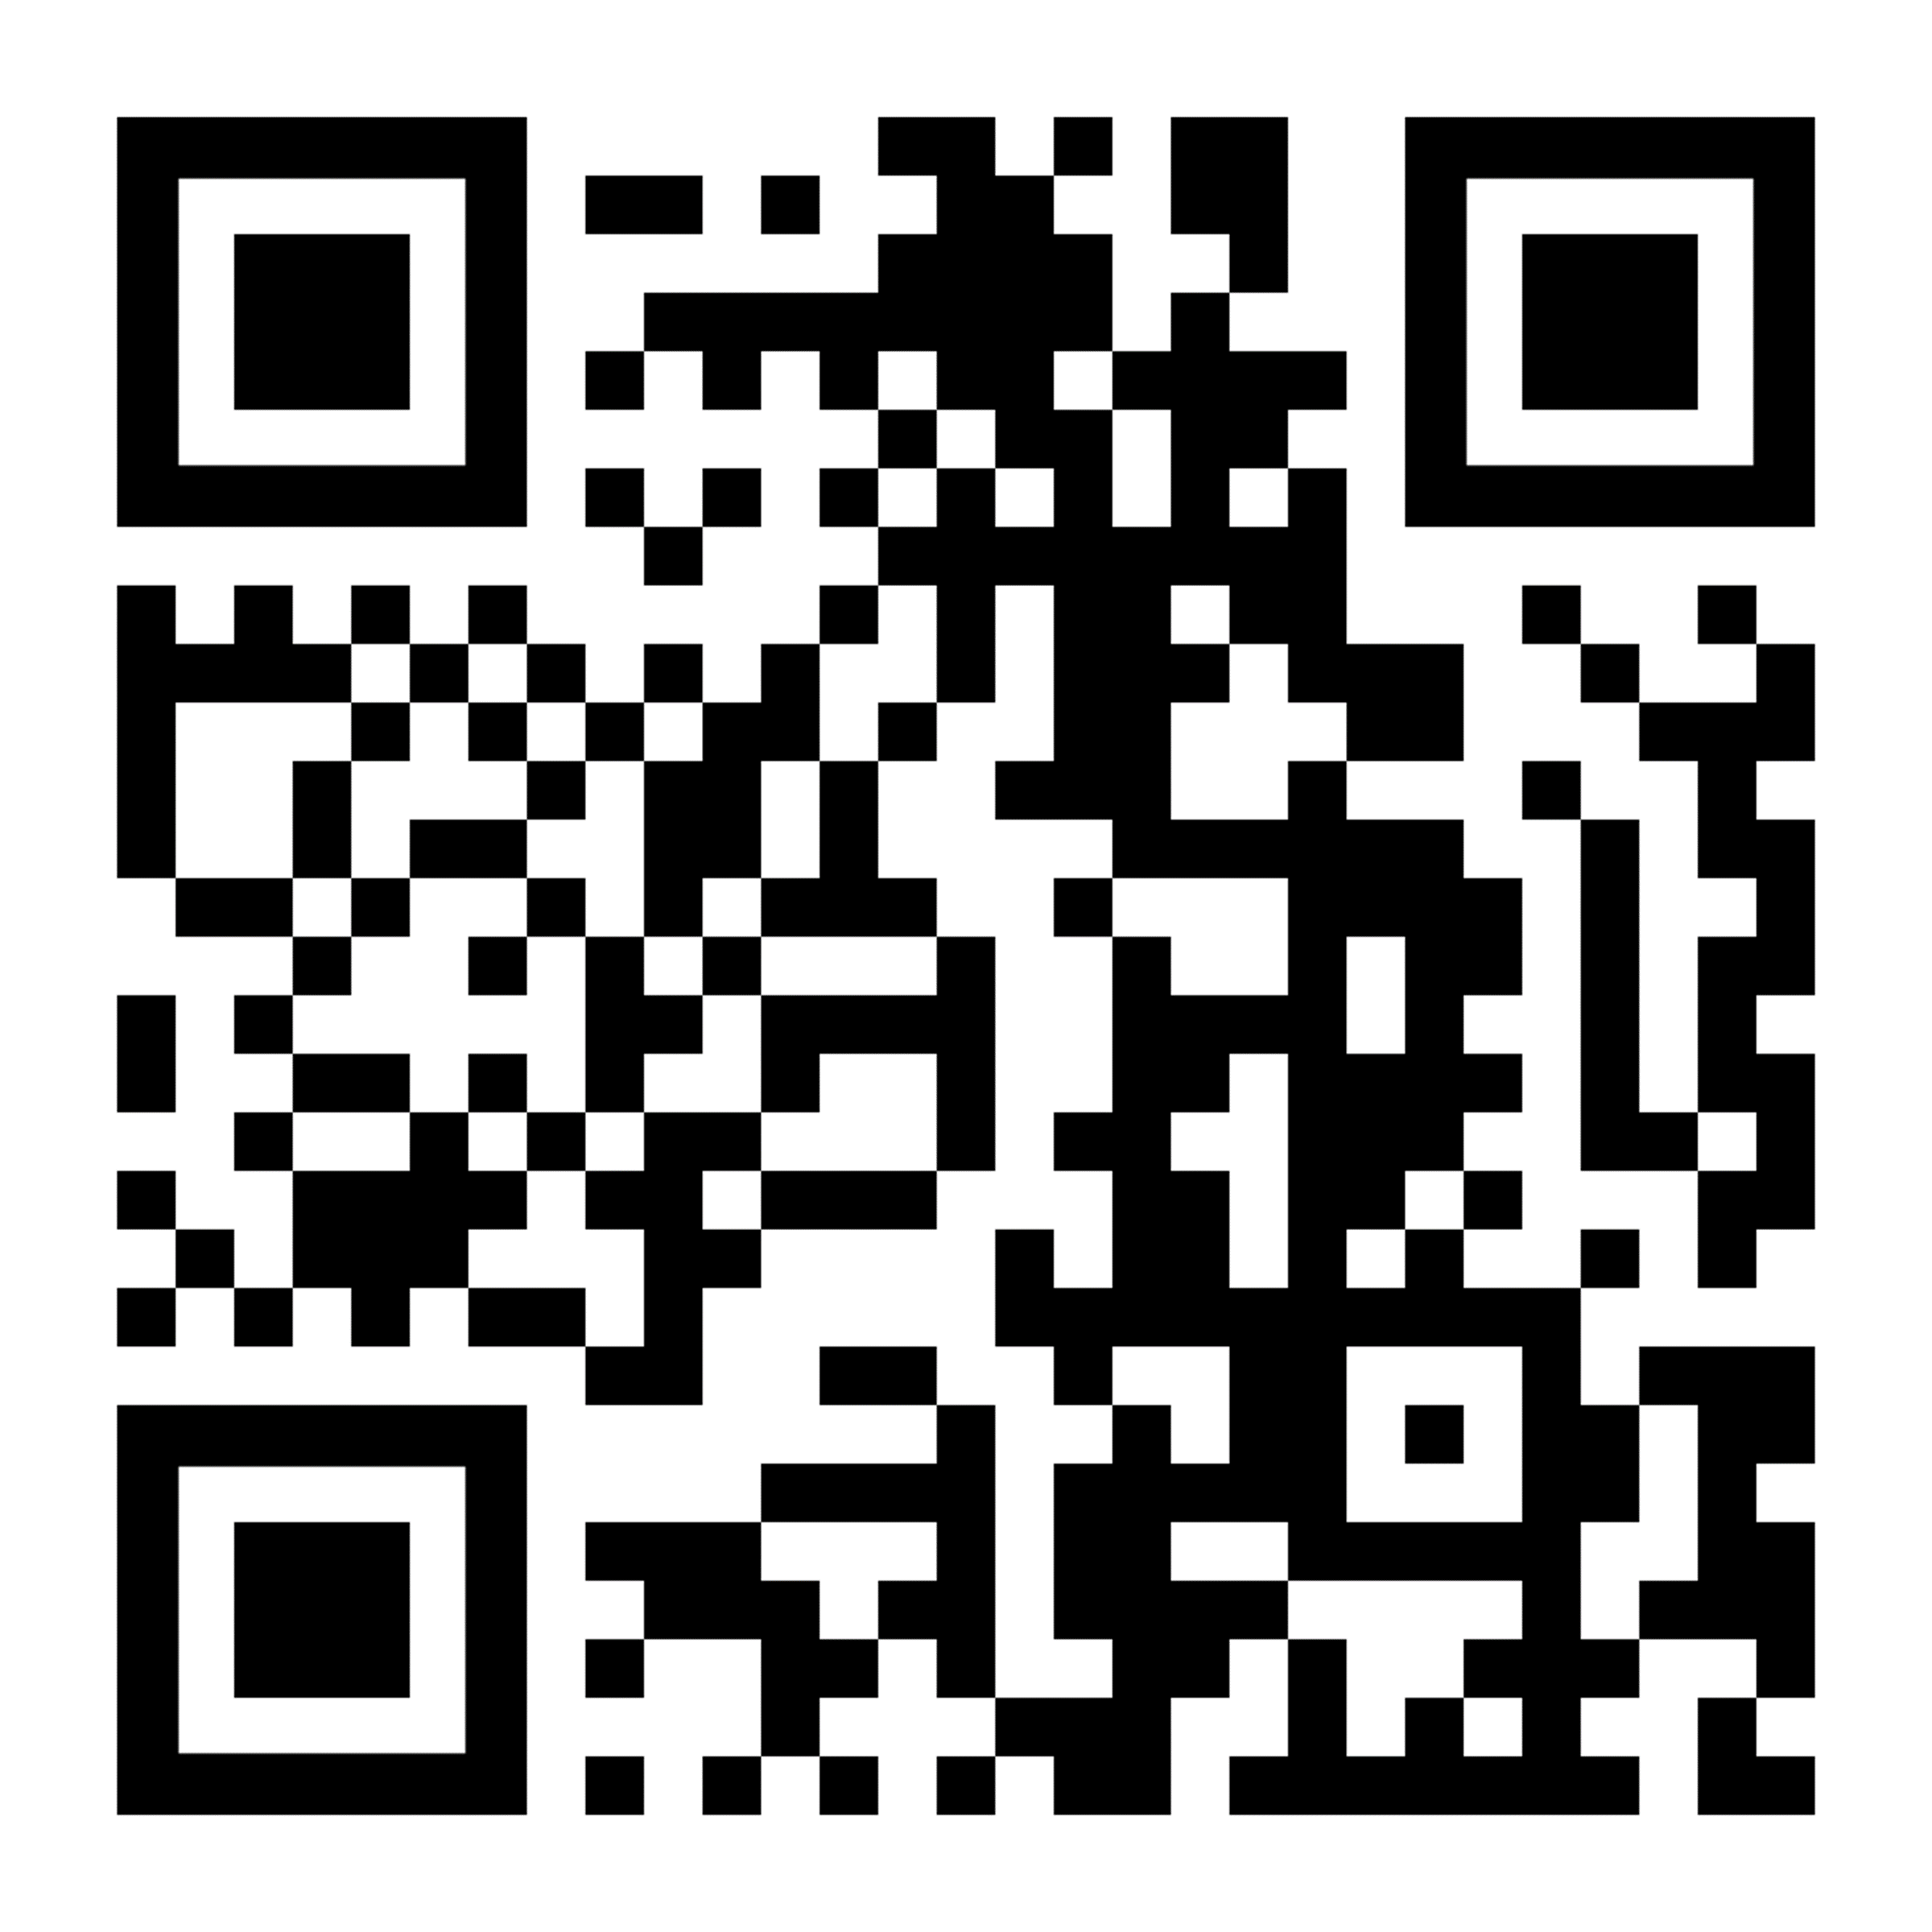
Covid – 19 Claims
Log in or register in ECOMP here:
https://www.ecomp.dol.gov/#/
Or scan this QR code to go
directly to ECOMP registration
You must have a positive PCR test to file a claim You must have worked within 21 days prior to when you took your positive test

Slide 3
Once you are logged in choose FILE CA-1 FOR COVID-1 Choose your District Indiana: 460-479 KY - WV: 247-268, 400-418, 420-427 Michigan 1: 480-485, 492 Michigan 2: 486-491, 493-499

Slide 4
Personal Information
Grade and step can be found on your paystub
Newly hired CCAs are Grade 1 Step BB
After first break in service CCAs are step AA

Slide 5
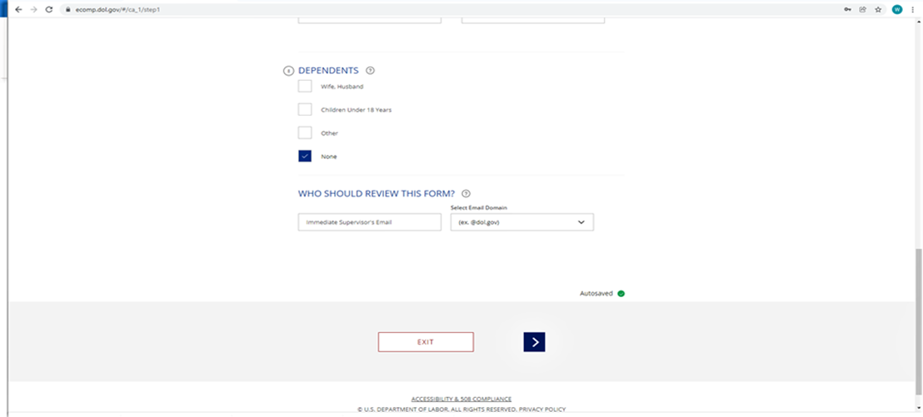
WHO SHOULD REVIEW THIS FORM? If you do not know your supervisor’s email address, just enter a current supervisor’s first name and then usps.gov in the drop-down menu. That should be enough to get the claim processed.

Slide 6
# 10 Date: The last day you worked prior to your positive covid test
# 12: Occupation: Type Carrier and choose from Carrier City, Carrier Technician or City Carrier Assistant
#13: Cause of Injury
Type exactly this
Frequent high-risk exposure to coworkers and the public for 8+ hours a day 5/days a week while sorting and delivering mail. (If you are under light duty change the number of hours and days you work)
#14: Nature of Injury
Positive COVID 19 test on (date of lab test),with symptoms if any

Slide 7
Witness
There is no need to fill this out

Slide 8
Attachments
You can scan a pdf or take a picture (jpeg) of your positive Covid - 19 lab results and upload on this page.
Make sure the image you upload is readable.
Write and save the document control number, DCN in case it gets lost.
Note: if uploaded as “medical”, it will not generate a DCN, so upload it as “non-medical” to get a DCN.
If you have a problem uploading your test results you must wait until your supervisor completes their review and you get a claim number.

Slide 9
Choose COP, Continuation of Pay and sign
#17: Choose Continuation of Regular Pay (COP)
Then click on SIGN AND FILE

Slide 10
Your CA-1 claim for Covid-19 has been filed!
Download a copy of the CA-1 to keep for your records
Check your email for verification
Check your ECOMP dashboard daily to track the status of your claim

Slide 11
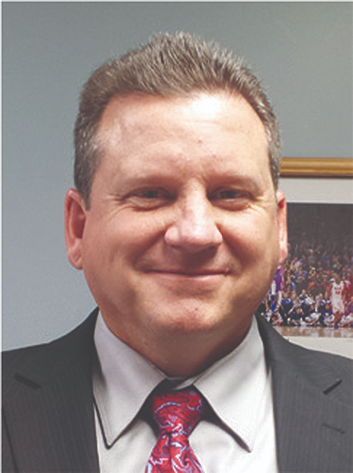
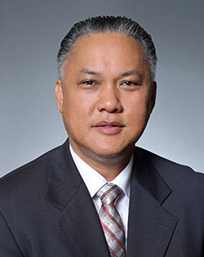
If you have problems with your claim, you are not getting paid COP, or your claim is denied, contact Branch 14 at 502-964-3200
Region 6 NBA David Mudd
NALC Region 6
43456 Mound Road, Suite 501
Sterling Heights, MI 48314
586-997-9917

