Slide 1
“Nothing to fear but fear itself” FDR inaugural address 1933
Harpal S. Mangat MD
American Physician & Surgeons Association Webinar. June 2021

Slide 2
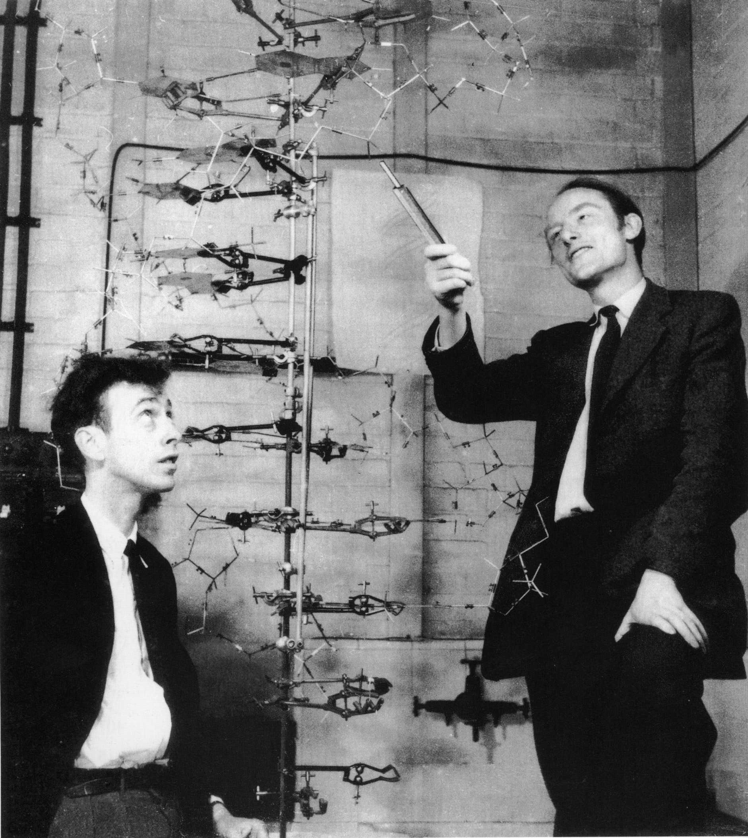
Understanding a Disease Treatment
Know the anatomy, physiology & pharmacology of the body
Understand and comprehend the modus operandi of pathogen
“Stand on the Shoulders of Giants”
“Use Peak to Peek Principle”

Slide 3
ACE 2 Receptors Fundamentals
Anatomy:
Ubiquitous in epithelium:
Alveoli Dyspnea & Pulmonary Embolism GI Diarrhea
Olfactory neuroepithelium. Pathway into brain cisterns explains headaches, loss of smell and taste
Physiology:
ACE 2 enzymes activate Bradykinin resulting in increased cell permeability.
Body secretes hyaluronic acid that mops up excess alveolar fluid. “ Bulls in a China Shop”
Covid enters the cell via the ACE 2 receptors
Pharmacology:
ACE 2 inhibitors, ARB blockers & Ibuprofen upregulate ACE 2 expression. AVOID Ibuprofen for Fever

Slide 4
Covid Bronchial Alveolar Lavage Evidence
COVID BAL samples show upregulation of hyaluronan synthases & downregulation of hyaluronidase.
Combined with increased lung hyperpermeability results in formation of Hyaluronic acid that mops up fluid.
Hyaluronic acid inhibits gas exchange ,damages alveoli in inappropriate ventilator settings.(US has highest mortality rate)
“Beware of Bulls in a China Shop”

Slide 5
JAK STAT Signaling Pathway
JAK STAT pathway is the cytokine signaling pathway that initiates cytokine storm.
JAK 2 receptor blockers prevent cytokine signaling.
Drugs that block JAK 2 signaling :
Famotidine
Barictinab
Apoquel (dogs)

Slide 6
Coronaviruses
Coronaviruses discovered Glasgow 1964 by June Almeida.
Recognized commensals living in the respiratory secretions of the nasopharynx with a characteristic crown appearance from the spike proteins.
All Coronaviruses immobilize the lung T cell response.
Think atypical viral/bacterial pneumonia, fungi (mucormycosis) complications.

Slide 7
Covid Habitat
Covid sits in Facial Hair and Ventilation Systems
Bergama Italy study showed Covid adheres to particulate matter, confirmed by Harvard Fine particulate matter and Covid Study in the US.
The Tiger in the Bronx Zoo NYC caught Covid.
Bearded men please wash your beards in particulate polluted cities( Delhi & Detroit)

Slide 8
COVID 19 RNA virus with 16 gene fragments of HIV1,HIV2 and SIV. COVID 19 thousand fold increase of affinity to ACE 2 receptors than other Coronaviruses. Indian Variant 200 x more infectious
Jean claude Perez § Luc Montagnier (2008 Nobel Prize) - COVID-19, SARS and Bats Coronaviruses Genomes Unexpected Exogenous RNA Sequences
Tasuku Honjo MD (2018 Nobel Prize). Covid 19 not a natural virus.

Slide 9
Treatment in the first 10 days highly effective. Nov 2020 Senate Hearing Now Congress record
Key slide
Questions to non Physicians /Berlin/Mehra/Jha Xceptions
3 points

Slide 10
Objective of phase zero treatment
Prevent Covid tracking to lung ACE 2 receptors.
Nasal rinses decreases the viral load
Bevespi/Breztri contains glycopyrrolate that dries up respiratory secretions where Covid resides.
Ipratropium bromide dries up secretions.
Ciclesonide (Alvesco) effective in Korean studies, Budnesonide (Pulmicort) effective in Texas.

Slide 11
Phase Zero Treatment
Objective of Phase Zero is to decrease viral load and prevent spike protein attachment
Nasal rinses decrease viral Load
Bevespi a micelle formulation of glycopyrrolate a long known respiratory drying agent. It dries up the secretions that Covid lives in.
Ciclesonide (Alvesco) has been shown in Korean studies to be effective in treating Covid. Texas study shows efficacy of Budnesonide.
Ipratropium Bromide decreases secretions
In our study of symptom improvement in 24 Covid positive patients Bevespi was effective in reducing symptoms. (more effective than Bamlanavimab)
Sotrovimab elevates pulmonary T cell Function. Key fact CD4 cells

Slide 12
Intracellular Covid life cycle

Slide 13
Phase 1 Intervention

Slide 14
Phase 1 Intervention (within 10 days)
Objective of phase one treatment is to prevent the spike protein adhering to the ACE 2 receptor and shut down the Bradykinin storm.
Monoclonal antibodies initially Bamlanivimab or Casirivimab with variants now Bamlanivimab + Etesivimab or Casirivimab + Indevimab now Sotrovimab
Benadryl shuts down the Bradykinin storm.

Slide 15
Objective of Phase 1 Intervention
Prevent Covid adherence ACE 2 receptors and stop bradykinin storm.
Monoclonal antibodies target spike protein but can take 2-6 days for viral load come to zero. Monitor potential complications eg pulmonary emboli. Note COVID variants showing resistance choose monoclonal antibody wisely.
Diphenhydramine(Benadryl) stops the bradykinin storm. Less hyaluronic acid (no need for Bulls in the China shop)

Slide 16
Current Criteria for Monoclonal Antibody Usage within 10 days and Oxygen saturation > 92%
Age >65 BMI>35
CKD Diabetes
Immunosuppressive disease/treatment
Age > 55 and:
Cardiovascular disease/HTN
COPD other chronic respiratory disease
Age 12-17 and;
BMI>85 percentile
Sickle Cell Disease
Congenital/acquired heart disease
Neurodevelopmental disorder CP/MD
Asthma/Reactive Airways Disease/Chronic Respiratory Disease.

Slide 17
Phase 2 Intervention

Slide 18
Phase 2 Intervention
“Studies on HCQ correlate with the number of tweets” Winston Hide PhD –Harvard University
2 Bonus points for Clinicians + 1 Clinicians

Slide 19
Phase 2 Intervention

Slide 20
Phase 2 Intervention
Objective of Phase two intervention is to maintain encapsulated virus in an endosome and prevent viral replication.
HCQ downregulates the immune system. HCQ inhibits endosymal TLR interaction
Viral replication is inhibited by protease inhibitors (kaletra lopinavir+ritonavir) and protease polymerase inhibitor eg Remdesevir.
Avoid Favipiravir- Indian experience to slow for narrow viral proliferation window.

Slide 21
Phase 3 Intervention

Slide 22
Phase 3 intervention & AJ (Diagnosis ?)
Objective is to decrease cytokine signaling that initiates & perpetuates the Cytokine storm.
Famotidine is a JAK 2 inhibitor prevents the cytokine signal being transmitted. Famotidine 40 mg po qd in initial phases step up to 40 mg po/iv bid if required.
Eli Lilly Baricitinab new expensive JAK 2 inhibitor
Solumedrol/Prednisone 60 mg bid increasing to 6 hourly in ICU setting.
46 y.o male in Delhi who had AZ vaccine 4 weeks earlier 2 weeks later he started getting fevers chills & tested positive for Covid.
Day 8 became dyspneic CT confirmed Covid Pneumonia today is day 20 you get a call.
Received ECMO, on IV antibiotics/antifungal /Remdesevir and Tocilizumab oxygen saturation on 15 L Oxygen 90% in prone. D dimer 563 (normal less than 234)

Slide 23
What is AJ mortality risk and what do you next
Repeat D dimer 834, following medications added
Repeat dosage of Remdesevir, Tocilizumab
40 mg IV famotidine bid,
50 mg Benadryl qhs
60 mg solumedrol q 6 hourly
Follow up D dimer dropped to 329
Oxygen Saturation increased to 95% sitting up

Slide 24
Clinical Case AP Frederick MD
44 male presents after Xmas family gathering PMHX: type 1 Diabetes x 39 yrs, BMI 36, Sleep apnea, ARDS 2004 with:
Intermittent dry cough X 7 days
Sore throat X 3 days
Diarrhea 1-2 days
Constant headache x 5 days
New onset shortness of breath Pulse oximetry 95% with fever x 1 day no chills
Loss of taste and smell x 5 days
Covid PCR done yesterday pending result
What do you do next ?

Slide 25
AP What do yo do next
Kaletra (lopinavir, Ritonavir)
Hydroxychloroquine
Aspirin
Alvesco (Ciclesonide)
Bevespi (Glycopyrrolate)
Benadryl (Diphenylhydramine)
Clarithromycin
Methylprednisolone dose pack
128 slice CT angio PE rule out

Slide 26
The House is burning what I do next?
COVID PCR POSITIVE NEXT DAY
Patient receives Bamlanivimab infusion on day 9.
Infusion staff tell him everything OK and they will call him a week .
Patient did not follow up as requested for daily checks.
Patient called and reminded to do CT scan returns on day 14 short of breath I flight stairs.
What do you do next?

Slide 27
What do you do next

Slide 28
Teaching point
It takes 2-6 days for the viral load to come to zero after monoclonal antibody.
Where is AP on the mortality risk?
What do you do next?

Slide 29
Phase 4 Intervention

Slide 30
AP phase 4 Intervention ( the staircase is gone)
Patient refuses hospitalization, sister placed on ventilator.
128 slice CT peripheral PE & Covid Pneumonia.
Eliquis 10 mg bid added.
Famotidine 40 Mg qd added.
IV solumedrol 60mg bid x 5 d & Prednisone Taper.
IV ceftriaxone 2gm qd x 5 days followed by oral clarithromycin 500 mg bid.
Incentive spirometry
10 days after monoclonal antibody infusion patients develops fever and chills. Started on Valtrex 1 gm tid x 7 days. Chills resolved after 24 hours
AP returned to work 3 weeks after initial Covid infection.
Sister returns home 4 weeks after initial Covid infection with supplemental Oxygen
Remember “ No Bulls in a China shop needed”

Slide 31
Phase 4 Intervention
Anticipate complications & treat :
Pulmonary Embolus
Atypical Pneumonia (Mycoplasma, Legionella)
Viral Pneumonia
Atypical Fungi (Mucormycosis)

Slide 32
Recovery times for High risk patients v Non High risk patients
High Risk Patients are those eligible for monoclonal antibody treatment.
Multi drug therapy is the treatment for lesser risk individuals .
The high risk patients I have seen were also treated with multi drug therapy as previously illustrated.
High risk patients treated before day 5 have a full recovery time of 3 days. Beyond day 5 the recovery time is variable as illustrated by AP
Average recovery time for non high risk patients are 7-10 days on multi drug therapy.
Personal experience since November 2020

Slide 33
Optum Contacts
National Network for home Iv infusions
Lynn Crummitt, RN, IgCN Keith Iovino, VP of Sales-East
Acute Care Specialist kiovino@optum.com
lcrummit@optum.com Stacie Kull, VP of Sales - West
240-457-3394 (mobile) skull@optum.com
866-715-6651 (fax)

Slide 34
NA
39 yo takes 1st Moderna shot
24 hours later starts getting dry cough dyspnea, fever , headache, loss of smell & taste.
Rapid Covid test positive 48 h later.
Repeat rapid Covid and PCR test positive 4 days later.
Oxygen saturation oscillating 92-97%.
Chest X ray normal & CT angio no PE.
Patient started on cephalexin & dexamethasone 6 mg qd (my associate) but continues with severe headache, loss of smell & taste.
Pulmonary symptoms partially resolve as well as the taste and smell.
Patient referred to me.

Slide 35
NA
2 weeks after first Moderna dose patient notices:
Severe Fronto-occipital headaches
Unable to watch TV with her 8 y.o son, sound is too loud and she cannot read the phone numbers of lawyers on TV ads.
She gets dizzy on standing from the sitting position.
What do you do next?
Where is the lesion ?
Neurologist, Ophthalmologist , ENT only.

Slide 36
NA
Physical exam reveals;
Diplopia on looking to the right and down and out to the right.
Weakness of the right buccinator and right orbicularis muscle.
Positive Rhomberg sign.
3T MRI Brain & Orbits ordered with attention to Sella Turcica. Internal Auditory Canal and Mastoid component of the facial nerve.
Neurology , Ophthalmology , ENT explain why did I ordered a 3T MRI and where do you look for the lesion?

Slide 37
NA Dx - comments Sudhir Kathuria MD

Slide 38
Neurological Covid
MRI shows :
Enhancement nerve sheaths along pre chiasmatic and intra canalicular segment the optic nerve.
Partial Empty Sella.
Multiple T2 flairs in the deep white matter of bilateral cerebral hemispheres.
Diffuse enhancement of mastoid segment of bilateral facial nerve.
What drugs do you choose to treat and why? (not Peter McCullough MD/ Lee Vliet MD)
Raymond Tu MD please comment on ASNR meeting and Covid findings

Slide 39
Long Hauler Study
Letter JAMA Otalaryngology-Head Neck Surgery October 2020
JHH autopsy research program found “Covid 19 in mastoid effusion 2 out of 3 post mortems”
K.Frazier, J Hooper, H Mostafa, C stewart
Study Presented at Christian Medical Dental Association National Virtual Conference April 2021

Slide 40
Thank You to my staff !!

Slide 41
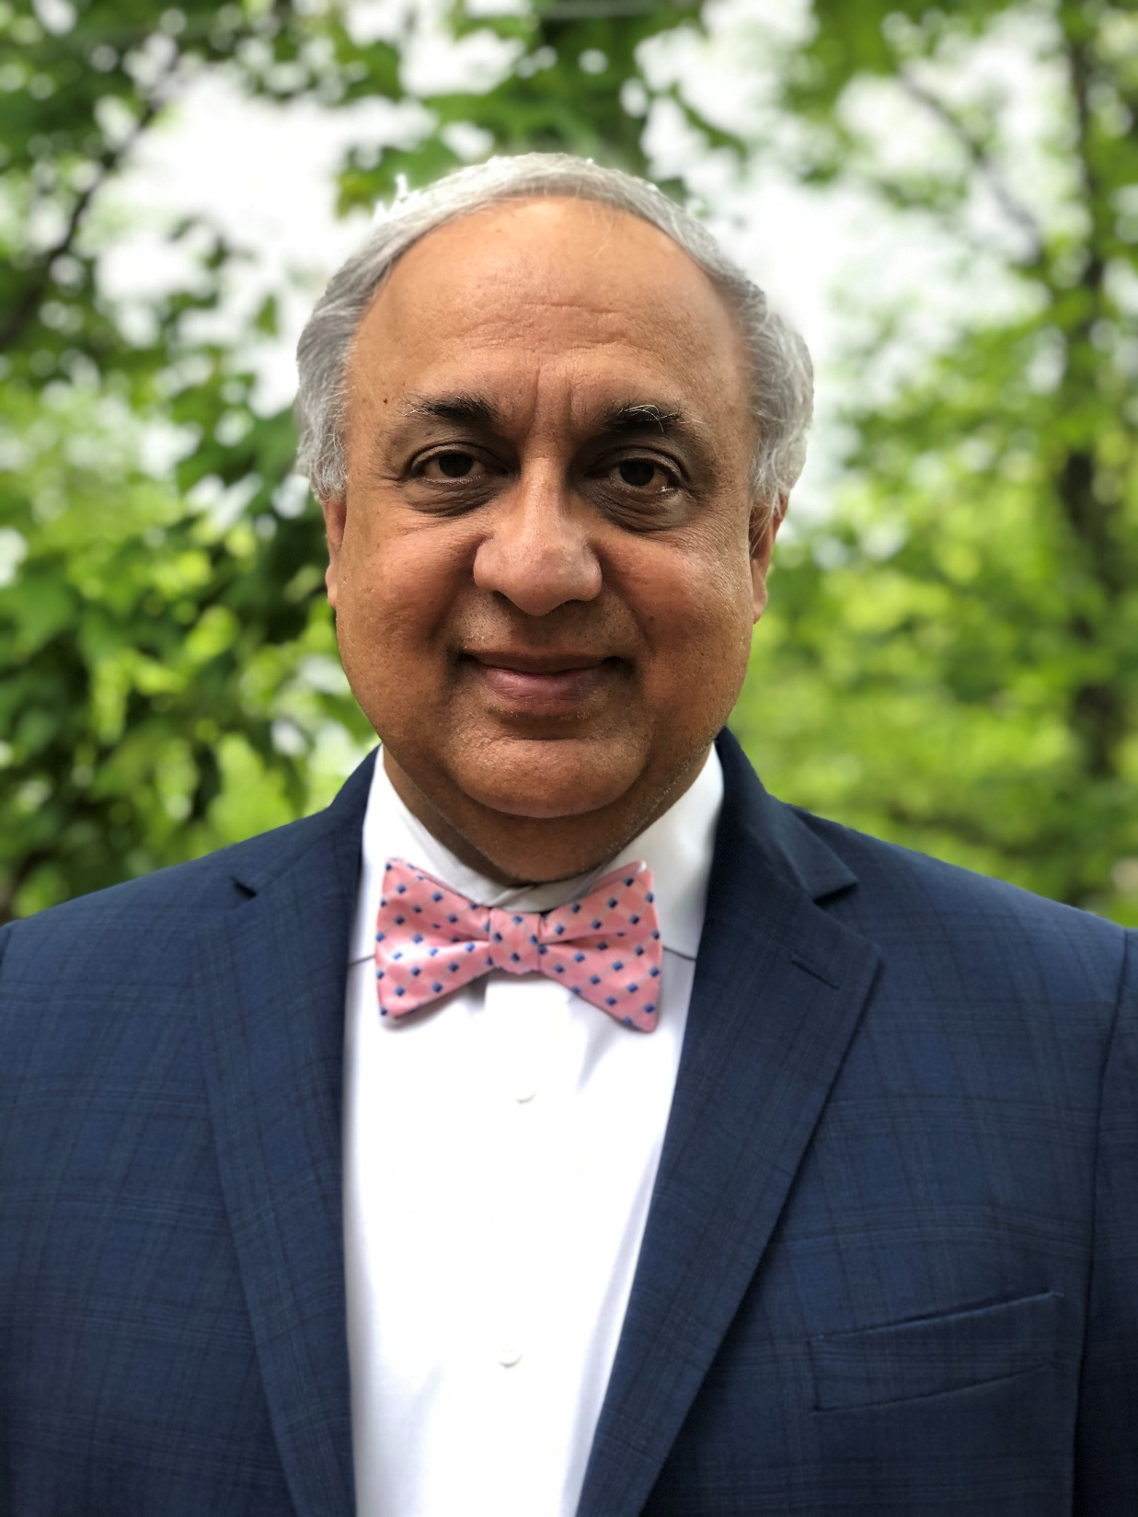
DR MANGAT EXPERIENCE
Dr Mangat has treated over 250 Covid patients with no deaths remotely.
Dr Mangat RCSI graduate, trained Trinity College Dublin teaching Hospitals and Oxford University.
Multi drug Covid treatment poster presented CMD 2021.
Early diagnosis of Covid Pulmonary embolism by 128 slice scanner before positive D dimer CMD 2021.
MRI findings in Covid Long Haulers CMD 2021
Dr Mangat just treated vaccine induced neurological complications.
Dr Mangat has 4 issued US patents
Dr Mangat speaks Nationally on early Covid treatment.
https://americaoutloud.com/early-treatment-works-for-covid-so-why-the-vaccine-push/

Slide 42
MULTI DRUG TREATMENT STUDY USING FDA APPROVRD DRUGS
Quantitative symptomatic data was observed for 26 patients with a lab-confirmed, positive Covid 19.
The following comorbidities existed in this cohort 5 patients above the age of 70 with one patient also having BMI greater than 35.
Five additional patients had BMI greater than 35 with one having co-existing diabetes. An additional patient had reactive airways disease
Early symptoms of COVID-19 include dry cough, sore throat, fever, chills, muscle aches, diarrhea, abdominal pain, shortness of breath, and loss of taste and smell were recorded in the first 10 days as multidrug treatment was given.
Early treatment, with a combination of the repurposed drugs Kaletra , Bevespi (glycopyrrolate-formoterol), Alvesco (ciclesonide), Benadryl (diphenhydramine), Monoclonal Antibodies (bamlanvimab), and Pepcid (famotidine)
A plot analysis was performed with calculation of correlation coefficients documenting symptom improvement.

Slide 43
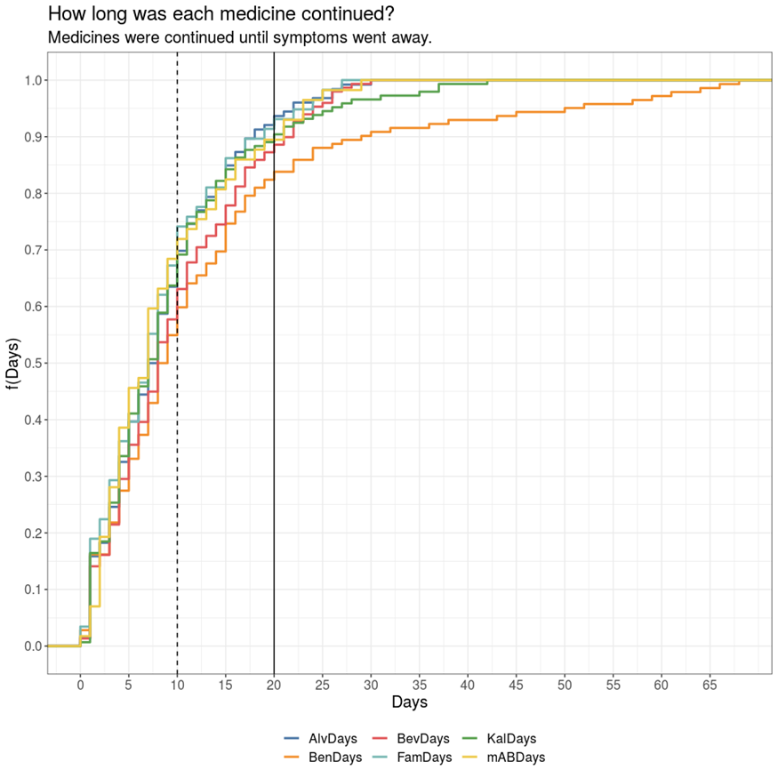
Data analysis with Correlation coefficients of symptom improvement
There is a negative correlation between some medicines and the number of symptoms, this is expected because as the treatment continues the patient gets better and number of symptoms decrease.
## correlation between KalDays (Kaletra days) and symptoms is -0.1407 ## correlation between BevDays( Bevespi days) and symptoms is -0.227 ## correlation between AlvDays ( Alvesco days)and symptoms is -0.2191 ## correlation between BenDays (Benadryl days) and symptoms is 0.0353 ## correlation between mABDays (Bamlanvimab days) and symptoms is 0.1429 ## correlation between FamDays (Famotidine) and symptoms is -0.155

Slide 44
Conclusions
Early treatment, with a combination of the repurposed drugs Kaletra , Bevespi (glycopyrrolate-formoterol), Alvesco (ciclesonide), Benadryl (diphenhydramine), Monoclonal Antibodies (bamlanvimab), and Pepcid (famotidine) interrupts the viral life cycle and prevents the progression into a cytokine storm.

Slide 45
Clinical Pearls
Using a 128 slice CT scanner with a skilled radiologist we started seeing ground glass appearance with crazy pavement lung findings on day 7, which we treated successfully with IV solumedrol 60 mg bid preventing the cytokine storm.
The 128 slice scanner enabled us to pick up early peripheral pulmonary emboli that was successfully treated with eliquis maintaining pulmonary function. It is important to note that Bamlanivimab takes 2-6 days to decrease the viral load after administration as disclosed in the original paper. We had one high risk patient with Diabetes and BMI greater than 35 that developed Pulmonary embolism after Bamlanivimab treatment that we successfully treated. The FDA did not disclose this or warn US physicians of this consequence.
Nasopahryngeal rinses displace all coronaviruses from their normal habitat in the back of the throat. We advised all our patients to do that on the onset of treatment to decrease the Covid viral load. Further investigative research needs to be done on this simple intervention.
As quoted in the reference coronaviruses immobilize the Pulmonary T cells. In this cohort we observed cases of viral pneumonias and atypical bacterial pneumonias which we prevented progressing by the appropriate use of valacylovir and clarithromycin.

