Slide 1
The Child with a Fever
Notes:
BOLD FONT – information or questions for instructors to read aloud
Regular font – potential learner responses, not all inclusive, encourage participation by accepting a variety of responses and provide gentle redirection if needed
Italic font – animations, activity instructions, or instructor information, not intended to be read to the students
The Child with a Fever starts on page 147 of your provider manual. This discussion will also include some content from Chapter 6, The Neonate, and Chapter 18, The Child with Special Healthcare Needs.
Objectives
Describe characteristics and selected causes of pediatric fever.
Discuss assessment and interventions for common pediatric febrile illnesses.

Slide 2
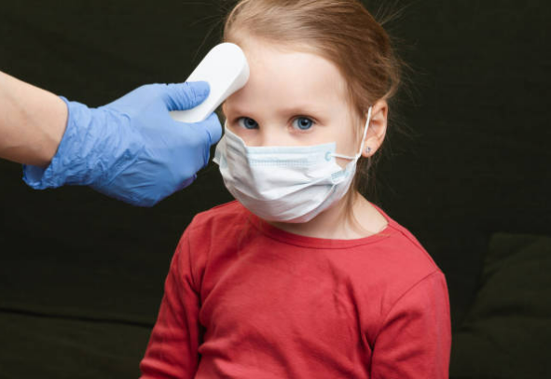
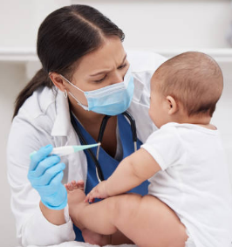
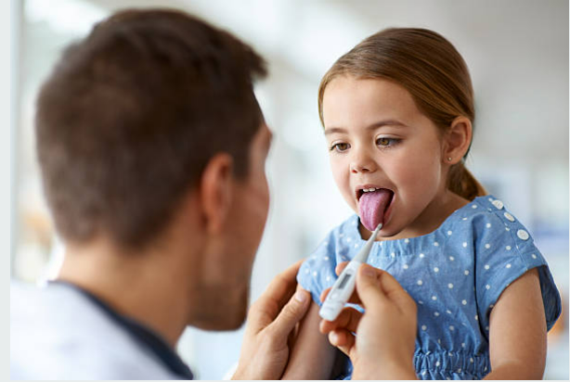
Notes:
How often do you see children with this presenting symptom?
What does a fever indicate?
Most commonly a healthy immune response to infection.
Less commonly a response to a toxin (malignant hyperthermia, neuroleptic malignant syndrome, sympathomimetics), brain injury (diffuse axonal injury) or heat exposure.
Do you know your policy for pediatric temperature measurement?
Come prepared with facility policy to discuss, be open to other facility’s variations. Refer to ENA’s Non-Invasive Temperature Measurement clinical practice guideline.
See page 149 in the provider manual for indications and cautions for various routes.

Slide 3

Notes:
Why are families concerned when their child has a fever?
Fever phobia, seizures (febrile seizures are discussed later in the presentation)
Fever and disease process teaching with anticipatory guidance can go a long way.

Slide 4
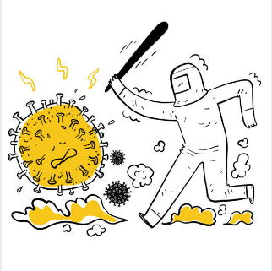
Notes:
What are the treatment goals for patients with a fever without significant alterations to the primary survey?
Identify and treat the underlying cause.
Antipyretics do not treat the underlying cause and are to be used to promote comfort and hydration.
It is important to teach caregivers that the fever is the body’s mechanism for killing an infectious agent. The fever itself is healthy and helps fight the illness. If the child is eating and drinking, we can often let the fever do its job.
In which patient populations is the presence of fever an urgent concern?
Immunocompromised – post transplant, receiving chemotherapy, on immunomodulators/immunosuppressants
Sickle cell disease, post-splenectomy, neonate
Other co-morbidities
Red flags on next slide

Slide 5

Altered mental status
Purpuric rash
Immunocompromised
Complex medical conditions
Neonate
Lack of immunizations
Travel to high-risk areas
Notes:
What red flags might be revealed in triage or the initial assessment?
Red flags appear on CLICK
How are high-risk patients identified? Are they triaged differently?
Often immediately isolated
Minimally given a higher triage acuity

Slide 6
Does your facility have a protocol for identifying and managing pediatric sepsis?
Notes:
Does your system have any automatic flags or triggers for patients at risk for sepsis based on vital signs and/or lab results?
Is a sepsis protocol initiated?
Study guide question
Have a facility-specific protocol as an example but be prepared to accept variations.
Why are protocols in place and how are they developed?
The intent of this question is to help learners understand the “why” of evidence-based protocols.

Slide 7

Causes of pediatric fever
Other signs and symptoms
Interventions
Age-specific considerations
TIMES UP
Click to Start
Notes:
In groups of no more than 4 students, students will use a blank piece of paper, large sticky note, or whiteboard to record their answers. Discuss general causes, symptoms, and interventions after 5-10 minutes (listen to students to see when conversation is straying). Pediatric fever workup slides follow this slide.
Elect a spokesperson. Take no more than 10 minutes to discuss and write down your answers.
Causes:
Neonates – maternal transmission of group B strep
Group A strep is a common cause of pharyngitis, can lead to rheumatic fever if untreated
Meningitis
Osteomyelitis
Urinary tract infection
Upper or lower respiratory tract infection
Gastrointestinal infection including surgical emergencies
Other signs and symptoms:
Skin abnormalities – rash, erythema, petechiae/purpura
Dysuria
Nausea, vomiting, diarrhea
Sore throat, cough, rhinorrhea
Abdominal pain
Limp

Slide 8
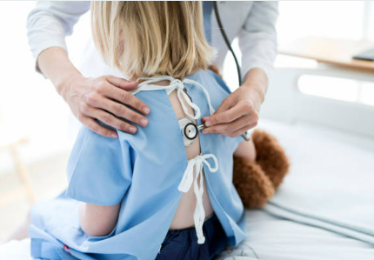
History and Head-to-Toe
Notes:
We are going to talk a bit about what might be included in the workup in a child with a fever. A good history with targeted questions and physical exam (including looking, listening, and feeling) may determine a likely febrile source and eliminate the need for unnecessary diagnostic testing.

Slide 9
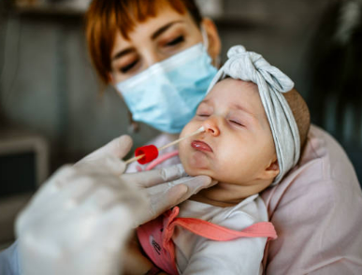
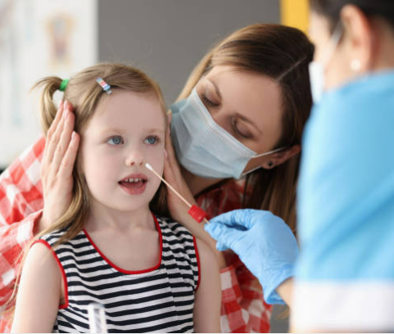
Fever Workup
Notes:
What nasal or oropharyngeal swabs might you obtain?
What techniques have you seen that make obtaining these swabs safer and less traumatic for children?

Slide 10
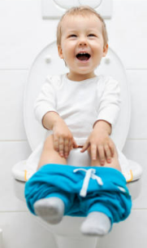

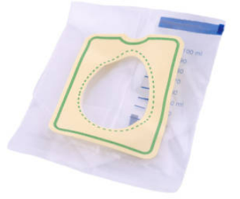
Fever Workup
Notes:
What methods do you use to obtain a pediatric urine sample based on the patient age?
A caregiver may need to help with obtaining a clean catch sample for toilet-trained children.
Specimens may be obtained by straight catheter or urine collection bag depending on facility policy.
What are the downsides to using a urine bag to collect a sample?
Skin contamination makes these samples inappropriate for urine cultures.

Slide 11
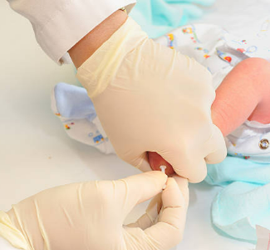
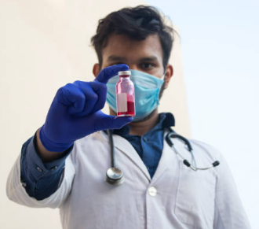

Fever Workup
ENA Image
Notes:
Does your department have pediatric blood tubes? Are there any samples that you might collect via heel stick?
Not all departments have pediatric blood tubes. Consider contacting the lab to see how much blood is required or what alternatives are available. The volume of blood required for adult-sized blood tubes can be a significant loss in a neonate or dehydrated infant.

Slide 12
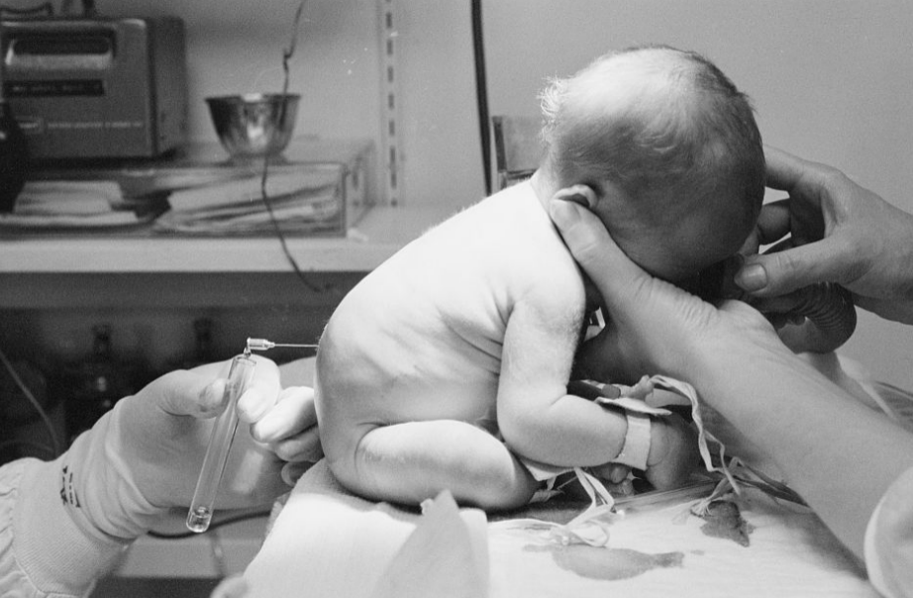
Fever Workup
Notes:
This image is from 1967. What has changed? What PPE is required?
What other positions have you seen or used? What must be closely monitored during this procedure?
Airway positioning and respiratory effort
Image from https://www.loc.gov/item/2005695713/
Rights information: https://www.loc.gov/rr/print/res/133_bro.html

Slide 13

Notes:
Why is fever one of the most common reasons for an ED visit in toddlers and school-aged children?
Children in this age group tend to play closely together, share toys and cups and food, easily transmitting a variety of pathogens.
What common complication of a fever is frightening for caregivers?
Accept a variety of answers, but lead into a conversation about febrile seizures.

Slide 14
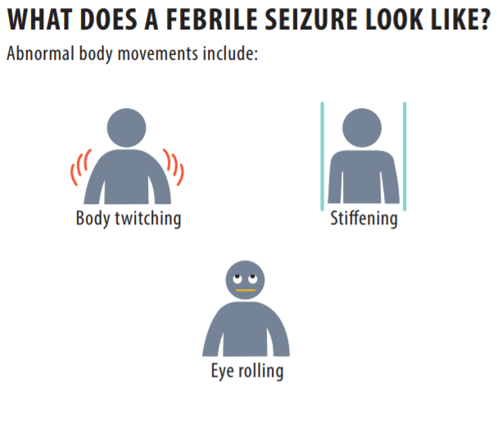
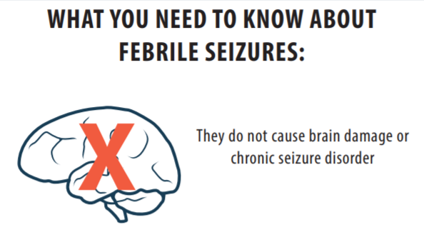
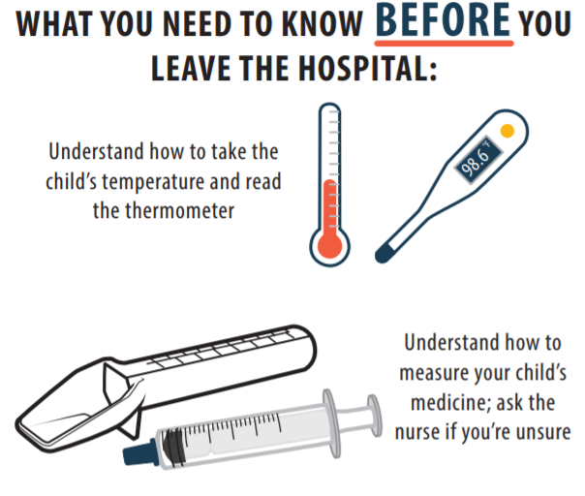
Notes:
This is from ENA’s febrile seizure discharge infographic. Reassure caregivers that febrile seizures are not associated with epilepsy or brain damage.
Do you have pediatric antipyretic dosing information readily available for caregivers?
Important teaching points include that routinely alternating antipyretics (acetaminophen and ibuprofen) or administering any combination cough and cold medications can lead to organ damage from unintentional overdose. Aspirin is used for specific illnesses such as rheumatic fever and Kawasaki disease but is not otherwise recommended for children.
Enau.ena.org – practice resources

Slide 15
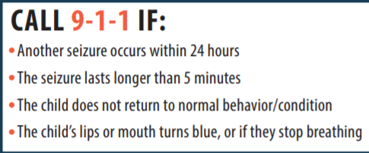
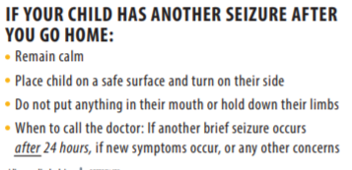
Notes:
This is also included on ENA’s febrile seizure discharge infographic.
Enau.ena.org – practice resources

Slide 16
Fever Overview
Fever is a physiologic response to fight a pathogen
Treat the patient, not the symptom
  Use antipyretics if the child is uncomfortable
  Do not use cold baths or apply alcohol to the skin
Do not treat pediatric fever with aspirin
Combination cough/cold medications and alternating antipyretics can lead to overdoses, causing kidney and liver damage
Covering the child with a blanket will not cause harm
  This may prevent shivering, which increases metabolic demand.
Notes:
In healthy children, most fevers are self-limited and benign.
There is no evidence that fever makes the illness worse.
There is no evidence that reducing fever reduces the morbidity or mortality from a febrile illness unless the child has an underlying pre-existing condition that limits the ability to tolerate increased metabolic demands.
It is acceptable and encouraged to provide a febrile child with a blanket for comfort.

Slide 17
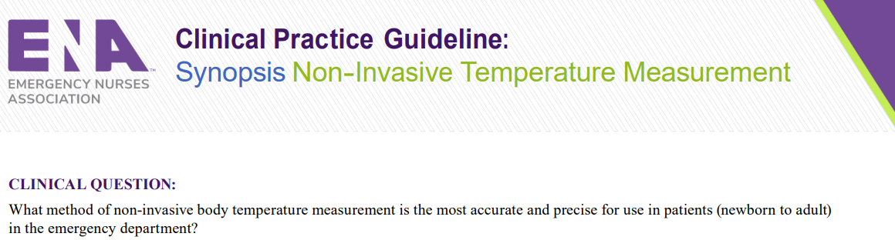
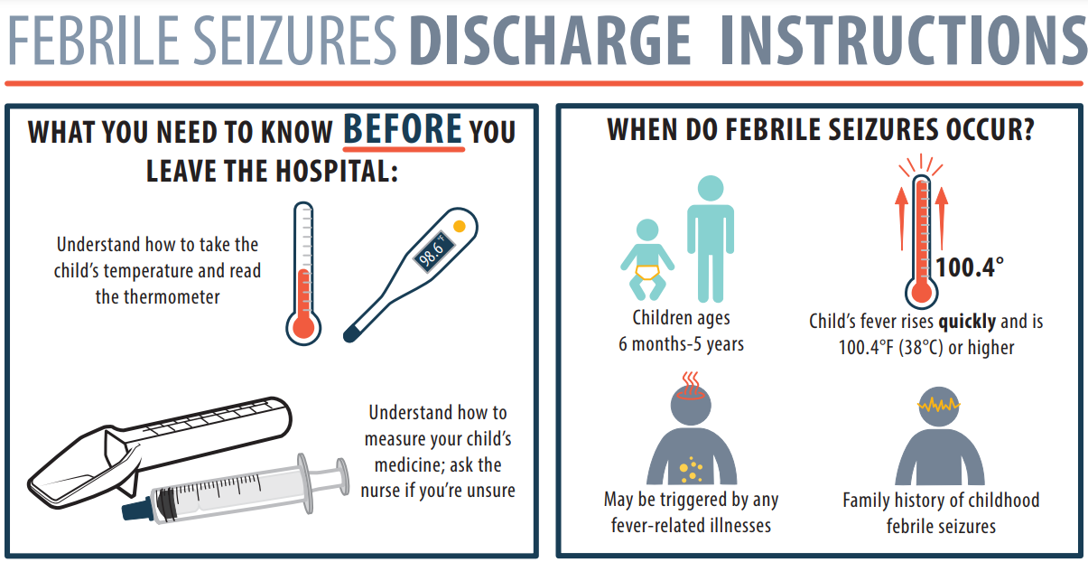
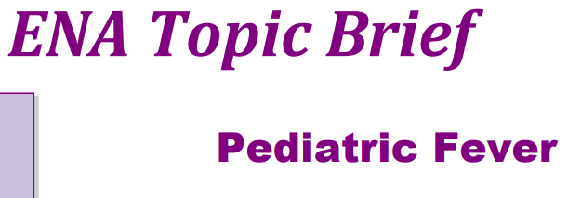
Notes:
All resources mentioned in this presentation are available at enau.ena.org.
Many are free to non-members but require a login. Click “Practice Resources” to search by keyword.

Slide 18

The Child with a Fever
Notes:
Other causes for fever beyond the scope of this discussion include heat stroke and toxin exposure. Toxicology will be briefly discussed in The Child with an Altered Mental Status. Does anyone have any questions?

Slide 19
Two-minute physical stress buster
Notes:
Two minutes of safe physical exertion: jumping jacks, boxer jabs, lunges, jogging in place, side-kicks, dance, neck/arm stretches

