Slide 1
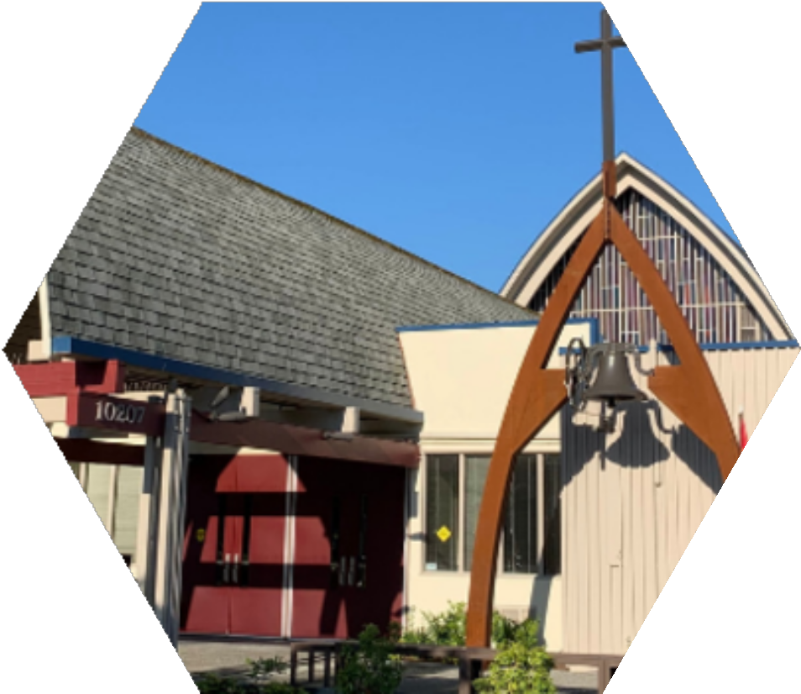
FIRST LUTHERAN
CHURCH
VISION FOR MISSION - 2025

Slide 2
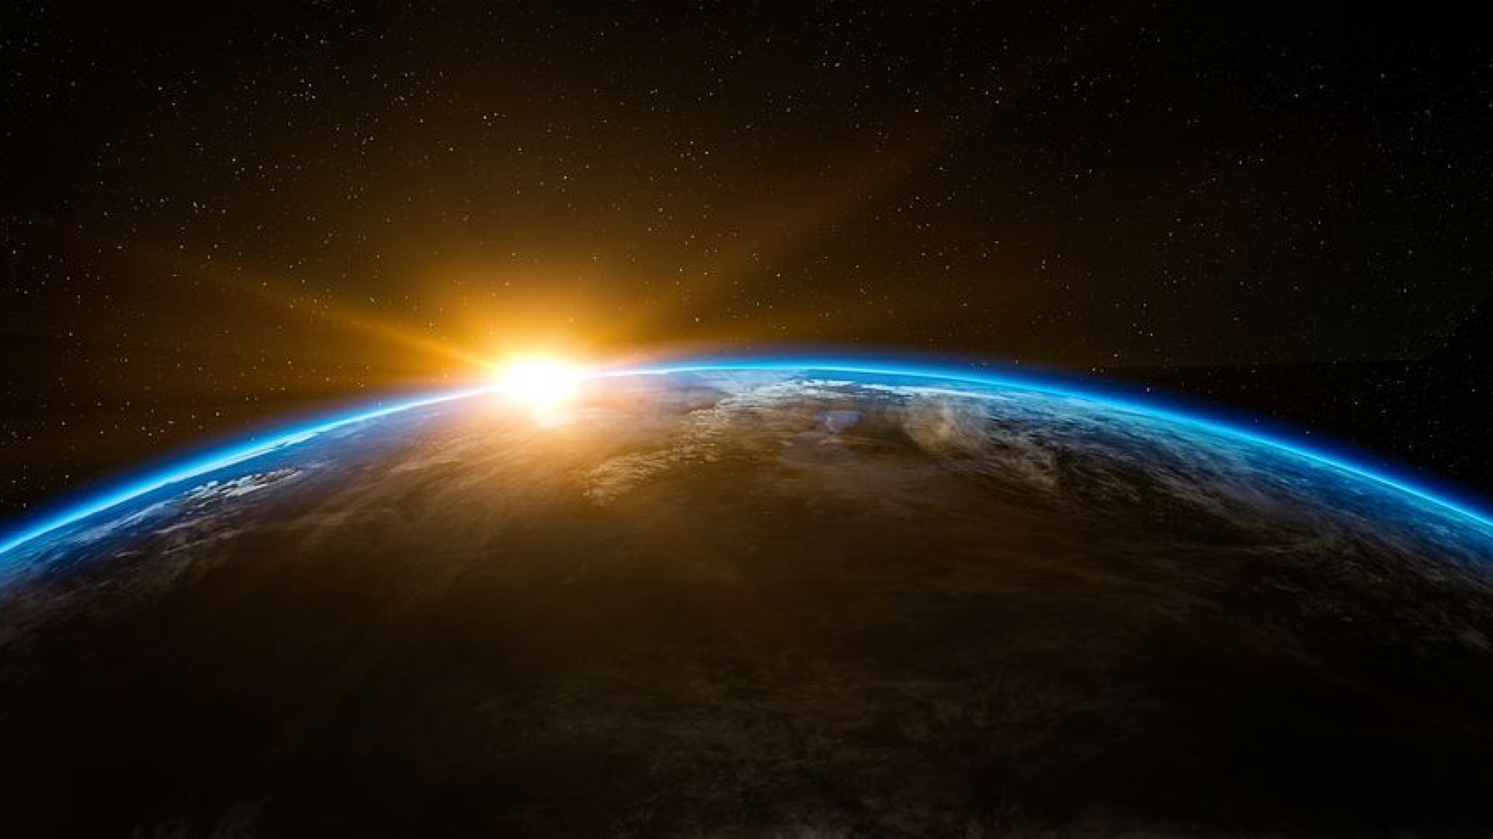
We desire to care for all of God's creation.
First Lutheran Church of Bothell Vision 2025

Slide 3
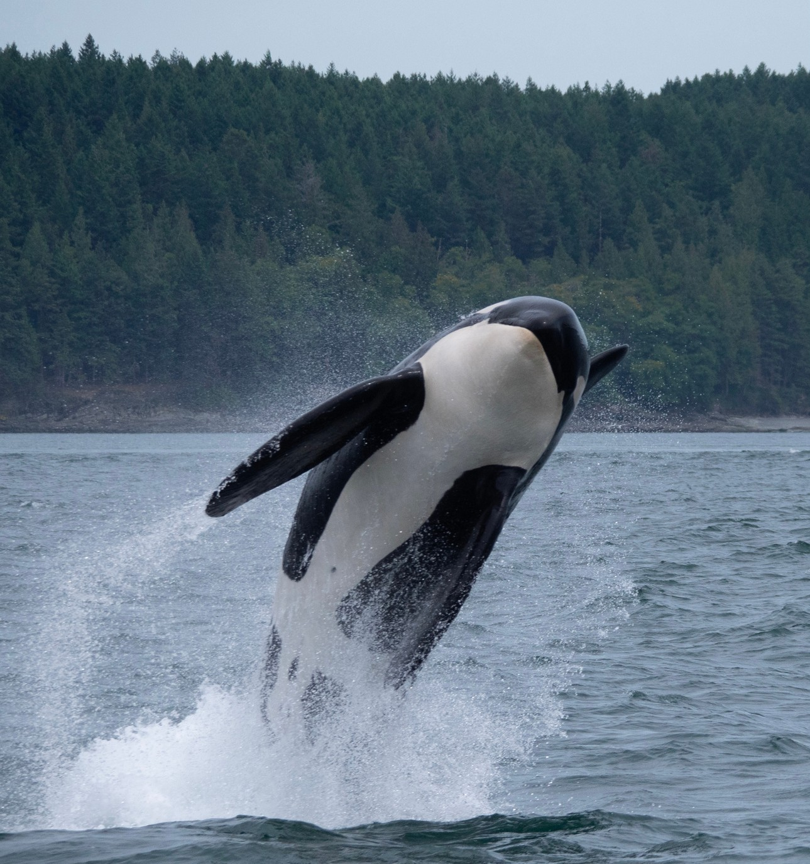
We will reduce our environmental footprint.
Action 1: We will become a ‘Green Congregation’ (see Earth Ministry guidelines).
Action 2: We will find additional ways to reduce our footprint.
We will provide educational opportunities for our congregation and community to promote good stewardship of our natural resources.
Action 1: Form a ‘sustainability task force’ to ensure that this happens.

Slide 4
FLC SUSTAINABILITY TASK FORCE
Joe Siebert (Chair)
Susan Berg
Kathy Konieczka
Karen Thomas

Slide 5
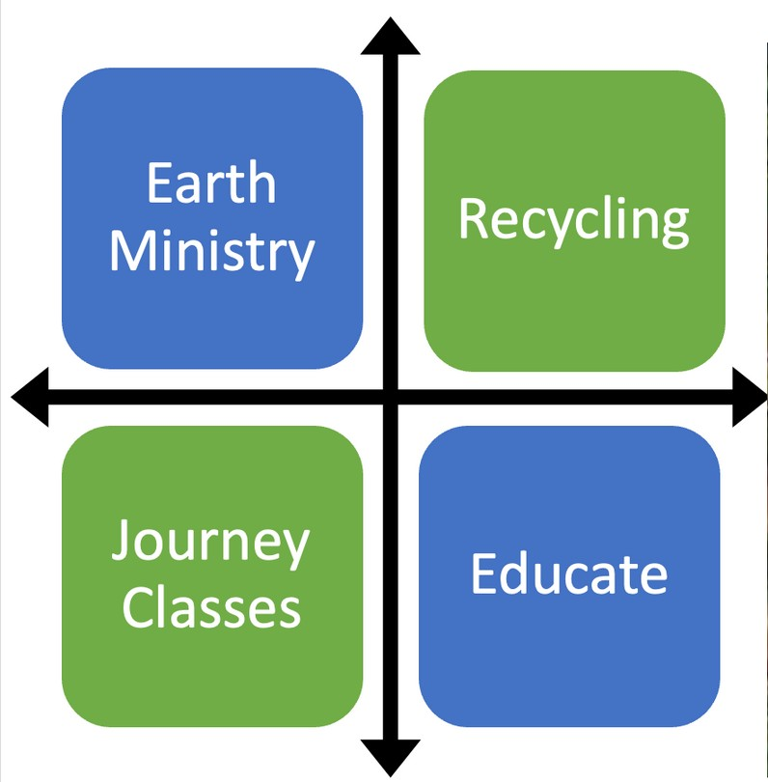
Task Force Accomplishments
Certified Greening Congregation
Trash, Recycling & Compost
Annual Education Components
Support of Local Sustainability Efforts

Slide 6
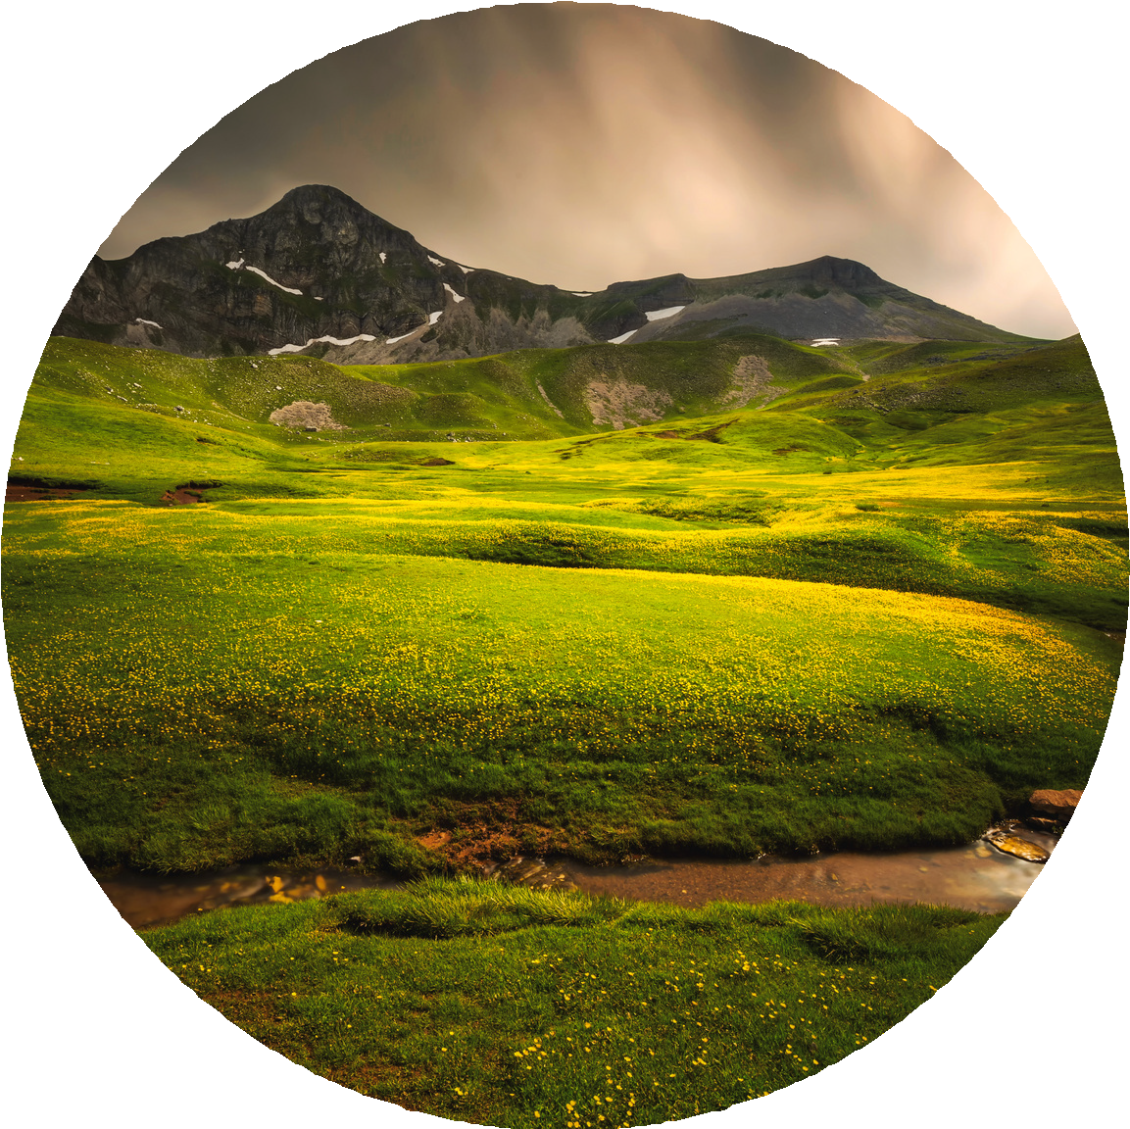
First Lutheran Church of Bothell
CREATION CARE

Slide 7
Three Pillars of Action
Celebrate
Educate
Advocate

Slide 8
Adopted in 2022
SOCIAL STATEMENT
WE BELIEVE that God is the creator of all there is, seen and unseen, and that He charged humankind with the responsibility to care for His creation. Looking at our world today, we at First Lutheran Church of Bothell recognize that we have failed.
Rather than caring for God’s gifts by identifying, understanding and practicing the principles that will sustain our environment, humankind continues to act as if the abundance of God’s creation is ours to use, exploit, and deplete through our apathy and greed. We believe that the devastation created by the continued plundering of our world is an affront to our Creator.
First Lutheran Church is committed to being faithful guardians of all that God has given us. By effecting changes within our church building and church grounds, we became a Greening Congregations partner in consultation with Earth Ministry* in November, 2021. We pledge to preserve this status by developing an annual plan and by performing yearly self-evaluations.

Slide 9
Adopted in 2022
SOCIAL STATEMENT
We will proactively seek out other opportunities to reduce our collective and our individual carbon footprints, such as designing new practices for our church’s waste disposal, composting and recycling efforts. We will also develop blueprints for ongoing actions that support our three foundational pillars of Celebrate, Educate and Advocate for the care of God’s earth.
Celebrate: We will recognize and celebrate, through our worship, our liturgy and other events, days that are specifically dedicated to the awareness, support and protection of our world. Examples of such days include: Earth Day; Rogation Day; World Environment Day; Earth Hour and ELCA’s Stewardship of Creation Sunday.
Educate: We will provide continual education for ourselves and our community through knowledge-based communications such as: Christian education classes for all ages; Journey classes; articles in the church’s monthly newsletters and dedicating a page about creation care on our website.
Advocate: We will, as a church, find ways to advocate for creation care on a continuing basis for our community and our expanded community, including other churches and local, county and state governmental agencies.

Slide 10
Adopted in 2022
SOCIAL STATEMENT
As we move forward in our resolve to be good custodians of God’s creation, we will monitor and adjust our methods to meet our ever- changing world. We recognize that our global neglect of God’s gift is at a crisis point. Although we are in a race, there is no finish line. Awareness and thoughtful stewardship must be our continuing way of life if we want to save and protect all that God has given us.
*Earth Ministry is a Seattle-based organization that engages with the faith community in environmental stewardship and advocacy.

Slide 12
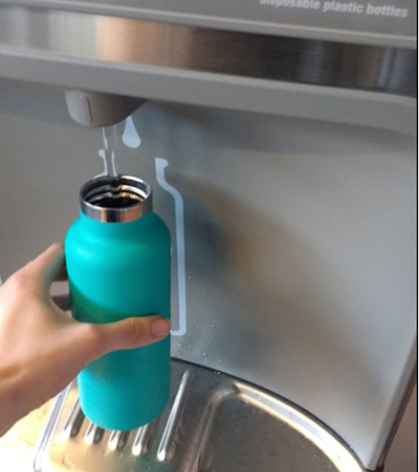
Reduce Plastic Consumption
We installed two bottle refill stations. As of the week of July 4, 2022, we have kept 1,153 bottles out of the trash/recycling process.

Slide 13
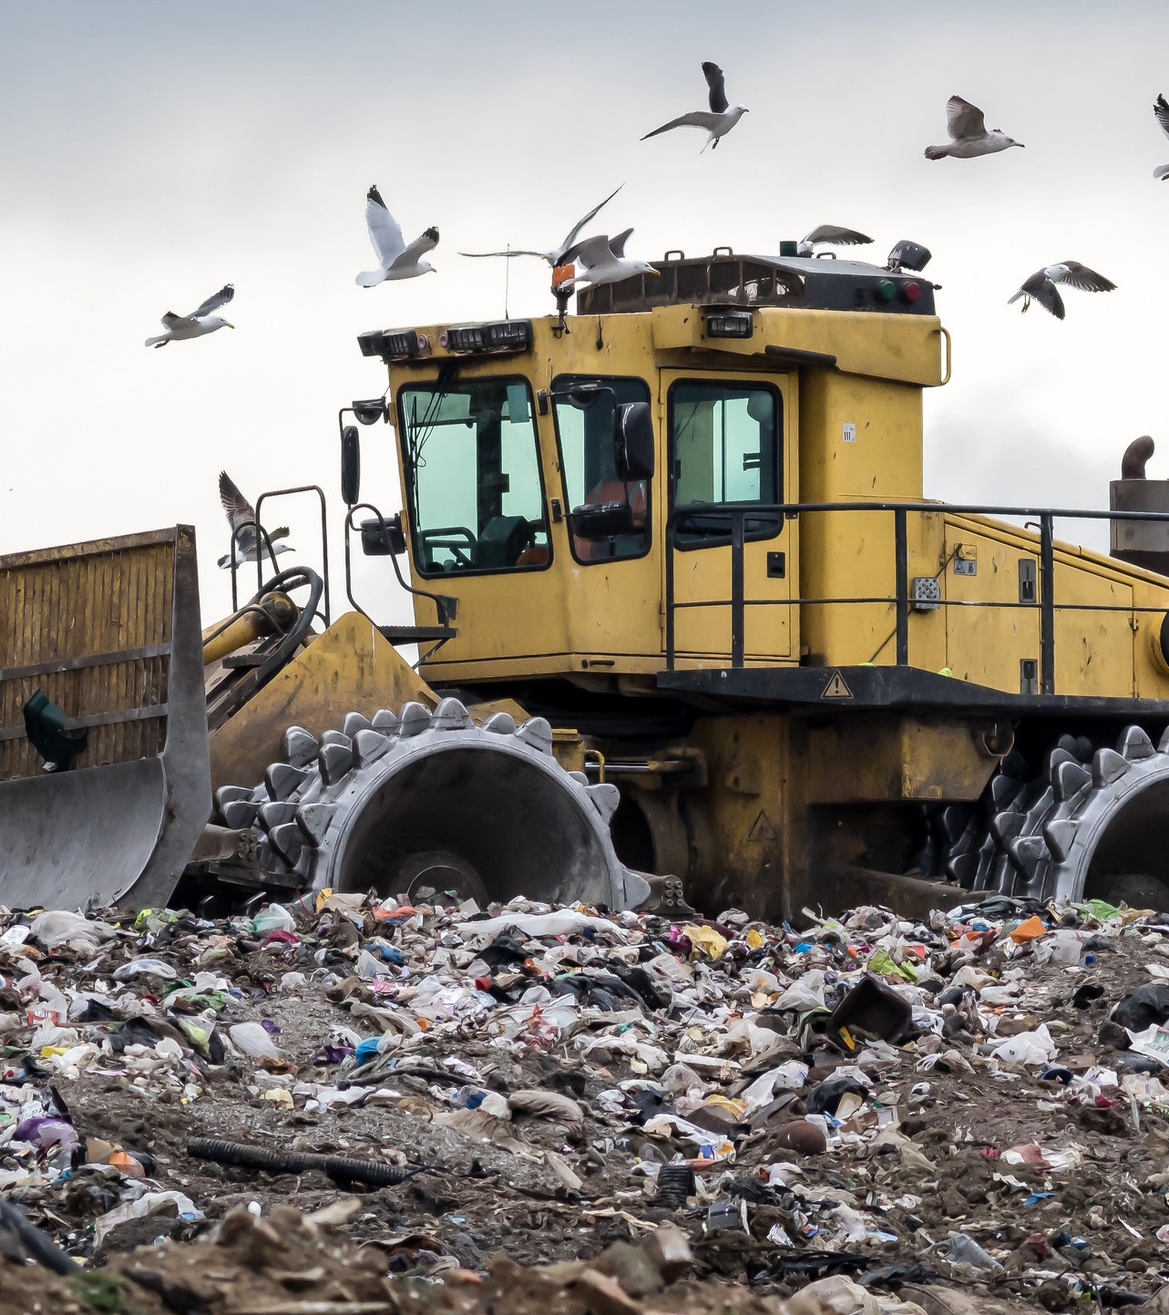
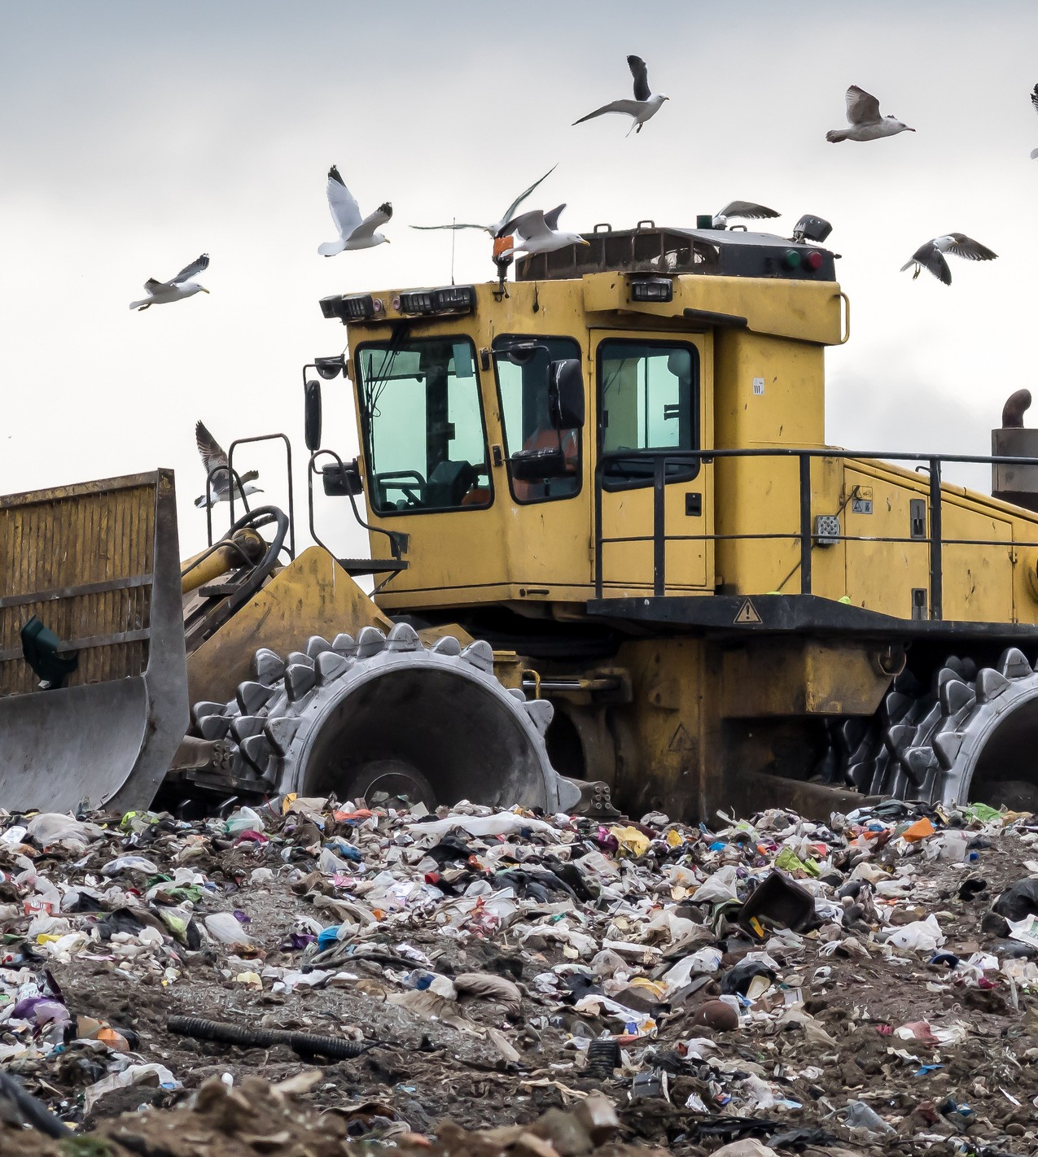
Reduce Landfill Waste
We deployed four compost bins in the restrooms for collection of paper towels to keep them out of the trash. We began textile recycling.

Slide 14
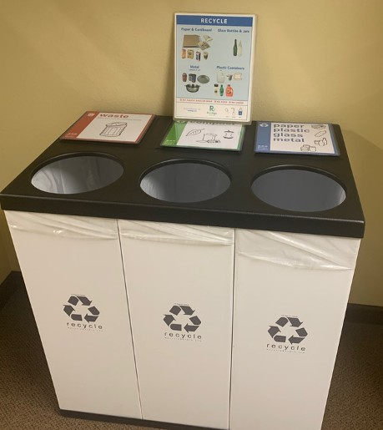
New Trash/Recycle/Compost Containers
FLC Building & Property Committee purchased and deployed two of the three-bin trash containers that have trash/recycle/compost slots. We reduced the size of our dumpster to 2 yards and obtained a lockable recycle dumpster from Recology per the sustainability team's recommendations.

Slide 15
We deployed two bins (office & sacristy) to collect used batteries so that they can be dropped off at Recology.

Slide 16
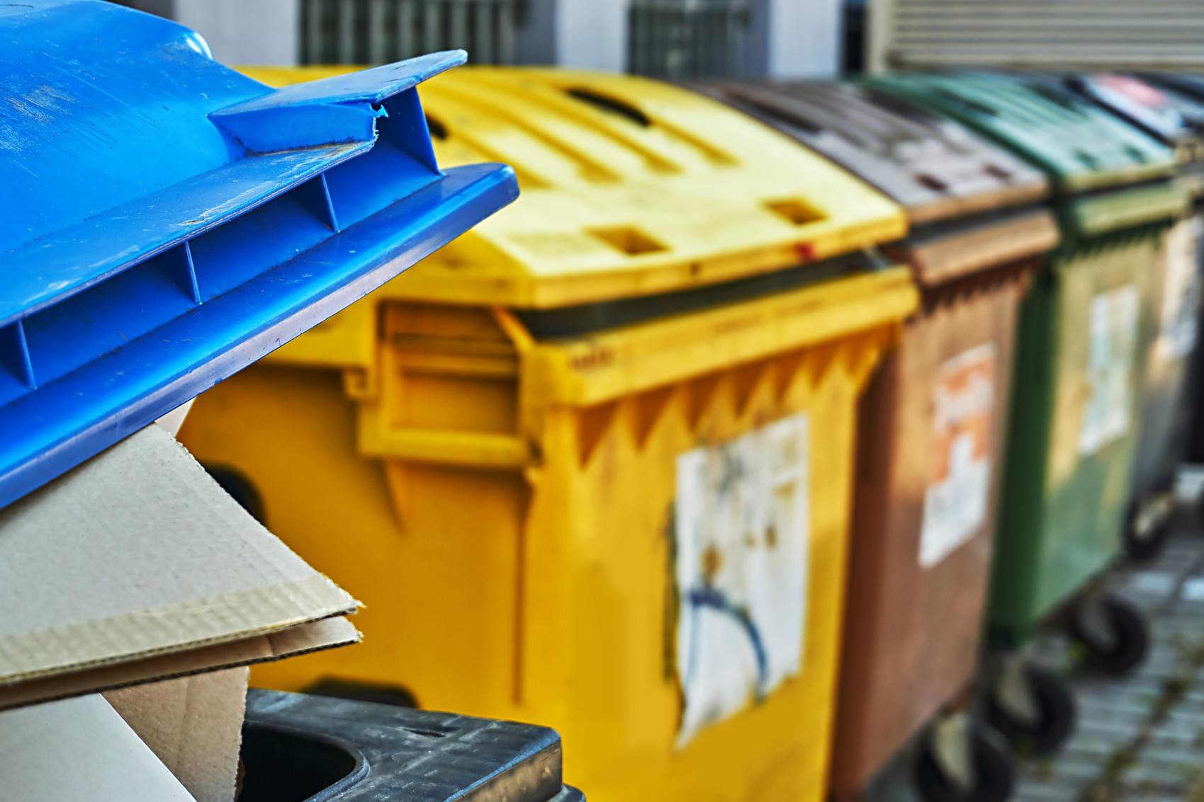
Reduced Easy Access to Dump on Property
The Building & Property Committee acquired locks for trash and recycling bins.

Slide 17
Increased Participation From Outside Groups
We re-wrote the FLC Building Use Form to help outside groups embrace our sustainability practices while in the FLC building. It was approved by Building & Property.

Slide 18
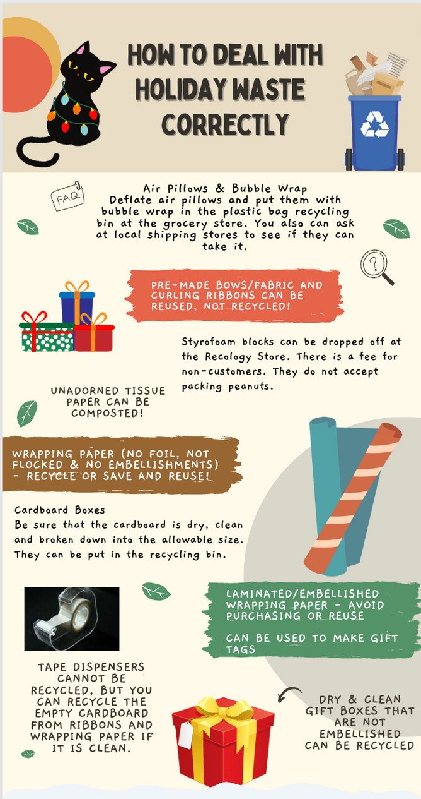
Communication Strategy
Utilize social media, newsletters (weekly and monthly) and individual inserts to increase education & participation in congregational Creation Care efforts.

Slide 19
Book Recommendati^{i}ons
B
o
o
k
r e g
u h s, G I
u eg
R
e
c
o
m
m
e
n
d
a
t
o
n
s
a
)
ea
Simpler Living Compassionate Life: A Christian Perspective, edited by Michael Schut (2009)
Queen Sugar, Natalie Baszile Larose, Louise Erdrich
A Girl of the Limberlost, G,ene Stratton-Port Happiness, Like Water, C, hinelo Okparanta Backyard Giants, Susan Warren
Six Walks: In the Footsteps of Henry David Thoreau, Ben Shattuck
Animal, Vegetable, Miracle,lBarbara Kingsolver
S
e o ir p
k
n
i
P
e
s l pi
y Wa S
ma
m
e n e, o n a l h
l,
pl
rs S
L
f e r ks at
e
p u
o t s d
:
t V
L
c ar i e
L
i n c
e
iv
ti
,
se Li ik an t
k
t
i
v N
e t h
a
n
e, a Er m
s, e
bl
g
t
d b W
F
e
C
ed ali
ri er at Su o
,
o
i e c l
s ot
M
m
te
h os er
a s
ir
pa
as
C
e
c
s
b
z
G
hi W
ps
e
si
y
il
e
n ar
,
o
M
e
n
e r of
B
n
i
e
lo e
a
a
c
S
n H
r
t
ha
tr O
e ba
e
e
a k
nr
r
Li
l
tt p
y a
f
S
o ar
K
e:
c
n a
D
i
A
ut
P
t
vi gs
C
(
or a
d
o
h
2
t T
l
ri
0
h v
st
0
o er
i
9
r
n
u
d
B
t
n t
a
h
-
n
a n
Q
L A H B
Si B A
u
ar
G
a ac x e ni
,

Slide 20
Movie Recommendations
Wall-E Whale Rider
Winged Migration Before the Flood 2040
River Blue
All Life on Our Planet

Slide 21
FLC
CREATION CARE LOGO

Slide 22
Creation Care Logo
The FLC Creation Care team would like to introduce a new logo that supports our Social Statement and our church’s work on the care of God’s creation. The blue arrow at the top represents the sky and the heavens while the green arrow on the bottom represents the earth. The hands of a 7-year-old child are holding a seedling of a bay laurel. Our future and the future of our earth are in the hands of the generations to come. The bay laurel, mentioned in the Bible, symbolizes victory. The Creation Care team designed the logo and has gifted it to FLC.

Slide 23
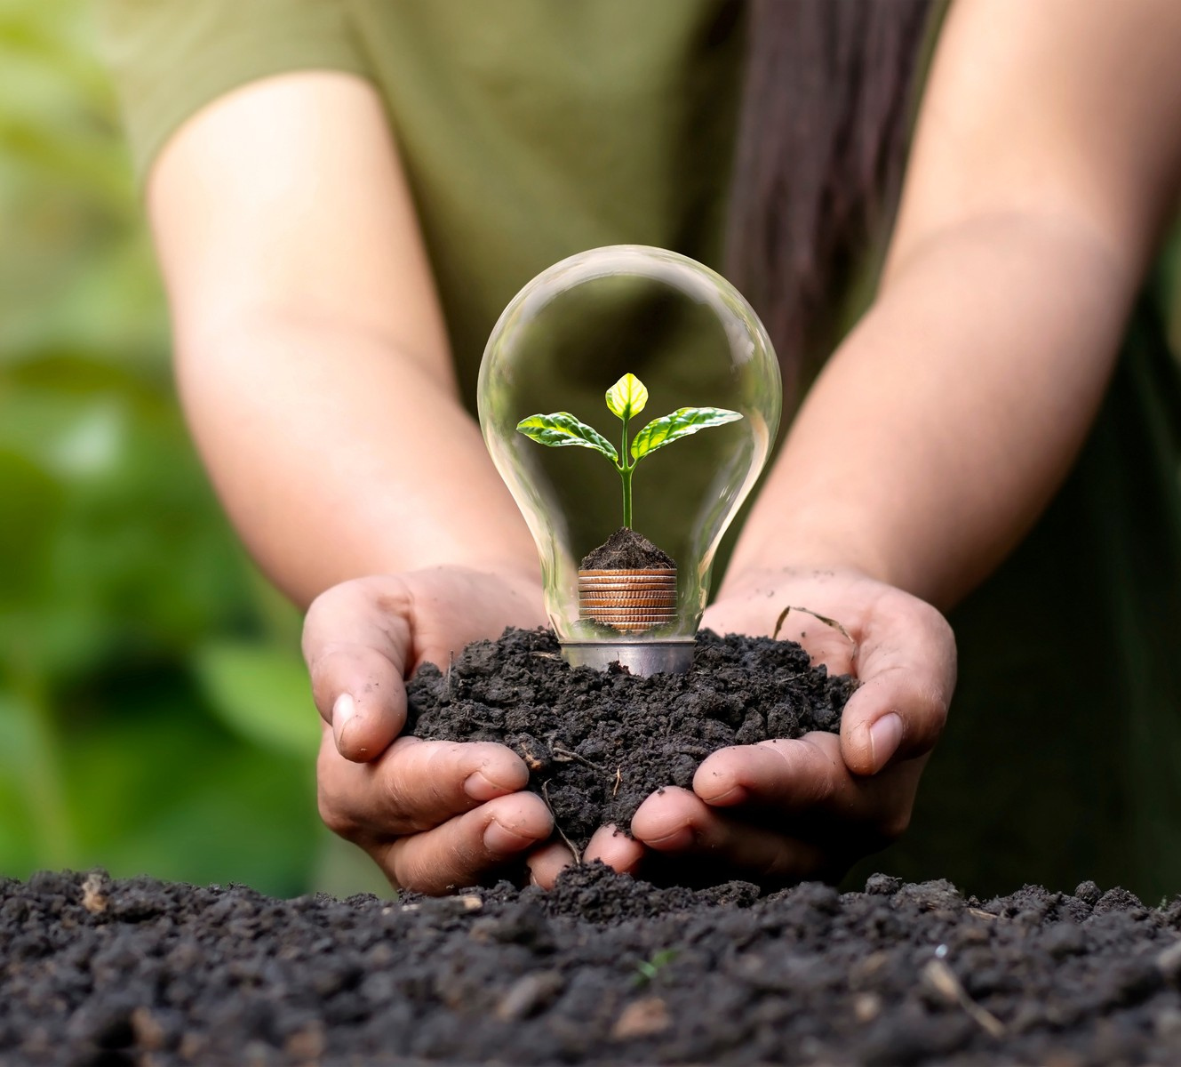
WHAT'S NEXT?

Slide 24
Brainstorming Future Opportunities
COMMUNITY ENGAGEMENT
COMMUNITY PARTNERSHIPS
EXPLORE YOUTH CONNECTIONS
We hope to organize a Bothell Street Cleanup Project
as an annual event.
We hope to create partnerships with local conservation groups and educate the congregation of opportunities available (North Creek Forest, Whale Scouts, Shelton View Woods).
Explore ways to carry work forward to youth at FLC as well as youth groups (Girl Scouts & Cub Scouts) who meet at FLC.
Let’s take a hike – an opportunity to explore the North Creek Forest with a hike exploring the important conservation work.

Slide 25
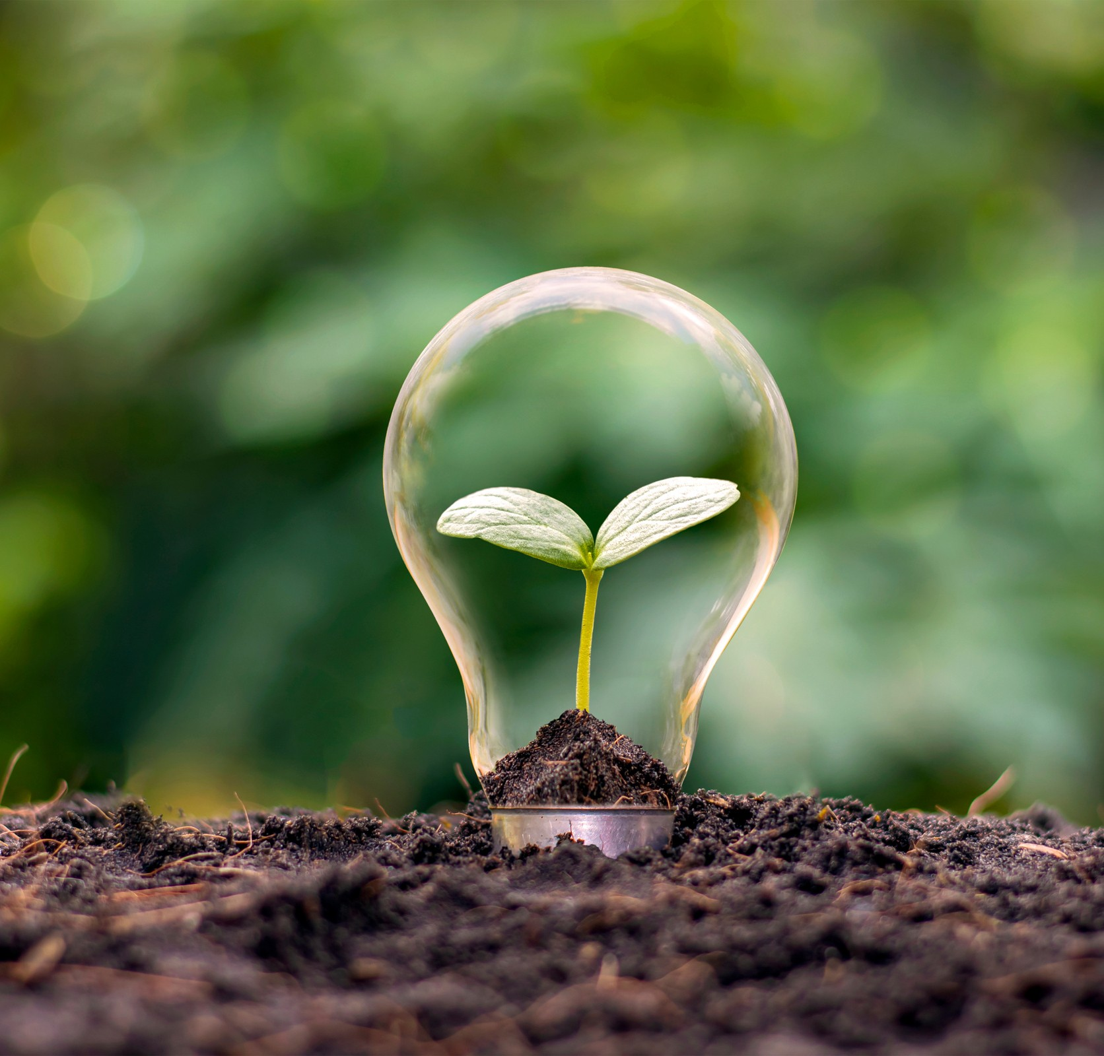
What is your passion?
How would you like to help?

