Slide 1
The Child with an Abdominal Concern
Notes:
BOLD FONT – information or questions for instructors to read aloud
Regular font – potential learner responses, not all inclusive, encourage participation by accepting a variety of responses and provide gentle redirection for incorrect information.
Italic font – animations, activity instructions, or instructor information, not intended to be read to the students
The Child with Vomiting starts on page 157 of your provider manual. The Child with Abdominal Pain starts of page 173 of your provider manual.
Objectives
Discuss pediatric conditions that may present with vomiting or abdominal pain.
Anticipate interventions for dehydration and hypoglycemia.
Describe the management of children who have ingested button batteries or magnets.

Slide 2

List potentially life-threatening concerns presenting with pediatric vomiting and/or abdominal pain.
Click to Start
TIMES UP
Notes:
Vomiting and abdominal pain are common pediatric presentations. What are the worst-case scenarios?
In groups of no more than 4, the students will use a blank piece of paper, whiteboard, or large sticky note to record answers. Discuss answers after 5 minutes (listen to students to see when conversation is straying and redirect if necessary).
Elect a spokesperson. Take no more than 5 minutes to discuss and write down your answers. Think about general causes, symptoms, and interventions.
Main concerns are dehydration, hypoglycemia, electrolyte disturbances (hypo/hypernatremia discussed in The Child with an Altered Mental Status), an emergent surgical abdomen, and increased intracranial pressure.
We will talk about some specific signs and symptoms related to a surgical abdomen, but first let us talk about dehydration. What kind of shock is caused by dehydration?
Hypovolemic

Slide 3

Infant Dehydration
Altered mental status
Decreased urine output
Dry mucous membranes
Hypotension
Irritable when touched
Restless or sleepy
Poor feeding
Signs of shock
  Delayed capillary refill, hypotension, weak pulses, tachycardia, tachypnea
Sunken eyes
Sunken fontanelle
Photo by Yến Yến on Unsplash
Notes:
What are some signs of dehydration in an infant?
CLICK, all answers will appear at once
What are some anatomic and developmental differences that predispose young children to dehydration?
Greater relative body surface area = increased insensible fluid loss through skin
Greater water ratio to body mass
Unable to concentrate urine
Cannot communicate hydration needs or access fluids independently
Higher respiratory rate = increased insensible fluid loss through respiration

Slide 4
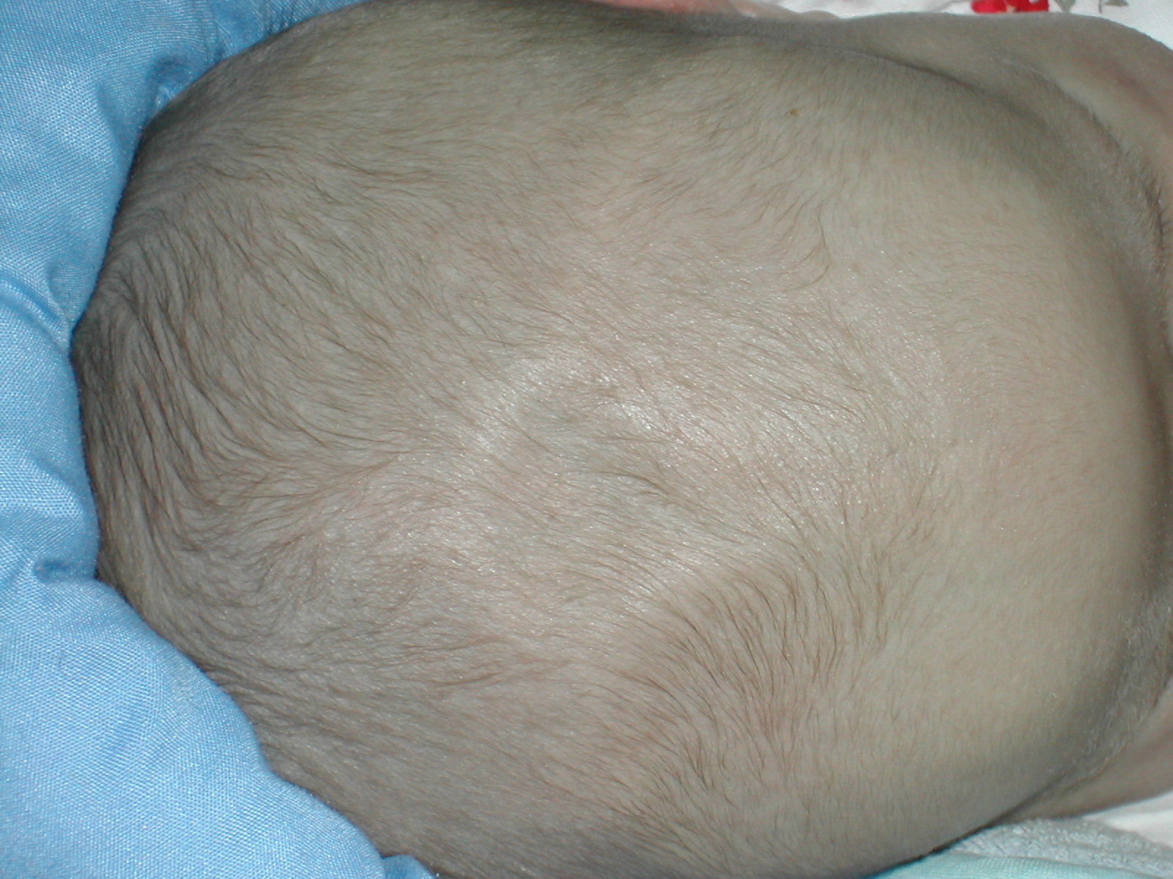
Johann Dréo (User:Nojhan) (https://commons.wikimedia.org/wiki/File:Human_anterior_fontanelle_1_month_dscn1449.jpg), „Human anterior fontanelle 1 month dscn1449“, https://creativecommons.org/licenses/by-sa/3.0/legalcode
Notes:
Has anyone seen or felt a sunken fontanelle before? What do you think about palpating the fontanelle as a primary survey assessment?
This assessment can be considered in circulation and disability. What else can the fontanelle assessment tell you?
Sunken = dehydration, hypovolemia
Tense or bulging = concerning for elevated intracranial pressure (head trauma, hydrocephalus)
If you note a tense or bulging fontanelle, what workup will be considered?
Skeletal survey, ophthalmology assessment – concerning for abusive head trauma.

Slide 5
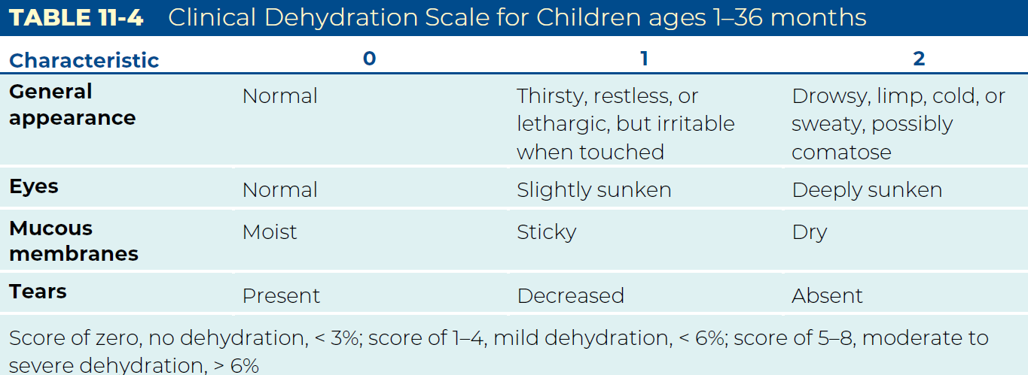
Notes:
There is a scale that quantifies the extent of pediatric dehydration. The mucous membrane assessment is important. When do we need to intervene?
Ideally before the child becomes hypovolemic or hypoglycemic.
Table from page 163 of the provider manual.

Slide 6
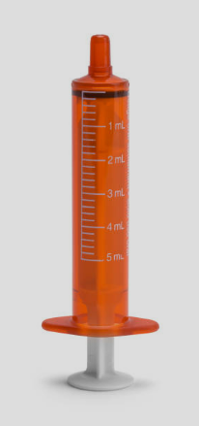
Dehydration Concerns and Options
When is it safe to offer oral fluids?
How do you teach a parent to encourage oral intake?
How do you measure an infant’s intake and output?
Notes:
Let’s talk through how we manage dehydration.
CLICK for each question and oral syringe image
Oral fluids can be offered if the physician or advanced practice provider has evaluated the patient and determined that a surgical emergency is unlikely.
Oral rehydration solution 5–10 mL every 2–5 minutes using a medicine cup or oral syringe – start with small amounts every 5 minutes and increase as tolerated. If the patient vomits, wait ten minutes before offering more. Oral syringes are offered to infants in addition to nursing or bottle feeds. Antiemetics may be considered.
Count syringes of oral rehydration solution, note nursing attempts/duration, measure volume in bottle feeds, weigh diapers; 1gm = 1 mL

Slide 7
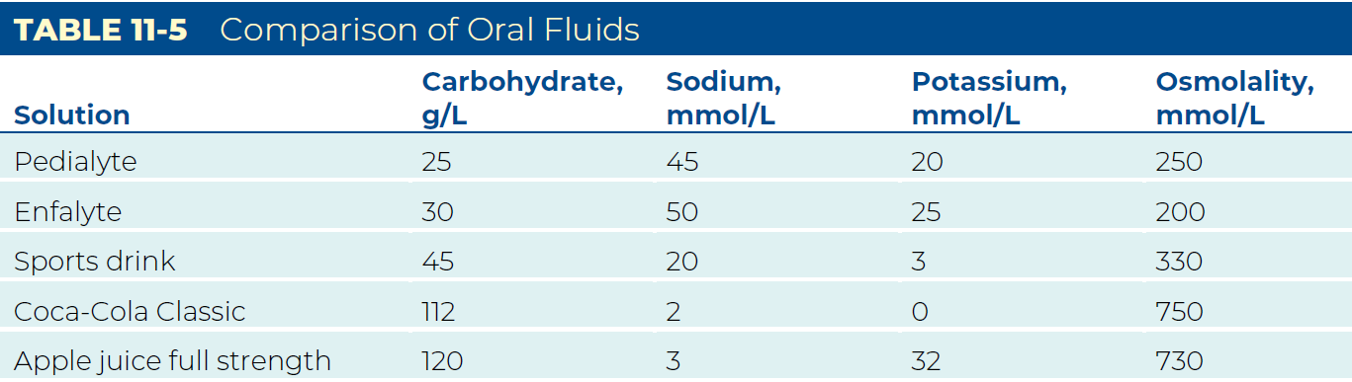
Fluid Options
How much fluid do you administer, and what type?
  Oral, IV
  Neonate, cardiac/fluid overload concern
  Bolus, maintenance
Notes:
Oral rehydration solution: 50–100 mL/kg over 2-4 hours
2 mL/kg for each vomiting episode, 10 mL/kg for each loose stool
IV: 20 mL/kg, reassess
10 mL/kg for neonates or with cardiac/fluid overload concern
Refer to facility policy for maintenance fluid calculation, maintenance fluids should include dextrose
Why are full-strength juices or sodas not recommended?
Fluids and foods high in simple sugars can increase diarrhea
Why is plain water not enough?
May lead to hyponatremia and hypoglycemia
If applicable: Is anyone administering subcutaneous fluids?
Share the facility’s subcutaneous fluid policy if applicable.
Table from page 163 of the provider manual.

Slide 8
Hypoglycemia Management
An infant has a blood glucose of 40 mg/dL (2.22 mmol/L).
If you do not have IV access, what are your options?
  Oral — caution
  Glucagon — caution
What is the ideal concentration of dextrose to administer? Why?
What can you do if you only have D50?
  10 kg child, need 2 mL/kg of D25
  Dilute 10 mL of D50 with 10 mL of compatible IV solution for an appropriate dose of D25
Notes:
CLICK to reveal Oral — caution and Glucagon — caution
Cautions: aspiration in patients with an altered mental status
Glucagon converts glycogen into glucose. Children have limited stores so glucagon might not be effective. Also, glucagon will deplete their glycogen stores for ongoing energy needs.
Refer to page 211 in the provider manual for oral management options.
Ideal is D10W 2.5–5mL/kg
Maximum concentration of 12.5%
Higher concentrations are contraindicated because they irritate young children’s fragile vasculature.
CLICK to reveal instructions to dilute D50 to D25
D25 may be acceptable for children > 5 years of age
Can dilute D50 to D25 if D10W is not available and administer 1–2 mL/kg
Example: D25 2 mL/kg for a 10kg child = 20 mL
Draw up 10 mL of D50 and dilute with of 10 mL of sterile water or 0.9% sodium chloride for an appropriate dose of D25.

Slide 9
History Questions
Onset of vomiting, diarrhea, or abdominal pain
Pattern of vomiting, diarrhea, or abdominal pain
  Vomiting on awakening is concerning for a space-occupying lesion
Description of vomitus and stools
Description and location of abdominal pain
  Radiating, sharp, crampy, intermittent?
Last bowel movement, normal bowel pattern
Associated symptoms such as headache, cough, fever
Ill contacts
Dietary or medication changes
Any changes to the child’s routine
Sexual health history
Notes:
What history questions can you ask when a child presents with abdominal pain or vomiting to anticipate needed interventions?
CLICK, all answers appear at once
You can also ask a child what their favorite food is and if they would eat it right now. Unless the child just ate a full meal, it is concerning if they have no interest in their favorite food.
Do you have any tips for obtaining an accurate sexual health history?
Normalize the questions and be specific. “Some patients your age are sexually active. Have you started having sex? What kind of sexual contact have you had?”
See Clinical Pearl on page 175 of the provider manual.

Slide 10
What do you suspect?
What can you anticipate?
Notes:
In groups of no more than 4 students, use a blank piece of paper, whiteboard, or large sticky note to record answers.
Elect a spokesperson. Take no more than 10 minutes to consider the signs and symptoms on the next slide. What do you think is going on and what can you anticipate?
Listen to students to see when the conversation is straying.
Advance to next slide to show signs and symptoms for this activity. Answers will appear on click – do not click until after the group activity is complete.

Slide 11
What Do You Suspect?
Hungry infant who vomits after feeding
  Pyloric stenosis
Bilious emesis in a young child
  Bowel obstruction – surgical emergency
Vomiting, diarrhea, hyperactive bowel sounds
  Gastroenteritis
Tight, distended abdomen or rebound tenderness
  Peritonitis, bowel perforation – surgical emergency
Tender mass, may bulge when crying
  Hernia – reducible or surgical?
Sticky dark stools
  GI bleeding – blood replacement if in shock
Diarrhea, tenesmus*, blood in stools, weight loss
  Inflammatory bowel disease (Crohn’s, ulcerative colitis)
1. GI bleeding
2. Gastroenteritis
3. Hernia
4. Pyloric stenosis
5. IBD
6. Peritonitis
7. Bowel obstruction
Click to Start
*the sensation of the need to pass stool with an empty bowel
TIMES UP
Notes:
Match the answers on the right to the symptoms on the left. Then, write down your anticipated interventions.
CLICK for each answer
Pyloric stenosis – surgical consult, intravenous rehydration if needed
Bowel obstruction – surgical emergency
Gastroenteritis – stool cultures, rehydration, possible antiemetics
Peritonitis, bowel perforation - surgical emergency
Hernia – reducible or surgical?
GI bleeding – blood replacement if in shock, gastrointestinal consult to determine source and recommended management
Inflammatory bowel disease (Crohn’s disease or ulcerative colitis) – gastrointestinal consult
As nurses, we communicate the patient history and physical assessment findings verbally and with documentation to help the physician or advanced practice provider determine the plan of care.

Slide 12
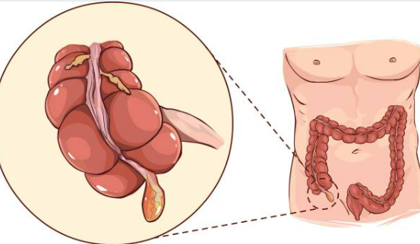
Appendicitis
Most common abdominal surgical emergency in childhood
Peaks between the ages of 9–12
While rare, appendicitis is more dangerous in infants
  Higher perforation rate (70–85%) than in children (7%)
Vague presentations and delays in seeking care may lead to a perforated appendix, septic shock, and death
Notes:
Most people would suspect appendicitis with right lower quadrant abdominal pain. Children are often unable to localize pain and will point to their umbilicus when asked where the pain is. It is also not uncommon for the pain to migrate as the condition progresses. It is particularly dangerous in infants.
How are you seeing appendicitis diagnosed, and what are the options when it is?
Ultrasound, non-surgical management with antibiotics and close monitoring is becoming more common
What do you do to prepare the child and parents for surgery?
Refer to Chapter 3, Pediatric Differences, for approach adaptations to make the experience less frightening.

Slide 13

Other Signs and Symptoms
Difficulty ambulating
Anorexia
Irritability
Grunting respirations
Notes:
Table 11-7 describes findings related to presentation of appendicitis per age group.
Adolescents tend to present with the classic signs and symptoms as seen in adult appendicitis
What other causes of unilateral abdominal pain are concerning? Is there an additional test you would consider for the child on this slide?
Pregnancy test
Ectopic pregnancy, ovarian torsion, testicular torsion
Abdominal pain is one example of when the nurse needs to ask tactful but specific questions about sexuality, gender identity, sexual organs, and gender-affirming therapies.
Refer to ENA practice resources: Care of Gender Expansive and Transgender Patients Topic Brief
Care of LGBTQ Patients in the Emergency Care Setting Toolkit
Cultural Diversity and Gender Inclusivity in the Emergency Care Setting Position Statement
Lina Medina reportedly gave birth at age 5 in the 1930’s. Girls can become pregnant before they are 10 years old – menarche (the onset of menses) is trending younger.

Slide 14

Notes:
Watch this video. Most physicians and advanced practice providers would diagnose this child with minimal testing based on the history and how the child is positioned.
Typical presentation for intussusception – image on next slide.

Slide 15
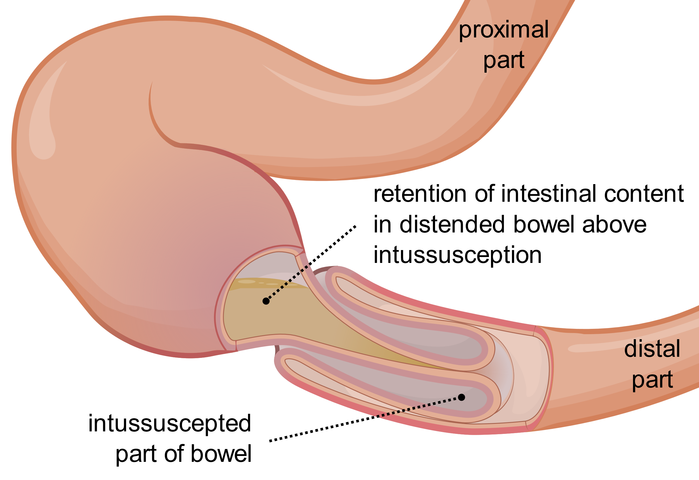
Olek Remesz (wiki-pl: Orem, commons: Orem) (https://commons.wikimedia.org/wiki/File:Intussusception_EN.svg), „Intussusception EN“, https://creativecommons.org/licenses/by-sa/3.0/legalcode
Notes:
Intussusception often presents with crampy, intermittent, severe abdominal pain.
The bowel may self-reduce, relieving the pain. There may be occult blood or “currant jelly” bleeding mixed with mucous in the stool.
Vomiting may become bilious as the obstruction progresses.
Intussusception is visible on ultrasound and may be treated surgically or with saline, contrast, or air enema under fluoroscopy.

Slide 16
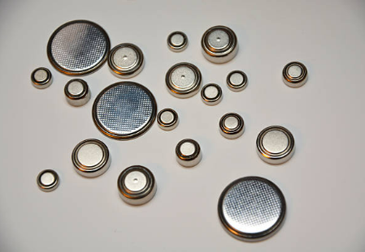

Notes:
Why are these pictures in a discussion about pediatric abdominal pain and vomiting?
Button battery and magnet ingestions may be a surgical emergency with an asymptomatic presentation. Bowel necrosis is a real concern.
What diagnostics and other interventions might be necessary?
Radiographs
Ultrasound
Oral honey (no honey for infants due to botulism risk) and/or sucralfate (button batteries)
Surgical or endoscopic management
Page 178 in the provider manual

Slide 17
Summary
Vomiting in children has many causes, from benign to life-threatening
In the infant and young toddler, be suspicious of head trauma in the child with vomiting, especially in the absence of fever and diarrhea.
A history of vomiting upon awakening is concerning at any age for a space-occupying lesion
For mild to moderate dehydration, oral rehydration is the preferred method of rehydration.
Rapid fluid administration is essential with signs of poor perfusion. Fluid bolus for a neonate is 10 mL/kg.
Notes:
Review some red flags & clinical pearls

Slide 18

The Child with an Abdominal Concern
Notes:
We have focused on the abdomen, but know that abdominal pain might be a sign of a respiratory condition in children OR abdominal pain and distention can cause respiratory compromise. Are there any other questions?

Slide 19
Write down 3 things that went well the last time you worked.
Notes:
Resilience booster, also encourage physical movement between presentations

