Slide 1
mBar Technologies, Inc
Productivity Through Innovation

Slide 2
mBar Technologies, Inc
Located in beautiful Boise, Idaho and nestled among a few of the largest semiconductor companies in the world, mBar Technologies, Inc has become a leading provider of precision refurbishment, calibration, repair, and engineering services. Creating innovative solutions that enhance process and machine productivity is our number one priority.
We provide products and services to customers across the globe in semiconductor and solar related specialty manufacturing industries. Our passion is working with people to develop innovative engineered designs that solve real world problems and enhance productivity.
From concept, to design, to final test and qualification, our team of professionals, WITH OVER 100 YEARS OF INDUSTRY EXPERIENCE, work effectively to meet your requirements whether they are aimed at maximizing system lifetime, lowering cost of ownership, or improving performance. Let us put our extensive knowledge and experience with precision equipment to work for you.

Slide 3
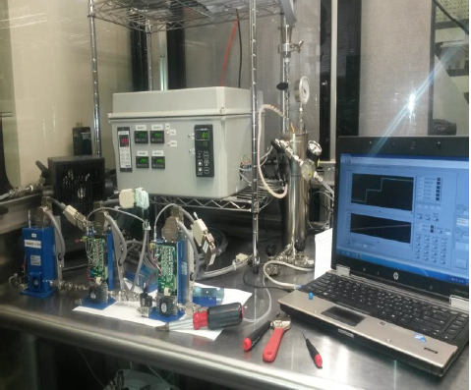
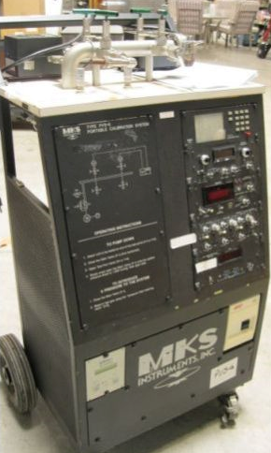
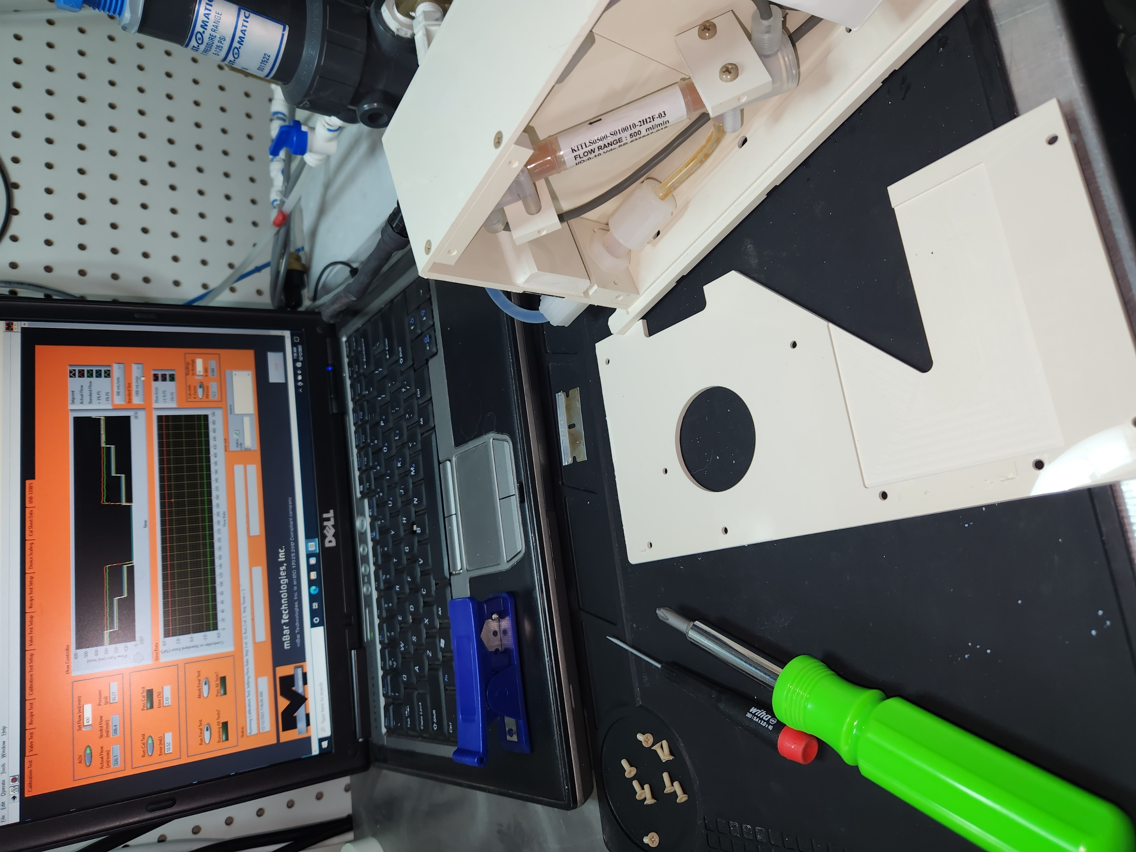
mBar Technologies, Inc People, Facilities, and Processes
100+ YEARS Industry Experience
ISO 17025:2017 Compliant
Last Audit 1-16-2025
Custom Test Stations
Custom Test Software
Custom Tracking System
Certified LabView Developers
Certified VBA/SQL Developers
MCITP Database Administrators
Machine/Weld Shops
HE Leak Checkers
Clean Room Environments
Proven Proprietary Methods

Slide 4
Malema/MSPL/Tokyo Keiso/AMAT Slurry Controller Test Software

Slide 5
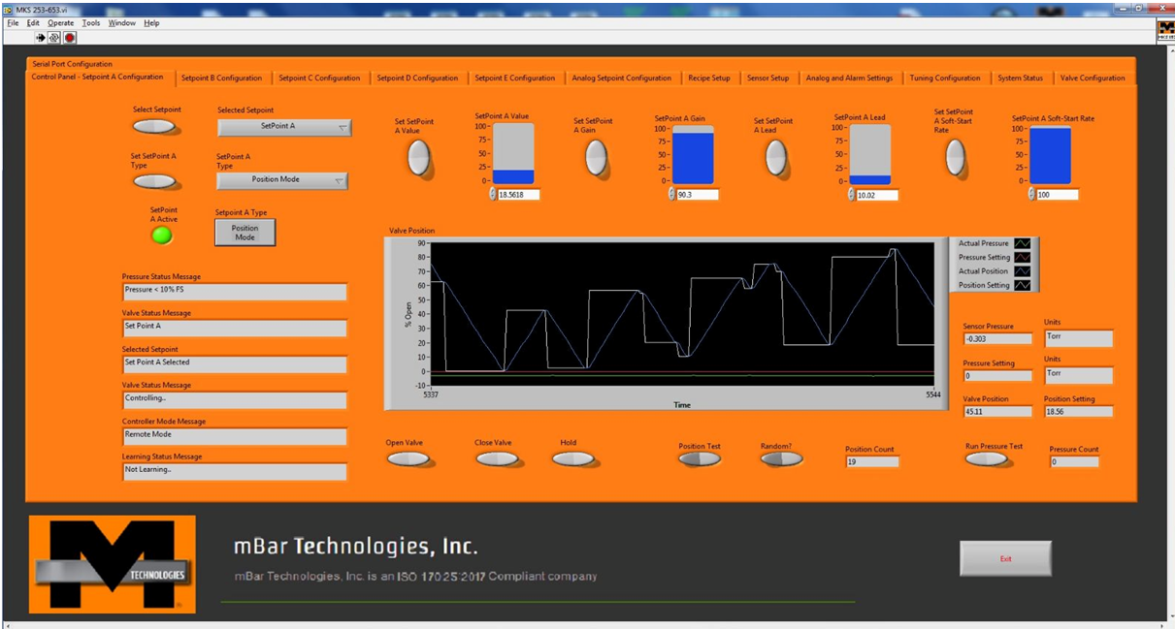
MKS 253 / 653 Valve Test Software

Slide 6
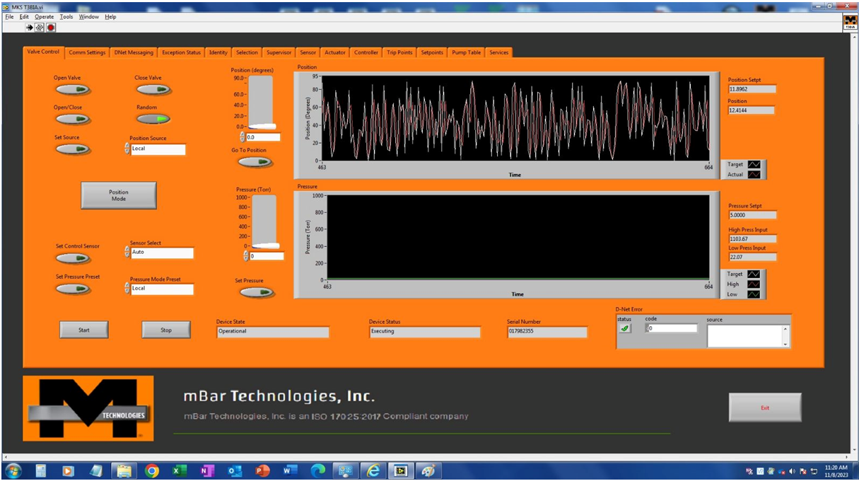
MKS 683 / TB3IA Smart Throttle Valve Software

Slide 7
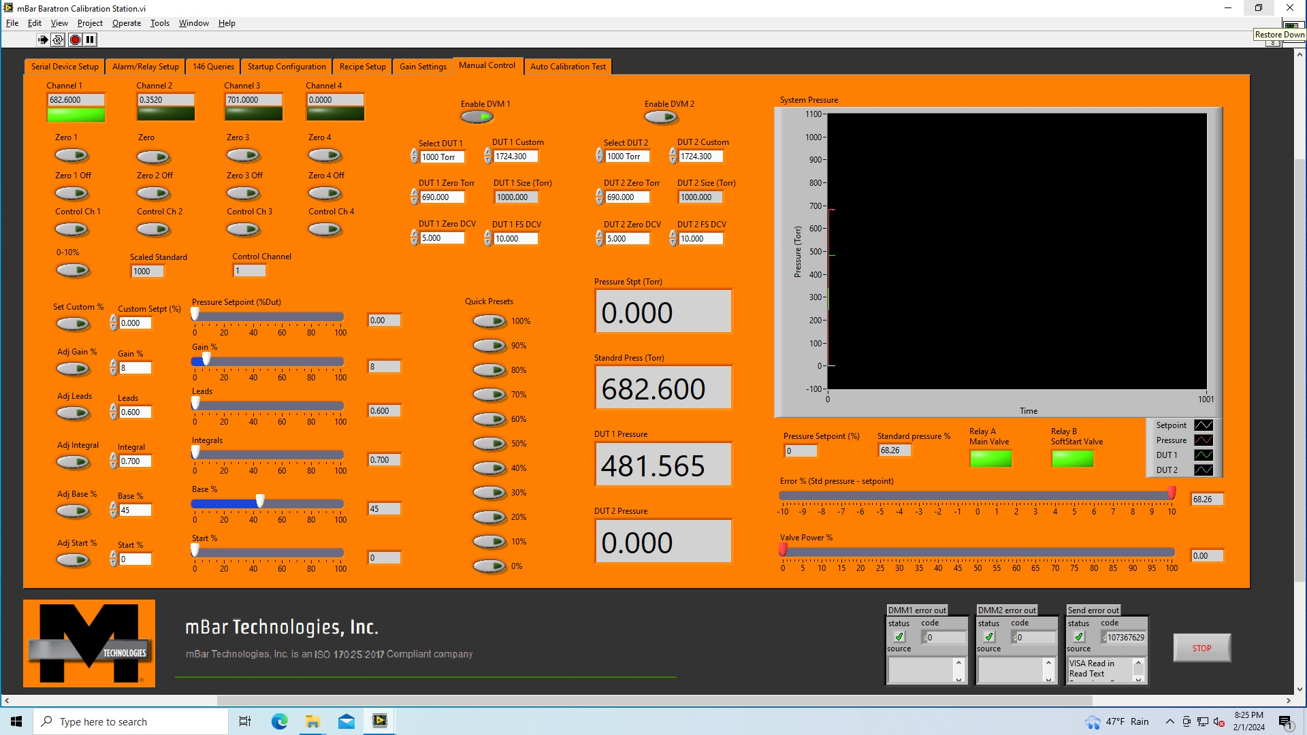
Capacitance Manometer Test Software

Slide 8
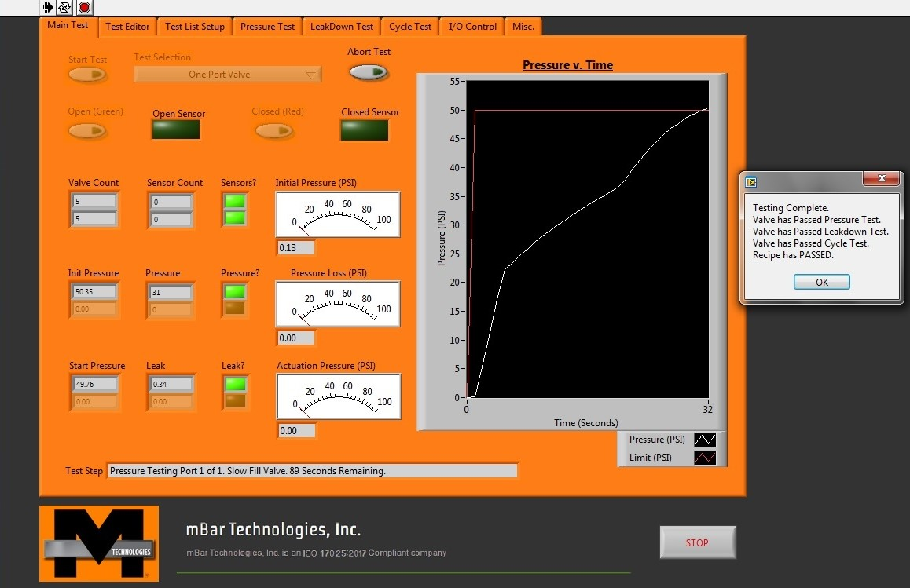
Isolation Valve Tester (1-4 Port)

Slide 11
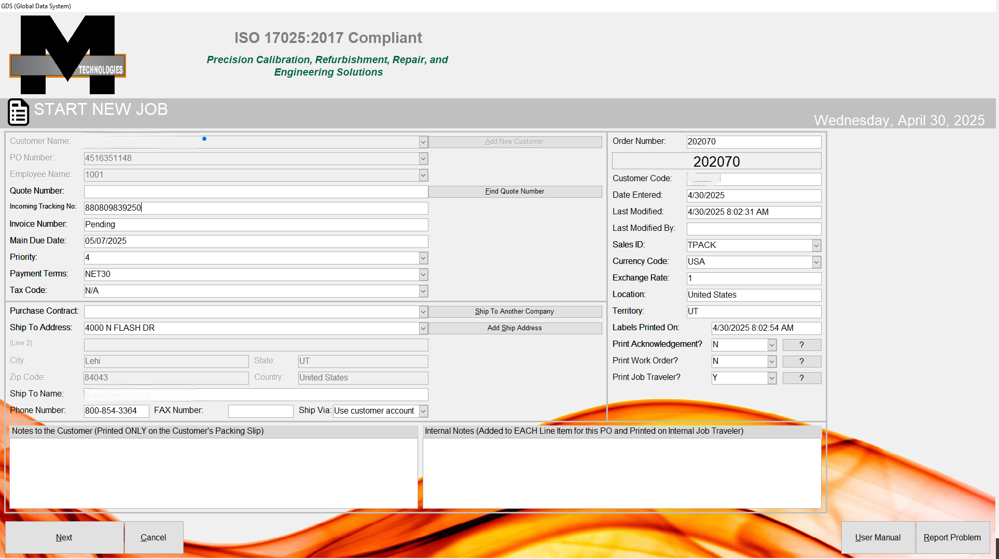

Slide 12
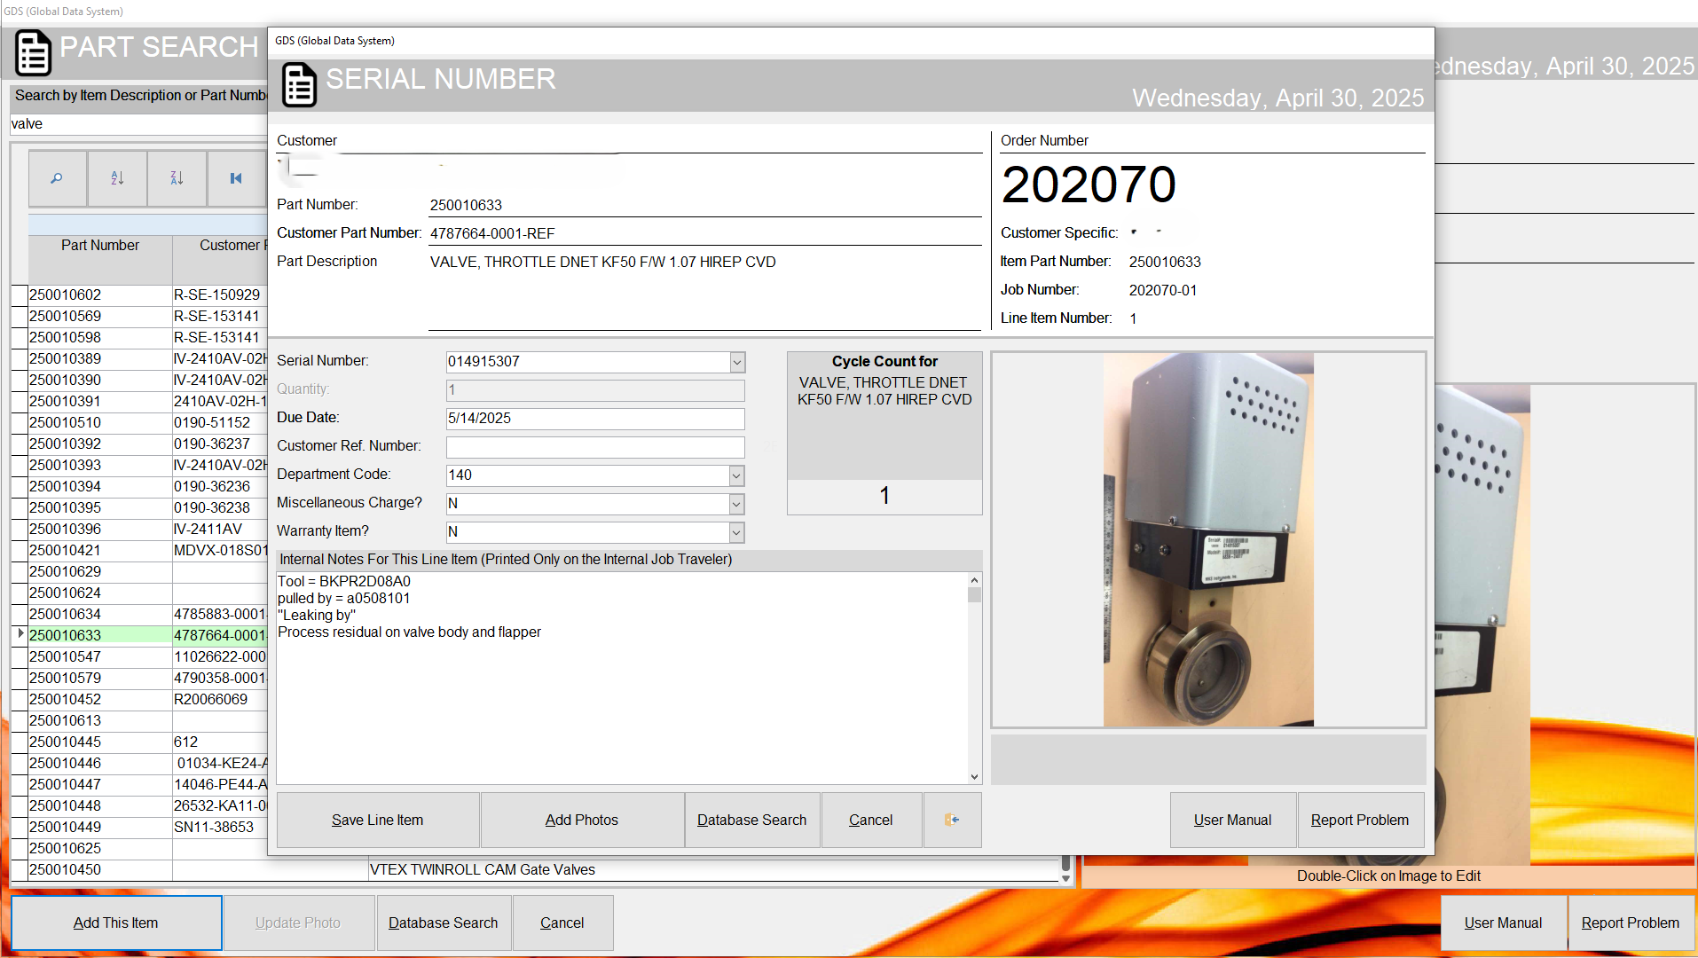

Slide 13
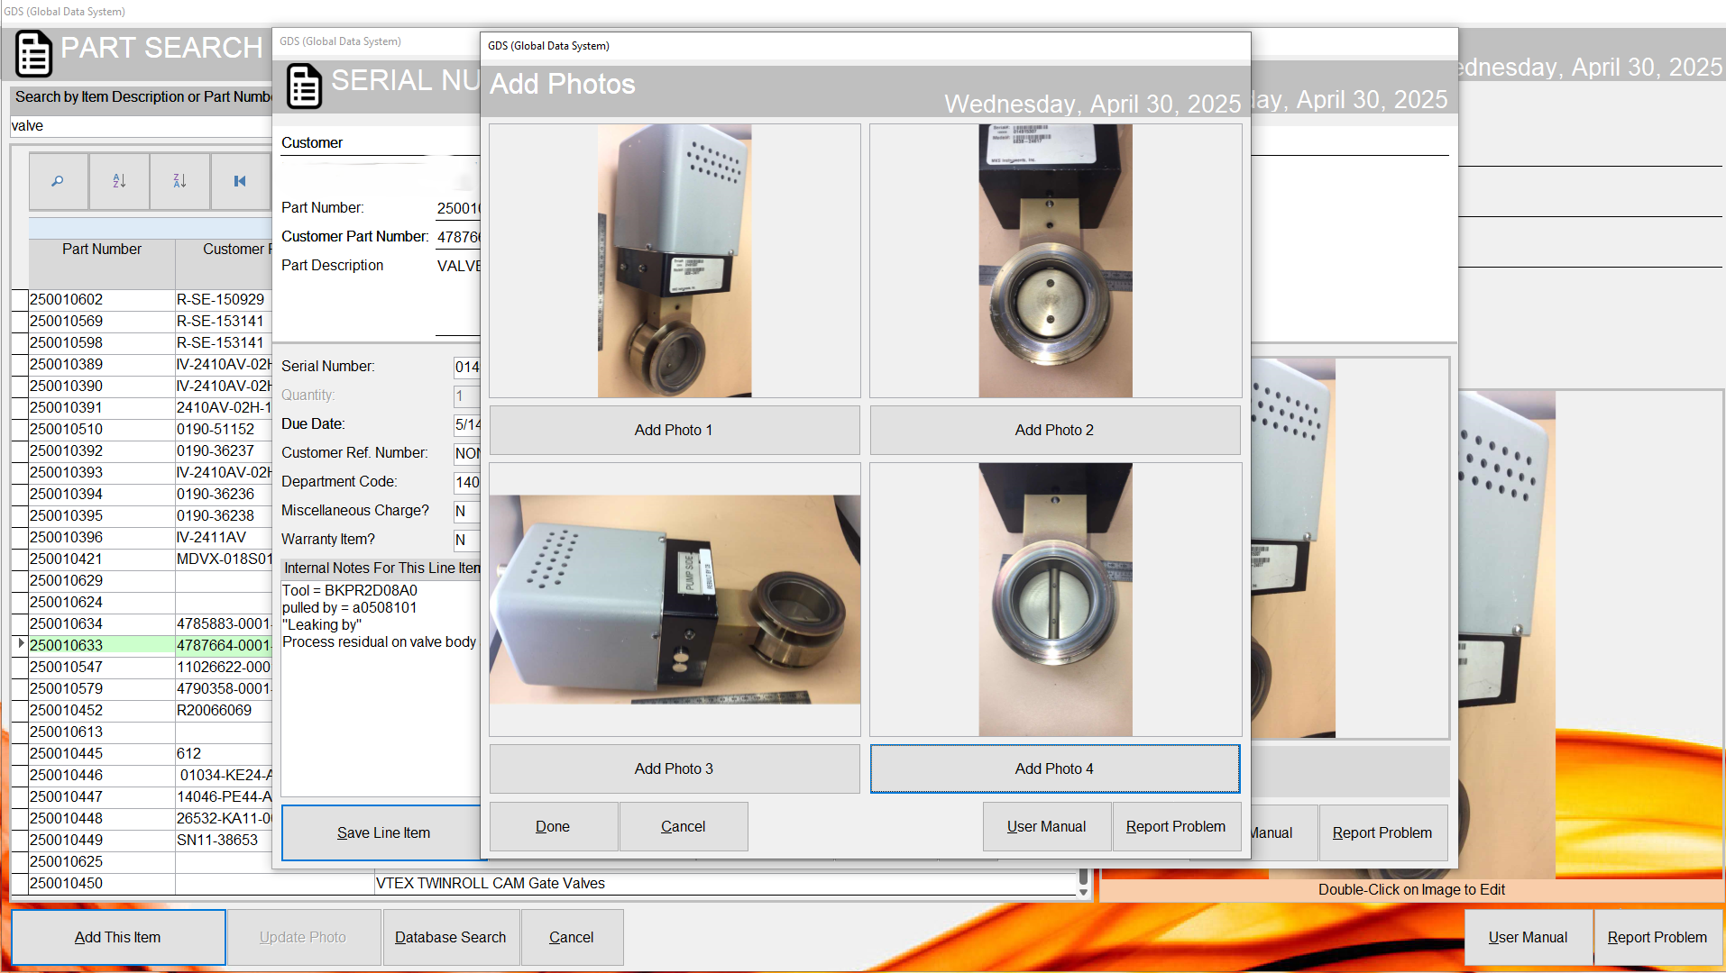

Slide 14
GDS History Search

Slide 15
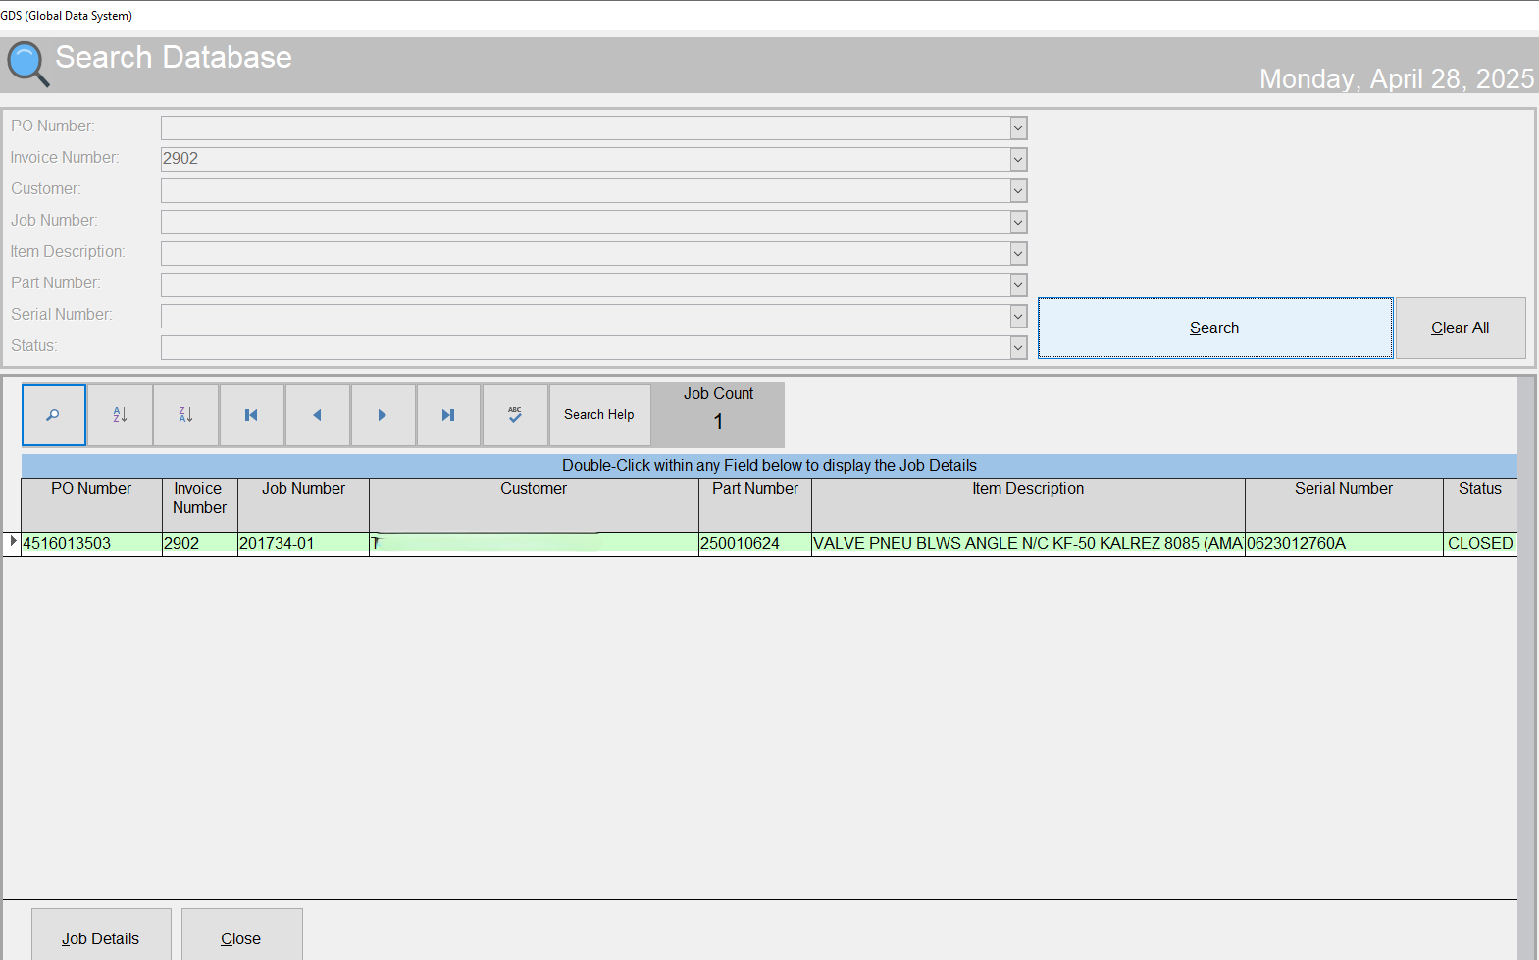

Slide 16
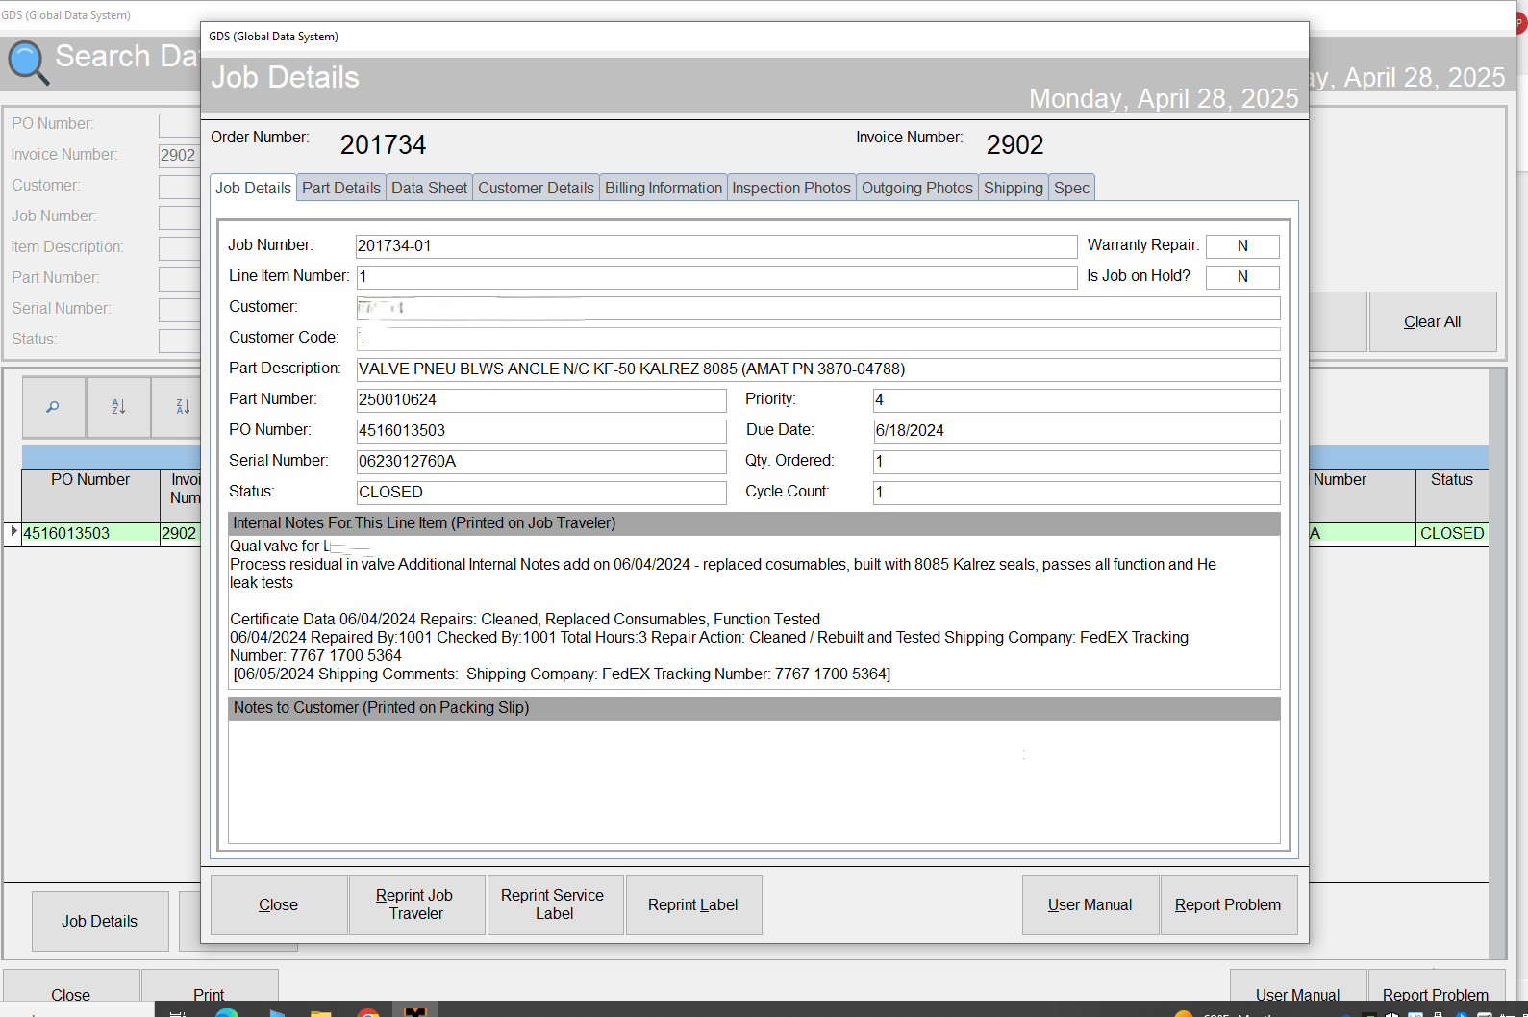

Slide 17
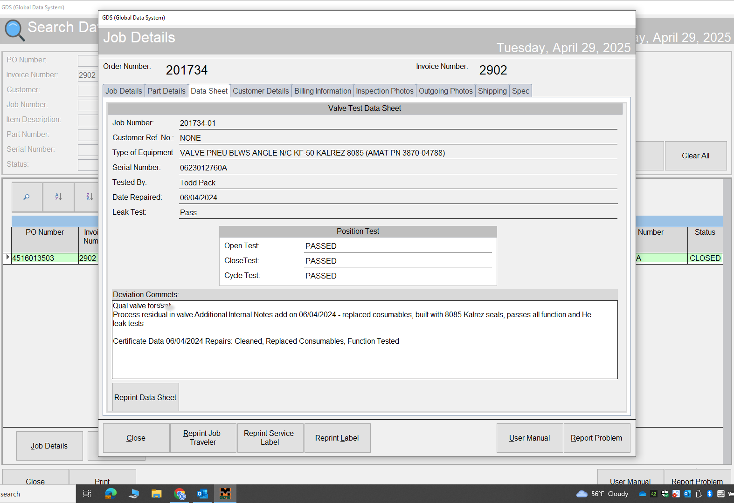

Slide 18
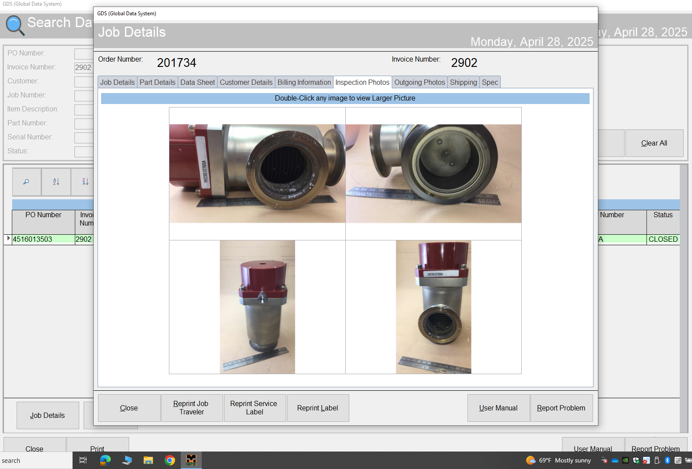

Slide 19
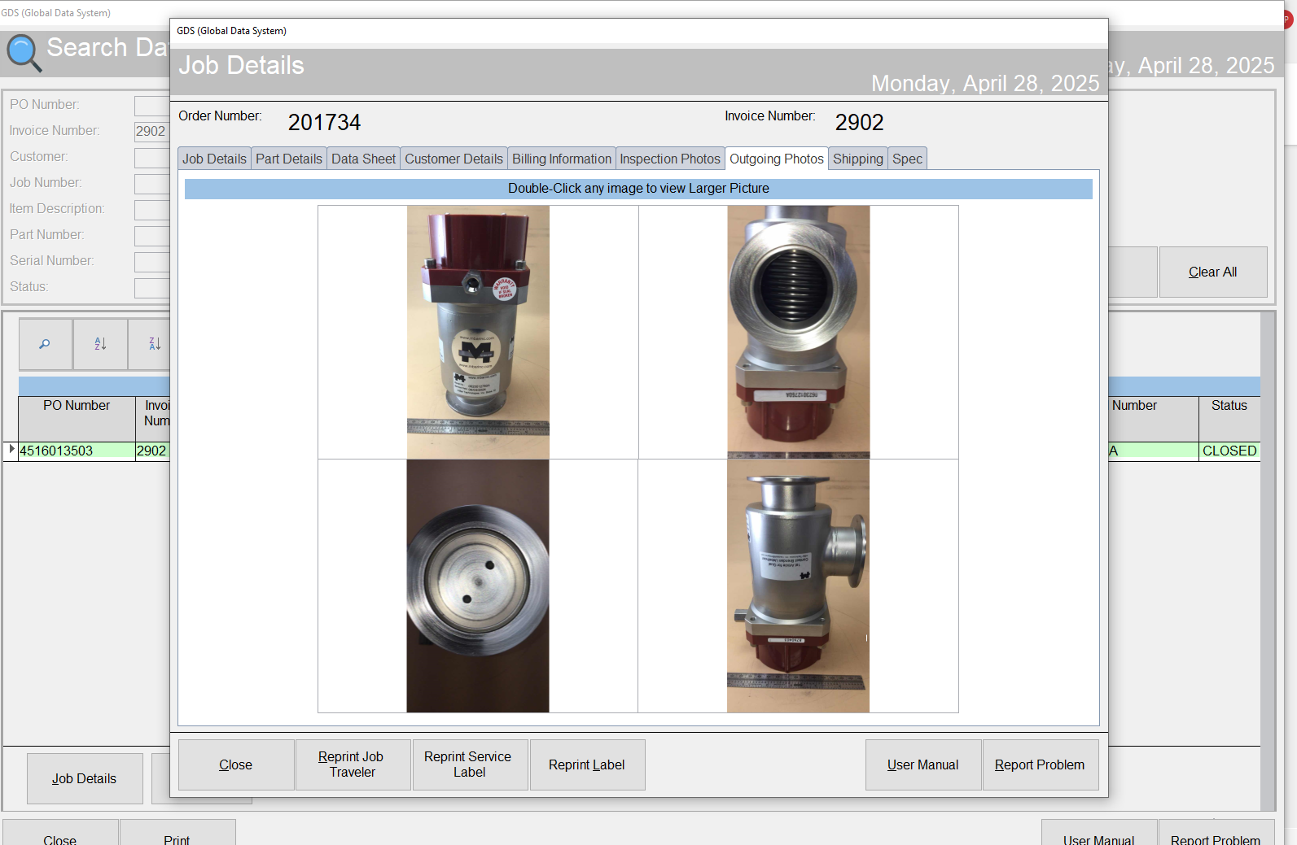

Slide 20
mBar Technologies, Inc Products

Slide 21
mBar Technologies, Inc Products
We refurbish/repair/calibrate many different types of parts and equipment including but not limited to:
Throttle Valves
Isolation Valves
Gate Valves
Liquid Injection Valves
Liquid Flow Meters
Capacitance Manometers
Slurry Pumps
Precision Welding
The mBar Technologies, Inc. team can help you determine what the best options are for your system needs; it may be refurbishment, repair, replacement, re-design, or a combination of these depending on the equipment and your goals. We can give you guidance on the impact of the available options so that you can make the optimum choice for enhancing your operations.

Slide 27
Thank You mBar Technologies, Inc tpack@mbarinc.com www.mbarinc.com

