Slide 1
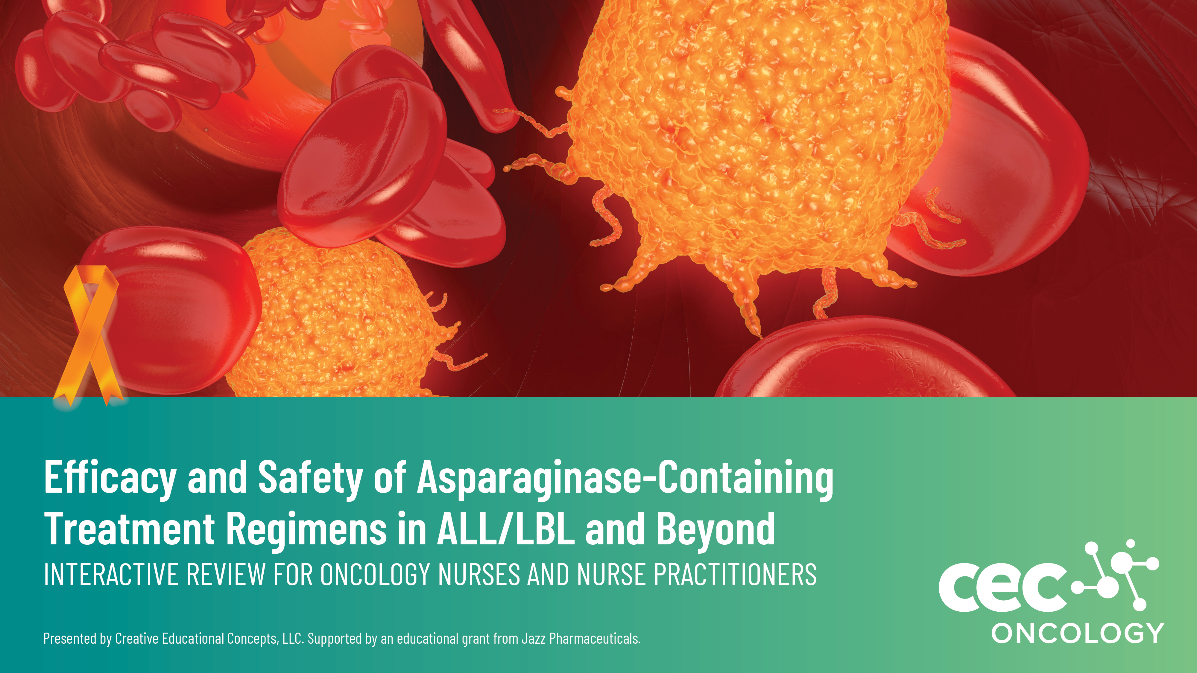
Efficacy and Safety of Asparaginase-containing Treatment Regimens in ALL/LBL and Beyond
INTERACTIVE REVIEW FOR ONCOLOGY NURSES AND NURSE PRACITIONERS

Slide 2
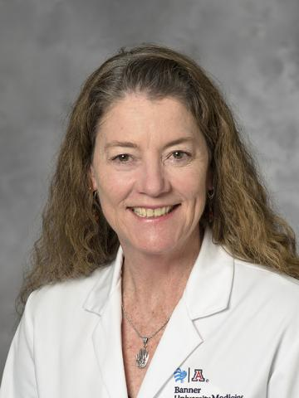
Sandra Kurtin
PhD, ANP-BC, FAPO
Director, Advanced Practice,
Nurse Practitioner
The University of Arizona Cancer Center
Assistant Professor of Clinical Medicine
Adjunct Clinical Professor of Nursing
The University of Arizona

Slide 3
Faculty Disclosures
It is the policy of Creative Educational Concepts LLC (CEC) to ensure independence, balance, objectivity, and scientific rigor and integrity in all their CME/CE activities. Activity planners, faculty, peer reviewers, and CEC staff must disclose to the participants any relationships with ineligible entities whose products or devices may be mentioned in this CE activity, or with the commercial supporter of this CE activity. An ineligible entity is defined as any entity producing, marketing, re-selling, or distributing health care goods or services consumed by, or used on, patients. Financial relationships may include research grants, consultant fees, travel, advisory boards, consultancy, speakers’ bureaus, other benefits, or having a self-managed equity interest in a company. CEC has evaluated, identified, and mitigated any potential conflicts of interest through a rigorous content validation procedure, use of evidence-based data/research, and a multidisciplinary peer review process. The following information is for participant information only. It is not assumed that these relationships will have a negative impact on the presentations.
Planner/Faculty
Sandra Kurtin, PhD, ANP-C, AOCN—has disclosed that she is an advisor or consultant to Abbvie, Agios, Amgen, AstraZeneca, Bristol Myers Squibb, lncyte, and Takeda.
Peer Reviewer
Stacy Muddiman, BSN, RN, OCN–has no relevant financial relationships to disclose in relation to the content of this activity.
CEC Staff
Katherine Lee, PharmD—has no relevant financial relationships to disclose in relation to the content of this activity.
Jessica Hall—has no relevant financial relationships to disclose in relation to the content of this activity.
Faculty of this CME/CE activity may include discussions of products or devices that are not currently labeled for use by the FDA. The faculty have been informed of their responsibility to disclose to the audience if they will be discussing off-label or investigational uses (any uses not approved by the FDA) of products or devices. CEC, the faculty, and any commercial supporter of this activity do not endorse the use of any product outside of the FDA labeled indications. Medical professionals should not utilize the procedures, products, or diagnosis techniques discussed during this activity without evaluation of their patient for contraindications or dangers of use.

Slide 4

Thank You
Presented by Creative Educational Concepts
Supported through an independent educational grant from Jazz Pharmaceuticals

Slide 5
Learning Objectives
Examine the rationale for using asparaginase in the treatment of pediatric and adult/young adult acute lymphoblastic leukemia (ALL)/lymphoblastic lymphoma (LBL), as well as in other disease states.
Appraise key clinical trial data of different asparaginase-containing regimens in ALL/LBL and apply that knowledge to selection of optimal asparaginase-containing treatments, based on patient-specific factors as well as the latest data.
Identify the different asparaginase products available, and distinguish them based upon dose, route, formulation, proper monitoring, PK profiles, and unique safety concerns.
Recognize asparaginase-related toxicities that lead to poorer patient prognosis, identify the difference between asparaginase infusion reactions and clinical/subclinical hypersensitivity, develop monitoring/interpretation strategies for serum asparaginase levels to optimize treatment, and understand silent inactivation.
Use a case-based approach to formulate clinical strategies for asparaginase-containing regimens, focusing on efficacy and safety of different formulations, and practice approaches to monitor asparaginase levels while also preventing and mitigating asparaginase-related toxicities.

Slide 6

How to Collect Credit for this Activity
To receive ANCC credit, scan the QR code to complete the evaluation online.
Participants can print their certificate or statement of credit immediately.
New to Creative Educational Concepts? You will need to create an account before you can claim credit.
Please go to: https://www.ceconcepts.com/

Slide 7


Polling with Poll Everywhere
Responding with Poll Everywhere
You may respond via browser or text message
Open your browser and navigate to pollev.com/cec500
or
Text phone number 22333
Then text your response (A, B, C, D, etc.)
Pollev.com/cec500
22333
cec500
Web voting
Text voting
Notes:
General use graphics to be customized according to your poll’s instructions

Slide 8
Pre-test Questions

Slide 9
A 28-year-old female is diagnosed with Ph-negative acute lymphoblastic leukemia. Which of the following is true regarding risk stratification and treatment choices for this patient?
She is classified as an adolescent/young adult and should be treated with a pediatric-based multi-agent regimen
She is classified as an adult and should be treated with a pediatric-based multi-agent regimen
She is classified as an adolescent/young adult and should be treated with a pediatric-based regimen that contains a tyrosine kinase inhibitor
The patient’s age does not matter as the recommended multi-agent regimens for adolescents/young adults and adults are the same for Ph-negative ALL
Notes:
Pre-test Question
Correct Answer: A

Slide 10
What is an appropriate strategy to manage a patient who develops a grade 3 hypersensitivity reaction to pegaspargase?
Rechallenge patient with pegaspargase with addition of anti-allergy premedications
Discontinue asparaginase permanently
Rechallenge with an erwinia-based asparaginase formulation
Rechallenge patient with desensitization protocol for pegaspargase
Notes:
Pre-test Question
Correct Answer: C

Slide 11
Which of the following is true regarding the different asparaginase formulations?
Pegaspargase and erwinia-based formulations are derived from different bacterial sources and do not pose a risk for cross-reactivity
Patients developing any grade hypersensitivity reactions to first-line asparaginase therapy should discontinue therapy immediately and may not rechallenge with additional asparaginase-based therapies.
Measuring serum asparaginase activity (SAA) may be warranted when there are gaps in asparaginase therapy or in the setting of relapse
A and C
Notes:
Pre-test Question
Correct Answer: D

Slide 12
How would you manage a patient on a pegaspargase treatment regimen that develops a grade 2 PICC-related thrombosis?
Admit for heparin infusion, chest CT to rule out pulmonary embolism (PE), and discontinue asparaginase
Start low–molecular weight heparin, transition to direct oral anticoagulant, chest CT, and discontinue asparaginase permanently
Start low–molecular weight heparin, transition to direct oral anticoagulant, chest CT, and resume asparaginase once symptoms resolve
Admit for heparin infusion, transition to direct oral anticoagulant, and continue asparaginase
Notes:
Pre-test Question
Correct Answer: C

Slide 13
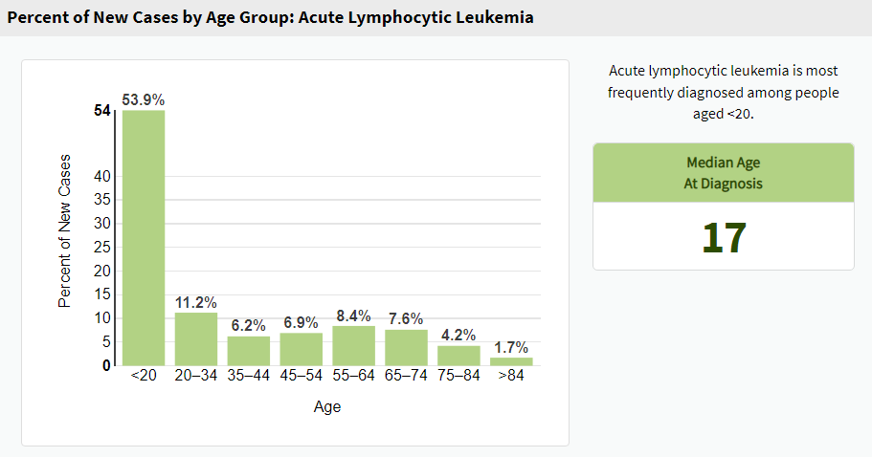
Acute Lymphoblastic Leukemia
Epidemiology and Etiology
Estimated 6,660 new cases and 1,560 deaths in 2022
5-year relative survival of 70.8% (2012–2018)
  Median age at death: 59 years
  <20 years: 87.6%
  ≥65 years: <20%
Etiology
Exposure to ionizing radiation, benzene, selected chemotherapy
Prior history of hematologic malignancy
Viral infections (e.g., human T-cell leukemia virus, Epstein-Barr virus)
Genetic syndromes (e.g., Down syndrome, Fanconi anemia, Bloom syndrome, Li-Fraumeni syndrome) are associated with an increased risk of acute myeloid leukemia (AML) and acute lymphoblastic leukemia (ALL)
Chronic autoimmune disease
13.5% diagnosed ≥65
https://seer.cancer.gov/statfacts/html/alyl.html; Bispo JAB, et al. Cold Spring Harb Perspect Med. 2020; Davis AS, et al. Am Fam Physician. 2014.
Notes:
Bispo, J. A. B., Pinheiro, P. S., & Kobetz, E. K. (2020). Epidemiology and Etiology of Leukemia and Lymphoma. Cold Spring Harb Perspect Med, 10(6). https://doi.org/10.1101/cshperspect.a034819
Davis, A. S., Viera, A. J., & Mead, M. D. (2014). Leukemia: an overview for primary care. Am Fam Physician, 89(9), 731-738.

Slide 14
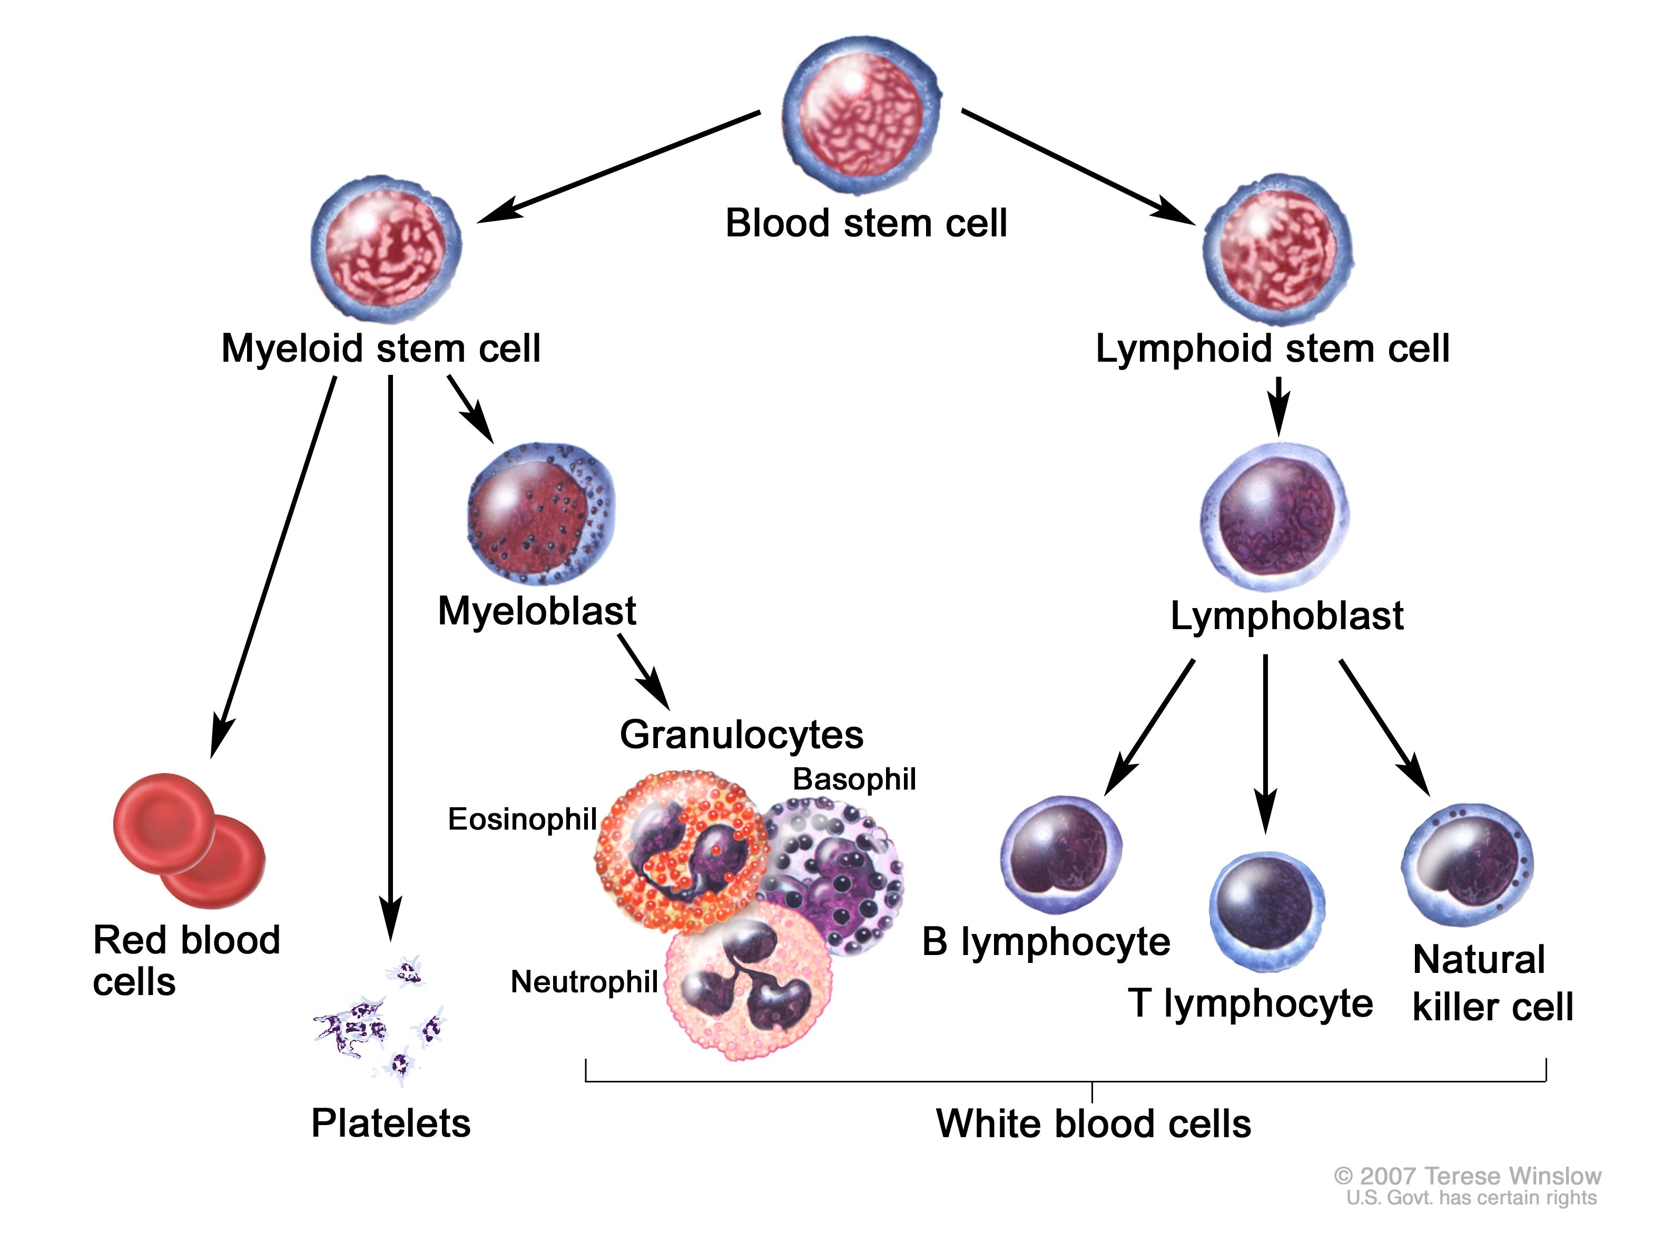
Acute Lymphoblastic Leukemia
Adult Disease Characteristics
 | B-Cell ALL | T-Cell ALL
Characteristics | 75%–80%% of adult cases | More favorable in adults with initial diagnosis; however, relapse is difficult to treat
 | Mature B-cell less favorable; treated with intense induction followed by allogeneic stem cell transplantation (SCT) | More commonly involves extra-medullary site
Immunophenotype | CD10, CD19, CD20, surface CD22, cytoplasmic CD22, cytoplasmic CD79a, cytoplasmic IgM, Pax5 | CD1a, CD2, cytoplasmic CD3, surface CD3, CD4, CD5, CD7, CD8
Jabbour E, et al. JAMA Oncol. 2018; Kurtin S. Semin Oncol Nurs. 2019; Figure from https://nci-media.cancer.gov/pdq/media/images/526538.jpg.
Notes:
Jabbour et al, JAMA Oncol. 2018;4(10):1413-1420. doi:10.1001/jamaoncol.2018.1915
Kurtin, S. (2019). Interdisciplinary Management of Acute Leukemia Across the Continuum of Care. Semin Oncol Nurs, 35(6), 150953. https://doi.org/10.1016/j.soncn.2019.150953

Slide 15
Lymphoblastic Lymphoma
Disease Characteristics
Lymphoblastic lymphoma (LBL) is a highly aggressive lymphoma that shares biological and morphological features with ALL
  Originates in either B-cells or T-cells
  Most common phenotype is T-cell
  Distinguished from ALL by having <20%–25% marrow infiltrating blasts
Lymphoblastic disorders in adults (100%)
90%
10%
Acute lymphoblastic leukemia, BM blasts >25%
Lymphoblastic lymphoma, BM blasts <25%
80%
20%
85%
15%
Considered a rare disease
  2%–4% of adult and <30% of children’s
  non-Hodgkin lymphomas
  Predominantly seen in young males (10–30 years)
Treatment is similar to ALL
Risk Factors
  Ataxia-telangiectasia, Nijmegen breakage syndrome, constitutional mismatch repair deficiency
  Human T-lymphotropic virus 1 (HTLV-1)
  Trisomy 21
  Other risk factors similar to ALL
B-cell
T-cell
T-cell
B-cell
Intermesoli T, et al. Curr Oncol Rep. 2022.
Notes:
Intermesoli, T., Weber, A., Leoncin, M., Frison, L., Skert, C., & Bassan, R. (2022). Lymphoblastic Lymphoma: a Concise Review. Curr Oncol Rep, 24(1), 1-12. https://doi.org/10.1007/s11912-021-01168-x

Slide 16
Adolescent and Young Adult/Adult ALL
Risk-stratified Treatment
ALL treatments represent one of the most complex
and intensive programs in cancer therapy.
  Initial treatment selection largely driven by:
  Age: adult, AYA*/adult, pediatric
  Fit vs frail (physiologic age)
  Eligibility for allogeneic stem cell transplant
  Goals of care
  Characteristics of the ALL
    T-cell vs B-cell
    Degree of leukocytosis
    Cytogenetic-molecular abnormalities (adult vs pediatric)
      Philadelphia chromosome (Ph)-positive ALL
        Unfavorable; 25% vs 3%
      Ph-like ALL
        Unfavorable; 20% vs 8%
      Hyperdiploidy
        Favorable; 2% vs 25%
      t(12;21)
        Favorable; 2% vs 25%
AYA, adolescent and young adult.
*The ALL panel considers AYA to be within the age range of 15–39 years.
NCCN Guidelines. Acute Lymphoblastic Leukemia. v2.2023.

Slide 17
Adolescent and Young Adult/Adult ALL
Risk-stratified Treatment
Risk Stratification
Ph+ ALL
(AYA and adult)
Ph-negative ALL
(AYA)
Ph-negative ALL
(Adult)
Ph+ AYA patients are grouped with fit, adult patients <65 years and relies on the addition of tyrosine kinase inhibitors that target BCR-ABL
Ph-negative ALL in AYA*/adult patients relies on multiagent pediatric regimens with a multiphase approach
  Induction
  Consolidation/intensification
  CNS treatment/prophylaxis
  Maintenance
Workup
Risk of relapse is related to:
  Achievement of minimal residual disease negativity following induction
  Incomplete therapy
  High-risk features
AYA, adolescent and young adult.
*The ALL panel considers AYA to be within the age range of 15–39 years.
NCCN Guidelines. Acute Lymphoblastic Leukemia. v2.2023.

Slide 18


Patient Case 1
28-Year-old Female with Lymphadenopathy
A 28-year-old female presents with progressive cervical and clavicular adenopathy over a 5-month period. No precipitating factors are reported, nor are night sweats or weight loss. She is initially treated with antibiotics.
A fine needle aspiration (FNA) of right cervical level II/III nodes is performed. Flow cytometry expressed TdT, cytoplasmic CD2, CD3, CD4, CD5. Findings are consistent with T-cell lymphoblastic lymphoma.
A CT of the chest/abdomen/pelvis finds multistation lymphadenopathy involving the bilateral cervical chain, bilateral supraclavicular, prevascular mediastinal, and bilateral axillary lymph nodes

Slide 19
Patient Case 1
28-Year-old Female with Lymphadenopathy
Further testing finds:
Bone marrow biopsy and aspirate
  Normocellular with trilineage hematopoiesis and 6.2% lymphoblasts
  Flow cytometry finds a small population of blasts with a T-cell phenotype is detected (CD2+, sCD3-, CD7+, CD5+, TDT+, cCD3+)
  Collective findings indicate low-level involvement by T-cell lymphoblastic lymphoma
Lumbar puncture (LP) with cytarabine 40 mg intrathecal (IT), flow cytometry negative
ECHO shows ejection fraction of 64%; no left or right ventricular dysfunction
HIV and hepatitis screens negative

Slide 20
A 28-year-old female is diagnosed with Ph-negative acute lymphoblastic leukemia. Which of the following is true regarding risk stratification and treatment choices for this patient?
She is classified as an adolescent/young adult and should be treated with a pediatric-based multi-agent regimen
She is classified as an adult and should be treated with a pediatric-based multi-agent regimen
She is classified as an adolescent/young adult and should be treated with a pediatric-based regimen that contains a tyrosine kinase inhibitor
The patient’s age does not matter as the recommended multi-agent regimens for adolescents/young adults and adults are the same for Ph-negative ALL
Notes:
Pre-test Question
Correct Answer: A

Slide 21
Common Multi-agent, Multi-phase Drug Regimens Used in Pediatric and AYA/Adult ALL
Induction
Most common: daunorubicin, vincristine, prednisone, asparaginase, methotrexate, dexamethasone, idarubicin May include rituximab in adult patients (hyper-CVAD regimen), may include nelarabine for T-cell ALL Ph+: add TKI—dasatinib, nilotinib, bosutinib, ponatinib (based on adverse event profile and mutational analyses) CNS prophylaxis is regimen specific (methotrexate, cytarabine) CNS treatment if positive at baseline—continued throughout induction, consolidation, and in maintenance
Consolidation
Cytarabine, etoposide, asparaginase, daunorubicin, vincristine, prednisone CNS-prophylaxis continued
Maintenance
6-mercaptopurine, 6-thioguanine, methotrexate, vincristine, prednisone
Targeted Therapies
Blinatumomab, inotuzumab
Cellular Therapies
CAR-T, allogeneic stem-cell transplant
NCCN Guidelines. Acute Lymphoblastic Leukemia. v2.2023.

Slide 22
Asparaginase in ALL/LBL
Asparaginase is a critical component of multi-agent ALL regimens
  Patients with lymphoblastic lymphoma benefit from multi-agent ALL regimens
Asparagine is one of twenty amino acids necessary for cell function and survival
Leukemic cells lack L-asparagine synthetase, required to make asparagine
Leukemic cells require exogenous asparagine for survival
Asparaginase lowers serum asparagine
  Hydrolyzing asparagine to aspartic acid and ammonia
  Leads to decreased protein synthesis in leukemic cells
  Eventual leukemic cell death via apoptosis
Continuous and prolonged asparagine depletion is associated with apoptosis of the leukemic clone
Incomplete therapy (<26 consecutive weeks of asparaginase) is associated with inferior outcomes in pediatric patients
Factors associated with suboptimal dosing of asparaginase
  Resistance
  Adverse events
  Underdosing
Juluri KR, et al. Blood Lymphat Cancer. 2022.
Notes:
Juluri, K. R., Siu, C., & Cassaday, R. D. (2022). Asparaginase in the Treatment of Acute Lymphoblastic Leukemia in Adults: Current Evidence and Place in Therapy. Blood Lymphat Cancer, 12, 55-79. https://doi.org/10.2147/blctt.S342052

Slide 23

Patient Case 1
28-Year-old Female with Lymphadenopathy
The patient is within the age range for AYA/adult-based treatment (age 15–39). She is started on the AALL0434 protocol (pediatric-based regimen).
Induction Regimen
Daunorubicin 25 mg/m² IV | Once per day; Days 1, 8, 15, 22
Vincristine 1.5 mg/m² IV (maximum dose of 2 mg/week) | Once per day; Days 1, 8, 15, 22
Pegaspargase 2,500 units/m² IV | Once; Day 4
Prednisone 30 mg/m² PO | Twice per day; Days 1 to 28
Consolidation
Nelarabine | Days 1–5
Cyclophosphamide | Day 8
Cytarabine | Days 8–11, 15–18
6MP | Days 8–21
Pegaspargase | Day 22
Vincristine | Days 22, 29
IT MTX | Days 18, 25
6MP, mercaptopurine; MTX, methotrexate.

Slide 24
Asparaginase Formulations
Formulation | Derived from E. coli | FDA-approved Indication | Half-life | Administration
Pegylated asparaginase (pegaspargase) | Yes | As a component of a multi-agent chemotherapeutic regimen for the treatment of pediatric and adult patients with: First-line ALL ALL and hypersensitivity to native forms of L-asparaginase | IM: 5.8 days IV: 5.3 days | Dose: 2,000–2,500 IU/m² Route: IM or IV Frequency: every 2 weeks
Erwinia asparaginase (asparaginase) (native)** | No | Treatment of patients with ALL as part of a multi-agent chemotherapeutic regimen | IM: 16 hours IV: 7.5 hours | Dose: 25,000 IU/m² Route: IM or IV Frequency: 3× a week
Calaspargase pegol-mknl | Yes | As a component of a multi-agent chemotherapeutic regimen for the treatment of ALL in pediatric and young adult patients age 1 month to 21 years | IV: 16.2 days | Dose: 2,500 IU/m² Route: IV Frequency: every 3 weeks
Erwinia chrysanthemi asparaginase-rywn (recombinant) | No | As a component of a multi-agent chemotherapeutic regimen given by intramuscular injection for the treatment of ALL and LBL in adult and pediatric patients 1 month or older who have developed hypersensitivity to E coli-derived asparaginase | IM: 18.2 hours | Dose: 25 mg/m² Route: IM Frequency: every 48 hours
**Non-recombinant asparaginase Erwinia chrysanthemi no longer available in U.S.
Maese L, et al. Blood. 2022; Vrooman LM, et al. J Clin Oncol. 2022;
Juluri KR, et al. Blood Lymphat Cancer. 2022; FDA Prescribing Information.
Notes:
ASPARLAS™ (calaspargase pegol – mknl) [package insert]. Boston, MA: Servier Pharmaceuticals; 2021.
ONCASPAR (pegaspargase) [package insert]. Boston, MA: Servier Pharmaceuticals; 2021.
ERWINAZE™ (asparaginase Erwinia chrysanthemi) [package insert]. Palo Alto, CA: Jazz Pharmaceuticals, Inc; 2019.
RYLAZE™ (asparaginase erwinia chrysanthemi (recombinant)-rywn) [package insert]. Palo Alto, CA: Jazz Pharmaceuticals; 2021.
Juluri, K. R., Siu, C., & Cassaday, R. D. (2022). Blood Lymphat Cancer, 12, 55-79

Slide 25
Incidence of Common
Adverse Events for Asparaginase
Adverse Event | All Grades (%) | Grade ≥3 (%)
Hypersensitivity | 7–22 | 4–10
Hyperbilirubinemia/↑LFTs | 86 | 24–39
Pancreatitis | 24 | 5–13
Hypertriglyceridemia | 77 | 11–51
Thrombosis |  | 11–27
Hypofibrinogenemia |  | 48–51
Hyperglycemia | 91 | 31–33
Aldoss I & Douer D. Blood. 2022; Maese L, et al. Front Pediatr. 2022.
Notes:
Aldoss, I., & Douer, D. (2020). How I treat the toxicities of pegasparaginase in adults with acute lymphoblastic leukemia. Blood, 135(13), 987-995. https://doi.org/10.1182/blood.2019002477

Slide 26
Risk Factors for Hypersensitivity to Asparaginase
Formulation of asparaginase
Route of administration
No premedication
Schedule of administration: second dose and future doses
HLA-DRB1 polymorphism
Younger age
Line of treatment
Concurrent use of other therapeutic agents including corticosteroids
Prior history of hypersensitivity to medications
Aldoss I, Douer D. Blood. 2020; Pourhassan H, et al. Curr Oncol Rep. 2022; NCCN Guidelines. Acute Lymphoblastic Leukemia. v2.2023.
Notes:
U.S. Department of Health and Human Services. (2017). Common Terminology Criteria for Adverse Events (CTCAE) Version 5.0. Retrieved from https://ctep.cancer.gov/protocolDevelopment/electronic_applications/ctc.htm
Aldoss, I., & Douer, D. (2020). How I treat the toxicities of pegasparaginase in adults with acute lymphoblastic leukemia. Blood, 135(13), 987-995. https://doi.org/10.1182/blood.2019002477

Slide 27
Adverse Event Prevention and Mitigation
Hypersensitivity
Prevention and management, general measures
  Premedication with histamine 1 (diphenhydramine, cetirizine), histamine 2 (famotidine), corticosteroid (hydrocortisone), and acetaminophen
  Slow the infusion for IV formulations for up to 2 hours
Treatment based on grade of infusion-related reaction
  Grade 1 or 2 without bronchospasm, hypotension, edema, or need for parenteral intervention (rash, flushing, urticaria, and drug fever ≥38°C) the asparaginase that caused the reaction may be continued, with consideration for anti-allergy premedication (such as hydrocortisone, famotidine or ranitidine, diphenhydramine, cetirizine, and acetaminophen).
  Grade 2 or higher systemic allergic reactions, urticaria, or anaphylaxis can be (but are not necessarily) associated with neutralizing antibodies and lack of efficacy.
  Grade ≥3 merit permanent discontinuation of the type of asparaginase that caused the reaction
    Erwinia formulations (erwinia, erwinia-rywn) may be used as a second-line agent in patients who have developed a systemic allergic reaction or anaphylaxis due to pegaspargase
Aldoss I, Douer D. Blood. 2020; Pourhassan H, et al. Curr Oncol Rep. 2022; NCCN Guidelines. Acute Lymphoblastic Leukemia. v2.2023;
U.S. Department of Health and Human Services. Common terminology criteria for adverse events (CTCAE). 2017.

Slide 28
Patient Case 2
35-Year-old Male with New Diagnosis of T-cell ALL
A 35-year-old male with newly diagnosed T-cell ALL has a history of hypertension, hyperlipidemia, and type 2 diabetes. He presented to the emergency department with chest pain and shortness of breath.
A chest CT shows a large mediastinal mass (15.5 × 9.4 × 10.7 cm), and biopsy confirms T-cell lymphoblastic leukemia/lymphoma. A US of the scrotum is negative for involvement.
A bone marrow biopsy finds T-lymphoblastic leukemia/lymphoma, with a blast count of 90%.
Started on Pediatric-based Regimen
IT cytarabine 100 mg | Day 0
Prednisone 30 mg/m² BID | Days 1–28
Vincristine 1.5 mg/m² | Days 1, 8, 15, 22
Daunorubicin 25 mg/m² | Days 1, 8, 15, 22
Pegaspargase 2,500 IU/m² IM | Day 4
IT MTX 15 mg | Days 8, 29
MTX, methotrexate;

Slide 29

Patient Case 2
35-Year-old Male with New Diagnosis of T-cell ALL
On Day 4 of a multi-agent regimen, the patient was given pegaspargase 2,500 IU/m² IV. He began having flushing of skin, coughing, chest pain, and trouble breathing when he was over halfway through the first administration of pegaspargase.
The pegaspargase infusion was discontinued, and his oxygen saturation decreased to 82%.
He was placed on oxygen and given IV diphenhydramine, hydrocortisone, and famotidine with incomplete resolution. Epinephrine 0.3 mg IM is given with gradual improvement.

Slide 30
What is an appropriate strategy to manage a patient who develops a grade 3 hypersensitivity reaction to pegaspargase?
Rechallenge with pegaspargase with addition of anti-allergy pre-medications
Discontinue asparaginase permanently
Rechallenge with an erwinia-based asparaginase formulation
Rechallenge patient with desensitization protocol for pegaspargase.
Notes:
C

Slide 31
Resistance to Asparaginase
Resistance to asparaginase may occur due to several factors:
Upregulation of asparagine synthetase
Production of neutralizing antibodies
  Results in removal of the protein
  Decreased therapeutic efficacy (often a result of hypersensitivity)
  Silent inactivation (not a result of hypersensitivity)
Measuring serum asparaginase activity (SAA) may be warranted when there are gaps in asparaginase therapy or in the setting of relapse
SAA-driven therapy is an emerging trend
  Included in NCCN guidelines
  Early adoption in Europe
  SAA is available as a CLIA-certified test with a turnaround time of less than 1 week
  Generally accepted SAA assay targets include a minimum trough of ≥0.1 IU/mL
  Data indicate that when SAA levels fall below 0.4 IU/mL, asparagine is no longer depleted and begins to rebound, suggesting an optimal trough of ≥0.4 IU/mL
van der Sluis IM, et al. Haematologica. 2016; NCCN Guidelines. Acute Lymphoblastic Leukemia. v2.2023.
Notes:
van der Sluis, I. M., Vrooman, L. M., Pieters, R., Baruchel, A., Escherich, G., Goulden, N., Mondelaers, V., Sanchez de Toledo, J., Rizzari, C., Silverman, L. B., & Whitlock, J. A. (2016). Consensus expert recommendations for identification and management of asparaginase hypersensitivity and silent inactivation. Haematologica, 101(3), 279-285. https://doi.org/10.3324/haematol.2015.137380

Slide 32
Treatment Decisions following Reaction to Asparaginase-based Therapy
Patient reaction to asparaginase
Characterize the reaction
based on available evidence
Clinical symptoms
Therapeutic drug monitoring
Previous asparaginase exposure
Anti-asparaginase antibody monitoring
Evidence of an infusion reaction
CTCAE grade 1
Flushing/rash/nausea
Patient’s first exposure
SAA >0.1 IU/mL
Elevated serum ammonia levels
Evidence unclear
CTCAE grade 2–4
Check SAA levels
Check serum ammonia levels
Evidence of HSRs
CTCAE grade 2–4
Systemic reaction
Patient has received multiple doses of asparaginase
Consider rechallenge with premedication
Continue to monitor SAA
Rechallenge with appropriate premedication
Decrease rate of infusion
Evaluate patient for hyperammonemia
Consider intervention with anti-ammonia agents
<10% of dose administered
Switch to asparaginase with different immunogenic profile
Monitor next dose if asparaginase therapy is continued
10%–50% of dose administered
Test SAA 3–5 days after dose
>50% of dose administered
Test SAA 4–7 days after dose
Burke MJ, Zalewska-Szewczyk B. Future Oncol. 2022.

Slide 33
Treatment Decisions following Reaction to Asparaginase-based Therapy
10%–50% of dose administered
Test SAA 3–5 days after dose
>50% of dose administered
Test SAA 4–7 days after dose
SAA <0.05 IU/mL
(inadequate activity)
Switch to asparaginase with different immunogenic profile
SAA ≥0.05 IU/mL
(acceptable activity)
Monitor asparaginase activity
Continue treatment and test SAA 7 days after first SAA test
Day 14 SAA <0.025 IU/mL (accelerated clearance)
Day 14 SAA 0.025–<0.1 IU/mL (accelerated clearance)
Day 14 SAA ≥0.1 IU/mL (accelerated activity)
First SAA was 0.05–<0.1 IU/mL
First SAA was <0.1 IU/mL
Switch to asparaginase with different immunogenic profile
Monitor next door; consider increasing asparaginase dose or switching
Continue asparaginase therapy
Burke MJ, Zalewska-Szewczyk B. Future Oncol. 2022.

Slide 34
Which of the following is true regarding the different asparaginase formulations?
Pegaspargase and erwinia-based formulations are derived from different bacterial sources and do not pose a risk for cross-reactivity
Patients developing any grade hypersensitivity reactions to first-line asparaginase therapy should discontinue therapy immediately and may not rechallenge with additional asparaginase-based therapies.
Measuring serum asparaginase activity (SAA) may be warranted when there are gaps in asparaginase therapy or in the setting of relapse
A and C
Notes:
Pre-test Question
Correct Answer: D

Slide 35
Adverse Event Profile for Asparaginase
Thromboembolism
Risk Factors | Prevention and management
Increasing age Obesity Mediastinal mass at diagnosis Low white blood cell count at diagnosis | Evaluate history of thrombosis Monitor symptoms closely, particularly for implanted central catheters Avoid replacement with cryoprecipitate to correct laboratory abnormalities in the absence of clinical bleed Maintain adequate platelet counts while patient is receiving anticoagulation
Non-CNS Thrombosis
Grade ≥2 or thromboembolic event, hold asparaginase until resolved and treat with appropriate antithrombotic therapy Low–molecular weight heparin or direct oral anticoagulant for 3 months (longer if still at risk) Upon resolution of symptoms and if antithrombotic therapy is stable or completed, consider resuming asparaginase Consider checking antithrombin III levels if administering heparin
CNS Thrombosis, Ischemia, or Stroke
For grade ≤3 or less, if symptoms/signs fully resolve, consider resuming asparaginase at lower doses and/or longer intervals between doses Grade 4, permanently discontinue asparaginase Consider antithrombotic therapy
Aldoss I, Douer D. Blood. 2020; Pourhassan H, et al. Curr Oncol Rep. 2022; NCCN Guidelines. Acute Lymphoblastic Leukemia. v2.2023.

Slide 36

Patient Case 1
28-Year-old Female with Lymphadenopathy
The patient is within the age range for AYA/adult-based treatment (age 15–39). She is started on AALL0434 protocol (pediatric-based regimen).
Induction Regimen
Daunorubicin 25 mg/m² IV | Once per day; Days 1, 8, 15, 22
Vincristine 1.5 mg/m² IV (maximum dose of 2 mg/week) | Once per day; Days 1, 8, 15, 22
Pegaspargase 2,500 units/m² IV | Once; Day 4
Prednisone 30 mg/m² PO | Twice per day; Days 1 to 28
Consolidation
Nelarabine | Days 1–5
Cyclophosphamide | Day 8
Cytarabine | Days 8–11, 15–18
6MP | Days 8–21
Pegaspargase | Day 22
Vincristine | Days 22, 29
IT MTX | Days 18, 25
She presents to clinic for a follow-up visit with complaints of right arm pain and swelling. She has a PICC line in the right arm that was placed during her hospital stay. A doppler US reveals a catheter-related deep venous thrombosis involving the right subclavian to right brachial vein.

Slide 37
How would you manage a patient on a pegaspargase treatment regimen that develops a grade 2 PICC-related thrombosis?
Admit for heparin infusion, chest CT to rule out pulmonary embolism (PE), and discontinue asparaginase
Start low–molecular weight heparin, transition to direct oral anticoagulant, chest CT, and discontinue asparaginase permanently
Start low–molecular weight heparin, transition to direct oral anticoagulant, chest CT, and resume asparaginase once symptoms resolve
Admit for heparin infusion, transition to direct oral anticoagulant, and continue asparaginase
Notes:
Pre-test Question
Correct Answer: C

Slide 38
Patient Case 1
28-Year-old Female with Lymphadenopathy
She is started on low–molecular weight heparin and then transitioned to a direct oral anticoagulant. A chest CT is negative for pulmonary emboli.
The PICC line is removed, and her swelling and pain improve.
She is restarted on asparaginase with continued anticoagulation using DOAC and low–molecular weight heparin based on platelet counts.
Labs Tuesday/Friday (CBC, CMP, fibrinogen, triglycerides, LDH, and amylase, lipase) with possible transfusion.

Slide 39
Adverse Event Profile for Asparaginase
Hyperbilirubinemia and Transaminitis
Hepatotoxicity is the most common adverse effect of pegaspargase in adults (reported in 24%–39% of adults treated with pediatric regimens)
Transaminitis in adults is common (all grade at 93%; grade ≥3 at 50%)
Risk Factors
Induction cycle Older age Obesity Higher dose of asparaginase Low albumin Low platelet count CC genotype of rs4880 polymorphism
Incidence and Duration
Almost always reversible Most common after initial dose Time to onset after administration of pegaspargase to grade ≥3 hyperbilirubinemia is ~2 weeks Median to resolution to grade 1 may be up to 4 weeks after administration of pegaspargase Generally, resolves and does not recur after initial dosing Grade ≥3 hepatotoxicity is low with Erwinia-derived asparaginase but no data support switching to Erwinia-derived asparaginase for hepatotoxicity
Prevention and Management
Hold drugs with known hepatotoxicity/primary liver metabolism Delay the next chemotherapy cycle until hyperbilirubinemia resolves to grade 1 and transaminitis is grade ≤2
Aldoss I, Douer D. Blood. 2020; Pourhassan H, et al. Curr Oncol Rep. 2022; NCCN Guidelines. Acute Lymphoblastic Leukemia. v2.2023;
U.S. Department of Health and Human Services. Common terminology criteria for adverse events (CTCAE). 2017.

Slide 40
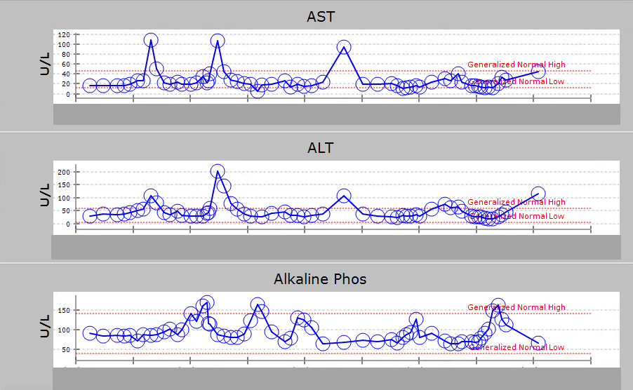
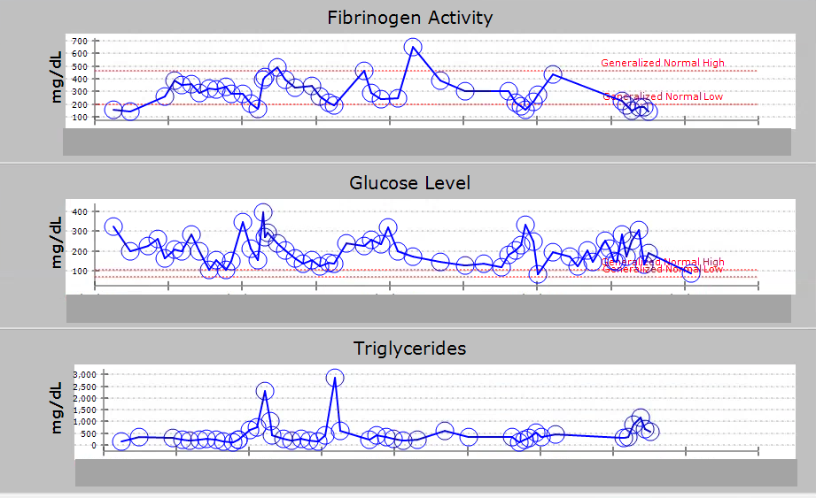
Patient Case 2
35-Year-old Male with New Diagnosis of T-cell ALL
Pegaspargase is discontinued permanently due to grade 3 infusion reaction/hypersensitivity. The patient is rechallenged with an erwinia asparaginase formulation (asparaginase Erwinia chrysanthemi-rywn) as a part of a multi-agent-regimen-drug shortage.
Pegaspargase
Erwinia (native)
Erwinia (recombinant)
Pegaspargase
Erwinia (native)
Erwinia (recombinant)

Slide 41
Adverse Event Profile for Asparaginase Pancreatitis
Risk factors
  Older age
  Native American ancestry
  High cumulative doses of asparaginase (≥240,000 U/m²)
  Asparaginase formulation
Prevention and management
  Treatment of pancreatitis
  Grade 2: enzyme elevation; radiologic findings only
    Hold asparaginase until enzyme levels or radiologic findings resolve
  Grade ≥3: severe pain, vomiting, medical intervention indicated; grade 4: life-threatening consequences, urgent intervention indicated
    Permanently discontinue asparaginase
Aldoss I, Douer D. Blood. 2020; Pourhassan H, et al. Curr Oncol Rep. 2022; NCCN Guidelines. Acute Lymphoblastic Leukemia. v2.2023;
U.S. Department of Health and Human Services. Common terminology criteria for adverse events (CTCAE). 2017.

Slide 42
Adverse Event Profile for Asparaginase
Hypofibrinogenemia/Hemorrhage
Risk factors
  Unknown
Prevention and management
  Not an indication to discontinue pegasparagase
  Monitor PT/PTT, fibrinogen levels prior to each dose of treatment
  Prophylactic replacement for fibrinogen levels below 50 mg/dL or during active bleeding or before procedures
  Avoid concurrent anticoagulation, monitor patients closely when anticoagulation is necessary
  Monitor for concurrent thrombocytopenia
Aldoss I, Douer D. Blood. 2020; Pourhassan H, et al. Curr Oncol Rep. 2022; NCCN Guidelines. Acute Lymphoblastic Leukemia. v2.2023.

Slide 43
Adverse Event Profile for Asparaginase
Hypertriglyceridemia
Risk factors
  More frequent during consolidation cycles
  Increased body mass index
  Younger age inverse association with increased age
  Pre-existing hypertriglyceridemia
Prevention and management
  Evaluate and treat other causes of underlying hypertriglyceridemia
  Generally, resolves spontaneously and quickly
  Because hypertriglyceridemia is a risk factor for pancreatitis and because both toxicities can occur post-asparaginase, clinicians may wish to treat hypertriglyceridemia to avoid pancreatitis
  Treatment/prevention with gemfibrozil or other fibrates, particularly for high-grade triglyceridemia (>1,000 mg/dL)
 | Triglyceride Levels | Management
Grade ≤3 | >500–1,000 mg/dL; >5.7–11.4 mmol/L | Continue asparaginase without interruption or dose adjustment
Grade 4 | >1,000 mg/dL; >11.4 mmol/L; life-threatening consequences | Hold asparaginase and resume when normalized
Aldoss I, Douer D. Blood. 2020; Pourhassan H, et al. Curr Oncol Rep. 2022; NCCN Guidelines. Acute Lymphoblastic Leukemia. v2.2023;
U.S. Department of Health and Human Services. Common terminology criteria for adverse events (CTCAE). 2017.

Slide 44
Adverse Event Profile for Asparaginase
Hyperglycemia
Risk factors
  Pre-existing diabetes or hyperglycemia
  Concurrent use of corticosteroids
Prevention and management
  Dietary restriction of simple sugars
  Adjustment of antidiabetic medications
  Continue asparaginase for grade ≤2 toxicity
  Hold asparaginase and glucocorticoids for grade ≥3 toxicity
    Grade 3: insulin therapy initiated; hospitalization indicated
    Grade 4: life-threatening consequences; urgent intervention indicated
  Insulin therapy should be initiated to achieve glycemic control
  Asparaginase can be continued if normal glucose levels are achieved with insulin (<200 mg/dL or 11 mmol/L)
Aldoss I, Douer D. Blood. 2020; Pourhassan H, et al. Curr Oncol Rep. 2022; NCCN Guidelines. Acute Lymphoblastic Leukemia. v2.2023;
U.S. Department of Health and Human Services. Common terminology criteria for adverse events (CTCAE). 2017.

Slide 45
Adverse Event Profile for Asparaginase
Hyperammonemia
Risk factors
  Already existing liver disease
Prevention and management (not well studied)
  Decreased protein intake
  Lactulose treatment
  Benzoic acid
  Arginine
  Sodium phenylbutyrate
Aldoss I, Douer D. Blood. 2020; Pourhassan H, et al. Curr Oncol Rep. 2022; NCCN Guidelines. Acute Lymphoblastic Leukemia. v2.2023.

Slide 46
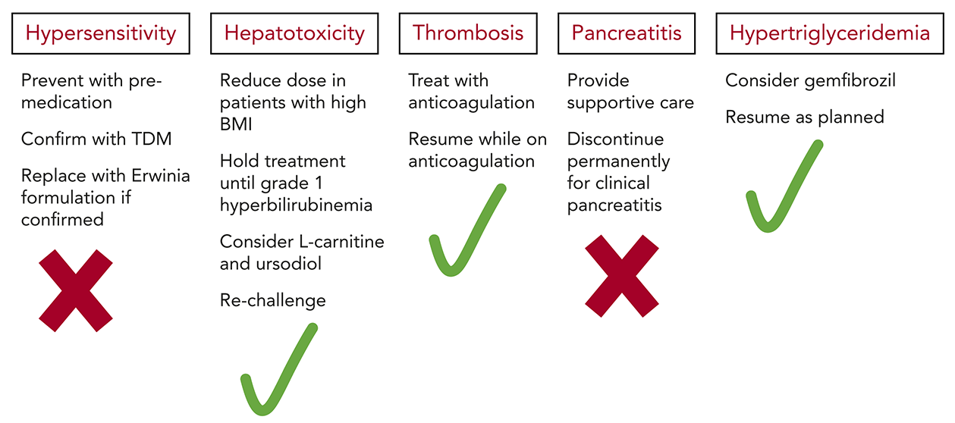
Pegaspariginase Toxicity in Adults
Aldoss I, Douer D. Blood. 2020.

Slide 47
Key Takeaways
Asparaginase plays a critical role in pediatric-inspired multi-agent regimens used to treat ALL and LBL
Although associated with unique toxicities, the majority are nonfatal, manageable, and reversible
Newer formulations of asparaginase offer alternatives to continuing asparaginase treatment
Familiarity with each formulation and consideration of prevention and management strategies is essential to optimizing therapy

Slide 48
How to Collect Credit for this Activity
To receive ANCC credit, scan the QR code to complete the evaluation online.
Participants can print their certificate or statement of credit immediately.
New to Creative Educational Concepts? You will need to create an account before you can claim credit.
Please go to: https://www.ceconcepts.com/

Slide 49
Efficacy and Safety of Asparaginase-containing Treatment Regimens in ALL/LBL and Beyond
INTERACTIVE REVIEW FOR ONCOLOGY NURSES AND NURSE PRACITIONERS

