Slide 1


Slide 2
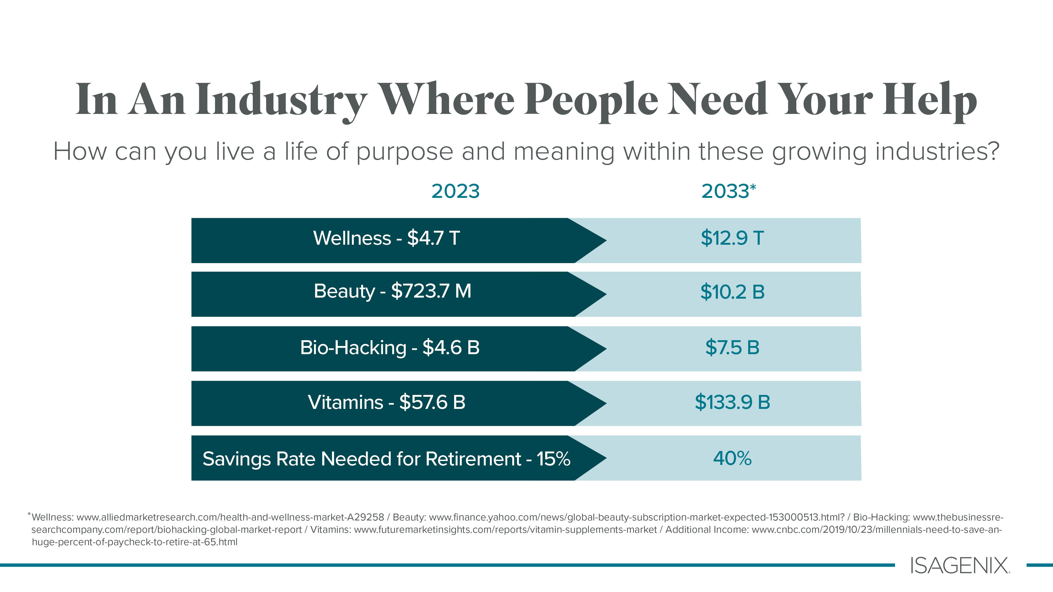

Slide 3


Slide 4


Slide 5




AND WHY?

Slide 6


Slide 7


Slide 8

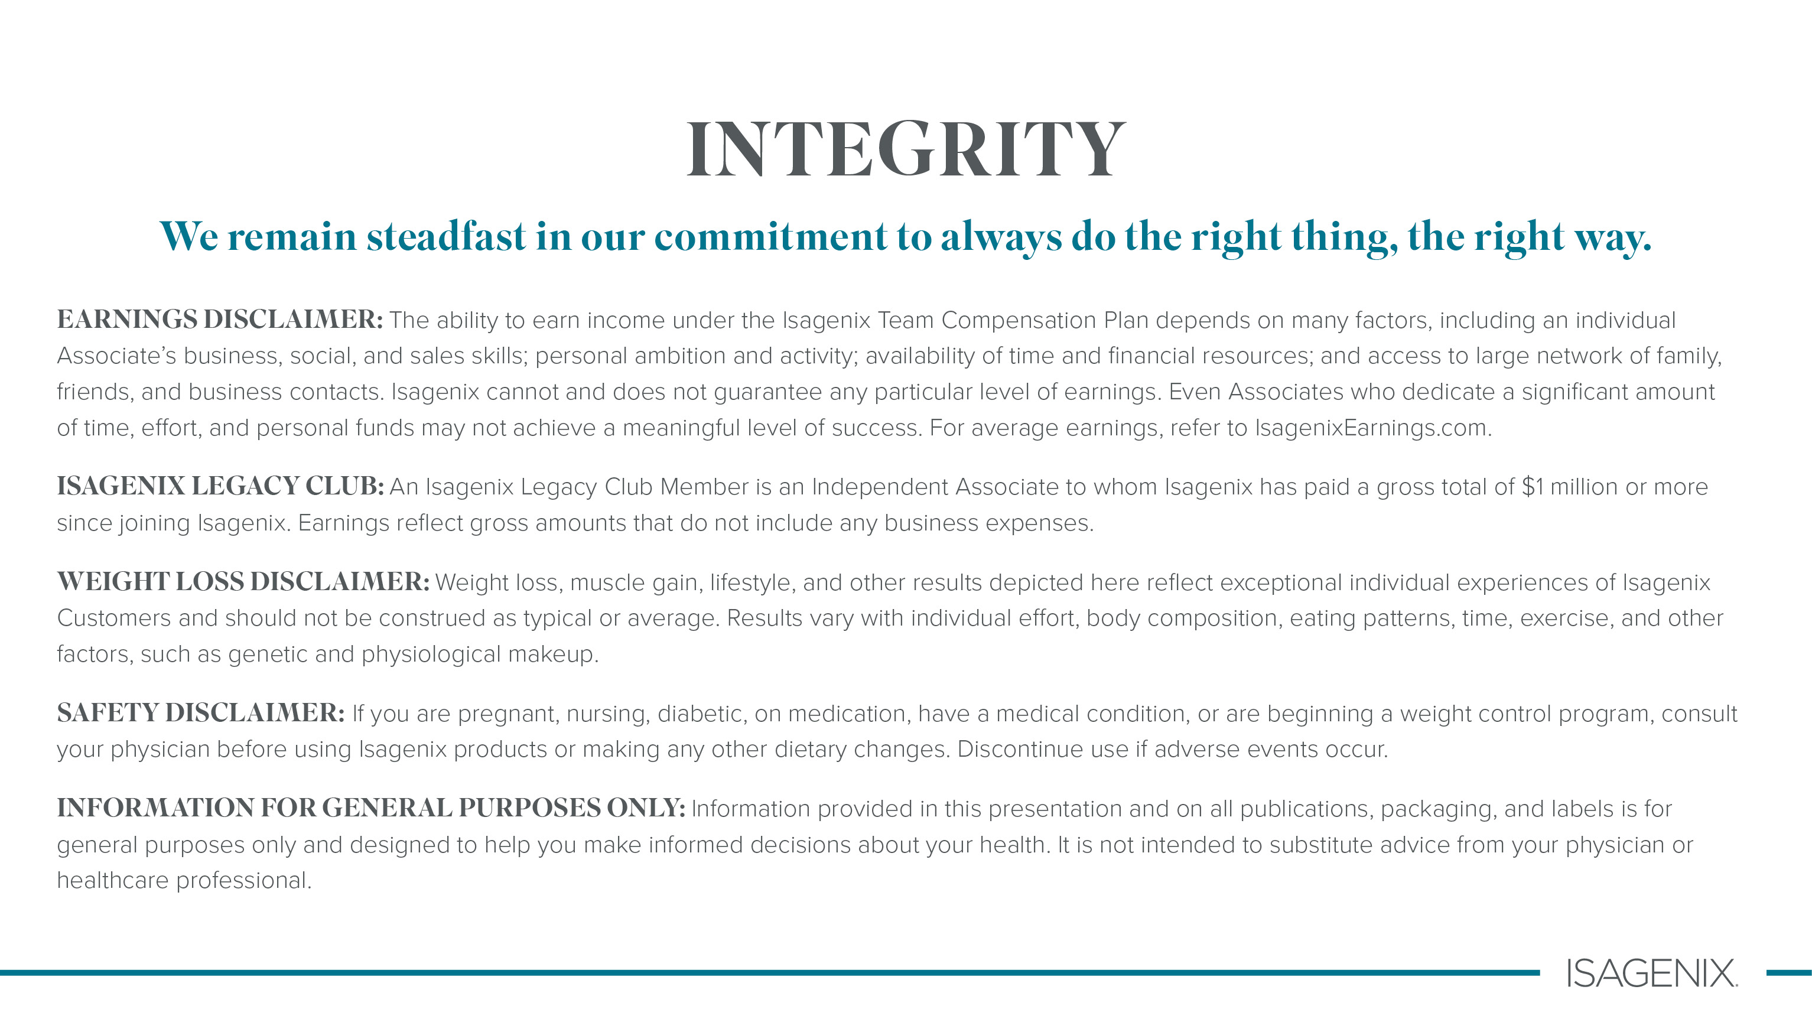


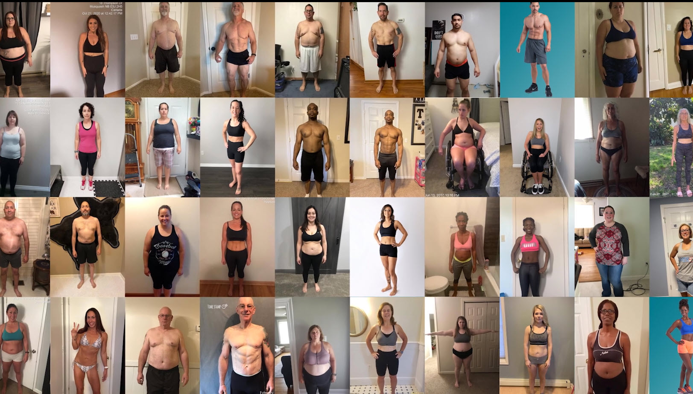


Imagine Your Ideal Life
If you want to feel better,
Isagenix can help with that.
1
YOUR OWN VIRTUAL STORE
AND WHY?
    No Storefront necessary
    No Employees
    Minimal Investment (other than reclaiming your health)
    Proven system with:
    Trainings
    Events
    Marketing
    Social media support
Real Individuals,
Real results.

Slide 9


Slide 10


Slide 11


Slide 12
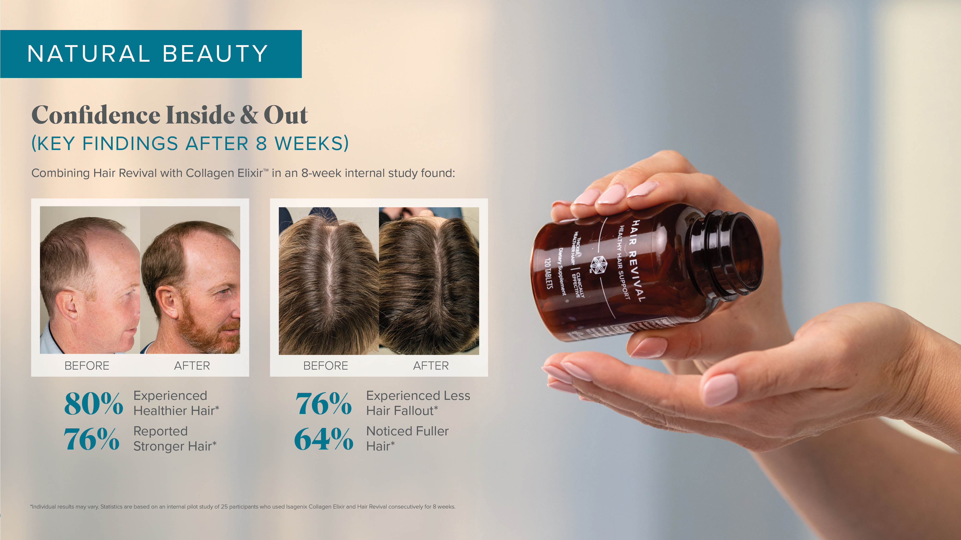

Slide 13


Slide 14
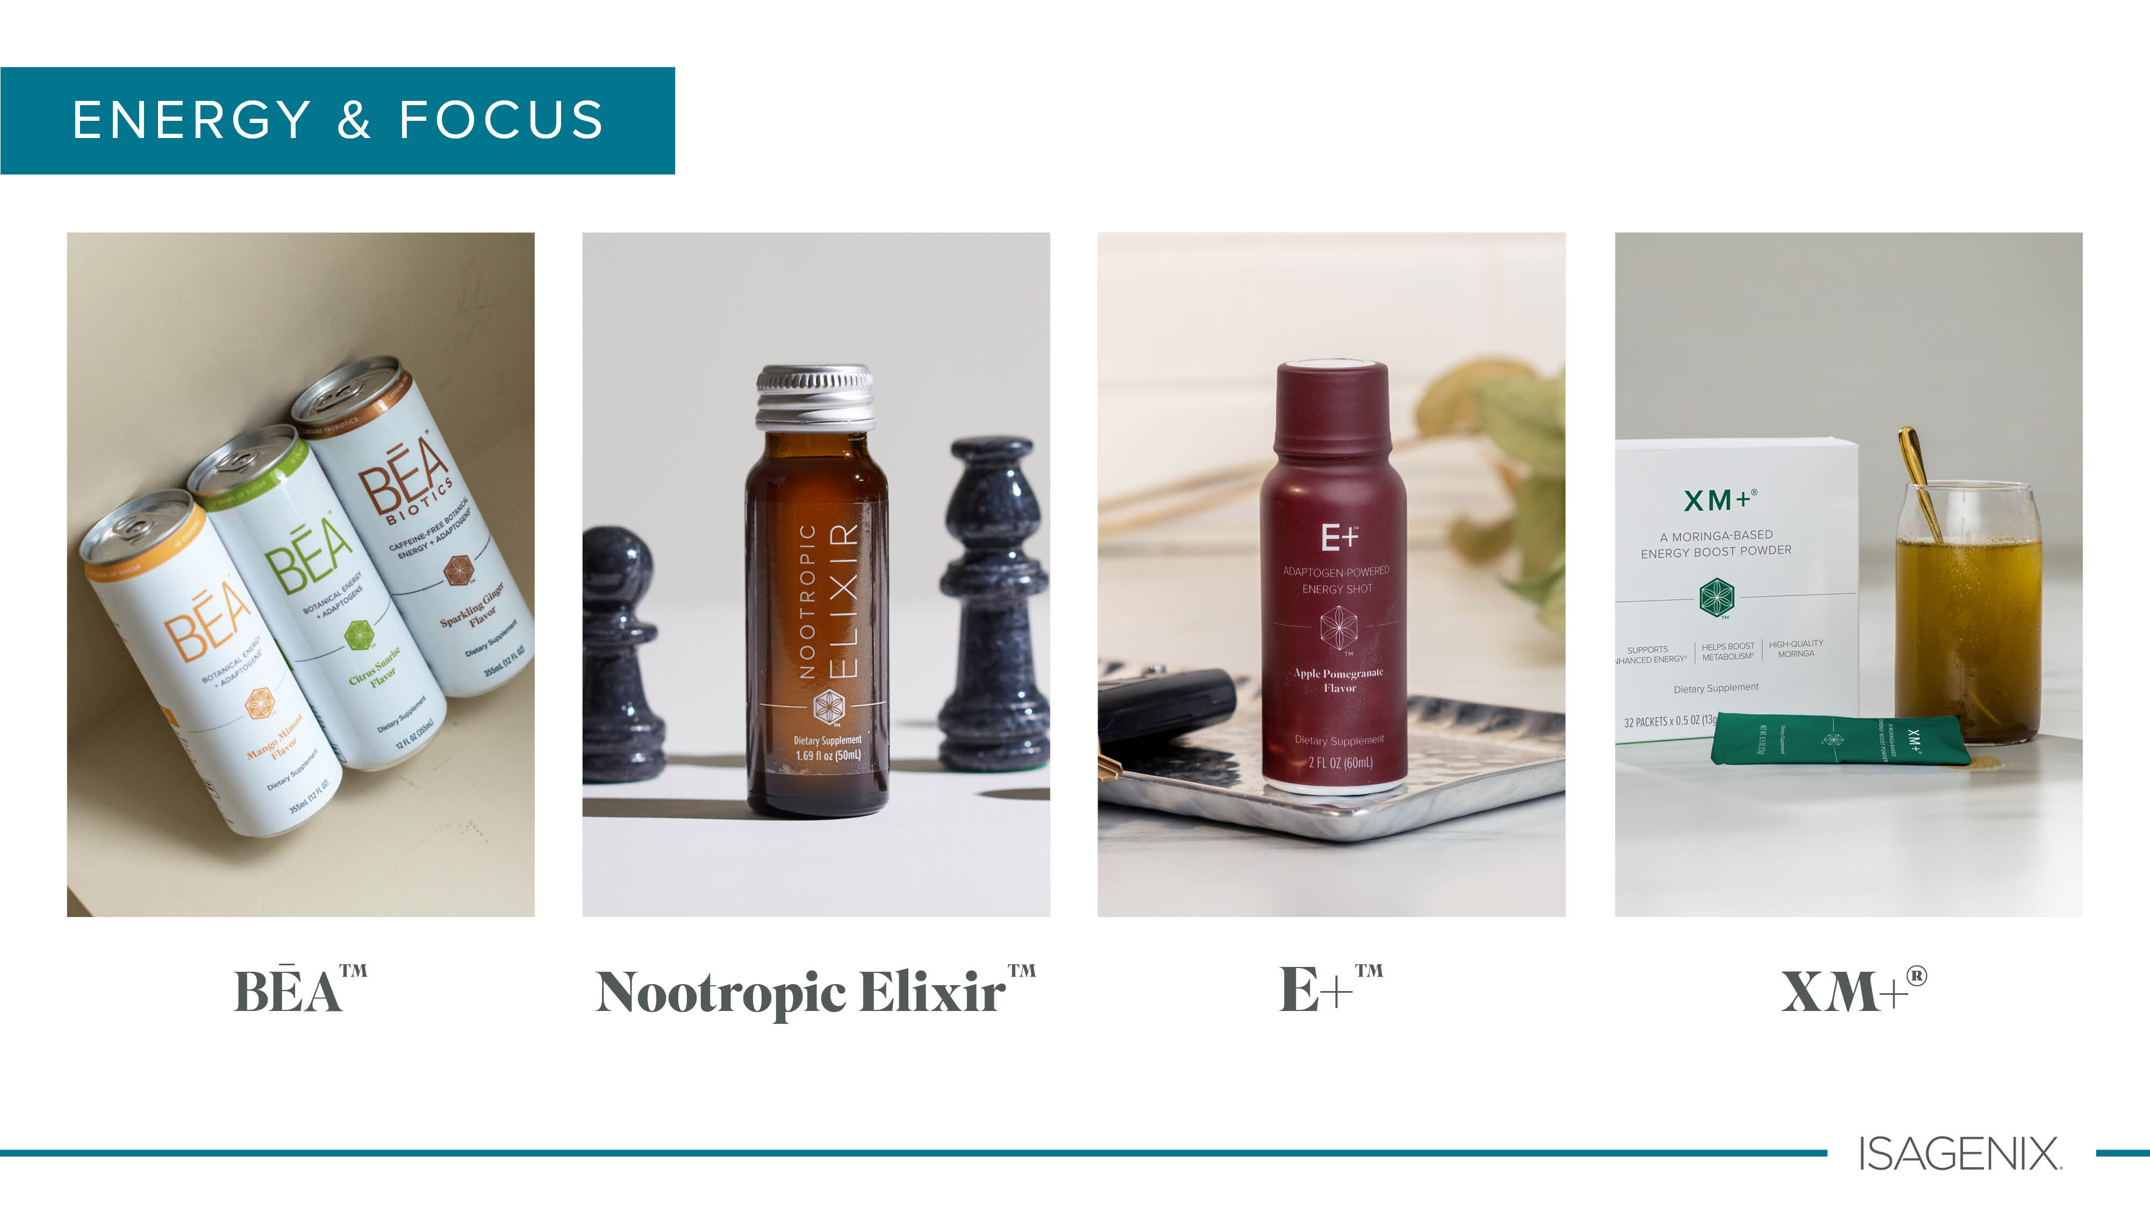

Slide 15


Slide 16


Slide 17


Slide 18
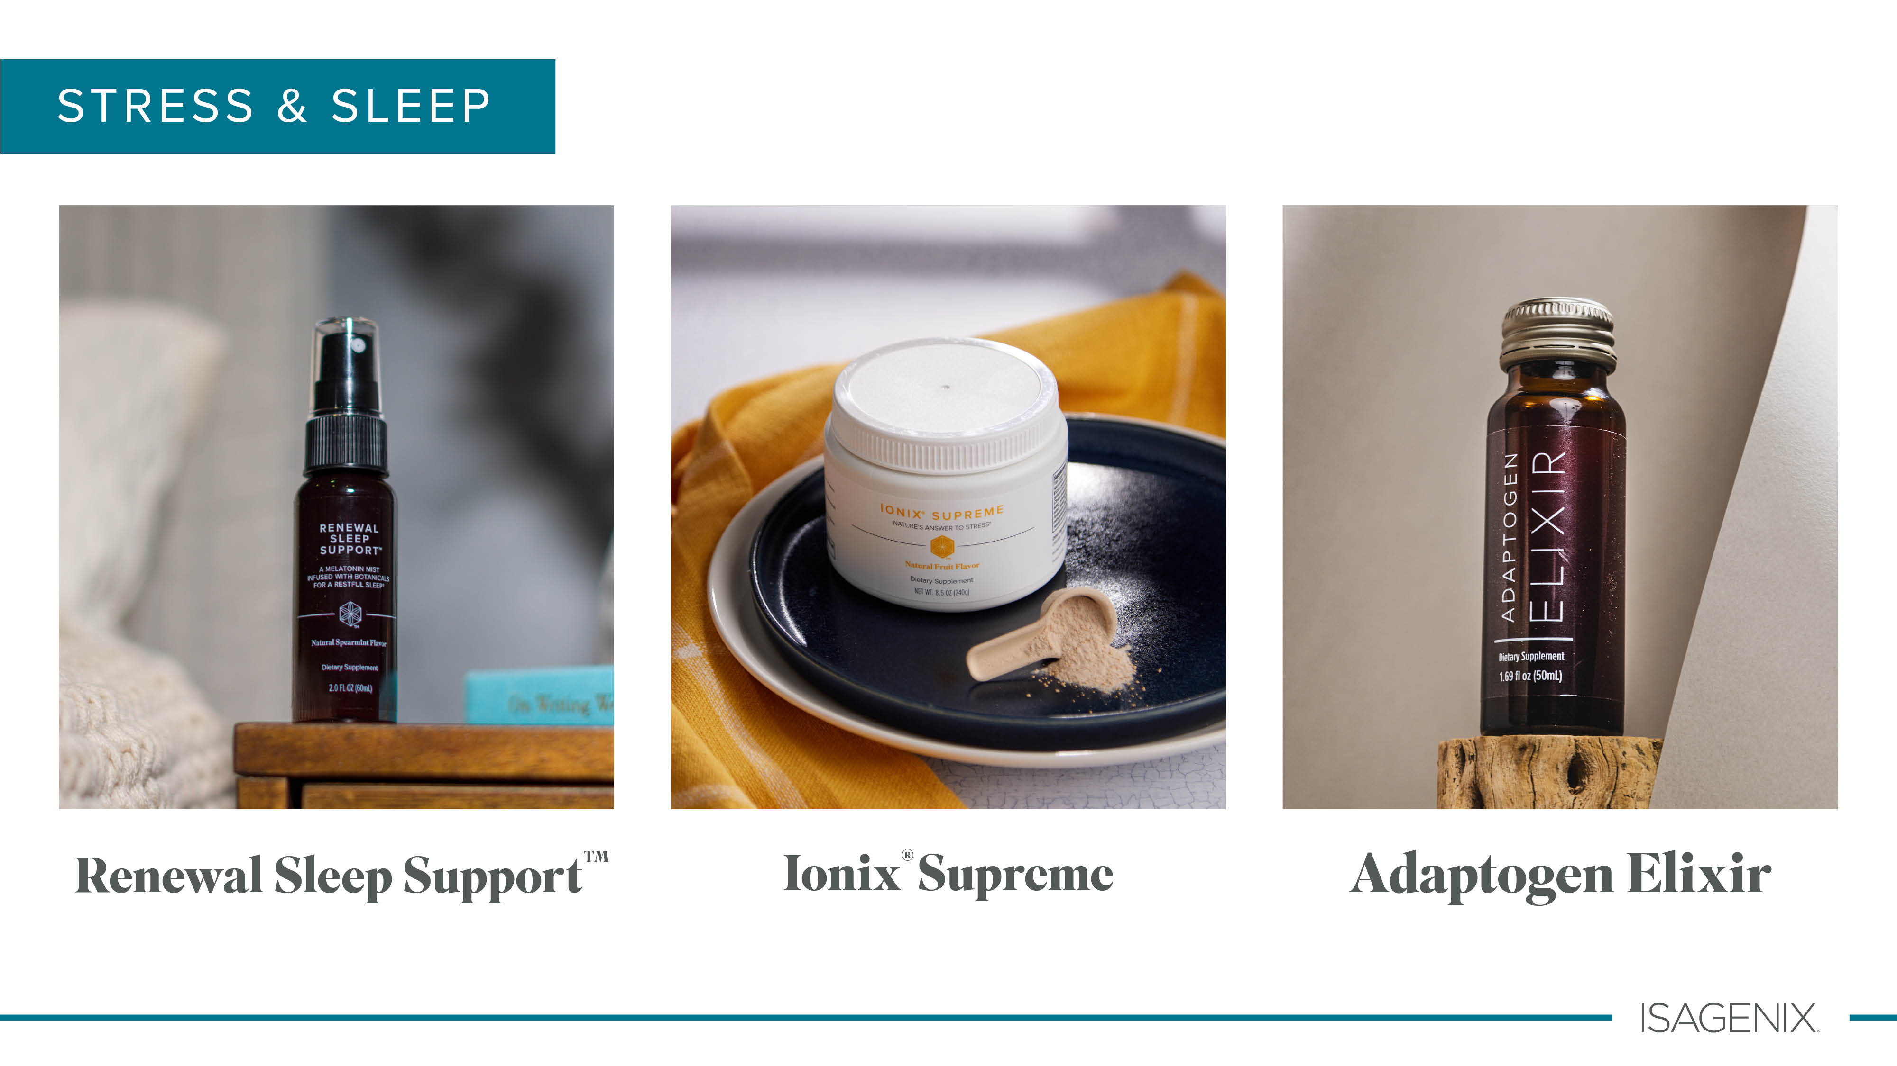

Slide 19


Slide 20

AND WHY?
PAIN RELIEF
PAIN RELIEF

Slide 21



PuraPlant 21
AND WHY?

Slide 22

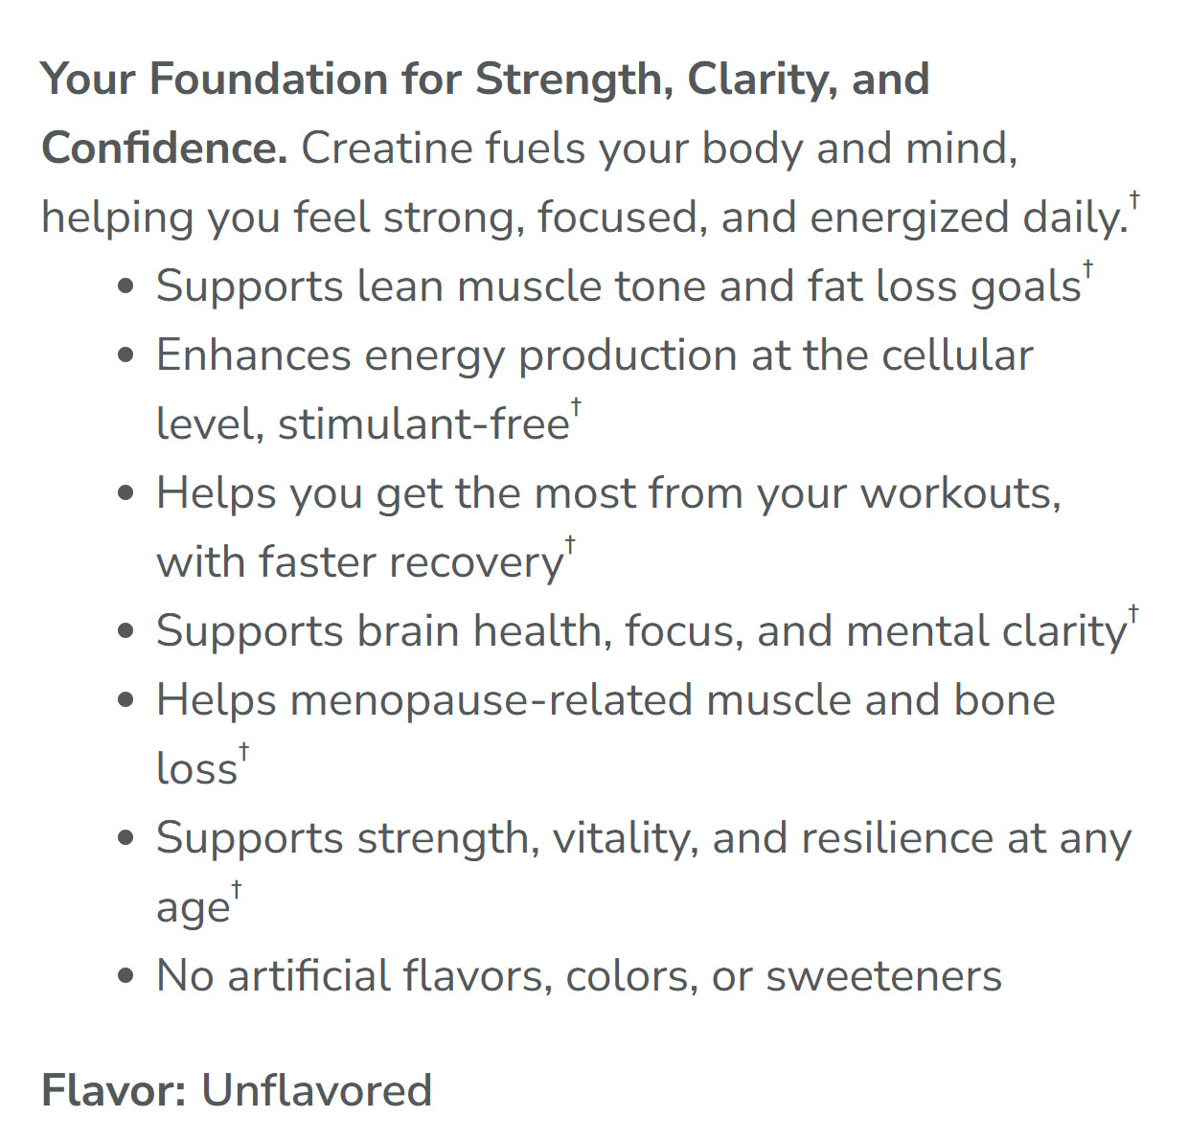
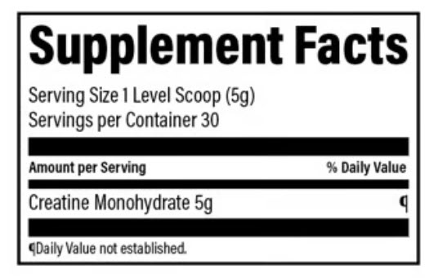
CREATINE
AND WHY?

Slide 23
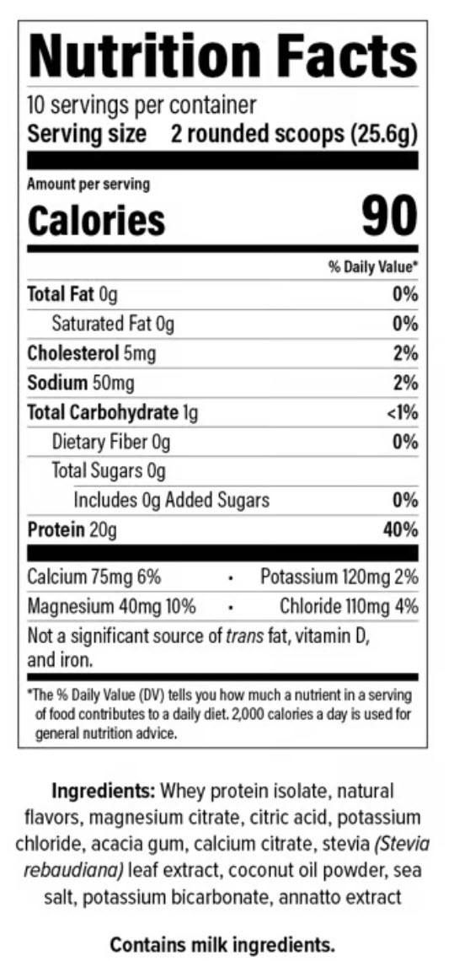

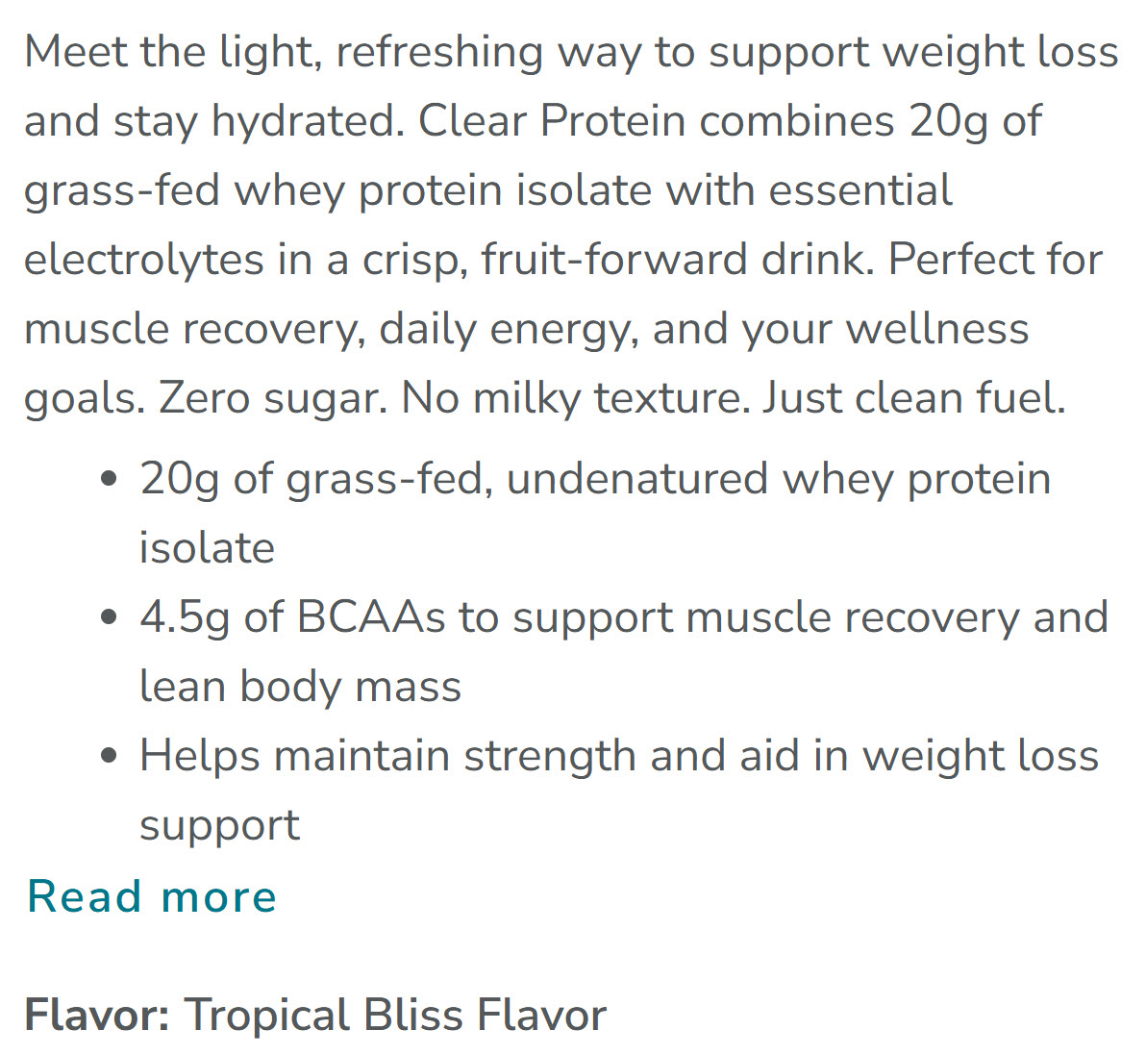
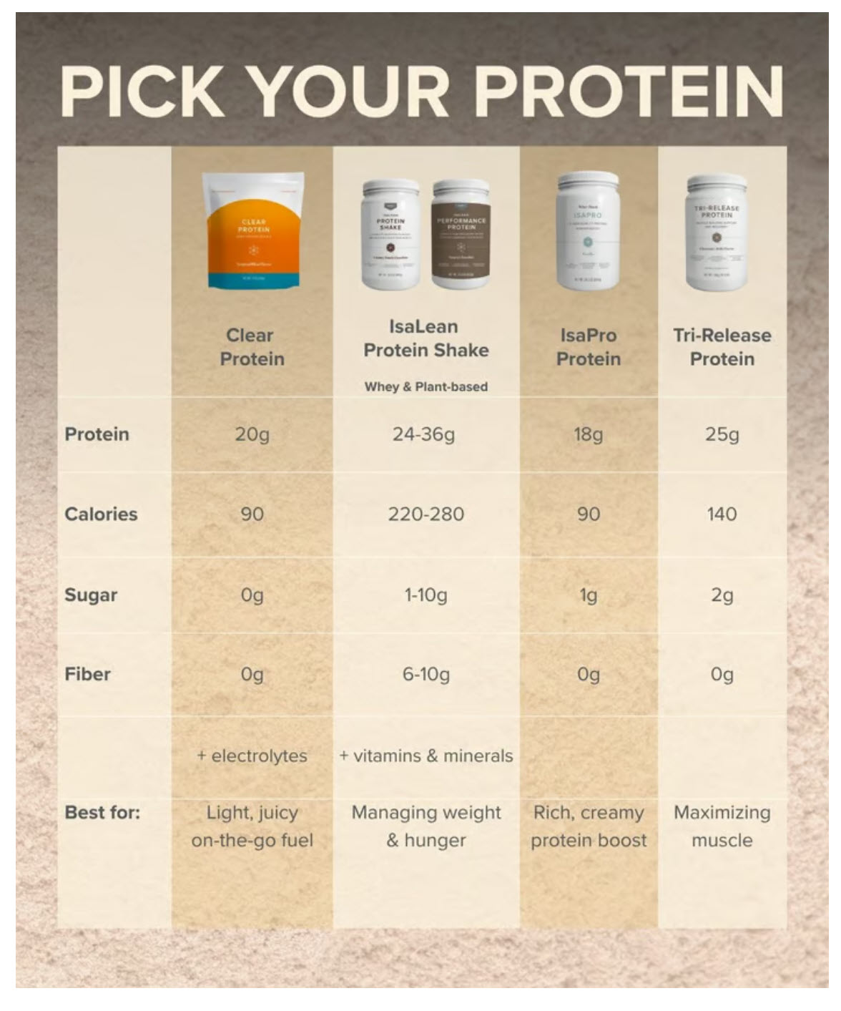
CLEAR PROTEIN
AND WHY?

Slide 24


Harmonia
AND WHY?

Slide 25


Slide 26
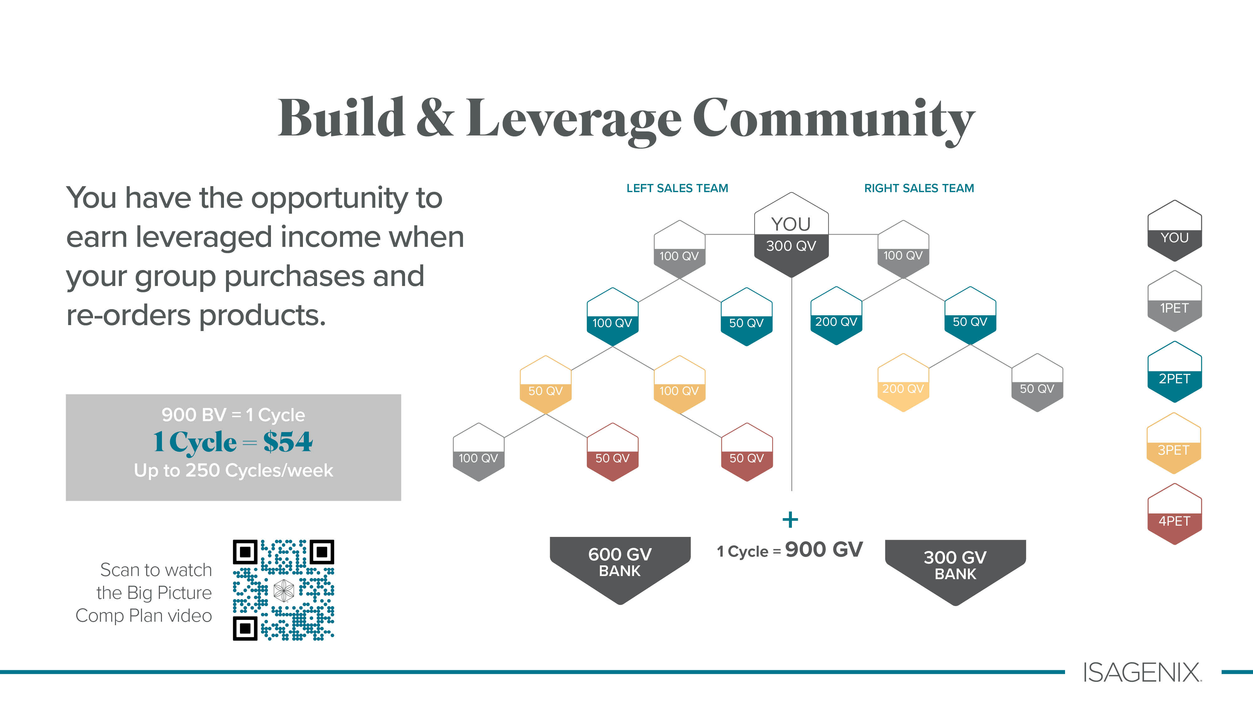
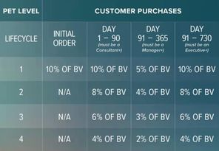
900 BV = 1 Cycle
Up to 250 Cycles/week
1 Cycle = $54
1 Cycle = $54

Slide 27
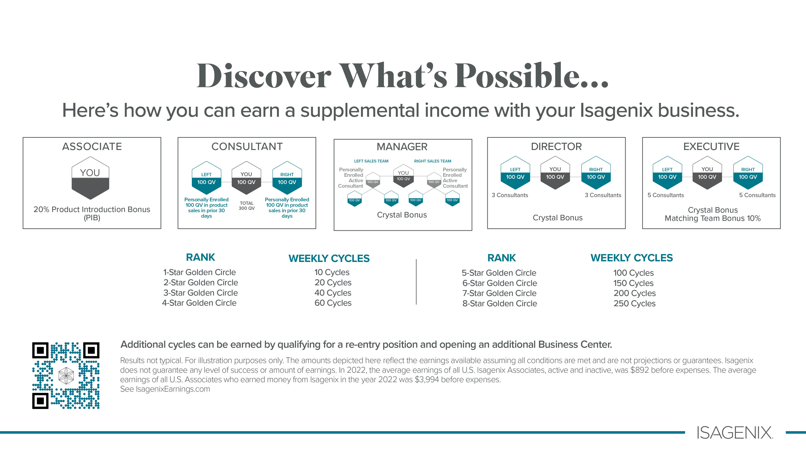
= $540
= $5,400
= $1,080
= $8,100
= $2,160
= $10,800
= $3,240
= $13,500

Slide 28

$29

Slide 29




56 MEALS
AND WHY?
1 Supermix
30 Bottles of Collagen
1 Supermix
1 Natural Accelerator
1 Isa Flush
Total $161.00 + Tax
100 BV
$330 + Tax
BV 198
Total $253.00 + Tax
159 BV
$320 + Tax
BV 198
All Packages are priced with a subscription.

Slide 30




$179.00 BV 110 (with Subscription)
$250.00 BV 157 (with Subscription)

Slide 31

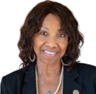

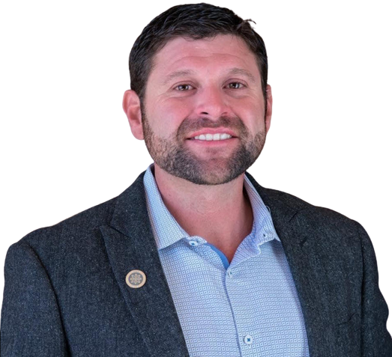
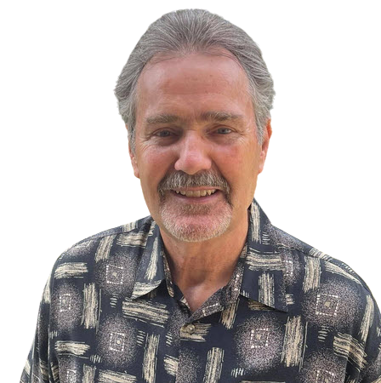
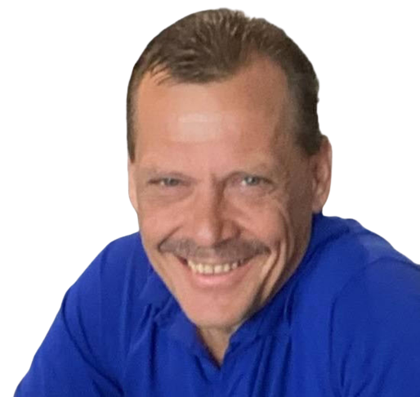
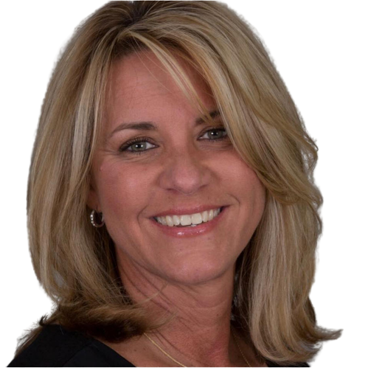
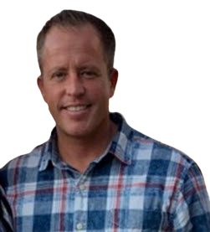
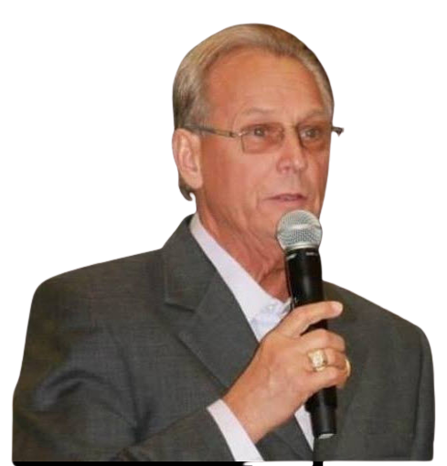
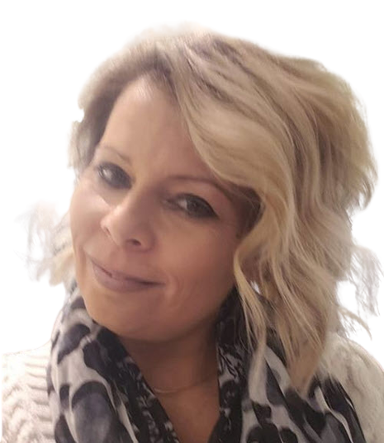
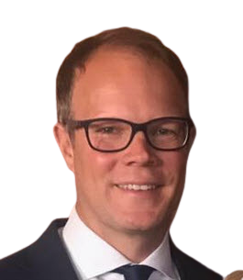
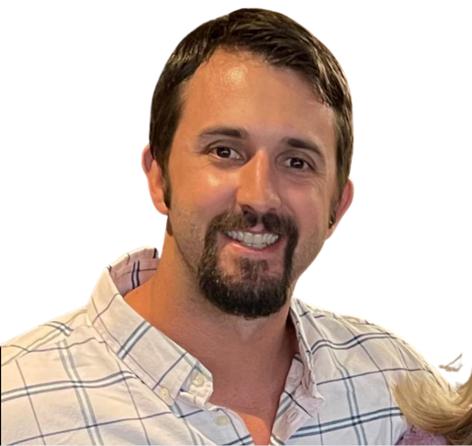
MEET THE FOUNDERS
Dr. Jerry Brown
Tommy Chapa
Ruth Claybrooks
Tom Waggoner
Rich Miller
THE LEGACY DEVELOPMENT GROUP
We are a collective of top earning individuals
in the direct selling industry, some of which have been together for 30 years.
Founding members have all earned millions, some tens of millions of dollars
and have helped people all over the world with building residual income. It
is important to note that none of these people have ever quit a direct
selling company ever! They have now found themselves in a unique position. United as
one group to build at their final company, Isagenix International. They are going to help people
all over the world build and secure substantial walk away incomes for their family and leave
a LEGACY.
JoAnne McMahon
Mike Chorost
Bob DeCant
Carrie Kimball Chorost
Joel McNinch
Landon Weaver

Slide 32


Slide 33
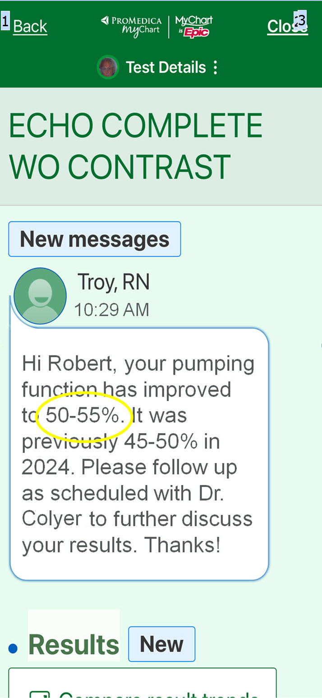
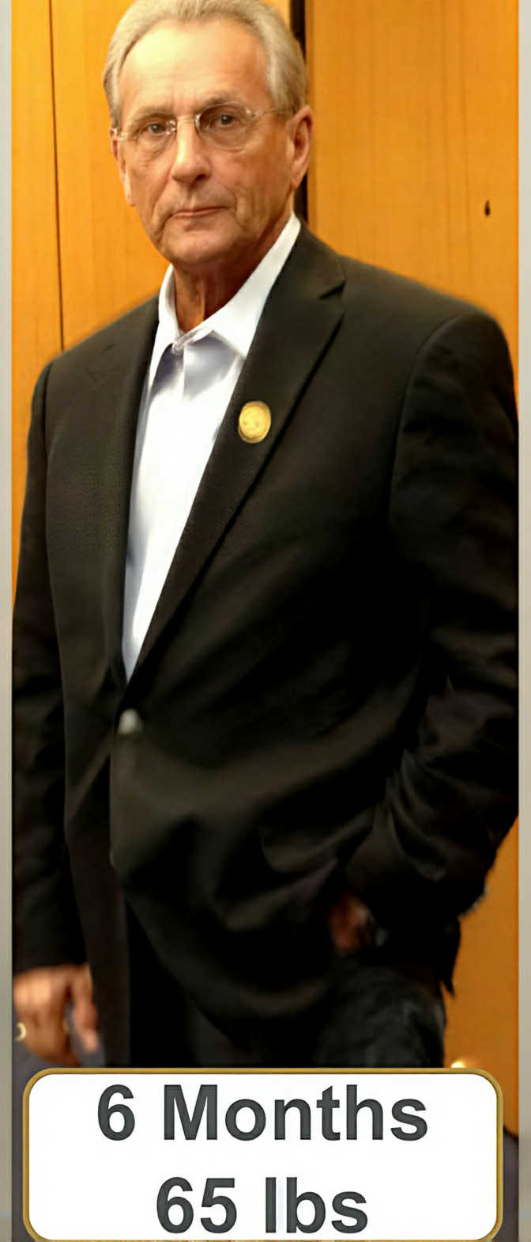
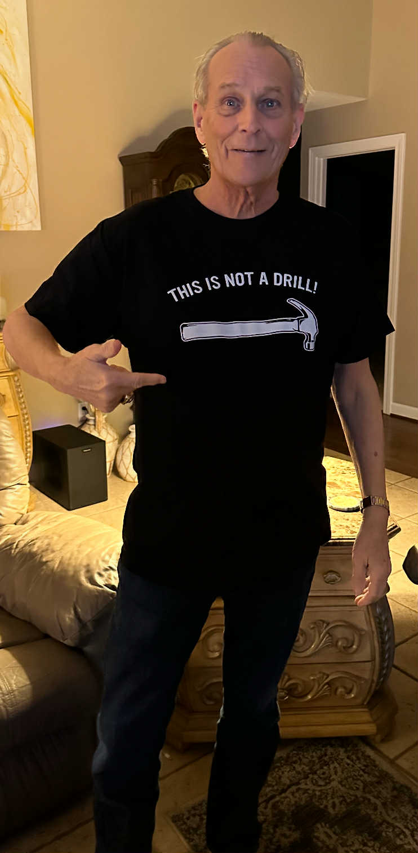
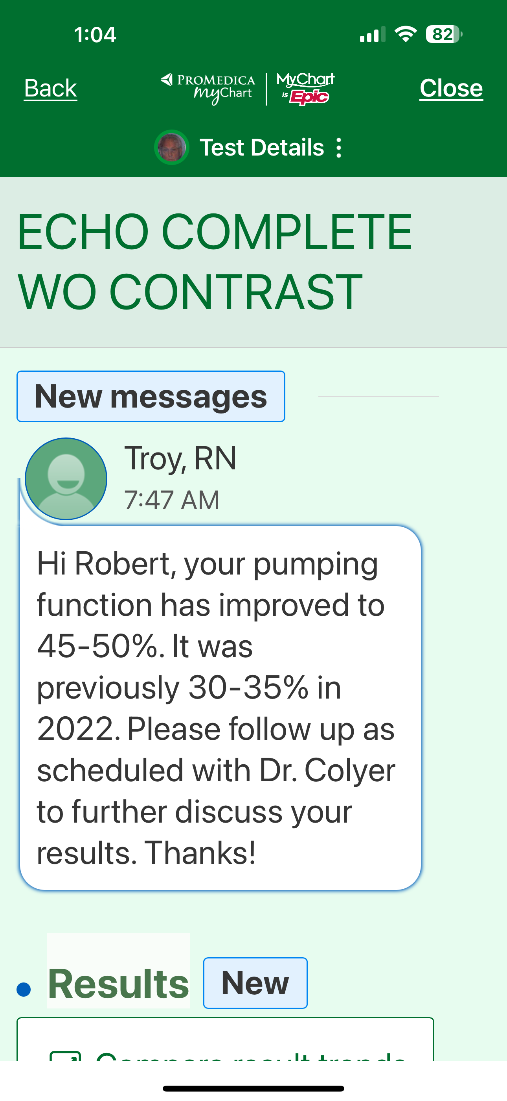
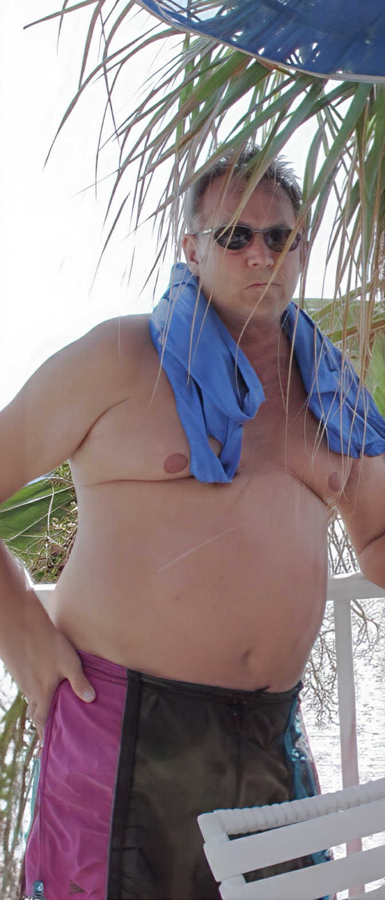
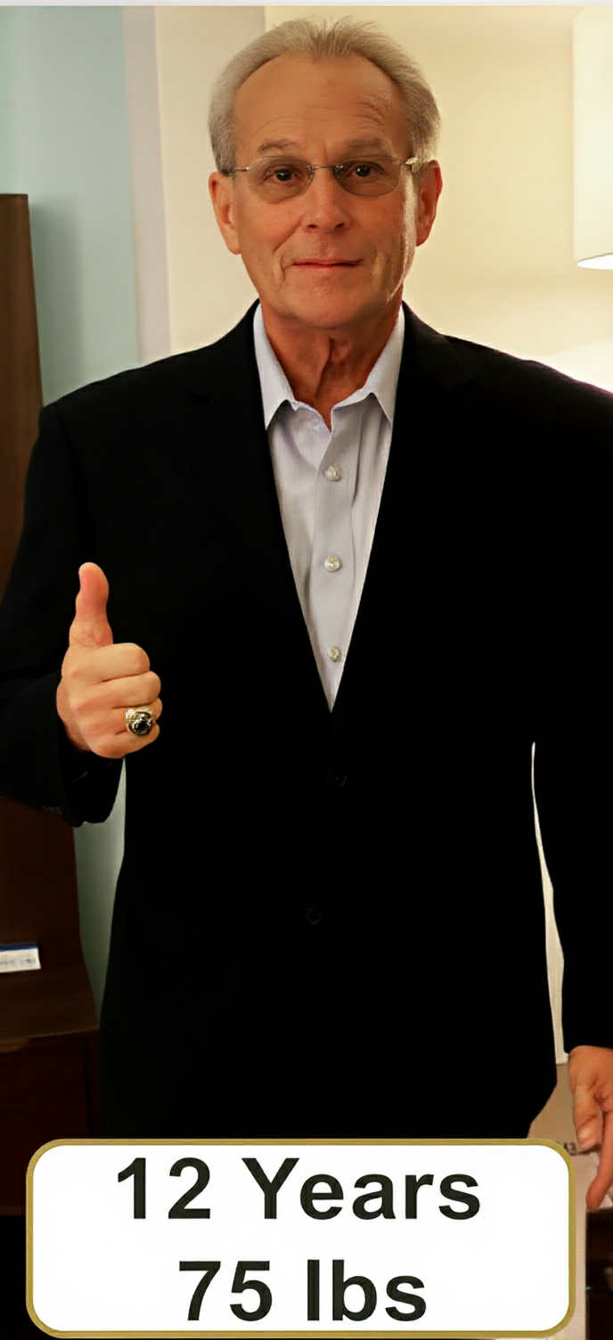
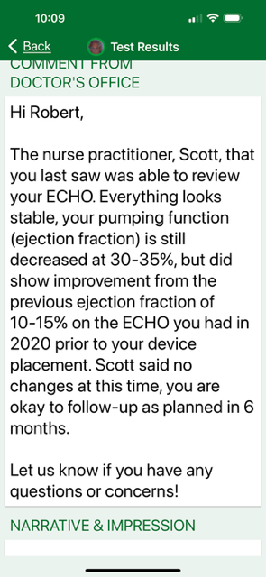
Date 05/05/2022
13 Years
95 lbs

Slide 34
