Slide 1
The Battle for the American Horse
Equine Welfare Alliance

Slide 2
What is the American horse?
Disposable commodity ?
or a
Trusting companion?

Slide 3
You don’t know who you are up against!

Slide 4
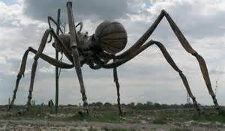
Who are we up against?
Big Ag
The Horse Slaughter Industry
Tapinoma sessile
Unfortunately… it has friends!
(~ $100 M per year)

Slide 6
Who Profits from Horse Slaughter?
Slaughter
Houses
Auctions
Racing
Rodeo
Kill Buyers
AQHA
Breeders

Slide 7
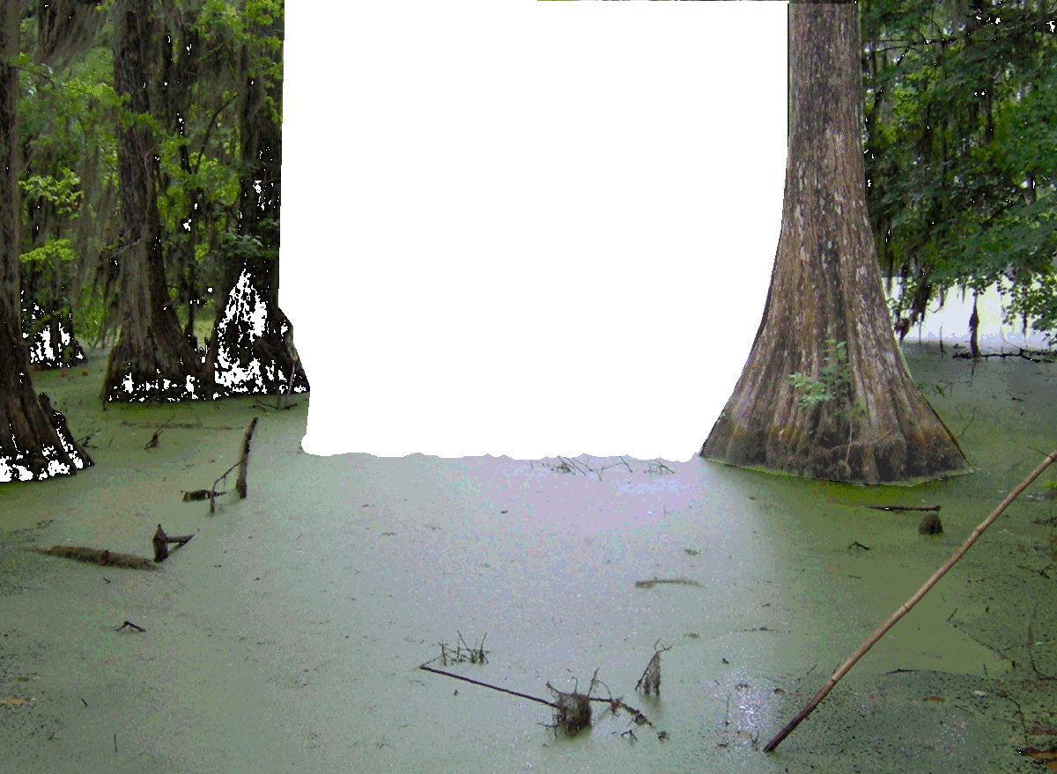
Who is in charge?
Charles Stenholm of
Olsson, Frank and Weeda
Sue Wallis
Dave Duquette

Slide 8
How important is horse slaughter to the horse industry?

Slide 9
Slaughter Strategy
Use gate keepers to block legislation
Develop talking points and repeat them
Use front organizations for credibility
Fill the media with phony abandonment stories
Use GAO to regain credibility
Leverage GAO report to reinstate inspections
Introduce legislation in agricultural states

Slide 10
A brief history of famous gate keepers

Slide 11
107th Congress Rep. Bob Goodlatte blocks HR 857

Slide 12
110th Congress Sen. Larry Craig blocks S 311

Slide 13
112th Congress Senator Max Baucus

Slide 14
Pro-slaughter Talking Points
Call slaughtered horses “unwanted”
Talk about old, lame and dangerous horses
Claim slaughter prevents abuse and neglect
Claim “ban” has made things worse
Call slaughter euthanasia, harvesting
Claim there is no place to bury horses
Talk about feeding horse meat to the starving
Warn of infringement of property rights

Slide 15
Our Strategy
Investigate and document every aspect of horse slaughter
Research all factors bearing on horse care
Investigate and counter media falsehoods with documented evidence
Warn horse meat consumers about health issues
Warn communities of cost of having a slaughter plant
Earn media trust as a platinum source of information
Educate grass roots volunteers to become effective at all of the above

Slide 16
Does slaughter really reduce abuse?

Slide 17
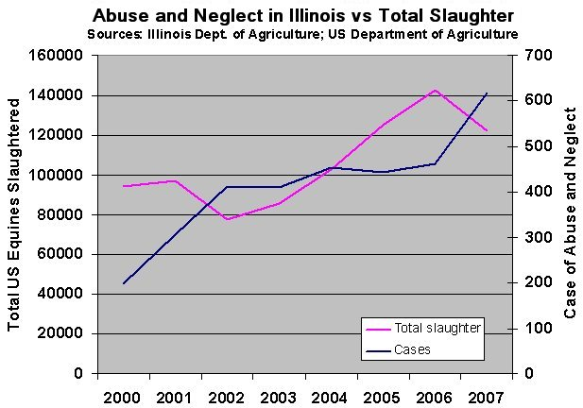

Slide 18
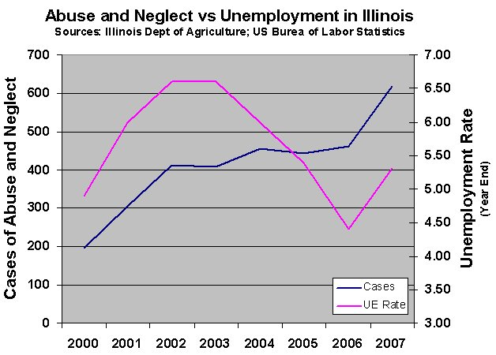

Slide 19
Poking fun at absurdity

Slide 20
Horse Harvesting

Slide 21
Bob Goodlatte explained to the media why we must have horse slaughter
"Millions of cats and dogs are humanely euthanized each year. But disposal of unwanted horses is not as simple as disposal of unwanted cats and dogs. It's illegal in many states to bury horses because they are vectors for West Nile virus.” – Rep. Bob Goodlatte

Slide 22
So if you look out at Dobbin’s grave and see this, remember Bob warned us!

Slide 23
Are slaughter horses really old, sick and lame?

Slide 24
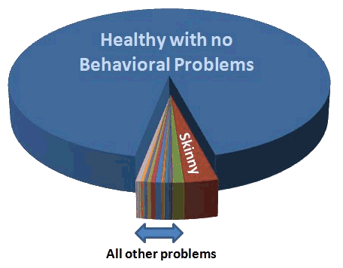
Example: Temple Grandin findings on horses arriving at slaughter.

Slide 25
The GAO Report

Slide 26
First paragraph of “what the GAO found”
Since domestic horse slaughter ceased in 2007, the slaughter horse market has shifted to Canada and Mexico. From 2006 through 2010, U.S. horse exports for slaughter increased by 148 and 660 percent to Canada and Mexico, respectively. As a result, nearly the same number of U.S. horses was transported to Canada and Mexico for slaughter in 2010—nearly 138,000—as was slaughtered before domestic slaughter ceased.

Slide 27
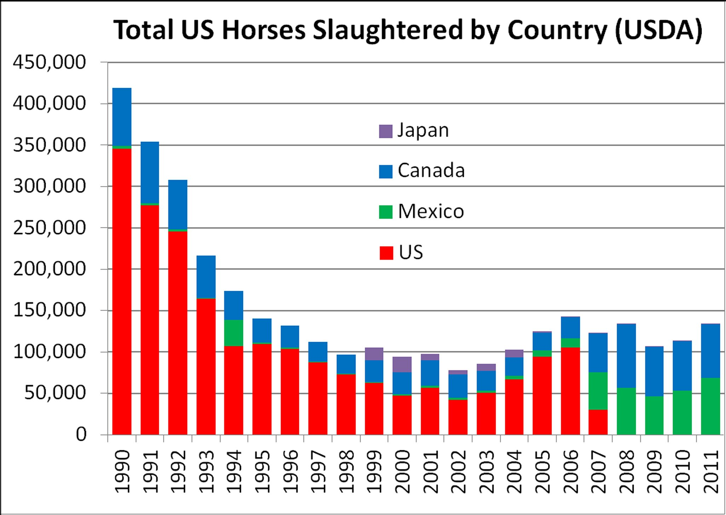

Slide 28
Second paragraph of “what the GAO found”
“State, local, tribal, and horse industry officials generally attributed these increases in neglect and abandonments to cessation of domestic slaughter and the economic downturn. Others, including representatives from some animal welfare organizations, questioned the relevance of cessation of slaughter to these problems.”

Slide 29
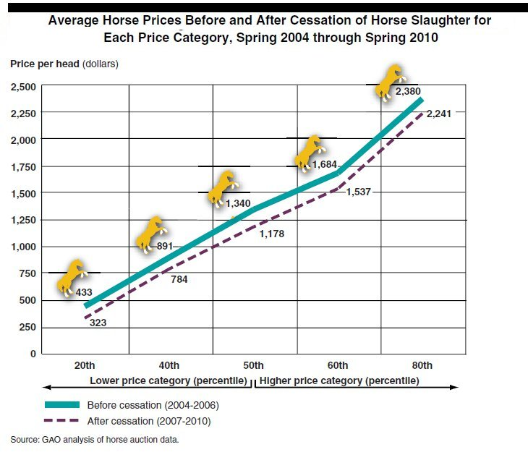

Slide 30
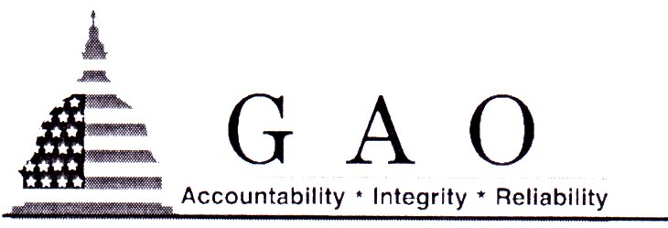
“GAO conducted this work at request of the Committees on Appropriations. Our regulations at 4 C.F.R. § 81.6(a), state that congressional correspondence and other papers relating to work performed in response to a congressional request may not be disclosed unless authorized the congressional requesters. In this instance we did not receive authorization from the congressional requesters to release these records. Therefore we decline to release the requested records on the basis of 4 C.F.R. § 81.6(a).”

Slide 32
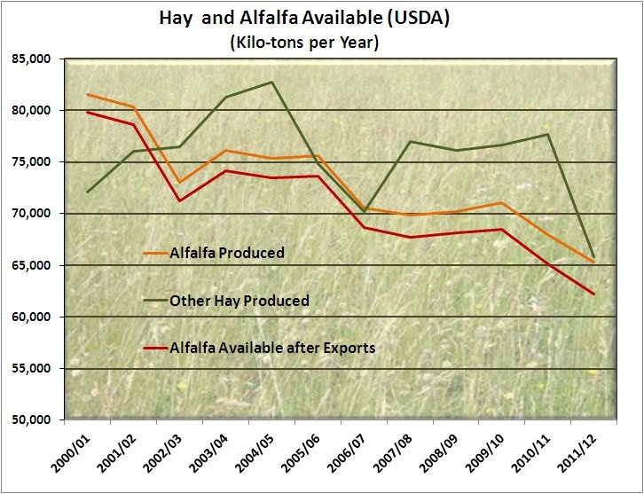

Slide 33
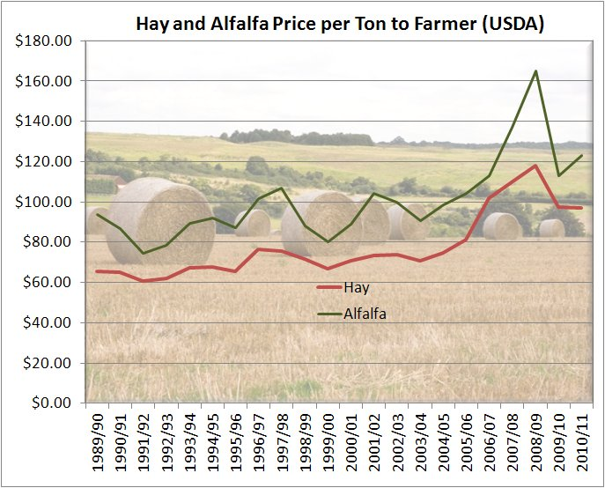

Slide 34
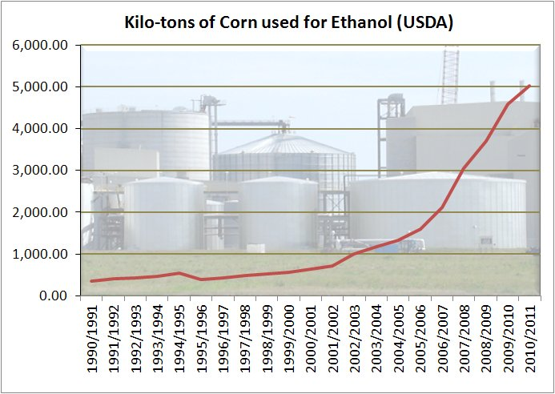

Slide 35
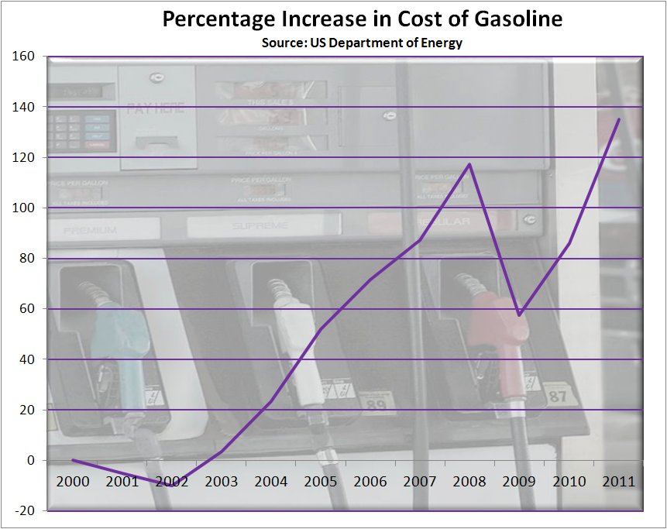

Slide 36
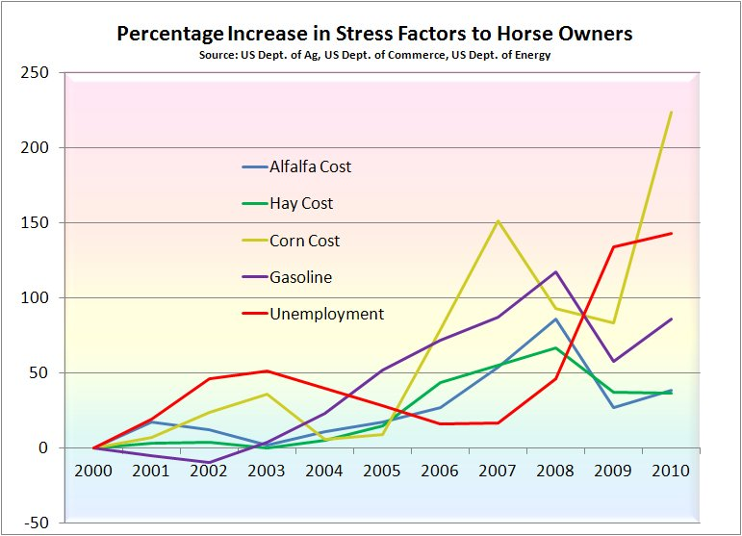

Slide 37
AVMA Corroborates our findings
According to a survey by the American Veterinary Medical Association (AVMA), private horse ownership declined 16.7% between 2006 and 2012.

Slide 38
American Horse Publication survey
A survey of horse owners by American Horse Publications found that approximately 23% of owners have a combined household income less than $50,000, while 65% of owners have an income of less than $100,000.

Slide 39
American Horse Survey (continued)
In the same survey, 73.8% of owners indicated that their costs per horse rose between 2007 and 2011, with the largest cost increases coming from feed, fuel, and veterinary care, respectively.

Slide 41
Trends this year

Slide 42
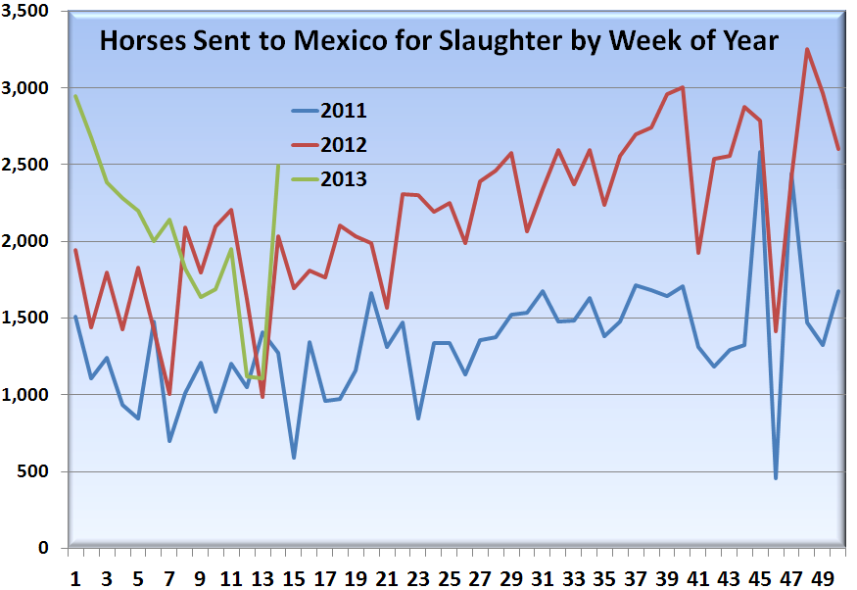

Slide 43
Disposable commodity ?
or a
Trusting companion?

