Slide 1
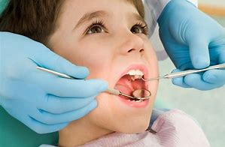
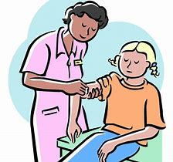
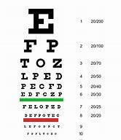
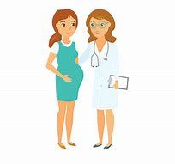
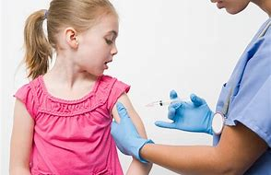
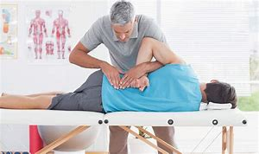
EL Civics – Health Unit Health Agency Vocabulary

Slide 2
flu shots
Shots to keep you from getting the flu.

Slide 3
immunizations
Shots for children to keep them from getting deadly diseases.

Slide 4
internal medicine
Health problems inside the body.

Slide 5
prenatal care
Medical help for women who are pregnant.
(going to have a baby)

Slide 6
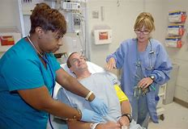
urgent care
Medical help for emergencies.

Slide 7
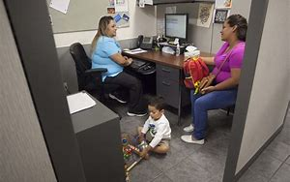
WIC screening
Help to see if you can receive WIC (food for women, infants and children)

Slide 8
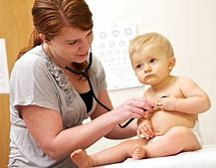
pediatrics
Doctor appointments for children from birth to 18 years old.

Slide 9
hearing test
A test to check how well you can hear.

Slide 10
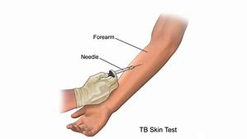
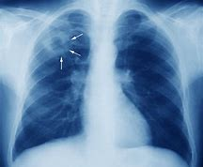
TB test
Skin test to see if you have tuberculosis.
(disease of the lungs).

Slide 11
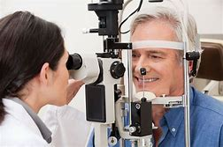
vision testing
A test to check how well you can see.

Slide 12
family practice
Doctor appointments for everyone in the family.

Slide 13
dental
Teeth care.

Slide 14
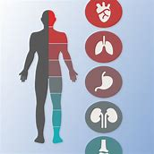
general medicine
Appointments that are not emergencies.

Slide 15
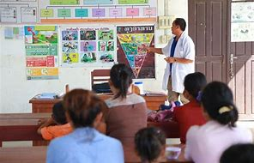
health education
Services about how to take good care of your body.

Slide 16
women’s health
Services about health concerns for a woman’s body.

Slide 17
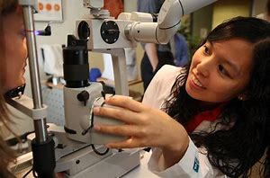
optometry
Services for your eyes.

Slide 18
medical/primary care
A doctor you see first for a health problem.

Slide 19
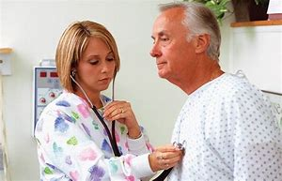
checkups
Yearly exams to check your general health.

Slide 20
psychiatry
Services for mental and emotional problems.

Slide 21
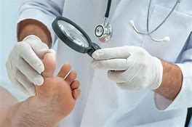
podiatry
Services for problems with your feet.

Slide 22
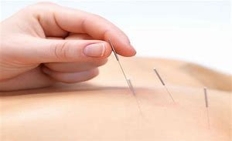
acupuncture
Services that use small needles to help relieve pain.

Slide 23
chiropractic care
Services that move your bones and muscles to help relieve pain.

Slide 24
pharmacy
Place where you can buy medicine.

