Slide 1

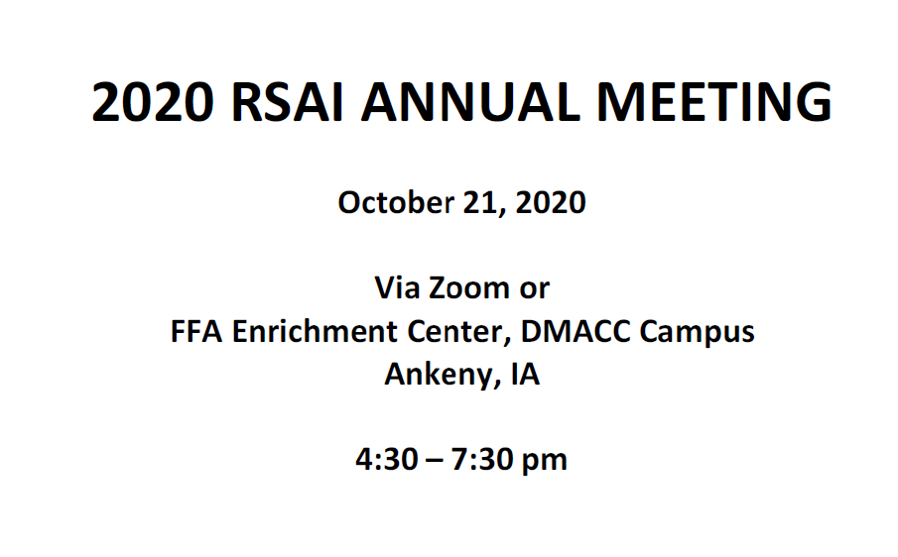

Slide 2
Summary of 2020 Legislative Session
RSAI Priority Action

Slide 3
Themes of Rural School Needs
Resources:
  $$$$$$$$$$$$$$; state, local, federal, other
  STAFF; recruiting, retaining, certification, economies of scale for accreditation
  Rural economic development investments or rural decay impact community capacity
Flexibility: One size does not fit all. Especially in rural schools, staff wear many hats. Strict expenditure and legal requirements do not always work with very small economies of scale. School board authority to decide what’s best for students.
Connections: to Internet, Services, Partnerships and Internships, connecting students and staff to content and supports. Distance to experiences and relevant connections for students (and staff).
Student needs: Changing demographics; poverty, mental health, immigration and aging resident population, transportation and other barriers to participation, population sparsity

Slide 4
Recent Accomplishments Benefiting Rural Districts
Before 2018:
  Management fund authority to pay for retirements over age 65 and costs of arbitration
  PPEL flexibility to pay for repairs over $1,500
  DoP Flexibility
  Home Rule Statute
  Categorical Fund Flexibility
In 2018 Session
  Even more DoP Flexibility
  Even more Categorical Fund Flexibility
  Staff Flexibility – CTE options for hard-to-staff content and local offerings of on-line learning
  Progress on Transportation (grants) and Formula Equality
  Extension of Operational Sharing Incentives
In 2019 Session
  Transportation in the Formula
  Formula Equity
  Extension of WGS/reorganization Incentives
  State Penny Extension
  Teacher shortage flexibility: Praxis waiver, concurrent enrollment STEM offer and teach, online learning flexibility

Slide 5

http://www.rsaia.org/2020-legislative-session.html

Slide 6

Adequate School Resources
SF 2142 was approved by 51 House members with 46 voting no and the Senate passed it on March 9, 31:17, sending it to the Governor (signed on March 12).
Set the SSA at 2.3% for FY 2021, second highest increase in 11 years, yet below the RSAI ask of 3.75%.
When Session reconvened after COVID closure, RSAI requested the 2.3% remain intact, and it did.
In context: combined with transportation, formula equity and formula funding, despite anticipation of economic decline due to the pandemic, it’s fair to say the 2020 Session made a good effort and kept their commitment for funding rural schools.
Setting up 2021: Zoomland folks, enter in chat, and those of you in person, write note – what are your biggest resource needs?

Slide 8
State Revenue Policy
School funding adequacy is a function of sufficient state revenues and mix of revenue sources for schools.
Continued property tax relief focus confuses the issue – state investment increases to make up for a reduced property tax dollar but schools don’t receive those funds as additional revenue.
Check out the Legislative Digest for additional information on tax cuts, policy decisions limiting state revenue, and increased tax credit thresholds of private school scholarships (STOs) – increased to $15 million in the 2020 Session.
REC (Oct. 13) estimated 4.1% growth in revenues net of transfers for FY 2022. That’s $316.5 million. FYI: 41% of that is $130 million. Watch for that number to be invested in PK-12 to preserve the PK-12 investment as a percentage of the state budget.

Slide 9
Resource Needs:
Adequate increase in SSA to fund:
  Continued programs and new expectations: computer science, dyslexia training, school safety and emergency plans, internships and college-level coursework
  Educators to teach and lead our schools; adequate salaries, benefits, training and ongoing support
  Bus drivers and support staff (paras, food service, custodians, secretaries)
  Course supports: science lab materials, career and technical education costs, fees to community colleges or other school districts for shared courses and content, music/art/drama opportunities for students
  Student needs: offset fees waived, provide instructional materials (online and at school), social workers and mental health supports, translators and ELL instructional materials and supports, behavior supports all the way up to therapeutic classrooms and mental health placements, talented and gifted content
  Extra- and co-curriculars: not just the heart of the community, but in many cases where students find their passion and learn to set goals and work collaboratively with others. Connect to peers and caring adults.

Slide 10
Question of the day:
How many of our RSAI priorities would fall off the list if schools had been adequately funded in the past or were adequately funded going forward?

Slide 11

Student Mental Health

Slide 12



Action Comments
SF 2261 Telehealth Services in schools creates a process for delivery of services without the school being in the bill processing role.
SF 2360 Classroom Management/Therapeutic Classrooms mirrors federal law in Least Restrictive Environment and sets up a grant process for additional therapeutic classrooms.
HF 2643 continuation of $2.1 million to the AEAs for educator training regarding children’s mental health in Omnibus Appropriations bill
SF 2261 was an RSAI priority, and is a good structural start. Helps to overcome geographic issues of services, but there’s still a shortage of MH professionals and gaps for those without insurance or Medicaid coverage.
LRE language was needed. Structure for therapeutic classroom grants is in place, but funding was delayed until 2022 (and it’s just a pilot project)
AEA training is a good start, but it’s not a one-time thing. Must be ongoing. This is the second year.
Staff need MH supports too.

Slide 13
2021 Session:
How did COVID closure impact mental health needs of students?
How about staff?
What about resources?
Do systems set up collaborative process for education, mental health, family and community stakeholders to assess and address mental health needs?
Governor’s plan for an additional penny of sales tax suffered from COVID closure too. Be watchful of whether proposals are significant new resources or a shift from local to state funding.

Slide 14

Educator Shortage and Quality Instruction
HF 2629 Future Ready Workforce provides for computer science which may be delivered exclusively online.
SF 2310 Online Learning allows financial literacy, world languages and computer science taught exclusively online under certain conditions. Also allowed use of federal funds for AEA online learning program.
HF 2359 Praxis test eliminated as an entrance exam to enroll in a college teaching program.
HF 2454 allows AA degree for some CTE teachers. Proposed BOEE Admin. Rules allowed for AA degree and other flexibility for substitutes, but may be back to the drawing board. Governor’s declaratory order provide substitute flexibility.
HF 2627 requires licensure reciprocity with other states with 1 year of experience.

Slide 15
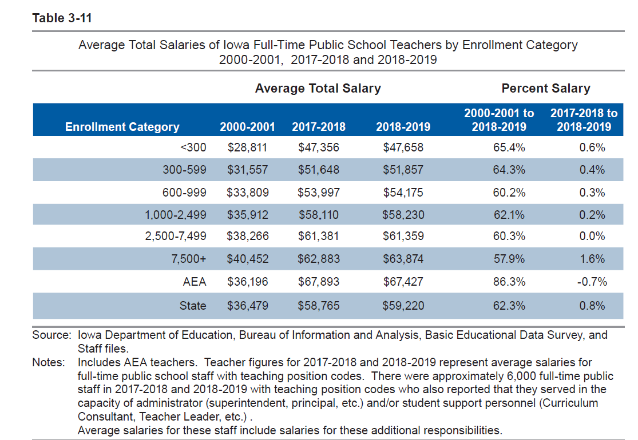
DE’s Annual Condition of Education Report shows average salary by school size (which is a good but not perfect predictor of rural districts), showing a growing difference in pay between the averages of the smallest and largest category of school size, now at $16,216, and more than $10,000 below the state average.
Rural schools tend to have younger teachers and lower class sizes, both of which can contribute to lower pay.

Slide 16
Geography and Sparsity Impacts Recruitment and Retention
Young teachers are not always willing to locate in a community with long commutes to amenities, so something has to make up for the lack of access to entertainment, housing, and other services.
Recent college graduate debt requires a high enough starting pay or other resource to help offset young teachers’ student loan payments.
Multiple preps and wearing many hats (teaching, coaching, etc.) may make it hard to keep young teachers drawn to other districts by higher salaries and fewer responsibilities.
Need for multiple certifications may require additional coursework, which can be a heavy lift for a new teacher/administrator

Slide 17
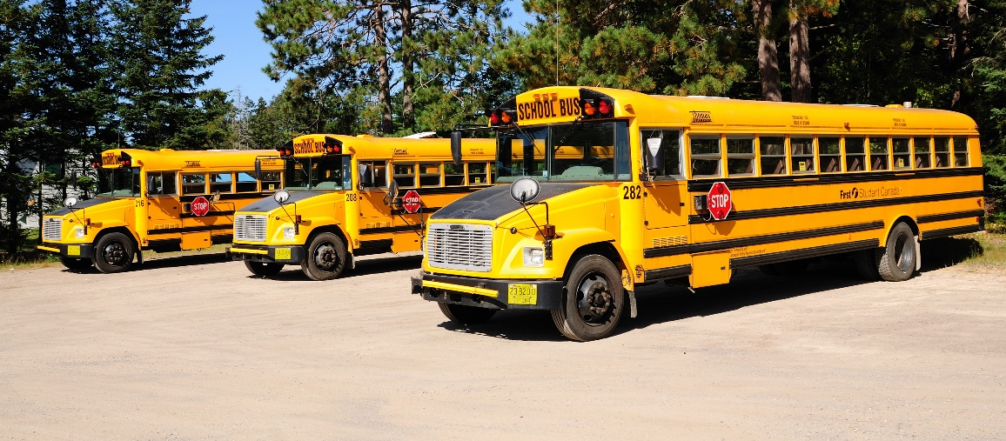
Transportation and Formula Equity

Slide 18
Transportation and Formula Equity
SF 2164 was approved, passed the House 98:1 and passed the Senate 48:0.
The bill provides an increase of $7.3 million compared to FY 2020, bringing the transportation total to $26.3 million. All districts are brought down to the state average and the remaining balance in the fund was distributed per student to all districts (87 cents per pupil).
Adds $10 to the minimum State Cost Per Pupil to close the gap to $155, at an estimated increase in State school aid of $5.3 million and a decrease to property taxes of $3.6 million. In prior years, the gap was closed by $5 per pupil. RSAI requested an accelerated approach which they delivered.
Set up for 2021: How does COVID interruption impact the annual transportation expenditures and report for the 2020-21 school year?

Slide 19
Opportunity Equity for At-risk Students/Poverty

Slide 20
Student Inequities and At-risk Needs
Despite the School Finance Interim Committee recommending and the House Education Committee approving a bill, HF 2490, the study of the impact of poverty on education and funding formula options to meet the needs of students did not advance out of House Appropriations Committee.
A bill also approved in the House Education Committee, HF 2497, would have allowed SBRC to grant spending authority up to 5% for Dropout Prevention (DoP), but died in the House Appropriations Committee.
Bills were introduced in both chambers to begin the conversation with the House carrying them further along the way than in the Senate.
FYI: Children from families with incomes at or below 130% of the poverty level are eligible for free lunch those 130-185% eligible for reduced lunch.

Slide 21
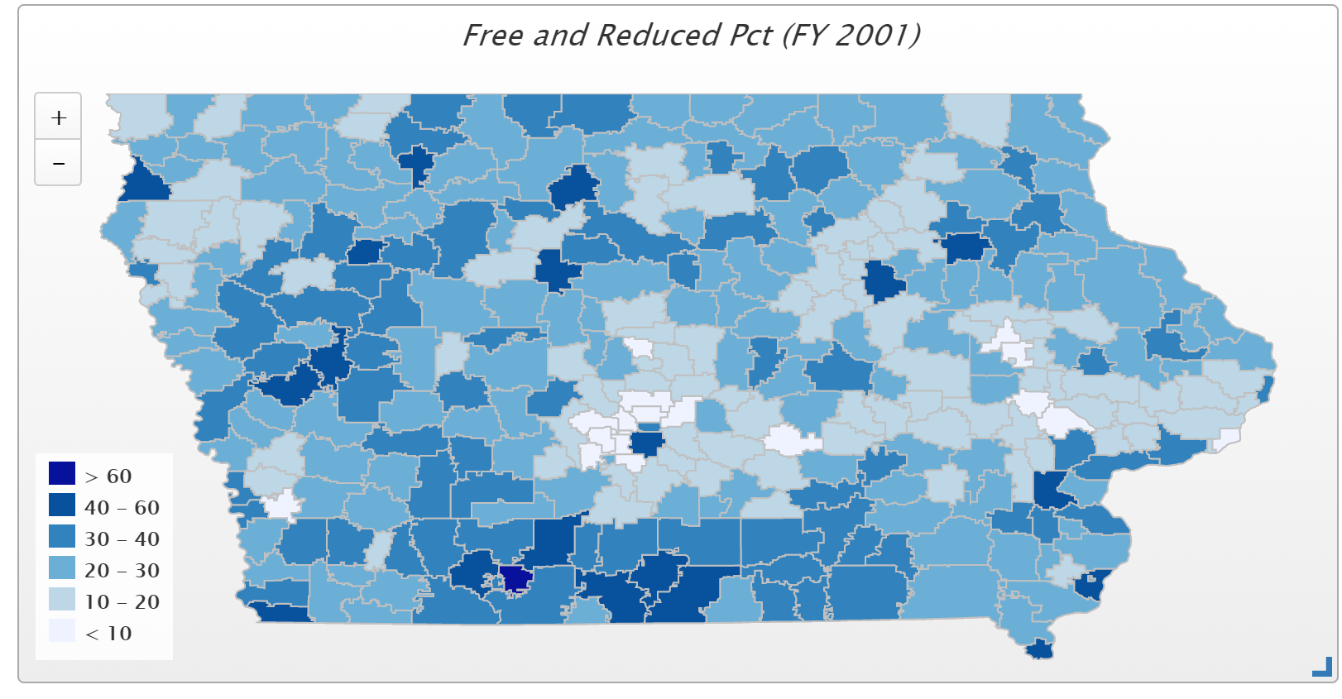
In 2001, only 4 districts had more than 50% of students eligible for FRPL (Waterloo, Keokuk, Wayne and Diagonal. Diagonal was the state high at 60.2% and the only district above 60%)

Slide 22
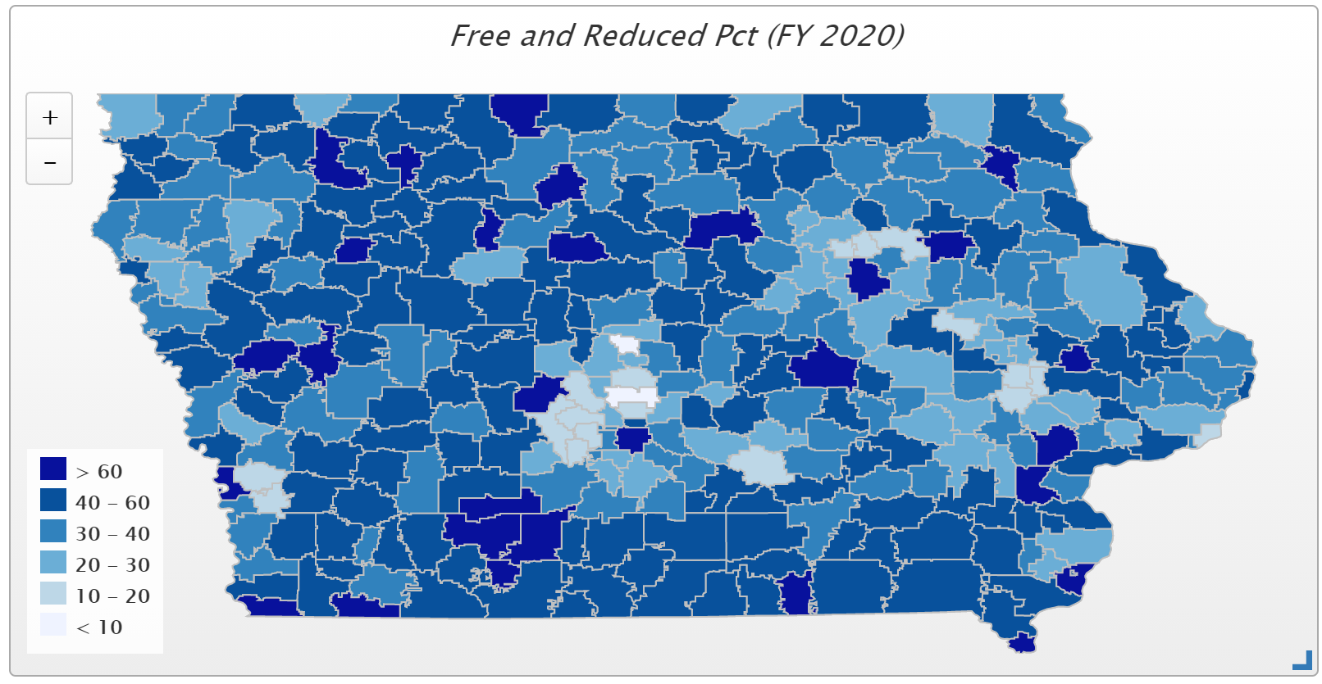
In FY 2020, 77 districts have more than half of their student on FRPL, and 29 districts have more than 60% of students eligible for FRPL. Those above 70% include Waterloo, Orient-Macksburg, Hamburg, Denison, Perry, Storm Lake, Des Moines, Lu Verne, and Postville.

Slide 23
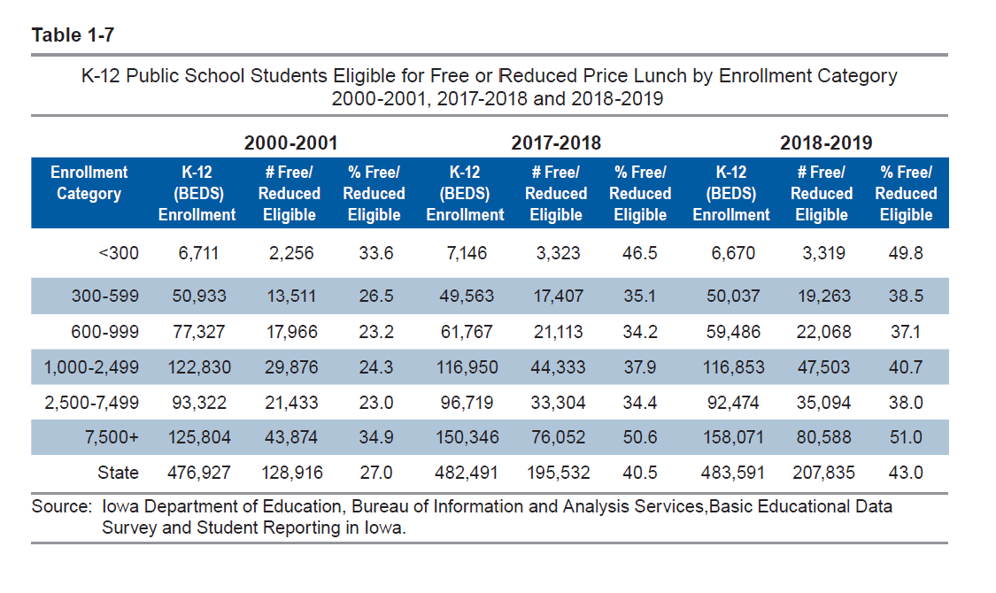
Districts in the largest and smallest enrollment categories had the highest percentage of students eligible for free or reduced price lunch (Table 1-7).

Slide 24

Reorganization and Whole Grade Sharing Incentives Extension
Although the Gov.’s Future Ready Workforce bill originally added a work-based learning coordinator position for operational sharing, it was removed from the final version of the bill.
RSAI also supported a bill which would have added an SRO position to the list of potential shared positions.

Slide 25
Reorganization and Whole Grade Sharing Incentives Extension
  2018: Extension of Operational Sharing Incentives through budget year beginning July 1, 2024
  2019: Extension of WGS and Reorganization Incentives for reorgs effective no later than July 1, 2024
  Incentives provide an impetus for districts to work together to deliver greater educational opportunities for students through WGS, either one-way, which 43 districts used in the 2019-20 school year or with two-way agreements, which 14 districts used. Three districts that previously participated in whole grade sharing were reorganized effective July 1, 2019, lowering the total number of school districts in Iowa to 327.
  In the 2019-20 school year, 239 districts also received operational sharing supplementary weighting. Of those, 93 districts qualified for the full 21 student weighting, or $144,480 per district.

Slide 27
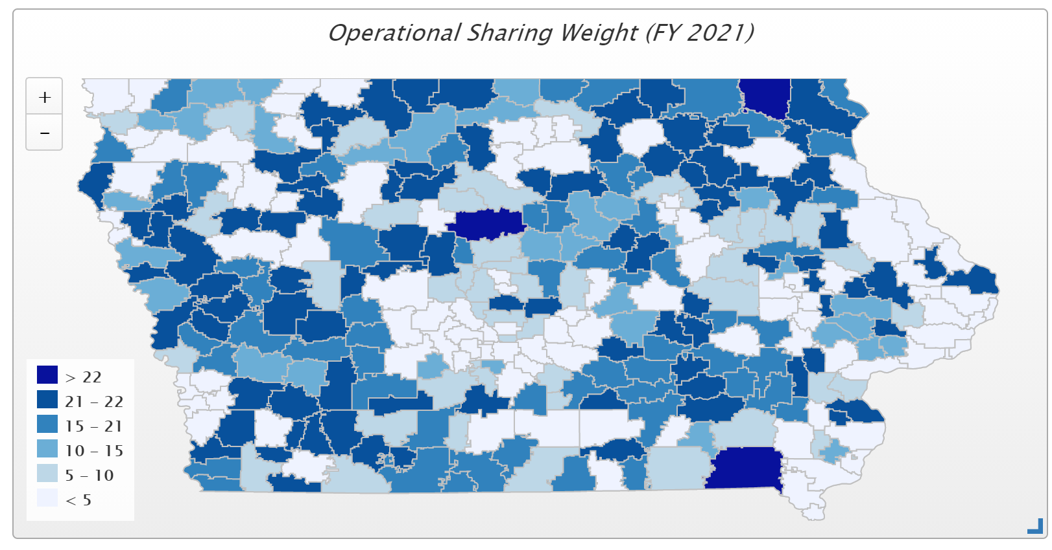
235 districts receive operational sharing incentives in the 2021 fiscal year. $25.7 million total.

Slide 28

Quality Preschool

Slide 29
Quality Preschool
HF 2460 would have allowed districts to serve and count young 5-year-olds in PK, was approved by the House Appropriations Committee, but did not get approval of the full House.
COVID-19 Impact: PK enrollments lower in Fall 2020. PK does not have an on-time funding component or budget guarantee, so next year’s PK budget will be based on this Fall’s enrollment count. Also, DE guidance prohibits school districts from using general fund for PK expansion.
Is the solution a one-time hold harmless or permanent fix to the formula that sets up funding for PK expansion?

Slide 30
School Safety
SF 284 would have added School Resource Office (SRO) position to operational sharing, but did not move forward.
SF 2155 would have allowed additional ISL funds to pay for one SRO per district, although approved in the Senate Education Committee, did not advance out of the Senate Ways and Means Committee.
There were no school safety bills in the Iowa House.

Slide 31
Bonding Capacity/Simple Majority
No bills proposed to lower vote requirement for school bond issue from 60% supermajority to a simple majority (50% +1)
Did stop a proposal to limit bond issue elections to the November school board election, which failed to advance in the House Local Government Committee.
Senate bill to place restrictions on SAVE revenue purpose statements had also proposed a 60% supermajority for RPS votes.

Slide 32
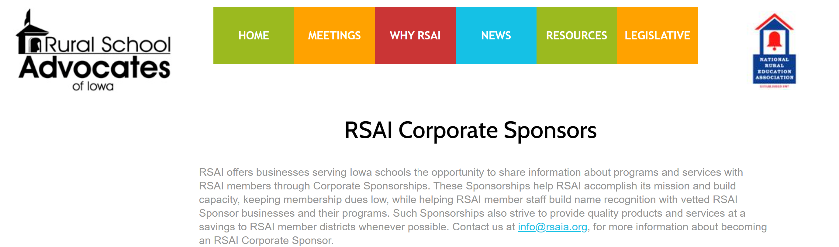


Slide 33
RSAI Legislative Group (one-year term without term limits) supports RSAI’s policy development and advocacy! includes at large members of the Leadership Group (Dennis McClain, Dan Peterson and vacant so Justin Daggett filled in) plus:
SW – Tim Mitchell / Riverside Superintendent
NE – Barb Schwamman / Osage and Riceville Superintendent
SE – Joel Pedersen / Cardinal Superintendent
NW – Brian Johnson/ Prairie Valley and Southeast Webster Grand Superintendent

Slide 34
RSAI 2021 Legislative Priorities
See the RSAI website meeting tab for more information such as RSAI Legislative Digest, Position Papers which will be updated after language is finalized at this meeting, Legislative Priorities, and this PPT on the annual meeting tab
http://www.rsaia.org/

Slide 35
THANK YOU FOR YOUR VOICE on behalf of rural students!
Stay connected through the Interim and into the Legislative Session
Let us know what you need to beef up your advocacy efforts.
Professional Advocate
Margaret Buckton, margaret@iowaschoolfinance.com
1201 63rd Street, Des Moines, IA 50311 (515) 201-3755 cell

