Slide 1
Chromium Interim Measure & Characterization Campaign Successes
Doug Hintze
Manager
Environmental Management Los Alamos Field Office
Glenn Morgan
President
N3B Los Alamos

Slide 2
Los Alamos National Laboratory Organizational Structure
National Nuclear Security Administration Los Alamos Field Office
Environmental Management Los Alamos Field Office
Triad National Security, LLC
N3B Los Alamos
Weapons Programs
Global Security
Science, Technology & Engineering
Operations & Business
Capital Projects
Waste Disposition
Soil and Water
& D&D
WP
GS
STE
OPS
Los Alamos Legacy
Cleanup Contract
Management & Operating Contract

Slide 3
Chromium Interim Measure and Characterization Campaign: Actions Taken So Far
Since elevated hexavalent chromium concentrations were discovered in one well on LANL property in 2005, DOE has taken the following actions:
Installed a network of monitoring wells to characterize and monitor plume extent and behavior
Developed comprehensive groundwater model to guide installation of wells and to support a better understanding of the plume
Planned and implemented an Interim Measure (IM) consisting of a pump and treat system to arrest migration of the downgradient edge of the plume
Operating the IM along LANL’s boundary with the Pueblo de San Ildefonso for over one year, successfully shrinking the plume along the southern boundary
Pumped and treated over 103 million gallons of water from the plume
Developing plans to install two additional monitoring wells to better characterize the northwestern and southwestern portions of the plume
Spent over $90M to characterize the plume, arrest its migration through operation of the IM, and study remedial options for a final remedy

Slide 4
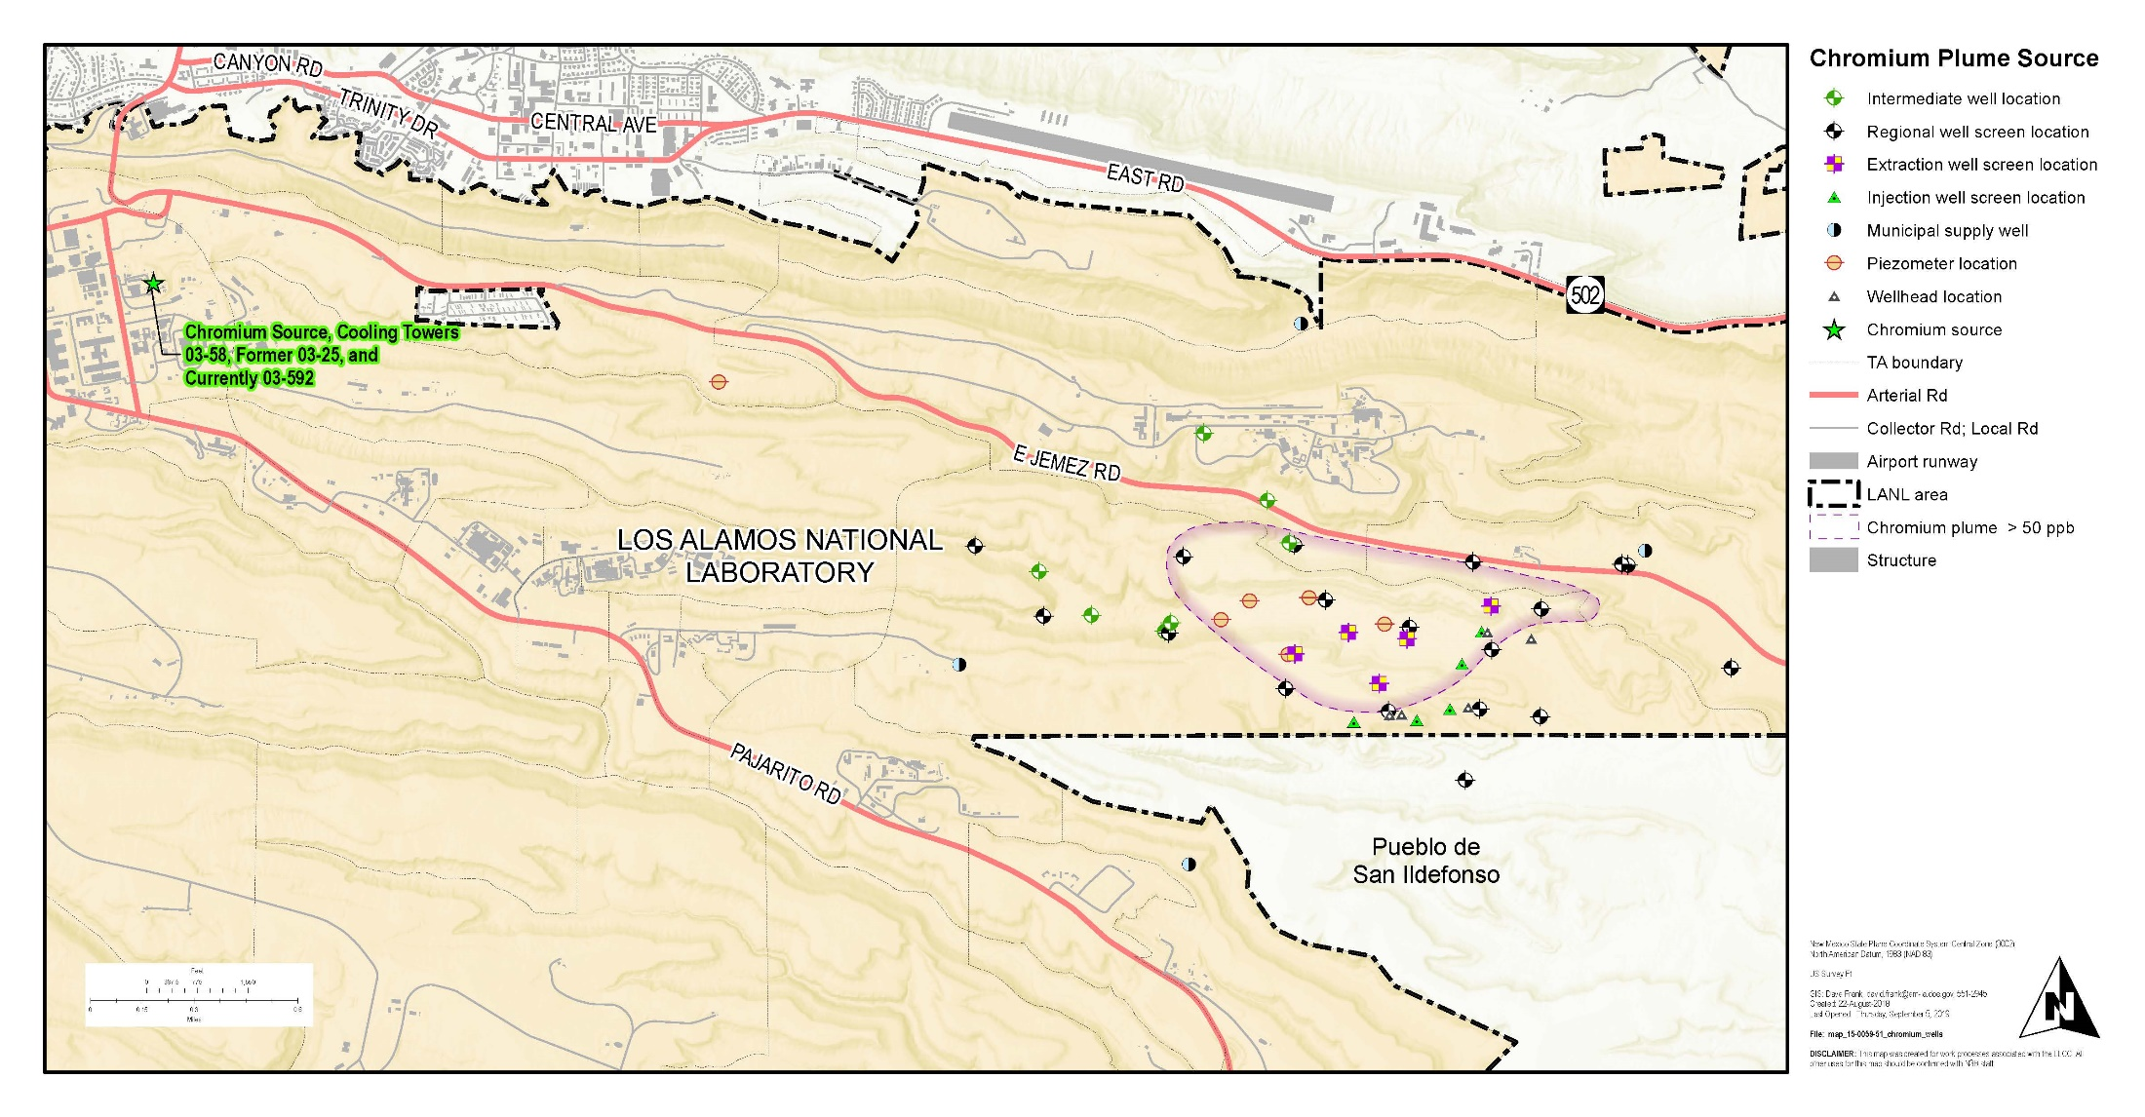
Chromium Plume Location
Chromium Plume

Slide 5
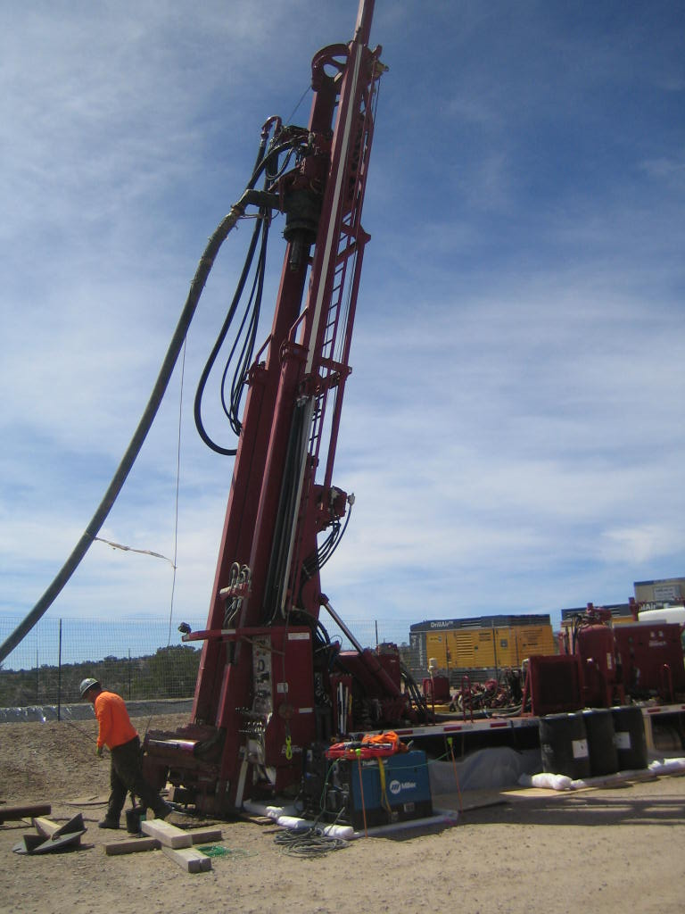
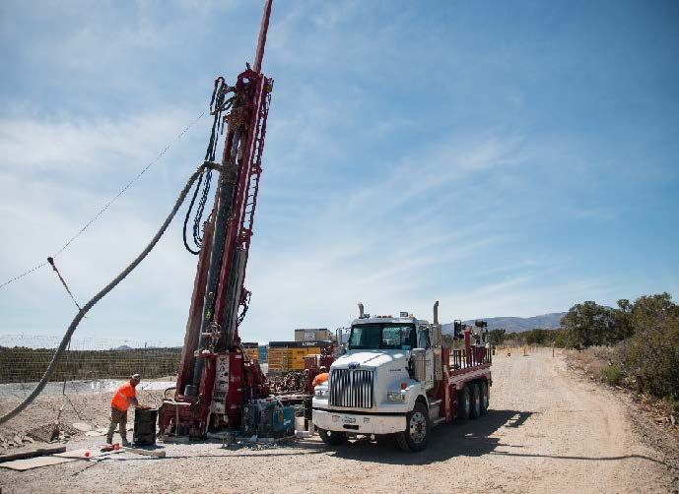
Developing a Strategy
We saw an evolving problem
We developed a groundwater model to help identify a strategy
The model-based strategy required angle drilling because of the complex terrain, deep groundwater, and sensitive cultural sites
Angled drilling has enabled wells to be installed in locations that otherwise would not have been possible.

Slide 6
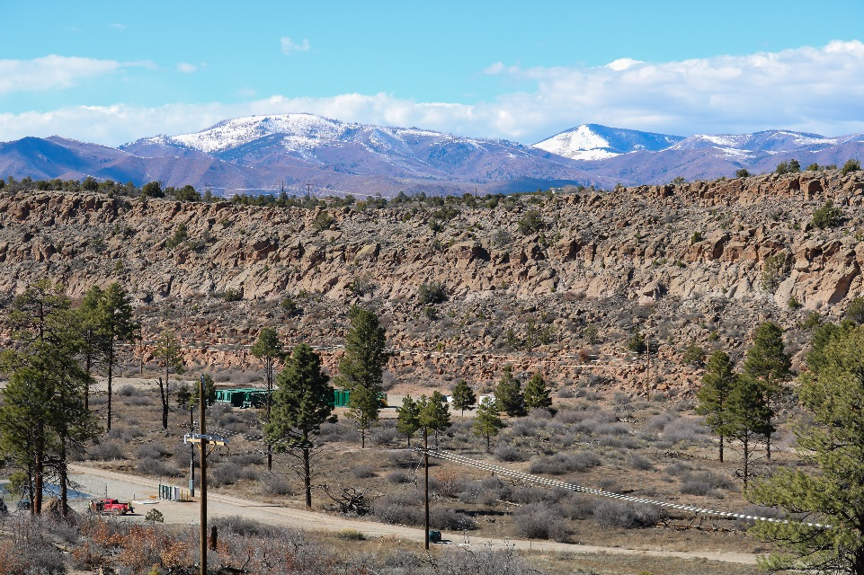
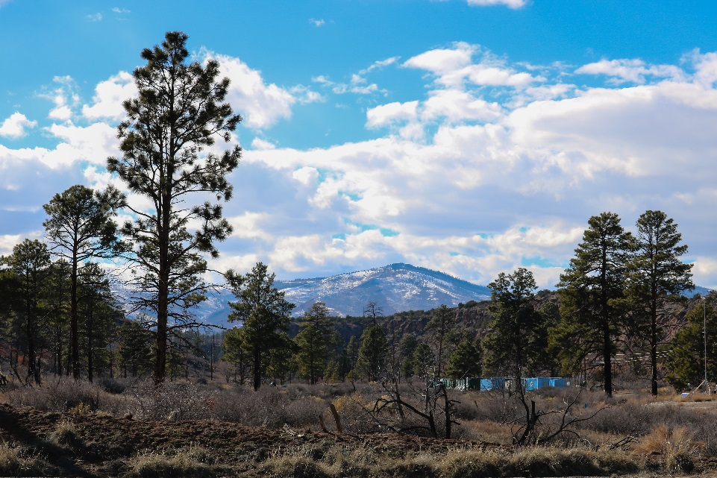
Developing a Strategy (continued)
We interfaced effectively with regulators and with the Pueblo de San Ildefonso
Successfully worked through complex regulatory reviews, particularly with the National Environmental Policy Act
Built a complex infrastructure with minimal above ground disturbance
Operated Interim Measure and are seeing better than expected plume mitigation
We will continue to build on our progress in the final remediation design
Project infrastructure was designed to have a minimum visual impact.

Slide 7
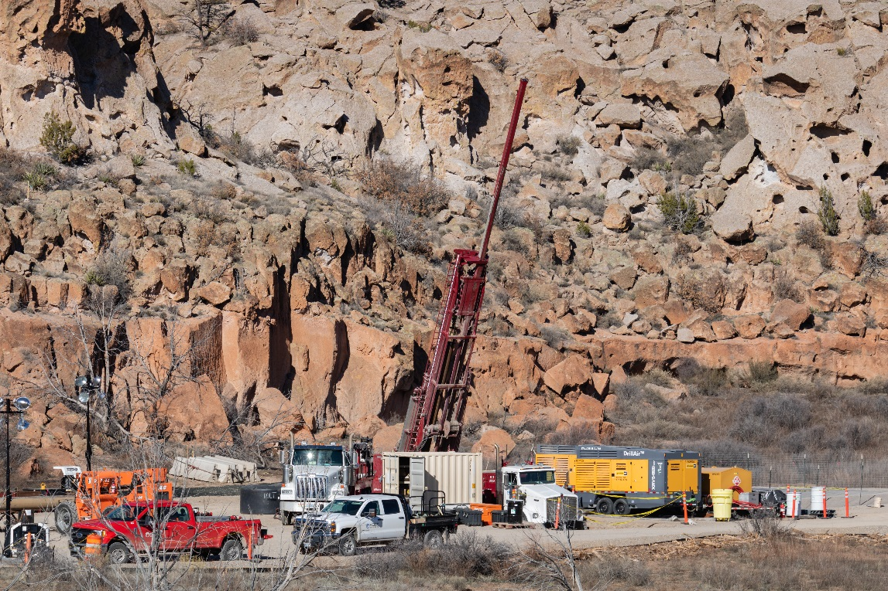
A Work in Progress
The following has been installed as part of this campaign:
16 regional aquifer wells/screens
4 perched-intermediate wells
6 piezometers
5 extraction wells
5 injection wells
Groundwater treatment system
3 miles of piping
The monitoring well R-70 was installed in spring of 2019.

Slide 8
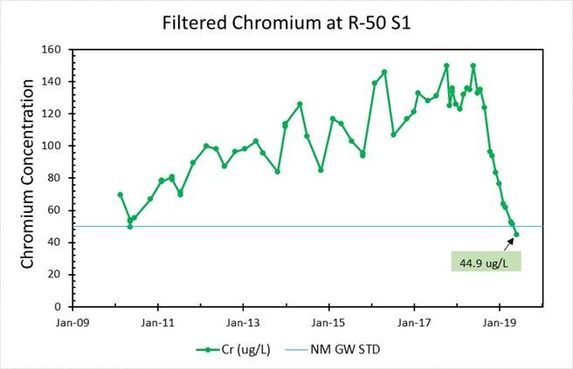
Signs of Success
R-50 is a monitoring well located at the southern edge of the plume, north of Pueblo de San Ildefonso

Slide 9
Questions
Produced by Los Alamos Legacy Cleanup Contractor, N3B Los Alamos on behalf of DOE’s Environmental Management Los Alamos Field Office

