Slide 1
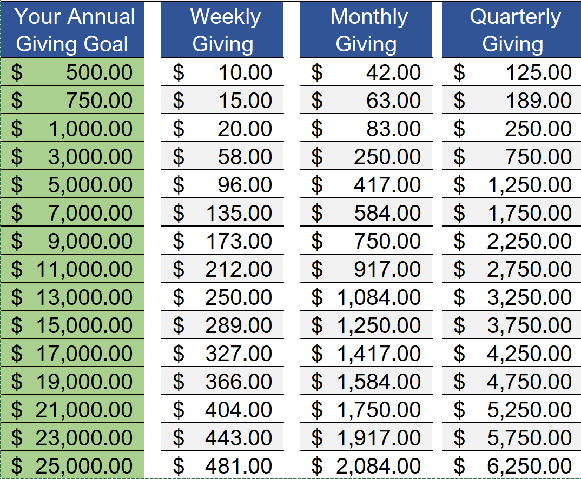
Intentional
Generosity
…decide in your heart how much to give. And don’t give reluctantly or in response to pressure. “For God loves a person who gives cheerfully.” 2 Corinthians 9:7 NLT

