Slide 1

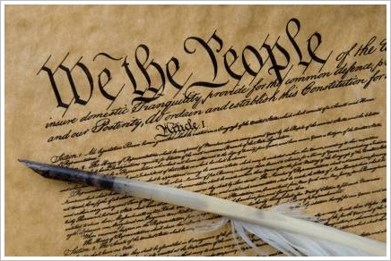
What’s Not in the bill of rights
ACE
These materials have been adapted, with permission from The Florida Bar Benchmarks Adult Civic Education Program, for use in Louisiana. Principal authors of the Florida Benchmarks Program are Annette Boyd Pitts and Richard Levenstein. For assistance with adaptation in other states, contact staff@flrea.org

Slide 2
What is a Constitution?

Slide 3
What is a Constitution?
Establishes a plan of government or rule book for government
Serves as a contract between the people and the government
Sets forth the structure and
functions of government
Lists some of the rights of the
people
What else would you add?
Notes:
Ask audience generally what a constitution is. Review

Slide 4
What Does a Constitution Do?
It limits power of the government
It assigns powers of the government
It organizes government
It establishes rule of law
It protects the rights of the people
Anything else?
What is the difference between a Constitution and statutes? Should one be more general than the other?
Notes:
What does a Constitution do? Differentiate between a Constitution and Statutes.

Slide 5

Fun Facts……
India has the longest written Constitution of any sovereign country in the world
444 Articles, 12 schedules, 94 amendments
US Constitution is the shortest
  7 Articles and 27 Amendments

Slide 6
Federal v. State Constitutions
Should there be different expectations for what is included in the U.S. Constitution v. the State constitutions?
How should a federal constitution differ from a state constitution?
Notes:
Differentiate between federal and state constitutions. Briefly discuss how state constitutions address state governments and the US Constitution addresses the federal government. State constitutions are generally changed or amended a little more easily than the US Constitution. While changes to a state Constitution may at times be warranted, it is important to recognize that state statutes may be better suited for some modifications that are sometimes presented as constitutional amendments. The Florida Constitution has been completely rewritten five times from its original draft in 1838. Our population has grown in Florida from 54,477 in 1840 to over 19 million today. While there are needs to be addressed through constitutional amendments, such changes should not be taken lightly and should be based on a broad and deep consensus of the governed.

Slide 7
The Hierarchy of Law
If there is a conflict between a lower law and a higher one, the higher one “prevails”.
United States Constitution
Acts of Congress
Federal laws
State Constitutions
The U.S. Constitution is the “Supreme Law of the Land.”
State Statutes (laws)
City and County Ordinances
Notes:
Highlight the hierarchy of law. The US Constitution as the highest law in the land.

Slide 8
Parts of the US Constitution
If you were to dissect or cut up
the US Constitution into three
main parts and reassemble as
a puzzle, what would be the
three main parts?

Slide 9
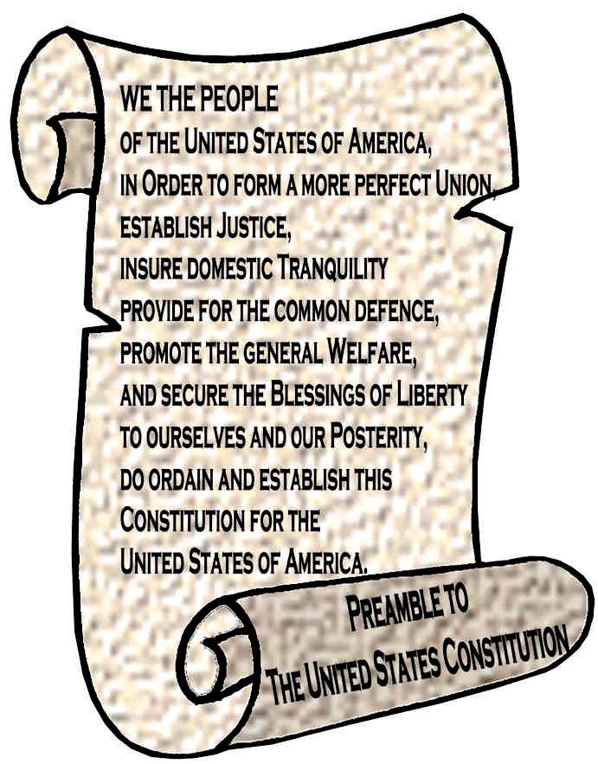
Parts of the United States Constitution
  Preamble
  Seven Articles
  27 Amendments

Slide 10

The Bill of Rights
Today we know the Bill of Rights as the first ten amendments to the US Constitution.
But, actually there were 12 amendments proposed instead of 10!!
Today we will explore which amendments were ratified (approved) and are included in the Bill of Rights?

Slide 11

Rights
Distribute the list of 12 proposed amendments to be included in the Bill of Rights. (Handout 1)
All of these proposals were submitted but only 10 were ratified.
Which amendments/rights do you think were approved?
Individually, place a check mark by each amendment you think was ratified/approved to be included in the Bill of Rights.

Slide 12
The Bill of Rights
Highlight the two amendments, from the original Bill of Rights, which were not included.

Slide 13

The First Amendment
Many of us recognize the First Amendment today which includes the right to freedom of religion, speech, press, assembly, and petition.
But was this really intended to be the First Amendment??

Slide 14

The Proposed First Amendment
The First Amendment in the proposed Bill of Rights addressed the numbers of members of the House of Representatives and stated,
“ After the first enumeration required by the first article of the Constitution, there shall be one Representative for every thirty thousand, until the number shall amount to 100, after which the proportion shall be so regulated by Congress, that there shall be not less than 100 Representatives, nor less than one Representative for every 40,000 persons, until the number of Representatives shall amount to 200; after which the proportion shall be so regulated by Congress, that there shall not be less than 200 Representatives, nor more than one Representative for every 50,000 persons.”
“ After the first enumeration required by the first article of the Constitution, there shall be one Representative for every thirty thousand, until the number shall amount to 100, after which the proportion shall be so regulated by Congress, that there shall be not less than 100 Representatives, nor less than one Representative for every 40,000 persons, until the number of Representatives shall amount to 200; after which the proportion shall be so regulated by Congress, that there shall not be less than 200 Representatives, nor more than one Representative for every 50,000 persons.”
But it did not receive enough support so it was never ratified.

Slide 15
Positive or Negative?
If the real First Amendment had passed, it would have required that the size of the US House of Representatives be adjusted with every Decennial Census (every ten years).
TODAY we could theoretically have over 6,000 members in the House based on one Representative per 50,000 persons as proposed.

Slide 16
Interesting to note
In 1790, the population of the United States was approximately 4 million.
Today our population is approximately 311 million.
With 435 House members today, each represents approximately 714,000 plus persons.

Slide 17
In the Articles of Confederation
The Articles of Confederation (the first constitution of the United States) allowed only one vote per state. More than one delegate was allowed to participate but each state only had one vote in the legislative branch.
How would you compare representation under the Articles of Confederation to the proposal of representation under the US Constitution?

Slide 18
The Second Proposed Amendment
The second proposed amendment in the original Bill of Rights was not the right to bear arms (as it is today). The second proposed amendment addressed compensation of Senators and Representatives.
Although it too was not ratified as part of the Bill of Rights, it has since become the 27th Amendment to the US Constitution.

Slide 19
Proposed in 1789 and Ratified in May 1992
The 27th Amendment to the US Constitution reads just as it did in the proposal to the original Bill of Rights in 1789,
“No law, varying the compensation for the services of the Senators or Representatives, shall take effect, until an election of Representatives shall have intervened.”

Slide 20
27th Amendment
Longest running amendment effort in the history of the United States.
Drafted and proposed in 1789 but not ratified until 1992.
How did it happen?

Slide 21
Steps in The Amendment process

Slide 22
Two part process
There are two parts to the constitutional amendment process. See Article 5 of the US Constitution.
Article V
Part One: Proposal Process
Part Two: Ratification Process

Slide 23
Proposal process
There are two ways spelled out in the US Constitution to propose an amendment.
1. The proposal must pass both Houses of Congress (House and Senate) by a 2/3 majority in each.
OR
2. A Constitutional Convention must be called by 2/3 of the legislatures of the States.

Slide 24
Ratification process
The proposed amendment must next be approved, or ratified, by ¾ of the states.
This may be done by passage through the state legislature or by a state convention. This may be specified in the text of the amendment.

Slide 25


In or out?
As a group, after each proposal is announced, either do a Thumbs Up or Thumbs Down if you think it passed or failed as an amendment to the US Constitution.

Slide 26
Thumbs up or down?
1947: the income tax maximum for an individual should not exceed 25%;

Slide 27
1971: American citizens should have the alienable right to an environment free of pollution

Slide 28
1876: The forbidding of religious leaders from occupying a governmental office or receiving federal funding

Slide 29
1916: All acts of war should be put to a national vote. Anyone voting yes had to register as a volunteer for service in the United States Army

Slide 30
Thumbs up or down?
1914: Finding divorce to be illegal

Slide 31
Did you know
Approximately 10,000 amendments have been proposed in Congress since 1789.
The success rate of an amendment to become part of the US Constitution is less than 1%.
www.constitutionfacts.com

Slide 32
What’s Missing?

Slide 33
What’s Missing?
Distribute copies of the summary of the outline and 27 amendments to the US Constitution. (Handout 3) What other ideas have failed over the years. What are some new ideas that may be under consideration?
In groups of five, brainstorm ideas for a new amendment to the US Constitution.

Slide 34
Constitutional Amendment Proposal
As time permits, using the Constitutional Amendment Proposal Form, each group will come to a consensus on their idea to amend the US Constitution.
As a full group, debrief and evaluate each proposal.
Notes:
Make sure the audience understands that an amendment to the US Constitution will impact the entire country.

Slide 35
Proposed Ideas for 28th Amendment
After groups share their ideas for a 28th amendment, post this proposal which has been circulating throughout the country. Seek input.
Proposed 28th Amendment to the United States Constitution:
"Congress shall make no law that applies to the citizens of the United States that does not apply equally to the Senators and Representatives; and, Congress shall make no law that applies to the Senators and Representatives that does not apply equally to the citizens of the United States".

Slide 36
Sources
www.constitutionfacts.com
www.usconstitution.net
www.constitutioncenter.org
www.archives.gov
www.ourdocuments.gov
Center for Civic Education. We the People…the Citizen and the Constitution. Calabasas, CA. 2009.

Slide 37

Peggy Cotogno
Executive Director
Peggy.cotogno@lsba.org
These materials have been adapted, with permission from The Florida Bar Benchmarks Adult Civic Education Program, for use in Louisiana. Principal authors of the Florida Benchmarks Program are Annette Boyd Pitts and Richard Levenstein. For assistance with adaptation in other states, contact staff@flrea.org

