Slide 1
Changing Admissions and Financial Aid Focus from Student Headcount to Net Tuition Revenue (NTR)
FCIS Finance Institute
Palmer Ball Consulting, LLC
palmerballconsulting@gmail.com
www.palmerballconsulting.com
Palmer D. Ball
July 28, 2023

Slide 2
“Net Tuition Revenue – the Only Number that Matters”
NBOA Net Assets Nov / Dec 2017
Caveat – with this presentation, I am totally looking at the financial side of a school’s financial aid program and its impact on the financial sustainability of a school. I’m wearing my “business officer blinders” and am not looking at the value a student brings to the program, which is of course very important. My presentation and the associated spreadsheets are looking at the dollars, because at the end of the day, the dollars are what determines if the school can stay in business.

Slide 3
Net Tuition Revenue Analysis – Student Headcount vs NTR
Sample School |  |  | Headcount |  | NTR
Net Tuition Revenue Calculation |  |  | Focus |  | Focus
 |  |  | Actual |  | Actual
 |  |  | 6/30/20 |  | 6/30/21
Net Tuition Revenue |  |  | 4,485,101 |  | 4,766,527
 | Increase in Tuition Income |  | 244,526 |  | 264,375
 | Change in Other Tuitions |  | -8,970 |  | -19,663
 | Change in Financial Aid |  | -183,740 |  | 36,714
 | Increase in Net Tuition Revenue |  | 51,816 |  | 281,426
 |  |  | 0 |  | 0
 | Percentage Change in Net Tuition Revenue |  | 1.2% |  | 6.3%
 | Percentage of Tuition Increase Realized |  | 22% |  | 115%
 | Net Tuition Revenue per Student |  | 9,442 |  | 10,229
 | Change in Net Tuition Revenue per Student |  | 10 |  | 786
Enrollment |  |  | 475 |  | 466
 | Change in Enrollment |  | 5 |  | (9)
 | Percentage Change in Enrollment |  | 1.1% |  | -1.9%

Slide 4
Financial Aid Mission / Philosophy
Purposes of financial aid – what is your school’s Financial Aid mission? Is it -
To support the mission of the school?
To provide socio-economic diversity?
To provide access and affordability?
To fill empty seats?
Mission driven financial aid that is funded by endowment or other sources is wonderful, but the reality for a school that uses financial aid to fill empty seats is VERY different.
Does your school have empty seats and use aid to fill them or had students leave the school because of financial aid (or lack thereof)?
Caveat – my presentation is really geared towards schools with empty seats and capacity to grow (for example, recently experienced an enrollment decline and are trying to return to former numbers).

Slide 5
Reminder - ALL students receive Financial Aid (Tuition Gap)
 | Car |  |  |  |  | Independent
 | Dealership |  |  |  |  | School
40,000 Sales Price |  |  |  |  | 23,000 Cost of Goods Sold
 |  | } |  |  |  |  | }
 |  | } |  |  |  |  | }
 |  | } | Profit |  |  |  | } | Loss
 |  | } |  |  |  |  | }
 |  | } |  |  |  |  | }
37,000 Cost of Goods Sold |  |  |  |  | 17,000 Sales Price |  | >
 |  |  |  |  |  |  | > | Financial Aid
 |  |  |  |  |  |  | >
 |  |  |  |  | 11,000 Average Funds Collected
Independent schools are bad business models in that they charge less than it costs to educate a student.

Slide 6
Does your school consider Financial Aid to be an Expense or a Revenue Generator?
How your school views financial aid makes a huge difference in how it awards financial aid.
I worked with a school that considered financial aid to be a budgeted expense line item and once the budget was reached, all financial aid spending had to stop. Prospective new students who needed aid were turned away in August and told that the financial aid budget had been spent.
Had this same school considered financial aid to be a revenue generator, they would have judiciously made awards in August to new students that would have generated positive Net Tuition Revenue (NTR). They might not have given a student a 15,000 financial aid award, but they might have given a 5,000 award that would have generated 10,000 in NTR.

Slide 7
Does your school consider Financial Aid to be an Expense or a Revenue Generator?
On the other end of the spectrum, I knew a Board member who considered financial aid an “accounting” entry that could be ignored since it wasn’t “real dollars” and thought the School should collect whatever it could for every empty seat (i.e. the airplane empty seat philosophy).
I noted the School could do it for a seat or two, but couldn’t fill up an entire class with students paying $2,000 each.
Unlike the empty seat airline philosophy, this could be a 14 year commitment.
At the end of the day, the net tuition revenue a school collects is “real dollars” to pay salaries, utilities, etc., and it takes a lot of “real dollars” to pay a school’s salaries, utilities, etc.

Slide 8
Does your school consider Financial Aid to be an Expense or a Revenue Generator?
On the other end of the spectrum (continued)……
Look at NTR chart by grade. Are there so many kids on aid or remission in a particular grade that the school is effectively running a section for nothing but aid students? Is that a bad thing?
If that is the case, is the school even covering the teacher’s salary?
Reality, when a minority family showed up in early August with 3 Lower School children and wanted to pay $2,000 per student and the School had empty seats, the School enrolled them.
In hindsight, the School probably shouldn’t have done it because of the impact on NTR, the long term commitment to this family, etc.

Slide 9
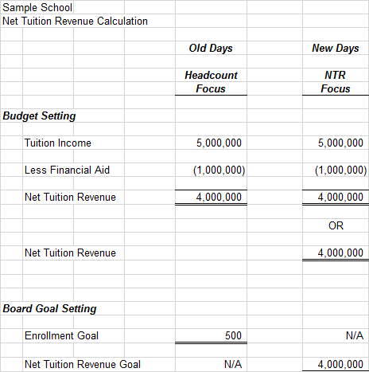
NTR Calculation – Budget and Board Goal Setting
Old Days – a school can meet their enrollment goal and MISS the budgeted NTR number.

Slide 10
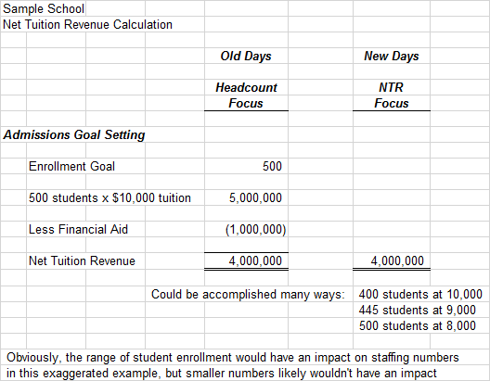
NTR Calculation – Admissions Goal Setting
New Days – a school can meet its NTR goal any number of ways.

Slide 11
Tools to Evaluate the Effectiveness of Your School’s Financial Aid Program
Net Tuition Revenue Chart
Net Tuition Revenue per Grade Chart
14 Year Financial Aid Chart
Awards by Tuition Band (dollar amount and number of awards)
Financial Aid Dashboard
Copies of all tools have been provided with the PowerPoint!

Slide 12
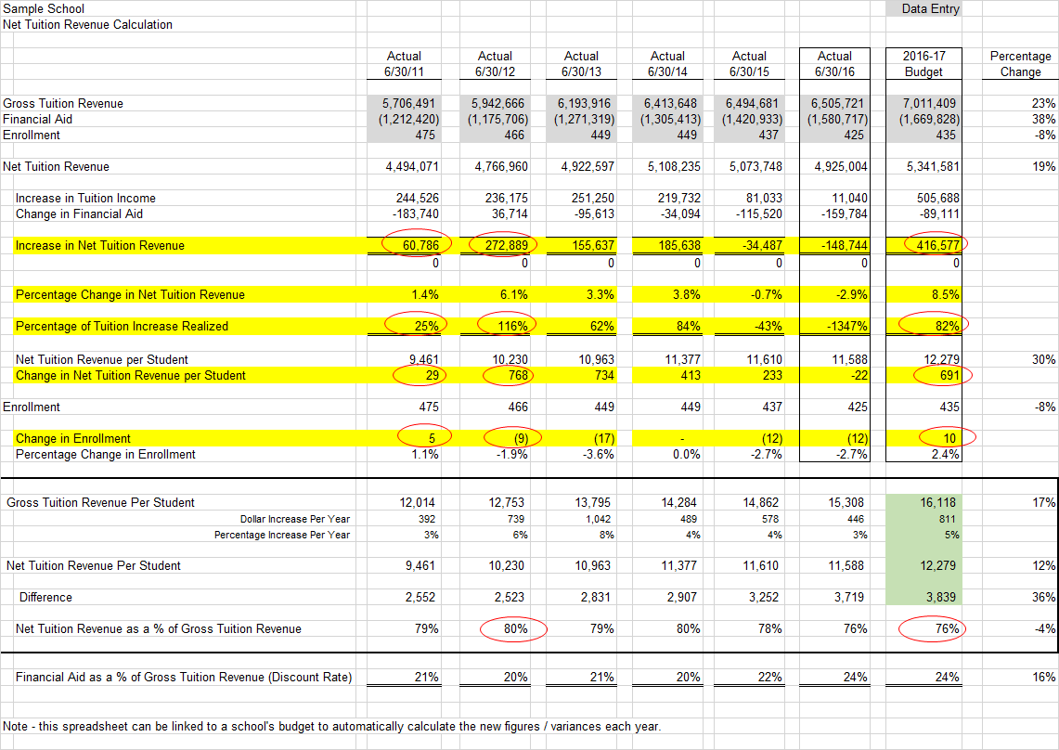
Tools – Net Tuition Revenue Chart

Slide 13
Tools - Net Tuition Revenue per Grade Chart
Sample School
2021-22 Financial Aid and Net Tuition Revenue by Grade
 |  |  |  |  |  |  |  |  |  |  |  |  |  |  |  |  | Gross |  | Net
 |  |  |  |  | Percentage |  | Value of |  | Percentage |  | Average |  |  |  | Percentage |  | Tuition |  | Tuition
 |  |  | Number |  | of Number |  | Actual |  | of Value of |  | Grant Per |  | Opening |  | of Class |  | by |  | by
 |  |  | of Awards |  | of Awards |  | Awards |  | Actual Awards |  | Award |  | Enrollment |  | With Aid |  | Grade |  | Grade
5th |  |  | 12 |  | 7% |  | 80,000 |  | 7% |  | 6,667 |  | 37 |  | 32% |  | 592,000 |  | 512,000
6th |  |  | 13 |  | 8% |  | 70,000 |  | 6% |  | 5,385 |  | 40 |  | 33% |  | 640,000 |  | 570,000
7th |  |  | 11 |  | 7% |  | 90,000 |  | 8% |  | 8,182 |  | 40 |  | 28% |  | 640,000 |  | 550,000
8th |  |  | 18 |  | 11% |  | 127,500 |  | 11% |  | 7,083 |  | 40 |  | 45% |  | 640,000 |  | 512,500
Total Middle School |  |  | 54 |  | 32% |  | 367,500 |  | 31% |  |  |  | 157 |  | 34% |  | 2,512,000 |  | 2,144,500

Slide 14
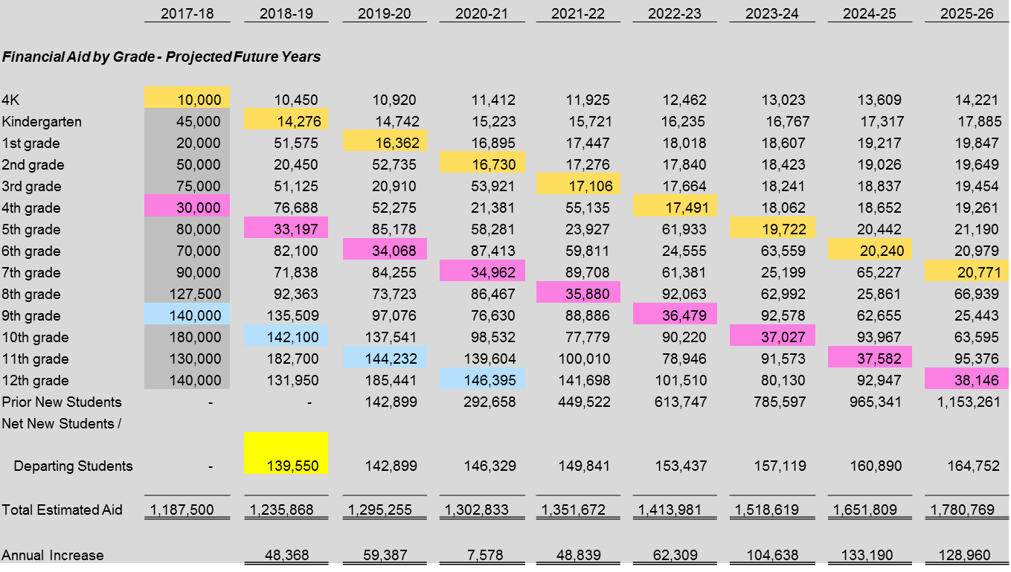
Tools - 14 Year Financial Aid Chart
In some respects, this chart is irrelevant given F/A budgets don’t “matter.”
It’s value in projecting future growth is relevant.

Slide 15
Tools – Dollar Amount of Awards by Tuition Band
 |  |  | 2018-19 |  | 2019-20 |  | 2020-21 |  | 2021-22
Dollar Amount of Awards as a % of Tuition
 | 1 - 25% |  | 23,300 |  | 21,300 |  | 10,730 |  | 2,740 |  | -88%
 | 26 - 50% |  | 151,800 |  | 114,700 |  | 133,564 |  | 154,800 |  | 2%
 | 51 - 75% |  | 261,900 |  | 262,400 |  | 355,025 |  | 273,365 |  | 4%
 | 76 - 100% |  | 23,000 |  | 18,600 |  | 20,800 |  | 86,400 |  | 276%
Dollar Amount of Awards as a % of Tuition |  |  | 460,000 |  | 417,000 |  | 520,119 |  | 517,305

Slide 16
Tools – Financial Aid Dashboard

Slide 17
Financial Aid Dashboard (Financial Aid Metrics to Monitor and Track)
Determine key financial aid numbers for your school and track those through a dashboard. For example, I wanted to track the following, year by year, to determine if the trend was positive or negative -
Net Tuition Revenue
Net Tuition Revenue per student
Financial aid as a percentage of gross tuition (discount rate)
NAIS average is in the 20 – 22% range
NAIS average INCLUDES tuition remission – for apples to apples comparison, include tuition remission in your discount rate calculation
Percentage of tuition paid by financial aid recipients
51% / 49% metric
Number of awards in the percentage of tuition bands (i.e. 0-25%, 26-50%, 51-75%, 76-100%)
Number of new students on financial aid
Percentage of full pay students vs. % of students receiving aid
Impacts Annual Giving, campaign giving, parent volunteers, etc.

Slide 18
Set a Goal to Collect More, on Average, from Financial Aid Recipients than the School Gives Them
My former school wanted to make awards that were, on average, less than the funds we collected from each family. Said another way, we wanted them to pay us more than we gave them.
Thus, our goal was to collect 51%, or more, on average, from each family and give awards that averaged 49%, or less, of tuition.
We tracked the 51 / 49% metric throughout the financial aid award process.
This means if the school gives an 80% award, they need to offset it with a 20% award.

Slide 19
Set a Goal to Collect More, on Average, from Financial Aid Recipients than the School Gives Them
I used to jokingly tell the Admissions Director he could give all the $2,000 and $3,000 awards he wanted. It was the $18,000 awards that worried me.
A family that can pay $18,000 and only needs $2,000 in aid will have a very positive Net Tuition Revenue impact on the school. They will help with NTR and help with the 51 / 49% metric.
On the other hand, a family that can only pay $2,000 and needs $18,000 in aid will not have a very positive impact on NTR and the 51 / 49% metric.

Slide 20
Set a Goal to Collect More, on Average, from Financial Aid Recipients than They Receive
Sample School
2021-22 Financial Aid and Net Tuition Revenue by Grade |  |  |  |  |  |  |  |  |  |  |  |  |  |  |  |  |  |  |  |  |  | Gross |  |  |  | Net Tuition
 |  |  |  |  |  |  |  |  |  |  |  |  |  |  |  |  |  |  |  |  |  | Tuition |  |  |  | Revenue
 |  |  |  |  | Percentage |  | Value of |  | Percentage |  | Average |  |  |  | Percentage |  |  | Gross |  | Net |  | Produced |  |  |  | Produced
 |  |  | Number |  | of Number |  | Actual |  | of Value of |  | Grant Per |  | Opening |  | of Class |  |  | Tuition by |  | Tuition by |  | by F/A |  | F/A |  | By F/A
 |  |  | of Awards |  | of Awards |  | Awards |  | Actual Awards |  | Award |  | Enrollment |  | With Aid |  |  | Grade |  | Grade |  | Recipients |  | Awarded |  | Recipients
9th |  |  | 15 |  | 21% |  | 140,000 |  | 24% |  | 9,333 |  | 40 |  | 38% |  |  | 680,000 |  | 540,000 |  | 255,000 |  | 140,000 |  | 115,000
10th |  |  | 25 |  | 35% |  | 180,000 |  | 31% |  | 7,200 |  | 40 |  | 63% |  |  | 680,000 |  | 500,000 |  | 425,000 |  | 180,000 |  | 245,000
11th |  |  | 14 |  | 20% |  | 130,000 |  | 22% |  | 9,286 |  | 40 |  | 35% |  |  | 680,000 |  | 550,000 |  | 238,000 |  | 130,000 |  | 108,000
12th |  |  | 17 |  | 24% |  | 140,000 |  | 24% |  | 8,235 |  | 40 |  | 43% |  |  | 680,000 |  | 540,000 |  | 289,000 |  | 140,000 |  | 149,000
 | Total Upper School |  | 71 |  | 100% |  | 590,000 |  | 100% |  | 8,310 |  | 160 |  | 44% |  |  | 2,720,000 |  | 2,130,000 |  | 1,207,000 |  | 590,000 |  | 617,000
 |  |  |  |  |  |  |  |  | Net Tuition Revenue as a Percentage of Gross Tuition Revenue |  |  |  |  |  |  |  |  |  |  | 78% |  | F/A Recipients Pay |  |  |  | 51%
 |  |  |  |  |  |  |  |  |  |  |  |  |  |  |  |  |  |  |  |  |  | F/A Recipients Receive |  |  |  | 49%

Slide 21
Track the Percentage of Financial Aid Awards by Tuition Band – Set Goals for New Student Enrollment
Calculate the number of awards and dollar amount of awards by tuition band (i.e. 51 – 75% of tuition)
Monitor the change in the bands over time. From a NTR standpoint, obviously you’d rather see growth in the 0 – 25% and 26 – 50% bands and decline in the 51 – 75% and 75 – 100% bands.
Before the financial aid award season begins, set goals for new student enrollment for each of those bands.

Slide 22
Track the Percentage of Financial Aid Awards by Tuition Band – Set Goals for New Student Enrollment
A former Head gave ten 100% awards to a community scholarship program. It about killed the School’s budget.
I told the Head and Admissions Director the program had been great and had brought in some great students, but it wasn’t financially sustainable.
Each year thereafter, I started giving the Admissions Director a budgeted number of large new awards for the year and told him he had to live within that. The 1st year, I told him he could have five 75 – 100% financial aid awards.
He could choose to use them all on March 1, but he couldn’t come back on August 1 and tell me about this great new kid he had found.
I encouraged him to use those 5 awards very judiciously to get us the best kids he could.
We liked the economic and social diversity those awards provided, but we couldn’t fill the school with kids that were paying very little to be there.

Slide 23
Track the Percentage of Financial Aid Awards by Tuition Band – Set Goals for New Student Enrollment
Sample School
Financial Aid Analysis for PK - 12 |  |  |  |  |  |  |  |  |  |  |  |  | % Change
 |  |  |  |  |  |  |  |  |  |  |  |  | Since
 |  |  | 2017-18 |  | 2018-19 |  | 2019-20 |  | 2020-21 |  | 2021-22 |  | 2017-18
Total Awards as a Percentage of Tuition
 | 1 - 25% |  | 35 |  | 42 |  | 39 |  | 56 |  | 42 |  | 20%
 | 26 - 50% |  | 57 |  | 63 |  | 68 |  | 74 |  | 92 |  | 61%
 | 51 - 75% |  | 55 |  | 32 |  | 53 |  | 55 |  | 83 |  | 51%
 | 76 - 100% |  | 39 |  | 44 |  | 51 |  | 57 |  | 63 |  | 62%
Total Awards as a Percentage of Tuition |  |  | 186 |  | 181 |  | 211 |  | 242 |  | 280

Slide 24
Analyze Financial Aid Awards as Percentage of Family Income
A longstanding NAIS rule of thumb is that families should be able to spend about 10% of family income on independent school tuition.
Look at family income per the 3rd party financial aid provider, apply the 10% calculation, and use that as a barometer of need, in order to provide equity between families (i.e. aim for parity so there aren’t families paying 25% of family income and others paying 4%).
- This is regardless of the number of children, so if a family can only pay 10,000, that number doesn’t change if it is 1 child or 3 children
- This doesn’t look at college tuitions
- This doesn’t look at siblings that might be at other independent schools (i.e. if your school is single sex or doesn’t cover all grade levels)
Obviously other factors need to come into play that can change award decisions (retirement assets, home values, etc.).

Slide 25
Board Reporting - Visually Monitor and Track the Trends of Your School’s Financial Aid Program - Sample Charts Shown
Net Tuition Revenue Chart
Net Tuition Revenue per Student Chart
Percentage Paid by Financial Aid Recipients
Financial Aid as a Percentage of Gross Tuition (Discount Rate)
Percentage of Each Class with Financial Aid Bar Chart
Gap between Gross and Net Tuition Revenue per Student
Dollar Amount of Financial Aid by Division
Dollar Amount of Financial Aid
Number of Financial Aid Recipients
Average Financial Aid Award per Recipient
Percentage of Full Pay Students

Slide 26
Net Tuition Revenue

Slide 27
Net Tuition Revenue per Student

Slide 28
Percentage Paid by Financial Aid Recipients

Slide 29
Financial Aid as a % of Gross Tuition Revenue (Discount Rate) (NAIS average is in the 20 - 22% range and INCLUDES Tuition Remission)

Slide 30
Percentage of Each Class with Financial Aid Bar Graph

Slide 31
Gap between Gross and Net Tuition Revenue Per Year (Discount Rate)

Slide 32
Dollar Amount of Financial Aid Awards by Division

Slide 33
Dollar Amount of Financial Aid

Slide 34
Number of Financial Aid Recipients

Slide 35
Average Financial Aid Award Per Recipient

Slide 36
Percentage of Full Pay Students

Slide 37
Baumol’s Disease (aka the reason tuition increases faster than inflation each year)
The Consumer Price Index (CPI) reflects the cost of a “market basket of goods” (loaf of bread, gallon of milk, etc.). The annual change in CPI reflects savings in efficiencies achieved through modernization of technology, etc. in the production of that loaf of bread, gallon of milk, etc.
Labor intensive industries (i.e. medical profession, colleges and universities, K-12, etc.), for the most part, cannot realize the savings other industries realize through technology. Smartboards, laptops and online classes can’t replace teachers.
By definition, the costs of labor intensive industries increase more than CPI each year because they can’t achieve savings through technology. Hence why college and K-12 tuition goes up faster than inflation.
Commonfund HEPI Index (Higher Ed Price Index) calculates CPI + 2%

Slide 38
Higher Education Price Index (HEPI) Restated Tuition
Tuition |  | 2016-17 |  | 2017-18 |  | 2018-19 |  | 2019-20 |  | 2020-21 |  | 2021-22
2% Tuition Increase |  | 17,000 |  | 17,340 |  | 17,687 |  | 18,041 |  | 18,401 |  | 18,769
HEPI Conversion |  | 1.16 |  | 1.13 |  | 1.10 |  | 1.08 |  | 1.05 |  | 1.00
Restated Tuition Using the HEPI Index |  | 19,757 |  | 19,631 |  | 19,450 |  | 19,463 |  | 19,326 |  | 18,769
Effective tuition increase each year |  |  |  | (127) |  | (180) |  | 12 |  | (137) |  | (556)
 |  |  |  |  |  |  |  | Covid 2nd Quarter
3% Tuition Increase |  | 17,000 |  | 17,510 |  | 18,035 |  | 18,576 |  | 19,134 |  | 19,708
HEPI Conversion |  | 1.16 |  | 1.13 |  | 1.10 |  | 1.08 |  | 1.05 |  | 1.00
Restated Tuition Using the HEPI Index |  | 19,757 |  | 19,823 |  | 19,834 |  | 20,041 |  | 20,095 |  | 19,708
Effective tuition increase each year |  |  |  | 66 |  | 10 |  | 207 |  | 54 |  | (387)
 |  |  |  |  |  |  |  | Covid 2nd Quarter

Slide 39
General Observations
Financial aid, kept in balance, actually improves a school’s financial situation.
If your school ended F/A tomorrow and
lost 160 existing students on aid, and
decreased tuition by $1,000 due to financial aid savings,
would you pick up 160 new students to take their place because tuition is now $1,000 less and your school is now more affordable?
The answer is probably no. Financial Aid actually helps lower the cost for all families due to NTR.

Slide 40
General Observations
Colleges have started lowering tuition and reducing financial aid using NTR as the philosophy to get sticker shock out of the way.
That can work in the college environment where 95% of all students receive some form of financial assistance. It doesn’t work in the independent school world where maybe 35% receive financial assistance.

Slide 41
General Observations
Some schools are now providing “inclusion aid” which allows students to be fully included in the life of the school (i.e. financial aid for school trips, music lessons, etc.)
This is part of their efforts toward DEIB (Diversity, Equity, Inclusion and Belonging)

Slide 42
General Observations
A lot of growth in financial aid comes from full pay families rotating out and being replaced by financial aid families. Enrollment could stay the exact same but financial aid could go up significantly as a larger % of the student body is now on aid than the prior year.
So when financial aid goes up $100,000 and enrollment goes up 5 students, it is NOT appropriate to conclude those 5 additional students are all receiving awards of $20,000 each. If your school brought in 60 new students, it could be that a larger number of those 60 new students are receiving aid.

Slide 43
Recommendations
Focus on Net Tuition Revenue when preparing the School’s annual budget, setting annual goals for Admissions, etc.
Don’t focus on headcount or financial aid dollars
Focus on Net Tuition Revenue for each student
Set goals that are indicative of positive NTR growth
Aim to receive 51%, or more, on average, from financial aid recipients (i.e. award 49%, or less, to recipients)
Monitor that percentage during the awards process
Determine the maximum number of new students to be awarded aid the highest tuition award band (76 - 100%)
Set goal for financial aid as a % of gross tuition revenue (discount rate)

Slide 44
Recommendations
Consider preparing a 14 Year Financial Aid model to anticipate the impact of small and large financial aid classes moving through the school
Pay attention to Net Tuition Revenue by Grade and the percentage of each grade on aid. Use that information to make informed decisions about future awards.
Possibly don’t make new awards for a class where 68% of the class is on aid
Likewise, be more generous in making awards in a class where 38% of the class is on aid
Consider benchmarking financial aid with benchmark schools (similar schools in the region and aspirational schools) through DASL or BIIS or regional groups. See how the school stacks up with other schools.

Slide 45
Recommendations
Analyze financial aid and student retention in the Early Childhood, as well as Pre-Kindergarten and Kindergarten, programs.
I researched and determined 2/3rds of all financial aid recipients in those programs were gone by 2nd grade.
It turned out the School was simply buying the students for 2 – 3 years
When tuition increased for the full day programs, they couldn’t afford to remain, even with significant financial aid increases by the school
The School eventually eliminated all aid in the ½ day program and eliminated all need based aid in the Pre-Kindergarten and Kindergarten program.

Slide 46
Recommendations
Consider implementing Flexible or Indexed Tuition as a means of attracting families that might not otherwise consider the school.
It is truly financial aid by a different name using the same financial aid application and award process
Removes the stigma of “financial aid”
Publish tuition range for the Middle School of $5,000 - $21,000 vs publishing a price tag of $21,000
Keeps families on the website / admissions phone call and in the admissions funnel longer
Please email me if you want more info on Indexed Tuition – I am happy to send you resources I have gathered over time.

Slide 47
Recommendations
Consider starting a merit scholarship program in the Upper School. Advantages –
Recruits high quality students that will help with SAT averages, college admissions, National Merit Semi-Finalists, etc.
Limited number of years of financial aid awards.
Recruits families that might not NEED financial aid but wouldn’t have considered the school otherwise.
In all likelihood, will bring siblings to the school.
Be willing to provide financial aid, above and beyond the scholarships, if needed.
Give a limited number of prestigious, high dollar amount awards to top notch candidates.
Give a lot more smaller awards to 2nd tier candidates that might not have previously considered the school – anytime you can provide a $5,000 award and attract a family that can pay $16,000, that is good.

Slide 48
Conclusion
Financial Aid is an important tool in the enrollment process.
If managed properly, financial aid can positively impact enrollment and financial sustainability.
If managed poorly, financial aid can negatively impact a school’s financial sustainability.
Focus on Net Tuition Revenue, and Net Tuition Revenue per student, vs. student headcount, to appropriately manage the school’s financial aid and financial sustainability.
Set budget and Admissions goals accordingly.
Set specific financial aid related goals before the financial aid season begins and monitor the school’s progress in meeting those goals.

Slide 49
The End Questions? Comments?
Any Questions?
The End

